Slide 1
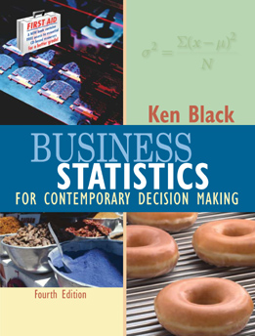
Business Statistics, 4e by Ken Black
Chapter 6
Continuous
Distributions

Slide 2
Learning Objectives
Understand concepts of the uniform distribution.
Appreciate the importance of the normal distribution.
Recognize normal distribution problems, and know how to solve them.
Decide when to use the normal distribution to approximate binomial distribution problems, and know how to work them.
Decide when to use the exponential distribution to solve problems in business, and know how to work them.
Notes:
2

Slide 3
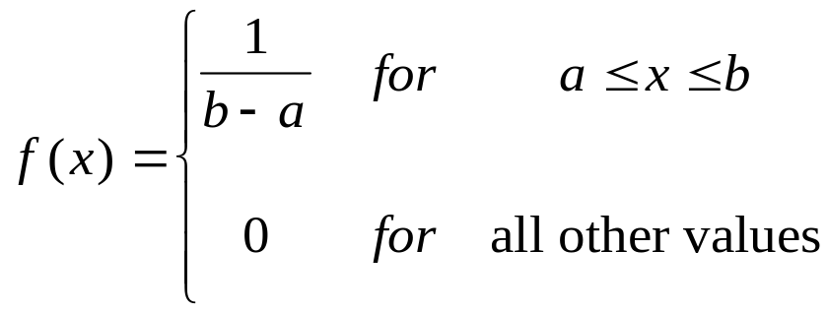
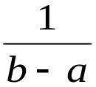


Uniform Distribution
Area = 1
a
b
Notes:
3

Slide 4
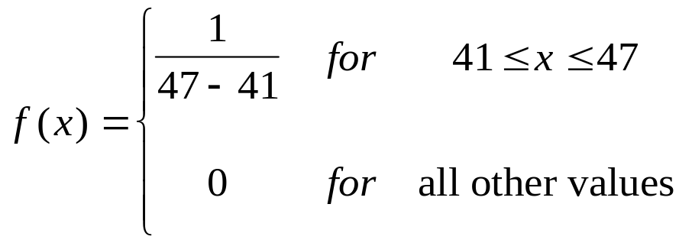
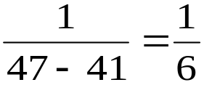


Uniform Distribution of Lot Weights
Area = 1
Notes:
4

Slide 5
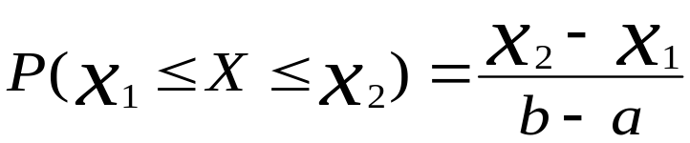
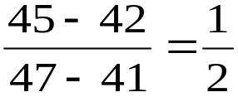
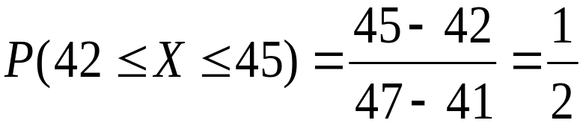


Uniform Distribution Probability
Area
= 0.5
Notes:
5

Slide 6
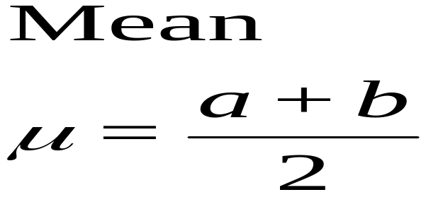
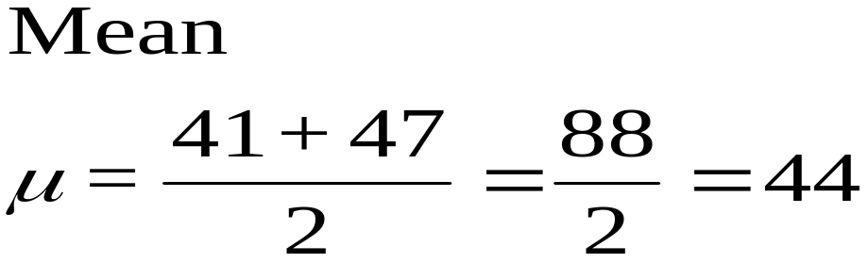
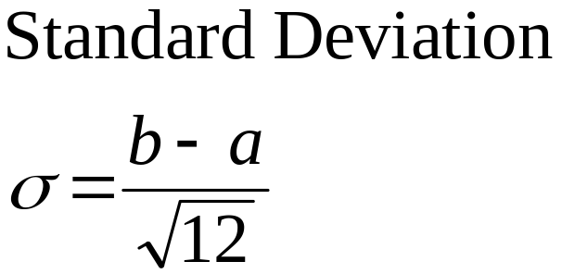
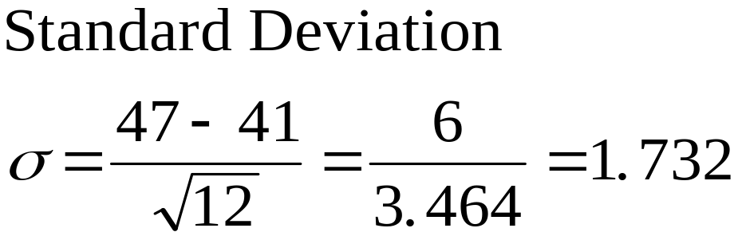
Uniform Distribution
Mean and Standard Deviation
Notes:
6

Slide 7

Characteristics of the Normal Distribution
Continuous distribution
Symmetrical distribution
Asymptotic to the horizontal axis
Unimodal
A family of curves
Area under the curve sums to 1.
Area to right of mean is 1/2.
Area to left of mean is 1/2.
1/2
1/2
X
Notes:
7

Slide 8
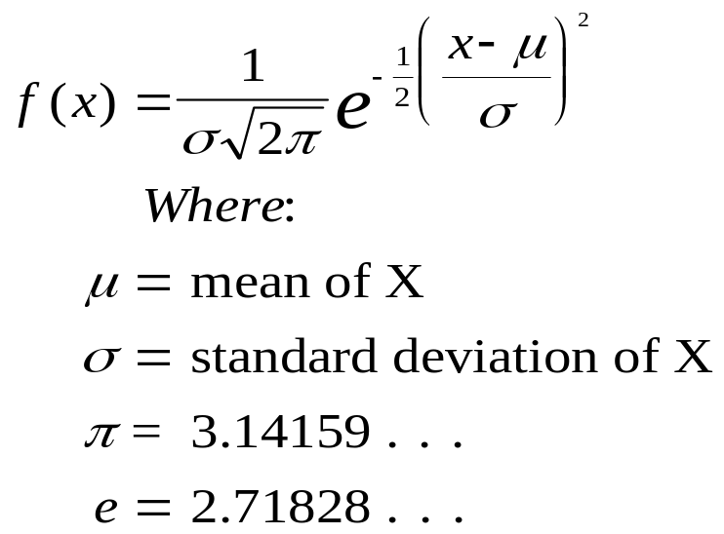
Probability Density Function of the Normal Distribution
X
Notes:
8

Slide 9


Normal Curves for Different
Means and Standard Deviations
20
30
40
50
60
70
80
90
100
110
120
Notes:
9

Slide 10

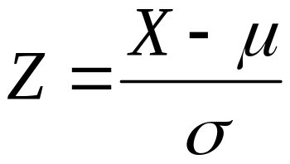
Standardized Normal Distribution
A normal distribution with
  a mean of zero, and
  a standard deviation of one
Z Formula
  standardizes any normal distribution
Z Score
  computed by the Z Formula
  the number of standard deviations which a value is away from the mean
σ
=
1
Notes:
10

Slide 11
Z Table
  Second Decimal Place in Z
Z 0.00 0.01 0.02 0.03 0.04 0.05 0.06 0.07 0.08 0.09
0.00 0.0000 0.0040 0.0080 0.0120 0.0160 0.0199 0.0239 0.0279 0.0319 0.0359
0.10 0.0398 0.0438 0.0478 0.0517 0.0557 0.0596 0.0636 0.0675 0.0714 0.0753
0.20 0.0793 0.0832 0.0871 0.0910 0.0948 0.0987 0.1026 0.1064 0.1103 0.1141
0.30 0.1179 0.1217 0.1255 0.1293 0.1331 0.1368 0.1406 0.1443 0.1480 0.1517
0.90 0.3159 0.3186 0.3212 0.3238 0.3264 0.3289 0.3315 0.3340 0.3365 0.3389
1.00 0.3413 0.3438 0.3461 0.3485 0.3508 0.3531 0.3554 0.3577 0.3599 0.3621
1.10 0.3643 0.3665 0.3686 0.3708 0.3729 0.3749 0.3770 0.3790 0.3810 0.3830
1.20 0.3849 0.3869 0.3888 0.3907 0.3925 0.3944 0.3962 0.3980 0.3997 0.4015
2.00 0.4772 0.4778 0.4783 0.4788 0.4793 0.4798 0.4803 0.4808 0.4812 0.4817
3.00 0.4987 0.4987 0.4987 0.4988 0.4988 0.4989 0.4989 0.4989 0.4990 0.4990
3.40 0.4997 0.4997 0.4997 0.4997 0.4997 0.4997 0.4997 0.4997 0.4997 0.4998
3.50 0.4998 0.4998 0.4998 0.4998 0.4998 0.4998 0.4998 0.4998 0.4998 0.4998
Notes:
11

Slide 12

Table Lookup of a
Standard Normal Probability
Z 0.00 0.01 0.02
0.00 0.0000 0.0040 0.0080
0.10 0.0398 0.0438 0.0478
0.20 0.0793 0.0832 0.0871
1.00 0.3413 0.3438 0.3461
1.10 0.3643 0.3665 0.3686
1.20 0.3849 0.3869 0.3888
-3
-2
-1
0
1
2
3
Notes:
12

Slide 13
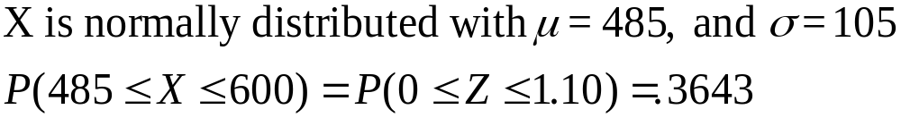
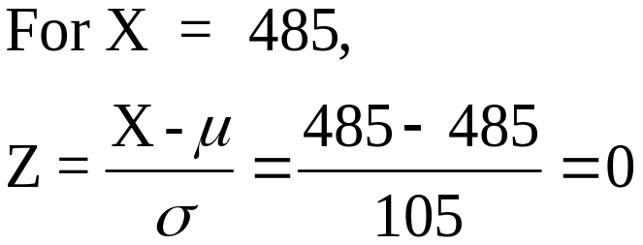
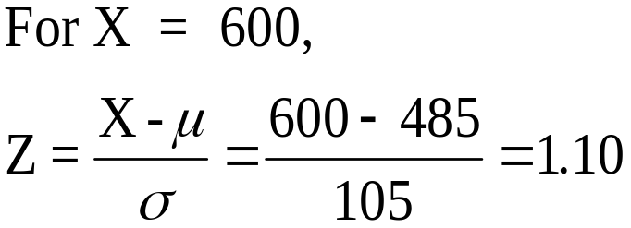
Applying the Z Formula
Z 0.00 0.01 0.02
0.00 0.0000 0.0040 0.0080
0.10 0.0398 0.0438 0.0478
1.00 0.3413 0.3438 0.3461
1.10 0.3643 0.3665 0.3686
1.20 0.3849 0.3869 0.3888
Notes:
13

Slide 14
Normal Approximation of the Binomial Distribution
The normal distribution can be used to approximate binomial probabilities
Procedure
  Convert binomial parameters to normal parameters
  Does the interval lie between 0 and n? If so, continue; otherwise, do not use the normal approximation.
  Correct for continuity
  Solve the normal distribution problem
μ
±
3
σ
Notes:
25

Slide 15
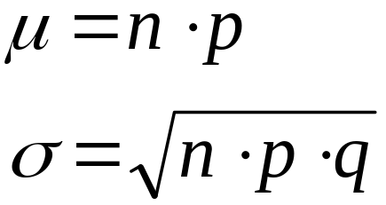
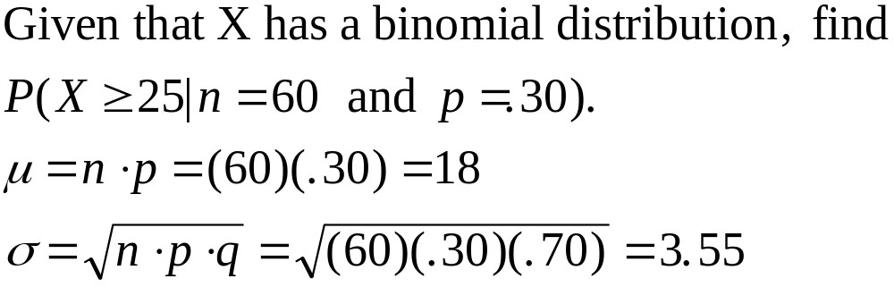
Normal Approximation of Binomial: Parameter Conversion
Conversion equations
Conversion example:
Notes:
26

Slide 16
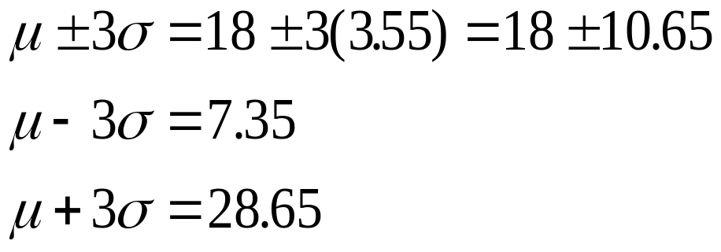
Normal Approximation of Binomial: Interval Check
0
10
20
30
40
50
60
n
70
Notes:
27

Slide 17
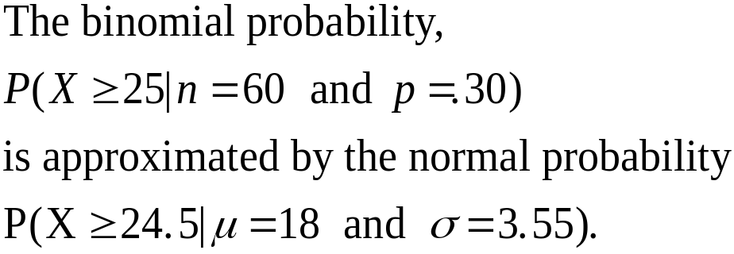
Normal Approximation of Binomial: Correcting for Continuity
Values Being Determined
Correction
X>
X≥
X<
X≤
≤X≤
<X<
+.50
-.50
-.50
+.05
-.50 and +.50
+.50 and -.50
Notes:
28

Slide 18
Normal Approximation of Binomial: Graphs
0.12
0.10
0.08
0.06
0.04
0.02
0
6
8
10
12
14
16
18
20
22
24
26
28
30
Notes:
29

Slide 19
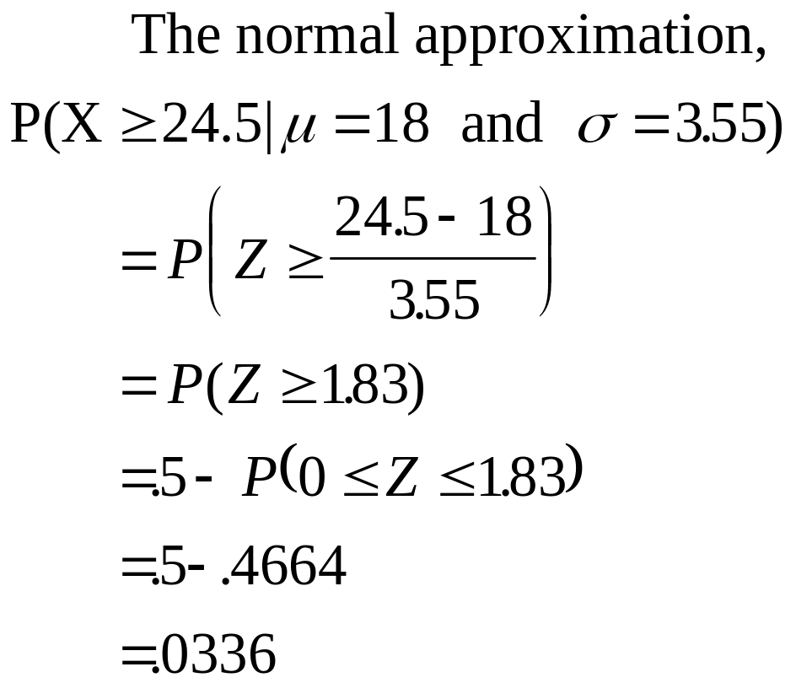
Normal Approximation of Binomial: Computations
X
P(X)
25
26
27
28
29
30
31
32
33
Total
0.0167
0.0096
0.0052
0.0026
0.0012
0.0005
0.0002
0.0001
0.0000
0.0361
Notes:
30

Slide 20
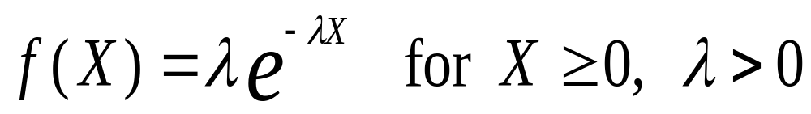
Exponential Distribution
Continuous
Family of distributions
Skewed to the right
X varies from 0 to infinity
Apex is always at X = 0
Steadily decreases as X gets larger
Probability function
Notes:
31

Slide 21
Graphs of Selected Exponential Distributions
2.0
1.8
λ = 2.0
1.6
λ = 1.0
1.4
λ = 0.5
1.2
λ = 0.2
1.0
0.8
0.6
0.4
0.2
0.0
0
1
2
3
4
5
6
7
8
Notes:
32

Slide 22
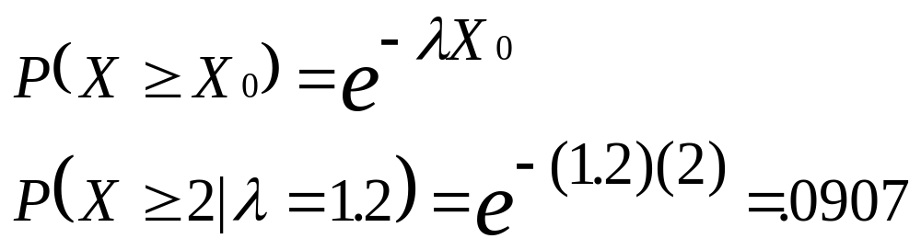
Exponential Distribution:
Probability Computation
1.2
1.0
λ = 1.2
0.8
0.6
0.4
0.2
0.0
0
1
2
3
4
5
Notes:
33

