Slide 1
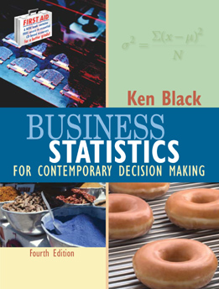
Business Statistics, 4e by Ken Black
Chapter 15
Building Multiple Regression Models

Slide 2
Learning Objectives
Analyze and interpret nonlinear variables in multiple regression analysis.
Understand the role of qualitative variables and how to use them in multiple regression analysis.
Learn how to build and evaluate multiple regression models.
Learn how to detect influential observations in regression analysis.
Notes:
2

Slide 3
General Linear Regression Model
Y = β₀ + β₁X₁ + β₂X₂ + β₃X₃ + . . . + β_{k}X_{k}+ ε
  Y = the value of the dependent (response) variable
  β₀ = the regression constant
  β₁ = the partial regression coefficient of independent variable 1
  β₂ = the partial regression coefficient of independent variable 2
  β_{k} = the partial regression coefficient of independent variable k
  k = the number of independent variables
  ε = the error of prediction
Notes:
4

Slide 4



Non Linear Models: Mathematical Transformation
First-order with Two Independent Variables
Second-order with One Independent Variable
Second-order with an
Interaction Term
Second-order with
Two Independent
Variables
Notes:
27

Slide 5
Sales Data and Scatter Plot for 13 Manufacturing Companies
Number of
500
Sales
Manufacturing
450
Manufacturer
($1,000,000)
Representatives
400
1
2.1
2
350
2
3.6
1
300
3
6.2
2
Sales
250
200
4
10.4
3
150
5
22.8
4
100
6
35.6
4
50
7
57.1
5
0
8
83.5
5
0
2
4
6
8
10
12
9
109.4
6
Number of Representatives
10
128.6
7
11
196.8
8
12
280.0
10
13
462.3
11
Notes:
28

Slide 6
Excel Simple Linear Regression Output for the Manufacturing Example
Regression Statistics
Multiple R
0.933
R Square
0.870
Adjusted R Square
0.858
Standard Error
51.10
Observations
13
Coefficients
Standard Error
t Stat
P-value
Intercept
-107.03
28.737
-3.72
0.003
numreps
41.026
4.779
8.58
0.000
ANOVA
df
SS
MS
F
Significance F
Regression
1
192395
192395
73.69
0.000
Residual
11
28721
2611
Total
12
221117
Notes:
29

Slide 7
Manufacturing Data with Newly Created Variable
Number of
Mgfr Reps
X₁
Sales
(No. Mgfr Reps)²
X₂ = (X₁)²
Manufacturer
($1,000,000)
1
2.1
2
4
2
3.6
1
1
3
6.2
2
4
4
10.4
3
9
5
22.8
4
16
6
35.6
4
16
7
57.1
5
25
8
83.5
5
25
9
109.4
6
36
10
128.6
7
49
11
196.8
8
64
12
280.0
10
100
13
462.3
11
121
Notes:
30

Slide 8
Scatter Plots Using Original and Transformed Data
500
500
450
450
400
400
350
350
300
300
Sales
250
250
200
Sales
200
150
150
100
100
50
50
0
0
0
2
4
6
8
10
12
0
50
100
150
Number of Representatives
Number of Mfg. Reps. Squared

Slide 9
Computer Output for Quadratic Model to Predict Sales
Regression Statistics
Multiple R
0.986
R Square
0.973
Adjusted R Square
0.967
Standard Error
24.593
Observations
13
Coefficients
Standard Error
t Stat
P-value
Intercept
18.067
24.673
0.73
0.481
MfgrRp
-15.723
9.5450
- 1.65
0.131
MfgrRpSq
4.750
0.776
6.12
0.000
ANOVA
df
SS
MS
F
Significance F
Regression
2
215069
107534
177.79
0.000
Residual
10
6048
605
Total
12
221117
Notes:
32

Slide 10
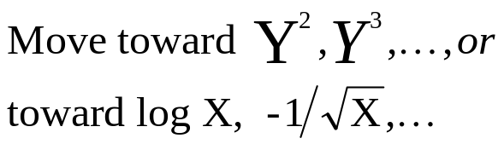
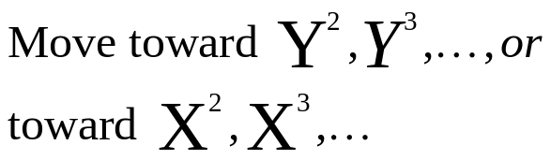
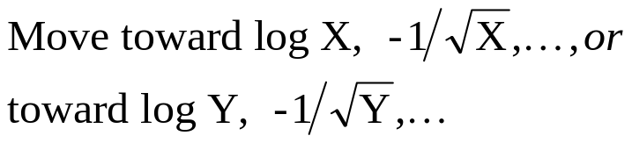
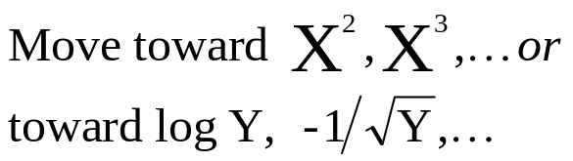
Tukey’s Four Quadrant Approach

Slide 11
Prices of Three Stocks over a 15-Month Period
Stock 1
Stock 2
Stock 3
41
36
35
39
36
35
38
38
32
45
51
41
41
52
39
43
55
55
47
57
52
49
58
54
41
62
65
35
70
77
36
72
75
39
74
74
33
83
81
28
101
92
31
107
91

Slide 12
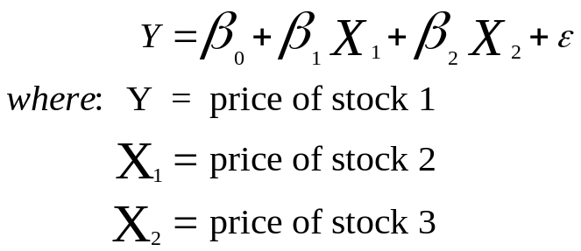
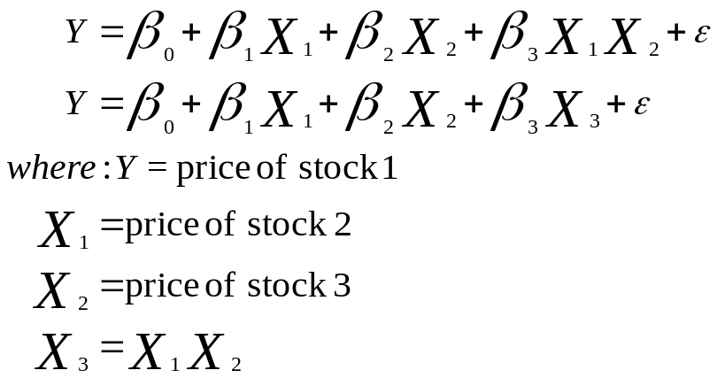
Regression Models for the Three Stocks
First-order with
Two Independent Variables
Second-order with an
Interaction Term
Notes:
35

Slide 13
Regression for Three Stocks:
First-order, Two Independent Variables
The regression equation is
Stock 1 = 50.9 - 0.119 Stock 2 - 0.071 Stock 3
Predictor Coef StDev T P
Constant 50.855 3.791 13.41 0.000
Stock 2 -0.1190 0.1931 -0.62 0.549
Stock 3 -0.0708 0.1990 -0.36 0.728
S = 4.570 R-Sq = 47.2% R-Sq(adj) = 38.4%
Analysis of Variance
Source DF SS MS F P
Regression 2 224.29 112.15 5.37 0.022
Error 12 250.64 20.89
Total 14 474.93

Slide 14
Regression for Three Stocks:
Second-order With an Interaction Term
The regression equation is
Stock 1 = 12.0 - 0.879 Stock 2 - 0.220 Stock 3 – 0.00998 Inter
Predictor Coef StDev T P
Constant 12.046 9.312 1.29 0.222
Stock 2 0.8788 0.2619 3.36 0.006
Stock 3 0.2205 0.1435 1.54 0.153
Inter -0.009985 0.002314 -4.31 0.001
S = 2.909 R-Sq = 80.4% R-Sq(adj) = 25.1%
Analysis of Variance
Source DF SS MS F P
Regression 3 381.85 127.28 15.04 0.000
Error 11 93.09 8.46
Total 14 474.93

Slide 15
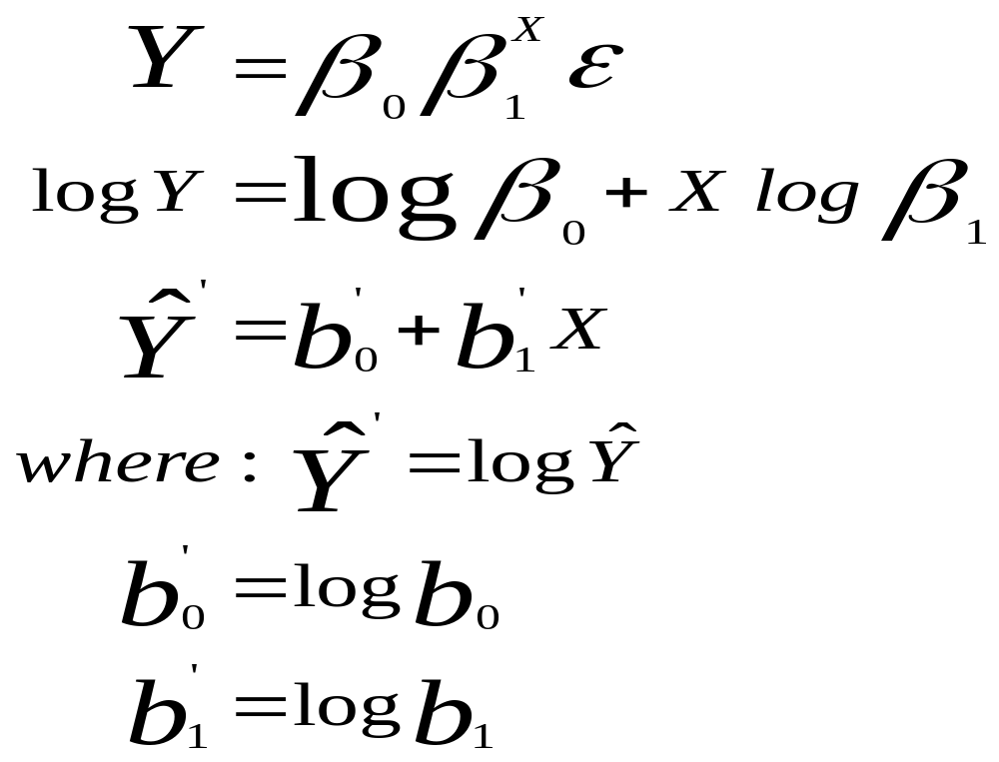
Nonlinear Regression Models:
Model Transformation
Notes:
38

Slide 16
Data Set for Model Transformation Example
ORIGINAL DATA
TRANSFORMED DATA
Company
Y
X
Company
LOG Y
X
1
2580
1.2
1
3.41162
1.2
2
11942
2.6
2
4.077077
2.6
3
9845
2.2
3
3.993216
2.2
4
27800
3.2
4
4.444045
3.2
5
18926
2.9
5
4.277059
2.9
6
4800
1.5
6
3.681241
1.5
7
14550
2.7
7
4.162863
2.7
Y = Sales ($ million/year)
X = Advertising ($ million/year)
Notes:
39

Slide 17
Regression Output for Model Transformation Example
Regression Statistics
Multiple R
0.990
R Square
0.980
Adjusted R Square
0.977
Standard Error
0.054
Observations
7
Coefficients
Standard Error
t Stat
P-value
Intercept
2.9003
0.0729
39.80
0.000
X
0.4751
0.0300
15.82
0.000
ANOVA
df
SS
MS
F
Significance F
Regression
1
0.7392
0.7392
250.36
0.000
Residual
5
0.0148
0.0030
Total
6
0.7540
Notes:
40

Slide 18
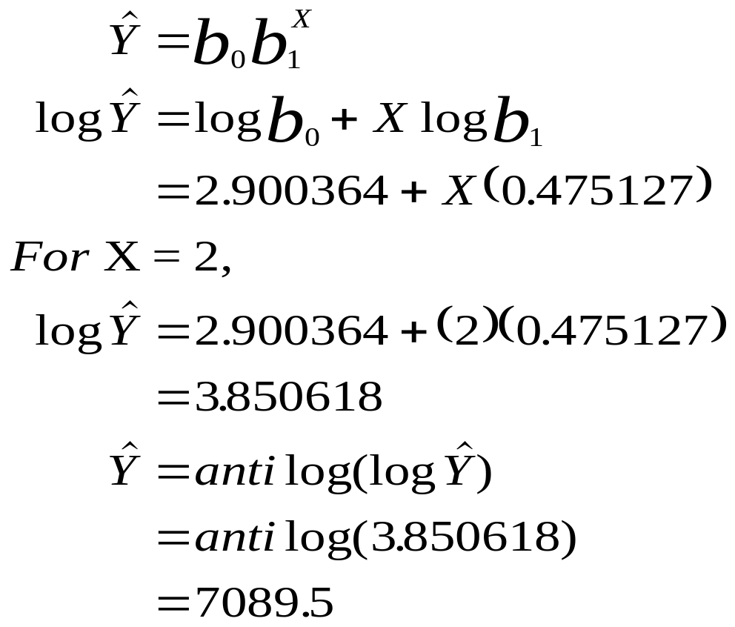
Prediction with the
Transformed Model
Notes:
41

Slide 19
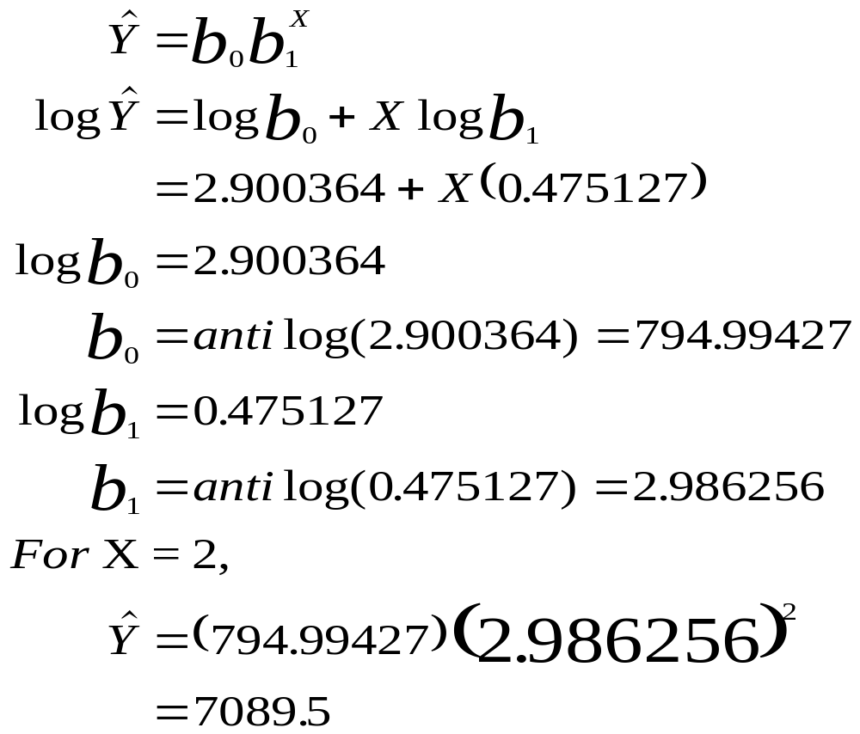
Prediction with the
Transformed Model
Notes:
42

Slide 20
Indicator (Dummy) Variables
Qualitative (categorical) Variables
The number of dummy variables needed for a qualitative variable is the number of categories less one. [c - 1, where c is the number of categories]
For dichotomous variables, such as gender, only one dummy variable is needed. There are two categories (female and male); c = 2; c - 1 = 1.
Your office is located in which region of the country? ___Northeast ___Midwest ___South ___West number of dummy variables = c - 1 = 4 - 1 = 3
Notes:
23

Slide 21
Data for the Monthly Salary Example
Monthly
Salary
($1000)
Gender
(1=Male,
0=Female)
Age
(10 Years)
Observation
1
1.548
3.2
1
2
1.629
3.8
1
3
1.011
2.7
0
4
1.229
3.4
0
5
1.746
3.6
1
6
1.528
4.1
1
7
1.018
3.8
0
8
1.190
3.4
0
9
1.551
3.3
1
10
0.985
3.2
0
11
1.610
3.5
1
12
1.432
2.9
1
13
1.215
3.3
0
14
0.990
2.8
0
15
1.585
3.5
1
Notes:
24

Slide 22
Regression Output for the Monthly Salary Example
The regression equation is
Salary = 0.732 + 0.111 Age + 0.459 Gender
Predictor Coef StDev T P
Constant 0.7321 0.2356 3.11 0.009
Age 0.11122 0.07208 1.54 0.149
Gender 0.45868 0.05346 8.58 0.000
S = 0.09679 R-Sq = 89.0% R-Sq(adj) = 87.2%
Analysis of Variance
Source DF SS MS F P
Regression 2 0.90949 0.45474 48.54 0.000
Error 12 0.11242 0.00937
Total 14 1.02191
Notes:
25

Slide 23
Regression Model Depicted with Males and Females Separated
1.800
1.600
Males
1.400
1.200
1.000
Females
0.800
0
2
3
4
Notes:
26

Slide 24
Data for Multiple Regression to Predict Crude Oil Production
Y
X₁
X₂
X₃
X₄
X₅
55.7
74.3
83.5
598.6
21.7
13.30
55.7
72.5
114.0
610.0
20.7
13.42
52.8
70.5
172.5
654.6
19.2
13.52
57.3
74.4
191.1
684.9
19.1
13.53
59.7
76.3
250.9
697.2
19.2
13.80
Y World Crude Oil Production
X₁ U.S. Energy Consumption
X₂ U.S. Nuclear Generation
X₃ U.S. Coal Production
X₄ U.S. Dry Gas Production
X₅ U.S. Fuel Rate for Autos
60.2
78.1
276.4
670.2
19.1
14.04
62.7
78.9
255.2
781.1
19.7
14.41
59.6
76.0
251.1
829.7
19.4
15.46
56.1
74.0
272.7
823.8
19.2
15.94
53.5
70.8
282.8
838.1
17.8
16.65
53.3
70.5
293.7
782.1
16.1
17.14
54.5
74.1
327.6
895.9
17.5
17.83
54.0
74.0
383.7
883.6
16.5
18.20
56.2
74.3
414.0
890.3
16.1
18.27
56.7
76.9
455.3
918.8
16.6
19.20
58.7
80.2
527.0
950.3
17.1
19.87
59.9
81.3
529.4
980.7
17.3
20.31
60.6
81.3
576.9
1029.1
17.8
21.02
60.2
81.1
612.6
996.0
17.7
21.69
60.2
82.1
618.8
997.5
17.8
21.68
60.6
83.9
610.3
945.4
18.2
21.04
60.9
85.6
640.4
1033.5
18.9
21.48

Slide 25
Model-Building:
Search Procedures
All Possible Regressions
Stepwise Regression
Forward Selection
Backward Elimination
Notes:
43

Slide 26
All Possible Regressions with Five Independent Variables
Single
Two
Three
Four
Predictor
Predictors
Predictors
Predictors
Five Predictors
X
X
,X
X
,X
,X
X
,X
,X
,X
X
,X
,X
,X
,X
1
1
2
1
2
3
1
2
3
4
1
2
3
4
5
X
X
,X
X
,X
,X
X
,X
,X
,X
2
1
3
1
2
4
1
2
3
5
X
X
,X
X
,X
,X
X
,X
,X
,X
3
1
4
1
2
5
1
2
4
5
X
X
,X
X
,X
,X
X
,X
,X
,X
4
1
5
1
3
4
1
3
4
5
X
X
,X
X
,X
,X
X
,X
,X
,X
5
2
3
1
3
5
2
3
4
5
X
,X
X
,X
,X
2
4
1
4
5
X
,X
X
,X
,X
2
5
2
3
4
X
,X
X
,X
,X
3
4
2
3
5
X
,X
X
,X
,X
3
5
2
4
5
X
,X
X
,X
,X
4
5
3
4
5
Notes:
58

Slide 27
Stepwise Regression
Perform k simple regressions; and select the best as the initial model
Evaluate each variable not in the model
  If none meet the criterion, stop
  Add the best variable to the model; reevaluate previous variables, and drop any which are not significant
Return to previous step

Slide 28
Forward Selection
Like stepwise, except variables are not reevaluated after entering the model

Slide 29
Backward Elimination
Start with the “full model” (all k predictors)
If all predictors are significant, stop
Otherwise, eliminate the most nonsignificant predictor; return to previous step

Slide 30
Stepwise: Step 1 - Simple Regression Results for Each Independent Variable
Dependent
Independent
Variable
Variable
t-Ratio
2
R
Y
X
11.77
85.2%
1
Y
X
4.43
45.0%
2
Y
X
3.91
38.9%
3
Y
X
1.08
4.6%
4
Y
X
33.54
34.2%
5
Notes:
49

Slide 31
MINITAB Stepwise Output
Stepwise Regression
F-to-Enter: 4.00 F-to-Remove: 4.00
Response is CrOilPrd on 5 predictors, with N = 26
Step 1 2
Constant 13.075 7.140
USEnCons 0.580 0.772
T-Value 11.77 11.91
FuelRate -0.52
T-Value -3.75
S 1.52 1.22
R-Sq 85.24 90.83
Notes:
53

Slide 32
Multicollinearity
Condition that occurs when two or more of the independent variables of a multiple regression model are highly correlated
  Difficult to interpret the estimates of the regression coefficients
  Inordinately small t values for the regression coefficients
  Standard deviations of regression coefficients are overestimated
  Sign of predictor variable’s coefficient opposite of what expected
Notes:
59

Slide 33
Correlations among Oil Production Predictor Variables
 | Energy Consumption | Nuclear | Coal | Dry Gas | Fuel Rate
Energy Consumption | 1 | 0.856 | 0.791 | 0.057 | 0.791
Nuclear | 0.856 | 1 | 0.952 | -0.404 | 0.972
Coal | 0.791 | 0.952 | 1 | -0.448 | 0.968
Dry Gas | 0.057 | -0.404 | -0.448 | 1 | -0.423
Fuel Rate | 0.796 | 0.972 | 0.968 | -0.423 | 1

