Slide 1
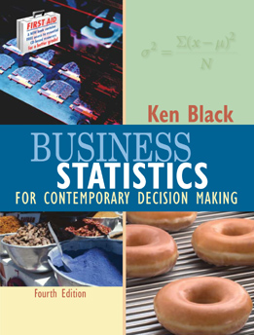
Business Statistics, 4th by Ken Black
Chapter 1
Introduction
to Statistics

Slide 2
Learning Objectives
Define statistics
Become aware of a wide range of applications of statistics in business
Differentiate between descriptive and inferential statistics
Classify numbers by level of data and understand why doing so is important
Notes:
2
2

Slide 3
Statistics in Business
Accounting — auditing and cost estimation
Economics — regional, national, and international economic performance
Finance — investments and portfolio management
Management — human resources, compensation, and quality management
Management Information Systems — performance of systems which gather, summarize, and disseminate information to various managerial levels
Marketing — market analysis and consumer research
International Business — market and demographic analysis
Notes:
8
7

Slide 4
What is Statistics?
Science of gathering, analyzing, interpreting, and presenting data
Branch of mathematics
Course of study
Facts and figures
A death
Measurement taken on a sample
Type of distribution being used to analyze data
Notes:
11
8

Slide 5
Population Versus Sample
Population — the whole
  a collection of persons, objects, or items under study
Census — gathering data from the entire population
Sample — a portion of the whole
  a subset of the population
Notes:
12
9

Slide 6
Population
Notes:
13

Slide 7
Population and Census Data
Identifier
Color
MPG
RD1
Red
12
RD2
Red
10
RD3
Red
13
RD4
Red
10
RD5
Red
13
BL1
Blue
27
BL2
Blue
24
GR1
Green
35
GR2
Green
35
GY1
Gray
15
GY2
Gray
18
GY3
Gray
17
Notes:
14
11

Slide 8
Sample and Sample Data
Identifier
Color
MPG
RD2
Red
10
RD5
Red
13
GR1
Green
35
GY2
Gray
18
Notes:
15

Slide 9
Descriptive vs. Inferential Statistics
Descriptive Statistics — using data gathered on a group to describe or reach conclusions about that same group only
Inferential Statistics — using sample data to reach conclusions about the population from which the sample was taken
Notes:
16
13

Slide 10
Parameter vs. Statistic
Parameter — descriptive measure of the population
  Usually represented by Greek letters
Statistic — descriptive measure of a sample
  Usually represented by Roman letters
Notes:
17
14

Slide 11
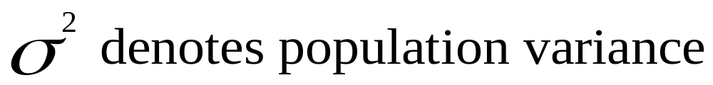
Symbols for Population Parameters
Notes:
18
15

Slide 12
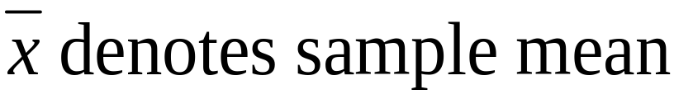
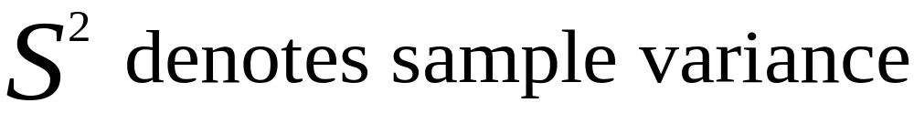
Symbols for Sample Statistics
Notes:
19
16

Slide 13
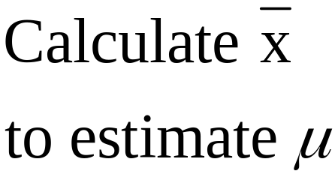
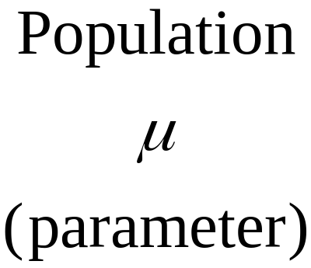
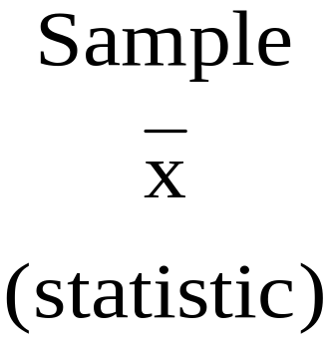

Process of Inferential Statistics
Notes:
20
17

Slide 14
Levels of Data Measurement
Nominal — Lowest level of measurement
Ordinal
Interval
Ratio — Highest level of measurement
Notes:
21
18

Slide 15
Nominal Level Data
Numbers are used to classify or categorize
  Example: Employment Classification
      1 for Educator
      2 for Construction Worker
      3 for Manufacturing Worker
  Example: Ethnicity
      1 for African-American
      2 for Anglo-American
      3 for Hispanic-American
Notes:
22
19

Slide 16
Ordinal Level Data
Numbers are used to indicate rank or order
  Relative magnitude of numbers is meaningful
  Differences between numbers are not comparable
  Example: Ranking productivity of employees
  Example: Taste test ranking of three brands of soft drink
  Example: Position within an organization
      1 for President
      2 for Vice President
      3 for Plant Manager
      4 for Department Supervisor
      5 for Employee
Notes:
23
20

Slide 17


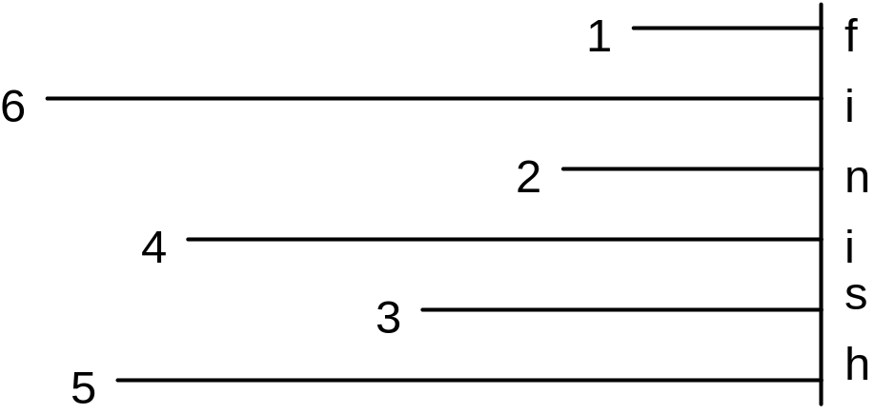
Example of Ordinal Measurement
Notes:
24
21

Slide 18
Ordinal Data
Faculty and staff should receive preferential treatment for parking space.
Strongly
Agree
Neutral
Disagree
Strongly
Agree
Disagree
1
2
3
4
5

Slide 19
Interval Level Data
Distances between consecutive integers are equal
  Relative magnitude of numbers is meaningful
  Differences between numbers are comparable
  Location of origin, zero, is arbitrary
  Vertical intercept of unit of measure transform function is not zero
  Example: Fahrenheit Temperature
  Example: Calendar Time
  Example: Monetary Utility
Notes:
26
22

Slide 20
Ratio Level Data
Highest level of measurement
  Relative magnitude of numbers is meaningful
  Differences between numbers are comparable
  Location of origin, zero, is absolute (natural)
  Vertical intercept of unit of measure transform function is zero
  Examples: Height, Weight, and Volume
  Example: Monetary Variables, such as Profit and Loss, Revenues, and Expenses
  Example: Financial ratios, such as P/E Ratio, Inventory Turnover, and Quick Ratio.
Notes:
27
23

Slide 21
Usage Potential of Various
Levels of Data
Ratio
Interval
Ordinal
Nominal
Notes:
28
24

Slide 22
Data Level, Operations, and Statistical Methods
Data Level
Meaningful Operations
Statistical
Methods
Nominal
Ordinal
Interval
Ratio
Classifying and Counting
All of the above plus Ranking
All of the above plus Addition, Subtraction, Multiplication, and Division
All of the above
Nonparametric
Nonparametric
Parametric
Parametric
Notes:
29
25

