Slide 1
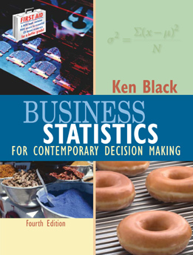
Business Statistics, 4e by Ken Black
Chapter 5
Discrete
Distributions

Slide 2
Learning Objectives
Distinguish between discrete random variables and continuous random variables.
Know how to determine the mean and variance of a discrete distribution.
Identify the type of statistical experiments that can be described by the binomial distribution, and know how to work such problems.
Notes:
2

Slide 3
Learning Objectives -- Continued
Decide when to use the Poisson distribution in analyzing statistical experiments, and know how to work such problems.
Decide when binomial distribution problems can be approximated by the Poisson distribution, and know how to work such problems.
Decide when to use the hypergeometric distribution, and know how to work such problems.
Notes:
3

Slide 4
Discrete vs Continuous Distributions
Random Variable -- a variable which contains the outcomes of a chance experiment
Discrete Random Variable -- the set of all possible values is at most a finite or a countably infinite number of possible values
  Number of new subscribers to a magazine
  Number of bad checks received by a restaurant
  Number of absent employees on a given day
Continuous Random Variable -- takes on values at every point over a given interval
  Current Ratio of a motorcycle distributorship
  Elapsed time between arrivals of bank customers
  Percent of the labor force that is unemployed
Notes:
4

Slide 5
Some Special Distributions
Discrete
  binomial
  Poisson
  hypergeometric
Continuous
  normal
  uniform
  exponential
  t
  chi-square
  F
Notes:
5

Slide 6
Discrete Distribution -- Example
Distribution of Daily Crises
P
r
o
b
a
b
i
l
i
t
y
Number of Crises
Probability
0.5
0.4
0
1
2
3
4
5
0.37
0.31
0.18
0.09
0.04
0.01
0.3
0.2
0.1
0
0
1
2
3
4
5
Number of Crises
Notes:
6

Slide 7
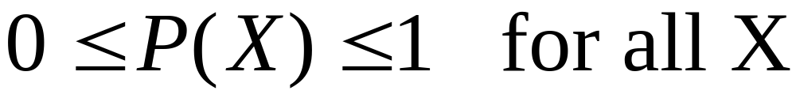
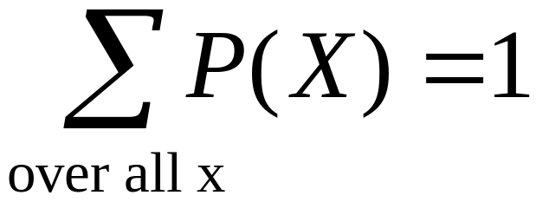
Requirements for a
Discrete Probability Function
Probabilities are between 0 and 1, inclusively
Total of all probabilities equals 1
Notes:
7

Slide 8
Requirements for a Discrete
Probability Function -- Examples
X
P(X)
X
P(X)
X
P(X)
-1
0
1
2
3
.1
.2
.4
.2
.1
1.0
-1
0
1
2
3
-.1
.3
.4
.3
.1
1.0
-1
0
1
2
3
.1
.3
.4
.3
.1
1.2
Notes:
8

Slide 9
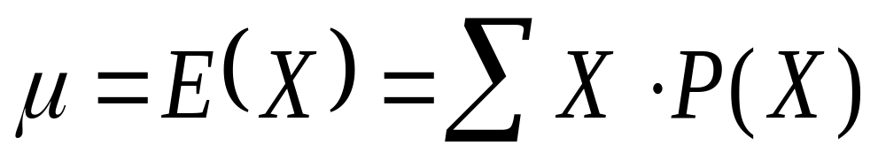
Mean of a Discrete Distribution
X
⋅
P
(
X
X
P(X)
)
-1
0
1
2
3
.1
.2
.4
.2
.1
-.1
.0
.4
.4
.3
1.0
Notes:
9

Slide 10
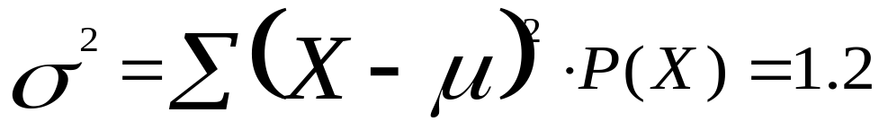
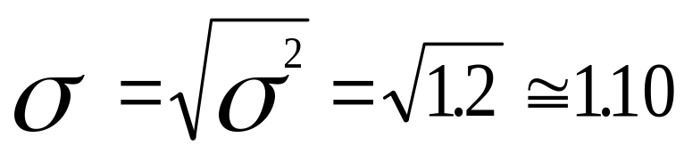


Variance and Standard Deviation of a Discrete Distribution
X
P(X)
X
−
μ
-1
0
1
2
3
.1
.2
.4
.2
.1
-2
-1
0
1
2
4
1
0
1
4
.4
.2
.0
.2
.4
1.2
Notes:
10

Slide 11
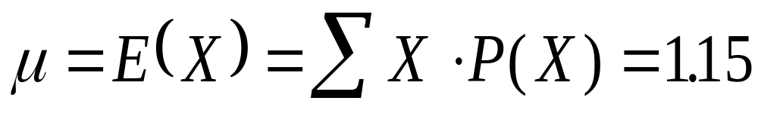
Mean of the Crises Data Example
X
P(X)
X
P(X)
•
P
r
o
b
a
b
i
l
i
t
y
0
.37
.00
0.5
0.4
1
.31
.31
0.3
2
.18
.36
0.2
3
.09
.27
0.1
4
.04
.16
0
5
.01
.05
0
1
2
3
4
5
Number of Crises
1.15
Notes:
11

Slide 12
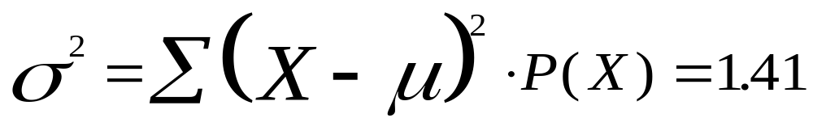
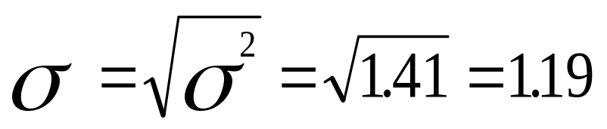
Variance and Standard Deviation of Crises Data Example
X
P(X)
(X-
)
(X-
)
(X-
)
P(X)
μ
μ
2
μ
•
2
0
.37
-1.15
1.32
.49
1
.31
-0.15
0.02
.01
2
.18
0.85
0.72
.13
3
.09
1.85
3.42
.31
4
.04
2.85
8.12
.32
5
.01
3.85
14.82
.15
1.41
Notes:
12

Slide 13
Binomial Distribution
Experiment involves n identical trials
Each trial has exactly two possible outcomes: success and failure
Each trial is independent of the previous trials
  p is the probability of a success on any one trial
  q = (1-p) is the probability of a failure on any one trial
  p and q are constant throughout the experiment
  X is the number of successes in the n trials
Applications
  Sampling with replacement
  Sampling without replacement -- n < 5% N
Notes:
13

Slide 14
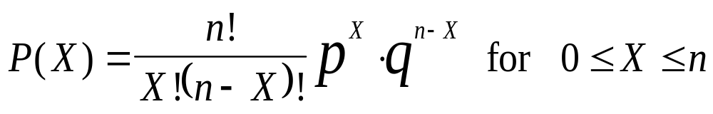
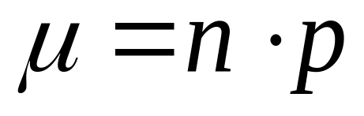
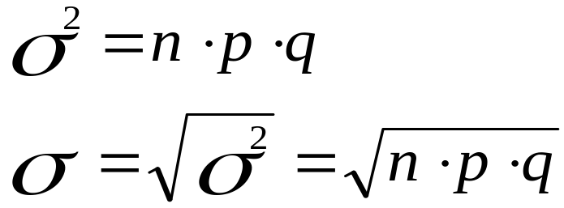
Binomial Distribution
Probability function
Mean value
Variance and standard deviation
Notes:
14

Slide 15
Binomial Distribution: Development
Experiment: randomly select, with replacement, two families from the residents of Tiny Town
Success is ‘Children in Household:’ p = 0.75
Failure is ‘No Children in Household:’ q = 1- p = 0.25
X is the number of families in the sample with ‘Children in Household’
Family
Children in Household
Number of Automobiles
Listing of Sample Space
(A,B), (A,C), (A,D), (D,D),
(B,A), (B,B), (B,C), (B,D),
(C,A), (C,B), (C,C), (C,D),
(D,A), (D,B), (D,C), (D,D)
A
B
C
D
Yes
Yes
No
Yes
3
2
1
2
Notes:
15

Slide 16
Binomial Distribution: Development Continued
Listing of Sample Space
P(outcome)
X
Families A, B, and D have children in the household; family C does not
Success is ‘Children in Household:’ p = 0.75
Failure is ‘No Children in Household:’ q = 1- p = 0.25
X is the number of families in the sample with ‘Children in Household’
(A,B), (A,C), (A,D), (D,D),
(B,A), (B,B), (B,C), (B,D),
(C,A), (C,B), (C,C), (C,D),
(D,A), (D,B), (D,C), (D,D)
1/16
1/16
1/16
1/16
1/16
1/16
1/16
1/16
1/16
1/16
1/16
1/16
1/16
1/16
1/16
1/16
2
1
2
2
2
2
1
2
1
1
0
1
2
2
1
2
Notes:
16

Slide 17
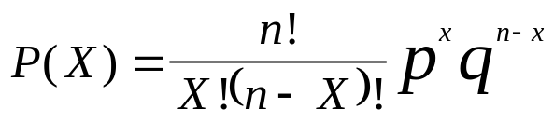
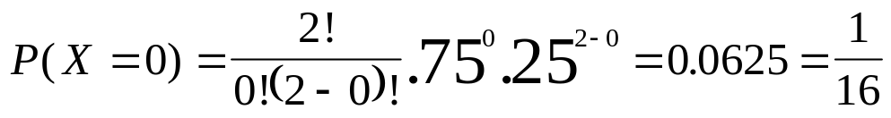
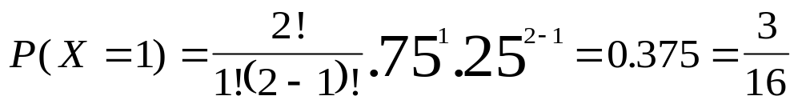
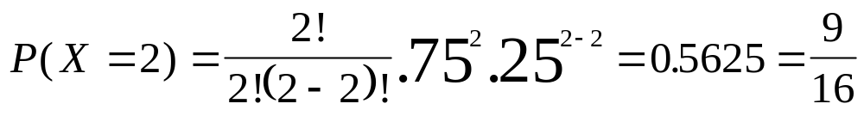
Binomial Distribution: Development Continued
Listing of
Sample
Space
P(outcome)
X
X
P(X)
0
1
2
1/16
6/16
9/16
1
(A,B),
(A,C),
(A,D),
(D,D),
(B,A),
(B,B),
(B,C),
(B,D),
(C,A),
(C,B),
(C,C),
(C,D),
(D,A),
(D,B),
(D,C),
(D,D)
1/16
1/16
1/16
1/16
1/16
1/16
1/16
1/16
1/16
1/16
1/16
1/16
1/16
1/16
1/16
1/16
2
1
2
2
2
2
1
2
1
1
0
1
2
2
1
2
Notes:
17

Slide 18
Binomial Distribution: Development Continued
Families A, B, and D have children in the household; family C does not
Success is ‘Children in Household:’ p = 0.75
Failure is ‘No Children in Household:’ q = 1- p = 0.25
X is the number of families in the sample with ‘Children in Household’
Possible Sequences
P(sequence)
X
(F,F)
(S,F)
(F,S)
(S,S)
(
0
1
1
2
.
25
)
(.
2
25
)
(.
25
)
=
(.
75
)
(.
25
)
(.
25
)
(.
75
)
(
.
75
)
(.
2
75
)
(.
75
)
=
Notes:
18

Slide 19
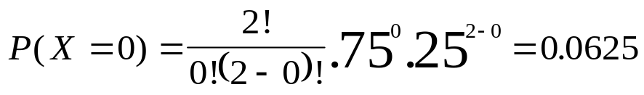
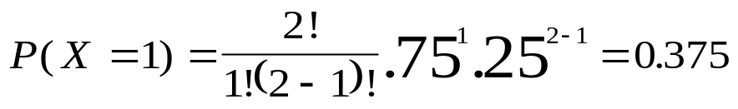
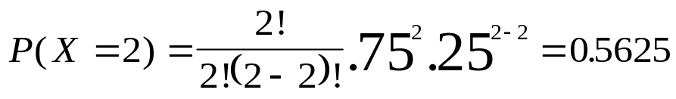
Binomial Distribution: Development Continued
Possible Sequences
P(sequence)
X
X
P(X)
(F,F)
(S,F)
(F,S)
(S,S)
0
1
1
2
0
1
2
(
.
25
(
)
.
25
)
2
2
(.
25
)
(.
25
)
(.
=
=0.0625
25
)
(.
25
)
=
(.
25
)
(.
75
)
(.
2
=0.375
75
)
(.
25
)
(
.
75
)
(.
2
75
)
(.
75
)
(.
=
=0.5625
25
)
(.
75
)
(
.
75
)
(.
2
75
)
(.
75
)
=
Notes:
19

Slide 20
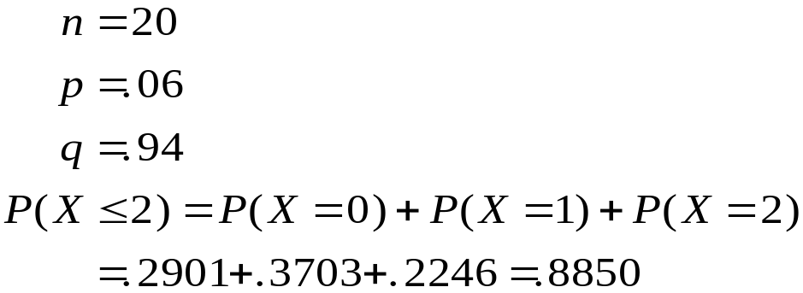
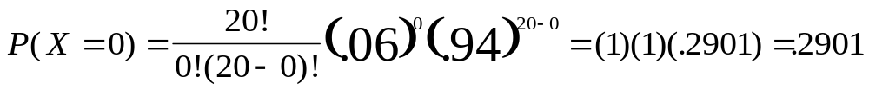
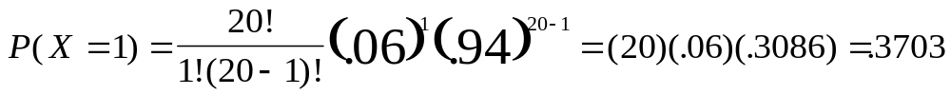
Binomial Distribution: Demonstration Problem 5.3
Notes:
20

Slide 21
Binomial Table
n = 20
PROBABILITY
X
0.1
0.2
0.3
0.4
0.5
0.6
0.7
0.8
0.9
0
0.122
0.012
0.001
0.000
0.000
0.000
0.000
0.000
0.000
1
0.270
0.058
0.007
0.000
0.000
0.000
0.000
0.000
0.000
2
0.285
0.137
0.028
0.003
0.000
0.000
0.000
0.000
0.000
3
0.190
0.205
0.072
0.012
0.001
0.000
0.000
0.000
0.000
4
0.090
0.218
0.130
0.035
0.005
0.000
0.000
0.000
0.000
5
0.032
0.175
0.179
0.075
0.015
0.001
0.000
0.000
0.000
6
0.009
0.109
0.192
0.124
0.037
0.005
0.000
0.000
0.000
7
0.002
0.055
0.164
0.166
0.074
0.015
0.001
0.000
0.000
8
0.000
0.022
0.114
0.180
0.120
0.035
0.004
0.000
0.000
9
0.000
0.007
0.065
0.160
0.160
0.071
0.012
0.000
0.000
10
0.000
0.002
0.031
0.117
0.176
0.117
0.031
0.002
0.000
11
0.000
0.000
0.012
0.071
0.160
0.160
0.065
0.007
0.000
12
0.000
0.000
0.004
0.035
0.120
0.180
0.114
0.022
0.000
13
0.000
0.000
0.001
0.015
0.074
0.166
0.164
0.055
0.002
14
0.000
0.000
0.000
0.005
0.037
0.124
0.192
0.109
0.009
15
0.000
0.000
0.000
0.001
0.015
0.075
0.179
0.175
0.032
16
0.000
0.000
0.000
0.000
0.005
0.035
0.130
0.218
0.090
17
0.000
0.000
0.000
0.000
0.001
0.012
0.072
0.205
0.190
18
0.000
0.000
0.000
0.000
0.000
0.003
0.028
0.137
0.285
19
0.000
0.000
0.000
0.000
0.000
0.000
0.007
0.058
0.270
20
0.000
0.000
0.000
0.000
0.000
0.000
0.001
0.012
0.122

Slide 22
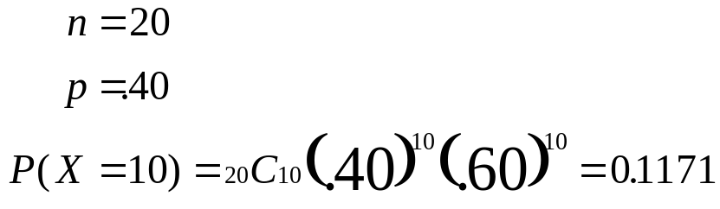
Using the Binomial Table
Demonstration Problem 5.4
n = 20
PROBABILITY
X
0.1
0.2
0.3
0.4
0
0.122
0.012
0.001
0.000
1
0.270
0.058
0.007
0.000
2
0.285
0.137
0.028
0.003
3
0.190
0.205
0.072
0.012
4
0.090
0.218
0.130
0.035
5
0.032
0.175
0.179
0.075
6
0.009
0.109
0.192
0.124
7
0.002
0.055
0.164
0.166
8
0.000
0.022
0.114
0.180
9
0.000
0.007
0.065
0.160
10
0.000
0.002
0.031
0.117
11
0.000
0.000
0.012
0.071
12
0.000
0.000
0.004
0.035
13
0.000
0.000
0.001
0.015
14
0.000
0.000
0.000
0.005
15
0.000
0.000
0.000
0.001
16
0.000
0.000
0.000
0.000
17
0.000
0.000
0.000
0.000
18
0.000
0.000
0.000
0.000
19
0.000
0.000
0.000
0.000
20
0.000
0.000
0.000
0.000

Slide 23
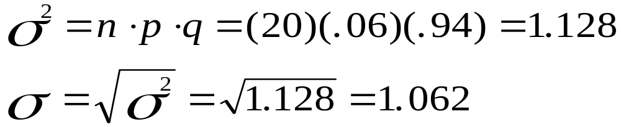
Binomial Distribution using Table: Demonstration Problem 5.3
n = 20
PROBABILITY
X
0.05
0.06
0.07
0
0.3585
0.2901
0.2342
1
0.3774
0.3703
0.3526
2
0.1887
0.2246
0.2521
3
0.0596
0.0860
0.1139
4
0.0133
0.0233
0.0364
5
0.0022
0.0048
0.0088
6
0.0003
0.0008
0.0017
7
0.0000
0.0001
0.0002
8
0.0000
0.0000
0.0000
…
…
…
…
20
0.0000
0.0000
0.0000
Notes:
23

Slide 24
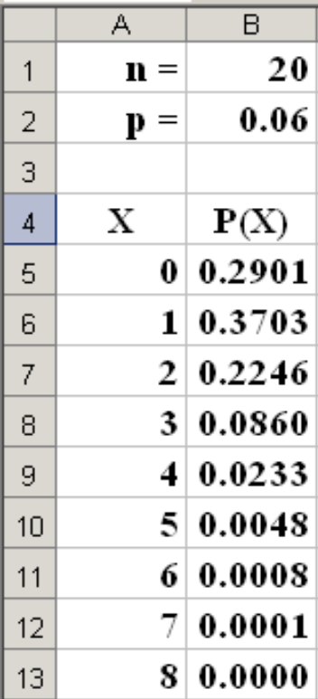
Excel’s Binomial Function
n = | 20
p = | 0.06
X | P(X)
0 | =BINOMDIST(A5,B$1,B$2,FALSE)
1 | =BINOMDIST(A6,B$1,B$2,FALSE)
2 | =BINOMDIST(A7,B$1,B$2,FALSE)
3 | =BINOMDIST(A8,B$1,B$2,FALSE)
4 | =BINOMDIST(A9,B$1,B$2,FALSE)
5 | =BINOMDIST(A10,B$1,B$2,FALSE)
6 | =BINOMDIST(A11,B$1,B$2,FALSE)
7 | =BINOMDIST(A12,B$1,B$2,FALSE)
8 | =BINOMDIST(A13,B$1,B$2,FALSE)
9 | =BINOMDIST(A14,B$1,B$2,FALSE)

Slide 25
Graphs of Selected Binomial Distributions
n = 4
PROBABILITY
P = 0.5
X
0.1
0.5
0.9
1.000
0.900
0
0.656
0.063
0.000
0.800
0.700
1
0.292
0.250
0.004
0.600
P(X)
0.500
0.400
2
0.049
0.375
0.049
0.300
0.200
3
0.004
0.250
0.292
0.100
0.000
4
0.000
0.063
0.656
0
1
2
3
X
4
P = 0.1
P = 0.9
1.000
1.000
0.900
0.900
0.800
0.800
0.700
0.700
0.600
0.600
P(X)
0.500
P(X)
0.500
0.400
0.400
0.300
0.300
0.200
0.200
0.100
0.100
0.000
0.000
0
1
2
3
X
4
0
1
2
3
X
4

Slide 26
Poisson Distribution
Describes discrete occurrences over a continuum or interval
A discrete distribution
Describes rare events
Each occurrence is independent any other occurrences.
The number of occurrences in each interval can vary from zero to infinity.
The expected number of occurrences must hold constant throughout the experiment.
Notes:
32

Slide 27
Poisson Distribution: Applications
Arrivals at queuing systems
  airports -- people, airplanes, automobiles, baggage
  banks -- people, automobiles, loan applications
  computer file servers -- read and write operations
Defects in manufactured goods
  number of defects per 1,000 feet of extruded copper wire
  number of blemishes per square foot of painted surface
  number of errors per typed page
Notes:
33

Slide 28
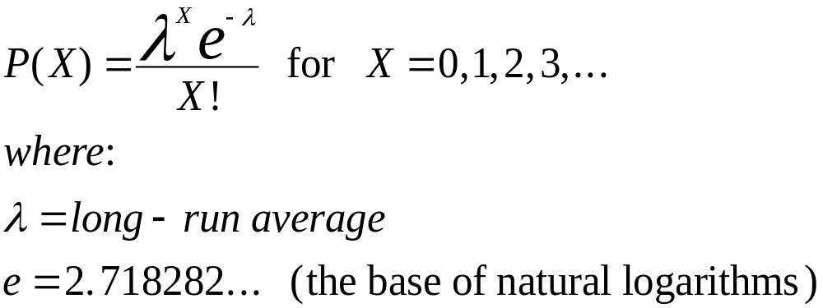
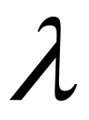
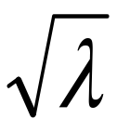
Poisson Distribution
Probability function
Mean value
Variance
Standard deviation
Notes:
34

Slide 29
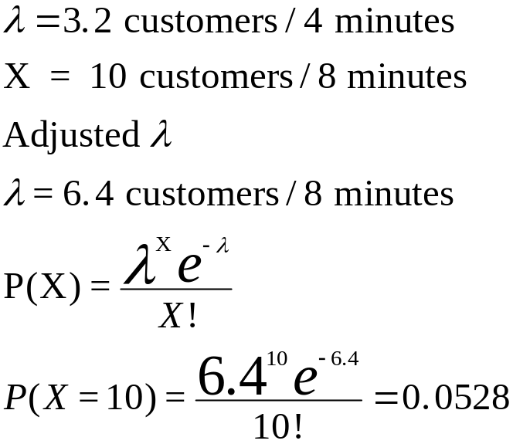
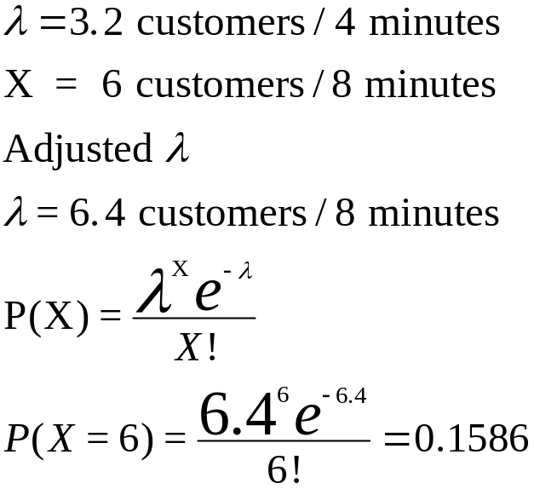
Poisson Distribution: Demonstration Problem 5.7
Notes:
35

Slide 30
Poisson Distribution: Probability Table
λ
X
0.5
1.5
1.6
3.0
3.2
6.4
6.5
7.0
8.0
0
0.6065
0.2231
0.2019
0.0498
0.0408
0.0017
0.0015
0.0009
0.0003
1
0.3033
0.3347
0.3230
0.1494
0.1304
0.0106
0.0098
0.0064
0.0027
2
0.0758
0.2510
0.2584
0.2240
0.2087
0.0340
0.0318
0.0223
0.0107
3
0.0126
0.1255
0.1378
0.2240
0.2226
0.0726
0.0688
0.0521
0.0286
4
0.0016
0.0471
0.0551
0.1680
0.1781
0.1162
0.1118
0.0912
0.0573
5
0.0002
0.0141
0.0176
0.1008
0.1140
0.1487
0.1454
0.1277
0.0916
6
0.0000
0.0035
0.0047
0.0504
0.0608
0.1586
0.1575
0.1490
0.1221
7
0.0000
0.0008
0.0011
0.0216
0.0278
0.1450
0.1462
0.1490
0.1396
8
0.0000
0.0001
0.0002
0.0081
0.0111
0.1160
0.1188
0.1304
0.1396
9
0.0000
0.0000
0.0000
0.0027
0.0040
0.0825
0.0858
0.1014
0.1241
10
0.0000
0.0000
0.0000
0.0008
0.0013
0.0528
0.0558
0.0710
0.0993
11
0.0000
0.0000
0.0000
0.0002
0.0004
0.0307
0.0330
0.0452
0.0722
12
0.0000
0.0000
0.0000
0.0001
0.0001
0.0164
0.0179
0.0263
0.0481
13
0.0000
0.0000
0.0000
0.0000
0.0000
0.0081
0.0089
0.0142
0.0296
14
0.0000
0.0000
0.0000
0.0000
0.0000
0.0037
0.0041
0.0071
0.0169
15
0.0000
0.0000
0.0000
0.0000
0.0000
0.0016
0.0018
0.0033
0.0090
16
0.0000
0.0000
0.0000
0.0000
0.0000
0.0006
0.0007
0.0014
0.0045
17
0.0000
0.0000
0.0000
0.0000
0.0000
0.0002
0.0003
0.0006
0.0021
18
0.0000
0.0000
0.0000
0.0000
0.0000
0.0001
0.0001
0.0002
0.0009

Slide 31
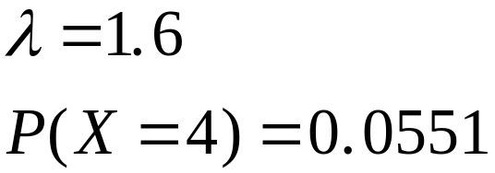
Poisson Distribution: Using the Poisson Tables
λ
X
0.5
1.5
1.6
3.0
0
0.6065
0.2231
0.2019
0.0498
1
0.3033
0.3347
0.3230
0.1494
2
0.0758
0.2510
0.2584
0.2240
3
0.0126
0.1255
0.1378
0.2240
4
0.0016
0.0471
0.0551
0.1680
5
0.0002
0.0141
0.0176
0.1008
6
0.0000
0.0035
0.0047
0.0504
7
0.0000
0.0008
0.0011
0.0216
8
0.0000
0.0001
0.0002
0.0081
9
0.0000
0.0000
0.0000
0.0027
10
0.0000
0.0000
0.0000
0.0008
11
0.0000
0.0000
0.0000
0.0002
12
0.0000
0.0000
0.0000
0.0001

Slide 32
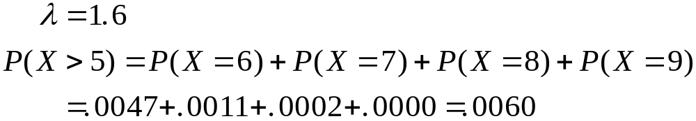
Poisson Distribution:
Using the
Poisson
Tables
λ
X
0.5
1.5
1.6
3.0
0
0.6065
0.2231
0.2019
0.0498
1
0.3033
0.3347
0.3230
0.1494
2
0.0758
0.2510
0.2584
0.2240
3
0.0126
0.1255
0.1378
0.2240
4
0.0016
0.0471
0.0551
0.1680
5
0.0002
0.0141
0.0176
0.1008
6
0.0000
0.0035
0.0047
0.0504
7
0.0000
0.0008
0.0011
0.0216
8
0.0000
0.0001
0.0002
0.0081
9
0.0000
0.0000
0.0000
0.0027
10
0.0000
0.0000
0.0000
0.0008
11
0.0000
0.0000
0.0000
0.0002
12
0.0000
0.0000
0.0000
0.0001

Slide 33
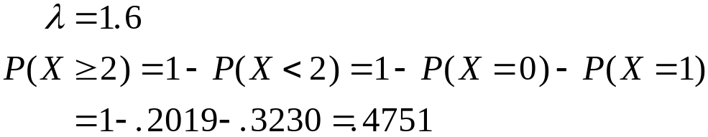
Poisson Distribution: Using the Poisson Tables
λ
X
0.5
1.5
1.6
3.0
0
0.6065
0.2231
0.2019
0.0498
1
0.3033
0.3347
0.3230
0.1494
2
0.0758
0.2510
0.2584
0.2240
3
0.0126
0.1255
0.1378
0.2240
4
0.0016
0.0471
0.0551
0.1680
5
0.0002
0.0141
0.0176
0.1008
6
0.0000
0.0035
0.0047
0.0504
7
0.0000
0.0008
0.0011
0.0216
8
0.0000
0.0001
0.0002
0.0081
9
0.0000
0.0000
0.0000
0.0027
10
0.0000
0.0000
0.0000
0.0008
11
0.0000
0.0000
0.0000
0.0002
12
0.0000
0.0000
0.0000
0.0001

Slide 34


Poisson Distribution: Graphs
0.35
0.16
0.30
0.14
0.25
0.12
0.20
0.10
0.15
0.08
0.06
0.10
0.04
0.05
0.02
0.00
0.00
0
1
2
3
4
5
6
7
8
0
2
4
6
8
10
12
14
16
Notes:
40

Slide 35
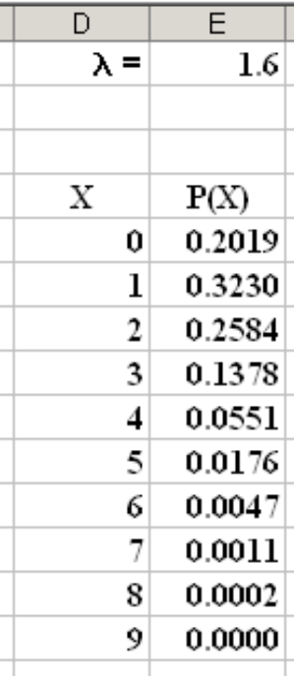
Excel’s Poisson Function
λ = | 1.6
X | P(X)
0 | =POISSON(D5,E$1,FALSE)
1 | =POISSON(D6,E$1,FALSE)
2 | =POISSON(D7,E$1,FALSE)
3 | =POISSON(D8,E$1,FALSE)
4 | =POISSON(D9,E$1,FALSE)
5 | =POISSON(D10,E$1,FALSE)
6 | =POISSON(D11,E$1,FALSE)
7 | =POISSON(D12,E$1,FALSE)
8 | =POISSON(D13,E$1,FALSE)
9 | =POISSON(D14,E$1,FALSE)

Slide 36

Poisson Approximation of the Binomial Distribution
Binomial probabilities are difficult to calculate when n is large.
Under certain conditions binomial probabilities may be approximated by Poisson probabilities.
Poisson approximation
Notes:
41

Slide 37
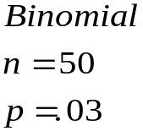
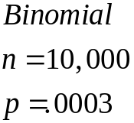
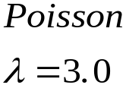

Poisson Approximation of the Binomial Distribution
X
Error
X
Error
0
0.0498
0.0498
0.0000
0
0.2231
0.2181
-0.0051
1
0.1494
0.1493
0.0000
1
0.3347
0.3372
0.0025
2
0.2240
0.2241
0.0000
2
0.2510
0.2555
0.0045
3
0.2240
0.2241
0.0000
3
0.1255
0.1264
0.0009
4
0.0471
0.0459
-0.0011
4
0.1680
0.1681
0.0000
5
0.0141
0.0131
-0.0010
5
0.1008
0.1008
0.0000
6
0.0035
0.0030
-0.0005
6
0.0504
0.0504
0.0000
7
0.0008
0.0006
-0.0002
7
0.0216
0.0216
0.0000
8
0.0001
0.0001
0.0000
8
0.0081
0.0081
0.0000
9
0.0000
0.0000
0.0000
9
0.0027
0.0027
0.0000
10
0.0008
0.0008
0.0000
11
0.0002
0.0002
0.0000
12
0.0001
0.0001
0.0000
13
0.0000
0.0000
0.0000
Notes:
42

Slide 38
Hypergeometric Distribution
Sampling without replacement from a finite population
The number of objects in the population is denoted N.
Each trial has exactly two possible outcomes, success and failure.
Trials are not independent
X is the number of successes in the n trials
The binomial is an acceptable approximation, if n < 5% N. Otherwise it is not.
Notes:
25

Slide 39
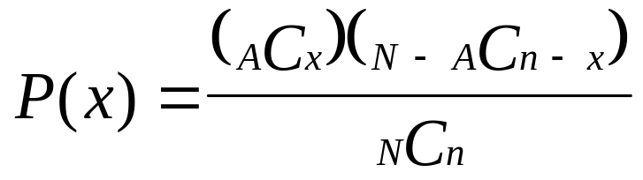
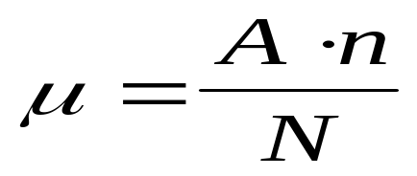
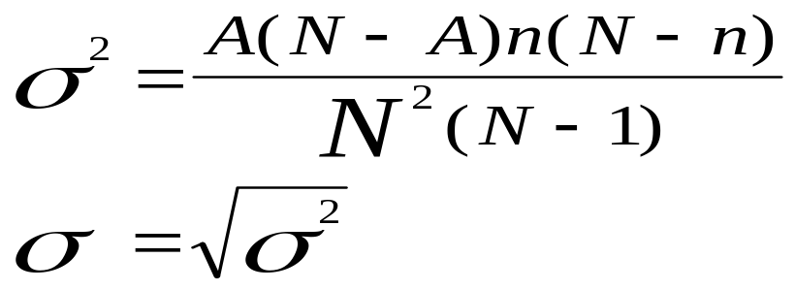
Hypergeometric Distribution
Probability function
  N is population size
  n is sample size
  A is number of successes in population
  x is number of successes in sample
Mean value
Variance and standard deviation
Notes:
26

Slide 40
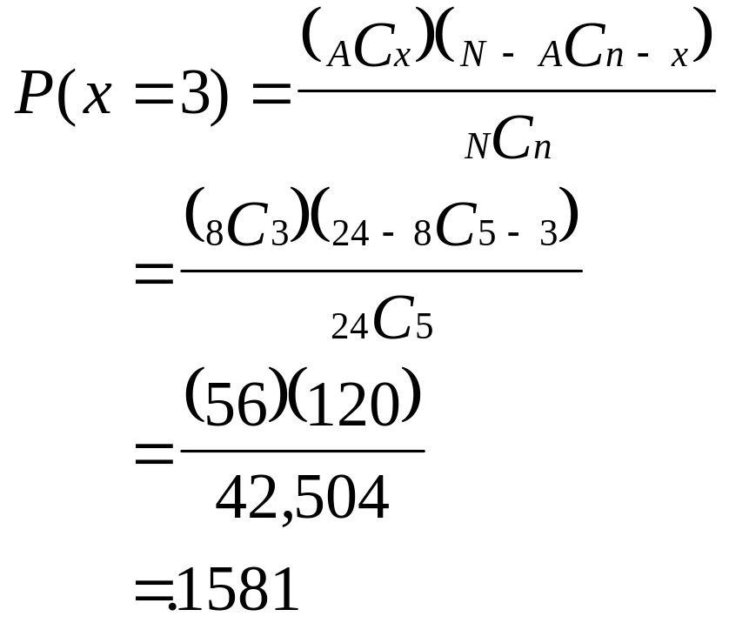
Hypergeometric Distribution:
Probability Computations
N = 24
X = 8
n = 5
x
P(x)
0
0.1028
1
0.3426
2
0.3689
3
0.1581
4
0.0264
5
0.0013
Notes:
27

Slide 41
Hypergeometric Distribution: Graph
N = 24
0.40
X = 8
0.35
n = 5
0.30
0.25
x
P(x)
0.20
0
0.1028
0.15
1
0.3426
0.10
2
0.3689
0.05
3
0.1581
0.00
0
1
2
3
4
5
4
0.0264
5
0.0013
Notes:
28

Slide 42
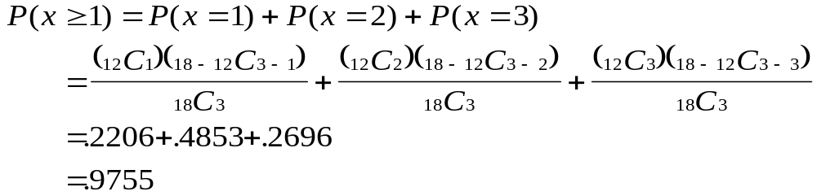
Hypergeometric Distribution:
Demonstration Problem 5.11
N = 18
n = 3
A = 12
X
P(X)
0
0.0245
1
0.2206
2
0.4853
3
0.2696

Slide 43
Hypergeometric Distribution:
Binomial Approximation (large n)
Hypergeometric
Binomial
N = 24
n = 5
X = 8
p = 8/24 =1/3
n = 5
x
P(x)
P(x)
Error
0
0.1028
0.1317
-0.0289
1
0.3426
0.3292
0.0133
2
0.3689
0.3292
0.0397
3
0.1581
0.1646
-0.0065
4
0.0264
0.0412
-0.0148
5
0.0013
0.0041
-0.0028
Notes:
30

Slide 44
Hypergeometric Distribution:
Binomial Approximation (small n)
Hypergeometric
Binomial
N = 240
n = 5
X = 80
p = 80/240 =1/3
n = 5
x
P(x)
P(x)
Error
0
0.1289
0.1317
-0.0028
1
0.3306
0.3292
0.0014
2
0.3327
0.3292
0.0035
3
0.1642
0.1646
-0.0004
4
0.0398
0.0412
-0.0014
5
0.0038
0.0041
-0.0003
Notes:
31

Slide 45
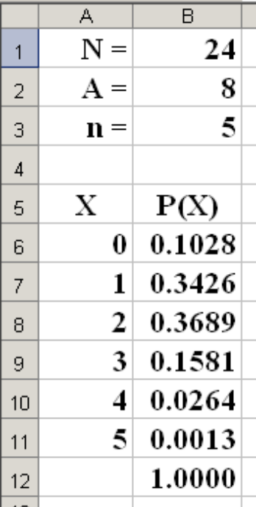
Excel’s Hypergeometric Function
N = | 24
A = | 8
n = | 5
X | P(X)
0 | =HYPGEOMDIST(A6,B$3,B$2,B$1)
1 | =HYPGEOMDIST(A7,B$3,B$2,B$1)
2 | =HYPGEOMDIST(A8,B$3,B$2,B$1)
3 | =HYPGEOMDIST(A9,B$3,B$2,B$1)
4 | =HYPGEOMDIST(A10,B$3,B$2,B$1)
5 | =HYPGEOMDIST(A11,B$3,B$2,B$1)
 | =SUM(B6:B11)

