Slide 1

Business Statistics, 3e by Ken Black
Chapter 7
Sampling &
Sampling
Distributions

Slide 2
Learning Objectives
Determine when to use sampling instead of a census.
Distinguish between random and nonrandom sampling.
Decide when and how to use various sampling techniques.
Be aware of the different types of error that can occur in a study.
Understand the impact of the Central Limit Theorem on statistical analysis.
Use the sampling distributions of and .
x

p
Notes:
2

Slide 3
Reasons for Sampling
Sampling can save money.
Sampling can save time.
For given resources, sampling can broaden the scope of the data set.
Because the research process is sometimes destructive, the sample can save product.
If accessing the population is impossible; sampling is the only option.
Notes:
3

Slide 4
Reasons for Taking a Census
Eliminate the possibility that a random sample is not representative of the population.
The person authorizing the study is uncomfortable with sample information.
Notes:
4

Slide 5
Population Frame
A list, map, directory, or other source used to represent the population
Overregistration -- the frame contains all members of the target population and some additional elements
  Example: using the chamber of commerce membership directory as the frame for a target population of member businesses owned by women.
Underregistration -- the frame does not contain all members of the target population.
  Example: using the chamber of commerce membership directory as the frame for a target population of all businesses.
Notes:
5

Slide 6
Random Versus Nonrandom Sampling
Random sampling
  Every unit of the population has the same probability of being included in the sample.
  A chance mechanism is used in the selection process.
  Eliminates bias in the selection process
  Also known as probability sampling
Nonrandom Sampling
  Every unit of the population does not have the same probability of being included in the sample.
  Open the selection bias
  Not appropriate data collection methods for most statistical methods
  Also known as nonprobability sampling
Notes:
6

Slide 7
Random Sampling Techniques
Simple Random Sample
Stratified Random Sample
  Proportionate
  Disportionate
Systematic Random Sample
Cluster (or Area) Sampling
Notes:
7

Slide 8
Simple Random Sample
Number each frame unit from 1 to N.
Use a random number table or a random number generator to select n distinct numbers between 1 and N, inclusively.
Easier to perform for small populations
Cumbersome for large populations
Notes:
8

Slide 9
Simple Random Sample:
Numbered Population Frame
01 Alaska Airlines
02 Alcoa
03 Amoco
04 Atlantic Richfield
05 Bank of America
06 Bell of Pennsylvania
07 Chevron
08 Chrysler
09 Citicorp
10 Disney
11 DuPont
12 Exxon
13 Farah
14 GTE
15 General Electric
16 General Mills
17 General Dynamics
18 Grumman
19 IBM
20 Kmart
21 LTV
22 Litton
23 Mead
24 Mobil
25 Occidental Petroleum
26 JCPenney
27 Philadelphia Electric
28 Ryder
29 Sears
30 Time
Notes:
9

Slide 10
Simple Random Sampling:
Random Number Table
9
9
4
3
7
8
7
9
6
1
4
5
7
3
7
3
7
5
5
2
9
7
9
6
9
3
9
0
9
4
3
4
4
7
5
3
1
6
1
8
5
0
6
5
6
0
0
1
2
7
6
8
3
6
7
6
6
8
8
2
0
8
1
5
6
8
0
0
1
6
7
8
2
2
4
5
8
3
2
6
8
0
8
8
0
6
3
1
7
1
4
2
8
7
7
6
6
8
3
5
6
0
5
1
5
7
0
2
9
6
5
0
0
2
6
4
5
5
8
7
8
6
4
2
0
4
0
8
5
3
5
3
7
9
8
8
9
4
5
4
6
8
1
3
0
9
1
2
5
3
8
8
1
0
4
7
4
3
1
9
6
0
0
9
7
8
6
4
3
6
0
1
8
6
9
4
7
7
5
8
8
9
5
3
5
9
9
4
0
0
4
8
2
6
8
3
0
6
0
6
5
2
5
8
7
7
1
9
6
5
8
5
4
5
3
4
6
8
3
4
0
0
9
9
1
9
9
7
2
9
7
6
9
4
8
1
5
9
4
1
8
9
1
5
5
9
0
5
5
3
9
0
6
8
9
4
8
6
3
7
0
7
9
5
5
4
7
0
6
2
7
1
1
8
2
6
4
4
9
3
N = 30
n = 6
Notes:
10

Slide 11
Simple Random Sample:
Sample Members
01 Alaska Airlines
02 Alcoa
03 Amoco
04 Atlantic Richfield
05 Bank of America
06 Bell Pennsylvania
07 Chevron
08 Chrysler
09 Citicorp
10 Disney
11 DuPont
12 Exxon
13 Farah
14 GTE
15 General Electric
16 General Mills
17 General Dynamics
18 Grumman
19 IBM
20 KMart
21 LTV
22 Litton
23 Mead
24 Mobil
25 Occidental Petroleum
26 Penney
27 Philadelphia Electric
28 Ryder
29 Sears
30 Time
N = 30
n = 6
Notes:
11

Slide 12
Stratified Random Sample
Population is divided into nonoverlapping subpopulations called strata
A random sample is selected from each stratum
Potential for reducing sampling error
Proportionate -- the percentage of thee sample taken from each stratum is proportionate to the percentage that each stratum is within the population
Disproportionate -- proportions of the strata within the sample are different than the proportions of the strata within the population
Notes:
12

Slide 13
Stratified Random Sample: Population of FM Radio Listeners
Stratified by Age
20 - 30 years old
(homogeneous within)
(alike)
Hetergeneous
(different)
between
30 - 40 years old
(homogeneous within)
(alike)
Hetergeneous
(different)
between
40 - 50 years old
(homogeneous within)
(alike)
Notes:
13

Slide 14
Systematic Sampling
Convenient and relatively easy to administer
Population elements are an ordered sequence (at least, conceptually).
The first sample element is selected randomly from the first k population elements.
Thereafter, sample elements are selected at a constant interval, k, from the ordered sequence frame.
N
k
=
,
n
where
:
n
=
sample size
N
=
population size
k
=
size of selection interval
Notes:
14

Slide 15
Systematic Sampling: Example
Purchase orders for the previous fiscal year are serialized 1 to 10,000 (N = 10,000).
A sample of fifty (n = 50) purchases orders is needed for an audit.
k = 10,000/50 = 200
First sample element randomly selected from the first 200 purchase orders. Assume the 45th purchase order was selected.
Subsequent sample elements: 245, 445, 645, . . .
Notes:
15

Slide 16
Cluster Sampling
Population is divided into nonoverlapping clusters or areas
Each cluster is a miniature, or microcosm, of the population.
A subset of the clusters is selected randomly for the sample.
If the number of elements in the subset of clusters is larger than the desired value of n, these clusters may be subdivided to form a new set of clusters and subjected to a random selection process.
Notes:
16

Slide 17
Cluster Sampling
Advantages
  More convenient for geographically dispersed populations
  Reduced travel costs to contact sample elements
  Simplified administration of the survey
  Unavailability of sampling frame prohibits using other random sampling methods
Disadvantages
  Statistically less efficient when the cluster elements are similar
  Costs and problems of statistical analysis are greater than for simple random sampling
Notes:
17

Slide 18
Cluster Sampling
Grand Forks
Fargo
Portland
Boise
Buffalo
Pittsfield
Milwaukee
Cedar Rapids
Cincinnati
San Jose
Denver
Kansas City
Louisville
San
Diego
Phoenix
Atlanta
Sherman-
Dension
Tucson
Odessa-
Midland
Notes:
18

Slide 19
Nonrandom Sampling
Convenience Sampling: sample elements are selected for the convenience of the researcher
Judgment Sampling: sample elements are selected by the judgment of the researcher
Quota Sampling: sample elements are selected until the quota controls are satisfied
Snowball Sampling: survey subjects are selected based on referral from other survey respondents
Notes:
19

Slide 20
Errors
Data from nonrandom samples are not appropriate for analysis by inferential statistical methods.
Sampling Error occurs when the sample is not representative of the population
Nonsampling Errors
  Missing Data, Recording, Data Entry, and Analysis Errors
  Poorly conceived concepts , unclear definitions, and defective questionnaires
  Response errors occur when people so not know, will not say, or overstate in their answers
Notes:
20

Slide 21
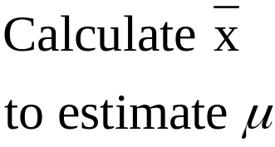
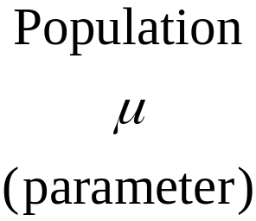
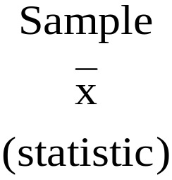
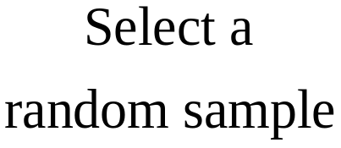
Sampling Distribution of
x
Proper analysis and interpretation of a sample statistic requires knowledge of its distribution.
Process of
Inferential Statistics
Notes:
21

Slide 22
Distribution of a Small Finite Population
N = 8
54, 55, 59, 63, 68, 69, 70
Population Histogram
3
2
Frequency
1
0
52.5
57.5
62.5
67.5
72.5

Slide 23
Sample Space for n = 2 with Replacement
Sample
Mean
Sample
Mean
Sample
Mean
Sample
Mean
1
(54,54)
54.0
17
(59,54)
56.5
33
(64,54)
59.0
49
(69,54)
61.5
2
(54,55)
54.5
18
(59,55)
57.0
34
(64,55)
59.5
50
(69,55)
62.0
3
(54,59)
56.5
19
(59,59)
59.0
35
(64,59)
61.5
51
(69,59)
64.0
4
(54,63)
58.5
20
(59,63)
61.0
36
(64,63)
63.5
52
(69,63)
66.0
5
(54,64)
59.0
21
(59,64)
61.5
37
(64,64)
64.0
53
(69,64)
66.5
6
(54,68)
61.0
22
(59,68)
63.5
38
(64,68)
66.0
54
(69,68)
68.5
7
(54,69)
61.5
23
(59,69)
64.0
39
(64,69)
66.5
55
(69,69)
69.0
8
(54,70)
62.0
24
(59,70)
64.5
40
(64,70)
67.0
56
(69,70)
69.5
9
(55,54)
54.5
25
(63,54)
58.5
41
(68,54)
61.0
57
(70,54)
62.0
10
(55,55)
55.0
26
(63,55)
59.0
42
(68,55)
61.5
58
(70,55)
62.5
11
(55,59)
57.0
27
(63,59)
61.0
43
(68,59)
63.5
59
(70,59)
64.5
12
(55,63)
59.0
28
(63,63)
63.0
44
(68,63)
65.5
60
(70,63)
66.5
13
(55,64)
59.5
29
(63,64)
63.5
45
(68,64)
66.0
61
(70,64)
67.0
14
(55,68)
61.5
30
(63,68)
65.5
46
(68,68)
68.0
62
(70,68)
69.0
15
(55,69)
62.0
31
(63,69)
66.0
47
(68,69)
68.5
63
(70,69)
69.5
16
(55,70)
62.5
32
(63,70)
66.5
48
(68,70)
69.0
64
(70,70)
70.0

Slide 24
Distribution of the Sample Means
Sampling Distribution Histogram
20
15
10
Frequency
5
0
53.75
56.25
58.75
61.25
63.75
66.25
68.75
71.25

Slide 25
1,800 Randomly Selected Values from an Exponential Distribution
F
r
e
q
u
e
n
c
y
450
400
350
300
250
200
150
100
50
0
0
.5
1
1.5
2
2.5
3
3.5
4
4.5
5
5.5
6
6.5
7
7.5
8
8.5
9
9.5
10
X
Notes:
25

Slide 26
Means of 60 Samples (n = 2) from an Exponential Distribution
F
r
e
q
u
e
n
c
y
9
8
7
6
5
4
3
2
1
0
0.00
0.25
0.50
0.75
1.00
1.25
1.50
1.75
2.00
2.25
2.50
2.75
3.00
3.25
3.50
3.75
4.00
x
Notes:
26

Slide 27
Means of 60 Samples (n = 5) from an Exponential Distribution
F
r
e
q
u
e
n
c
y
10
9
8
7
6
5
4
3
2
1
0
0.00
0.25
0.50
0.75
1.00
1.25
1.50
1.75
2.00
2.25
2.50
2.75
3.00
3.25
3.50
3.75
4.00
x
Notes:
27

Slide 28
Means of 60 Samples (n = 30) from an Exponential Distribution
16
F
r
e
q
u
e
n
c
y
14
12
10
8
6
4
2
0
0.00
0.25
0.50
0.75
1.00
1.25
1.50
1.75
2.00
2.25
2.50
2.75
3.00
x
Notes:
28

Slide 29
1,800 Randomly Selected Values from a Uniform Distribution
F
r
e
q
u
e
n
c
y
250
200
150
100
50
0
0.0
0.5
1.0
1.5
2.0
2.5
3.0
3.5
4.0
4.5
5.0
X
Notes:
29

Slide 30
Means of 60 Samples (n = 2) from a Uniform Distribution
F
r
e
q
u
e
n
c
y
10
9
8
7
6
5
4
3
2
1
0
1.00
1.25
1.50
1.75
2.00
2.25
2.50
2.75
3.00
3.25
3.50
3.75
4.00
4.25
x
Notes:
30

Slide 31
Means of 60 Samples (n = 5) from a Uniform Distribution
F
r
e
q
u
e
n
c
y
12
10
8
6
4
2
0
1.00
1.25
1.50
1.75
2.00
2.25
2.50
2.75
3.00
3.25
3.50
3.75
4.00
4.25
x
Notes:
31

Slide 32
Means of 60 Samples (n = 30) from a Uniform Distribution
F
r
e
q
u
e
n
c
y
25
20
15
10
5
0
1.00
1.25
1.50
1.75
2.00
2.25
2.50
2.75
3.00
3.25
3.50
3.75
4.00
4.25
x
Notes:
32

Slide 33
Central Limit Theorem
For sufficiently large sample sizes (n ≥ 30),
the distribution of sample means , is approximately normal;
the mean of this distribution is equal to μ, the population mean; and
its standard deviation is ,
regardless of the shape of the population distribution.
x
σ
n
Notes:
33

Slide 34
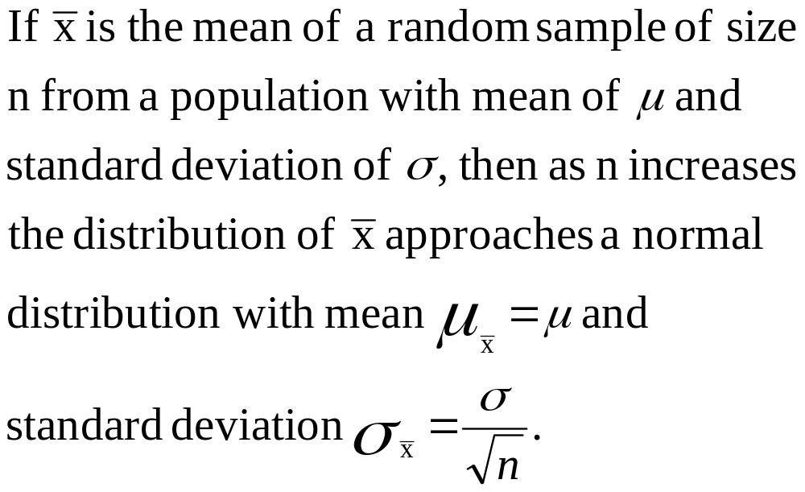
Central Limit Theorem
Notes:
34

Slide 35
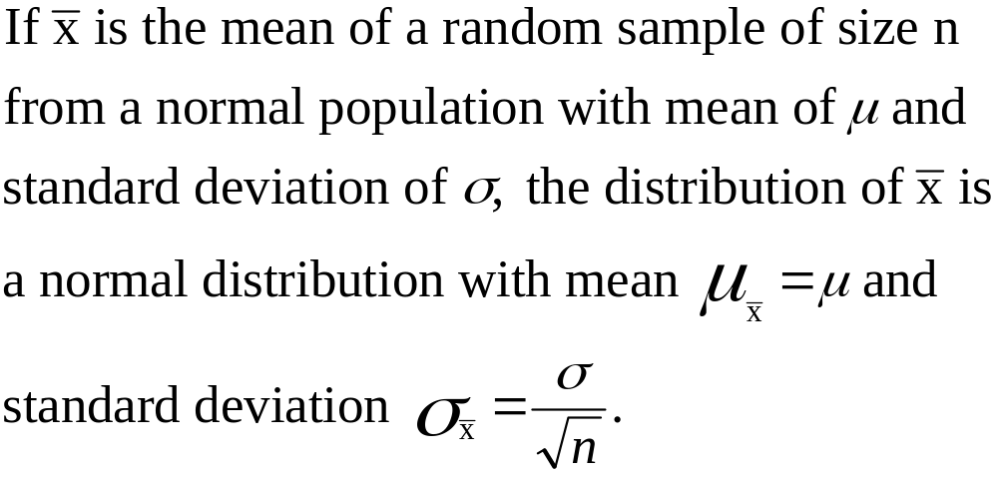
Sampling from a Normal Population
The distribution of sample means is normal for any sample size.
Notes:
35

Slide 36
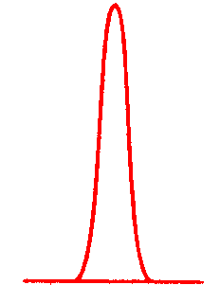
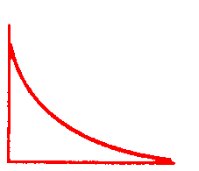
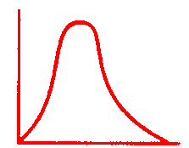
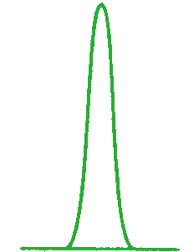
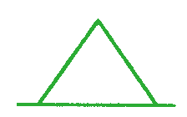
Distribution of Sample Means for Various Sample Sizes
Exponential
Population
n = 2
n = 5
n = 30
Uniform
Population
n = 2
n = 5
n = 30
Notes:
36

Slide 37
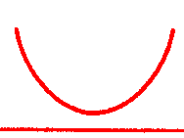
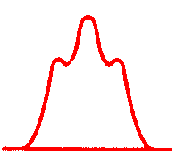
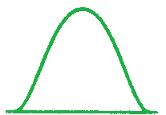
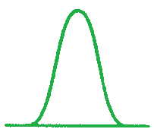
Distribution of Sample Means for Various Sample Sizes
U Shaped
Population
n = 2
n = 5
n = 30
Normal
Population
n = 2
n = 5
n = 30
Notes:
37

Slide 38
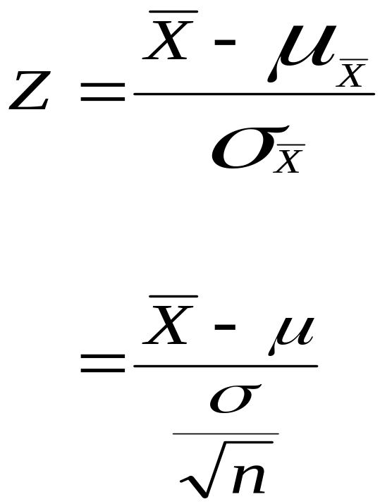
Z Formula for Sample Means
Notes:
38

Slide 39
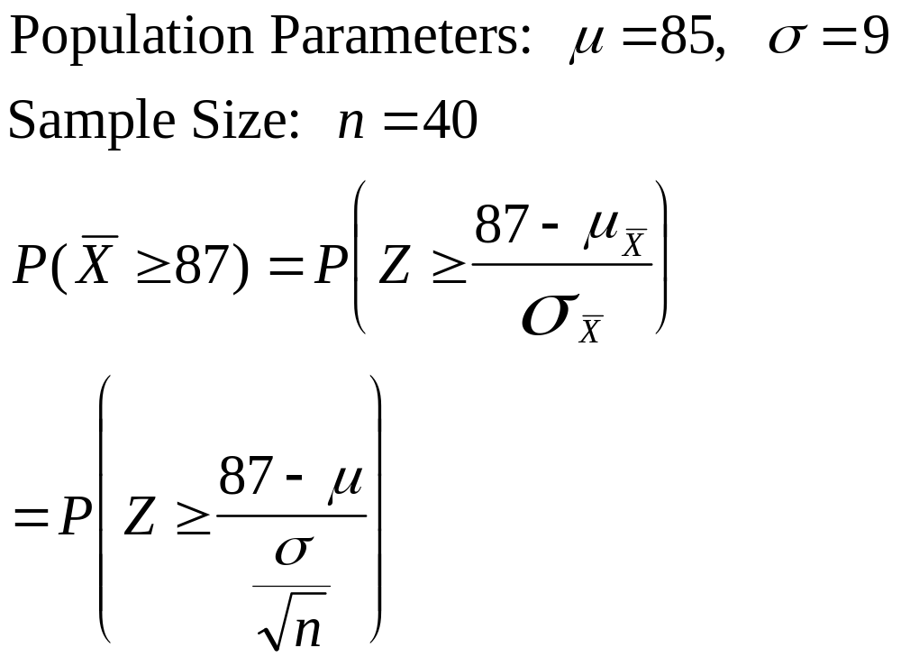
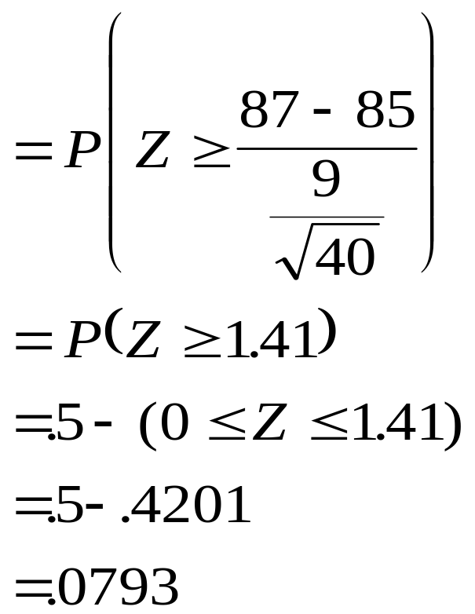
Solution to Tire Store Example
Notes:
39

Slide 40
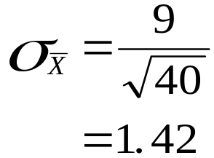

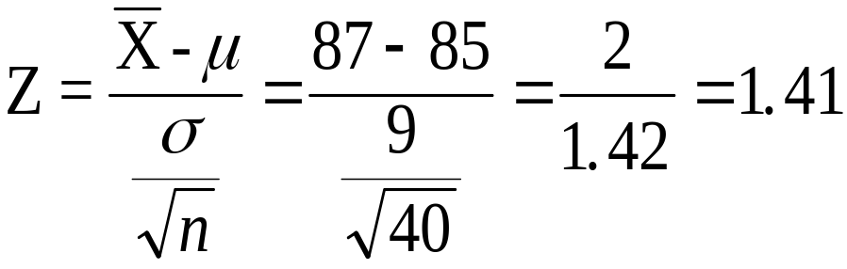
Graphic Solution to Tire Store Example
.5000
.5000
.4207
.4207
85
87
X
0
1.41
Z
Equal Areas
of .0793
Notes:
40

Slide 41


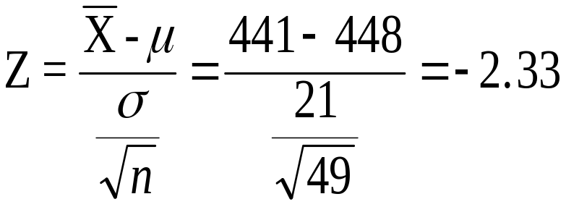
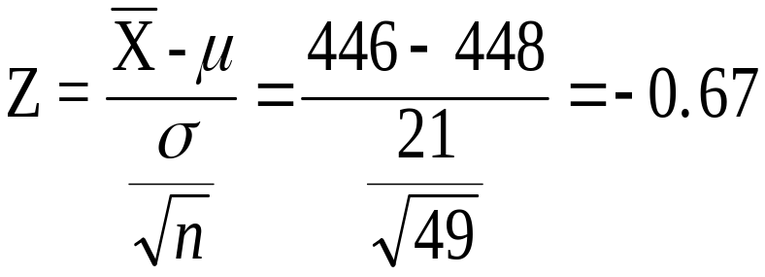
Graphic Solution for
Demonstration Problem 7.1
.4901
.4901
.2486
.2486
.2415
.2415
441
446
448
X
-2.33
-.67
0
Z
Notes:
41

Slide 42
Sampling from a Finite Population without Replacement
In this case, the standard deviation of the distribution of sample means is smaller than when sampling from an infinite population (or from a finite population with replacement).
The correct value of this standard deviation is computed by applying a finite correction factor to the standard deviation for sampling from a infinite population.
If the sample size is less than 5% of the population size, the adjustment is unnecessary.
Notes:
42

Slide 43
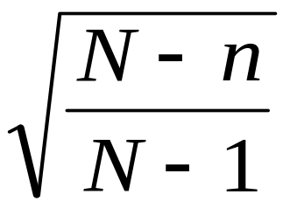
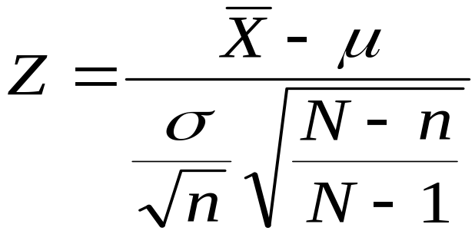
Sampling from a Finite Population
Finite Correction Factor
Modified Z Formula
Notes:
43

Slide 44
Finite Correction Factor for Selected Sample Sizes
Population Sample Sample % Value of
Size (N) Size (n) of Population Correction Factor
6,000 30 0.50% 0.998
6,000 100 1.67% 0.992
6,000 500 8.33% 0.958
2,000 30 1.50% 0.993
2,000 100 5.00% 0.975
2,000 500 25.00% 0.866
500 30 6.00% 0.971
500 50 10.00% 0.950
500 100 20.00% 0.895
200 30 15.00% 0.924
200 50 25.00% 0.868
200 75 37.50% 0.793
Notes:
44

Slide 45
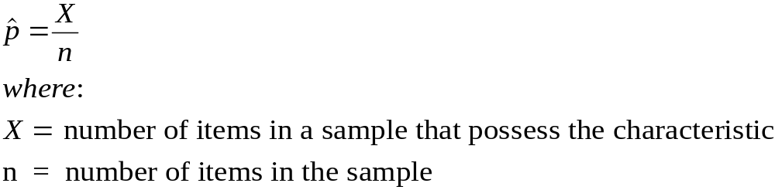
Sampling Distribution of
p

Sample Proportion
Sampling Distribution
  Approximately normal if nP > 5 and nQ > 5 (P is the population proportion and Q = 1 - P.)
  The mean of the distribution is P.
  The standard deviation of the distribution is
P
⋅
Q
n
Notes:
47

Slide 46
Z Formula for Sample Proportions

p
−
P
Z
=
P
⋅
Q
n
where
:

p
=
sample proportion
n
=
sample size
P
=
population proportion
Q
=
1
−
P
n
⋅
P
>
5
n
⋅
Q
>
5
Notes:
48

Slide 47
Solution for Demonstration Problem 7.3
Population Parameters
.
P
=
0
15
−
P
.
10
=
P
Z
≥
P
⋅
Q
Q
=
1
-
P
=
1
−
.
10
=
.
90
n
Sample
n
=
80
.
15
−
.
10
=
P
≥
(.
10
)
X
=
12
(.
90
)
80
X
12
0
.

05
p
=
=
=
0
.
15
=
P
Z
≥
n
80
0
.
0335
μ
=
P
(
Z
≥
1
.
.
49
)
15
−


p
=
.
5
−
P
(
0
≤
Z
≤
1
.
P
49
)
(
p
≥
.
15
)
=
P
Z
≥
σ
=
.
5
−
.

4319
p
=
.
0681
Notes:
49

Slide 48

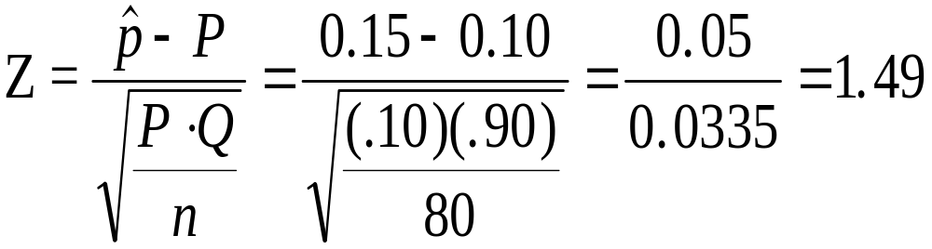
Graphic Solution for Demonstration Problem 7.3
.5000
.5000
.4319
.4319
^
0.10
0.15
p
0
1.49
Z
Notes:
50

