Slide 1

Business Statistics, 4e by Ken Black
Chapter 12
Analysis of Categorical Data

Slide 2
Learning Objectives
Understand the χ² goodness-of-fit test and how to use it.
Analyze data using the χ² test of independence.
Notes:
2

Slide 3
χ² Goodness-of-Fit Test
The χ² goodness-of-fit test compares
expected (theoretical) frequencies
of categories from a population distribution
to the observed (actual) frequencies
from a distribution to determine whether
there is a difference between what was
expected and what was observed.
Notes:
6

Slide 4
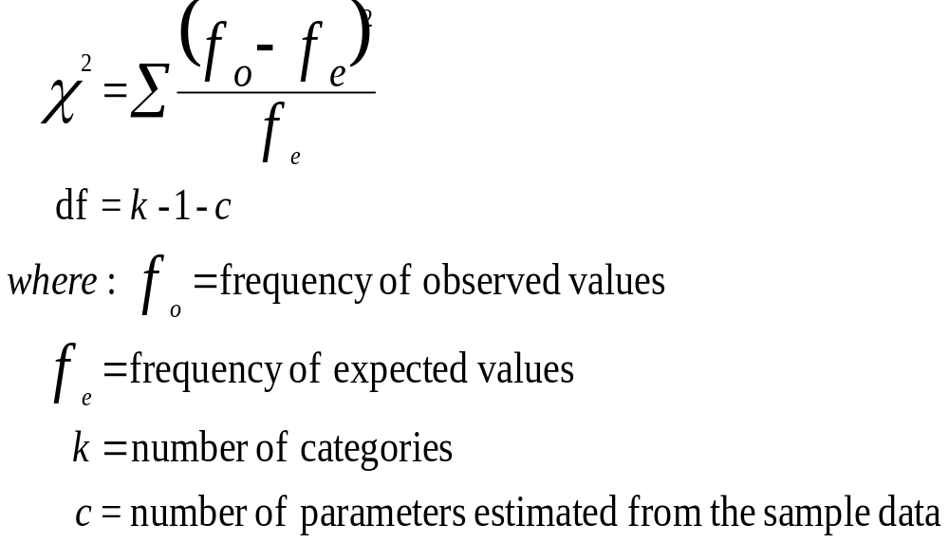
χ² Goodness-of-Fit Test
Notes:
7

Slide 5
Milk Sales Data for Demonstration Problem 12.1
Month
Gallons
January
1,610
February
1,585
March
1,649
April
1,590
May
1,540
June
1,397
July
1,410
August
1,350
September
1,495
October
1,564
November
1,602
December
1,655
18,447
Notes:
8

Slide 6
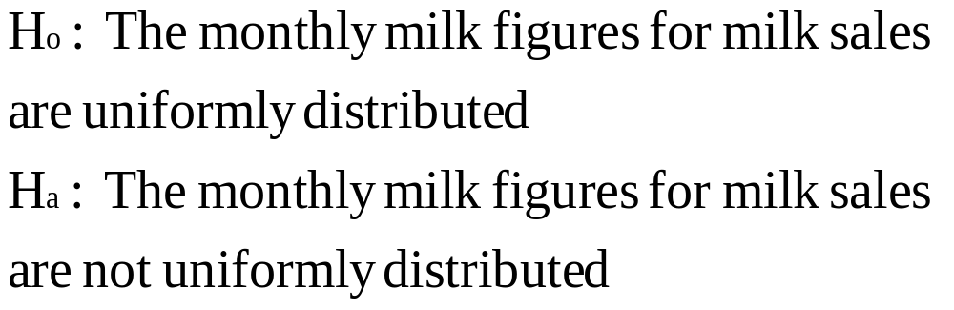
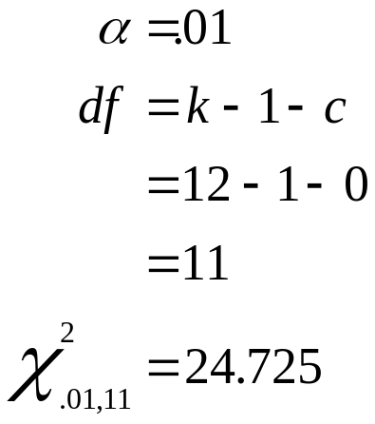
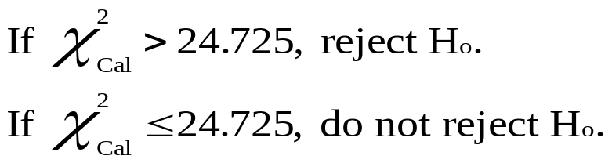
Hypotheses and Decision Rules for Demonstration Problem 12.1
Notes:
9

Slide 7
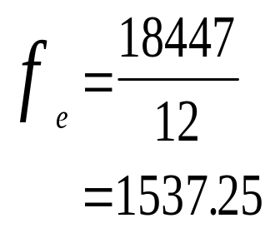
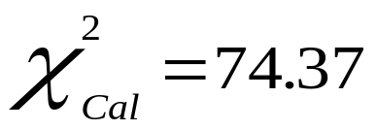
Calculations for Demonstration Problem 12.1
Month
f_{o}
f_{e}
(f_{o} - f_{e})²/f_{e}
January
1,610
1,537.25
3.44
February
1,585
1,537.25
1.48
March
1,649
1,537.25
8.12
April
1,590
1,537.25
1.81
May
1,540
1,537.25
0.00
June
1,397
1,537.25
12.80
July
1,410
1,537.25
10.53
August
1,350
1,537.25
22.81
September
1,495
1,537.25
1.16
October
1,564
1,537.25
0.47
November
1,602
1,537.25
2.73
December
1,655
1,537.25
9.02
18,447
18,447.00
74.38
Notes:
10

Slide 8
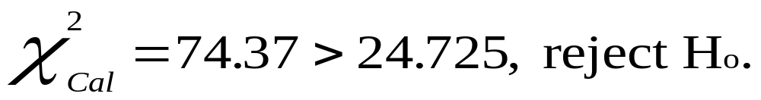
Demonstration Problem 12.1: Conclusion
df = 11
0.01
Non Rejection
region
24.725
Notes:
11

Slide 9
Bank Customer Arrival Data for Demonstration Problem 12.2
Number of
Observed
Arrivals
Frequencies
0
7
1
18
2
25
3
17
4
12
≥5
5
Notes:
12

Slide 10
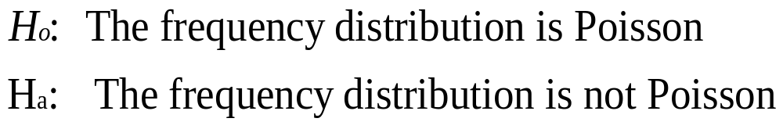
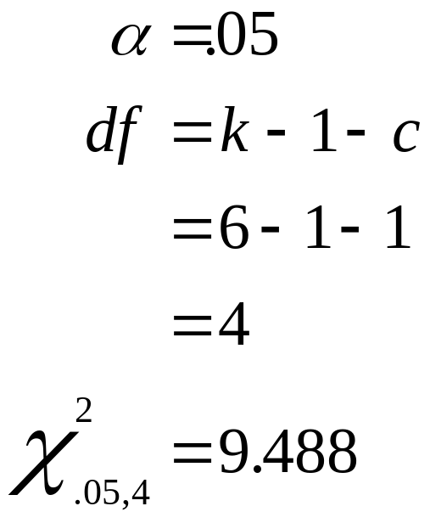
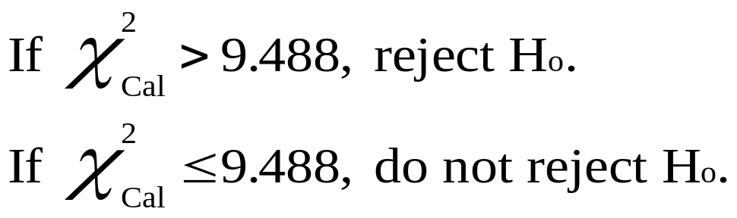
Hypotheses and Decision Rules for Demonstration Problem 12.2
Notes:
13

Slide 11
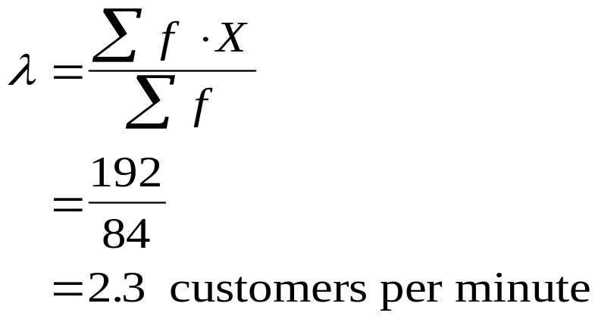
Calculations for Demonstration Problem 12.2:
Estimating the Mean Arrival Rate
Number of
Observed
Mean
Arrival
Rate
Arrivals
X
Frequencies
f
f·X
0
7
0
1
18
18
2
25
50
3
17
51
4
12
48
≥5
5
25
192
Notes:
14

Slide 12
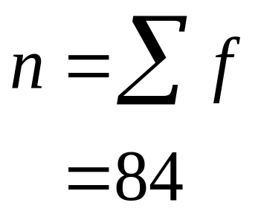
Calculations for Demonstration Problem 12.2: Poisson Probabilities for λ = 2.3
Expected
Expected
Number of
Probabilities
Frequencies
Arrivals X
P(X)
n·P(X)
0
0.1003
8.42
1
0.2306
19.37
2
0.2652
22.28
3
0.2033
17.08
4
0.1169
9.82
Poisson
Probabilities
for λ = 2.3
≥5
0.0838
7.04
Notes:
15

Slide 13
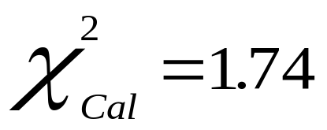
χ² Calculations for Demonstration Problem 12.2
Number of
Observed
Expected
(f_{o} - f_{e})²
f_{e}
Arrivals
X
Frequencies
f
Frequencies
nP(X)
0
7
8.42
0.24
1
18
19.37
0.10
2
25
22.28
0.33
3
17
17.08
0.00
4
12
9.82
0.48
≥5
5
7.04
0.59
84
84.00
1.74
Notes:
16

Slide 14

Demonstration Problem 12.2: Conclusion
df = 4
0.05
Non Rejection
region
9.488
Notes:
17

Slide 15
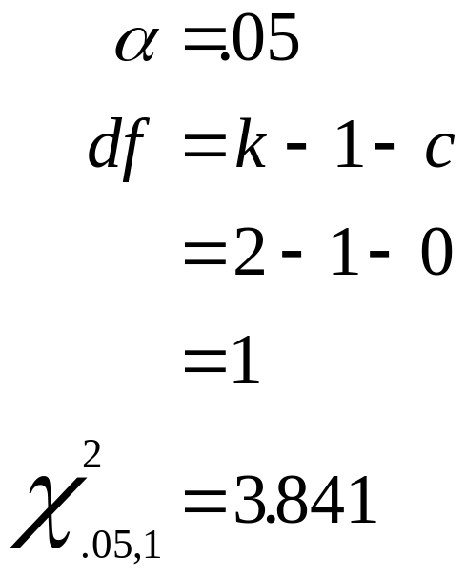
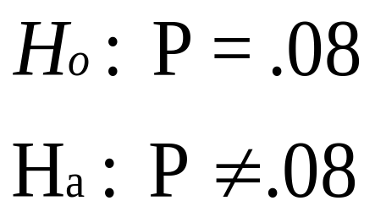
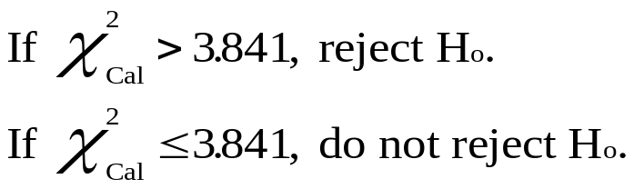
Using a χ² Goodness-of-Fit Test to Test a Population Proportion
Notes:
18

Slide 16
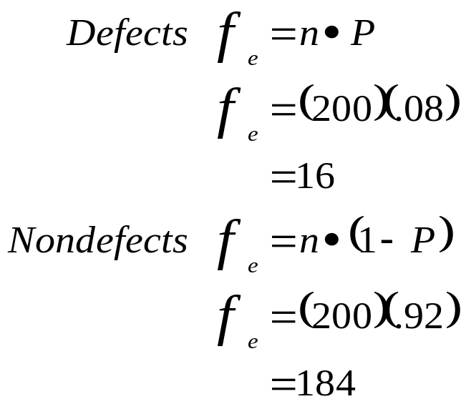
Using a χ² Goodness-of-Fit Test to Test a Population Proportion: Calculations
f_{o}
f_{e}
(
)
f
−
f
2
Defects
33
16
χ
o
e
2
∑
=
f
Nondefects
167
184
e
200
200
(
)
(
)
2
167
2
−
33
184
n =
−
16
=
+
16
184
=
18.0625 + 1.5707
=
19.6332
Notes:
19

Slide 17

Using a χ² Goodness-of-Fit Test to Test a Population Proportion: Conclusion
df = 1
0.05
Non Rejection
region
3.841
Notes:
20

Slide 18
χ² Test of Independence
Used to analyze the frequencies of two variables with multiple categories to determine whether the two variables are independent.
Qualitative Variables
Nominal Data
Notes:
21

Slide 19
χ² Test of Independence: Investment Example
In which region of the country do you reside?
  A. Northeast B. Midwest C. South D. West
Which type of financial investment are you most likely to make today?
  E. Stocks F. Bonds G. Treasury bills
Type of financial
Contingency Table
Investment
E
F
G
A
O₁₃
n_{A}
Geographic
B
n_{B}
Region
C
n_{C}
D
n_{D}
n_{E}
n_{F}
n_{G}
N
Notes:
22

Slide 20
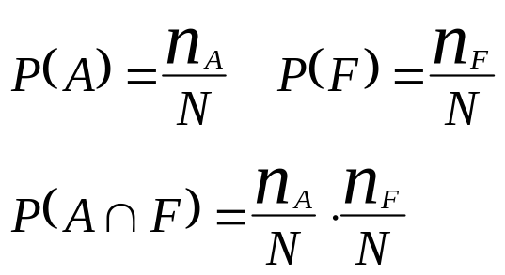
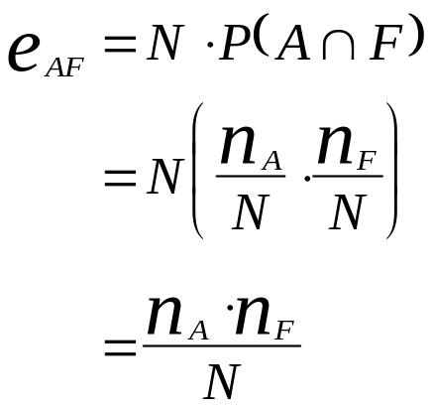
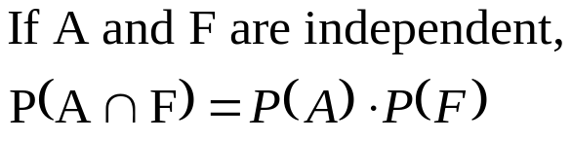
χ² Test of Independence: Investment Example
Type of Financial
Contingency Table
Investment
E
F
G
A
e₁₂
n_{A}
Geographic
B
n_{B}
Region
C
n_{C}
D
n_{D}
n_{E}
n_{F}
n_{G}
N
Notes:
23

Slide 21
χ² Test of Independence: Formulas
(
(
)
n
)
n
e
=
i
j
Expected
Frequencies
ij
N
where
:
i
=
the row
j
=
the column
n
n
=
the total
of row i
i
n
=
the total
of column
j
j
N
=
the total
of all fr
equencies
(
)
Calculated χ²
(Observed χ²)
f
−
f
2
χ
2
∑
∑
o
e
=
f
where
e
:
df
=
(r
-
1)(c
-
1)
r
=
the number
r of rows
c
=
the number
r of columns
Notes:
24

Slide 22
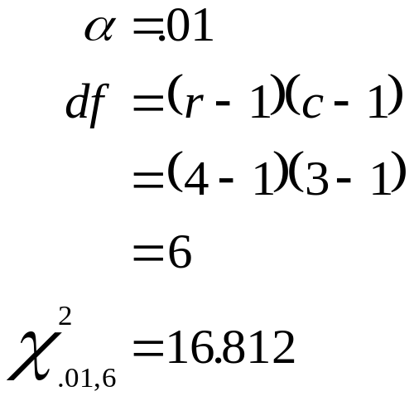
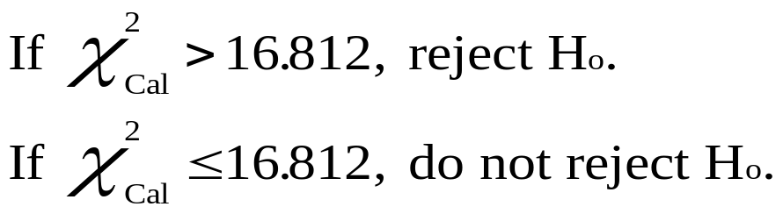
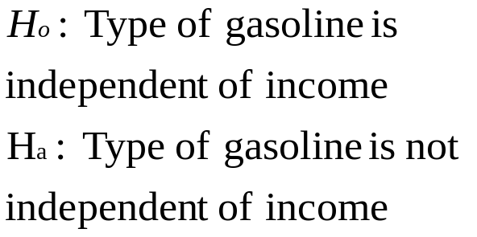
χ² Test of Independence: Gasoline Preference Versus Income Category
Type of
r = 4
Gasoline
c = 3
Extra
Income
Regular
Premium
Premium
Less than $30,000
$30,000 to $49,999
$50,000 to $99,000
At least $100,000
Notes:
25

Slide 23
Gasoline Preference Versus Income Category: Observed Frequencies
Type of
Gasoline
Extra
Income
Regular
Premium
Premium
Less than $30,000
85
16
6
107
$30,000 to $49,999
102
27
13
142
$50,000 to $99,000
36
22
15
73
At least $100,000
15
23
25
63
238
88
59
385
Notes:
26

Slide 24
Gasoline Preference Versus Income Category: Expected Frequencies
(
(
)
Type of
n
)
n
e
=
i
j
Gasoline
ij
N
Extra
(
)
107
(
)
Income
e
238
Regular
Premium
Premium
=
11
385
Less than $30,000
(66.15)
(24.46)
(16.40)
=
66
85
16
6
107
.
15
(
)
$30,000 to $49,999
(87.78)
(32.46)
(21.76)
107
(
)
e
88
=
102
27
13
142
12
385
$50,000 to $99,000
(45.13)
(16.69)
(11.19)
=
24
.
46
36
22
15
73
(
)
107
(
)
e
59
At least $100,000
(38.95)
(14.40)
(9.65)
=
13
385
15
23
25
63
=
16
238
88
59
385
.
40
Notes:
27

Slide 25
Gasoline Preference Versus Income Category: χ² Calculation
(
)
f
−
f
2
χ
o
e
2
∑
∑
=
f
e
(
)
(
)
(
)
88
−
66
2
2
2
.
15
16
−
24
.
46
6
−
16
.
40
=
+
+
+
66
.
15
24
.
46
16
.
40
(
)
(
)
(
)
102
−
87
2
2
2
.
78
27
−
32
.
46
13
−
21
.
76
+
+
+
87
.
78
32
.
46
21
.
76
(
)
(
)
(
)
36
−
45
2
2
2
.
13
22
−
16
.
69
15
−
11
.
19
+
+
+
45
.
13
16
.
69
11
.
19
(
)
(
)
(
)
15
−
38
2
2
2
.
95
23
−
14
.
40
25
−
9
.
65
+
+
38
.
95
14
.
40
9
.
65
=
70
.
78
Notes:
28

Slide 26

Gasoline Preference Versus Income Category: Conclusion
df = 6
0.01
Non rejection
region
16.812
Notes:
29

