Slide 1

Business Statistics, 4e by Ken Black
Chapter 16
Time Series
Forecasting &
Index Numbers

Slide 2
Learning Objectives
Gain a general understanding of time series forecasting techniques.
Understand the four possible components of time-series data.
Understand stationary forecasting techniques.
Understand how to use regression models for trend analysis.
Learn how to decompose time-series data into their various elements and to forecast by using decomposition techniques..
Understand the nature of autocorrelation and how to test for it.
Understand autoregression in forecasting.
Notes:
2

Slide 3
Time-Series Forecasting
Time-series data: data gathered on a given characteristic over a period of time at regular intervals
Time-series techniques
  Attempt to account for changes over time by examining patterns, cycles, trends, or using using information about previous time periods
  Naive Methods
  Averaging
  Smoothing
  Decomposition
Forecast error: Error = X_{actual} - X_{forecast}
Notes:
4

Slide 4
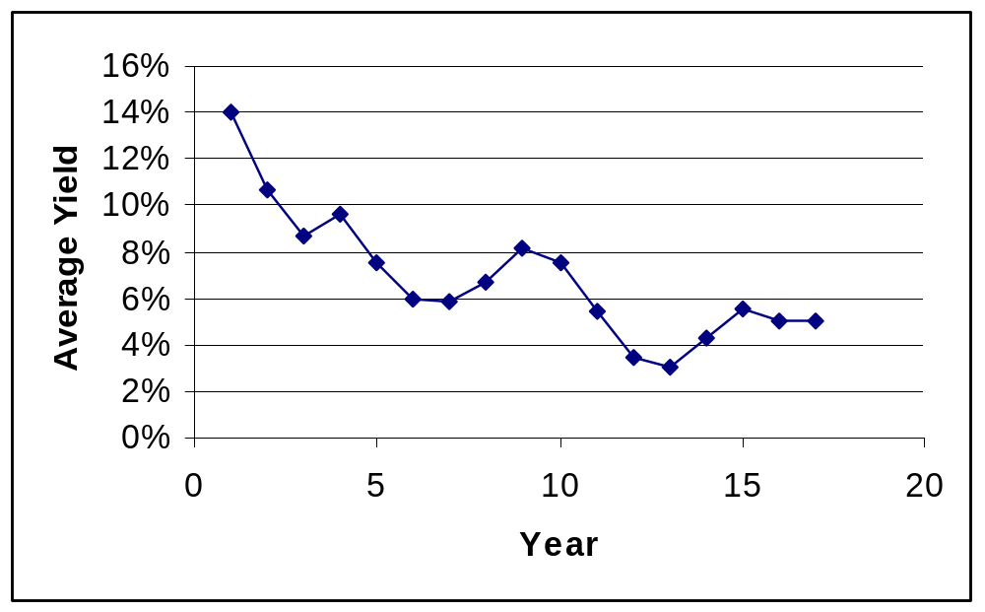
Bond Yields of Three-Month Treasury Bills
Year | Average Yield
1 | 14.03%
2 | 10.69%
3 | 8.63%
4 | 9.58%
5 | 7.48%
6 | 5.98%
7 | 5.82%
8 | 6.69%
9 | 8.12%
10 | 7.51%
11 | 5.42%
12 | 3.45%
13 | 3.02%
14 | 4.29%
15 | 5.51%
16 | 5.02%
17 | 5.07%

Slide 5
Composite Time Series Data
1
2
3
4
5
6
7
8
9
10
11
12
13
Year

Slide 6
Components of Time Series Data
Trend
Seasonal
Cyclical
Irregular

Slide 7
Components of Time Series Data
Irregular
fluctuations
Cyclical
Trend
Seasonal
1
2
3
4
5
6
7
8
9
10
11
12
13
Year

Slide 8
Measurement of Forecasting Error
e_{t} = X_{t} - F_{t}
Mean Absolute Deviation (MAD)
Mean Square Error (MSE)
Mean Percentage Error (MPE)
Mean Absolute Percentage Error (MAPE)
Mean Error (ME)
Notes:
5

Slide 9
Nonfarm Partnership Tax Returns: Actual and Forecast with α = .7
Year
Actual
Forecast
Error
1
1402
2
1458
1402.0
56.0
3
1553
1441.2
111.8
4
1613
1519.5
93.5
5
1676
1584.9
91.1
6
1755
1648.7
106.3
7
1807
1723.1
83.9
8
1824
1781.8
42.2
9
1826
1811.3
14.7
10
1780
1821.6
-41.6
11
1759
1792.5
-33.5
Notes:
6

Slide 10
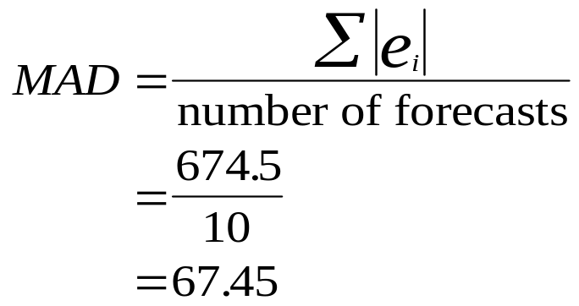
Mean Absolute Deviation: Nonfarm Partnership Forecasted Data
Year
Actual
Forecast
Error
|Error|
1
1402.0
2
1458.0
1402.0
56.0
56.0
3
1553.0
1441.2
111.8
111.8
4
1613.0
1519.5
93.5
93.5
5
1676.0
1584.9
91.1
91.1
6
1755.0
1648.7
106.3
106.3
7
1807.0
1723.1
83.9
83.9
8
1824.0
1781.8
42.2
42.2
9
1826.0
1811.3
14.7
14.7
10
1780.0
1821.6
-41.6
41.6
11
1759.0
1792.5
-33.5
33.5
674.5
Notes:
8

Slide 11
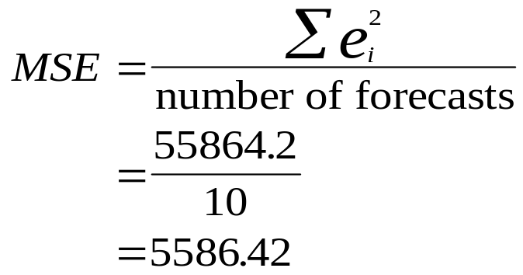
Mean Square Error: Nonfarm Partnership Forecasted Data
Year
Actual
Forecast
Error
Error²
1
1402
2
1458
1402.0
56.0
3136.0
3
1553
1441.2
111.8
12499.2
4
1613
1519.5
93.5
8749.7
5
1676
1584.9
91.1
8292.3
6
1755
1648.7
106.3
11303.6
7
1807
1723.1
83.9
7038.5
8
1824
1781.8
42.2
1778.2
9
1826
1811.3
14.7
214.6
10
1780
1821.6
-41.6
1731.0
11
1759
1792.5
-33.5
1121.0
55864.2
Notes:
9

Slide 12
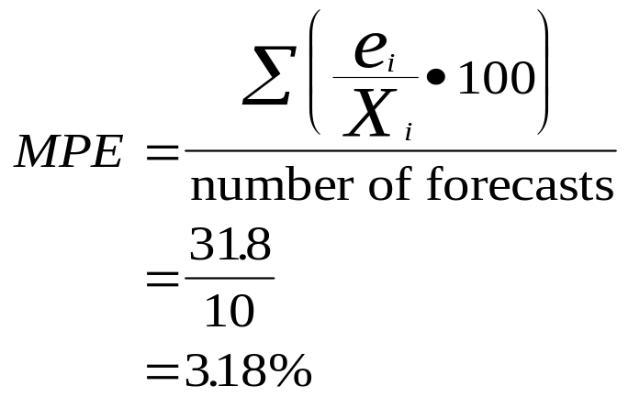
Mean Percentage Error: Nonfarm Partnership Forecasted Data
Year
Actual
Forecast
Error
Error %
1
1402
2
1458
1402.0
56.0
3.8%
3
1553
1441.2
111.8
7.2%
4
1613
1519.5
93.5
5.8%
5
1676
1584.9
91.1
5.4%
6
1755
1648.7
106.3
6.1%
7
1807
1723.1
83.9
4.6%
8
1824
1781.8
42.2
2.3%
9
1826
1811.3
14.7
0.8%
10
1780
1821.6
-41.6
-2.3%
11
1759
1792.5
-33.5
-1.9%
31.8%
Notes:
10

Slide 13
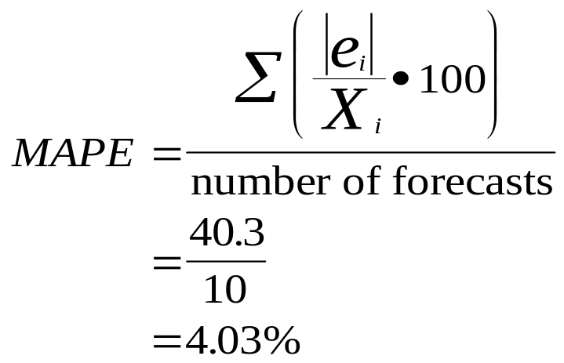
Mean Absolute Percentage Error: Nonfarm Partnership Forecasted Data
Year
Actual
Forecast
Error
|Error %|
1
1402
2
1458
1402.0
56.0
3.8%
3
1553
1441.2
111.8
7.2%
4
1613
1519.5
93.5
5.8%
5
1676
1584.9
91.1
5.4%
6
1755
1648.7
106.3
6.1%
7
1807
1723.1
83.9
4.6%
8
1824
1781.8
42.2
2.3%
9
1826
1811.3
14.7
0.8%
10
1780
1821.6
-41.6
2.3%
11
1759
1792.5
-33.5
1.9%
40.3%
Notes:
11

Slide 14
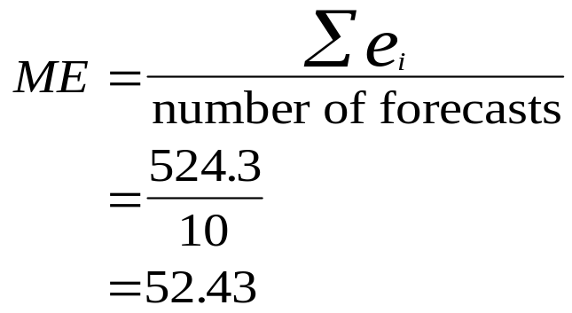
Mean Error for the Nonfarm Partnership Forecasted Data
Year
Actual
Forecast
Error
1
1402.0
2
1458.0
1402.0
56.0
3
1553.0
1441.2
111.8
4
1613.0
1519.5
93.5
5
1676.0
1584.9
91.1
6
1755.0
1648.7
106.3
7
1807.0
1723.1
83.9
8
1824.0
1781.8
42.2
9
1826.0
1811.3
14.7
10
1780.0
1821.6
-41.6
11
1759.0
1792.5
-33.5
524.3
Notes:
7

Slide 15
Smoothing Techniques
Naive Forecasting Models
Averaging Models
  Simple Averages
  Moving Averages
  Weighted Moving Averages
Exponential Smoothing
Notes:
34

Slide 16
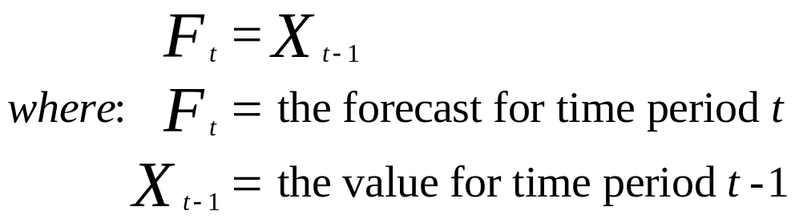
Naive Forecasting
Simplest of the
naive forecasting
models
We sold 532 pairs of shoes last
week, I predict we’ll
sell 532 pairs this week.
Notes:
35

Slide 17
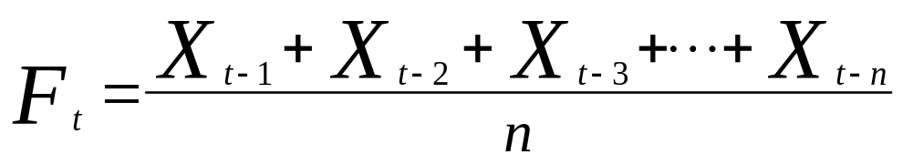
Simple Average Model
The monthly average last
12 months was 56.45, so I predict
56.45 for September.
Cents
Cents
per
per
Month
Year
Gallon
Month
Year
Gallon
January
2
61.3
January
3
58.2
February
63.3
February
58.3
March
62.1
March
57.7
April
59.8
April
56.7
May
58.4
May
56.8
June
57.6
June
55.5
July
55.7
July
53.8
August
55.1
August
52.8
September
55.7
September
October
56.7
October
November
57.2
November
December
58.0
December
Notes:
36

Slide 18
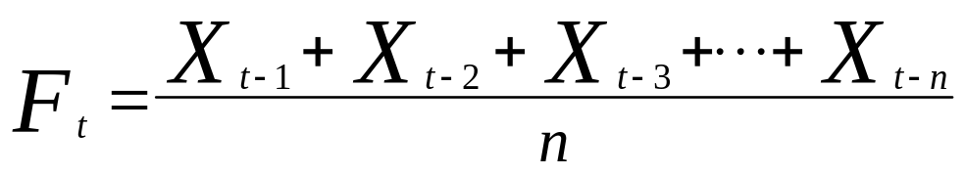
Moving Average
Updated (recomputed) for every new time period
May be difficult to choose optimal number of periods
May not adjust for trend, cyclical, or seasonal effects
Update me each period.
Notes:
37

Slide 19
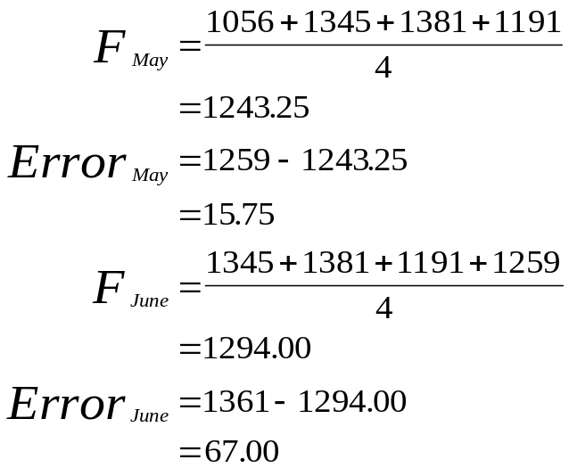
Demonstration Problem 16.1:
Four-Month Moving Average
4-Mo
Moving
Forecast
Months
Shipments
Average
Error
January
1056
February
1345
March
1381
April
1191
May
1259
1243.25
15.75
June
1361
1294.00
67.00
July
1110
1298.00
-188.00
August
1334
1230.25
103.75
September
1416
1266.00
150.00
October
1282
1305.25
-23.25
November
1341
1285.50
55.50
December
1382
1343.25
38.75
Notes:
38

Slide 20
Demonstration Problem 16.1:
Four-Month Moving Average
1500
1400
1300
Shipments
1200
1100
1000
0
2
4
6
8
10
12
Time
Shipments
4-Mo Moving Average

Slide 21
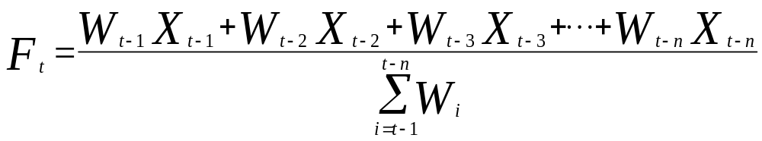
Weighted Moving Average Forecasting Model
Notes:
40

Slide 22
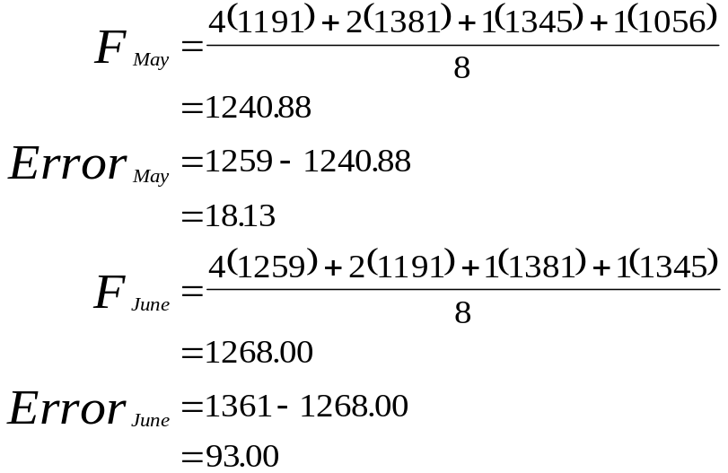
Demonstration Problem 16.2: Four-Month Weighted Moving Average
4-Mo
Weighted
Moving
Forecast
Months
Shipments
Average
Error
January
1056
February
1345
March
1381
April
1191
May
1259
1240.88
18.13
June
1361
1268.00
93.00
July
1110
1316.75
-206.75
August
1334
1201.50
132.50
September
1416
1272.00
144.00
October
1282
1350.38
-68.38
November
1341
1300.50
40.50
December
1382
1334.75
47.25
Notes:
41

Slide 23
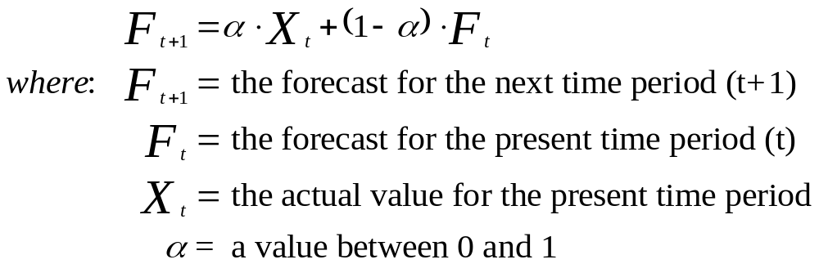
Exponential Smoothing
α is the exponential
smoothing constant
Notes:
42

Slide 24
Demonstration Problem 16.3: α = 0.2
 |  | α = | 0.2
Year | Housing Units (1,000) | F | e | |e| | e²
1984 | 1750 | -- | -- | -- | --
1985 | 1742 | 1750.0 | -8.0 | 8.0 | 64.0
1986 | 1805 | 1748.4 | 56.6 | 56.6 | 3203.6
1987 | 1620 | 1759.72 | -139.7 | 139.7 | 19521.7
1988 | 1488 | 1731.776 | -243.8 | 243.8 | 59426.7
1989 | 1376 | 1683.021 | -307.0 | 307.0 | 94261.8
1990 | 1193 | 1621.617 | -428.6 | 428.6 | 183712.2
1991 | 1014 | 1535.893 | -521.9 | 521.9 | 272372.6
1992 | 1200 | 1431.515 | -231.5 | 231.5 | 53599.0
1993 | 1288 | 1385.212 | -97.2 | 97.2 | 9450.1
1994 | 1457 | 1365.769 | 91.2 | 91.2 | 8323.0
1995 | 1354 | 1384.016 | -30.0 | 30.0 | 900.9
1996 | 1477 | 1378.012 | 99.0 | 99.0 | 9798.5
1997 | 1474 | 1397.81 | 76.2 | 76.2 | 5804.9
1998 | 1617 | 1413.048 | 204.0 | 204.0 | 41596.4
1999 | 1666 | 1453.838 | 212.2 | 212.2 | 45012.6
 |  |  |  | 2746.9 | 807048.2
 |  |  | MAD | 183.1
 |  |  | MSE |  | 53803.2

Slide 25
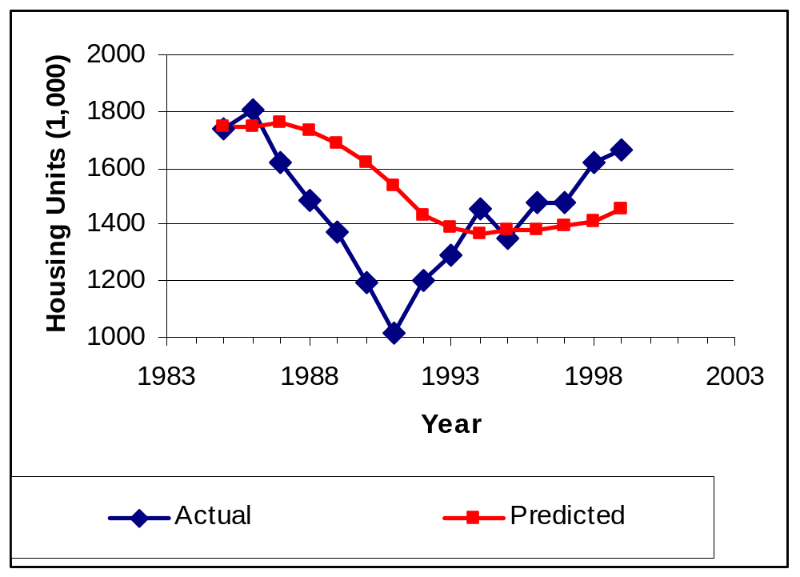
Demonstration Problem 16.3: α = 0.2

Slide 26
Demonstration Problem 16.3: α = 0.8
 |  | α = | 0.8
Year | Housing Units (1,000) | F | e | |e| | e²
1984 | 1750 | -- | -- | -- | --
1985 | 1742 | 1750.0 | -8.0 | 8.0 | 64.0
1986 | 1805 | 1743.6 | 61.4 | 61.4 | 3770.0
1987 | 1620 | 1792.72 | -172.7 | 172.7 | 29832.2
1988 | 1488 | 1654.544 | -166.5 | 166.5 | 27736.9
1989 | 1376 | 1521.309 | -145.3 | 145.3 | 21114.6
1990 | 1193 | 1405.062 | -212.1 | 212.1 | 44970.2
1991 | 1014 | 1235.412 | -221.4 | 221.4 | 49023.4
1992 | 1200 | 1058.282 | 141.7 | 141.7 | 20083.9
1993 | 1288 | 1171.656 | 116.3 | 116.3 | 13535.8
1994 | 1457 | 1264.731 | 192.3 | 192.3 | 36967.3
1995 | 1354 | 1418.546 | -64.5 | 64.5 | 4166.2
1996 | 1477 | 1366.909 | 110.1 | 110.1 | 12120.0
1997 | 1474 | 1454.982 | 19.0 | 19.0 | 361.7
1998 | 1617 | 1470.196 | 146.8 | 146.8 | 21551.3
1999 | 1666 | 1587.639 | 78.4 | 78.4 | 6140.4
 |  |  |  | 1856.6 | 291437.8
 |  |  | MAD | 123.8
 |  |  | MSE |  | 19429.2

Slide 27
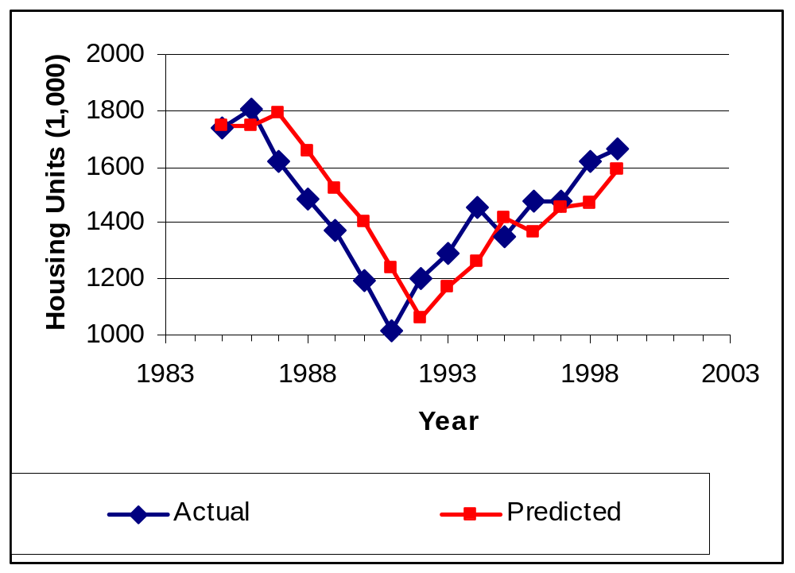
Demonstration Problem 16.3: α = 0.8

Slide 28
Trend Analysis
Linear Trend
Quadratic Trend
Holt’s Two Parameter Exponential Smoothing

Slide 29
Average Hours Worked per Week by Canadian Manufacturing Workers
Period
Hours
Period
Hours
Period
Hours
Period
Hours
1
37.2
11
36.9
21
35.6
31
35.7
2
37.0
12
36.7
22
35.2
32
35.5
3
37.4
13
36.7
23
34.8
33
35.6
4
37.5
14
36.5
24
35.3
34
36.3
5
37.7
15
36.3
25
35.6
35
36.5
6
37.7
16
35.9
26
35.6
7
37.4
17
35.8
27
35.6
8
37.2
18
35.9
28
35.9
9
37.3
19
36.0
29
36.0
10
37.2
20
35.7
30
35.7

Slide 30
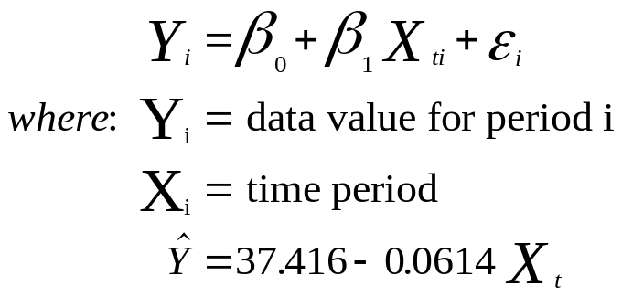
Excel Regression Output using Linear Trend
Regression Statistics
Multiple R
0.782
R Square
0.611
Adjusted R Square
0.5600
Standard Error
0.509
Observations
35
ANOVA
df
SS
MS
F
Significance F
Regression
1
13.4467
13.4467
51.91
.00000003
Residual
33
8.5487
0.2591
Total
34
21.9954
Coefficients
Standard Error
t Stat
P-value
Intercept
37.4161
0.17582
212.81
.0000000
Period
-0.0614
0.00852
-7.20
.00000003

Slide 31
Excel Graph of Hours Worked Data with a Trend Line
38.0
37.5
37.0
36.5
36.0
Work Week
35.5
35.0
34.5
0
5
10
15
20
25
30
35
Time Period

Slide 32
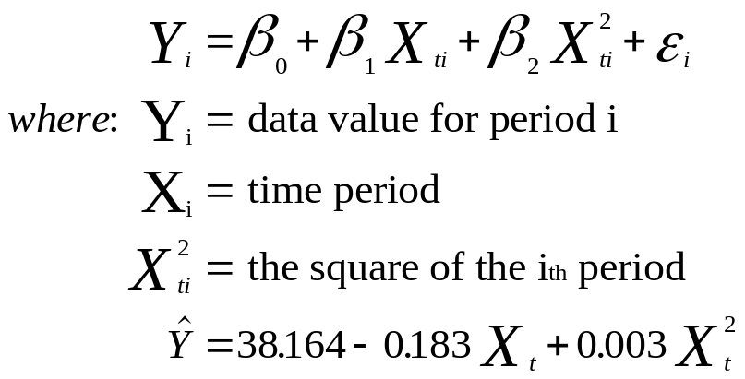
Excel Regression Output using Quadratic Trend
Regression Statistics
Multiple R
0.8723
R Square
0.761
Adjusted R Square
0.747
Standard Error
0.405
Observations
35
ANOVA
df
SS
MS
F
Significance F
Regression
2
16.7483
8.3741
51.07
1.10021E-10
Residual
32
5.2472
0.1640
Total
34
21.9954
Coefficients
Standard Error
t Stat
P-value
Intercept
38.16442
0.21766
175.34
2.61E-49
Period
-0.18272
0.02788
-6.55
2.21E-07
Period²
0.00337
0.00075
4.49
8.76E-05

Slide 33
Excel Graph of Hourly Data with Quadratic Trend Line
38.0
37.5
37.0
36.5
36.0
Work Week
35.5
35.0
34.5
0
5
10
15
20
25
30
35
Period

Slide 34
Time Series: Decomposition
Basis for analysis is the Multiplicative Model
Y = T · C · S · I
  where:
  T = trend component
  C = cyclical component
  S = seasonal component
  I = irregular component
Notes:
21

Slide 35
Household Appliance Shipment Data
Year
Quarter
Shipments
Year
Quarter
Shipments
1
1
4009
4
1
4595
2
4321
2
4799
3
4224
3
4417
4
3944
4
4258
2
1
4123
5
1
4245
2
4522
2
4900
3
4657
3
4585
4
4030
4
4533
3
1
4493
2
4806
Shipments in $1,000,000.
3
4551
4
4485
Notes:
22

Slide 36
Graph of Household Appliance Shipment Data
Shipments
4950
4800
4650
4500
4350
4200
4050
3900
0
4
8
12
16
20
Quarter
Notes:
23

Slide 37
Development of Four-Quarter Moving Averages
T·C
Ratios of
4 Qtr
Actual
4 Qtr
Centered
S·I(100)
Values to
Quarter
Shipments
M.T.
2 Yr M.T.
M.A.
M.A.
1
1
4009
2
4321
16,498
3
4224
16,612
33,110
4139
102.06%
4
3944
16,813
33,425
4178
94.40%
2
1
4123
17,246
34,059
4257
96.84%
2
4522
17,332
34,578
4322
104.62%
3
4657
17,702
35,034
4379
106.34%
4
4030
17,986
35,688
4461
90.34%
3
1
4493
17,880
35,866
4483
100.22%
2
4806
18,335
36,215
4527
106.17%
3
4551
18,437
36,772
4597
99.01%
4
4485
18,430
36,867
4608
97.32%
4
1
4595
18,296
36,726
4591
100.09%
2
4799
18,069
36,365
4546
105.57%
3
4417
17,719
35,788
4474
98.74%
4
4258
17,820
35,539
4442
95.85%
5
1
4245
17,988
35,808
4476
94.84%
2
4900
18,263
36,251
4531
108.13%
3
4585
4
4533
Notes:
24

Slide 38
Ratios of Actuals to Moving Averages
1
2
3
4
5
Q1
96.84%
100.22%
100.09%
94.84%
Q2
104.62%
106.17%
105.57%
108.13%
Q3
102.06%
106.34%
99.01%
98.74%
Q4
94.40%
90.34%
97.32%
95.85%
Notes:
25

Slide 39
Eliminate the Max and Min for each Qtr
1
2
3
4
5
Q1
96.84%
100.22%
100.09%
94.84%
Q2
104.62%
106.17%
105.57%
108.13%
Q3
102.06%
106.34%
99.01%
98.74%
Q4
94.40%
90.34%
97.32%
95.85%
S · I
Eliminate the maximum and the minimum for each quarter.
Average the remaining ratios for each quarter.
Notes:
26

Slide 40
Computation of Average of Seasonal Indexes
1
2
3
4
5
Average
Q1
96.84%
100.09%
98.47%
Q2
106.17%
105.57%
105.87%
Q3
102.06%
99.01%
100.53%
Q4
94.40%
95.85%
95.13%
Notes:
27

Slide 41
Final Adjustments of Seasonal Indexes
Final Adjusted
Seasonal
Average
Indexes
Adjustments are unnecessary since the four averages sum to 400.
Q1
98.47%
98.47%
Q2
105.87%
105.87%
Q3
100.53%
100.54%
Q4
95.13%
95.13%
Total
400.00%
400.00%
Notes:
28

Slide 42
Deseasonalized House Appliance Date
Year | Quarter | Shipments (T*C*S*I) | Seasonal Indexes (S) | Deseasonalized Data (T*C*I)
1 | 1 | 4009 | 98.47% | 4,071
 | 2 | 4321 | 105.87% | 4,081
 | 3 | 4224 | 100.53% | 4,202
 | 4 | 3944 | 95.12% | 4,146
2 | 1 | 4123 | 98.47% | 4,187
 | 2 | 4522 | 105.87% | 4,271
 | 3 | 4657 | 100.53% | 4,632
 | 4 | 4030 | 95.12% | 4,237
3 | 1 | 4493 | 98.47% | 4,563
 | 2 | 4806 | 105.87% | 4,540
 | 3 | 4551 | 100.53% | 4,527
 | 4 | 4485 | 95.12% | 4,715
4 | 1 | 4595 | 98.47% | 4,666
 | 2 | 4799 | 105.87% | 4,533
 | 3 | 4417 | 100.53% | 4,393
 | 4 | 4258 | 95.12% | 4,476
5 | 1 | 4245 | 98.47% | 4,311
 | 2 | 4900 | 105.87% | 4,628
 | 3 | 4585 | 100.53% | 4,561
 | 4 | 4533 | 95.12% | 4,765

Slide 43
Autocorrelation (Serial Correlation)
Autocorrelation occurs in data when the error terms of a regression forecasting model are correlated.
Potential Problems
  Estimates of the regression coefficients no longer have the minimum variance property and may be inefficient.
  The variance of the error terms may be greatly underestimated by the mean square error value.
  The true standard deviation of the estimated regression coefficient may be seriously underestimated.
  The confidence intervals and tests using the t and F distributions are no longer strictly applicable.
First-order autocorrelation occurs when there is correlation between the error terms of adjacent time periods.
Notes:
52

Slide 44
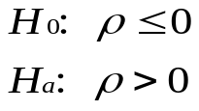
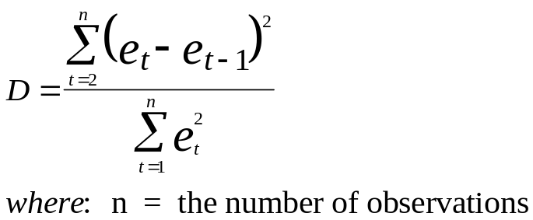
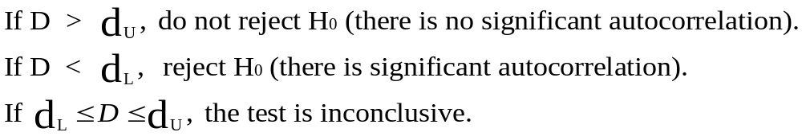
Durbin-Watson Test
Notes:
53

Slide 45
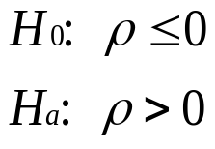
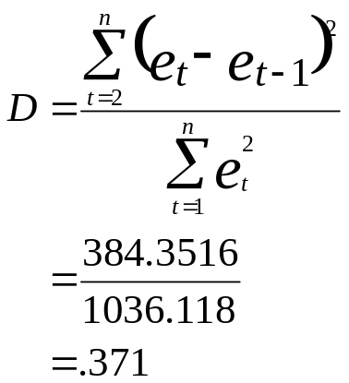
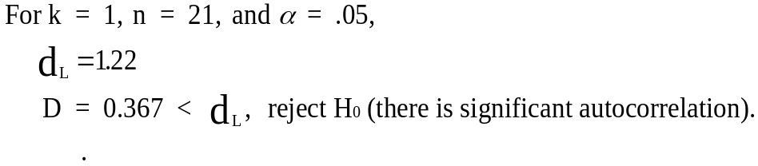
Durbin-Watson Test for the Oil and Gas Well Drilling Example
Notes:
59

Slide 46
Overcoming the
Autocorrelation Problem
Addition of Independent Variables
Transforming Variables
  First-differences approach
  Percentage change from period to period
  Use autoregression
Notes:
60

Slide 47
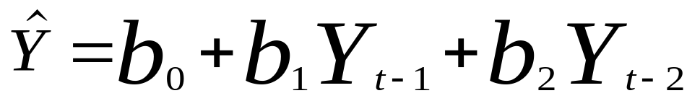
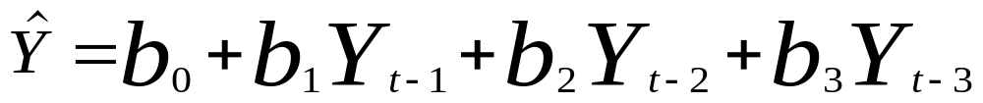
Autoregression Model
Autoregression Model with two lagged variables
Autoregression Model with three lagged variables
Notes:
61

Slide 48
Index Numbers
A ratio of a measure taken during one time frame to that same measure taken during another time frame, usually denoted as the base period
Simple Index Numbers
Unweighted Aggregate Price Indexes
Weighted Aggregate Price Index Numbers
  Laspeyres Price Index
  Paasche Price Index
Notes:
4

Slide 49
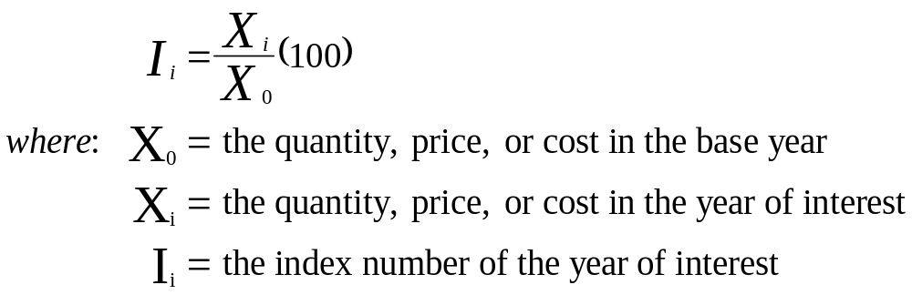
Simple Index Numbers
The motivation for using an index number is to reduce data to an easier-to-use, more convenient form.
Notes:
5

Slide 50
Index Numbers for Business Starts in the U. S.
Year | Starts | Index
1985 | 249,770 | 100.0
1986 | 253,092 | 101.3
1987 | 233,710 | 93.6
1988 | 199,091 | 79.7
1989 | 181,645 | 72.7
1990 | 158,930 | 63.6
1991 | 155,672 | 62.3
1992 | 164,086 | 65.7
1993 | 166,154 | 66.5
1994 | 188,387 | 75.4
1995 | 168,158 | 67.3
1996 | 170,475 | 68.3
1997 | 166,740 | 66.8
1998 | 155,141 | 62.1
1999 | 151,016 | 60.5

Slide 51
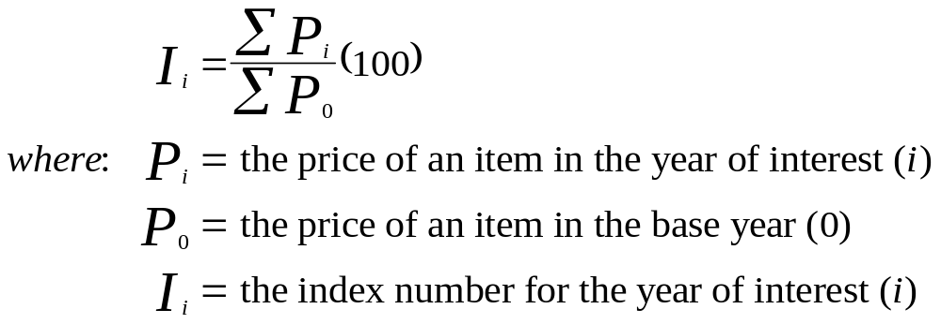
Unweighted Aggregate
Price Index Numbers
Notes:
7

Slide 52
Unweighted Aggregate Price Index for Basket of Food Items
 | Year
 | 1990 | 1995 | 2000
Eggs (dozen) | 0.78 | 0.86 | 1.06
Milk (1/2 gallon) | 1.14 | 1.39 | 1.59
Bananas (per lb) | 0.36 | 0.46 | 0.49
Potatoes (per lb) | 0.28 | 0.31 | 0.36
Sugar (per lb) | 0.35 | 0.42 | 0.43
Total | 2.91 | 3.44 | 3.93
Base
1990 | 100.00 | 118.21 | 135.05
1995 | 84.59 | 100.00 | 114.24
2000 | 74.05 | 87.53 | 100.00

Slide 53
Weighted Aggregate
Price Index Numbers
Computed by multiplying quantity weights and item prices in determining the market basket worth for a given year
Also called value indexes
Laspeyres - uses base period weights
Paasche - use current period weights
Notes:
9

Slide 54
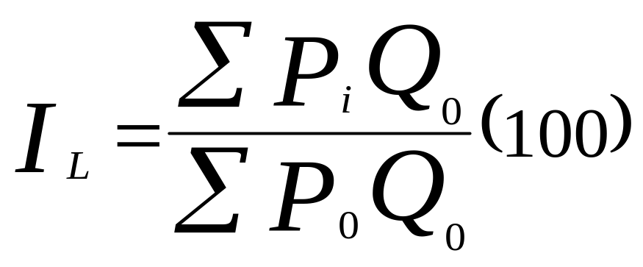
Laspeyres Price Index
Laspeyres Price Index uses base period weights
Notes:
10

Slide 55
Laspeyres Price Index: 1990 Base Year
1990 Quantity |  | Price
 |  | 1990 | 1995 | 2000
Eggs (dozen) | 45 | 0.78 | 0.86 | 1.06
Milk (1/2 gallon) | 60 | 1.14 | 1.39 | 1.59
Bananas (per lb) | 12 | 0.36 | 0.46 | 0.49
Potatoes (per lb) | 55 | 0.28 | 0.31 | 0.36
Sugar (per lb) | 36 | 0.35 | 0.42 | 0.43
Sum of Products |  | 135.82 | 159.79 | 184.26
Index Values |  | 100.00 | 117.65 | 135.66

Slide 56
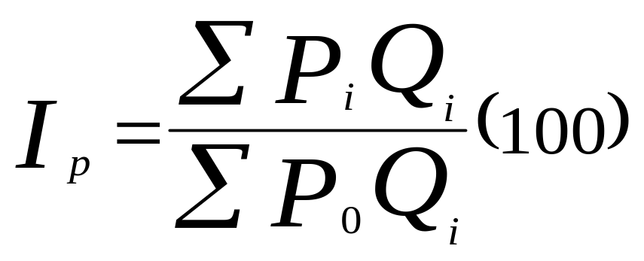
Paasche Price Index
Paasche Price Index
uses
current period weights
Notes:
14

Slide 57
Paasche Price Index: 199 Base Year
 | 1999 |  | 2000
 | Price | Quantity | Price | Quantity
Syringes (dozen) | 6.70 | 150 | 6.95 | 135
Cotton swabs (box) | 1.35 | 60 | 1.45 | 65
Patient record forms (pad) | 5.10 | 8 | 6.25 | 12
Children's Tylenol (bottle) | 4.50 | 25 | 4.95 | 30
Computer paper (box) | 11.95 | 6 | 13.20 | 8
Thermometers | 7.90 | 4 | 9.00 | 2
Numerator | 1342.60 |  | 1379.60
Denominator | 1342.60 |  | 1299.85
Index | 100.00 |  | 106.14

Slide 58
Important Indexes
Consumer Price Index (CPI)
Producer Price Index (PPI)
Dow Jones Industrial Average (DJIA)
Notes:
20

