Slide 1
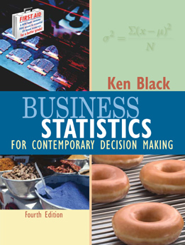
Business Statistics, 4e by Ken Black
Chapter 17
Nonparametric
Statistics

Slide 2
Learning Objectives
Recognize the advantages and disadvantages of nonparametric statistics.
Understand how to use the runs test to test for randomness.
Know when and how to use the Mann-Whitney U test, the Wilcoxon matched-pairs signed rank test, the Kruskal-Wallis test, and the Friedman test.
Learn when and how to measure correlation using Spearman’s rank correlation measurement.
Notes:
2

Slide 3
Parametric vs Nonparametric Statistics
Parametric Statistics are statistical techniques based on assumptions about the population from which the sample data are collected.
  Assumption that data being analyzed are randomly selected from a normally distributed population.
  Requires quantitative measurement that yield interval or ratio level data.
Nonparametric Statistics are based on fewer assumptions about the population and the parameters.
  Sometimes called “distribution-free” statistics.
  A variety of nonparametric statistics are available for use with nominal or ordinal data.
Notes:
3

Slide 4
Advantages of Nonparametric Techniques
Sometimes there is no parametric alternative to the use of nonparametric statistics.
Certain nonparametric test can be used to analyze nominal data.
Certain nonparametric test can be used to analyze ordinal data.
The computations on nonparametric statistics are usually less complicated than those for parametric statistics, particularly for small samples.
Probability statements obtained from most nonparametric tests are exact probabilities.
Notes:
4

Slide 5
Disadvantages of Nonparametric Statistics
Nonparametric tests can be wasteful of data if parametric tests are available for use with the data.
Nonparametric tests are usually not as widely available and well know as parametric tests.
For large samples, the calculations for many nonparametric statistics can be tedious.
Notes:
5

Slide 6
Runs Test
Test for randomness - is the order or sequence of observations in a sample random or not
Each sample item possesses one of two possible characteristics
Run - a succession of observations which possess the same characteristic
Example with two runs: F, F, F, F, F, F, F, F, M, M, M, M, M, M, M
Example with fifteen runs: F, M, F, M, F, M, F, M, F, M, F, M, F, M, F

Slide 7
Runs Test: Sample Size Consideration
Sample size: n
Number of sample member possessing the first characteristic: n₁
Number of sample members possessing the second characteristic: n₂
n = n₁ + n₂
If both n₁ and n₂ are ≤ 20, the small sample runs test is appropriate.

Slide 8
Runs Test: Small Sample Example
H₀: The observations in the sample are randomly generated.
H_{a}: The observations in the sample are not randomly generated.
α = .05
n₁ = 18
n₂ = 8
If 7 ≤ R ≤ 17, do not reject H₀
Otherwise, reject H₀.
1 2 3 4 5 6 7 8 9 10 11 12
D CCCCC D CC D CCCC D C D CCC DDD CCC
R = 12
Since 7 ≤ R = 12 ≤ 17, do not reject H₀

Slide 9
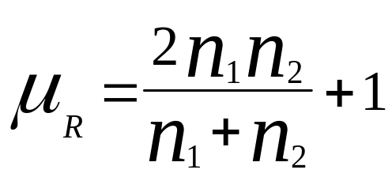
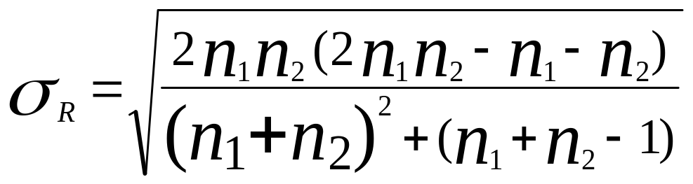
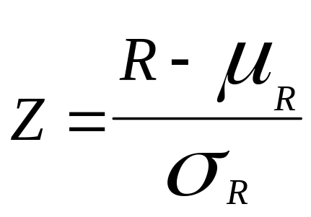
Runs Test: Large Sample
If either n₁ or n₂ is > 20, the sampling distribution of R is approximately normal.

Slide 10
Runs Test: Large Sample Example
H₀: The observations in the sample are randomly generated.
H_{a}: The observations in the sample are not randomly generated.
α = .05
n₁ = 40
n₂ = 10
If -1.96 ≤ Z ≤ 1.96, do not reject H₀
Otherwise, reject H₀.
1
1 2 3 4 5 6 7 8 9 0 11
NNN F NNNNNNN F NN FF NNNNNN F NNNN F NNNNN
12 13
FFFF NNNNNNNNNNNN R = 13

Slide 11
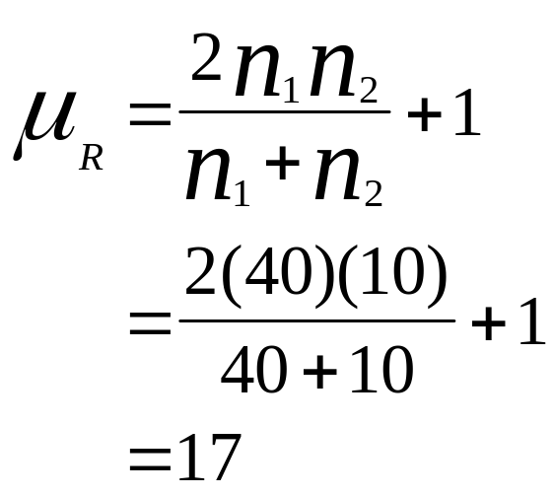
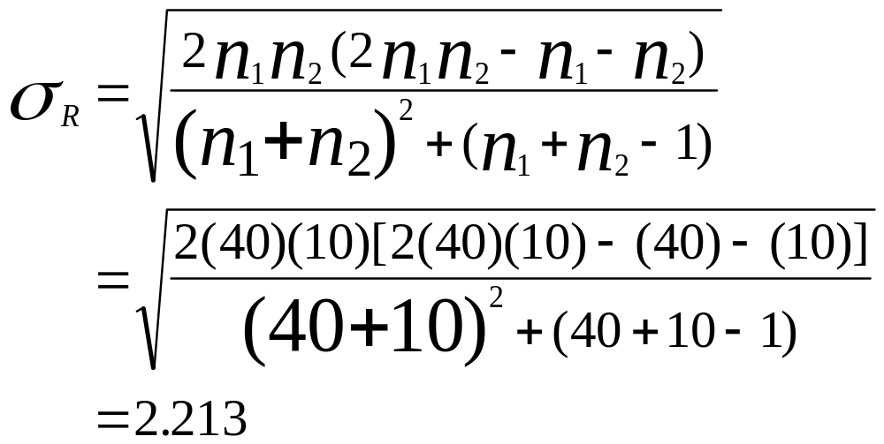
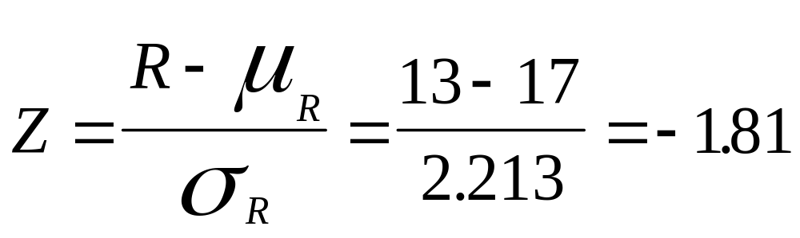
Runs Test: Large Sample Example
-1.96 ≤ Z = -1.81 ≤ 1.96,
do not reject H₀

Slide 12
Mann-Whitney U Test
Nonparametric counterpart of the t test for independent samples
Does not require normally distributed populations
May be applied to ordinal data
Assumptions
  Independent Samples
  At Least Ordinal Data
Notes:
37

Slide 13
Mann-Whitney U Test:
Sample Size Consideration
Size of sample one: n₁
Size of sample two: n₂
If both n₁ and n₂ are ≤ 10, the small sample procedure is appropriate.
If either n₁ or n₂ is greater than 10, the large sample procedure is appropriate.

Slide 14
Mann-Whitney U Test:
Small Sample Example
H₀: The health service population is identical to the educational service population on employee compensation
H_{a}: The health service population is not identical to the educational service population on employee compensation
Health
Educational
Service
Service
20.10
26.19
19.80
23.88
22.36
25.50
18.75
21.64
21.90
24.85
22.96
25.30
20.75
24.12
23.45

Slide 15
Mann-Whitney U Test:
Small Sample Example
α = .05
If the final p-value < .05, reject H₀.
W₁ = 1 + 2 + 3 + 4 + 6 + 7 + 8
= 31
W₂ = 5 + 9 + 10 + 11 + 12 + 13 + 14 + 15
= 89
Compensation
Rank
Group
18.75
1
H
19.80
2
H
20.10
3
H
20.75
4
H
21.64
5
E
21.90
6
H
22.36
7
H
22.96
8
H
23.45
9
E
23.88
10
E
24.12
11
E
24.85
12
E
25.30
13
E
25.50
14
E
26.19
15
E

Slide 16
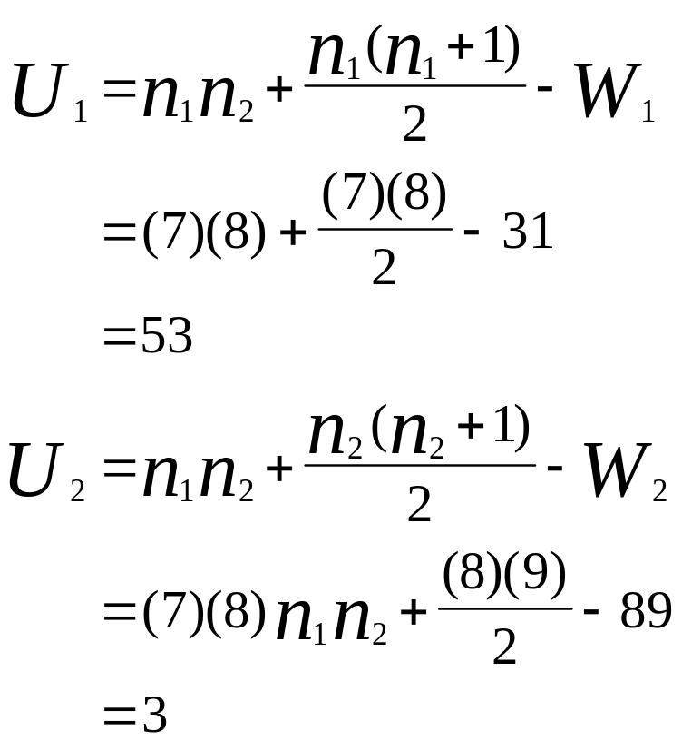
Mann-Whitney U Test:
Small Sample Example
Since U₂ < U₁, U = 3.
p-value = .0011 < .05, reject H₀.

Slide 17
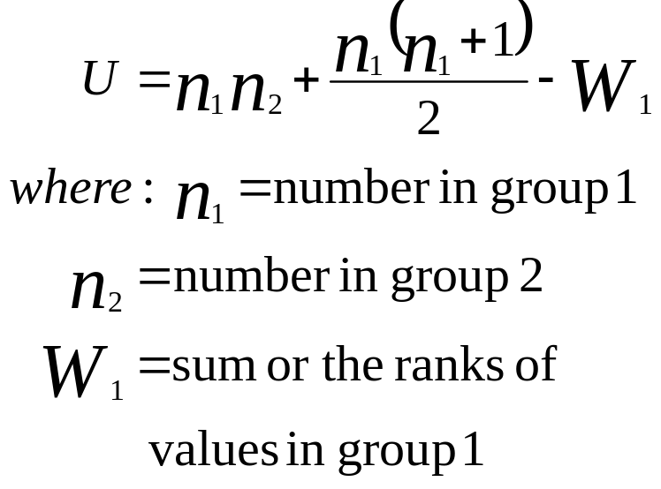
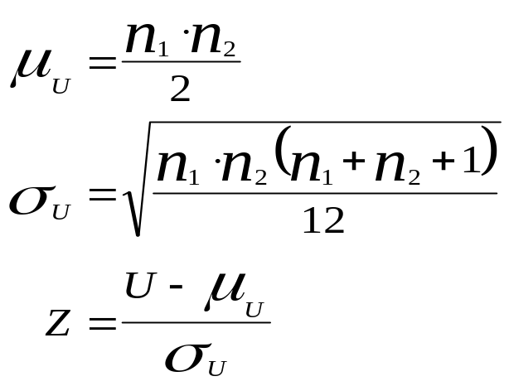
Mann-Whitney U Test:
Formulas for Large Sample Case
Notes:
42

Slide 18
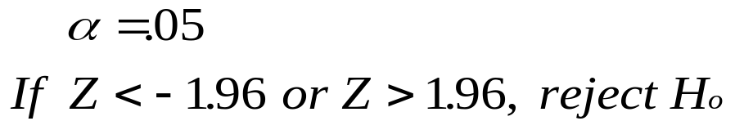
Incomes of PBS and Non-PBS Viewers
PBS
Non-PBS
24,500
41,000
39,400
32,500
H_{o}: The incomes for PBS viewers and non-PBS viewers are identical
H_{a}: The incomes for PBS viewers and non-PBS viewers are not identical
36,800
33,000
44,300
21,000
57,960
40,500
32,000
32,400
61,000
16,000
34,000
21,500
43,500
39,500
55,000
27,600
n₁ = 14
39,000
43,500
62,500
51,900
n₂ = 13
61,400
27,800
53,000
Notes:
43

Slide 19
Ranks of Income from Combined Groups of PBS and Non-PBS Viewers
Income
Rank
Group
Income
Rank
Group
16,000
1
Non-PBS
39,500
15
Non-PBS
21,000
2
Non-PBS
40,500
16
Non-PBS
21,500
3
Non-PBS
41,000
17
Non-PBS
24,500
4
PBS
43,000
18
PBS
27,600
5
Non-PBS
43,500
19.5
PBS
27,800
6
Non-PBS
43,500
19.5
Non-PBS
32,000
7
PBS
51,900
21
Non-PBS
32,400
8
Non-PBS
53,000
22
PBS
32,500
9
Non-PBS
55,000
23
PBS
33,000
10
Non-PBS
57,960
24
PBS
34,000
11
PBS
61,000
25
PBS
36,800
12
PBS
61,400
26
PBS
39,000
13
PBS
62,500
27
PBS
39,400
14
PBS
Notes:
44

Slide 20
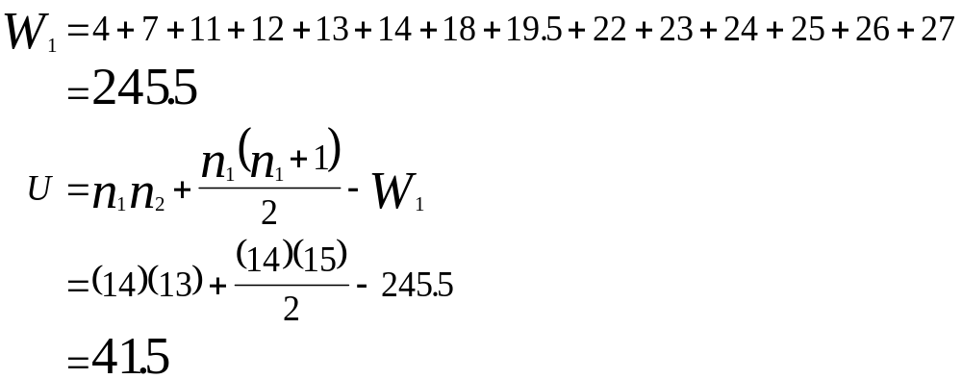
PBS and Non-PBS Viewers: Calculation of U
Notes:
45

Slide 21
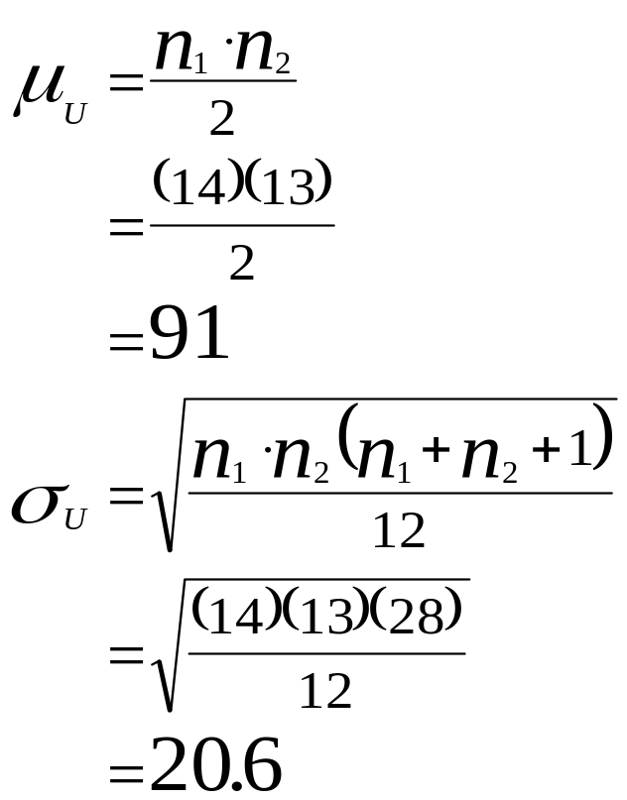
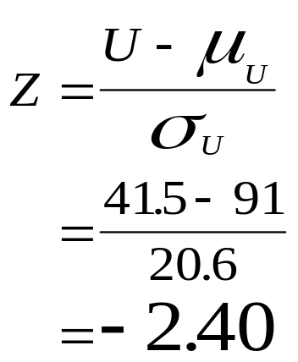
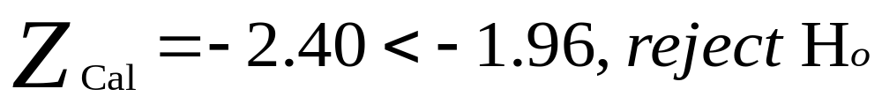
PBS and Non-PBS Viewers: Conclusion
Notes:
46

Slide 22
Wilcoxon Matched-Pairs
Signed Rank Test
A nonparametric alternative to the t test for related samples
Before and After studies
Studies in which measures are taken on the same person or object under different conditions
Studies or twins or other relatives
Notes:
47

Slide 23
Wilcoxon Matched-Pairs
Signed Rank Test
Differences of the scores of the two matched samples
Differences are ranked, ignoring the sign
Ranks are given the sign of the difference
Positive ranks are summed
Negative ranks are summed
T is the smaller sum of ranks

Slide 24
Wilcoxon Matched-Pairs Signed Rank Test: Sample Size Consideration
n is the number of matched pairs
If n > 15, T is approximately normally distributed, and a Z test is used.
If n ≤ 15, a special “small sample” procedure is followed.
  The paired data are randomly selected.
  The underlying distributions are symmetrical.

Slide 25
Wilcoxon Matched-Pairs Signed Rank Test: Small Sample Example
H₀: M_{d} = 0
H_{a}: M_{d} ≠ 0
n = 6
α =0.05
If T_{observed} ≤ 1, reject H_{0.}
Family
Pair
Pittsburgh
Oakland
1
1,950
1,760
2
1,840
1,870
3
2,015
1,810
4
1,580
1,660
5
1,790
1,340
6
1,925
1,765

Slide 26
Wilcoxon Matched-Pairs Signed Rank Test: Small Sample Example
Family
Pair
Pittsburgh
Oakland
d
Rank
1
1,950
1,760
190
+4
2
1,840
1,870
-30
-1
3
2,015
1,810
205
+5
4
1,580
1,660
-80
-2
5
1,790
1,340
450
+6
6
1,925
1,765
160
+3
T = minimum(T₊, T₋)
T₊ = 4 + 5 + 6 + 3= 18
T₋ = 1 + 2 = 3
T = 3
T = 3 > T_{crit} = 1, do not reject H₀.

Slide 27
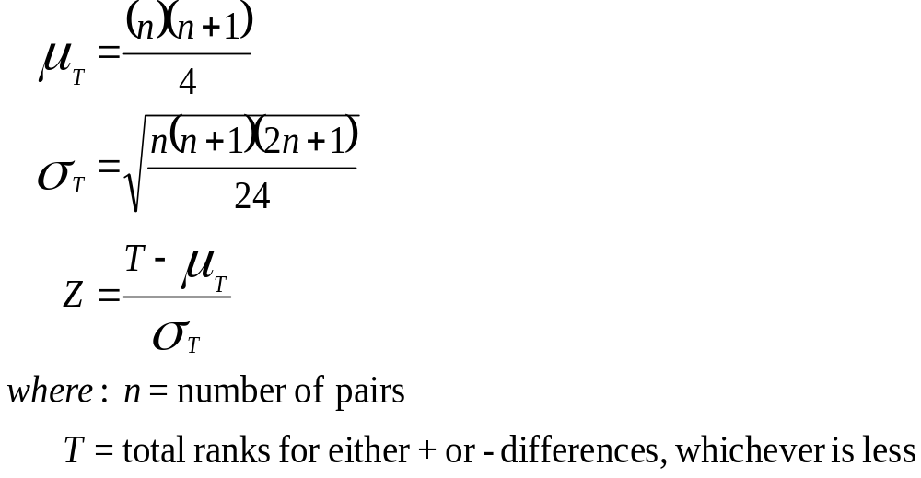
Wilcoxon Matched-Pairs Signed Rank Test: Large Sample Formulas
Notes:
52

Slide 28
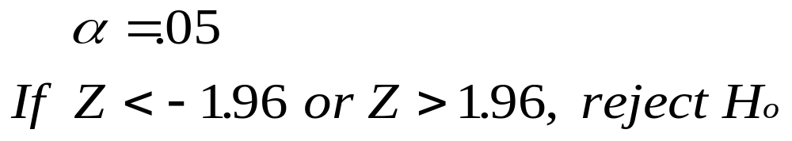
Airline Cost Data for 17 Cities,
1997 and 1999
H₀: M_{d} = 0
H_{a}: M_{d} ≠ 0
City
1979
1999
d
Rank
City
1979
1999
d
Rank
1
20.3
22.8
-2.5
-8
10
20.3
20.9
-0.6
-1
2
19.5
12.7
6.8
17
11
19.2
22.6
-3.4
-11.5
3
18.6
14.1
4.5
13
12
19.5
16.9
2.6
9
4
20.9
16.1
4.8
15
13
18.7
20.6
-1.9
-6.5
5
19.9
25.2
-5.3
-16
14
17.7
18.5
-0.8
-2
6
18.6
20.2
-1.6
-4
15
21.6
23.4
-1.8
-5
7
19.6
14.9
4.7
14
16
22.4
21.3
1.1
3
8
23.2
21.3
1.9
6.5
17
20.8
17.4
3.4
11.5
9
21.8
18.7
3.1
10
Notes:
53

Slide 29
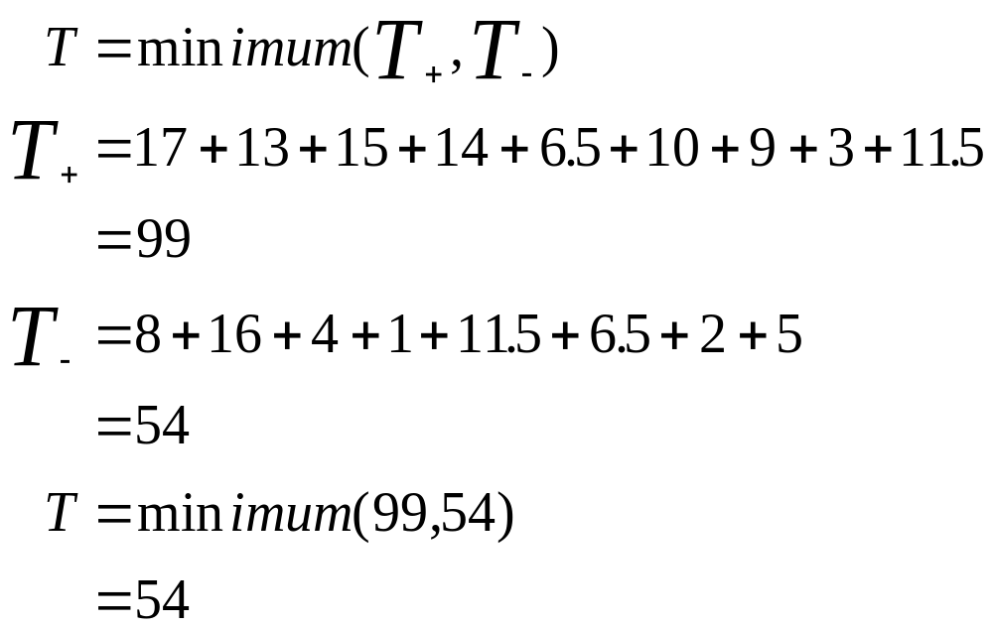
Airline Cost: T Calculation
Notes:
54

Slide 30
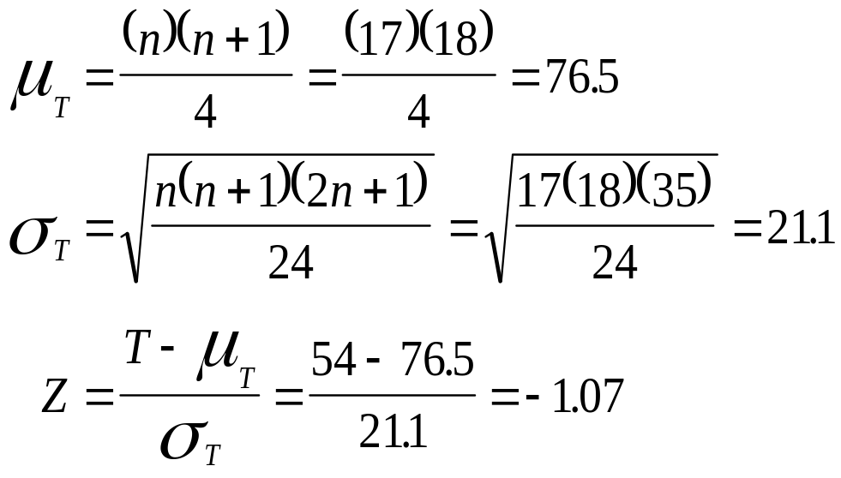
Airline Cost: Conclusion
Notes:
55

Slide 31
Kruskal-Wallis Test
A nonparametric alternative to one-way analysis of variance
May used to analyze ordinal data
No assumed population shape
Assumes that the C groups are independent
Assumes random selection of individual items
Notes:
56

Slide 32
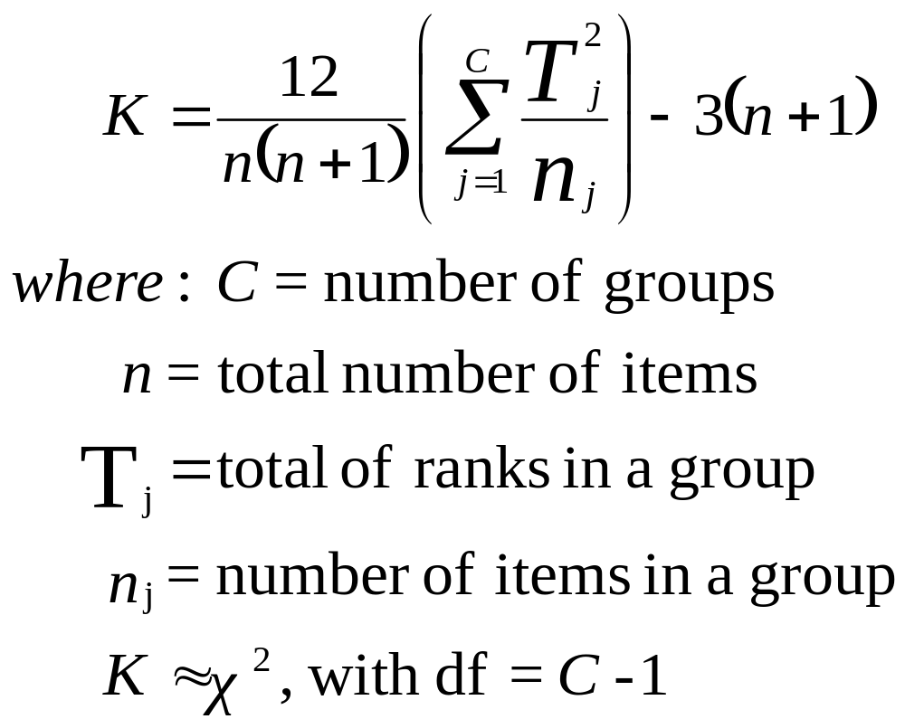
Kruskal-Wallis K Statistic
Notes:
57

Slide 33
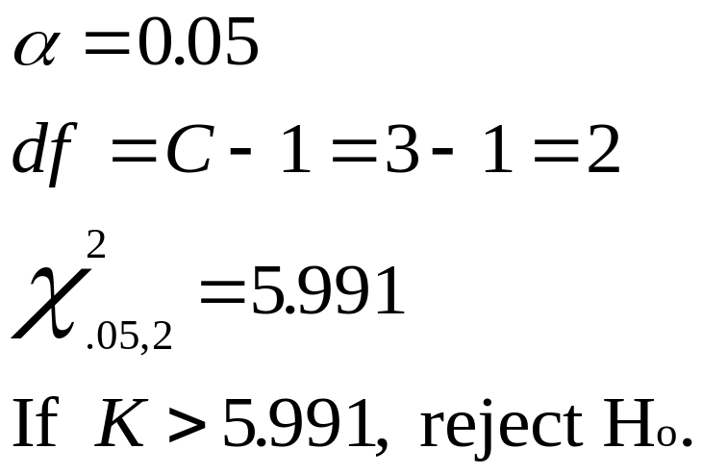
Number of Patients per Day per Physician in Three Organizational Categories
H_{o}: The three populations are identical
H_{a}: At least one of the three populations is different
Three or
Two
More
Partners
Partners
HMO
13
24
26
15
16
22
20
19
31
18
22
27
23
25
28
14
33
17
Notes:
58

Slide 34
Patients per Day Data:
Kruskal-Wallis Preliminary Calculations
Three or
Two
More
Partners
Partners
HMO
Patients
Rank
Patients
Rank
Patients
Rank
13
1
24
12
26
14
15
3
16
4
22
9.5
20
8
19
7
31
17
18
6
22
9.5
27
15
23
11
25
13
28
16
14
2
33
18
17
5
T₁ = 29
T₂ = 52.5
T₃ = 89.5
n₁ = 5
n₂ = 7
n₃ = 6
n = n₁ + n₂ + n₃ = 5 + 7 + 6 = 18
Notes:
59

Slide 35
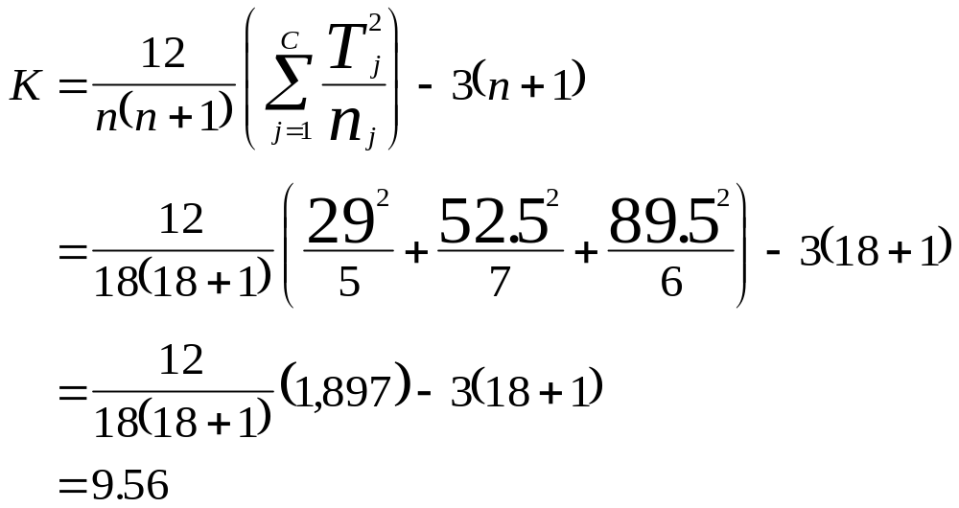
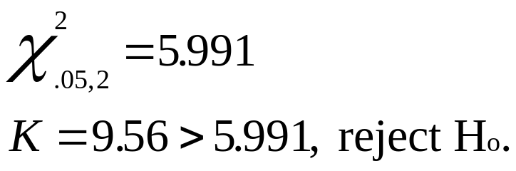
Patients per Day Data: Kruskal-Wallis Calculations and Conclusion
Notes:
60

Slide 36
Friedman Test
A nonparametric alternative to the randomized block design
Assumptions
  The blocks are independent.
  There is no interaction between blocks and treatments.
  Observations within each block can be ranked.
Hypotheses
  – H_{o}: The treatment populations are equal
  – H_{a}: At least one treatment population yields larger values than at least one other treatment population

Slide 37
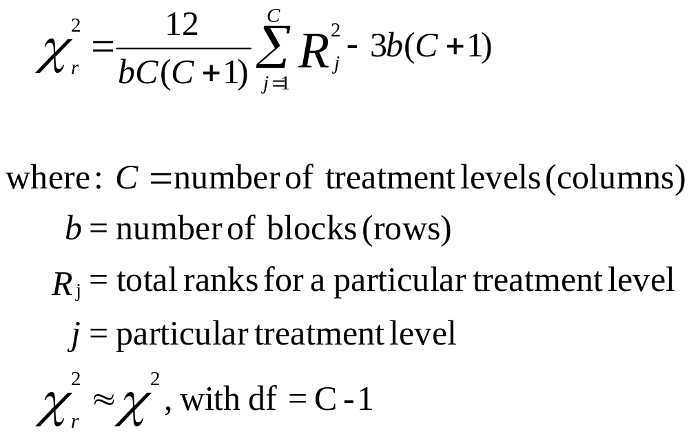
Friedman Test

Slide 38
Friedman Test: Tensile Strength of Plastic Housings
  H_{o}: The supplier populations are equal
  H_{a}: At least one supplier population yields larger values than at least one other supplier population
Supplier 1
Supplier 2
Supplier 3
Supplier 4
Monday
62
63
57
61
Tuesday
63
61
59
65
Wednesday
61
62
56
63
Thursday
62
60
57
64
Friday
64
63
58
66

Slide 39
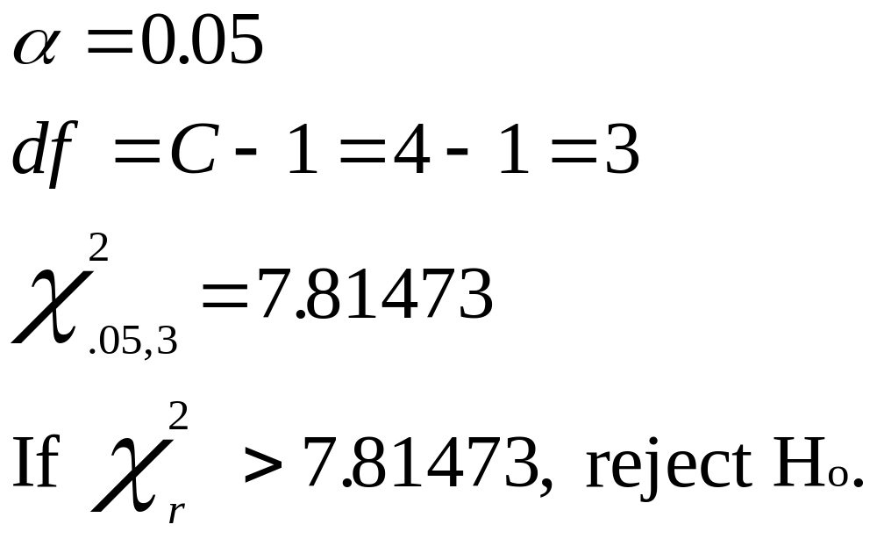
Friedman Test: Tensile Strength of Plastic Housings

Slide 40
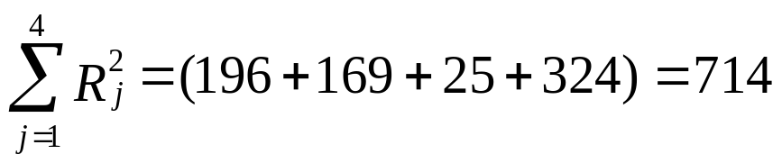
Friedman Test: Tensile Strength of Plastic Housings
Supplier 1
Supplier 2
Supplier 3
Supplier 4
Monday
3
4
1
2
Tuesday
3
2
1
4
Wednesday
2
3
1
4
Thursday
3
2
1
4
Friday
3
2
1
4
R
14
13
5
18
j
2
R
196
169
25
324
j

Slide 41
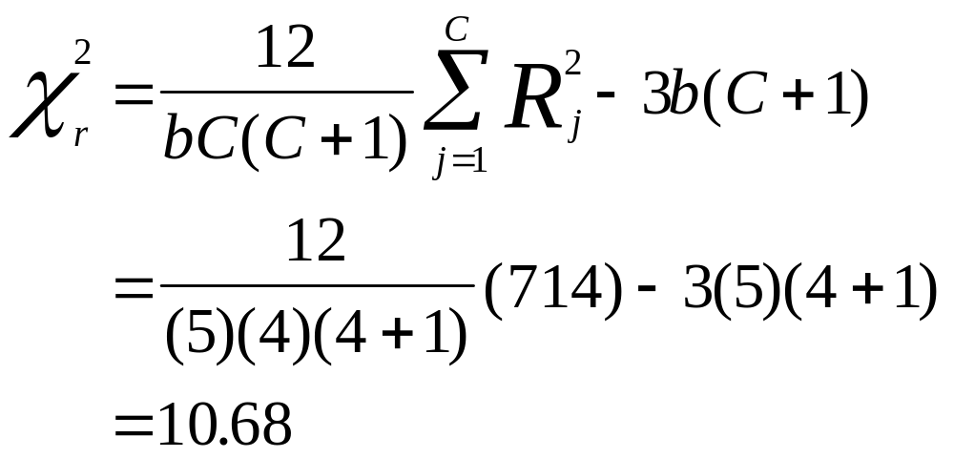
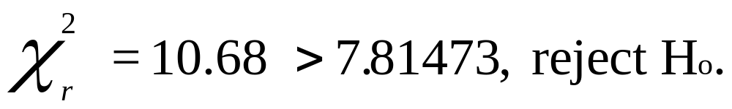
Friedman Test: Tensile Strength of Plastic Housings

Slide 42
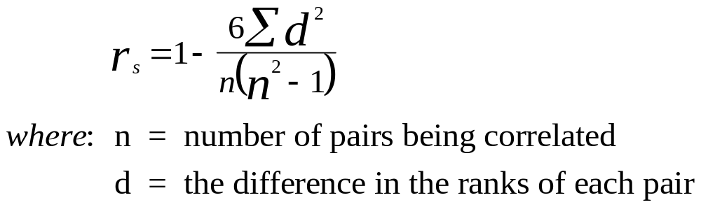
Spearman’s Rank Correlation
Analyze the degree of association of two variables
Applicable to ordinal level data (ranks)
Notes:
67

Slide 43
Spearman’s Rank Correlation for Cattle and Lamb Prices
Year | Cattle Prices ($/100 lb) | Lamb Prices ($/100 lb) | Rank Cattle | Rank: Lamb | d | d2
1988 | 66.60 | 69.10 | 6 | 7 | -1 | 1
1989 | 69.50 | 66.10 | 9 | 6 | 3 | 9
1990 | 74.60 | 55.50 | 13 | 2 | 11 | 121
1991 | 72.70 | 52.20 | 12 | 1 | 11 | 121
1992 | 71.30 | 59.50 | 10 | 3 | 7 | 49
1993 | 72.60 | 64.40 | 11 | 4 | 7 | 49
1994 | 66.70 | 65.60 | 7 | 5 | 2 | 4
1995 | 61.80 | 78.20 | 3 | 10 | -7 | 49
1996 | 58.70 | 82.80 | 1 | 12 | -11 | 121
1997 | 63.10 | 90.30 | 4 | 13 | -9 | 81
1998 | 59.60 | 72.30 | 2 | 8 | -6 | 36
1999 | 63.40 | 74.50 | 5 | 9 | -4 | 16
2000 | 68.60 | 79.40 | 8 | 11 | -3 | 9
 |  |  |  |  |  | 666

Slide 44
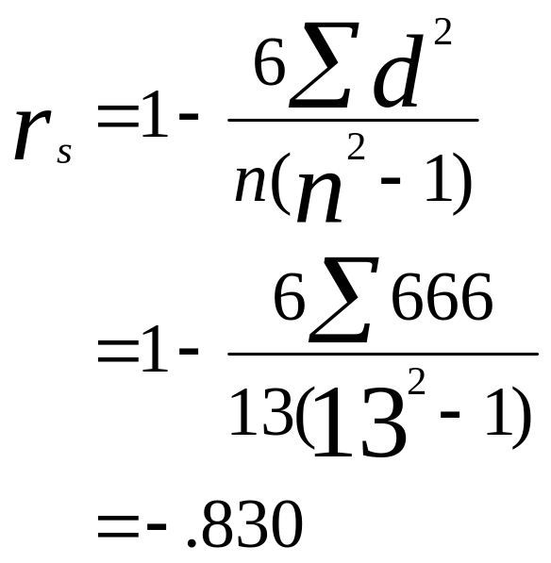
Spearman’s Rank Correlation for Cattle and Lamb Prices

