Slide 1
MIS 4470/5470 – Practical Computing for Data Analytics
Welcome

Slide 2
Outline
Introductions
Overview of data science and business analytics
Overview of our class
The pcda computing appliance
  How it works
  Hands on practice to get familiar with pcda
Steps to prepare for next class

Slide 3
Data science and data scientists
To gain insights from data through computation, statistics and visualization
“A data scientist is someone who knows more statistics than a computer scientist and more computer science than a statistician.” - Josh Blumenstock
“Data Scientist = statistician + programmer + coach + storyteller + artist” - Shlomo Aragnon

Slide 4
Big Data and Data Science Hype
Ambiguity of terms like “big data” and “data science”
  Meaning? Who? Where? How big is big?
Lack of respect for the foundation
  Decades of research and practice in statistics, computer science, engineering, science
  The media would have you believe “data science” is a new invention
Crazy hype regarding data science and what it can do
Statisticians already work on the “science of data”
“Anything that has to call itself a science, isn't”.
  Like modeling, data science has a large element of “craft”

Slide 5
Getting Past the Hype
There IS a gap between what has traditionally been taught in academia and the actual craft of analysis of large and complex data
  Sanitized, nicely formatted and structured datasets of reasonable size is NOT reality
  Exploratory data analysis and visualization given short shrift in stats classes
  Academia tends to have disciplinary chimneys while the practice of data science and business analytics is inherently cross-disciplinary
http://columbiadatascience.com/blog/
  Cathy O'Neil's (one of the Doing Data Science authors) blog that complements her book and that continues to try to get us all past the hype
  https://www.amazon.com/Weapons-Math-Destruction-Increases-Inequality/dp/0553418815

Slide 6
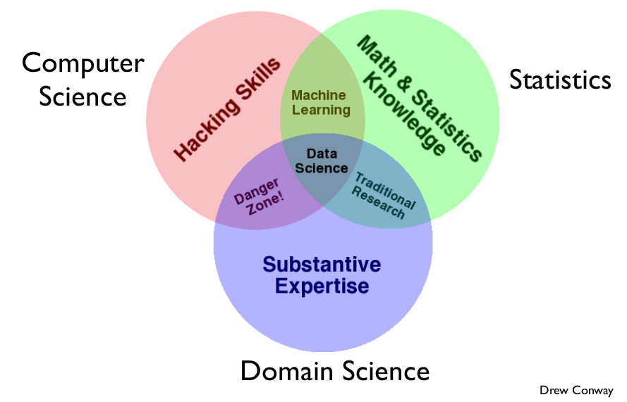
Conway's Data Science Venn Diagram

Slide 7
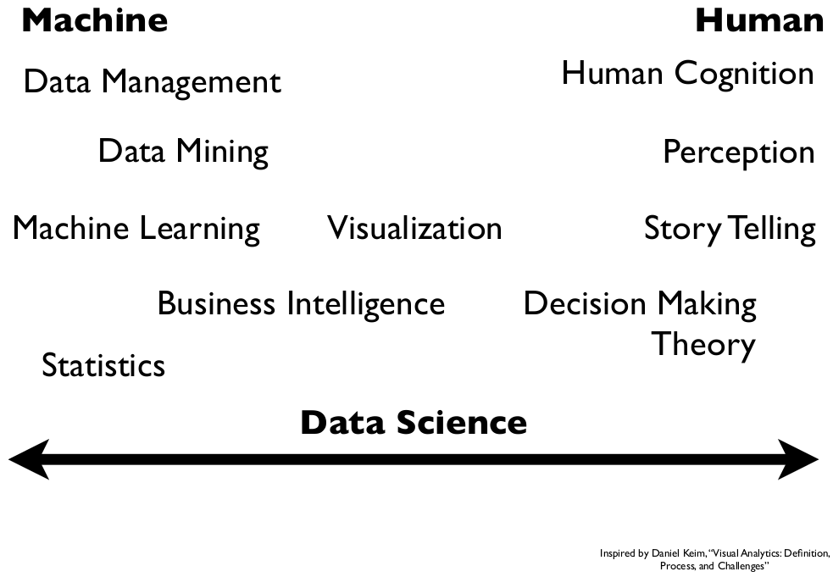
The machine - human continuum

Slide 8
Business analytics
Programming & databases
Math & stats
Domain
knowledge
Art and Craft
of modeling

Slide 9
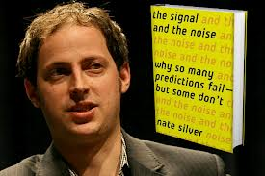
Historical perspective on the business analytics movement
Statistical analysis has been around for a long time
Operations research out of WWII
Decision support systems out of MIS
Data warehousing and business intelligence
Internet explodes
Computing power gets cheaper and cheaper
Machine learning & data mining out of CS
“Competing on Analytics” by Davenport
Connected devices and data sharing, “datafication”
Commodity computing, cloud computing
Nate Silver, the 538 Blog and 2012 election
Data can be building block for data products
Golden age for business analytics and data science

Slide 10
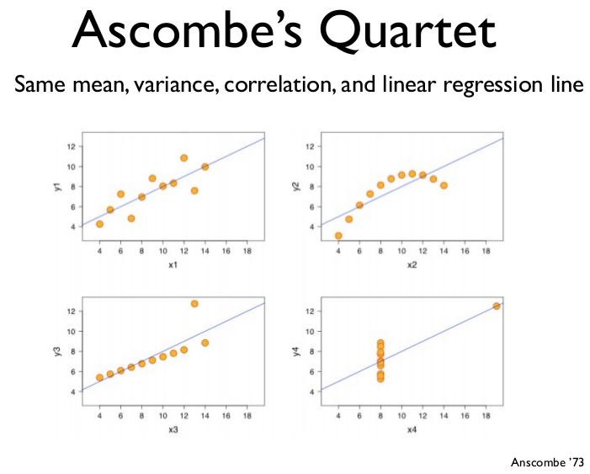
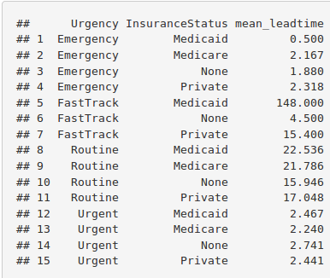
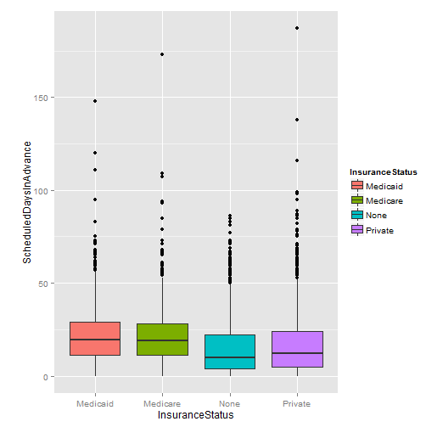
Descriptive Analytics
Exploratory data analysis
Statistics
Data visualization

Slide 11
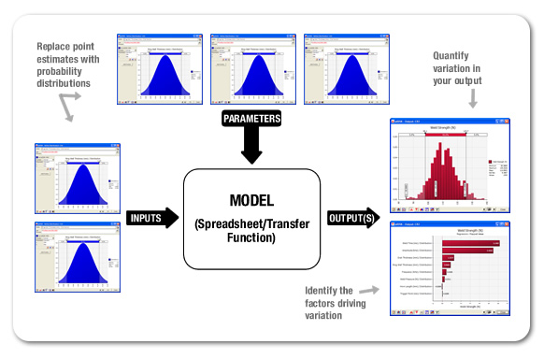
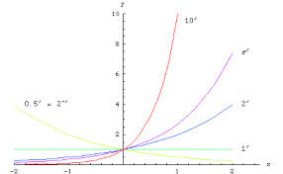
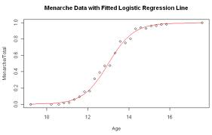
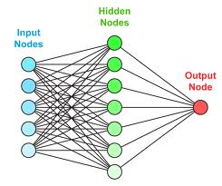
Predictive Analytics
Statistical models
Machine learning
Simulation
Other mathematical models

Slide 12
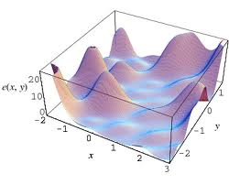
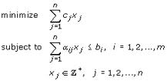
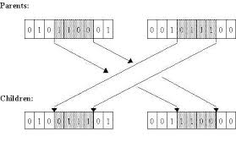
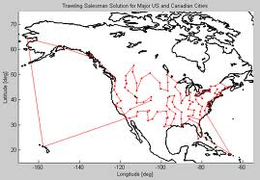
Prescriptive Analytics
Optimization models and solution algorithms
Optimizing heuristics

Slide 13
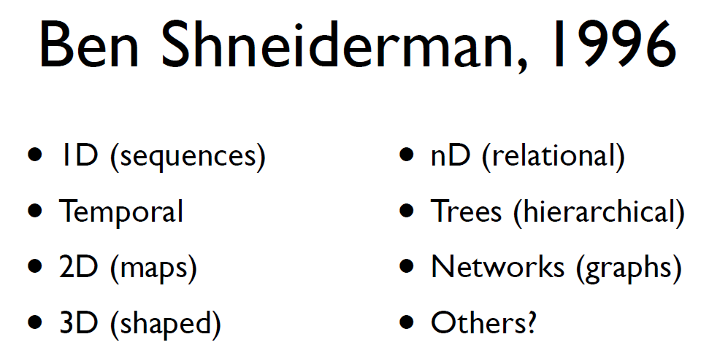
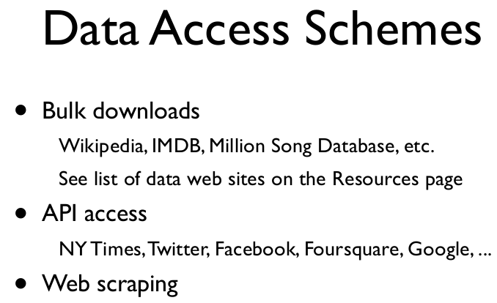

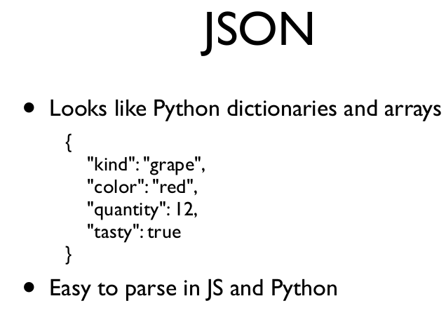
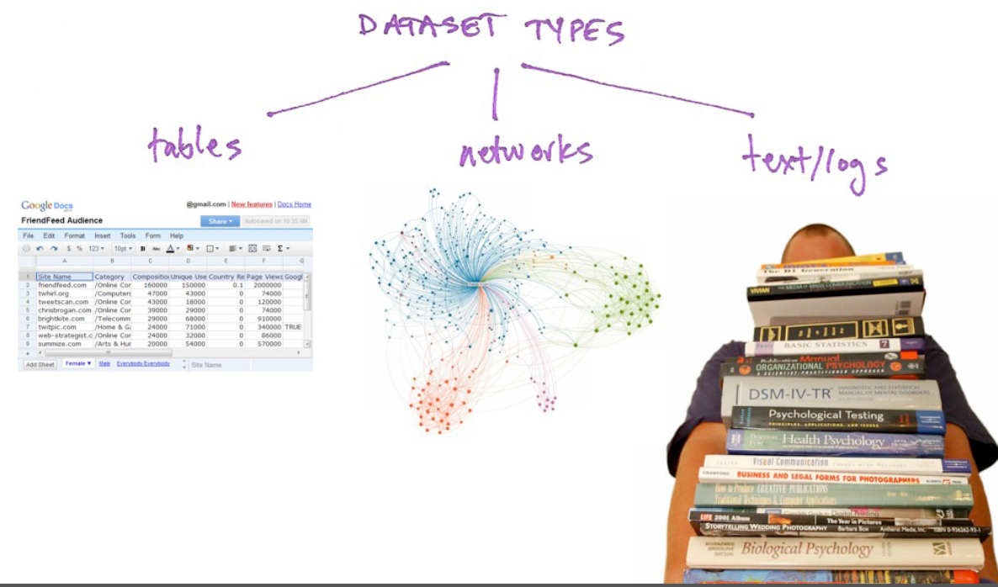
Beyond nice tables of data
cs109.org

Slide 14
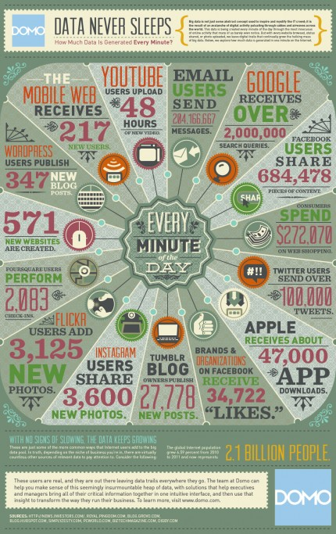
The Big Data problem
Data, data, more data than a single machine can handle, data coming at you faster
  4V's: Volume, velocity, variety, veracity
  Twitter generates 1.39MB/s (~42Tb/yr)
  Facebook sitting on PB's of data
  Walmart: 1.5M trans/hr = 1.43GB/hr of data
  http://www.domo.com/blog/2012/06/how-much-data-is-created-every-minute/
  moving this data around and extracting info from this data is a challenge

Slide 15
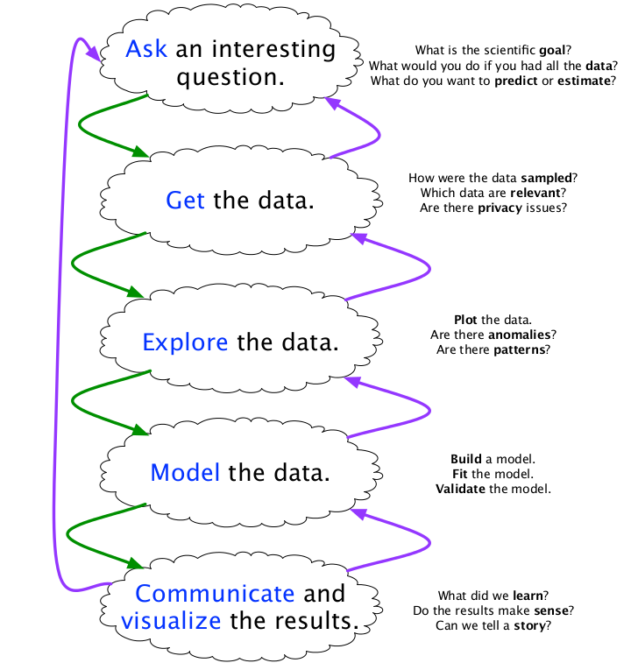
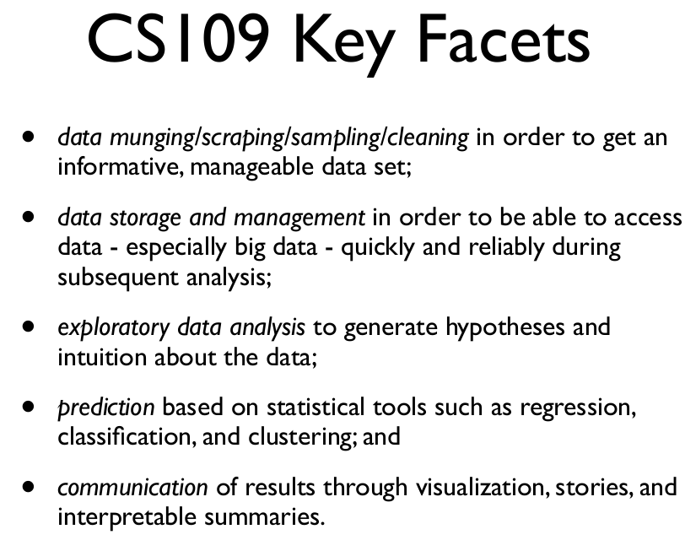
The Big Picture for Data Science
Abstractions AND ...
cs109.org

Slide 16
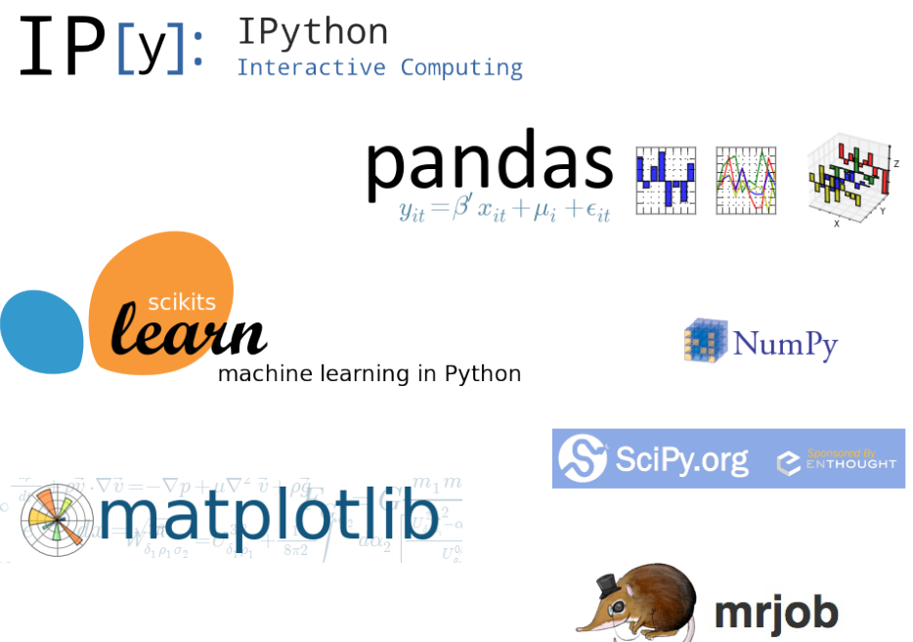
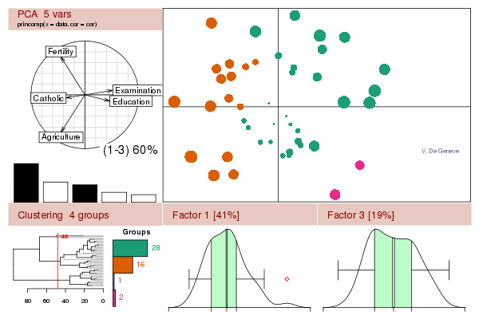


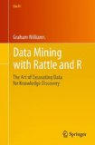

The Big Picture for Data Science
... Tools

Slide 17
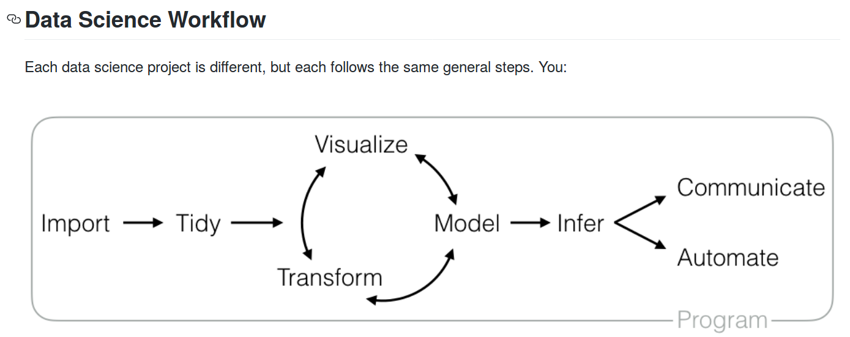
The Data Science workflow
https://github.com/rstudio/RStartHere

Slide 18
So, about this “big data” thing...
Hadoop = HDFS + MapReduce
Hadoop
Based on
GFS
HDFS
MapReduce
Hadoop Distributed File System
A fault tolerant, scalable, distributed file system that recovers gracefully from hardware and/or software failures and provides consistent results and performance
A programming model that lends itself to parallelization over a large cluster of commodity computers.

Slide 19
Syllabus and Moodle Site Review
Overview
Motivation
Books and website
Structure
Requirements

Slide 20
Our computing “appliance” - pcda
I created a virtual machine that is used via VirtualBox
We will all start out with the same software
You get a chance to learn some Linux
Tools like R and Python are multi-platform
You can download appliance and run on your own computer but will also be able to use in the lab

Slide 21
pcda – The Big Picture
Computer running Windows, Mac OS, or Linux
Programs
  MS Office
  Notepad
  Browser
  VirtualBox
Documents
  Spreadsheets, Word documents, text files,pdf
  Virtual machines
VM running Lubuntu Linux
Programs
  R, Python
  Geany
  LibreOffice
  Browser
  File Manager
  Shell
Documents
  R scripts, Python programs
  OpenOffice documents
  Text files, pdf
pcda

Slide 22
Lubuntu Linux
Lubuntu is a fast and lightweight operating system developed by a community of Free and Open Source enthusiasts.
The core of the system is based on Linux and Ubuntu.
Lubuntu uses the minimal desktop LXDE, and a selection of light applications.
We focus on speed and energy-efficiency. Because of this, Lubuntu has very low hardware requirements.

Slide 23
For those new to Lubuntu Linux
Ubuntu is widely used and the most Windows like Linux “distro”
  I've been using it for years on multiple machines
  Lubuntu is just a super lightweight version of Ubuntu
It's got a GUI that is very Windows like
It's got a Software Center that makes it easy to find, download and install new programs
It's totally FREE, both as in freedom and beer
There is a large Ubuntu user community

Slide 24
Why learn to use Linux for analytics?
Linux widely used in the data science and analytics world
Linux shell FAR superior to Windows command line application
  Powerful shell scripting language
  Tab completion
  Command line is often way more efficient than GUI
Linux is free and open source
Sets you apart from other business analysts who only know Windows and Microsoft applications

Slide 25
Why R and Python?
Both R and Python are widely used in the data science and business analytics worlds
A quote from Enterprise Data Analysis and Visualization: An Interview Study on the growing need for technically adept analysts:
  When discussing recruitment, one Chief Scientist said “analysts that can’t program are disenfranchised here”
Both support a combination of interactive use via tools like R Studio and Ipython/Jupyter along with programmatic use via text scripting
Huge communities and ecosystems supporting R and Python for analytics work
Both facilitate reproducible analysis
Some things that are simply hideously difficult to do in tools like Excel or a database, are simple in R and/or Python
  Group By or Pivoting type analysis for operations such as percentiles
  Small multiples and other complex graphing/charting/plotting
  Documenting and reproducing complex series of data cleaning and transformations

Slide 26
First peek at R and Python
Both can be used in multiple modes
  “scripts” or “programs”
  Interactive
This is really useful for data science work
In Downloads you’ll find a folder called peek_r_python
  Let’s explore a bit...

Slide 27
What I hope to do in this class
Introduce you to a new approach to doing data analysis and business analytics work
Motivate you to continue to learn to use tools like R and Python and to become a competent analytics programmer
Truly challenge you
Give you a chance to apply these tools and approaches to a data set of your own choosing

Slide 28
Stuff to do now
HW0_IntroToPCDA
  In-class exercise for becoming familiar with pcda and some GUI oriented Linux things
  Intro to data science
  prep for next class
Explore our Moodle site
This class will move at a brisk pace.
  Important you do the prep work for each class
  The more comfortable you are with these new tools, the more valuable class time will be

