Slide 1
Cloud Based Attendance System
Submitted in the partial fulfillment for the award of the degree of
BACHELOR OF ENGINEERING
IN
Computer Science – Cloud computing
Submitted by:
Aryendra Agnihotri - 20BCS4230
Anurag Tomar - 20BCS4245
Ankit Ahir - 20BCS4223
Under the Supervision of:
Miss. – Ramneet Kaur
Department of AIT-CSE
DISCOVER . LEARN . EMPOWER

Slide 2
Outline
Introduction to Project
Problem Formulation
Objectives of the work
Methodology used
Results and Outputs
Conclusion
Future Scope
References

Slide 3
Introduction to Project
Attendance Management System is software developed for daily student attendance in schools, colleges and institutes. It facilitates to access the attendance information of a particular student in a particular class. The information is sorted by the operators, which will be provided by the teacher for a particular class. This system will also help in evaluating attendance eligibility criteria of a student.
The purpose of developing attendance management system is to computerized the tradition way of taking attendance. Another purpose for developing this software is to generate the report automatically at the end of the session or in the between of the session.

Slide 4
Introduction to Project
The scope of the project is the system on which the software is installed, i.e. the project is developed as a desktop application, and it will work for a particular institute. But later on the project can be modified to operate it online.
Attendance Management System basically has two main modules for proper functioning:- First module is admin which has right for creating space for new batch. Any entry of new faculty, Updating in subject if necessary, and sending notice. Second module is handled by the user which can be a faulty or an operator. User has a right of making daily attendance, generating report.

Slide 5
Problem Formulation
The product Attendance Management system is an independent product and does not depend on any other product or system. The product will automate various tasks associated with handling student details and better organizing the stored information and optimum performance, thus helping the Colleges to ensure smooth working of these processes.
Our system has two types of accessing modes:-
i. Administrator
ii. User

Slide 6
Problem Formulation
(i) Administrator: Administrator have rights to manage student details, add a new student, provide register number for all students, assign each student a course etc., Administrator can update his profile, and also can give help to the teachers and students.
(ii) User: There are two users:-
Student: -Student do the login and see profile, Attendance Details etc.
Teacher:-Add student, view the student details and take attendance student.

Slide 7
Objectives of the Work
To provide a CLOUD ATTENDANCE MANAGEMENT SYSTEM which can help an organization to mantain an attendance record of its employees or students.
To keep the attendance record on the cloud to prevent lose of data and maintainance of physical records.

Slide 8
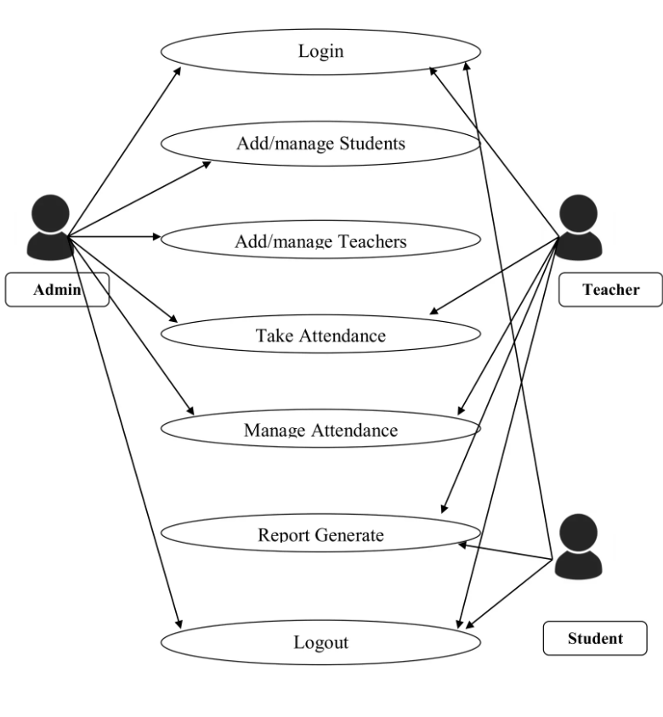
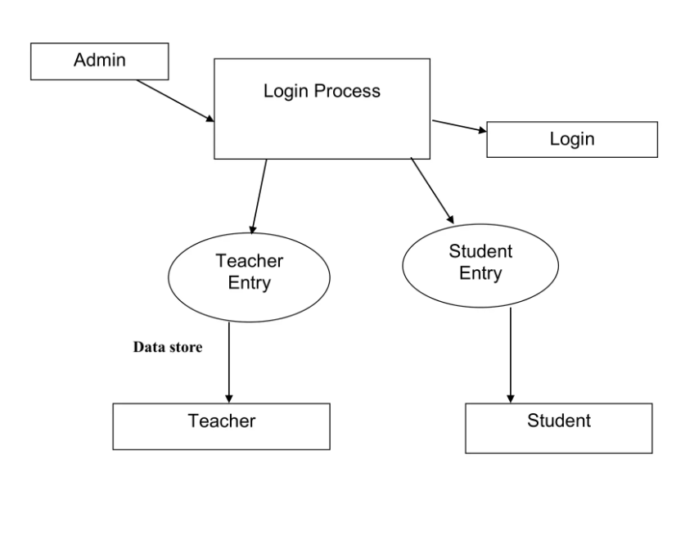
Methodology used

Slide 9
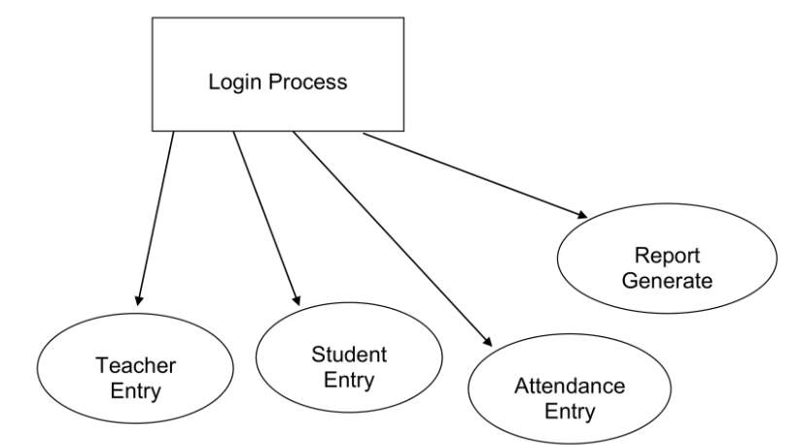
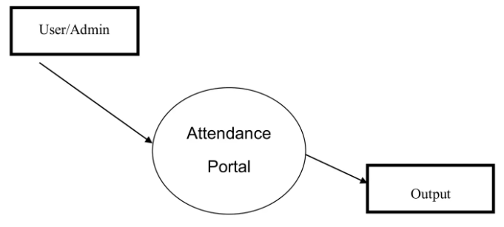
Methodology used

Slide 10
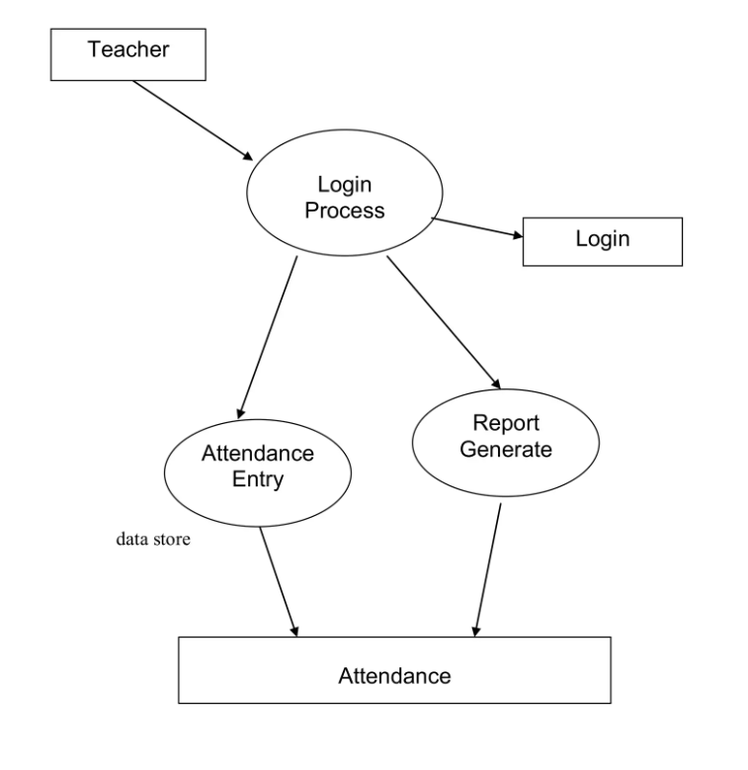
Methodology used

Slide 11
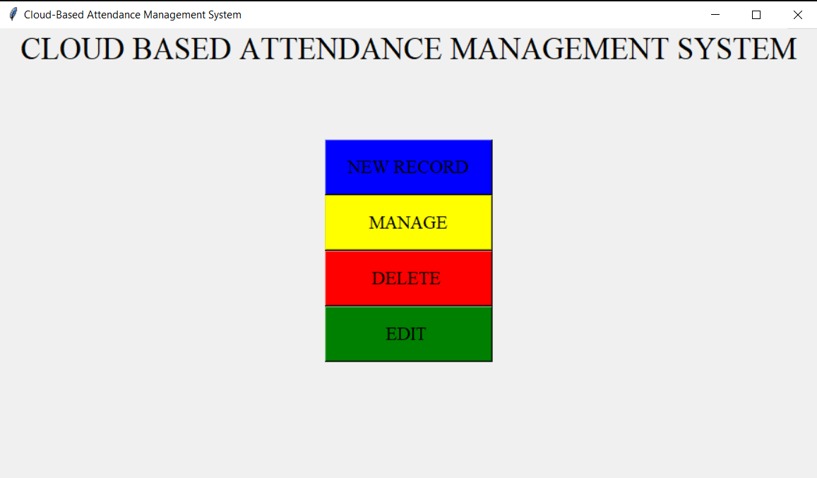
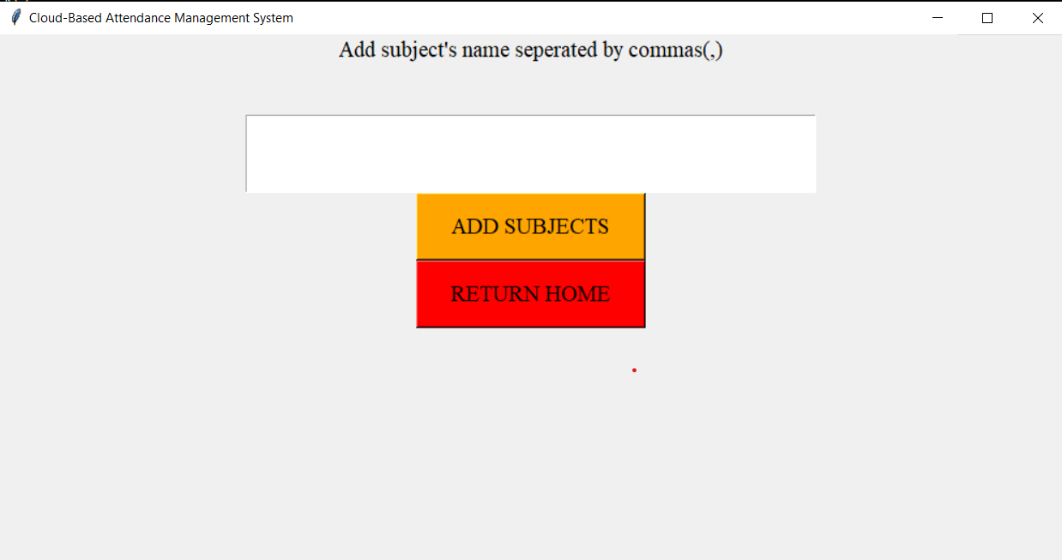
Results and Outputs

Slide 12
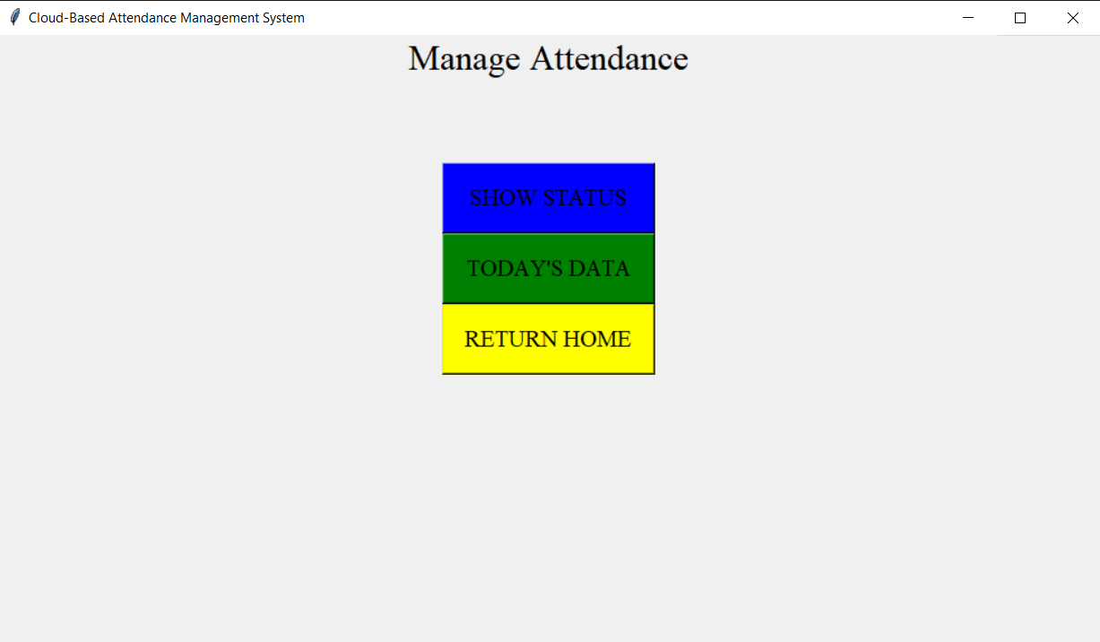
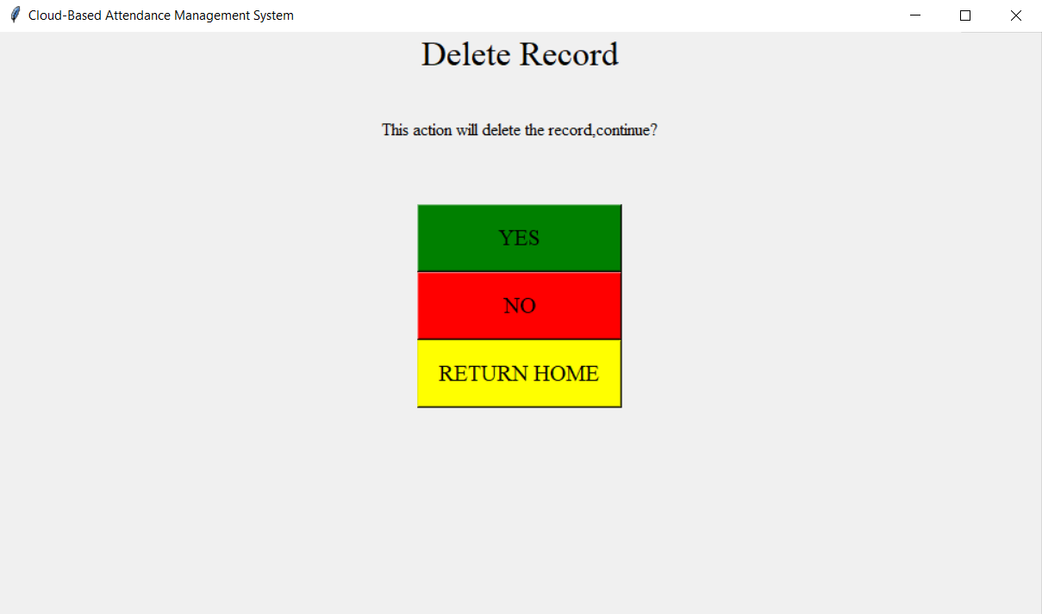
Results and Outputs

Slide 13
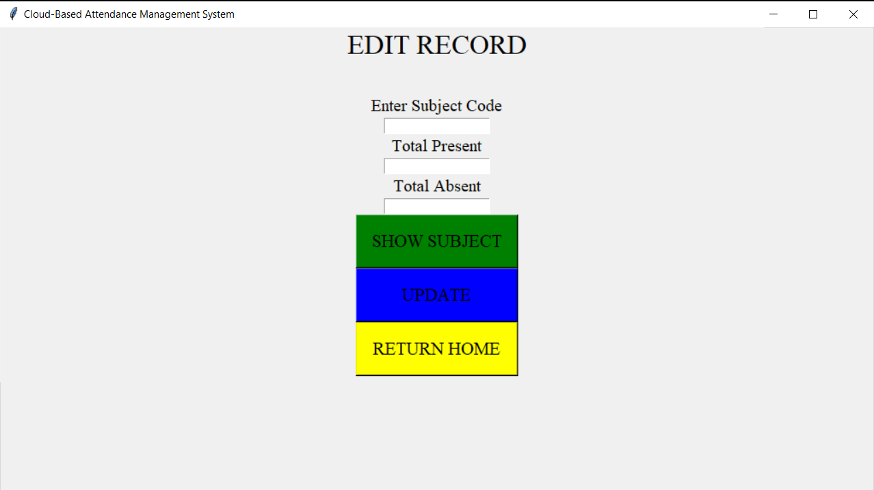
Results and Outputs

Slide 14
Conclusion
We created a Cloud based attendance system that provide easy attendance taking in an organization.
It provides secure storage of attendance records and eliminates physical record keeping.

Slide 15
Future Scope
Adding more information and attendance for employees and students.
Adding facial recognition for attendance taking.
Adding biometrics for more secure attendance taking and avoid proxy.

Slide 16
References
https://www.spica.com/attendance-management-system
https://biz30.timedoctor.com/cloud-based-time-and-attendance-system/
https://zicomsaas.com/iot/attendance/

