Slide 1
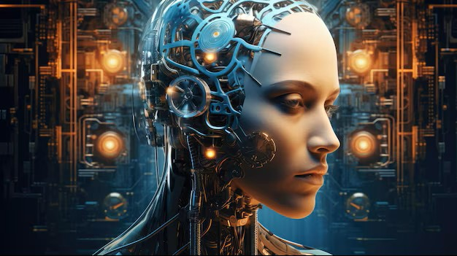
ARTIFICIAL INTELLIGENCE
PREPARED BY:
ANKITA SINGH

Slide 2
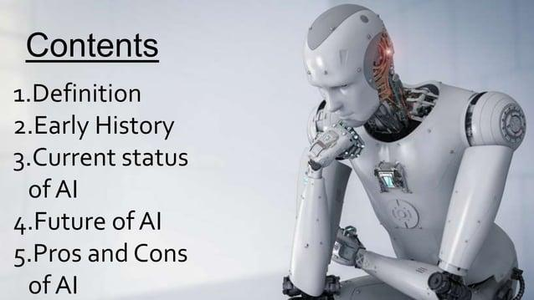

Slide 3
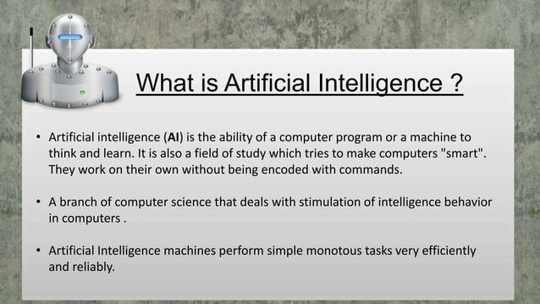

Slide 4
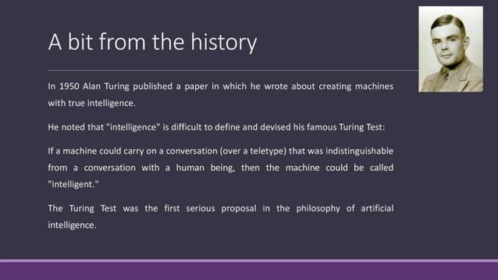

Slide 5
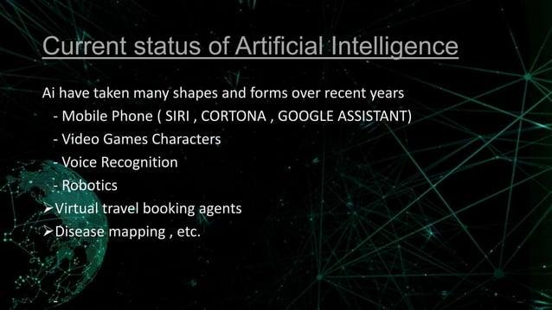

Slide 6
Some of the most common examples of AI in use today :
Chat GPT : Uses large language models (LLM) to generate text in response to questions or comments posed to it.
Google translator: Uses deep learning algorithms to translate text from one language to another language
Netflix: Uses machine learning algorithms to create personalized recommendations engines for user based on their previous viewing history .
Apple’s Siri : Apple voice –activated personal assistant ,Siri ,powered by deep neural networks (DNNs) to interact with users and complete their request.

Slide 7
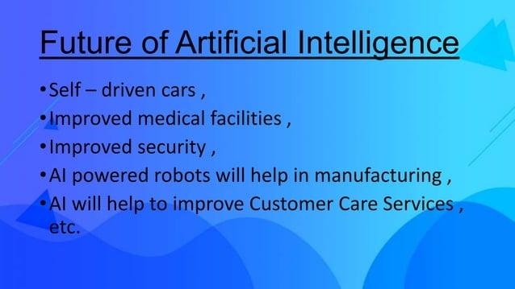

Slide 8
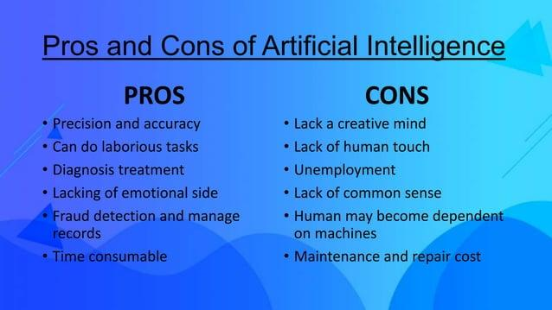

Slide 9
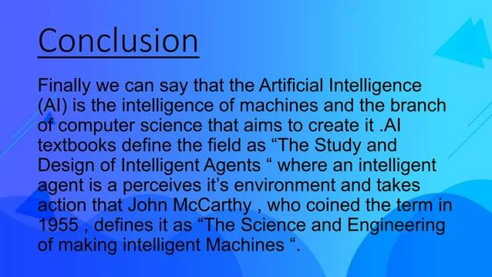

Slide 10


