Slide 1
Search Engines
Query Processing
All slides © CIIR, 2014-2016

Slide 2
Query processing topics
Query reformulation
Stemming
Spell checking
Query segmentation
Expansion
Relevance feedback
Context
Result presentation
Snippet generation
Advertising
Clustering
Facets
Interfaces
Cross-language IR

Slide 3
Information Needs
An information need is the underlying cause of the query that a person submits to a search engine
sometimes called query intent
Categorized using variety of dimensions
e.g., number of relevant documents
type of information that is needed
type of task that led to the requirement for information

Slide 4
Queries and Information Needs
A query can represent very different information needs
May require different search techniques and ranking algorithms to produce the best rankings
A query can be a poor representation of the information need
User may find it difficult to express the information need
User is encouraged to enter short queries both by the search engine interface, and by the fact that long queries don’t work

Slide 5
Interaction
Interaction with the system occurs
during query formulation and reformulation
while browsing the result
Key aspect of effective retrieval
users can’t change ranking algorithm but can change results through interaction
helps refine description of information need
e.g., same initial query, different information needs
how does user describe what they don’t know?

Slide 6
ASK Hypothesis
Belkin et al (1982) proposed a model called Anomalous State of Knowledge
ASK hypothesis:
difficult for people to define exactly what their information need is, because that information is a gap in their knowledge
Search engine should look for information that fills those gaps
Interesting ideas, little practical impact (yet)

Slide 7
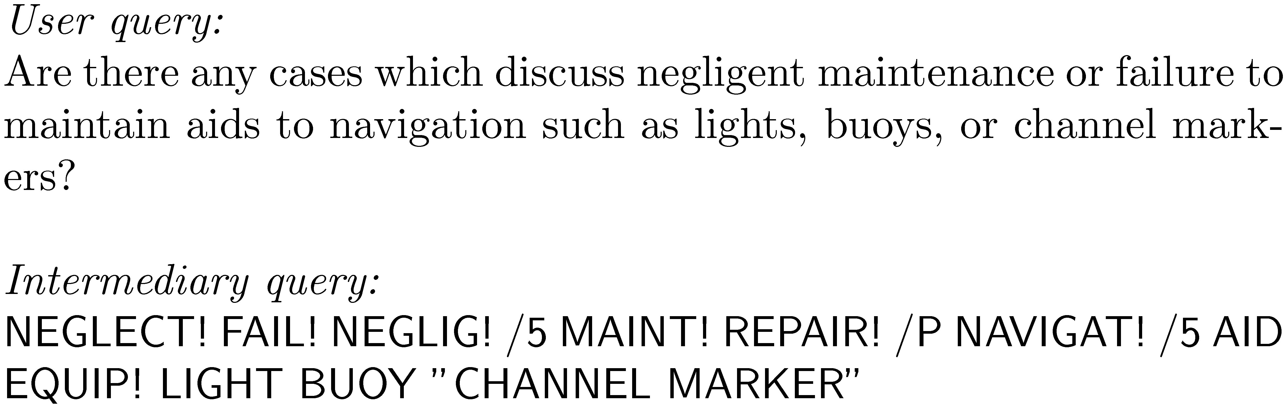
Keyword Queries
Query languages in the past were designed for professional searchers (intermediaries)

Slide 8
Keyword Queries
Simple, natural language queries were designed to enable everyone to search
Current search engines do not perform well (in general) with natural language queries
People trained (in effect) to use keywords
compare average of about 2.3 words/web query to average of 30 words/CQA query
Keyword selection is not always easy
query refinement techniques can help
Notes:
Current search engines work better with short queries
Return documents that contain all the query terms
No syntactic or semantic features is used for query

Slide 9
Query Reformulation
Rewrite or transform original query to better match underlying intent
Can happen implicitly or explicitly (suggestion)
Many techniques
Query-based stemming
Spelling correction
Segmentation
Substitution
Expansion
Notes:
Segmentation: “mobile company market share” → “mobile company” “market share”
Substitution : “mac os” → “mac operating system”
Expansion : “apple mobile” → “apple mobile iphone”

Slide 10
Query processing topics
Query reformulation
Stemming
Spell checking
Query segmentation
Expansion
Relevance feedback
Context
Result presentation
Snippet generation
Advertising
Clustering
Facets
Interfaces
Cross-language IR

Slide 11
Query-Based Stemming
Make decision about stemming at query time rather than during indexing
improved flexibility, effectiveness
Query is expanded using word variants
documents are not stemmed
e.g., “rock climbing” expanded with “climb”, not stemmed to “climb”
e.g., expand “selling stock” with “stocks” but not “stocking”

Slide 12
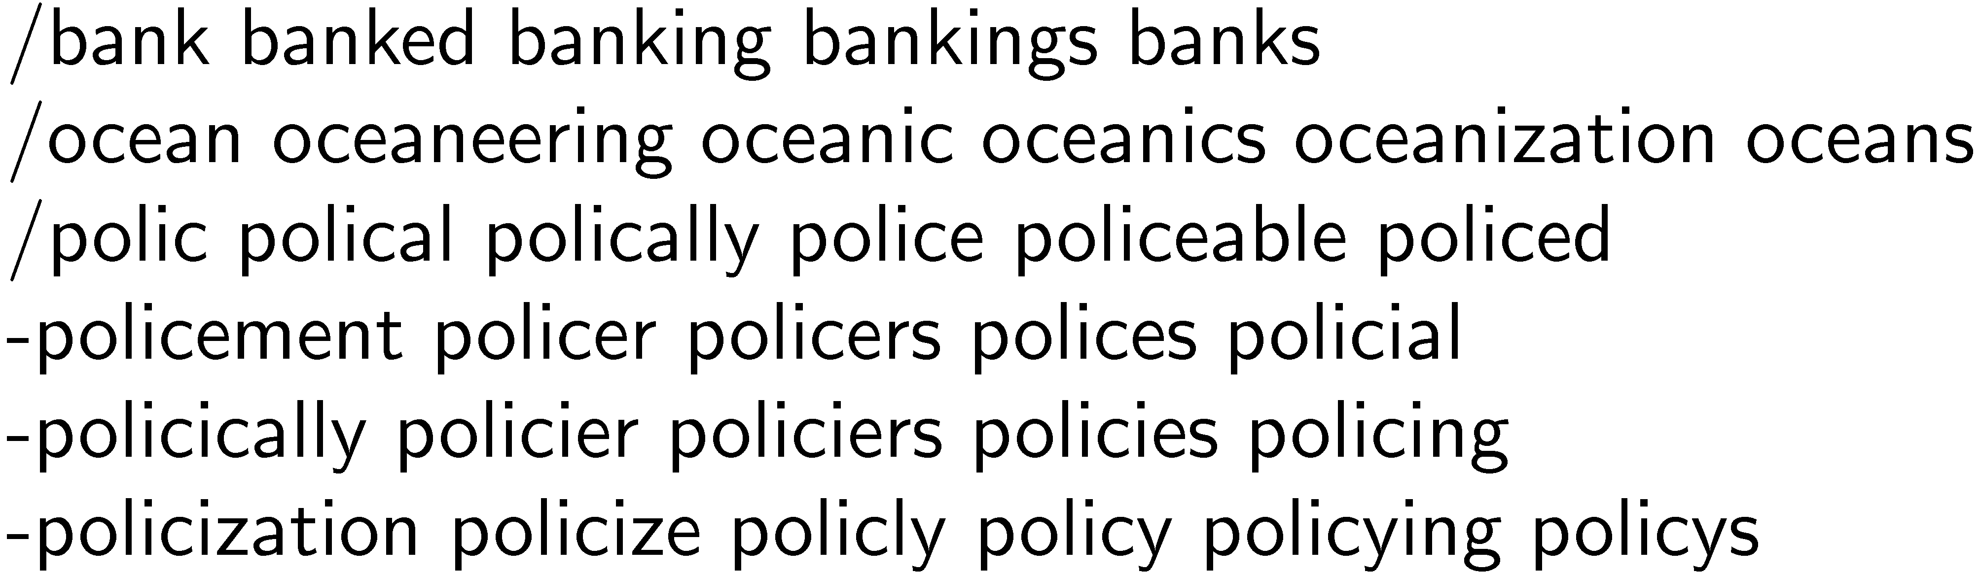
Stem Classes
A stem class is the group of words that will be transformed into the same stem by the stemming algorithm
generated by running stemmer on large corpus
e.g., Porter stemmer on TREC News
Notes:
Good candidate for a simple MapReduce program
Priblems:

Slide 13
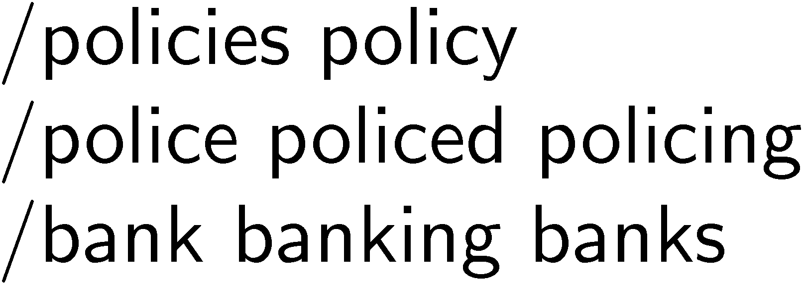
Stem Classes
Stem classes are often too big and inaccurate
Modify using analysis of word co-occurrence
Assumption:
Word variants that could substitute for each other should co-occur often in documents
e.g., reduces previous example /polic and /bank classes to

Slide 14
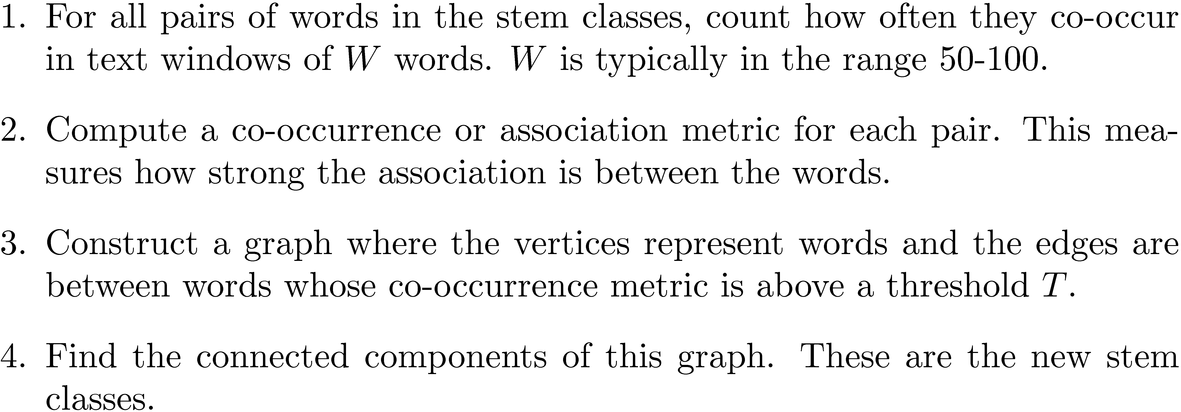
Modifying Stem Classes

Slide 15
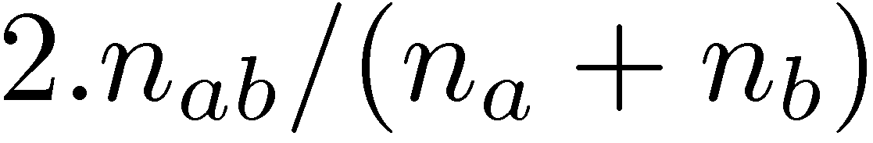
Modifying Stem Classes
Dices’ Coefficient is an example of a term association measure
where n_{x} is the number of windows containing x
Two vertices are in the same connected component of a graph if there is a path between them
forms word clusters
Example output of modification
Where else can we find co-occurrences?
Notes:
This approach for stemming is comparable to algorithmic stemmers
Can be used for other languages, e.g. using shared n-grams and co-occurrence

Slide 16
Query Log
Records all queries and documents clicked on by users, along with timestamp
Can be used for query-based stemming
Word variants that co-occur with other query words can be added to query
e.g., for the query “tropical fish”, “fishes” may be found with “tropical” in query log, but not “fishing”
Also used heavily for query transformation, query suggestion

Slide 17
Query processing topics
Query reformulation
Stemming
Spell checking
Query segmentation
Expansion
Relevance feedback
Context
Result presentation
Snippet generation
Advertising
Clustering
Facets
Interfaces
Cross-language IR

Slide 18
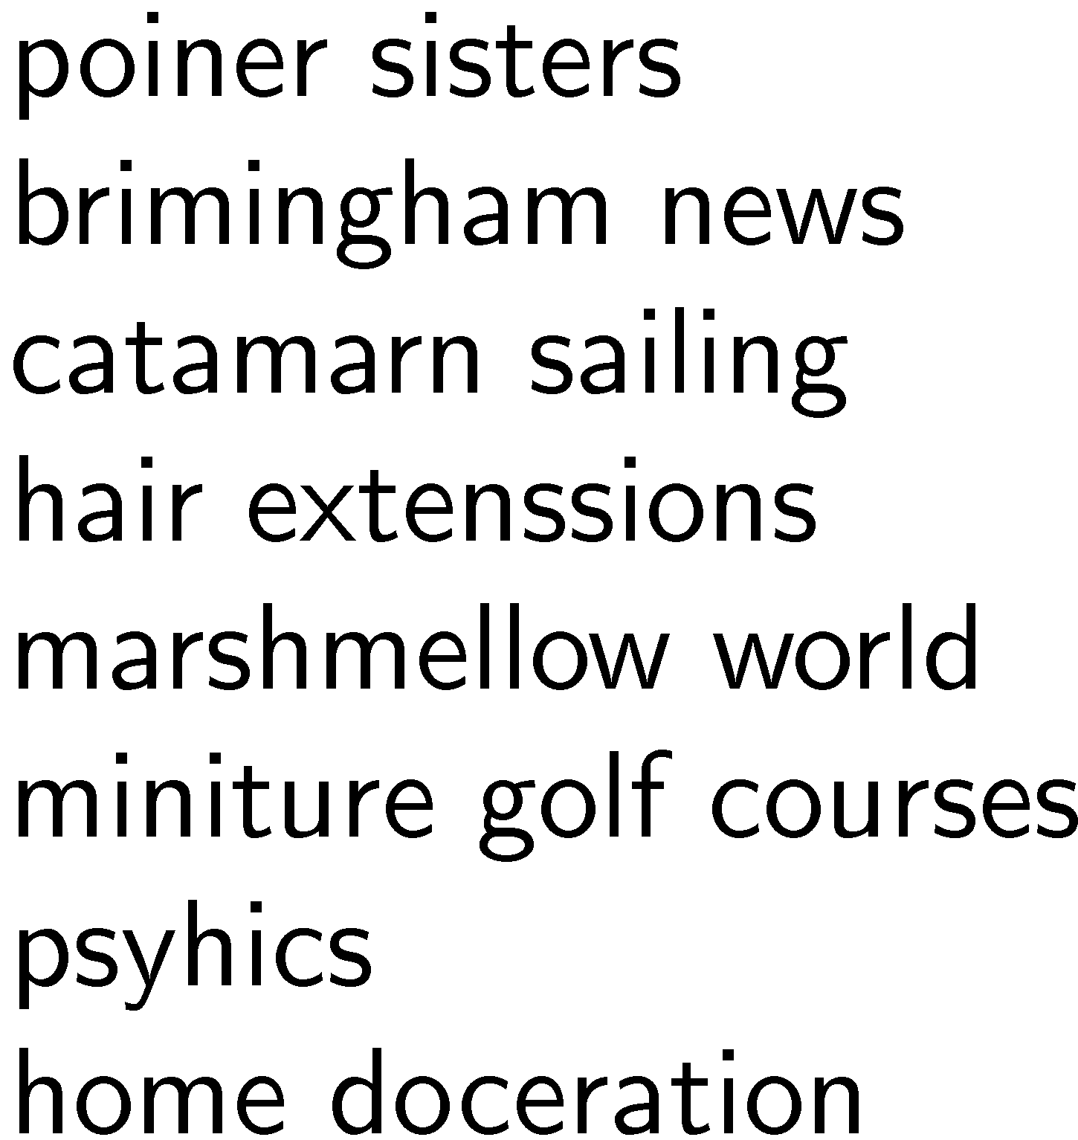
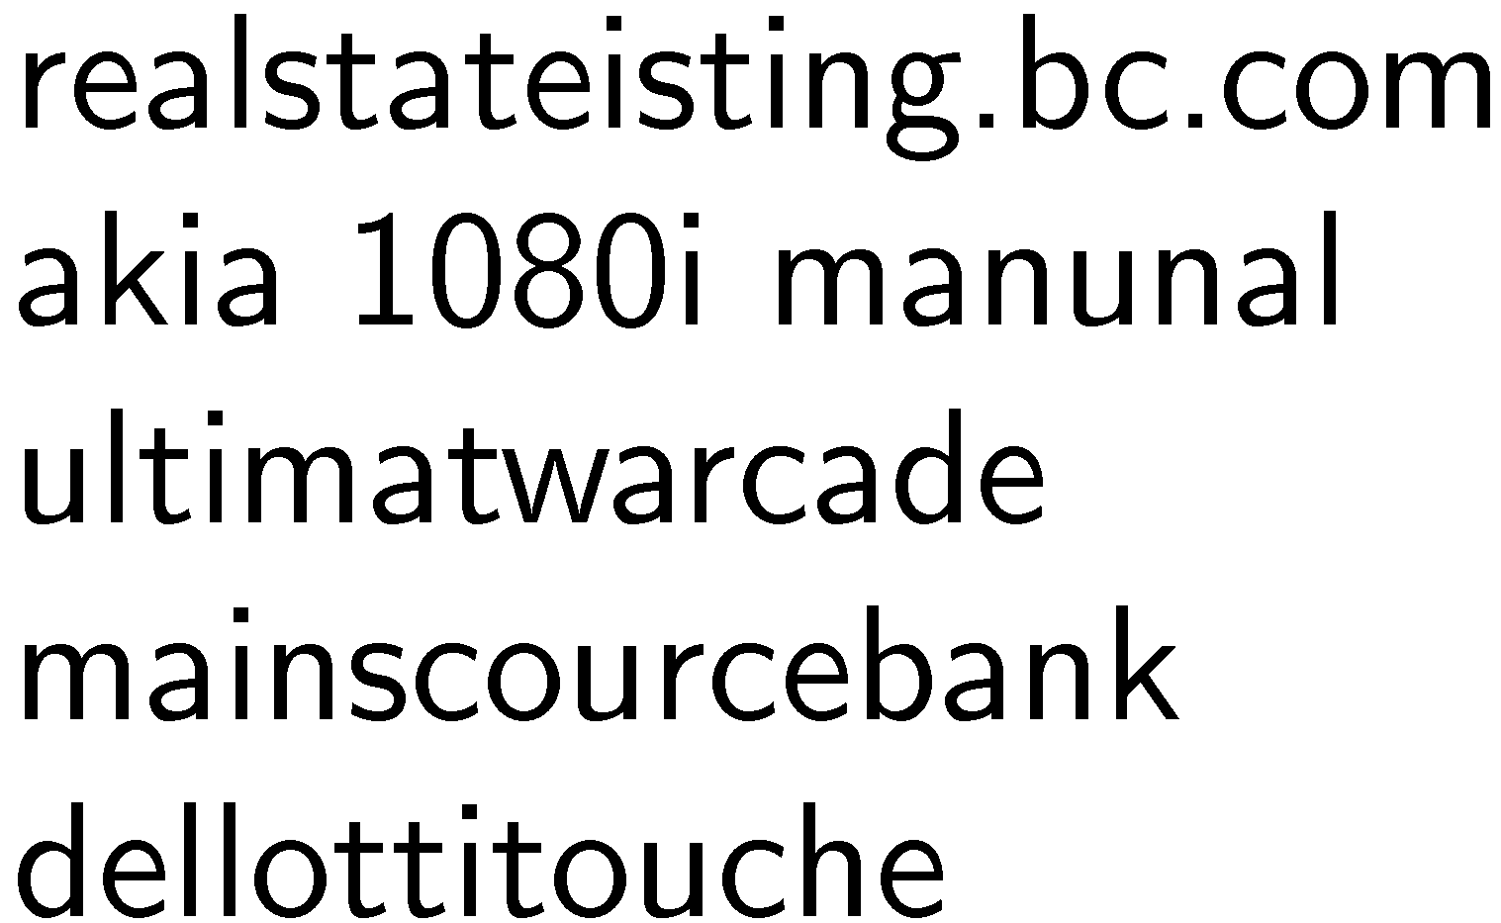
Spell Checking
Important part of query processing
10-15% of all web queries have spelling errors
Errors include typical word processing errors but also many other types, e.g.
Notes:
Some errors related to products, companies, people

Slide 19
Spell Checking
Basic approach: suggest corrections for words that are not in a spelling dictionary
Suggestions found by comparing word to dictionary words using similarity measure
Most common similarity measure is edit distance
number of operations required to transform one word into the other

Slide 20
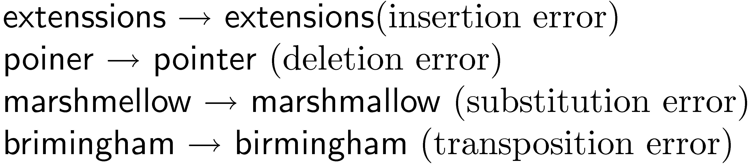

Edit Distance
Damerau-Levenshtein distance
counts the minimum number of insertions, deletions, substitutions, or transpositions of single characters required
e.g., Damerau-Levenshtein distance 1
distance 2
Notes:
>80% of errors are produced by single character errors

Slide 21
Edit Distance
Number of techniques are used to speed up calculation of edit distances
restrict to words starting with same character
restrict to words of same or similar length
restrict to words that sound the same
Last option uses a phonetic code to group words
e.g. Phonex, Soundex

Slide 22
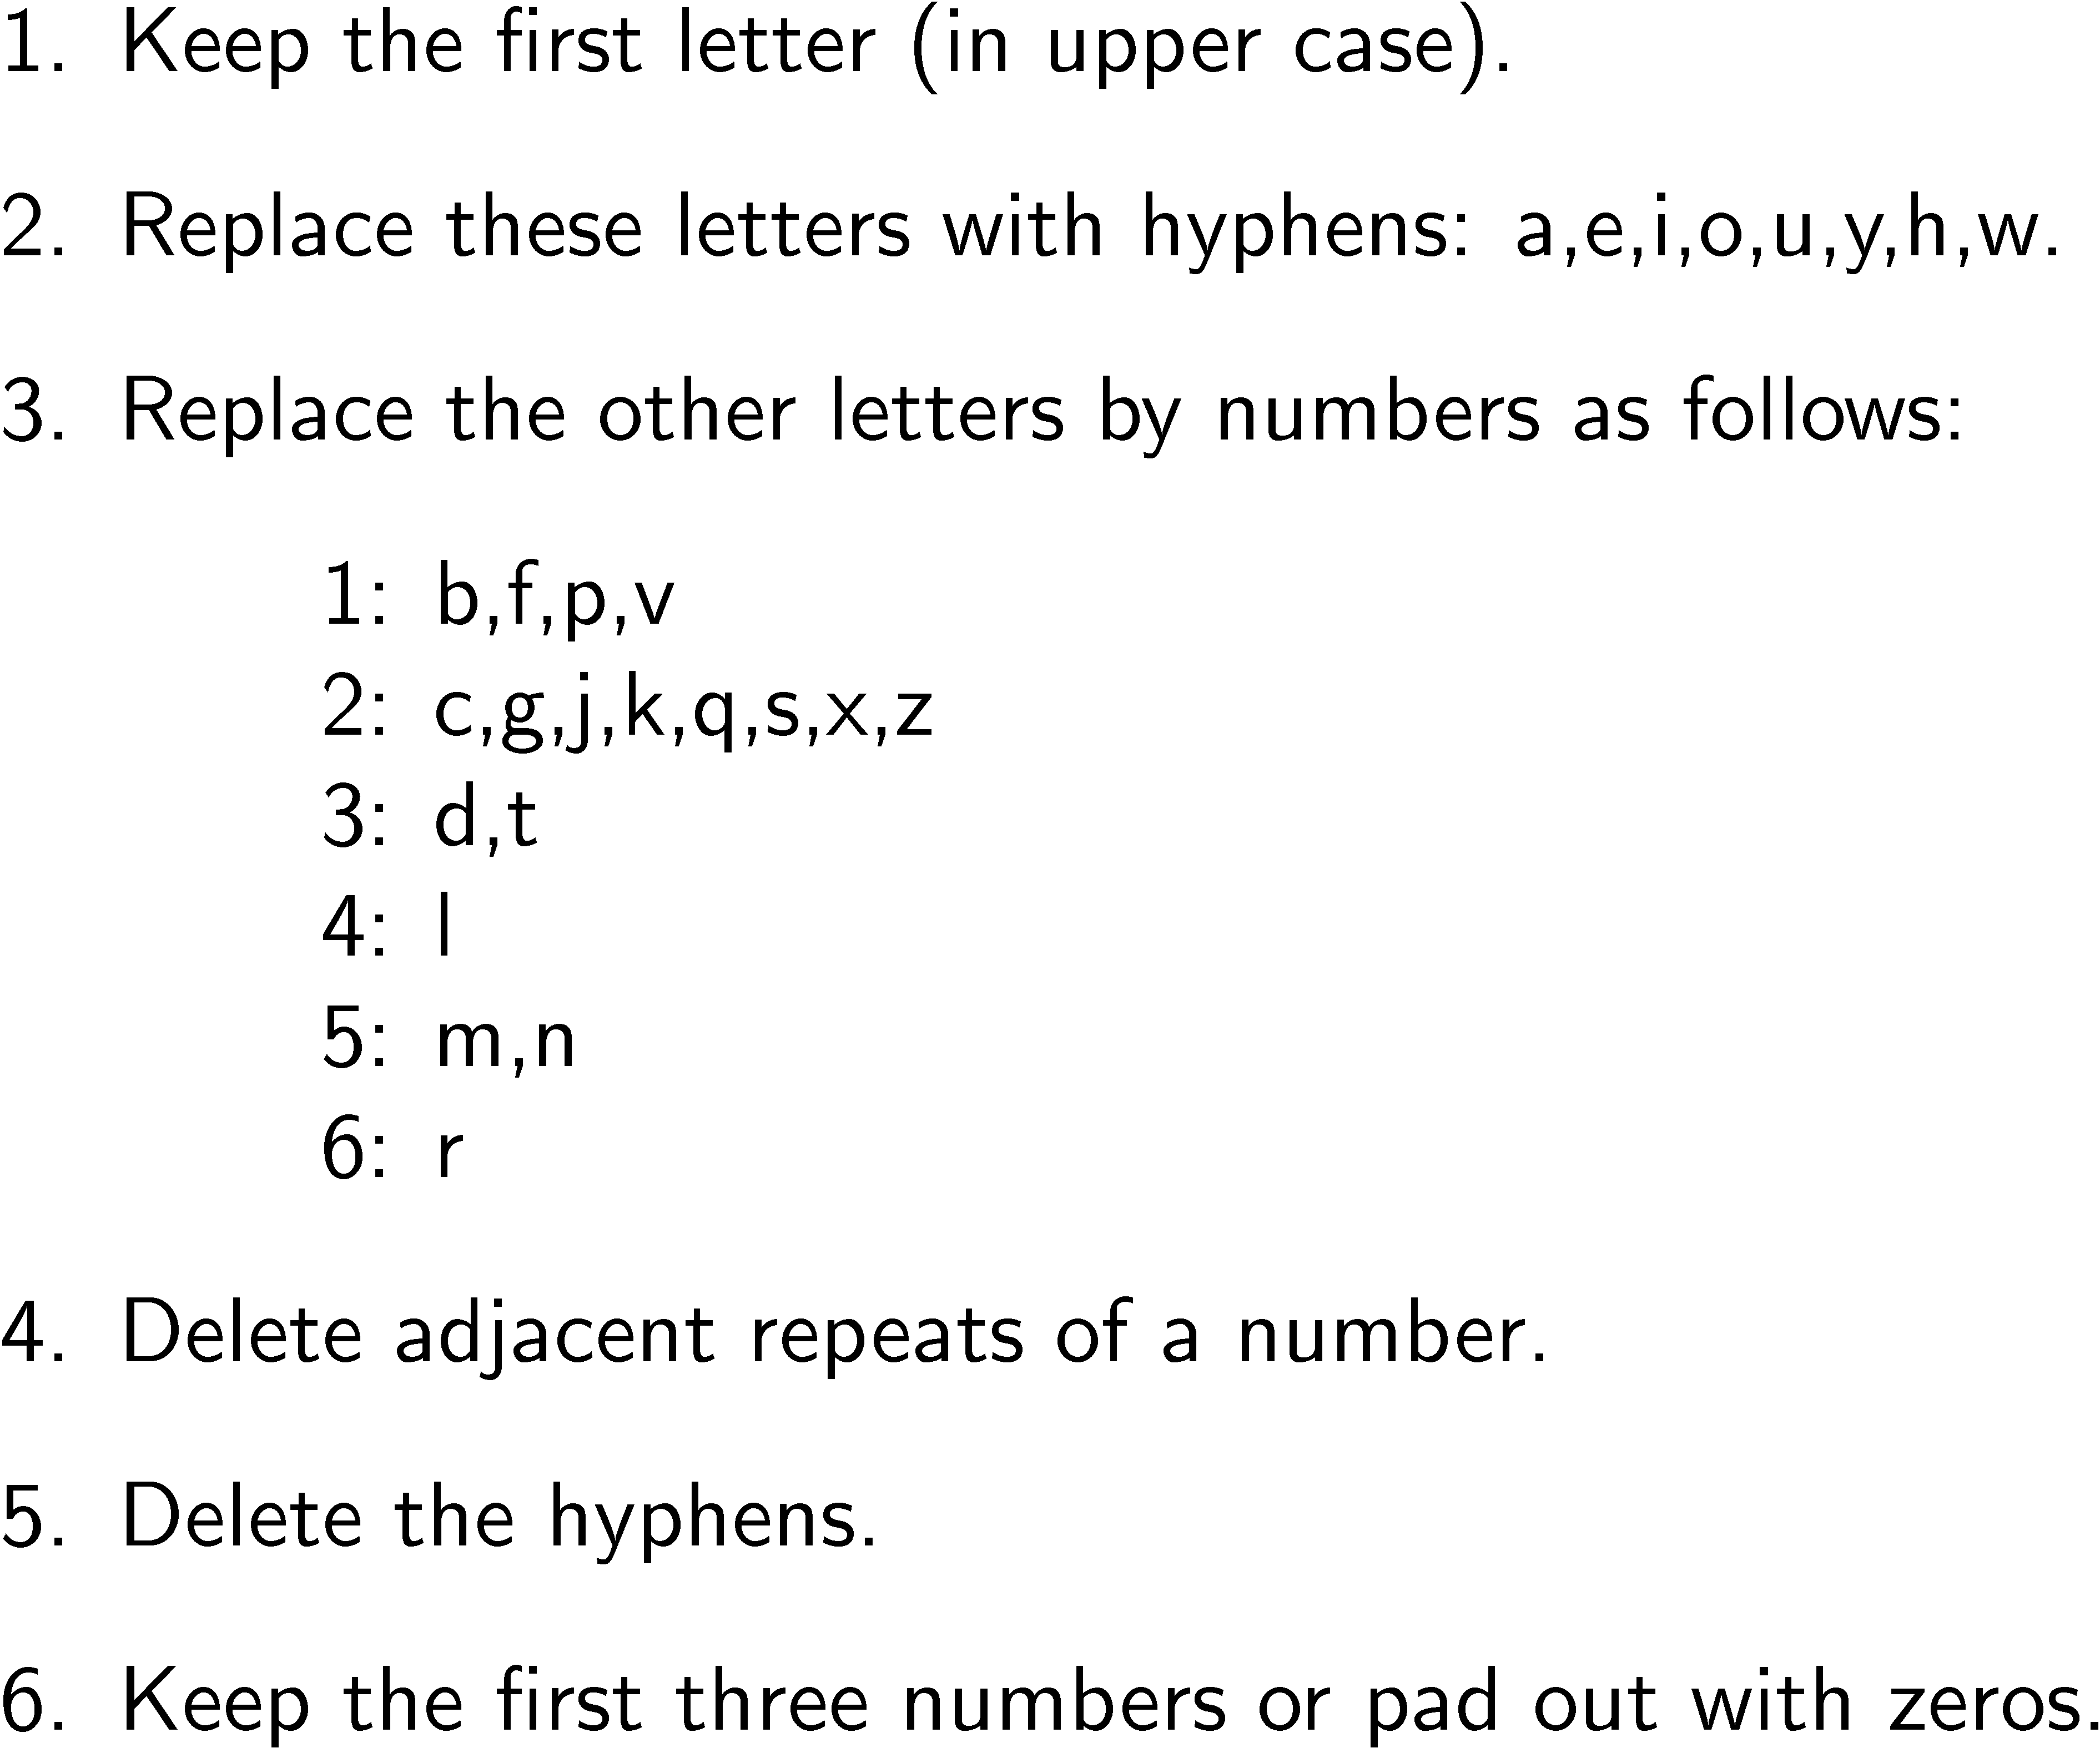
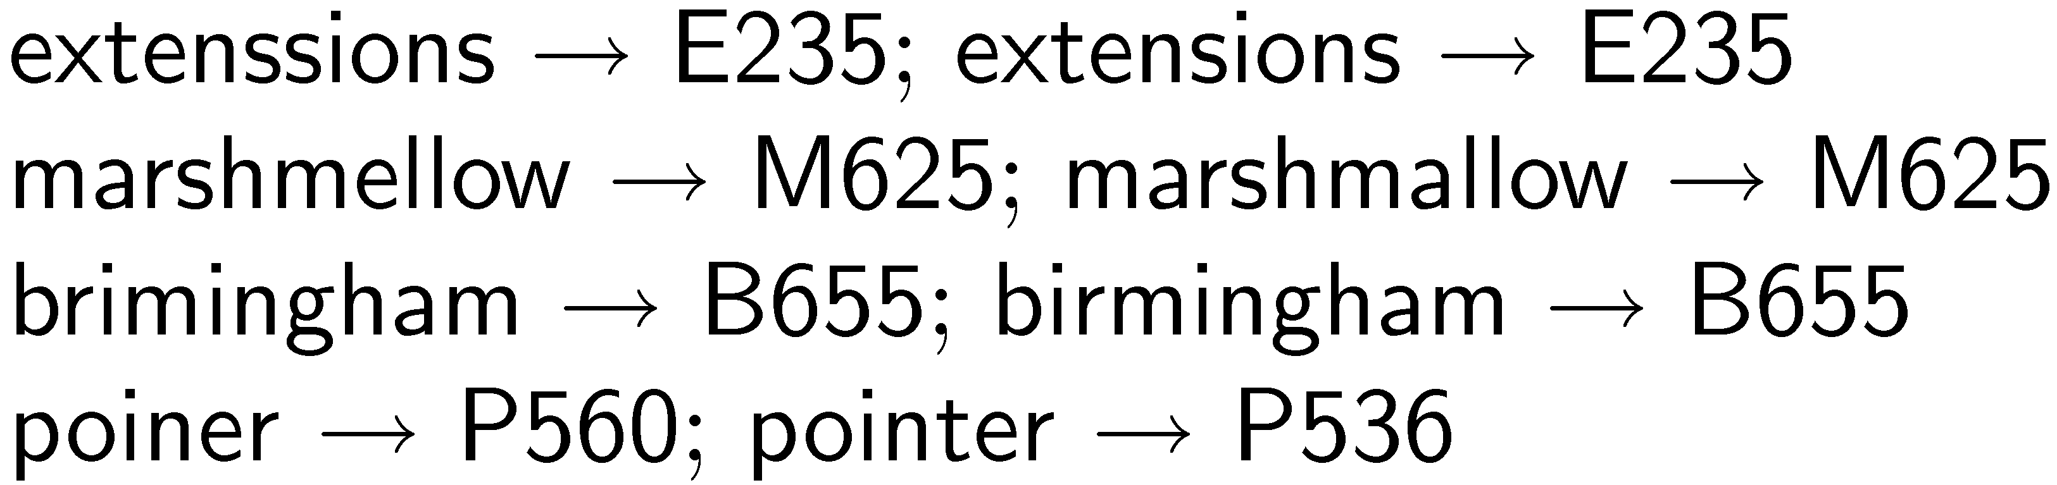
Soundex Code

Slide 23

Spelling Correction Issues
Ranking corrections
“Did you mean...” feature requires accurate ranking of possible corrections
Context
Choosing right suggestion depends on context (other words)
e.g., lawers → lowers, lawyers, layers, lasers, lagers but trial lawers → trial lawyers
Run-on errors
e.g., “mainscourcebank”
missing spaces can be considered another single character error in right framework
Notes:
Image snipped from https://www.mainsourcebank.com/index.htm

Slide 24
Noisy Channel Model
User chooses word w based on probability distribution P(w)
the language model (remember them?)
can capture context information, e.g. P(w₁|w₂)
User writes word, but noisy channel “causes” word e to be written instead with probability P(e|w)
called error model
represents information about the frequency of spelling errors
Notes:
A general framework

Slide 25
Noisy Channel Model
Need to estimate probability of correction
P(w|e) = P(e|w)P(w) treating P(e) as a constant
P(e|w) captures chance of that error happening
Estimate language model using context
e.g., P(w) = λP(w) + (1 − λ)P(w|w_{p})
w_{p} is word that occurred before e
e.g.,
“fish tink”
“tank” and “think” both likely corrections, but P(tank|fish) > P(think|fish)

Slide 26
Noisy Channel Model
Language model probabilities estimated using corpus and/or query log
Both simple and complex methods have been used for estimating error model
simple approach: assume all words with same edit distance have same probability, only edit distance 1 and 2 considered
more complex approach: incorporate estimates based on common typing errors

Slide 27
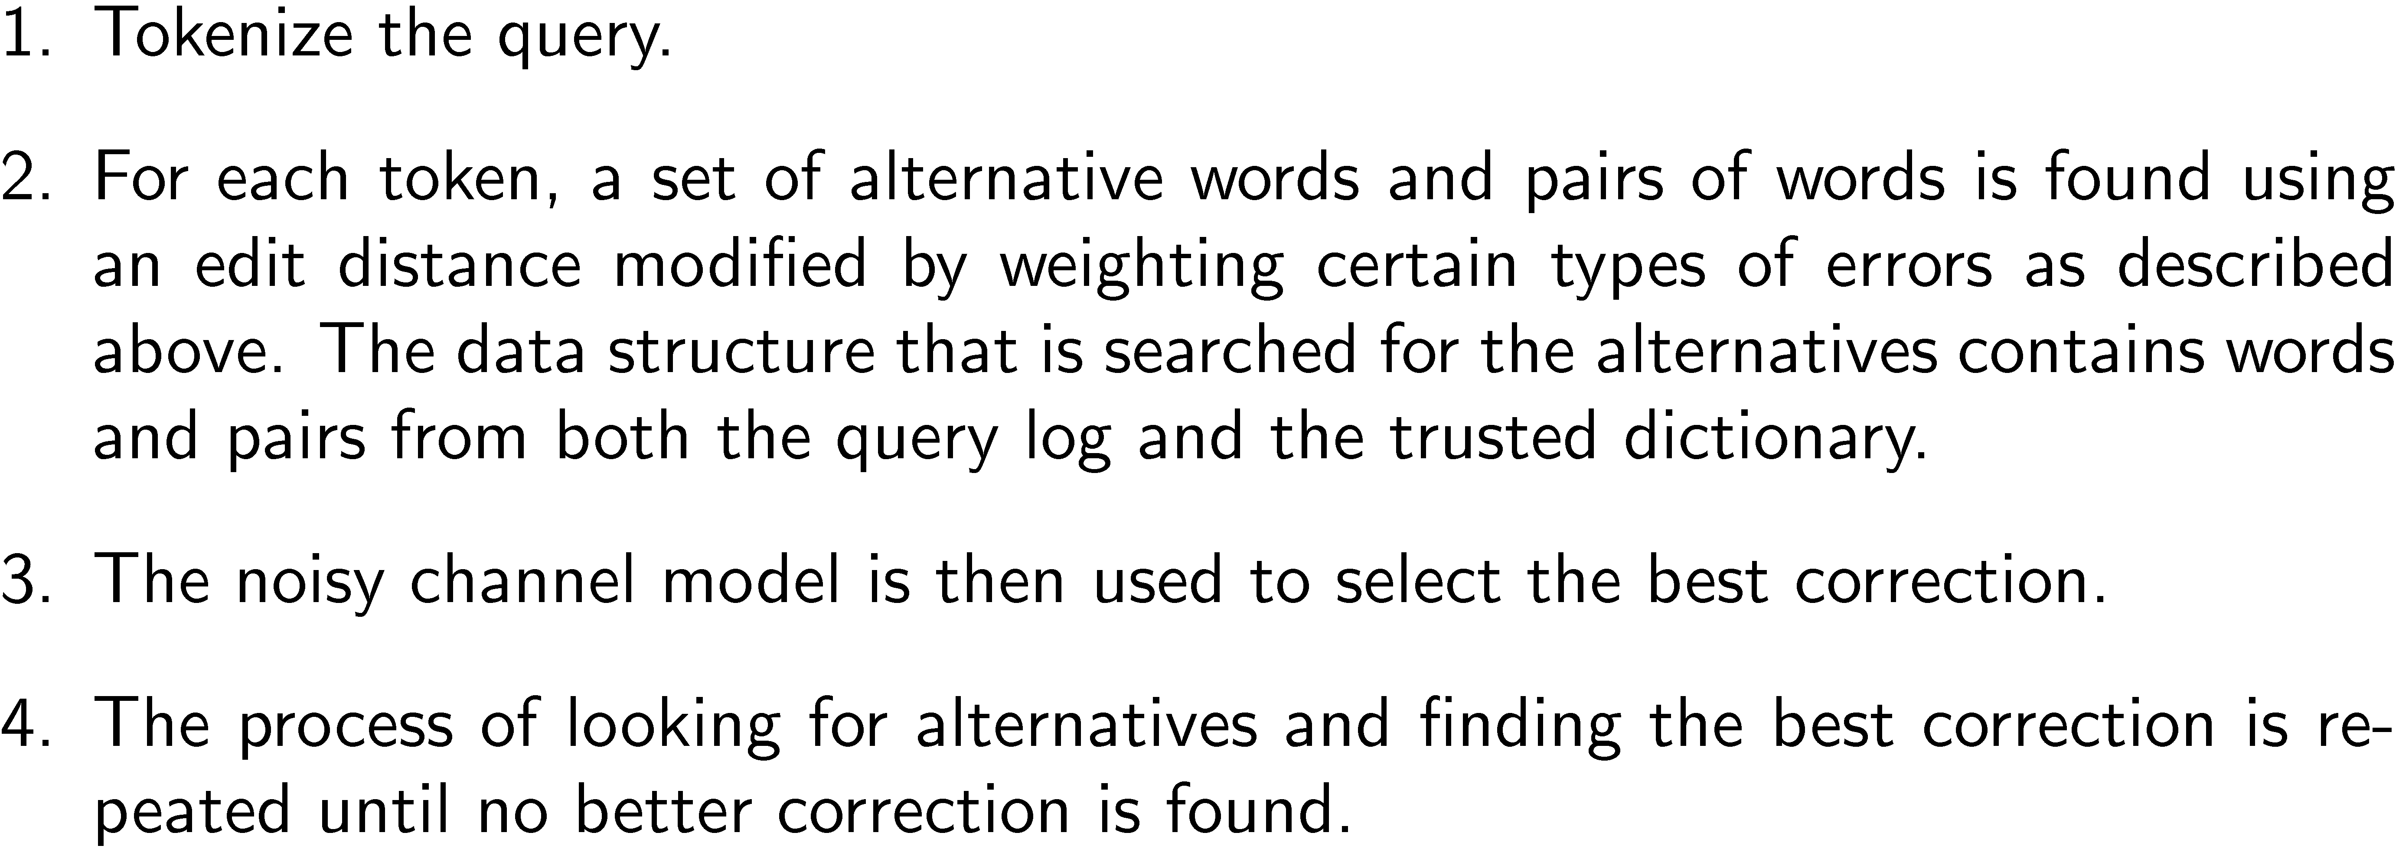
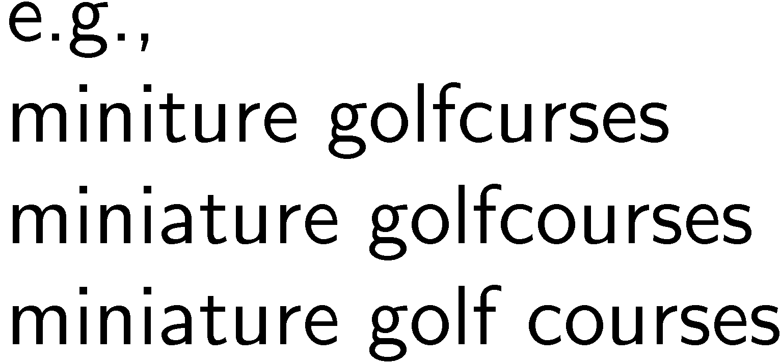
Example Spellcheck Process

Slide 28
Query processing topics
Query reformulation
Stemming
Spell checking
Query segmentation
Expansion
Relevance feedback
Context
Result presentation
Snippet generation
Advertising
Clustering
Facets
Interfaces
Cross-language IR

Slide 29
Query Segmentation
Break up queries into important “chunks”
e.g., “new york times square” becomes “new york” “times square”
Possible approaches:
 | Treat each term as a concept
[members] [rock] [group] [nirvana]
 | Treat every adjacent pair of terms as a concept
[members rock] [rock group] [group nirvana]
 | Treat all terms within a noun phrase “chunk” as a concept
[members] [rock group nirvana]
 | Treat all terms that occur in common queries as a single concept
[members] [rock group] [nirvana]

Slide 30
Query processing topics
Query reformulation
Stemming
Spell checking
Query segmentation
Expansion
Relevance feedback
Context
Result presentation
Snippet generation
Advertising
Clustering
Facets
Interfaces
Cross-language IR

Slide 31
Thesaurus
Used in early search engines as a tool for indexing and query formulation
specified preferred terms and relationships between them
also called controlled vocabulary
Particularly useful for query expansion
adding synonyms or more specific terms using query operators based on thesaurus
improves search effectiveness
If used correctly

Slide 32
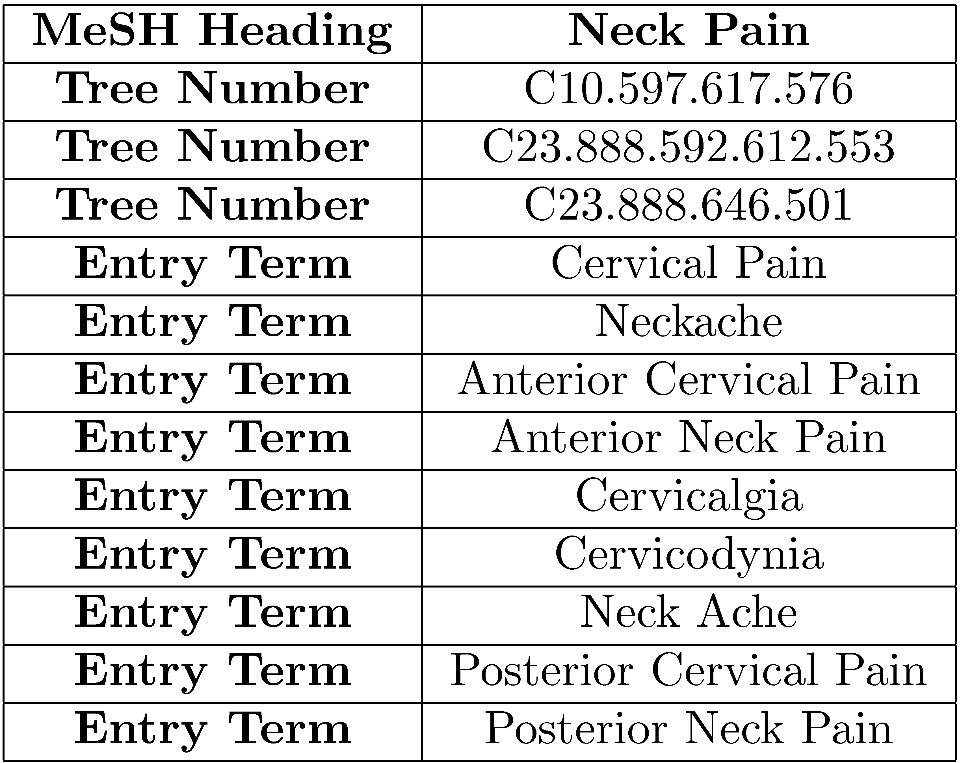
MeSH Thesaurus

Slide 33
Query Expansion
A variety of automatic or semi-automatic query expansion techniques have been developed
goal is to improve effectiveness by matching related terms
semi-automatic techniques require user interaction to select best expansion terms
Query suggestion is a related technique
alternative queries, not necessarily more terms

Slide 34
Query Expansion
Approaches usually based on an analysis of term co-occurrence
either in the entire document collection, a large collection of queries, or the top-ranked documents in a result list
query-based stemming also an expansion technique (do you see how?)
Automatic expansion based on general thesaurus not effective
does not take context into account

Slide 35
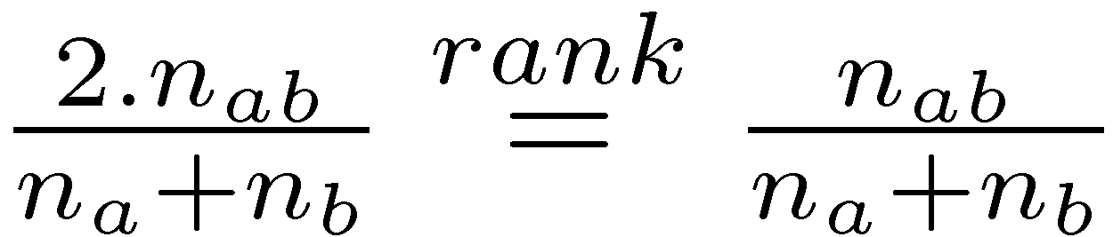
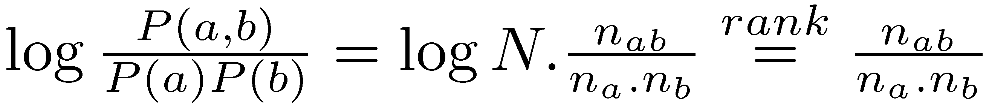
Term Association Measures
Dice’s Coefficient
Mutual Information

Slide 36
Term Association Measures
Mutual Information measure favors low frequency terms
Expected Mutual Information Measure (EMIM)
actually only 1 part of full EMIM, focused on word occurrence
Notes:
Full EMIM sums over the values a and b for random variables A and B

Slide 37
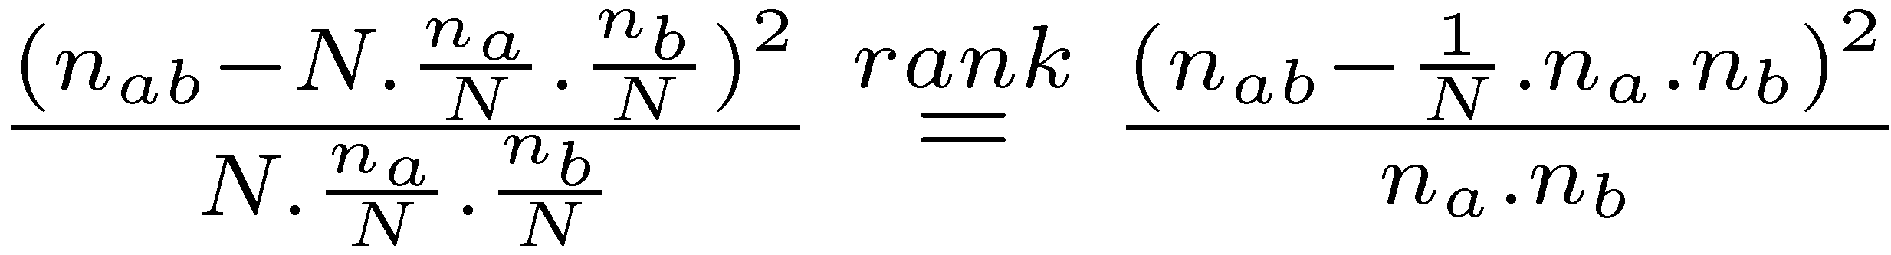
Term Association Measures
Pearson’s Chi-squared (χ²) measure
compares the number of co-occurrences of two words with the expected number of co-occurrences if the two words were independent
normalizes this comparison by the expected number
also limited form focused on word co-occurrence

Slide 38
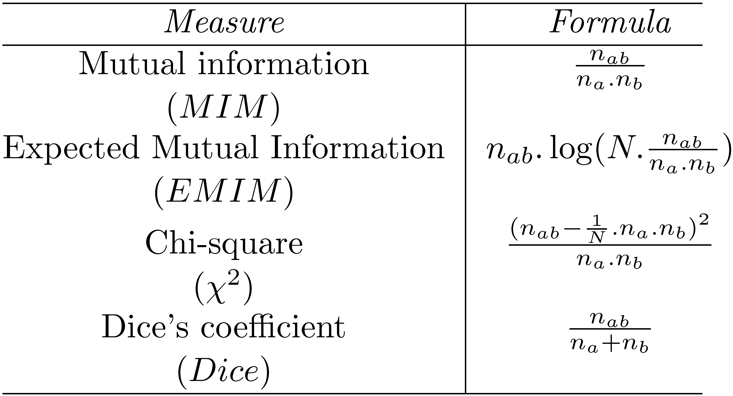
Association Measure Summary

Slide 39
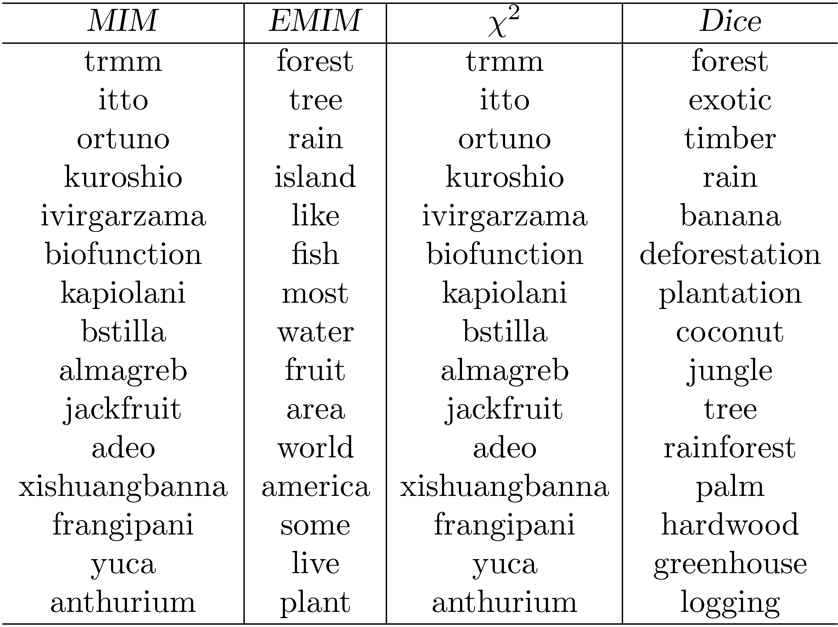
Association Measure Example
Most strongly associated words for “tropical” in a collection of TREC news
stories. Co-occurrence counts are measured at the document level.
Notes:
MIM and Chi: too specific (low frequency) terms
EMIM and Dice : general

Slide 40
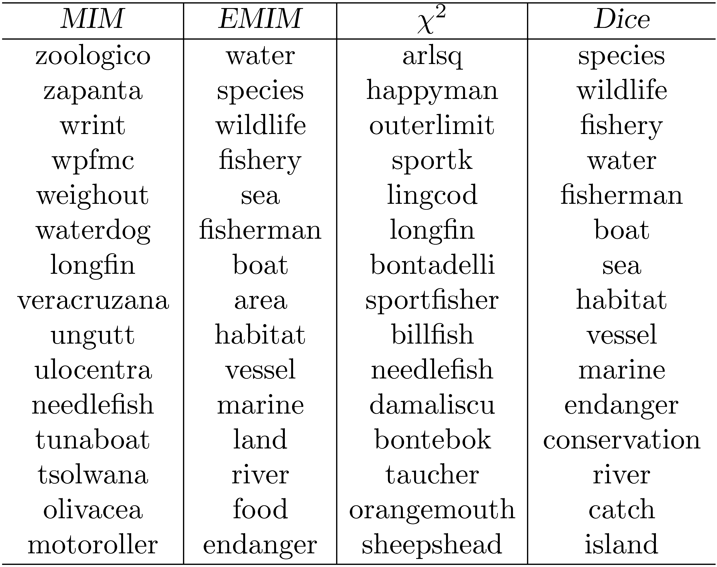
Association Measure Example
Most strongly associated words for “fish” in a collection of TREC news stories.
Co-occurrence counts are measured at the document level.

Slide 41
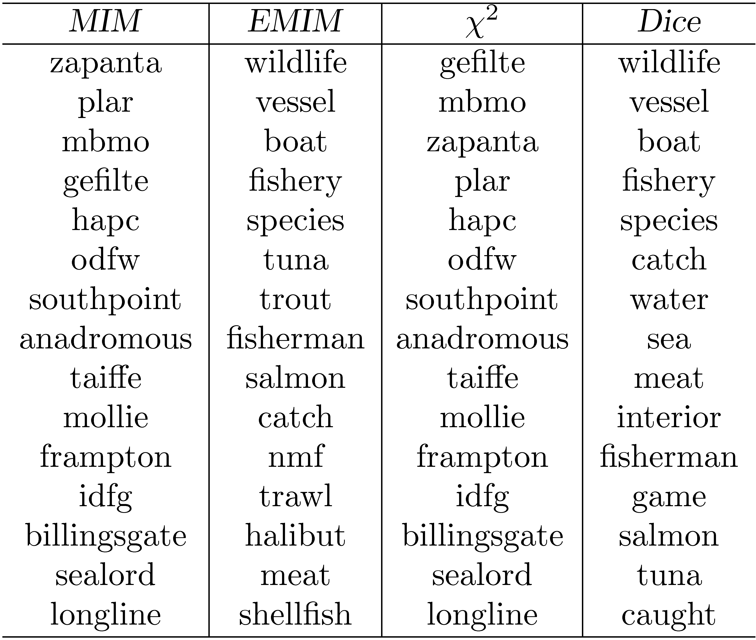
Association Measure Example
Most strongly associated words for “fish” in a collection of TREC news stories. Co-occurrence counts are measured in windows of 5 words.
Notes:
EMIM finds more specific terms
Dice is stable across window sizes

Slide 42
Association Measures
Associated words for “tropical” and “fish” are of little use for expanding the query “tropical fish”
Expansion based on whole query takes context into account
e.g., using Dice with term “tropical fish” gives the following highly associated words:
goldfish, reptile, aquarium, coral, frog, exotic, stripe, regent, pet, wet
Impractical for all possible queries (why?), other approaches used to achieve this effect

Slide 43
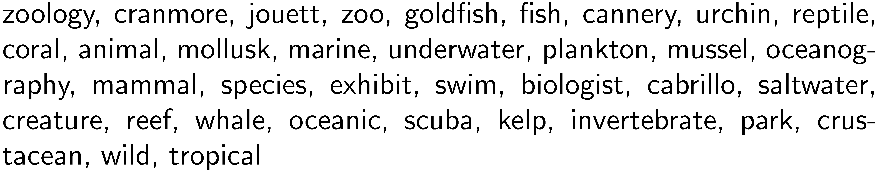
Other Approaches
Pseudo-relevance feedback
expansion terms based on top retrieved documents for initial query
Context vectors
Represent words by the words that co-occur with them
e.g., top 35 most strongly associated words for “aquarium” (using Dice’s coefficient):
Rank words for a query by ranking context vectors

Slide 44
Other Approaches
Query logs
Best source of information about queries and related terms
short pieces of text and click data
Query reformulation/expansion based on term associations in logs
e.g., most frequent words in queries containing “tropical fish” from MSN log:
stores, pictures, live, sale, types, clipart, blue, freshwater, aquarium, supplies
Query suggestion based on finding similar queries
group based on click data
Notes:
Group queries based on click data
Similarity measures like Dice’s measure
We can use graph structure to find related queries

Slide 45
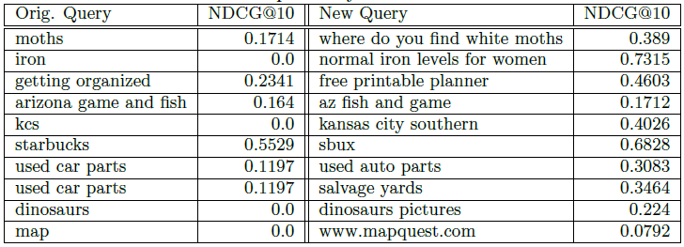
Query Suggestion using Logs

Slide 46
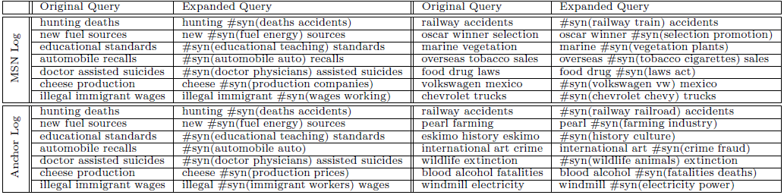
Query Reformulation using Logs

Slide 47
Query processing topics
Query reformulation
Stemming
Spell checking
Query segmentation
Expansion
Relevance feedback
Context
Result presentation
Snippet generation
Advertising
Clustering
Facets
Interfaces
Cross-language IR

Slide 48
Relevance Feedback
User identifies relevant (and maybe non-relevant) documents in the initial result list
System modifies query using terms from those documents and re-ranks documents
example of simple machine learning algorithm using training data
but, very little training data
Pseudo-relevance feedback just assumes top-ranked documents are relevant – no user input

Slide 49
Relevance Feedback Example
Top 10 documents
for “tropical fish”

Slide 50
Relevance Feedback Example
If we assume top 10 are relevant, most frequent terms are (with frequency):
a (926), td (535), href (495), http (357), width (345), com (343), nbsp (316), www (260), tr (239), htm (233), class (225), jpg (221)
too many stopwords and HTML expressions
Use only snippets and remove stopwords
tropical (26), fish (28), aquarium (8), freshwater (5), breeding (4), information (3), species (3), tank (2), Badman’s (2), page (2), hobby (2), forums (2)

Slide 51
Relevance Feedback Example
If document 7 (“Breeding tropical fish”) is explicitly indicated to be relevant, the most frequent terms are:
breeding (4), fish (4), tropical (4), marine (2), pond (2), coldwater (2), keeping (1), interested (1)
Specific weights and scoring methods used for relevance feedback depend on retrieval model
Notes:
The “Similar” option in google does the same thing
Search for “oil industry” and click “similar”
Doesn’t seem to be there any longer….

Slide 52
Relevance Feedback
Both relevance feedback and pseudo-relevance feedback are effective, but not used in many applications
pseudo-relevance feedback has reliability issues, especially with queries that don’t retrieve many relevant documents
Some applications use relevance feedback
filtering, “more like this”
Query suggestion more popular
may be less accurate, but can work if initial query fails
Notes:
Bad results if we have bad initial results
Query performance predictions
Get specific to some query aspects
“Apple” would go just to company
RF assumes initial relevant documents are not enough and user wants more documents
Not true for many web queries
Query suggestions assumes original query fails
More reasonable

Slide 53
Query processing topics
Query reformulation
Stemming
Spell checking
Query segmentation
Expansion
Relevance feedback
Context
Result presentation
Snippet generation
Advertising
Clustering
Facets
Interfaces
Cross-language IR

Slide 54
Context and Personalization
If a query has the same words as another query, results will be the same regardless of
who submitted the query
what other queries were submitted in the same session
where the query was submitted
These other factors (the context) could have a significant impact on relevance

Slide 55
User Models
Generate user profiles based on documents that the person looks at
such as web pages visited, email messages, or word processing documents on the desktop
Modify queries using words from profile
Generally not effective
imprecise profiles, information needs can change significantly
Privacy

Slide 56
Query Logs
Query logs provide important contextual information that can be used effectively
Context in this case is
previous queries that are the same
previous queries that are similar
query sessions including the same query
Query history for individuals could be used for caching or query transformation

Slide 57
Local Search
Location is context
Local search uses geographic information to modify the ranking of search results
location derived from the query text
location of the device where the query originated
e.g.,
“fishing supplies cape cod”
“fishing supplies” from mobile device in Hyannis

Slide 58
Local Search
Identify the geographic region associated with web pages
use location metadata that has been manually added to the document,
or identify locations such as place names, city names, or country names in text
Identify the geographic region associated with the query
10-15% of queries contain some location reference
Rank web pages using location information in addition to text and link-based features

Slide 59
Extracting Location Information
Type of information extraction
ambiguity and significance of locations are issues
Location names are mapped to specific regions and coordinates
Matching done by inclusion, distance
Notes:
Wasington :place or person
Springfield : matches 35 cities

Slide 60
Query processing topics
Query reformulation
Stemming
Spell checking
Query segmentation
Expansion
Relevance feedback
Context
Result presentation
Snippet generation
Advertising
Clustering
Facets
Interfaces
Cross-language IR

Slide 61
Snippet Generation
Query-dependent document summary
Simple summarization approach
rank each sentence in a document using a significance factor
select the top sentences for the summary
first proposed by Luhn in 50’s
Notes:
Related to query intention

Slide 62
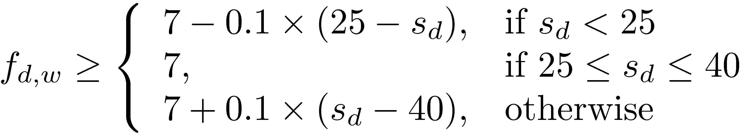
Sentence Selection
Significance factor for a sentence is calculated based on the occurrence of significant words
If f_{d,w} is the frequency of word w in document d, then w is a significant word if it is not a stopword and
where s_{d} is the number of sentences in document d
text is bracketed by significant words (limit on number of non-significant words in bracket)
Notes:
S_d=20 ➔ f= 6.5

Slide 63
Sentence Selection
Significance factor for bracketed text spans is computed by dividing the square of the number of significant words in the span by the total number of words
e.g.,
Significance factor = 4²/7 = 2.3
Notes:
Summarization approach
Query independent

Slide 64
Snippet Generation
Involves more features than just significance factor
e.g. for a news story, could use
whether the sentence is a heading
whether it is the first or second line of the document
the total number of query terms occurring in the sentence
the number of unique query terms in the sentence
the longest contiguous run of query words in the sentence
a density measure of query words (significance factor)
Weighted combination of features used to rank sentences

Slide 65
Snippet Generation
Web pages are less structured than news stories
can be difficult to find good summary sentences
Snippet sentences are often selected from other sources
metadata associated with the web page
e.g., <meta name="description" content= ...>
external sources such as web directories
e.g., Open Directory Project, http://www.dmoz.org
Structured pages like Wikipedia

Slide 66
Snippet Guidelines
All query terms should appear in the summary, showing their relationship to the retrieved page
When query terms are present in the title, they need not be repeated
allows snippets that do not contain query terms
Highlight query terms in URLs
Snippets should be readable text, not lists of keywords
Sometimes snippet can have extra information like an image

Slide 67
Query processing topics
Query reformulation
Stemming
Spell checking
Query segmentation
Expansion
Relevance feedback
Context
Result presentation
Snippet generation
Advertising
Clustering
Facets
Interfaces
Cross-language IR

Slide 68
Advertising
Sponsored search – advertising presented with search results
Contextual advertising – advertising presented when browsing web pages
Both involve finding the most relevant advertisements in a database
An advertisement usually consists of a short text description and a link to a web page describing the product or service in more detail

Slide 69
Online Advertising
Cost Per Mille (CPM) / Cost Per Impression (CPI)
Advertisers pay for exposure (view) of their message to a specific audience
Per Mille means per thousand impressions (or number of times an ad loads on the page)
Useful when user education is most important
Cost Per Click (CPC) / Pay Per Click (PPC)
Advertisers only pay when a user clicks the ad and is directed to the website
Useful when user destination is most important
Current approach in search engines

Slide 70
Searching Advertisements
Factors involved in ranking advertisements
similarity of text content to query
bids for keywords in query
popularity of advertisement
general popularity
query-specific popularity
goal is to maximize the expected profit
Small amount of text in advertisement
dealing with vocabulary mismatch is important
expansion techniques are effective
Notes:
Ranking can be done with different factors:
Based on bid: bad relevance, users unsatisfied
Based on relevance: might not maximize profit
Based on bid and relevance and expected clicks ..

Slide 71
Example Advertisements
Advertisements retrieved for query “fish tank”
Notes:
1 and 5 : exact match
3: partial match
2: related terms, retrieved by expansion
4: probably because of bids and popularity

Slide 72
Searching Advertisements
Query reformulation based on query log
queries in a same session
50% reformulation in query sessions
Pseudo-relevance feedback
expand query and/or document using the Web
use ad text or query for pseudo-relevance feedback
rank exact matches first, followed by stem matches, followed by expansion matches

Slide 73
Contextual Advertising
Generating a query from the page
Term selection
similar to sentence selection
significance factors
classification algorithms
term-level features, e.g, collection frequency, query log frequency, term positions, …

Slide 74
Query processing topics
Query reformulation
Stemming
Spell checking
Query segmentation
Expansion
Relevance feedback
Context
Result presentation
Snippet generation
Advertising
Clustering
Facets
Interfaces
Cross-language IR

Slide 75
Organizing Search Results
Meaningful grouping can help users to understand the results
Clustering
Faceted Categories

Slide 76
Clustering Results
Result lists often contain documents related to different aspects of the query topic
Clustering is used to group related documents to simplify browsing
Example: http://clusty.com/
Example clusters for
query “tropical fish”

Slide 77
Result List Example
Top 10 documents
for “tropical fish”

Slide 78
Clustering Results
Automatic
Can reveal new trends in data
e.g., after an event
Useful for vague or ambiguous queries

Slide 79
Clustering Requirements
Efficiency
must be specific to each query and are based on the top-ranked documents for that query
typically based on snippets
Easy to understand
Can be difficult to assign good labels to groups
Monothetic vs. polythetic clustering/classification
Notes:
Snippets
Short
Query-specific

Slide 80
Types of Clustering
Monothetic
every member of a class has the property that defines the class
typical assumption made by users
easy to understand
preferred in search result clustering
Polythetic
members of classes share many properties but there is no single defining property
most clustering algorithms (e.g. K-means) produce this type of output

Slide 81
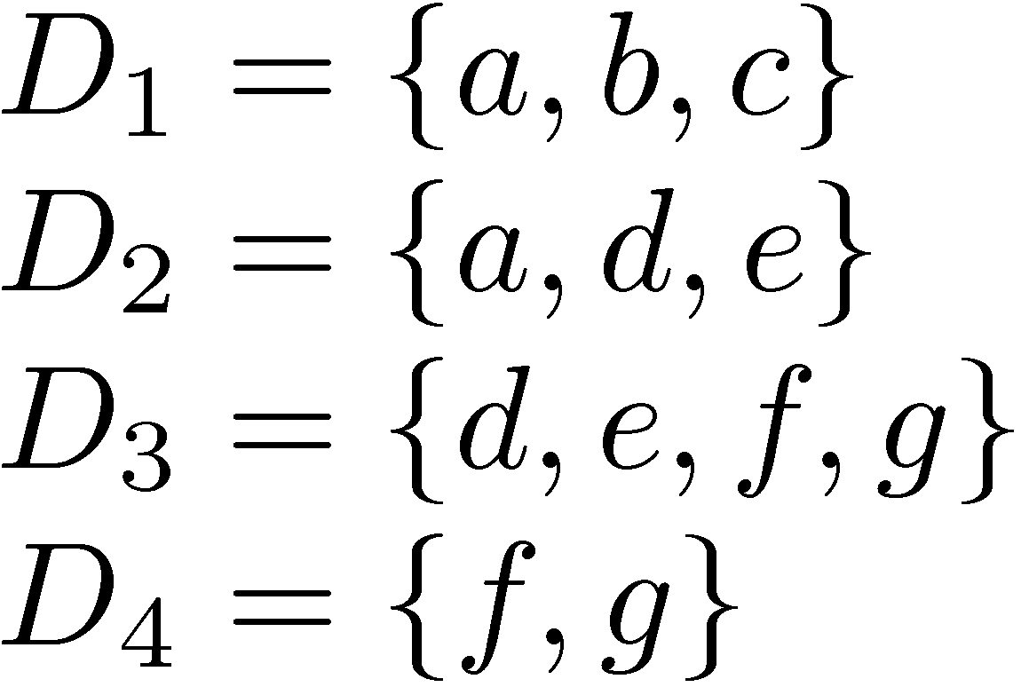
Classification Example
Possible monothetic classification
a and e are significant terms
{D₁,D₂} (labeled using a) and {D₂,D₃} (labeled e)
Possible polythetic classification
{D₂,D₃,D₄}, D₁
labels?

Slide 82
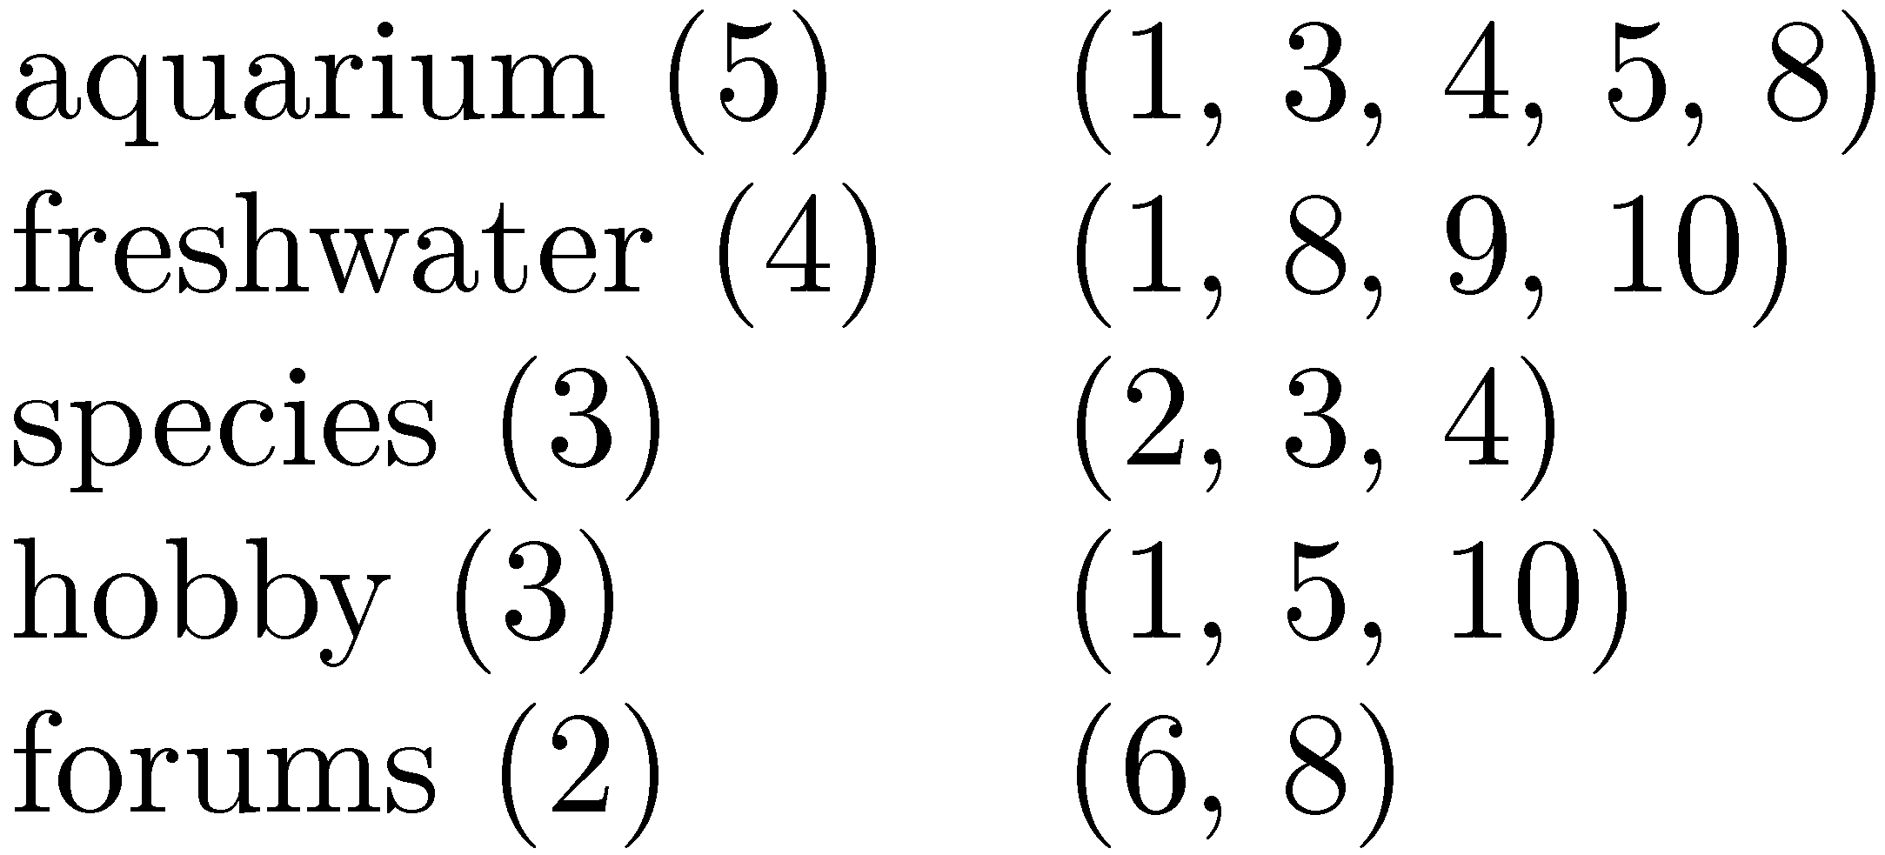
Result Clusters
Simple algorithm
group based on words in snippets
Refinements
use phrases
use more features
whether phrases occurred in titles or snippets
length of the phrase
collection frequency of the phrase
overlap of the resulting clusters,

Slide 83
Query processing topics
Query reformulation
Stemming
Spell checking
Query segmentation
Expansion
Relevance feedback
Context
Result presentation
Snippet generation
Advertising
Clustering
Facets
Interfaces
Cross-language IR

Slide 84
Faceted Classification
A set of categories, usually organized into a hierarchy, together with a set of facets that describe the important properties associated with the category
Manually defined
potentially less adaptable than dynamic clustering
Easy to understand
commonly used in e-commerce

Slide 85
Example Faceted Classification
Categories for “tropical fish”

Slide 86
Example Faceted Classification
Subcategories and facets for “Home & Garden”

Slide 87
Query processing topics
Query reformulation
Stemming
Spell checking
Query segmentation
Expansion
Relevance feedback
Context
Result presentation
Snippet generation
Advertising
Clustering
Facets
Interfaces
Cross-language IR

Slide 88
Visualization in Search Interfaces
Visualizing query terms in retrieved documents
Highlighting terms
Plotting term positions
Visualizing relation between terms
Visualizing relation between documents
Domain-specific visualization
Visualizing relation between authors in people search
Notes:
Plotting as in graphing, for example showing where the query terms are in the document

Slide 89
Design and Evaluation of Interfaces
A field of Human Computer Interaction (HCI)
Studies how people think about, respond to, and use technology
The quality of interface is determined by people responses
Subjective measures
Speed, familiarity, preferred features, …
Studying new features on a random subset of users and comparing their actions

Slide 90
Query processing topics
Query reformulation
Stemming
Spell checking
Query segmentation
Expansion
Relevance feedback
Context
Result presentation
Snippet generation
Advertising
Clustering
Facets
Interfaces
Cross-language IR

Slide 91
Cross-Language Search
Query in one language, retrieve documents in multiple other languages
Involves query translation, and probably document translation
Query translation can be done using bilingual dictionaries
Document translation requires more sophisticated statistical translation models
similar to some retrieval models

Slide 92
Two Approaches
Query translation
Translate English query into Chinese query
Search Chinese document collection
Translate retrieved results back into English
Document translation
Translate entire document collection into English
Search collection in English
Translate both?

Slide 93
Query Translation
Chinese Document
Collection
Chinese
documents
Retrieval
Engine
Results
Translation System
Chinese
queries
select
examine
English
queries

Slide 94
Document Translation
Chinese Document
Collection
Translation
System
Results
select
examine
Retrieval
Engine
English
queries
English Document
Collection

Slide 95
Tradeoffs
Query Translation
Often easier
Disambiguation of query terms may be difficult with short queries
Translation of documents must be performed at query time
Document Translation
Documents can be translated and stored offline
Automatic translation can be slow
More context for translation accuracy
Which is better?
Often depends on the availability of language-specific resources
Both approaches present challenges for interaction

