Slide 1
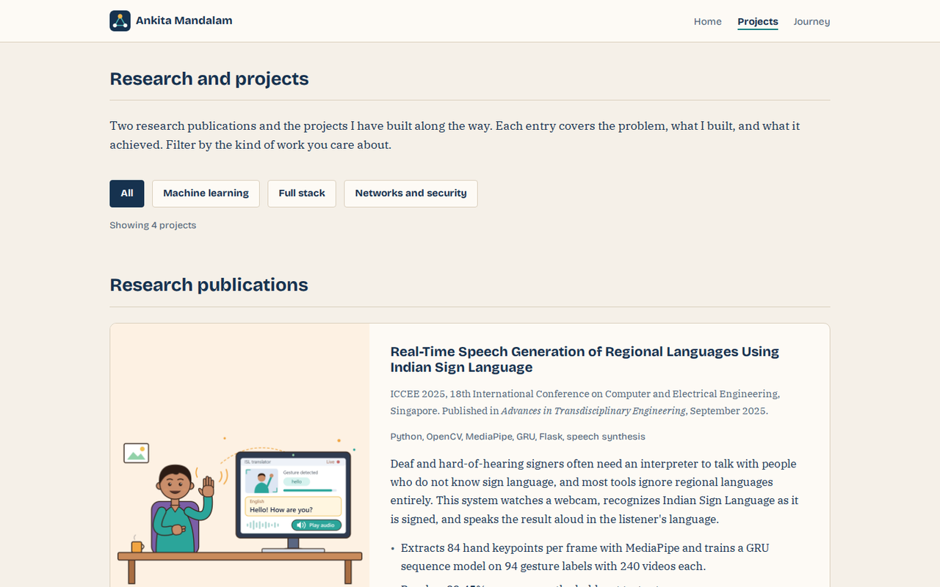
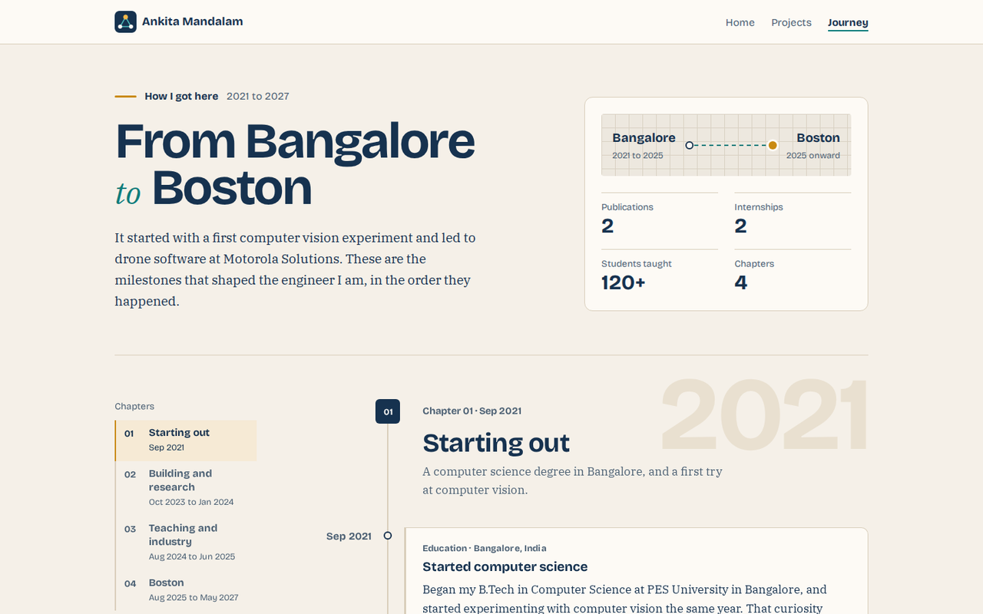
CS 5610 Web Development · Project 1
Ankita Mandalam
Personal Portfolio
MS Computer Science, Northeastern University
ankitam389.github.io/ankita-portfolio
Notes:
Hi, I'm Ankita Mandalam, a master's student in computer science at Northeastern University. This is my personal portfolio, built for Project 1 of CS 5610 Web Development.

Slide 2



The problem
One page can't show everything I've built.
Home
Who am I?
Two internships, two research papers, and four projects, across full-stack engineering, data, and machine learning. A resume can list them. It can't show them.
Projects
What have I built?
So the portfolio tells the story in three pages, each answering one question.
Journey
How did I get here?
Notes:
A resume gives me one page, and my work doesn't fit on one page. Over the last few years I've done two internships, published two research papers, and built projects across full-stack engineering, data, and machine learning. A resume can list those things, but it can't show them. So I split my story into three pages, each answering one question: who am I, what have I built, and how did I get here.

Slide 3



Who it's for
Maya
David
Priya
Technical recruiter
Engineering manager
IoT security researcher
Needs the basics fast: degree, graduation date, and job target, without scrolling.
Needs evidence of full-stack work, and a way to filter projects to find it.
Needs publications with venue and DOI, full keyboard access, and reduced motion.
Notes:
I designed for three visitors. Maya is a recruiter with two minutes, so my degree, graduation date, and job target sit at the top of Home. David is an engineering manager looking for full-stack work, so projects have real detail and a filter. And Priya is a researcher who uses the keyboard and prefers reduced motion, so every interaction works without a mouse and respects that setting.

Slide 4
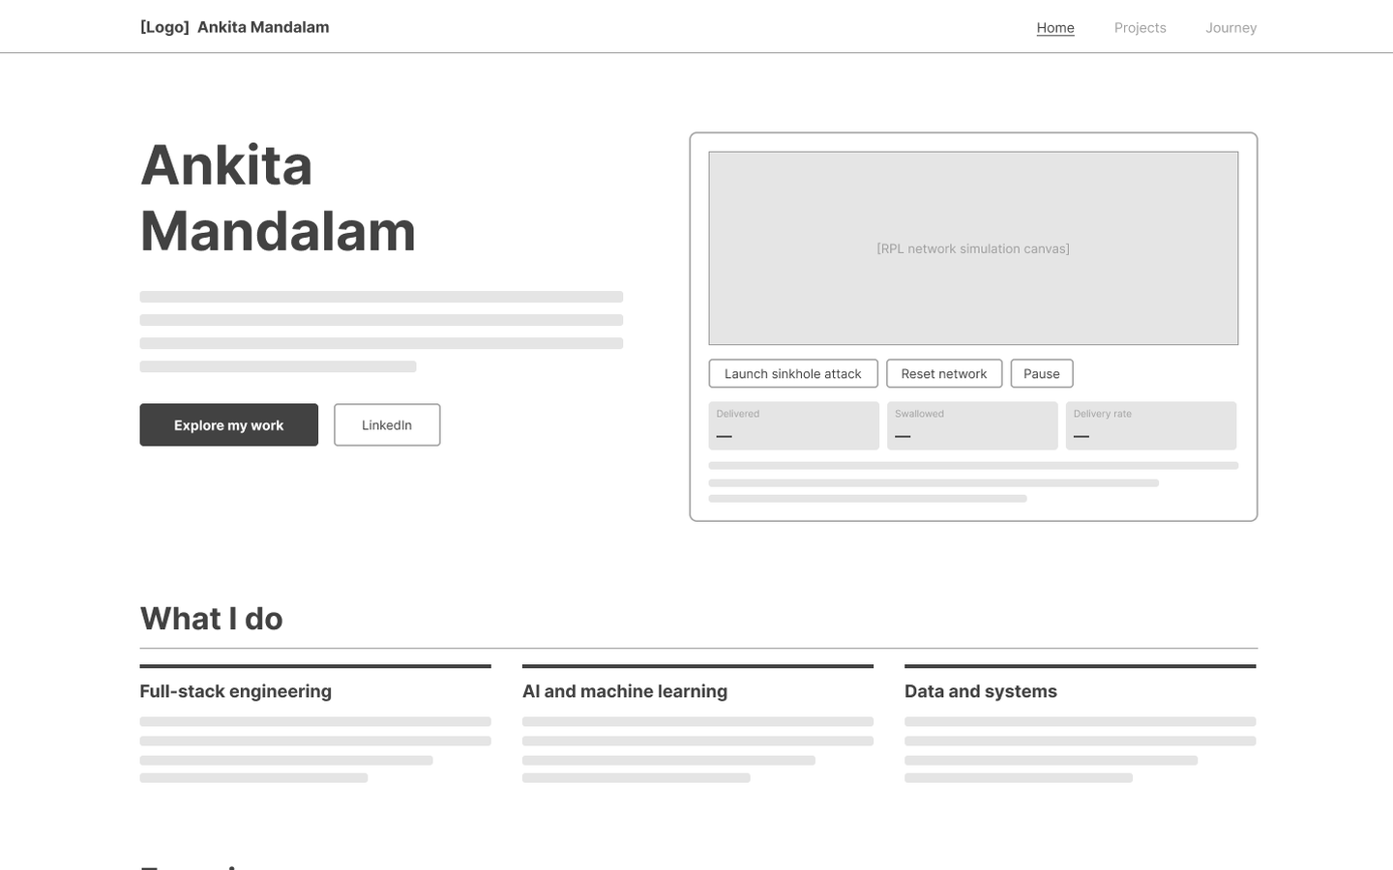
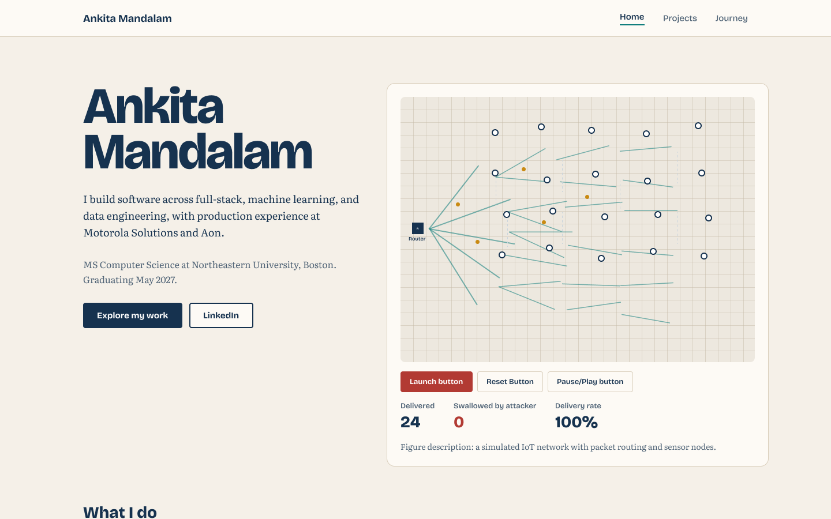
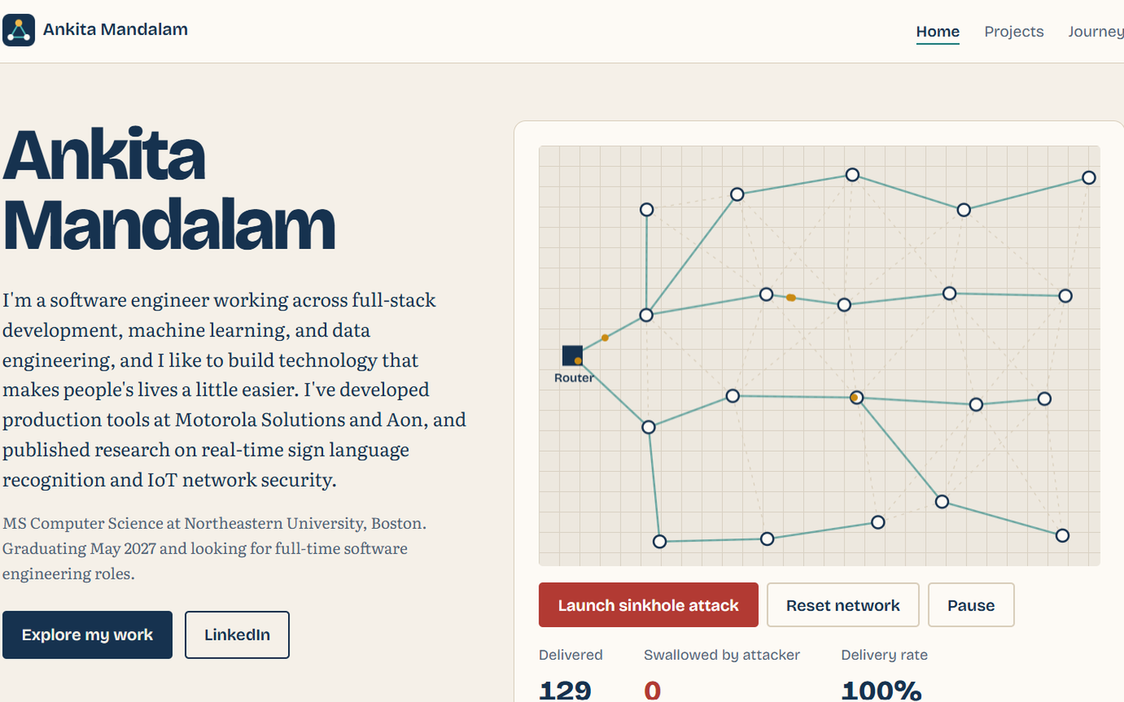
Design process
1 Wireframe
2 Figma mockup
3 Built page
Structure first
Look and feel
HTML, CSS, and JavaScript
The Home page at each stage
Notes:
Each page went through the same three steps: a low-fidelity wireframe to settle the structure, a high-fidelity mockup in Figma for the look and feel, and then the build. Here's the Home page at each stage.

Slide 5





How it's built
The stack
Under the hood: the simulation
Vanilla HTML5, CSS3, and ES6 modules, no frameworks
440+
Flexbox and CSS Grid layouts
lines of JavaScript, no libraries
ESLint, Prettier, and W3C validated
A seeded layout, so the network looks the same on every visit
Breadth-first search to rank each sensor's route to the router
Canvas rendering, with a text description for screen readers
Semantic HTML, keyboard access, reduced motion
Deployed on GitHub Pages
Next: a live tour of the portfolio
Notes:
The whole site is vanilla HTML, CSS, and JavaScript modules, with no frameworks. Layouts use Flexbox and CSS Grid, the code passes ESLint, Prettier, and the W3C validator, and it's deployed on GitHub Pages. The part I'm proudest of is the network simulation on the Home page: over 440 lines of my own JavaScript. It uses a seeded layout, so the network looks the same on every visit, breadth-first search to work out each sensor's route to the router, and canvas rendering with a text description for screen readers. Let me show you how it all comes together.

