Slide 1
REST APIs

Slide 2
Protocol:
Message format that can be understood by both client/server
SOAP has SOAP protocat
What about REST?
It has NONE
Can be XML, Json, Text
Service Definition
SOAP has WSDL
REST has none.
No SPECS

Slide 3
Its an architectural styles.
Set of guidelines
REST + Web Services = RESTful services
Some of the concepts of HTTP apply to REST
HyperText has HyperLinks i.e text that points to other links
Resource based URIs
HTTP methods
HTTP status codes
Message Headers/ Content Type
Same api could return both xml and json

Slide 4
PUT vs POST
PUT → update existing resource
POST → create new resource
GET, DELETE, PUT → repetable/idempotent
POST → not idempotent
i.e every duplicate call with same params create new resource
Client caches GET response as GET is idempotent
Choose the right method for client safeguard
eg. if on browser submit button GET is used, it can click refresh multiple time
if form submit, then use POST, to give message like “this might be a duplicate call”

Slide 5
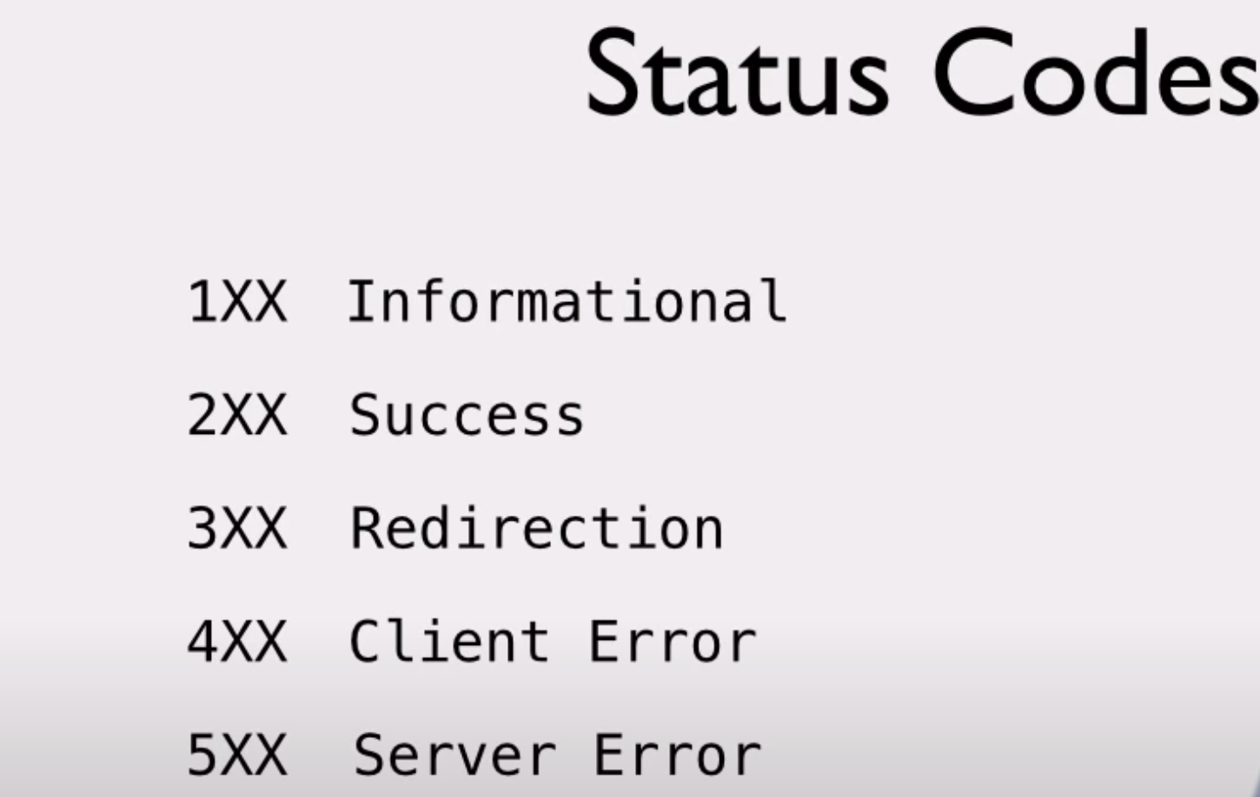
200- success/OK
201- created
404 – not found

Slide 6
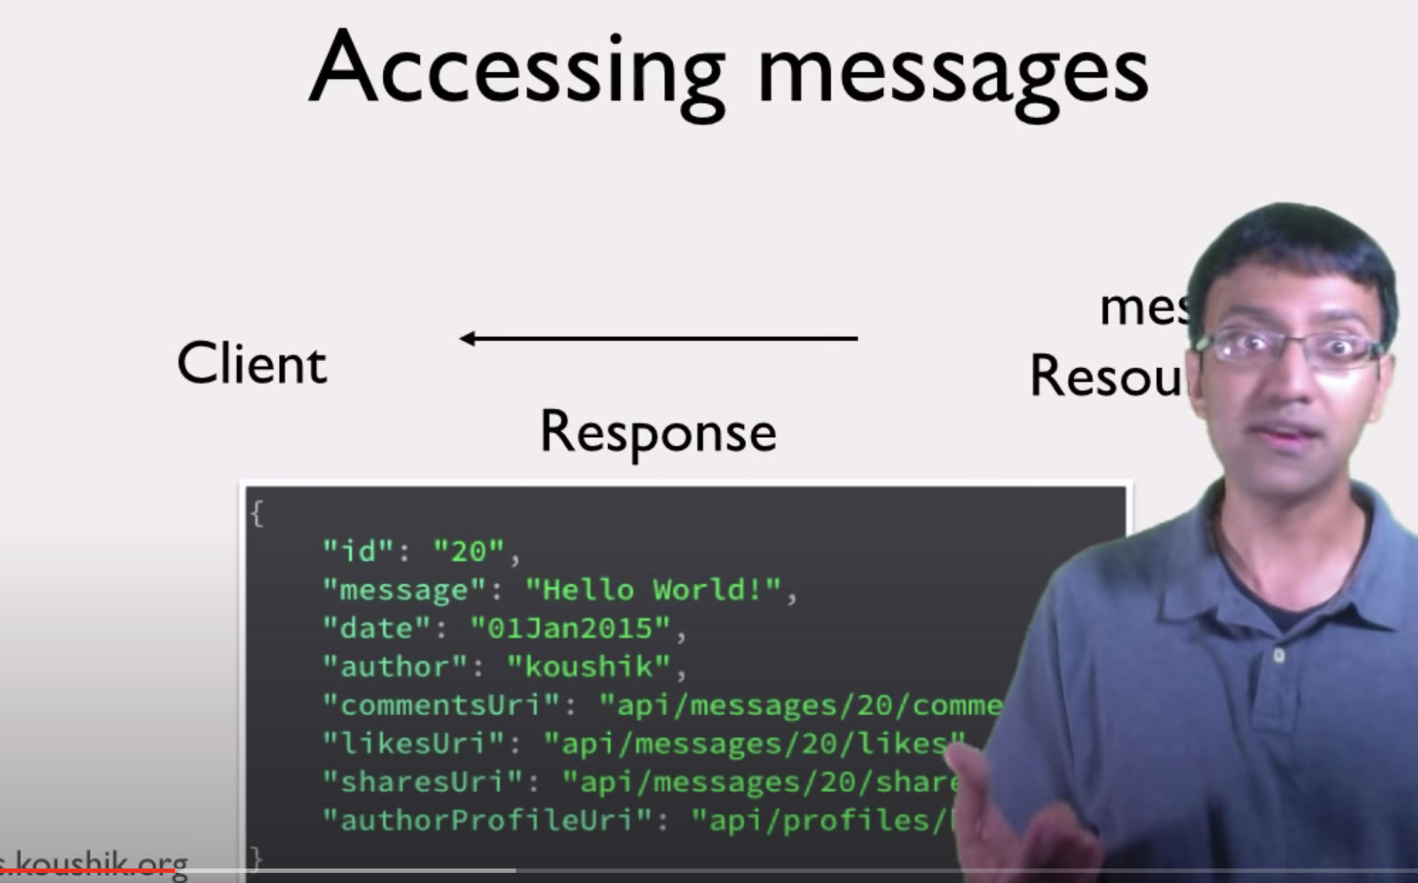
HATEOAS
Client send request to get Message ID
Server alsong with Message id and the message, it also send other api info like likes, comments etc api resource location in its response
to use them or not is upto the client

Slide 7
GET
@Path("/learnGET")
public class GetApis {
@GET
@Produces("application/xml")
public String sayHelloXML() {
String ret = "<?xml version=\"1.0\">"
+"Hello From XML";
return ret;
}
@GET
@Produces(MediaType.APPLICATION_JSON)
public String sayHelloJSON() {
JSONObject jsonObject = new JSONObject();
jsonObject.put("JSON", "Hello From JSON!");
String ret = "Greetings" + jsonObject;
return ret;
}
@GET
@Produces(MediaType.TEXT_PLAIN)
public String sayHelloPlain() {
return "Hello from plain text!";
}
}

Slide 8
I am giving one exapmle to undersand when do we use @Queryparam and @pathparam
For example I am taking one resouce is carResource class
If you want to make the inputs of your resouce method manadatory then use the param type as @pathaparam, if the inputs of your resource method should be optional then keep that param type as @QueryParam param
@Path("/car")
class CarResource {
@Get @produces("text/plain")
@Path("/search/{carmodel}")
public String getCarSearch(@PathParam("carmodel") String model,@QueryParam("carcolor")String color) {
//logic for getting cars based on carmodel and color ----- return cars
}
}

Slide 9
Exception
1. Jersey ExceptionMapper – Create custom exceptions
To handle custom exception in JAX-RS based web services, you should create an exception class and then implement the ExceptionMapper interface.

Slide 10
@Produces @Consumes
Produces and Consumes annotations are used for sharing theContent-Type and Accept headers information respectively with your webservice users.
Content-type header will help the receiver/consumer of your service, to treat the response as per the information in that header. If you mark the value of content-type header as application/json, then receiver can accordingly use a json parser.
Similarly, using the Consumes, you are assuring that Accept header is application/json so that you can do the json parsing/unmarshalling accordingly.

Slide 11
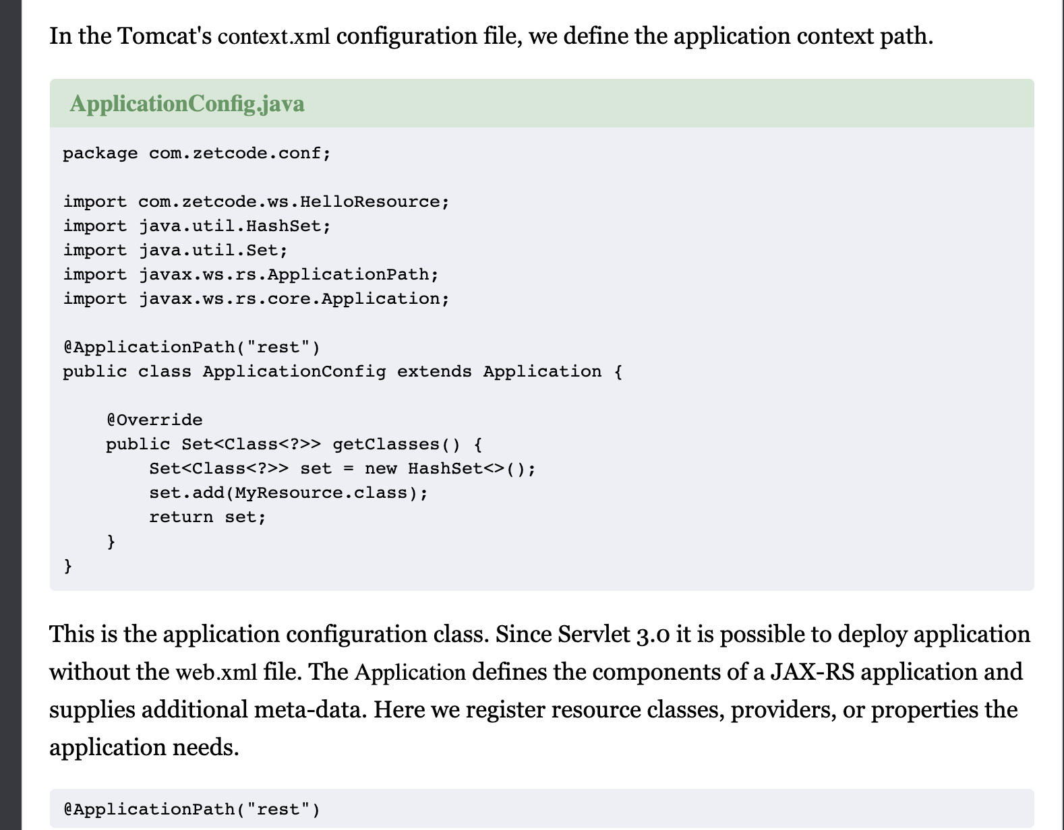
Application Path

Slide 12
Jersey implementation throws '404 Not Found' exception, when a path param is not being used on the client side for GET and ‘400’ Bad Request for POST
Unfortunately (or maybe fortunately) there is no mechanism in JAX-RS to make any params mandatory. If a parameter is not supplied it's value will be NULL and your resource should deal with it accordingly. I would recommend to use WebApplicationException to inform your users:
@GET
@Path("/some-path")
public String read(@QueryParam("name") String name)
{
if (name == null) {
throw new WebApplicationException( Response.status(Response.Status.BAD_REQUEST) .entity("name parameter is mandatory") .build() );
} // continue with a normal flow }

