Slide 1
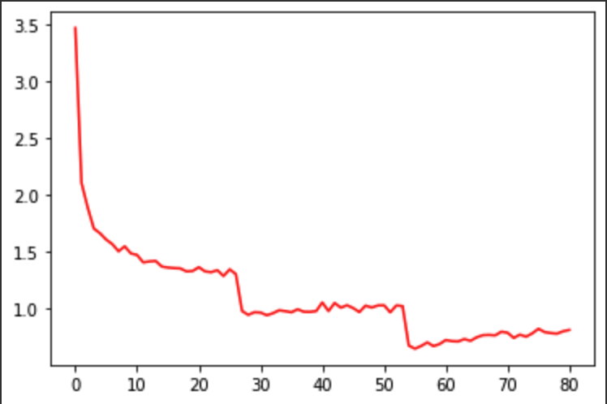
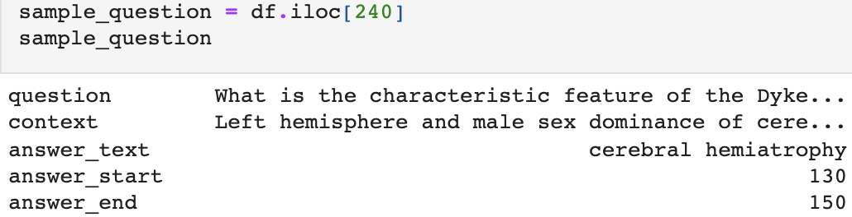
Question Answering model on different domains
Authors: Anand Ankit, Zi-Min Weng
University of Alabama at Birmingham
Intorduction:
In the recent years, the natural language processing (NLP) has been implemented in different application. Question-answering is a major application of NLP.
A QA models read the paragraph and questions and predict the correct terms.
There are numerous information on the Internet, people heavily rely on search engine to seek the information on the Internet to solve their problems. It is the importance of the QA models that automatically find the answers which the user want. Therefore, We implement two question-answering models,T5 and DistilBert and also train on several datasets.
Methodology :
For each paragraph, We use T5Tokenizer and DistilBertTokenizerFast from huggingface transformer package to separate every words in the context. In addition, the context and question are concatenated to encoding. For T5 model, we set the batch size to 4, learning rate to 1e-4, number of epoch to 5. For DistilBert model, we set the batch size to 32, learning rate to 5e-5, number of epoch to 3.In training part, we implement T5 model in Pytorch-lightening and DistilBert models in Pytorch and use GPU to accelerate the training procedure. The approximate time for training a model is 2 hours for Pytorch and 30 minutes for Pytorch-lightening.
Furthermore, we experimentally apply the BioASQ dataset on T5 model which is trained on SQuAD2.0.
Results :
Both the loss of T5 and DistilBert models decrease while training. The best T5 models are saved with the loss 0.2267 on SQuAD2.0 and 0.1217 on BioASQ.
Datasets:
We used BioASQ and SQuAD2.0 as our dataset. Each paragraph consists of question, context, answer_text, answer_start and answer_end. In BioASQ, 2065 paragraphs are extracted for training, 517 for validation. In SQuAD2.0, 602 paragraphs are extracted for training , 151 for validation.
Figure[2]:training loss curve of DistilBert
Reference :
https://analyticsindiamag.com/guide-to-question-answering-system-with-t5-transformer/
https://huggingface.co/transformers/custom_datasets.html
Figure[1]:an example in BioASQ dataset
uab.edu

Slide 2
Question Answering model on different domains
Authors: Anand Ankit, Zi-Min Weng
University of Alabama at Birmingham
Github Link:
https://github.com/elite7358/Question-answering-project
Contribution:
Ankit:
T5 model training and validation on BioASQ,
Merge the SQuAD2.0 dataset into T5 model,
Help Zi-Min on decoder part of DistilBert model.
Modified the code on Github
Zi-Min:
DistilBert model training and validation on SQuAD2.0
Poster and Github README
uab.edu

