Slide 1
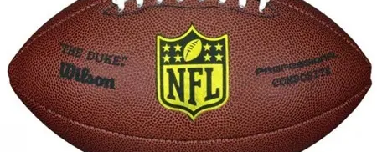
Analysis
NFL Players Careers

Slide 2

The Team
Tejas Desai
Ankita Patel
Amy Peters
Mamtha Sharma
Notes:
We call ourselves Charlie’s Angles

Slide 3
Project Inspiration
Something fun
Touches everyone’s life
Interests majority of people
Notes:
Talking Points
The Chicago Bears football season was just underway – it was a current topic in the media, Niki wears her Bears jacket to class each week
So our team decided to focus our project on the NFL
We were interested in exploring the relationship between career length and Hall of Fame eligibility
After nominating the team Git Hub Master, we decided to use data to address these questions:

Slide 4
The Head-Scratchers…
What criteria would be best used to predict future Hall of Fame candidates?
What does it mean when they say a player’s career was cut short?
Notes:
What criteria could be used to predict a future Hall of Fame candidate?
What does it mean when they say a player’s career was cut short?

Slide 5
DATA SOURCES EXPLORED AND REJECTED
KAGGLE – Combined NFL Data
NFLSavant.com
NFL.com
Statistica
Notes:
In our search for usable data we explored the usual haunts for Data Nerds. And we found:
Kaggle data was incomplete because the player data did not come with the positions they played
NFL Savant was a good source and we began work on it but rejected after some data validation checks turned up dead players playing between 2000-2010
We gave up on NFL.com after several attempts because api key wasn’t free
Statistica data, like Kaggle did not have all the information we needed to use.

Slide 6

DATA SOURCE
https://www.pro-football-reference.com/play-index/psl_finder.cgi
Notes:
In the end, Pro football reference was the only source with data that we could wrangle to make a complete data set.
So we used the data from this source although it had limitations that we will be talking about later in our presentation

Slide 7
DATA WRANGLING
Stage 1
Download Data
Stage 2
Structure and format data
Stage 3
Validate and quality check
Notes:
Data downloadi required some knowledge of the game to be able to get appropriate data groupled by the playing position
Once the data was formatted to a csv file, we went through the process of merging data for 4 playing positions but decided that the data would be more usable as separate files.
We divided the analysis of 4 positions between the 4 team members and pushed our work into Git Hub.
As the Git Master, I managed this process.
We did around 10% quality check on our final data to ensure data quality

Slide 8
Snippet of code
Initially for loop was used to extract * (HOF) players.
for row in range(te_data_df.shape[0]):
if te_data_df.loc[row,'Player'][-1] == '*':
te_data_df.loc[row,'hof'] = 1
else:
te_data_df.loc[row,'hof'] = 0
te_data_df.head()
for loop was replaced with simple command line below.
hof_qb = nfl_data_df[nfl_data_df['Player'].str.contains('\*')]
Notes:
This is a small snippet of out code where We extracted HoF players into a separate DF to compare and contrast their records with the current players. We tried to improve our code by sticking to the DRY principle as much as time permitted.
**Add to this if you think there is something else you want to cover.

Slide 9
Data Limitiations
The data sources available for free have been incomplete or unreliable
The data we worked with had limitations in only picking data from our cut off date of 1989. As a result, players’ data prior to 1989 has been left out and some HoF players are outliers in our plots
Notes:
As this data we used was free, it came with some limitations. When we grabbed data from 1989 to 2019 (30 yrs) the filtering mechanism that provided this data ignored the pre-1989 records.
As a result we have some outliers in our plots. This data is something we would have completed given some more time.
Free data sources at first glance contained good information but then proved unreliable

Slide 10
Question
What criteria sets apart players to be nominated to the Hall of Fame?
Notes:
Selection process for HoF is very involved process but the exact criteria which goes in selection of player in to HOF is not known.
As we learnt more about the game, we wanted to analyse the player records to arrive at a set of criteria that could possibly identify which of the current players are on track to be nominated for this honor
Based on our hypothesis the 3 criteria we identified that affected a players chances are: a) number of seasons played b) Num of yards gained c) number of passing touchdowns.

Slide 11
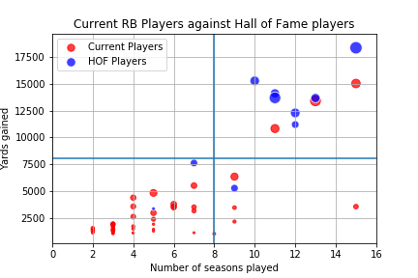
Emmit Smith 1990-2004
Frank Gore
2005-Present
Notes:
The blue dots in lower quadrants are the outliers in this plot because of the data limitiations we talked about earlier
Q1 not possible to have someone reach these yards in the short amount of time they played
Players in the q3, its is too soon to tell because they have not played adequate number of seasons.
This plot can predict that the players in q4 are unlikely to meet the requirements to be considered for hof
The players in q2 on the other hand have met/exceeded the criteria and are most likely to be considered for Hof nominations
Please note the size of the circles corresponds to the number of TDs

Slide 12
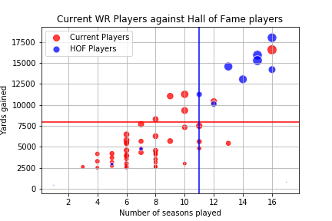
Jerry Rice
1989-2004
Larry Fitzgerald
2004-Present

Slide 13
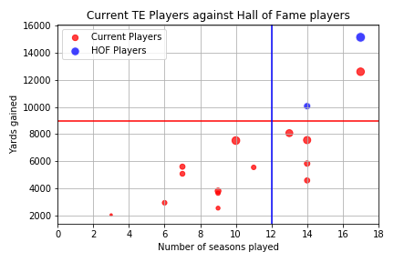
Tony Gonzales
1997-2013
Jason Witten
2003-Present

Slide 14
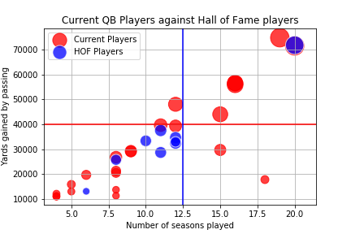
Brett Favre
1991-2010
??

Slide 15
Question
What does it mean when they say a player’s career was cut short?
Notes:
This is a statement we hear a lot when Football fans discuss players. We wanted to delve into what this question actually means with some solid analysis to back it up

Slide 16
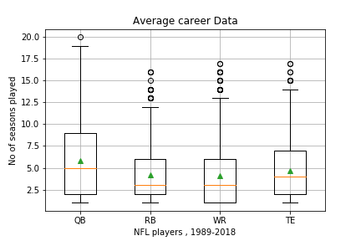
Summary Table
No of Season (Years) | St. Deviation | Mean | Median | 25th Percentile | 75th Percentile | IQR
QB | 4.43 | 5.78 | 5.00 | 2.00 | 9.00 | 7.00
RB | 3.12 | 4.21 | 3.00 | 2.00 | 6.00 | 4.00
WR | 3.31 | 4.11 | 3.00 | 1.00 | 6.00 | 5.00
TE | 3.43 | 4.63 | 4.00 | 2.00 | 7.00 | 5.00
Notes:
This plot is an attempt at understanding players career length going back 30 years.
We believed a box plot would show all the information we needed to understand what players careers look like grouped by the position they played.
As we can see in this plot QB’s enjoy a longer career comparatively to players in other positions.
This can be attributed to the fact that they don’t take as many hits being protected by the big, burly defense players.
Also, a QB role is more strategic so a seasoned, mature thinking with experience is an asset in this position.
Based on our analysis, the median for the number of seasons played by a QB was 4.5. So we conclude a QB who plays less than 4.5 seasons has had his career cut short
Following similar logic our analysis concludes that for RBs and WRs any player who played less than 3 seasons had his career cut short
For a TE the data suggests that anyone who plays less than 4 seasons has had his career cut short
There are of course outliers in our plots who have outperformed the other players.

Slide 17
Conclusions
Hall of Fame predictors for the offensive line positions RB, WR & TE would be recording over 8,000 yards gained and playing at least 7-9 seasons.
Hall of Fame predictors for the QB positions would be recording over 30,000 yards passing and playing at least 11 seasons.
Number of seasons played is highly correlated to the total yards gained
If the QB position did not reach the median of 5 season’s then their career could be considered cut short.
Seasons were cut short for WR & RB at 3 seasons and TE at 4 seasons
Notes:
Hall of Fame predictors for the offensive line positions RB, WR & TE :
Played at least 9 seasons
Recorded over 8,000 yards gained
Scored between 6-8 touchdowns per season
Hall of Fame predictors for QB are:
Played at least 11 seasons
Recorded over 30,000 yards
Threw for 10-15 touchdowns per season
Based on the analysis, if the player did not reach the median # of season, then their career was cut short.
QB – 5 seasons
WR, RB – 3 seasons
TE – 4 seasons

Slide 18
Conclusions
These Analysis and Calculations can be applied to all positions
These Analysis and Calculations can be applied to all players

