Slide 1

Data Science Capstone Project Report
SpaceX Falcon 9 First-Stage Landing Prediction
Ankita Choudhary
09.07.2026
GitHub Repository:
github.com/ankitarchoudhary/IBM-Data-Science-Capstone

Slide 2
Executive Summary
90
66.7%
94.4%
Launches Analyzed
Overall Success Rate
Best Model Accuracy
Methods Used
Key Results
Data collection: SpaceX REST API + Wikipedia web scraping
Data wrangling: derived binary landing outcome label
EDA: Matplotlib/Seaborn visualization + SQL queries
Interactive analytics: Folium map + Plotly Dash dashboard
Predictive modeling: 4 classification algorithms, tuned with GridSearchCV
KSC LC-39A: highest site success rate (77.3%)
GTO orbit: most common, but lowest success rate (51.9%)
Success rate rose from 0% (2013) to ~90% (2019)
KNN model: best predictor at 94.4% test accuracy
Zero false negatives in the best model's test predictions
GitHub Repository: github.com/ankitarchoudhary/IBM-Data-Science-Capstone

Slide 3

Introduction
Project Background
SpaceX advertises Falcon 9 launches at a fraction of the cost charged by other providers, largely because it reuses the first stage instead of discarding it after every flight. If the outcome of a landing attempt can be predicted from launch conditions, that prediction can be used to estimate launch cost. This project collects, explores, and models real Falcon 9 launch data to make that prediction.
Problem Statement
How do payload mass, launch site, and orbit affect first-stage landing success?
Has the landing success rate improved over time?
Which classification algorithm predicts landing outcome most accurately?
GitHub Repository: github.com/ankitarchoudhary/IBM-Data-Science-Capstone

Slide 4

Data Collection - SpaceX API
Structured JSON launch data retrieved directly from the SpaceX REST API.
GET request to the /launches endpoint
Parse JSON response into a DataFrame with pd.json_normalize()
Resolve rocket, launchpad, payload, and core IDs via follow-up API calls
Filter to single-core Falcon 9 launches only
Fill missing PayloadMass values with the column mean
Export to dataset_part_1.csv
GitHub Repository: github.com/ankitarchoudhary/IBM-Data-Science-Capstone

Slide 5

Data Collection - Web Scraping
Supplementary launch data scraped from the Wikipedia list of Falcon 9 and Falcon Heavy launches.
Request a fixed, archived Wikipedia revision (for reproducibility) with BeautifulSoup
Locate the launch records table among all tables on the page
Extract clean column names from table headers
Loop through table rows, parsing date, booster, site, payload, orbit, customer, and outcome
Use regex to reliably split combined date-time text into separate Date and Time fields
Export to dataset_part_2.csv
GitHub Repository: github.com/ankitarchoudhary/IBM-Data-Science-Capstone

Slide 6

Data Wrangling Methodology
The raw Outcome column (e.g. "True ASDS", "False Ocean") combines landing success and landing type as text. This was converted into a clean binary target label for modeling.
Class = 0 (Unsuccessful)
Class = 1 (Successful)
False ASDS / False RTLS / False Ocean - landing attempted but failed
None None - no core landing data available
None ASDS - drone-ship landing planned, outcome unrecorded
True ASDS - successful drone-ship landing
True RTLS - successful return-to-launch-site landing
True Ocean - successful controlled ocean landing
GitHub Repository: github.com/ankitarchoudhary/IBM-Data-Science-Capstone

Slide 7


EDA with Data Visualization - Overview
Matplotlib and Seaborn were used to visualize relationships between launch conditions and landing outcome, in order to identify which features are most predictive before modeling.
Scatter: Flight Number vs. Launch Site
Shows whether success became more common over time, and whether that differs by site.
Scatter: Payload Mass vs. Launch Site
Shows how payload mass and outcome interact at each site.
Bar Chart: Success Rate by Orbit
Compares landing reliability across the 11 orbit types in the data.
Line Chart: Yearly Success Trend
Tracks how SpaceX's landing success rate evolved from 2010 to 2020.
GitHub Repository: github.com/ankitarchoudhary/IBM-Data-Science-Capstone

Slide 8
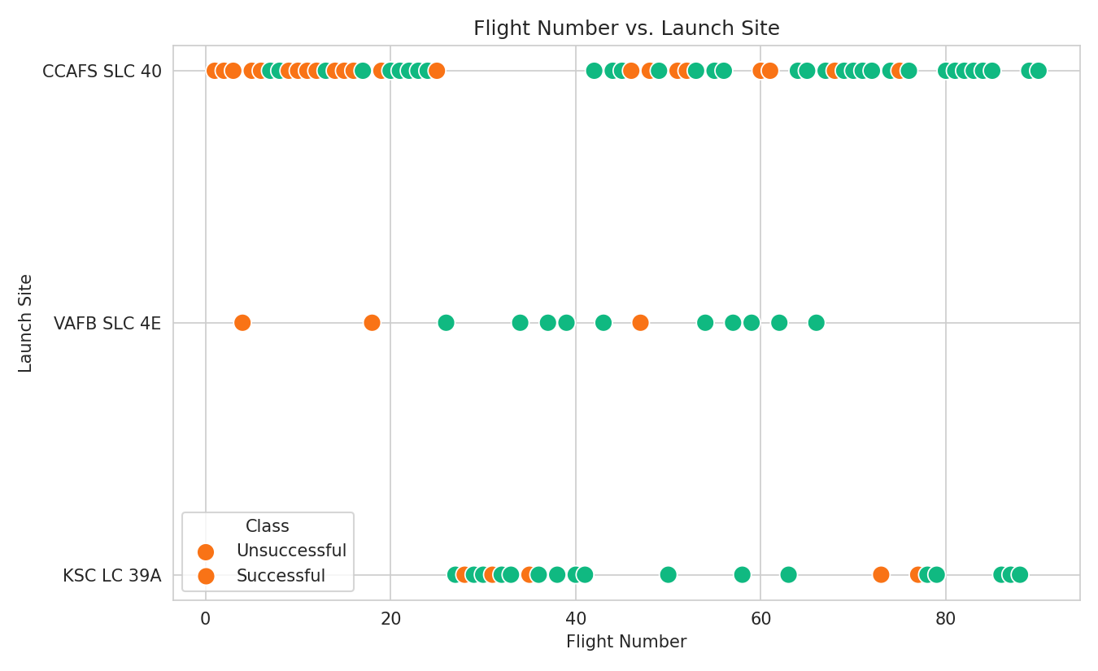
Result: Flight Number vs. Launch Site
Analysis: Early flight numbers (roughly 1-20) show mostly unsuccessful landings across all three sites, while later flight numbers are dominated by successful outcomes.
This confirms that landing success is strongly correlated with time (flight number), consistent with SpaceX's improving landing technology.
CCAFS SLC-40 accounts for the largest share of launches across the full flight-number range, while KSC LC-39A only begins appearing from the mid-20s onward.
GitHub Repository: github.com/ankitarchoudhary/IBM-Data-Science-Capstone

Slide 9
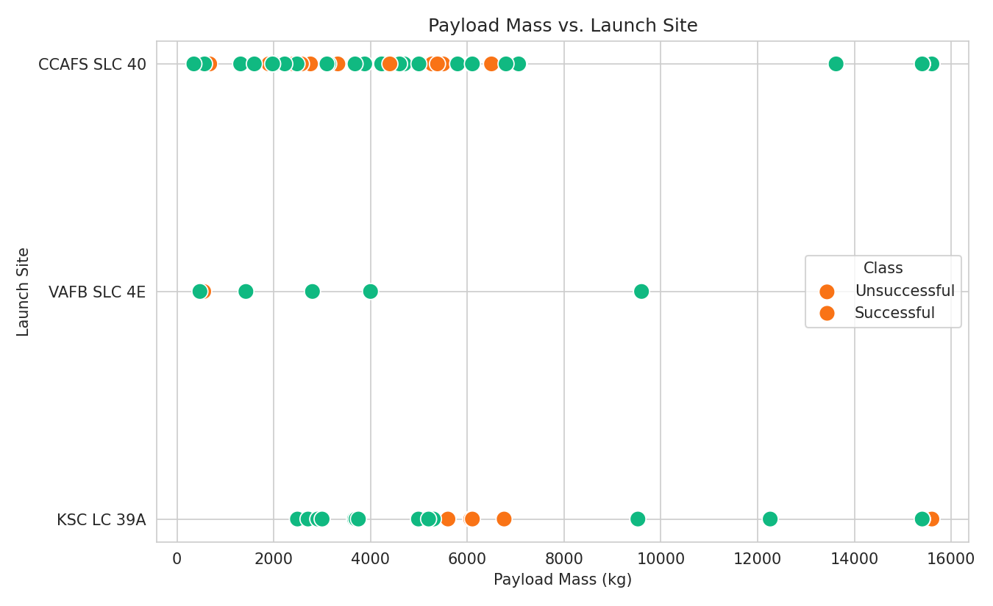
Result: Payload Mass vs. Launch Site
Analysis: VAFB SLC-4E and CCAFS SLC-40 both handle a wide range of payload masses, from under 1000 kg up to 15,000+ kg, with successes and failures spread across that range.
KSC LC-39A tends to handle heavier payloads on average and shows a higher concentration of successful (green) outcomes.
There is no single payload threshold that guarantees success at any site - outcome depends on a combination of factors, not payload mass alone.
GitHub Repository: github.com/ankitarchoudhary/IBM-Data-Science-Capstone

Slide 10
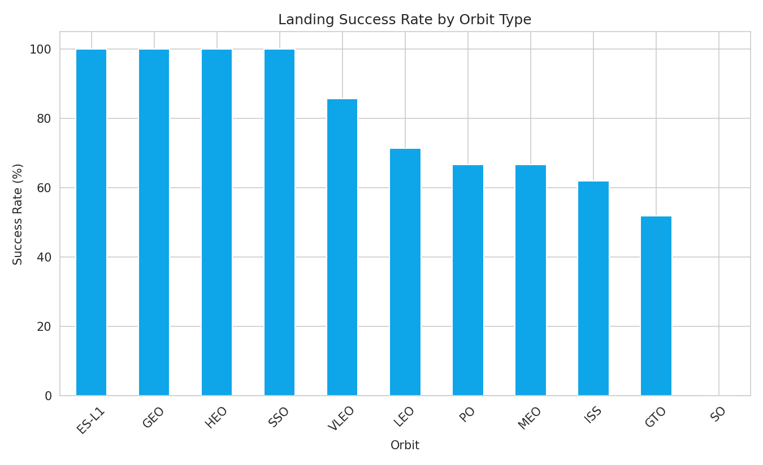
Result: Success Rate by Orbit Type
Analysis: ES-L1, GEO, HEO, and SSO orbits all reach a 100% success rate, though each of these has only 1-5 launches in the dataset, so the sample size is small.
GTO is the most common orbit by far (27 launches) but has the lowest success rate at 51.9%, making it the orbit type most in need of landing-technique improvement.
SO (a single launch) is the only orbit with a 0% success rate.
GitHub Repository: github.com/ankitarchoudhary/IBM-Data-Science-Capstone

Slide 11
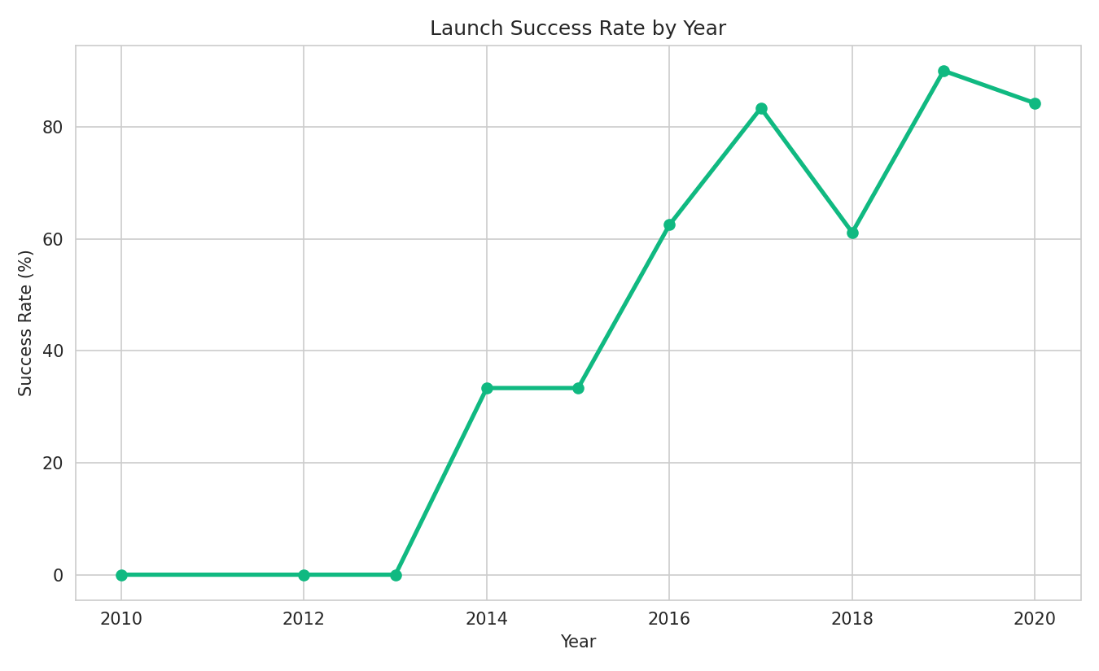
Result: Launch Success Rate by Year
Analysis: Success rate was 0% from 2010 to 2013, during SpaceX's earliest recovery experiments, before any successful landing had been achieved.
A steady climb begins in 2014-2016, followed by a jump to 83.3% in 2017 and a peak of 90% in 2019.
The dip in 2018 (61.1%) shows that progress was not perfectly linear year over year, but the overall decade-long trend is clearly upward.
GitHub Repository: github.com/ankitarchoudhary/IBM-Data-Science-Capstone

Slide 12
EDA with SQL - Overview
10 SQL queries were run against the wrangled dataset using SQLite, answering specific questions about launch sites, payload mass, success rates, and outcome rankings over time.
Unique launch sites
Booster(s) with maximum payload mass
Records where site begins with 'CCA'
Unsuccessful landings in 2020
Total & average payload mass
Outcome ranking between two dates
Successful landings with payload between 4000-6000 kg
Success rate by launch site
Total successful vs. unsuccessful counts
Average payload by orbit
GitHub Repository: github.com/ankitarchoudhary/IBM-Data-Science-Capstone

Slide 13
SQL Result: Launch Sites & Payload Mass
launch_site
CCAFS SLC 40
VAFB SLC 4E
KSC LC 39A
total_payload_mass | avg_payload_mass
549,446.3 kg | 6,105.0 kg
SELECT SUM(PayloadMass), AVG(PayloadMass) FROM spacex;
SELECT DISTINCT LaunchSite FROM spacex;
Success Rate by Launch Site
LaunchSite | Launches | Successes | Success Rate
KSC LC 39A | 22 | 17 | 77.3%
VAFB SLC 4E | 13 | 10 | 76.9%
CCAFS SLC 40 | 55 | 33 | 60.0%
GitHub Repository: github.com/ankitarchoudhary/IBM-Data-Science-Capstone

Slide 14
SQL Result: Outcome Ranking (2015-2018)
Outcome | Count
True ASDS | 12
True RTLS | 8
None None | 4
False ASDS | 4
True Ocean | 2
None ASDS | 2
SELECT Outcome, COUNT(*) FROM spacex
WHERE Date BETWEEN '2015-01-01' AND '2018-01-01'
GROUP BY Outcome ORDER BY COUNT(*) DESC;
True ASDS (drone-ship landing) was the most common recorded outcome in this period, at 12 launches.
True RTLS (return to launch site) follows with 8 successful landings.
'None None' (no attempt / no core data) appears 4 times, alongside 4 failed drone-ship attempts.
GitHub Repository: github.com/ankitarchoudhary/IBM-Data-Science-Capstone

Slide 15
SQL Result: Time Analysis - Unsuccessful Landings in 2020
Date | Serial | LaunchSite | Outcome
2020-01-19 | B1046 | KSC LC 39A | None None
2020-02-17 | B1056 | CCAFS SLC 40 | False ASDS
2020-03-18 | B1048 | KSC LC 39A | False ASDS
SELECT Date, Serial, LaunchSite, Outcome FROM spacex
WHERE Class = 0 AND Date LIKE '2020%';
Even by 2020, a small number of landing attempts still failed or had no recorded attempt, showing that landing was reliable but not perfect even late in the dataset's timeframe.
GitHub Repository: github.com/ankitarchoudhary/IBM-Data-Science-Capstone

Slide 16


Interactive Visual Analytics - Overview
Folium Map
Plotly Dash Dashboard
Launch site markers plotted with real coordinates, color-coded by landing outcome, with a calculated proximity distance from KSC LC-39A to the nearest coastline.
A dropdown to select a launch site, a pie chart of landing outcomes, a payload-mass range slider, and a scatter chart of payload vs. outcome.
GitHub URLs (project + notebooks):
github.com/ankitarchoudhary/IBM-Data-Science-Capstone
github.com/ankitarchoudhary/IBM-Data-Science-Capstone/blob/main/Phase5_Interactive_Visual_Analytics.ipynb

Slide 17
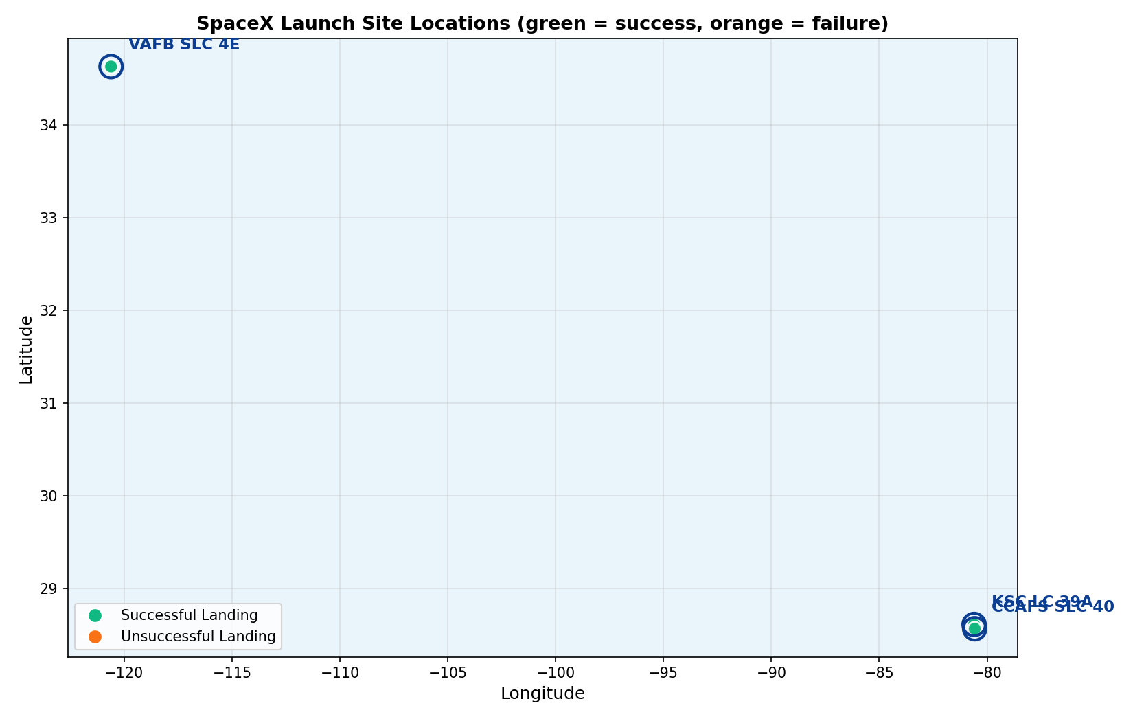
Result: Folium Map - Launch Site Markers
Analysis: the map plots all 90 launches at their real latitude/longitude, color-coded green for a successful landing and orange for unsuccessful, at the three launch sites (marked with circles).
CCAFS SLC-40 and KSC LC-39A (Florida, east coast) and VAFB SLC-4E (California, west coast) are both positioned directly on the coastline.
Visually, KSC LC-39A shows a noticeably higher concentration of green (successful) markers relative to its total launches, matching its 77.3% success rate calculated earlier.
GitHub Repository: github.com/ankitarchoudhary/IBM-Data-Science-Capstone

Slide 18
Result: Proximity Analysis
Distance from KSC LC-39A to the nearest coastline point: 5.86 km, calculated using the Haversine formula (great-circle distance on Earth's surface).
All launch sites are located close to the coast, so that any failed rocket falls over open water rather than a populated area.
Most launch sites are also close to the Equator, where the Earth's surface is already moving fastest, giving an extra speed boost to anything launched from there.
GitHub Repository: github.com/ankitarchoudhary/IBM-Data-Science-Capstone

Slide 19
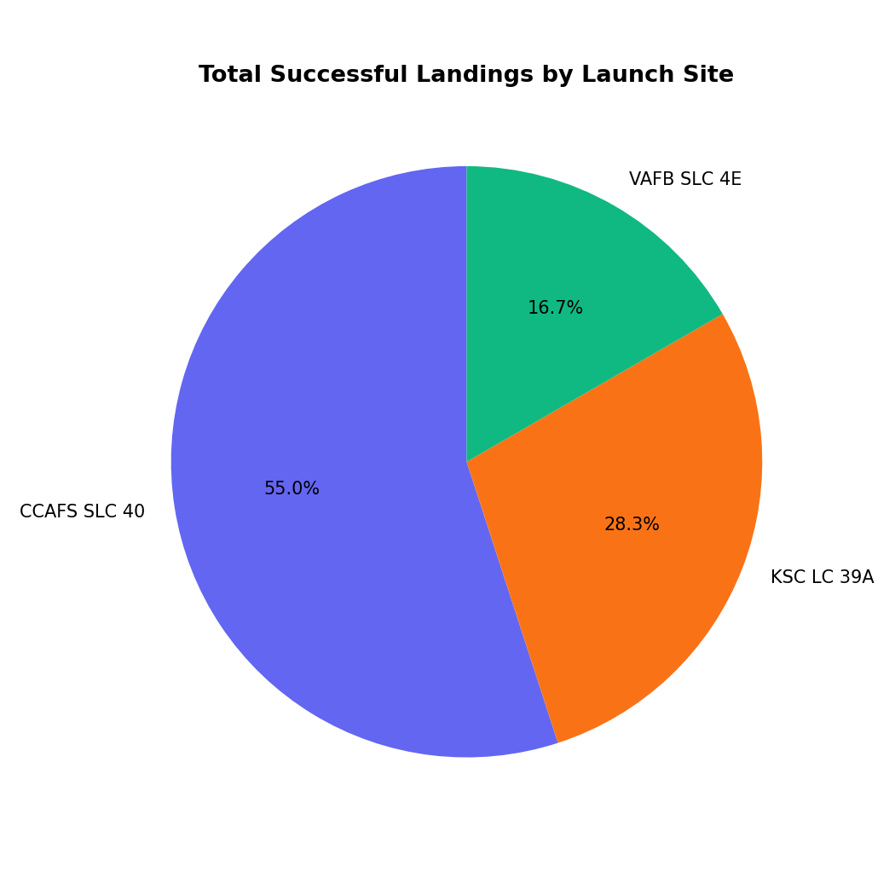
Result: Dashboard - Success Pie Chart
Analysis: this chart mirrors the dashboard's default 'All Sites' pie chart view, showing the share of total successful landings contributed by each launch site.
CCAFS SLC-40 contributes the largest share of successful landings (33 of 60), simply because it has the most total launches, not because it has the best success rate.
In the live dashboard, selecting a specific site from the dropdown switches this chart to show that site's own success-vs-failure split instead.
GitHub Repository: github.com/ankitarchoudhary/IBM-Data-Science-Capstone

Slide 20
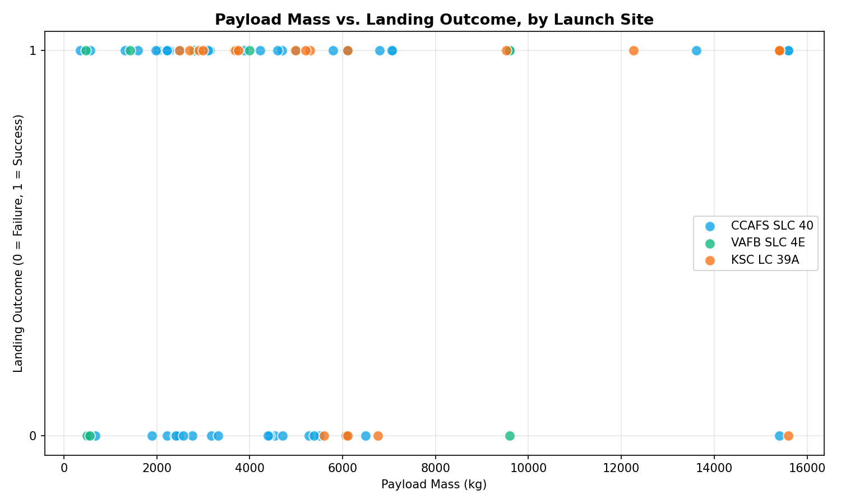
Result: Dashboard - Payload vs. Landing Outcome
Analysis: this scatter chart mirrors the dashboard's payload-vs-outcome view, with points colored by launch site instead of booster version, since all launches in this dataset use Falcon 9.
Successes (y=1) and failures (y=0) are visible across most of the payload range, but VAFB SLC-4E (green) launches cluster more tightly around successful outcomes.
In the live dashboard, the range slider lets a user filter this chart down to a specific payload window interactively.
GitHub Repository: github.com/ankitarchoudhary/IBM-Data-Science-Capstone

Slide 21

Predictive Analysis
GitHub Repository: github.com/ankitarchoudhary/IBM-Data-Science-Capstone

Slide 22
Model Comparison - Multiple Models & Evaluation
All 4 models were tuned with GridSearchCV (5-fold cross-validation, 72 training launches) and evaluated on 18 held-out test launches. Best parameters - KNN: n_neighbors=7, Manhattan distance, uniform weights.
GitHub Repository: github.com/ankitarchoudhary/IBM-Data-Science-Capstone

Slide 23
Confusion Matrix - Best Model (KNN)
 | Predicted: Did Not Land | Predicted: Landed
Actual: Did Not Land | 5 | 1
Actual: Landed | 0 | 12
Why KNN is the Best Model
17 of 18 test launches classified correctly (94.4% accuracy) - the highest of all 4 models.
Zero false negatives: every actual successful landing was correctly identified.
Only 1 false positive, a small, acceptable margin of error on a dataset this size.
KNN likely outperformed the linear models (Logistic Regression, SVM-linear) because the relationship between features and landing success is not purely linear - it depends on specific combinations of orbit, site, and payload that KNN's neighbor-based approach captures naturally.
GitHub Repository: github.com/ankitarchoudhary/IBM-Data-Science-Capstone

Slide 24

Conclusion
KNN predicts Falcon 9 first-stage landing success with 94.4% test accuracy and zero false negatives, making it a strong candidate for estimating launch cost ahead of time.
KSC LC-39A is both SpaceX's most reliable launch site (77.3% success) and, notably, was the first crewed NASA launch pad reused for commercial flight, a fact this data confirms is matched by strong technical performance.
Orbit type reveals an innovation trade-off: GTO missions (the heaviest, most commercially valuable payloads) are also the hardest to land, at 51.9% success, suggesting future cost reductions depend on improving GTO-specific landing profiles.
The sharp success-rate jump after 2016 lines up with SpaceX's public shift toward routine booster reuse, turning this dataset into a visible timeline of a real engineering learning curve.
Combining SQL, visualization, and ML on the same dataset shows a consistent story from three independent angles: site, orbit, and time all point to the same conclusion, increasing confidence in the result.
GitHub Repository: github.com/ankitarchoudhary/IBM-Data-Science-Capstone

