Slide 1
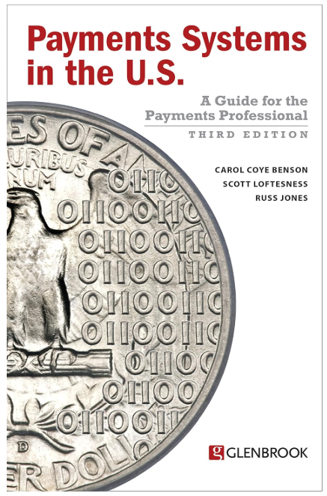
Payments Systems in the U.S.
Based on 2017 edition

Slide 2
Chapters
Introduction
Payments Systems Overview
Core Systems: Checking
Core Systems: ACH
Core Systems: Cards
Core Systems: Cash
Core Systems: Wire Transfer
Perspectives on Payments: System Users
Perspectives on Payments: Systems Providers
Payments Innovation

Slide 3
Session 1 Agenda
Introduction
Payments Systems Overview
Core Systems: Checking
Core Systems: ACH
Core Systems: Cards
Core Systems: Cash
Core Systems: Wire Transfer
Perspectives on Payments: System Users
Perspectives on Payments: Systems Providers
Payments Innovation

Slide 4
Introduction
What:
A comprehensive description of the payments systems (cards, checks, ACH, wires, and cash) that move money between and among consumers and enterprises in the U.S.
For whom:
Anyone in the payments industry – or needing to use payments products.
When:
Written in 2017, but is recommended by Industry leaders for basics

Slide 5
Payments Systems Overview

Slide 6
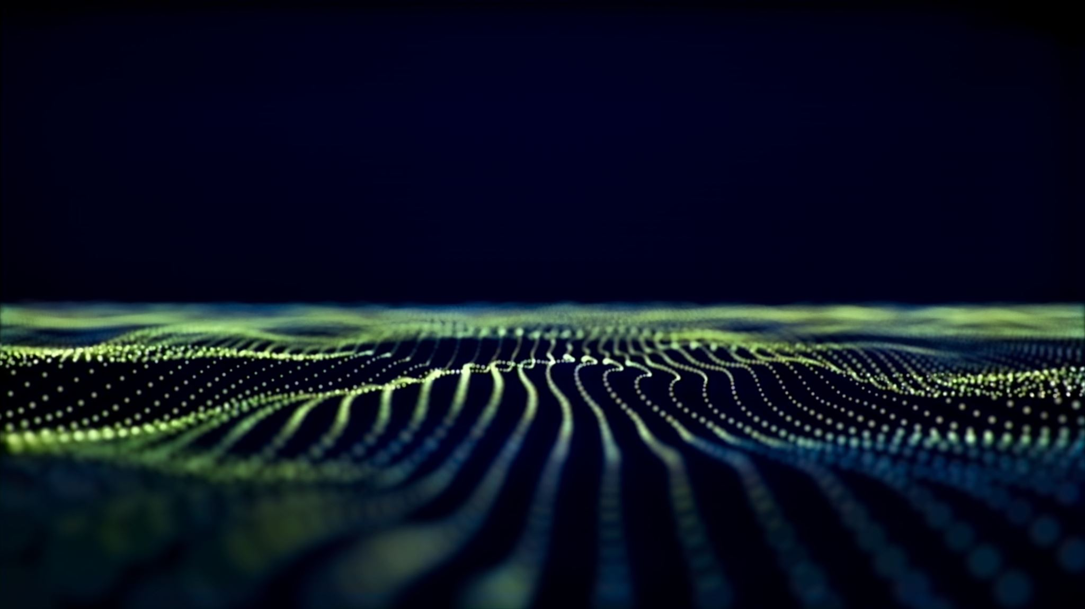
Payments System Models
Open-Loop Payment Systems (e.g., Visa, Mastercard):
Involve multiple parties: issuer banks, acquirers, processors, and card networks.
Revenue generated through shared transaction fees (interchange, network, processing).
Broad merchant acceptance across regions and industries.
Limited control over customer data and user experience.
High scalability due to global network interoperability.
Subject to strict regulatory compliance (e.g., PCI DSS, AML, KYC).
Closed-Loop Payment Systems (e.g., Starbucks App, Apple Pay within Apple ecosystem):
Operate within a single company’s ecosystem (issuer, processor, and merchant are the same).
Revenue retained entirely by the company; may include interest on stored value (float).
Limited to specific merchants or platforms.
Full control over customer data, loyalty programs, and user experience.
Limited scalability unless the brand’s ecosystem expands.
Lower processing costs due to fewer intermediaries.

Slide 7
Core Payment Systems in the US (1/2)
Payment System | Key Participants (Payer, Payee & Intermediaries) | Governance/Control (Operator & Oversight) | Revenue Model (Fees/Income) | Annual Volume (Transactions) | Annual Value (Dollar Amount)
Cash Ex: U.S. Dollar | Individuals/consumers, businesses (as payers/recipients); banks for distribution (ATMs, branches); U.S. Treasury & Federal Reserve (issuers) | Publicly issued currency controlled by the Federal Reserve and U.S. Treasury | Cost borne by government; No interchange fees for usage. | ~20% of consumer payment transactions count (2021) | ~6% of U.S. consumer payment value (2021)
Checks Ex: Bank Checks (Fed & Clearing House) | Payer (writes check) and payee (recipient); both parties’ banks (payor’s bank and payee’s bank); interbank clearing intermediaries (Federal Reserve or private clearing houses) for settlement. | Decentralized banking system: Federal Reserve and clearing houses provide check clearing services under U.S. regulations | Bank fees (e.g., account maintenance or per-check fees) fund the service; Federal Reserve charges banks modest fees for clearing checks (cost recovery basis) No merchant interchange fees. | ~14.5 billion (2018) (check usage declining ~7% annually over two decades). | ~$25 trillion (2018)
Cards Ex: Visa Network (Card Associations) | Cardholders (consumers); merchants; issuing banks (card issuers); acquiring banks (merchant banks); card network (e.g. Visa, MasterCard); payment processors. | Privately run card networks set operating rules subject to federal regulations | Fee-based model: Merchants pay a merchant discount fee per transaction, which includes an interchange fee (to issuing bank) and network fees | 131.2 billion (2018) (largest payment volume; includes credit, debit, and prepaid card transactions). | $7.08 trillion (2018) value per transaction is lower on average than check or wire).

Slide 8
Core Payment Systems in the US (2/2)
Payment System | Key Participants (Payer, Payee & Intermediaries) | Governance/Control (Operator & Oversight) | Revenue Model (Fees/Income) | Annual Volume (Transactions) | Annual Value (Dollar Amount)
ACH Ex: ACH Network (NACHA / FedACH) | Originators (individuals, businesses, or government sending payments); recipient parties; banks (originating & receiving depository institutions, ODFI/RDFI); ACH operators (Federal Reserve’s FedACH and The Clearing House’s EPN network); NACHA (rulemaking association). | Governance by NACHA (a non-profit industry association setting ACH rules) and oversight by regulators; operated by Federal Reserve (FedACH) and The Clearing House (Electronic Payments Network). | Cost-sharing model: Low per-transaction network fees (fractions of a cent) charged to member banks; funded by volume-based fees and membership dues | 29.1 billion (2021) growing ~8.7% annually). | $72.6 trillion (2021) (massive total value; second only to wires, reflecting salaries, mortgages, B2B payments)
Wire Transfers Ex: Fedwire (Federal Reserve) | Sender and receiver (often businesses, banks, or government); banks holding accounts for senders/receivers; central operator (e.g., Federal Reserve for Fedwire, or The Clearing House for CHIPS). Often involve correspondent banks for cross-bank transfers. | Centrally operated: Fedwire is run by the Federal Reserve, and CHIPS by The Clearing House (a private bank consortium), under U.S. payments regulation. | Transaction fees: Banks charge senders a substantial fee per wire (e.g., ~$15–$30 for domestic wires). The Federal Reserve and CHIPS also levy fees on member banks per transfer. | ~200 million (Fedwire 2021 transfers) (smallest volume among major systems). | $991 trillion (Fedwire 2021 value) (highest value;).

Slide 9
The Domains of Payment
Point of Sale (POS)
Swipe (magenetic stripe), EMV/Chip (Dip), Tap-to-pay (NFC)
Remote Commerce
Online payments
Bill Payment
Utilities, Insurance and Services that are recurring
Person-to-person (P2P) Payment
Domestic, Cross border remittances
Business-to-business (B2B) Payment
Income Payment
Salary, reimbursements

Slide 10
Payments System Flow
Type | Push Payments | Pull Payments
Flow | Payer (sender) → Recipient initiates the transaction to send money to a recipient | Payee (recipient) → Payer's account (typically after receiving prior authorization)
Common Rails | Wire transfers ACH credits (e.g., direct deposit), Newer real-time systems like The Clearing House's RTP or FedNow | ACH debits (e.g., automated bill pay) Paper checks Credit/debit card transactions
Control | The sender maintains full control over the timing and exact amount sent. | The recipient controls the collection schedule once a mandate or agreement is signed by the payer.
Use cases | Payroll disbursements Person-to-person (P2P) transfers, High-value one-off business payments | Monthly subscriptions Utility bills, Standard retail checkouts
Risks | Authorized Push Payment (APP) Fraud (Phishing) Data Entry Errors Irreversibility | Unauthorized debits Insufficient Funds Chargebacks/Friendly Fraud

Slide 11
Payments System Settlement
Type | Gross Settlement | Net Settlement
Example | Fedwire, FedNow | ACH (Nacha), Checks, Cards
Processing | Individual, one-to-one basis. Each transaction settles as it is processed. | Batched; offsets credits against debits. Net obligations calculated periodically.
Timing | Real-time; settled as processed | Deferred; settled at specific intervals
Liquidity | High; must fund every transaction | Low; only net balances are funded
Finality | Immediate and irrevocable | Final only after the netting cycle completes
Best for | High-value, urgent transfers | High-volume, routine payments (e.g., payroll)
*Converging Speeds: While ACH is a net system, the rapid growth of Same-Day ACH (processing $3.9 trillion in 2025) is narrowing the speed gap between traditional net settlement and real-time gross systems.

Slide 12
Ownership and Regulation
Ownership: From Bank owned to different ownership models
Regulations
Private System Rules
US Law and Federal Reserve Bank Regulation

Slide 13
Risk Management
Primary
Credit Risk
Fraud Risk
Liquidity Risk
Secondary
Operational Risk
Data Security Risk
Reputation Risk
Regulatory Risk
Forex Risk

Slide 14
Core Systems: Checking

Slide 15
Overview
Type | ‘Pull’ Payment (Claim on another account)
Ownership | No Single owner Check clearing houses owned by banks or private processors
Regulation | US law, network rules and Federal reserve bank regulation
Network Economics | Clears at par (processed without any additional collection or clearing charges, regardless of the bank branch's location)
Processing | Intrabank clearing by image or paper, batch
Risk Management | Managed by intermediaries and end parties
Features | Oldest and widely used Open loop payments system Negotiable instrument Transferable Claim on an account, usually another bank → via Clearing and Settlement

Slide 16
History of Checks
Origins in the 9th century Arabia, written promise to pay for goods upon delivery
The "Exchequer": In medieval England, the royal treasury was called the Exchequer. It was named after a checked (chequered) cloth used as a counting board to calculate taxes, resembling a large chessboard.
The First Forms: The Bank of England pioneered pre-printed "check paper" in 1717 to prevent fraud.
Spelling Split: In the 1800s, British English adopted the French-influenced spelling "cheque" to distinguish the financial instrument from other types of "checks," while American English kept the original "check" for both.

Slide 17
Value Chain
Payee
Bank of First Deposit
Clearing House
Check Writer’s Bank
Check Writer
Presenting Bank
Can submit paper check or image, to the clearing house or directly to the Paying bank
Blind Posting – not ensuring funds availability
Paying Bank

Slide 18
Evolution
Phase 1: Clearing Houses (1853–1950s)
Porters walked from bank to bank, carrying bags of gold (specie) to settle balances.
Phase 2: Automation – MICR and Sorters (1950s–2003)
As check volumes exploded post-WWII, manual sorting became a bottleneck.
The Problem: Increase in number of banks, porters had to gather on street corners for informal "Porters' Exchanges," leading to frequent record-keeping errors and security risks.
The Innovation: In 1853, the New York Clearing House was established as a central office where banks could meet to exchange checks and settle net balances.
Refinement: Banks began using "Clearing House Certificates" (quasi-currency) to settle accounts instead of moving physical gold, significantly reducing liquidity risks and the danger of bank runs.
MICR Technology: This string of numbers at the bottom of a check uses magnetic ink containing iron oxide, which machines can read even if obscured by stamps or signatures.
Reader-Sorters: Specialized machines called reader-sorters were introduced to automate the process. These machines could "read" the MICR data (routing, account, and check numbers) and physically sort thousands of checks per hour into different bank "pockets" for distribution.
Impact: Prior to this, clearing could take several days; with MICR, it became possible to process and clear checks within 24 hours.

Slide 19
Evolution
Phase 3: Imaging (2004–Present)
The final major shift moved the system from physical transport to digital transmission.
The Catalyst: The 9/11 attacks grounded planes across the US, halting the physical transport of checks and nearly freezing the financial system.
Check 21 Act: In response, the Check Clearing for the 21st Century Act (Check 21) went into effect on October 28, 2004.
Check Truncation: The law allowed banks to "truncate" (stop) the physical check and instead transmit a digital image. If a paper document was still needed, banks could create a Substitute Check—a legal paper reproduction of the digital image.
Modern Result: This phase enabled Remote Deposit Capture (RDC), allowing consumers and businesses to deposit checks via mobile phones or scanners without visiting a bank branch.
By 2010, 99% of checks clearing through the Fed was processed electronically

Slide 20
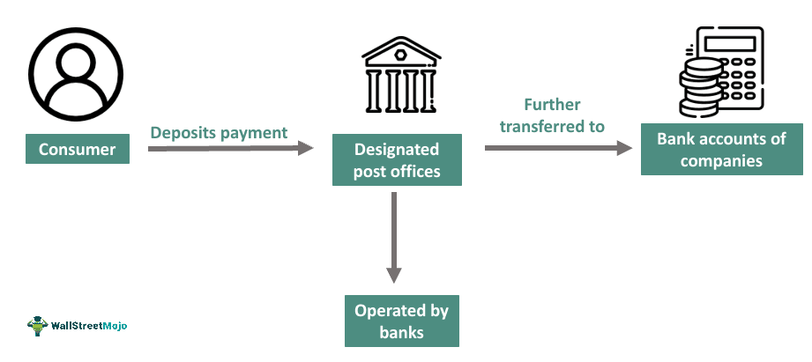
Lockbox System

Slide 21
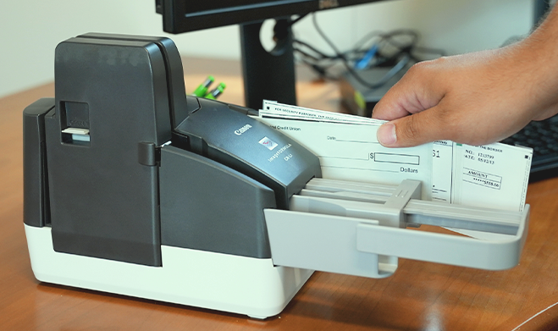
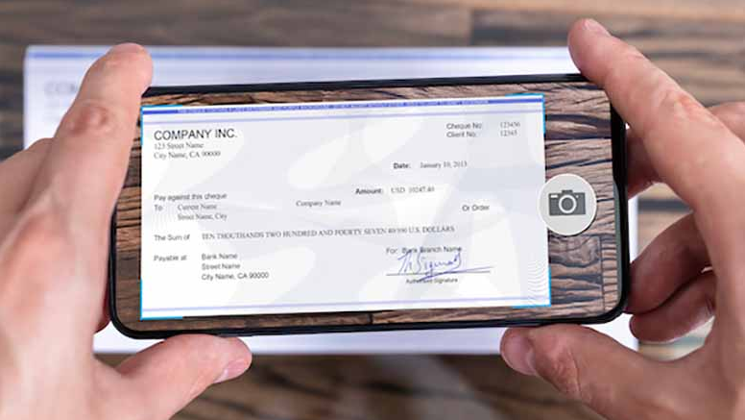
Remote Deposit Capture
Helps avoid a trip to make a deposit
Image of the check captured by Payee and deposits it electronically to the Payee’s bank or a third party processor
Providers are getting more flexible with scanning devices

Slide 22
Additional Information
Non-Sufficient Funds (NSF) fee is a good income for banks
Checking accounts – bundled service by Banks
US Savings accounts typically don’t allow checks
Many retail merchants have stopped accepting checks and shifted mostly to debit cards

Slide 23
Key Entities
The Federal Reserve Board and the Federal Reserve Banks (together, “the Fed”)
Largest check and check image clearing house in the US
Manager of national settlement service
Rule maker: Check 21 act and others
The Clearing House
Bank owned payments company
Originally the New York Clearing House (since 1853)

Slide 24
Core Systems: Wire Transfer

Slide 25
Overview
Type | ‘Push’ Payments
Ownership | Fedwire: Federal Reserve Bank CHIPS: The Clearing House
Regulation | Regulated by Article 4A of the Uniform commercial code and by the operating rules of the network
Network Economics | Clears at par
Processing | Electronic, real-time
Risk Management | Managed by networks, intermediaries and end parties
Features | Also called ‘large-value systems’ Cost of fraud is extremely high, can lead to existential crisis Risk Management systems is complex and expensive Transaction fees high

Slide 26
Uses, Purposes and Volumes
History
Herstatt risk: 1974 German bank failure, led to development of RTGS (Real-time Gross Settlement) and CLS (Continuous linked settlement) worldwide
Gross settlement is necessary to avoid risks of potential bank failure
Uses and Purposes
Time critical payments: Large value purchase with specific dates
Fully guaranteed payments
Immediate payments: for sale of security or settlement of a trade

Slide 27
The Value Chain
Sender of Funds
Wire transfer network
Receivers Bank
Receiver of Funds
Sender’s Bank
Fedwire
CHIPS
Flow of funds and messages
Fedwire
From Federal reserve banks
All banks can participate
CHIPS
The Clearing House Interbank Payments System
Private sector alternative
Only a few large banks can participate
SWIFT
Society for Worldwide Interbank Financial Telecommunication
The Payments system that is not payment system

Slide 28
Questions?

