Slide 1













IDEAS-TIH INTERNSHIP PRESENTATION
Time Series Analysis of Crop Data
UNDER THE GUIDANCE OF MS. KOULIKA PAUL
Presentation by
APARAJITA BASU
ANCHAL BHATTACHARYA ANKITA SARKAR
St. Xavier’s College (Autonomous), Kolkata

Slide 2
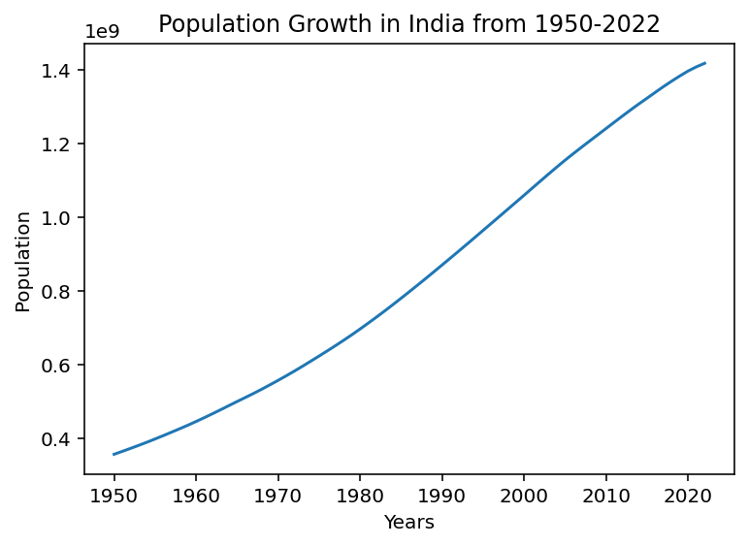
Understanding Time Series Data
A time series is a collection of observations made sequentially through time. So, it essentially represents observations for a single entity that vary over a period of time. A time series data is represented using a Line Diagram. Let X_{t} be a random variable denoting an observation of that entity at the t^{th} point of time.
Hence, the data can be denoted as X_{t}, X_{t+h}, X_{t+2h},…, where h is the time between two consecutive observations. The observations are equally spaced.
An example of time series data can be the population growth in India from 1950-2022.
The data has been collected from https://www.kaggle.com/datasets/amritharj/population-of-india-19502022. The adjoining Line Diagram represents the data.

Slide 3

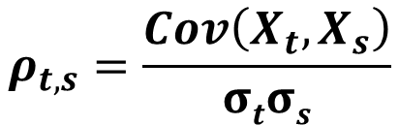

Mean, Variance and Autocorrelation
Let t and s be two time points.
Then, the mean function at time point t is given by –
$$μ_{t}=E\left(X_{t}\right)$$
This gives the expected value of the time series at time point t.
The variance function is given by –
$$σ_{t}^{2}=Var(X_{t})=E{\left(X_{t}−μ_{t}\right)}^{2}$$
The autocorrelation is the correlation between the two observations corresponding to the time points t and s in the same time series. The autocovariance is given by –
$Cov\left(X_{t},X_{s}\right)=E[\left(X_{t}−μ_{t}\right)$ $\left(X_{s}−μ_{s}\right)]$
Hence, the autocorrelation is given by –
$$ρ_{t,s}=\frac{Cov\left(X_{t},X_{s}\right)}{σtσs}$$

Slide 4
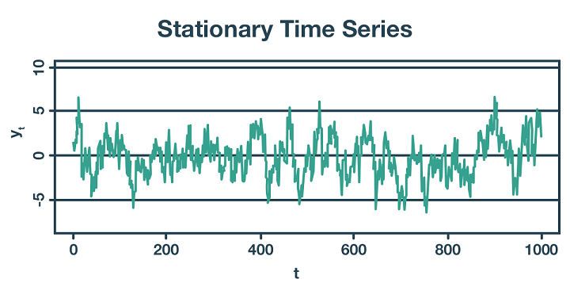
Stationary Time Series
A time series whose statistical properties – mean, variance, and autocorrelation – do not depend on time and hence do not vary over time is called a Stationary Time Series.
This characteristic is crucial for many time series models, like ARIMA, which assumes Stationarity for producing reliable forecasts using the data.
A Stationary time series does not exhibit trends or seasonality, making it appear flat and stable over time.
The figure alongside shows a Stationary Time Series. To assess the stationarity of a time series, statistical tests, like the Augmented Dickey-Fuller (ADF) Test, are commonly used. A visual inspection of the time series typically shows fluctuations around a constant mean with consistent variance and autocorrelation.
Source: https://blog.quantinsti.com/stationarity/

Slide 5
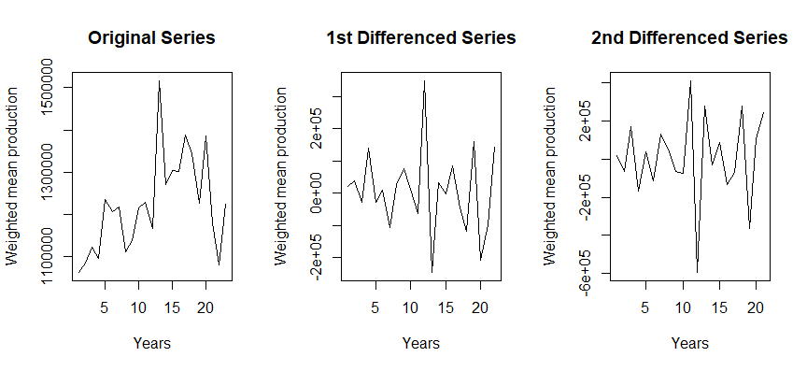

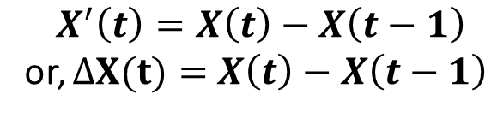
Non-Stationary Time Series
A time series is Non-Stationary if its mean, variance, or autocovariance changes over time.
Common causes for the non-stationarity of a time series are trend and seasonality. Most statistical models require stationarity. So, we usually convert a non-stationary time series into a stationary one for analysis.
Differencing removes trends and stabilizes the mean of the series. First-order differencing is most common.
First-order differencing :
$$X^{′}\left(t\right)=X\left(t\right)−X\left(t−1\right)$$
or, $ΔX(t)=$ $X\left(t\right)−X\left(t−1\right)$
Second-order differencing :
$$Δ^{2}X\left(t\right)=ΔX\left(t\right)−ΔX\left(t−1\right)$$
Note: We can continue this differencing until the series becomes stationary, which can be tested by the ADF Test.

Slide 6
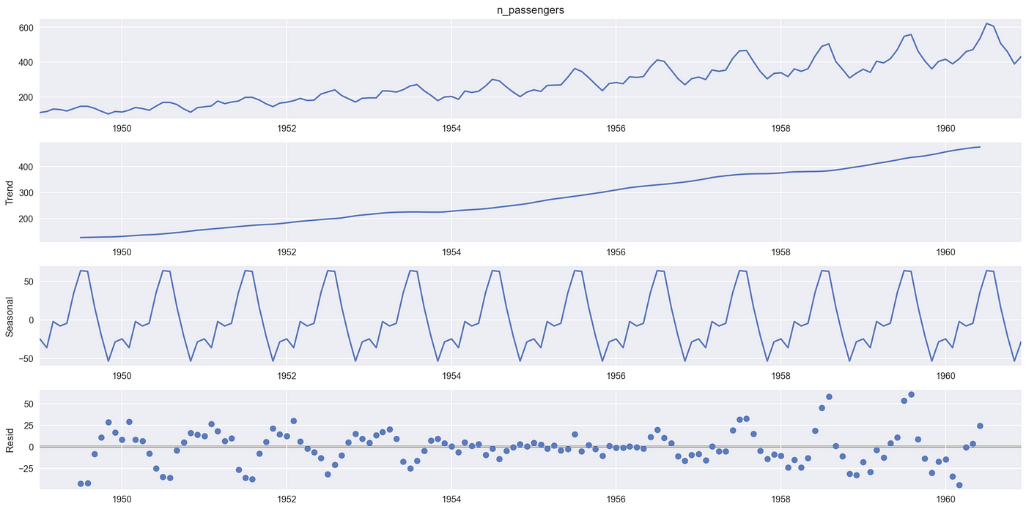
Decomposing Time Series
Time series data, collected sequentially over time, often exhibits underlying patterns that can be crucial for forecasting and understanding the driving forces behind the data. Two of the most fundamental components to analyse are trend and seasonality. Decomposing a time series involves separating these components from the raw data, providing a clearer picture of the underlying dynamics.

Slide 7
Decomposing Time Series
Trend: Trend refers to the long-term direction of the time series. It represents the persistent, gradual increase or decrease in the data over an extended period. The trend can be linear (a straight line), non-linear (curved), or even change direction over time. Identifying the trend helps in understanding the overall growth or decline trajectory of the phenomenon being observed.
For example, in sales data, a positive trend might indicate increasing market adoption, while a negative trend could signal declining popularity.
Seasonality: Seasonality, on the other hand, refers to the recurring, cyclical patterns within a fixed period. These fluctuations are often tied to calendar-based events (e.g., monthly, quarterly, yearly) or other regular cycles.
Examples include increased retail sales during the holiday season, higher electricity consumption in summer due to air conditioning, or monthly peaks in website traffic at the beginning of each month. Seasonality typically has a fixed and known frequency.

Slide 8
Decomposing Time Series
Decomposition techniques aim to isolate these components from the observed time series (Y_{t}). A common approach is the additive model, which assumes the time series is a sum of its components:
Y_{t} = Trend_{t} + Seasonality_{t} + Residual_{t}
Here, Residual_{t} represents the random or irregular fluctuations that remain after removing the trend and seasonality.
Another approach is the multiplicative model, which assumes the components multiply:
Y_{t} = Trend_{t} × Seasonality_{t} × Residual_{t}
The choice between additive and multiplicative models often depends on whether the magnitude of the seasonal fluctuations appears to be independent of the level of the time series (additive) or proportional to it (multiplicative).

Slide 9
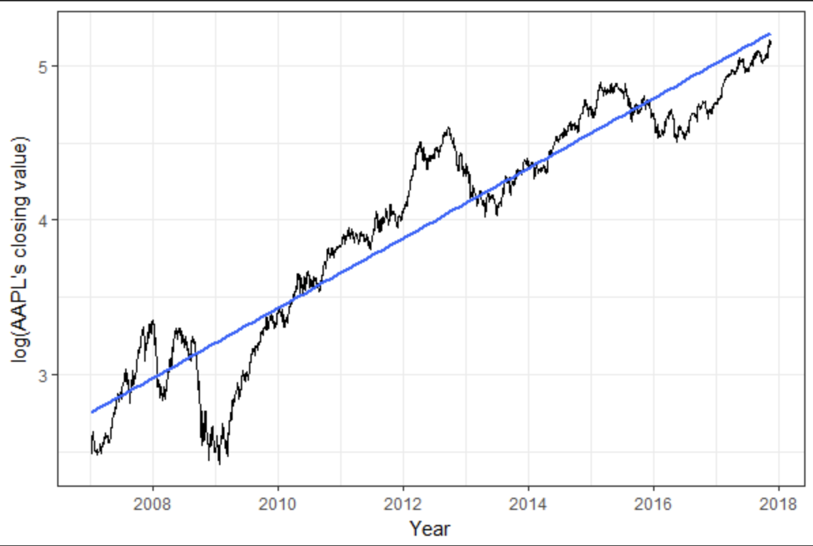
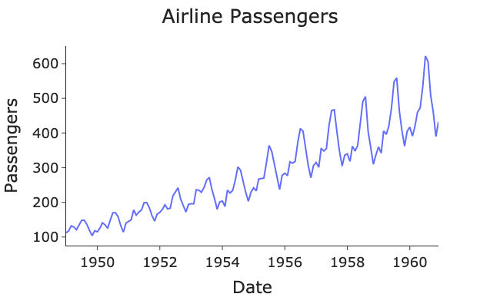
Decomposing Time Series
Analyzing the decomposed components offers valuable insights. Understanding the trend allows for long-term forecasting and strategic planning. Identifying and quantifying seasonality helps in short-term forecasting, inventory management, and resource allocation. The residual component can reveal unusual events or outliers that deviate from the expected patterns.

Slide 10
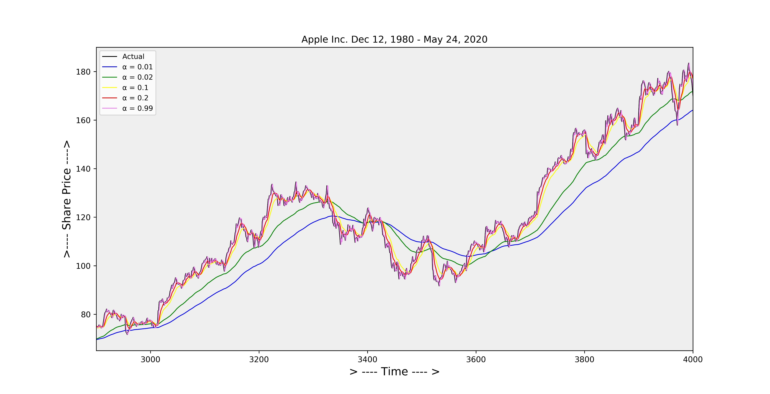
Exponential Smoothing
Exponential smoothing or exponential moving average (EMA) is a rule of thumb technique for smoothing time series data. Whereas in the simple moving average the past observations are weighted equally, exponential functions are used to assign exponentially decreasing weights over time. It is an easily learned and easily applied procedure for making some determination based on prior assumptions by the user, such as seasonality. Exponential smoothing is often used for analysis of time-series data.

Slide 11
Exponential Smoothing
The raw data sequence is often represented by {X_{t}} beginning at time t=0, and the output of the exponential smoothing algorithm is commonly written as {S_{t}}, which may be regarded as the best estimate of what the next value of X will be. When the sequence of observations begins at time t=0, the simplest form of exponential smoothing is given by the following formulas:
S₀ = X₀
S_{t} = αX_{t} + ( 1- α )S_{t-1} , t > 0
where α is the smoothing factor, and 0 ≤ α ≤ 1. If S_{t-1} is substituted into S_{t} continuously so that the formula of S_{t} is fully expressed in terms of {X_{t}}, then exponentially decaying weighting factors on each raw data x_{t} is revealed, showing how exponential smoothing is named.

Slide 12
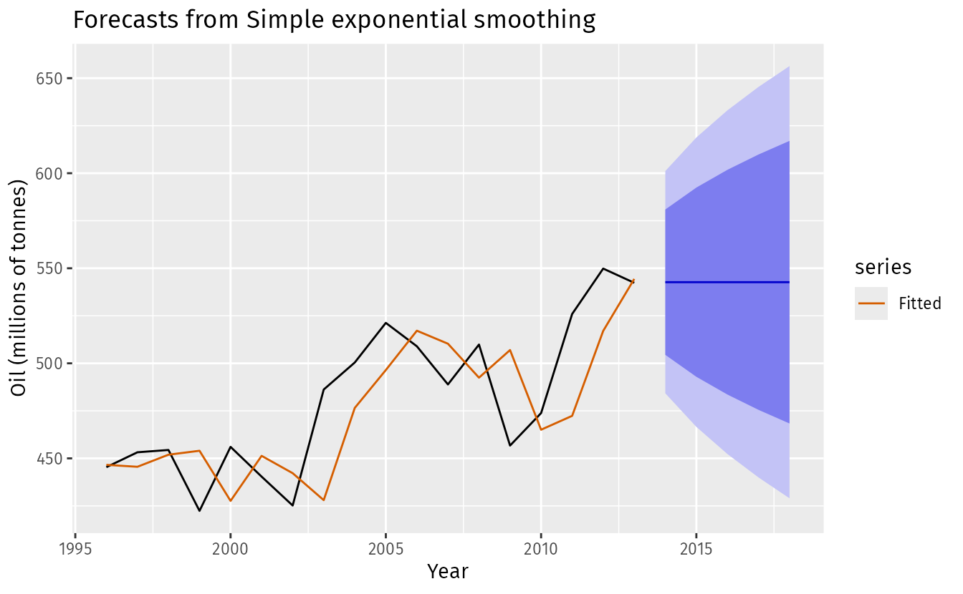
Simple Exponential Smoothing
The simplest form of exponential smoothing is given by the following formula:
S_{t} = αX_{t} + ( 1- α )S_{t-1}
= αX_{t} + α( 1 – α )X_{t-1} + ( 1 – α )²S_{t-2}
=α [ X_{t} + (1–α)X_{t-1} + (1–α)²X_{t-2} +…+ (1–α)^{t-1}X₁ ] + (1-α)^{t}X₀
where α is the smoothing factor, and 0 ≤ α ≤ 1.
This simple form of exponential smoothing is also known as an exponentially weighted moving average (EWMA). Technically it can also be classified as an autoregressive integrated moving average (ARIMA) (0,1,1) model with no constant term.

Slide 13
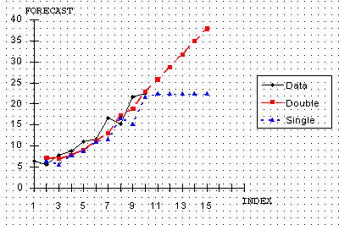
Double exponential smoothing (Holt linear)
Simple exponential smoothing does not do well when there is a trend in the data. In such situations, several methods were devised under the name "double exponential smoothing" or "second-order exponential smoothing“, which is the recursive application of an exponential filter twice, thus being termed "double exponential smoothing". The basic idea behind double exponential smoothing is to introduce a term to take into account the possibility of a series exhibiting some form of trend. This slope component is itself updated via exponential smoothing.
.

Slide 14
Double exponential smoothing (Holt linear)
Level Smoothing: The first exponential smoothing equation updates the level estimate, similar to simple exponential smoothing.
Trend Smoothing: The second equation updates the trend estimate, also using exponential smoothing.
Forecasting: The forecast for a future period is calculated by adding the current level estimate to the product of the trend estimate and the number of periods ahead.
When to Use Double Exponential Smoothing:
Data with a Linear Trend: The primary use case is when the time series data has a linear trend but no seasonality.
No Seasonal Pattern: The method is not suitable for data with seasonal patterns.
Growth or Decline: It's useful for forecasting products or services in a growth or decline phase.
.

Slide 15
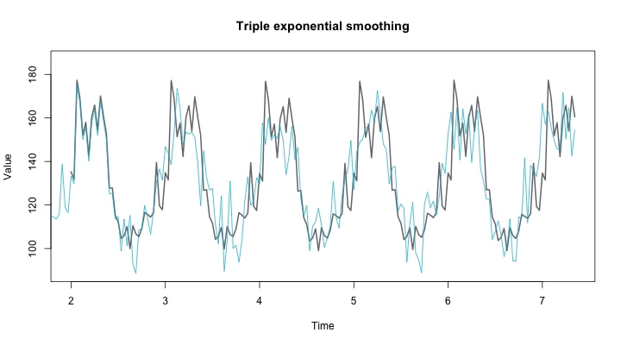
Triple exponential smoothing (Holt-Winters)
Triple exponential smoothing, also known as Holt-Winters' method, is a time series forecasting technique used when data exhibits both a trend (a general upward or downward movement) and seasonal component(regular patterns that repeat over time, like monthly or yearly cycles) , applying exponential smoothing three times to level, trend, and seasonality.
It applies exponential smoothing three times:
Level Smoothing: Estimates the underlying average level of the data. (α)
Trend Smoothing: Estimates the trend or rate of change in the data. (β)
Seasonal Smoothing: Estimates the seasonal component, capturing the recurring patterns.

Slide 16
Autoregressive (AR) Models
In an AR model, we forecast the variable of interest using a linear combination of past values of the variable. The term autoregression indicates that it is a regression of the variable against itself. An AR model of order p, written as AR(p), follows the general form:
X_{t} = c+ φ₁ X_{t-1} + φ₂ X_{t-2} +…+ φ_{p} X_{t-p} + Ꜫ_{t}
where, X_{t}: the value of the time series at time t
X_{t−i​}: represents the lagged values of the time series
c: constant term (also called the intercept)
φ_{i}​: autoregressive coefficients [where i=1(1)p], determines the strength and direction of the influence that past values have on the current observation.
Ꜫ_{t}: white noise (random error) term, follows a normal distribution with zero mean and constant variance.
The number of lags, p, determines how many past observations are used to predict the current value.

Slide 17
Autoregressive (AR) Models
For an AR(1) model:
φ₁= 0: X_{t} is equivalent to white noise.
φ₁=1 and c=0: X_{t} is equivalent to a random walk
φ₁=1 and c≠0: X_{t} is equivalent to a random walk with drift
φ₁< 0: X_{t} tends to oscillate around the mean.
These models can capture short-term dependencies and are particularly effective for stationary time series, where statistical properties like mean and variance do not change over time. in these cases, some constraints on the values of the parameters are required.
For an AR(1) model: -1<φ1<1
For an AR(2) model: -1<𝛷2<1, 𝛷1+𝛷2<1, 𝛷2−𝛷1<1
When p≥3, the restrictions are much more complicated.

Slide 18
Moving Average (MA) Models
A Moving Average (MA) model explains the current value of a time series as a function of past forecast errors (also called shocks or residuals). Unlike AR models that rely on past observations, MA models incorporate the influence of random disturbances from previous time steps.
The general form of an MA(q) model is given by:
X_{t}=µ + θ₁ ε_{t−1} + θ₂ ε_{t−2} +⋯+ θ_{q} ε_{t−q} + Ꜫ_{t}
where, μ: Mean of the time series
θ₁,θ₂,…,θ_{q}: Coefficients that determine the influence of past error terms
q: number of lagged forecast errors in the prediction equation.
ε_{t}: white noise at time t, assumed to be independent and identically distributed (i.i.d.), typically following a normal distribution. Of course, we do not observe the values of ε_{t}, so it is not a regression in the usual sense.

Slide 19

ACF (Autocorrelation Function)
Measures the correlation between observations of a time series and their lagged values.
It captures both direct and indirect relationships (i.e., the effect of intermediate lags).
Useful for identifying the q parameter in MA(q) models.
Example: The correlation at lag 2 includes not only the direct relationship between time t and t-2 but also indirect effects via t-1.
Functional Form:
$ρ_{k}$= $\frac{Cov(x_{t,}x_{t−k})}{Var(x_{t})}$= $\frac{E[(x_{t}−µ)(x_{t−k}−µ)]}{σ^{2}}$
where $ρ$_{k} is the autocorrelation at lag k and $σ^{2}$ is the variance (also assumed constant) of the time series.

Slide 20
PACF (Partial Autocorrelation Function)
Measures the correlation between observations of a time series and their lagged values, after removing the influence of shorter lags.
It reveals the direct relationship at each lag.
Useful for identifying the p parameter in AR(p) models.
Example: At lag 2, PACF shows the correlation between t and t-2 while controlling for the correlation via t-1.

Slide 21
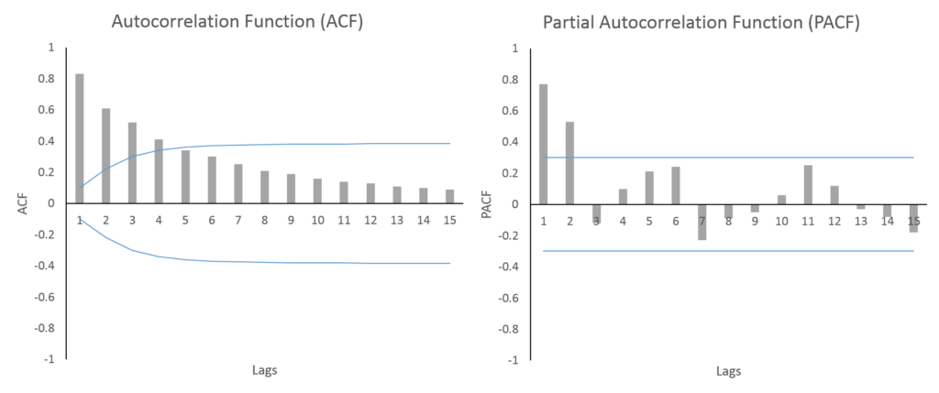
Key Difference:
At lag 1, both ACF and PACF show the same value since no intermediate lags exist to control for.
From lag 2 onwards, PACF adjusts for intervening lags, while ACF does not.

Slide 22

Combined ARMA(p,q) Model
An Autoregressive Moving Average (ARMA) model combines both autoregressive (AR) and moving average (MA) components to provide a more flexible and accurate description of stationary time series data. The AR part captures dependencies on past values, while the MA part accounts for the influence of past forecast errors.
X_{t}​ = c + $\sum_{i=1}^{p}{Φ_{i}}x_{t−i}$ + $\sum_{j=1}^{q}{Θ_{j}} Ꜫ_{t−j}$ + Ꜫ_{t}
Where,
X_{t}: the value of the time series at time t
c: a constant
φ₁,...,φ_{p}: AR coefficients (past values)
θ₁,...,θ_{q}: MA coefficients (past errors)
Ꜫ_{t}: white noise
Note: ARMA is used when the time series is stationary and both autocorrelation and residual structure cannot be captured by AR or MA models alone. It serves as a powerful baseline for many practical forecasting applications and forms the core of more advanced models like ARIMA (includes differencing for non-stationarity) and SARIMA (handles seasonality).

Slide 23
Non-seasonal ARIMA Models
If we combine differencing with autoregression and a moving average model, we obtain a non-seasonal AutoRegressive Integrated Moving Average (ARIMA) model.
X′_{t}=c+ ϕ₁X′_{t−1} +⋯+ ϕ_{p}X′_{t−p} + θ₁ε_{t−1} +⋯+ θq ε_{t−q} + ε_{t}
where X′_{t} is the differenced series (it may have been differenced more than once). The predictors on the right-hand side include both lagged values of X_{t} and lagged errors. We call this an ARIMA(p,d,q) model, where
p: order of the autoregressive part
d: degree of differencing involved
q: order of the moving average part.

Slide 24
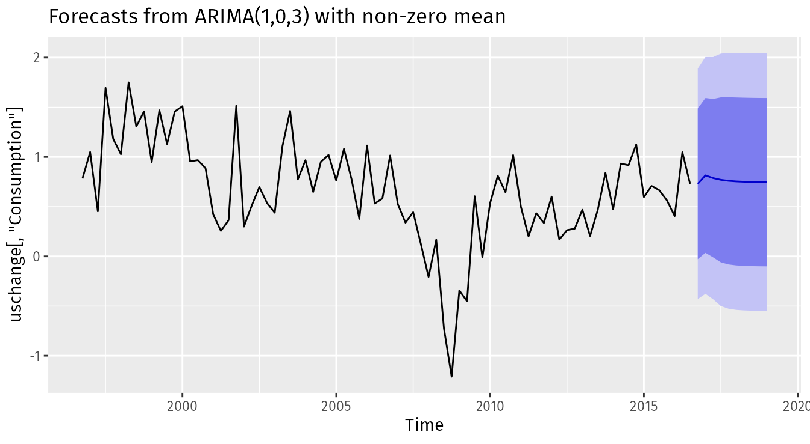
Non-seasonal ARIMA Models
Special cases:
White noise | ARIMA(0,0,0)
Random walk | ARIMA(0,1,0) with no constant
Random walk with drift | ARIMA(0,1,0) with a constant
Autoregression | ARIMA(p,0,0)
Moving average | ARIMA(0,0,q)

Slide 25
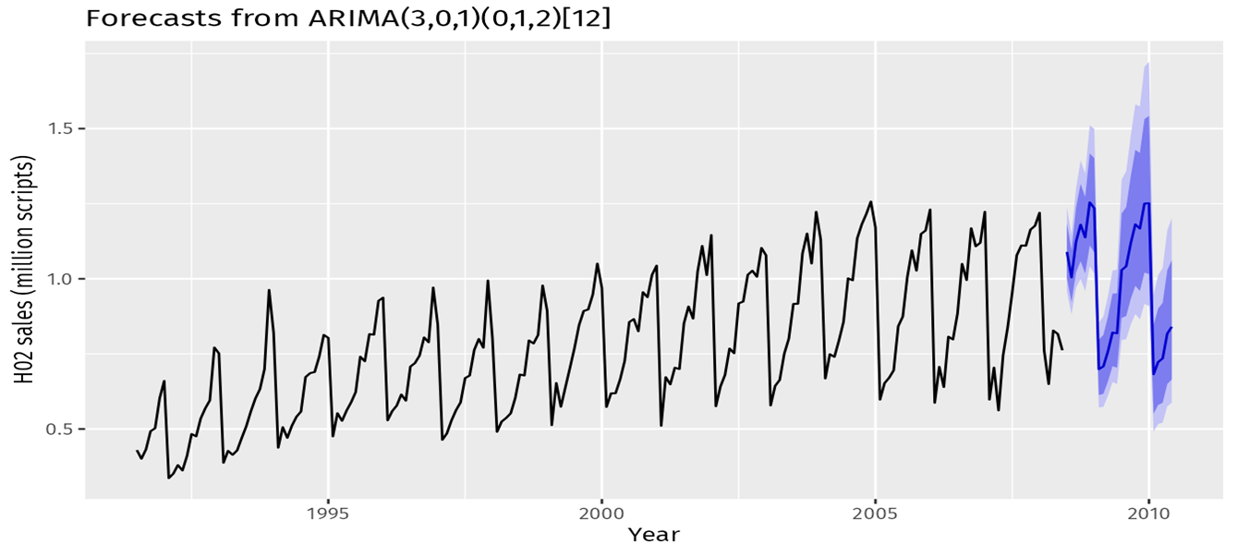
Seasonal ARIMA (SARIMA) Model
A seasonal ARIMA model is formed by including additional seasonal terms in the ARIMA models we have seen so far. It is written as follows: ARIMA (p,d,q) (P,D,Q)_{m}
(p,d,q): Non-seasonal part and (P,D,Q)_{m}: Seasonal part with m=number of observations per year.
Seasonal Autoregressive (P): This component captures the relationship between the current value of the series and its past values, specifically at seasonal lags.
Seasonal Integrated (D): differencing required to remove seasonality from the series.
Seasonal Moving Average (Q): models the dependency between the current value and the residual errors of the previous predictions at seasonal lags.

Slide 26

Understanding FASAL Statistics
FASAL Statistics refer to the comprehensive data related to crop production, including area sown, yield, and total production for various crops across different regions and periods. These statistics are crucial for understanding the agricultural landscape of a country.
Agriculture is a cornerstone of the Indian economy, contributing significantly to GDP and employing a major portion of the population. To enhance agricultural production in India, the FASAL Program was developed, under the Ministry of Agriculture and Farmers Welfare, which plays an important role in Forecasting Crop Production in India. FASAL Statistics in India are primarily collected and compiled by government agencies at various levels (central and state). Key sources include the State Agricultural Departments, Directorate of Economics and Statistics, NSSO and so on.

Slide 27
Analyzing Key Crops of West Bengal
West Bengal has a significant agricultural sector, characterized by fertile land and diverse cropping patterns. Rice and Jute are two of its most important crops. So, in this project, we focus on the time series analysis and forecasting of these two crops in West Bengal. The data was collected from https://www.data.gov.in/catalog/district-wise-season-wise-crop-production-statistics-0, which contains district-wise and season-wise crop production data for different Indian states from 1997 to 2019.
We have extracted the data about Rice and Jute Production in West Bengal and, for each Season, we have taken the weighted mean of the district-wise production, considering the production area as the weights.
We carry out our analysis separately on these two datasets. Accurate forecasts for Rice and Jute production is extremely essential as they can assist the state government, agricultural departments, farmers, and related industries in making informed decisions regarding cultivation, storage, marketing, and policy interventions.

Slide 28


Analyzing Key Crops of West Bengal
Rice: The Staple Food Crop
Rice is the primary food crop of West Bengal, forming a crucial part of the local diet and economy.
Understanding its production trends is vital for ensuring regional food security and planning for distribution.
Factors like monsoon patterns, irrigation facilities, and government policies significantly influence rice production.
Jute: The Golden Fibre - A Key Cash Crop
Jute has historically been a major cash crop for West Bengal, supporting a significant industrial base and providing income to farmers.
Its production is influenced by factors such as market demand, government support for the jute industry, and weather conditions.

Slide 29
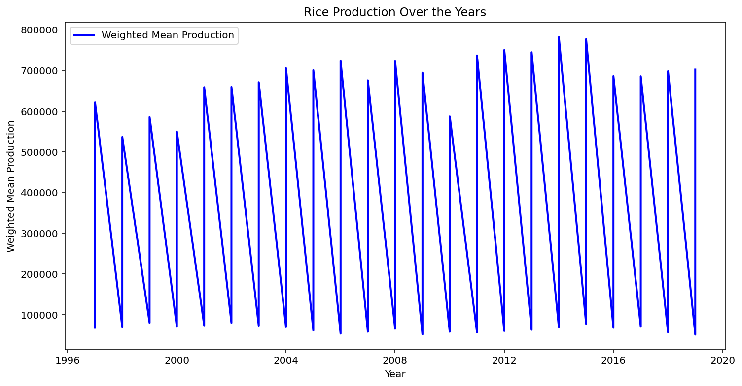
Rice Production in West Bengal
Rice is a staple cereal grain cultivated globally. Sowing times vary by region and variety, often coinciding with the rainy season (e.g., June-July). Harvesting typically occurs 3-6 months after sowing, depending on the variety and growing conditions (e.g., October-November). The data is available from 1997 to 2019 for autumn, summer and winter. The line diagram is given below.
Rice production exhibits substantial year-to-year variability.
A recurring pattern of high production followed by lows suggests potential seasonal or economic influences.
After the initial dip in the late 1990s, production generally shows a trend of recovery with higher peaks in the later years.
The year 2016 recorded the highest rice production within the observed period.
Despite a dip after 2016, the production in 2019 remains at a relatively high level.

Slide 30
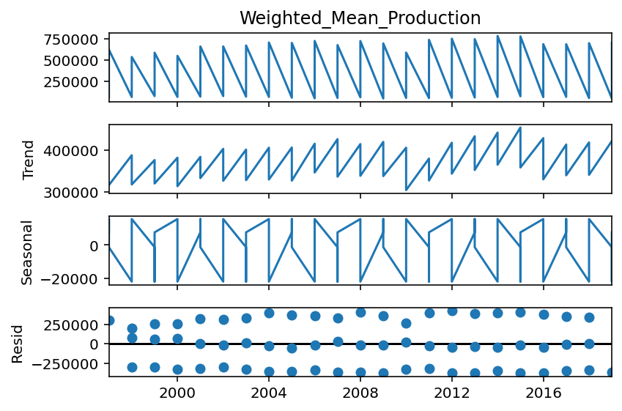
Rice Production in West Bengal
We first get the decomposition plot.
Original Line Diagram (1st panel): This is the original time series data showing the rice production over the years (1997 to 2019). There seems to be a generally increasing level of production over time, with noticeable short-term ups and downs. There appears to be a repetitive pattern over the years, hinting at potential seasonality.
Trend (2nd panel): This plot isolates the underlying long-term direction of the rice production. The trend component shows a general upward movement in the production over the observed period. However, it's not a smooth, consistent increase; there are periods of slower growth or even slight dips within the overall upward trajectory. This suggests that while there's a general tendency for increased production, it's influenced by other factors causing shorter-term variations.

Slide 31
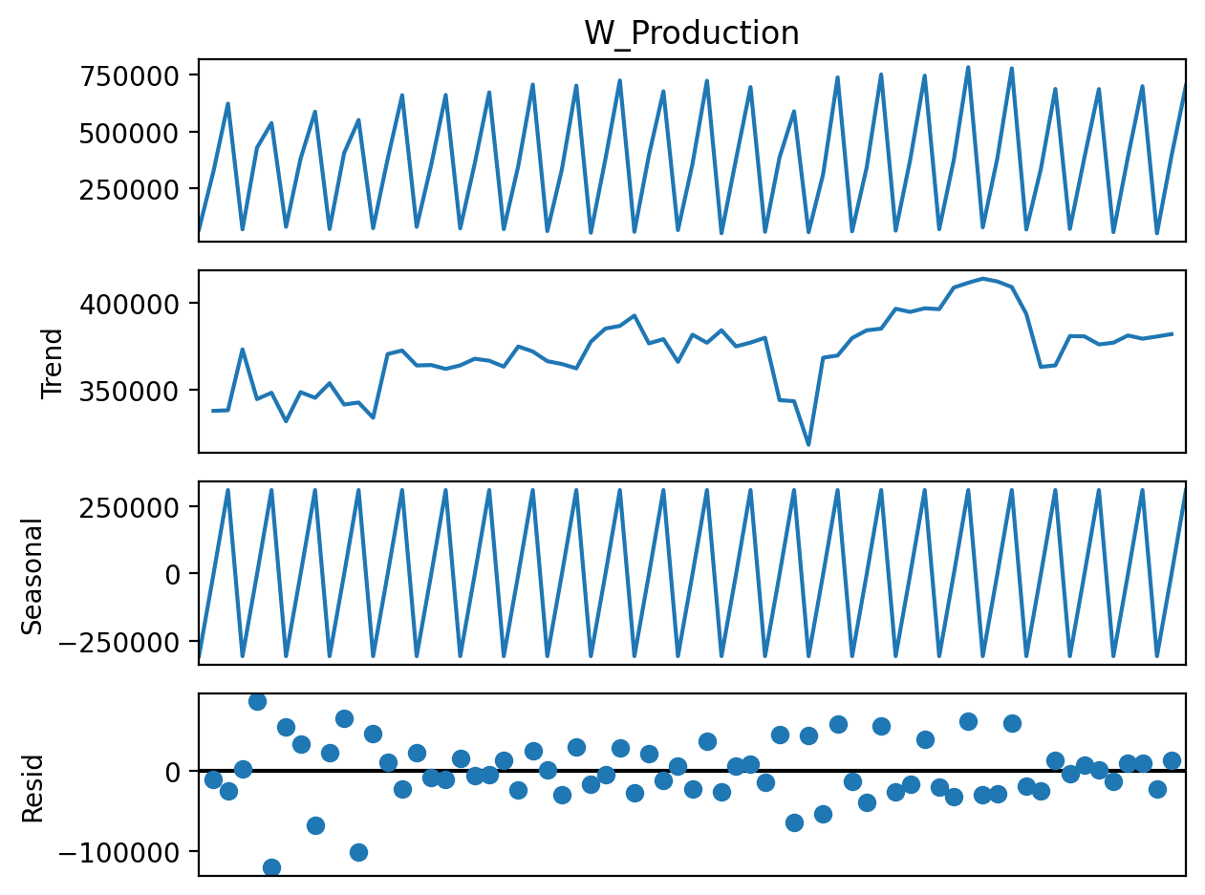
Rice Production in West Bengal
We first get the decomposition plot.
Seasonality (3rd panel): This plot reveals the recurring patterns within the rice production data that occur over a fixed period (likely a year). The seasonal component shows a consistent up-and-down pattern that repeats annually. The peaks likely correspond to the main harvest season, while the troughs represent periods of lower production before the next harvest. The magnitude of this seasonal effect appears relatively consistent throughout the observed period.
Residual (4th panel): This plot shows the irregular or random fluctuations in rice production that are not explained by the trend or the seasonal components. In this plot, the residuals appear to be somewhat scattered around zero, suggesting that the trend and seasonal components have captured a significant portion of the variability in the original data.

Slide 32

Rice Production in West Bengal
We then apply the Augmented Dickey-Fuller (ADF) Test to check the stationarity of the series. The hypotheses are such that,
H₀: the time series is non-stationary
H₁: the time series is stationary
We get the p-value as 0.0338 < α=0.05. So, we reject the null hypothesis and say that the data is stationary. So, no differencing is involved.
Note: We should consider d=0 for ARIMA modelling.

Slide 33
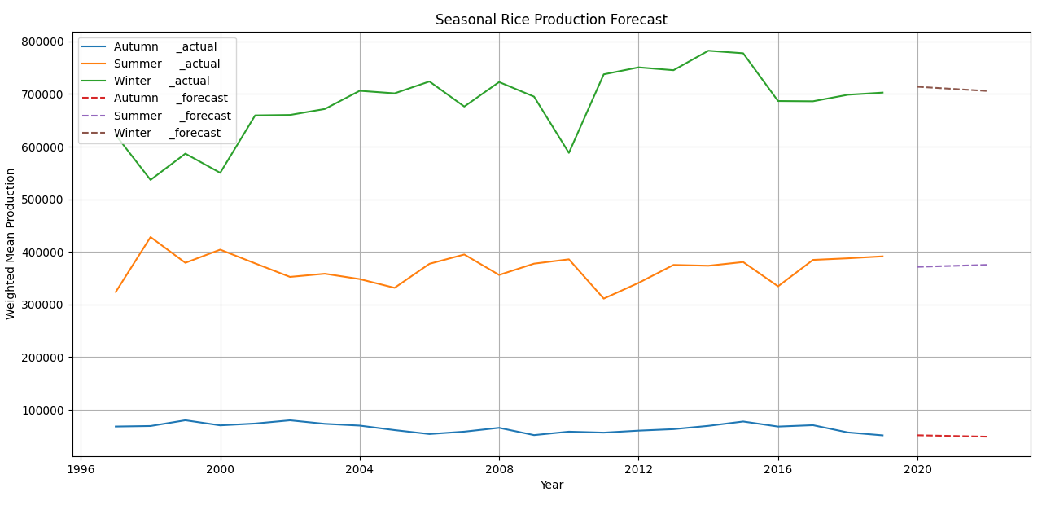
Rice Production in West Bengal
Error Metrics:
Season: Autumn
MAE: 5031.03
RMSE: 6550.94
MAPE: 8.10%
Season: Summer
MAE: 20913.17
RMSE: 27041.92
MAPE: 5.59%
Season: Winter
MAE: 40009.52
RMSE: 45374.70
MAPE: 5.93%

Slide 34
Rice Production in West Bengal
Observations: All seasons show slight continuation of recent trends — no sharp shifts or anomalies. Forecasts are smooth, which is typical for exponential smoothing unless trend or seasonality is explicitly modeled.
WINTER
Forecast Line
(Brown dashed):
Slight decline, from around 715,000 to 705,000. From Error Metrics, MAPE: 5.93% indicates good performance even with the highest absolute errors. Reflects confidence in proportional accuracy.
AUTUMN
Forecast Line
(Red dashed):
Nearly flat, forecasting production to stay around 60,000–65,000.MAPE (8.10%) indicates slightly less accuracy, suggests that autumn data may be more volatile or harder to capture with smoothing.
SUMMER
Forecast Line
(Purple dashed):
Mild upward trend, stabilizing near 380,000. MAPE: 5.59% indicates strong accuracy despite higher raw errors. Production values are large, so small percentage deviations are tolerable.

Slide 35
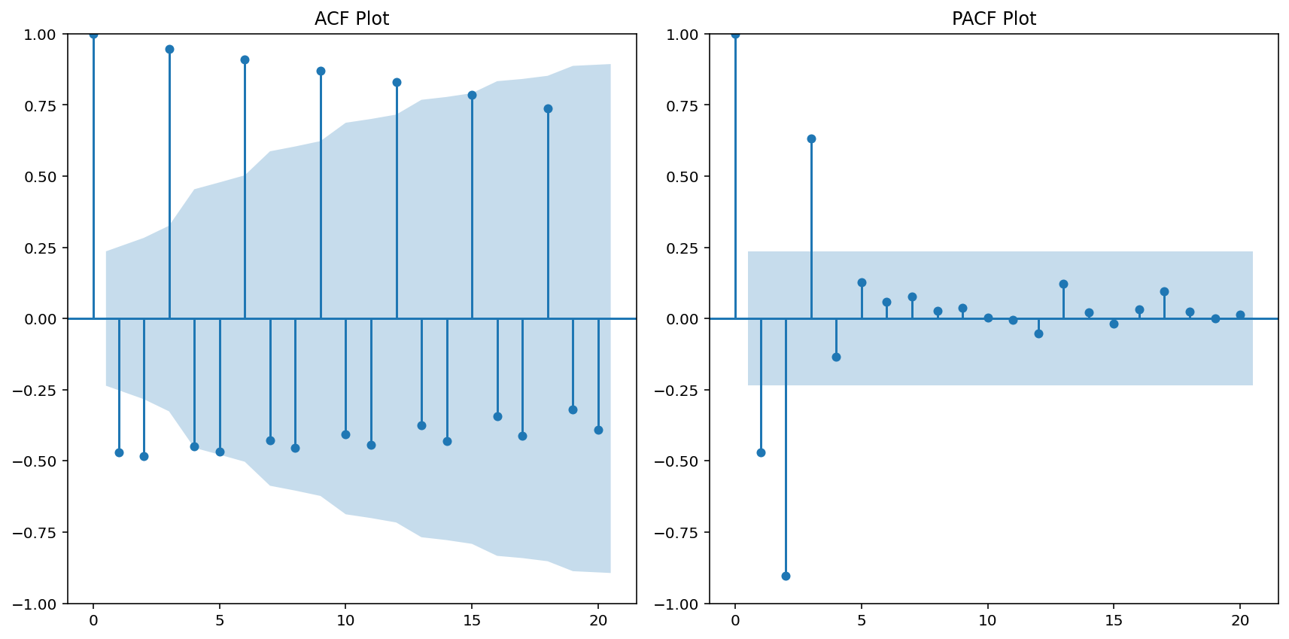
Rice Production in West Bengal
Note: We consider p=1 & q=4 for ARIMA modelling.
Now, we consider the Autocorrelation and Partial Autocorrelation Plots.
The ACF plot shows significant spikes at lags 1, 2, 3, and 4 (outside the confidence interval).
Based on this, ( q = 4 ) is likely a good choice, indicating that the moving average model considers the previous 4 lags.
The PACF plot has a significant spike at lag 1 and becomes less prominent afterward (inside the confidence interval for higher lags). This sharp cutoff at lag 1 suggests ( p = 1 ) for the AR component (Autoregressive model), indicating that the current value depends primarily on the immediate prior value.

Slide 36
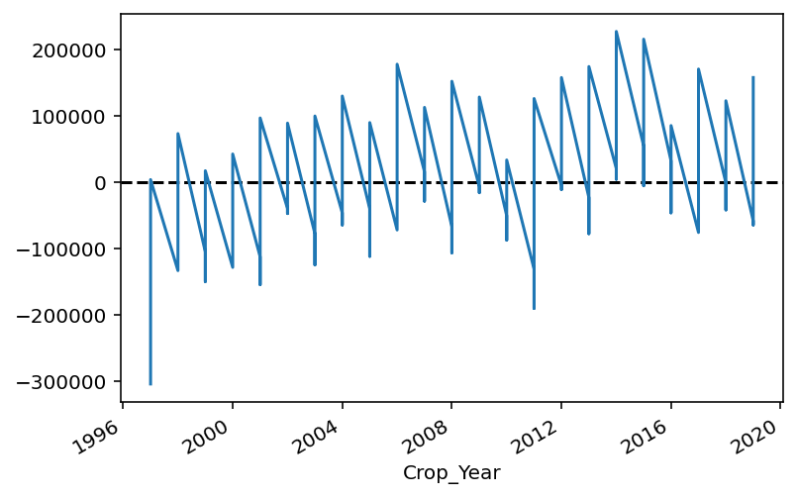
Rice Production in West Bengal
We plot the residuals against time after fitting the ARIMA(1,0,4) model.
Centered around zero: Residuals generally fluctuate above and below zero, indicating no consistent bias.
No obvious patterns: Lack of clear trends or seasonality in the errors suggests the model captured these components.
Relatively consistent variance: The spread of residuals appears reasonably stable over time.
Presence of some outliers: A few larger deviations indicate some unpredictable events.
Overall good fit (tentative): The model seems to have captured much of the predictable variation.

Slide 37

Rice Production in West Bengal
As there exists a clear seasonality in the data we have calculated the seasonal differencing once with lag=3 (as there are 3 seasons). Now we test if the seasonal patterns are removed from the data or not by seasonal differencing once by ADF test.
Note: As there are 3 seasons, we should consider s=3 for SARIMA modelling
We get the p-value as 0.00128 < α=0.05. So, we can say that the seasonal patterns are removed from the data.
Note: We should consider D=1 for SARIMA modelling.
Note: We fit a SARIMA (1,1,4,3) model
(The P and Q remain the same as the p and q of the ARIMA model)

Slide 38
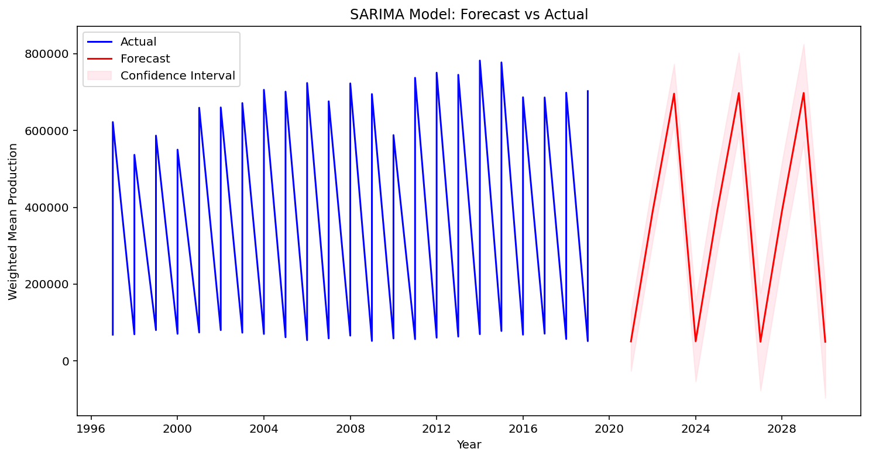
Rice Production in West Bengal
We plot the SARIMA(1,1,4,3) model with the forecasting of the next 10 years (2020 – 2030)
Cyclical Forecast: Model predicts continued up-and-down patterns in rice production.
Increasing Swings: The forecast suggests larger production highs and lows in the future.
Growing Uncertainty: Confidence interval widens over time, indicating less prediction certainty further out.
Seasonality Captured: The model effectively projects the recurring seasonal variations.
Underlying Trend Less Clear: No strong upward or downward long-term trend is evident in the forecast's average level.
Future Volatility: Increased amplitude suggests potentially more volatile rice production in the coming decade.
Forecast Dependent on Past: Predictions rely on historical patterns and may not account for unforeseen events.

Slide 39
Rice Production in West Bengal
1. On average, the forecast deviates by 31,019 units from the actual values. This indicates a relatively small absolute error magnitude, suggesting that the model performs well in terms of precision.
2. The RMSE value of 33,897 reflects the standard deviation of residuals (prediction errors). Since RMSE considers squared errors, it gives more weight to larger errors than MAE. The close values between MAE and RMSE indicate that the forecast errors are fairly consistent and not significantly influenced by extreme deviations.
ERROR METRICS:
MAE: 31019.006017904547
RMSE: 33896.95763089267
MAPE: 8.864465271876673
3. The forecast has a MAPE of 8.86%, which means, on average, the model's predictions deviate by 8.86% from the actual values in percentage terms, so, it can be considered very accurate in many forecasting contexts, highlighting that the SARIMA model is well-fitted and performs excellently in capturing the patterns of the data.
Overall Interpretation:
The error metrics suggest the model is performing robustly, with minimal absolute and percentage errors. The low MAPE, in particular, is a strong indicator of reliable forecasting accuracy.

Slide 40
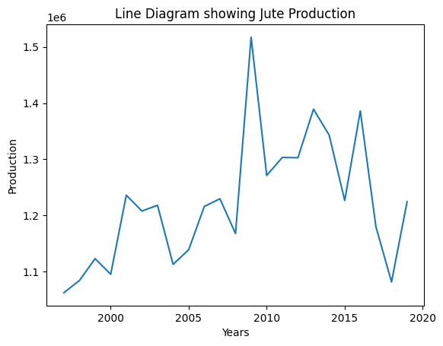
Jute Production in West Bengal
Jute is a Kharif Crop, grown only once a year, with sowing occurring between March and May and harvesting taking place from June to September. So, the yearly data is available from 1997 to 2019 from the Kharif Season. We plot that in a line diagram.
There’s a general upward trend in jute production initially, although it's not strictly linear. Production increased until a sharp peak in 2009, which seems to be the highest production value on the chart.
There are significant fluctuations throughout the graph, indicating variability in production. Some sharp drops and rebounds suggest periods of external shocks, like weather, policy changes, etc..
The highest production reaches above 1.5 metric tonnes, and then there's a noticeable decline followed by volatility in the subsequent data points.
Towards the end, after a sharp drop, there's a small rebound, which might indicate a recovery or seasonal effect.

Slide 41
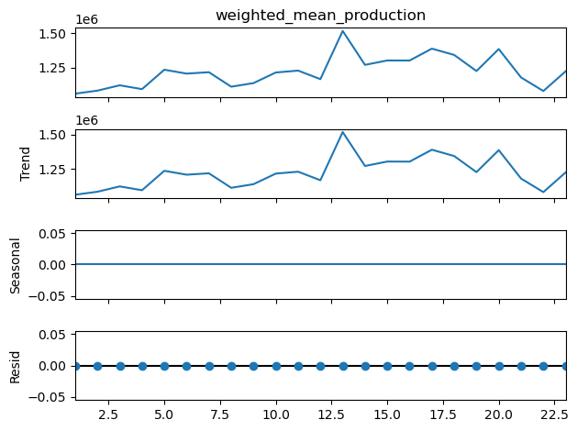
Jute Production in West Bengal
We first get the decomposition plot.
Observed Line Chart (Top Panel): It shows the original jute production values over time. There is moderate fluctuation with an upward trend until around the 13th year, i.e., 2009, followed by a few drops and recoveries. This aligns with what we saw in the initial line plot.
Trend (2nd Panel): The trend line captures the general increase up to the peak, then a gradual decline. This confirms that production has long-term movement, which needs to be handled in modelling (e.g., through differencing).

Slide 42
Jute Production in West Bengal
Seasonality (3rd Panel): The seasonal component is flat (zero), as expected. This confirms that the data does not have seasonality within the year since jute is an annual Kharif-season crop and the data is available yearly.
Residual (4th Panel): The residuals are very small and relatively constant. This indicates that most of the variance in the data is explained by the trend component, not noise or seasonality.

Slide 43
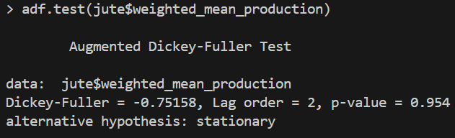
Jute Production in West Bengal
We then apply the Augmented Dickey-Fuller (ADF) Test to check the stationarity of the series. The hypotheses are such that,
H₀: the time series is non-stationary
H₁: the time series is stationary
Note: We should consider d=2 for ARIMA modelling.
We get the p-value as 0.954 > α=0.05. So, we accept the null hypothesis and say that the data is non-stationary. As seen before, there is a trend in the data which makes it non-stationary. So, the trend needs to be handled by differencing.
The following table sums the ADF test results after differencing.
Series | ADF Statistic | p-value | Stationarity
Original Series | -0.75158 | 0.954 | Non-stationary
1st differencing | -3.5619 | 0.0553 | Borderline non-stationary
2nd differencing | -5.4338 | <0.01 | Stationary

Slide 44
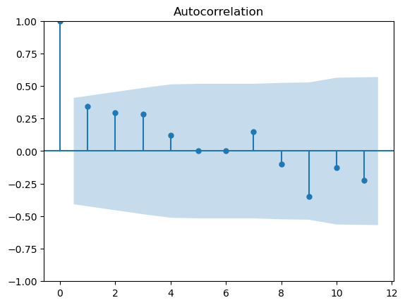
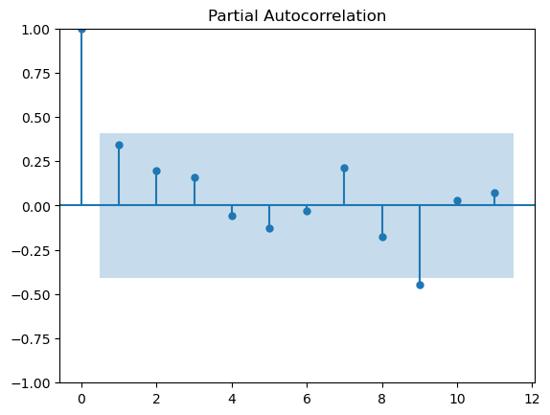
Jute Production in West Bengal
Note: We consider p=3 & q=1 for ARIMA modelling.
Now, we consider the Autocorrelation and Partial Autocorrelation Plots.
The ACF plot shows a small spike at lag 1, though it is still within the confidence interval, and then a slow tapering off. So, we take the Moving Average process to be of order 1 for our model. So, q = 1.
We see mildly significant spikes up to lag 3, though the still values fall within the confidence interval. This suggests a cut-off at lag 3, meaning the data likely has an AR(3) component. So, p = 3.
Note: We fit an ARIMA(3,2,1) model

Slide 45
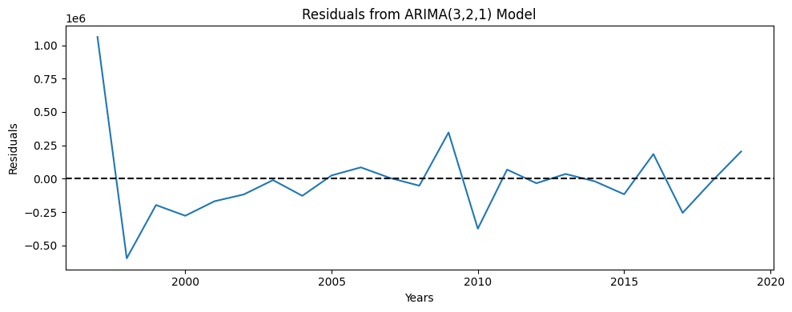
Jute Production in West Bengal
We plot the residuals against time after fitting the ARIMA(3,2,1) model.
We can see no clear trend in residuals. This is good as the residuals don’t seem to follow systematic upward or downward trends. The values alternate around 0, indicating that the model is neither overpredicted nor underpredicted. A sharp spike, in the beginning, can suggest some mild errors committed in the predicted values for the initial years.

Slide 46
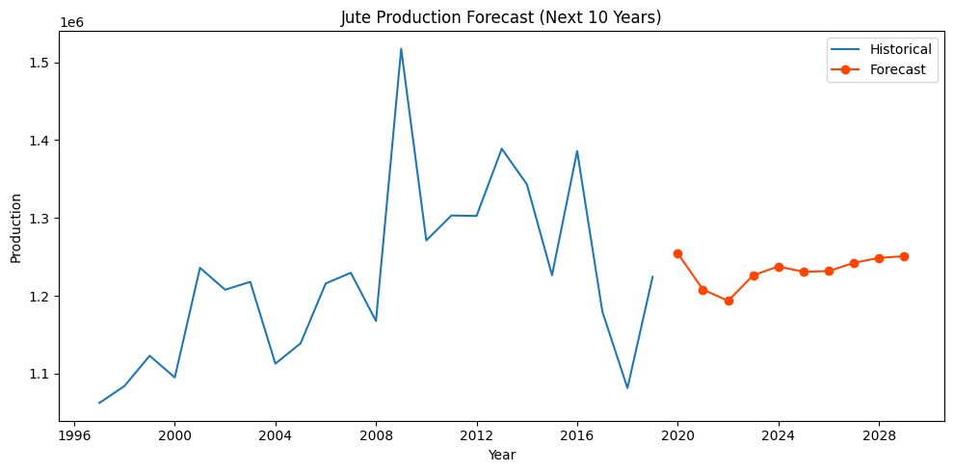
Jute Production in West Bengal
The forecast picks up from 2019 and projects a generally stable trend from 2020 to 2029. After a slight dip around 2021–2022, production stabilizes and gradually increases. No major spikes or crashes are predicted — the model suggests that jute production is likely to remain relatively consistent.
The drop immediately after 2019 may be due to sudden changes in recent production values in the original dataset or due to some errors in forecasting. From 2023 onward, forecast values show a modest upward trend, suggesting consistent productivity. There will be no major growth or decline — production is likely to stay within a narrow range (1.2 – 1.25 metric tonnes).
Note: There can be inaccuracies in prediction as the model assumes no external shocks or drastic policy/environmental changes.

Slide 47
Jute Production in West Bengal
Error Metrics:
MAE: 275250.6795822271
RMSE: 306467.149294462
MAPE:23.49357824738806
Interpretation:
For the previous forecasting graph:
MAE (Mean Absolute Error): The average difference between the actual values and the predicted values is approximately 275,250.68.
RMSE (Root Mean Squared Error): The standard deviation of the residuals (prediction errors) is roughly 306,467.15.
MAPE (Mean Absolute Percentage Error): The average percentage error between the forecasted values and the actual values is 23.49%, suggesting that the model has moderate forecasting accuracy.
Overview:
On average, the model's forecasts deviate by about 23.49% from the true values.

Slide 48
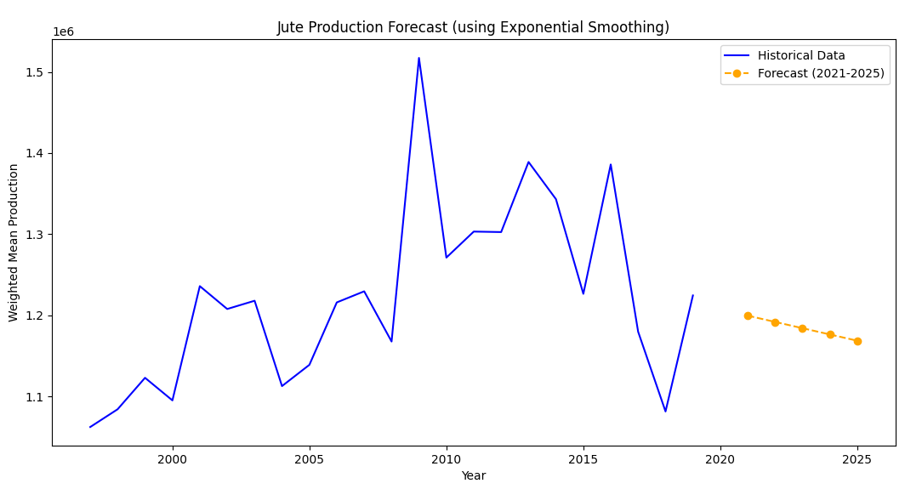
Jute Production in West Bengal
Error Metrics:
MAE: 3.2
RMSE: 3.521363372331802
MAPE: 2.7385814185814183
As the MAE value is very low and the small MAPE value reflects high accuracy in forecasting, so, overall it shows strong forecasting performance with very minimal deviation from the actual values.
Findings from the graph: The forecast line indicates a possibility of observing a slightly decreasing pattern in jute production in the next 5 years (2021-2025). Also, from the previous forecasting model, we have observed that there is a slightly decreasing pattern just after 2020. So, the results are more or less similar in both cases, indicating a reliable forecast.

