Slide 1
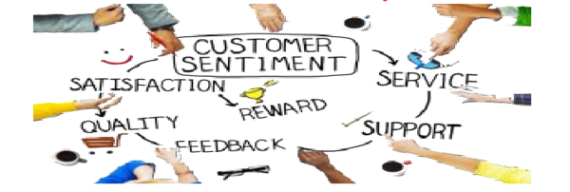
NLP Sentiment Analysis for Customer Feedback on headphones
Dataset: data_sentiment_headphone.csv
Presented by~
Ankita Shinde
31031421029

Slide 2

Problem Statement
This is an add-on project for a client that wants to learn about their customers' sentiments through feedback and ratings in order to retain them and enhance their services to fulfil their needs.

Slide 3
Techniques Used to Resolve Problem
Tokenization
Punctuation Elimination
Normalization
Stopwords Removal
Lemmatiazation
World Cloud
Classifier: Naive Bayes

Slide 4
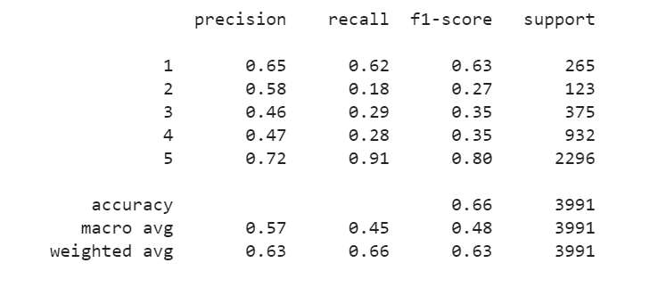
Accuracy

Slide 5

Conclusion and Further Scope
Online reviews have become a platform for building trust and influencing consumer buying patterns. With such dependency there is a need to handle such large volume of reviews and present credible reviews before the consumer. Our research is aiming to achieve this by conducting sentiment analysis headphone reviews.
Data from customer feedback can be used to identify areas for improvement. Sentiment analysis can help you extract value and insights from customer feedback data, as well as develop effective customer satisfaction strategies.
The reviews of headphones highlighted different features under word cloud. The key feature identification from reviews using word cloud helps marketers understand the most preferred features by customers.
In future, the work can be extended to perform multi- class classification of reviews for the better judgement of the product. It can also be used to predict rating of a product from the review. Further we can add more domain specific keywords to improve accuracy as well we can use TFID. Extension of work will be very beneficial for the e-commerce industry for customer satisfaction and trust.

