Slide 1
BERT NLU Pre-training

Slide 2
Agenda
Keywords (Prerequisites)
Pre-training & transfer learning in NLP
Motivation for BERT
Pre-training & Fine-tuning
Comparative Studies

Slide 3
Keywords
Embeddings
Language Model (LM)
Bidirectional Training
Word vectors – TfIdf/count vector
Fine - Tuning
SOTA, a lot of SOTA!
Transformers

Slide 4

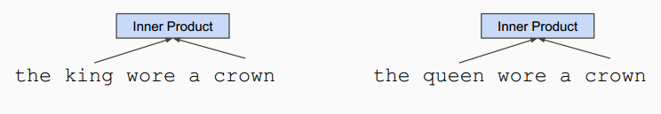
Pre-training in NLP
Word embeddings are the basis of deep learning for NLP
Embeddings are often pre-trained on text corpus from co-occurrence statistics

Slide 5
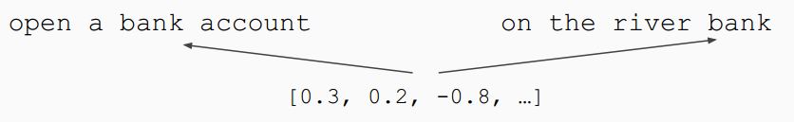
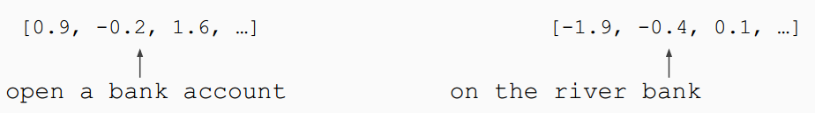
Contextual Representations
Word embeddings like (GloVe, word2vec) are context free
A fixed embeddings vector for each word
Does not take into account different possible usage of the word
Train contextual representations

Slide 6
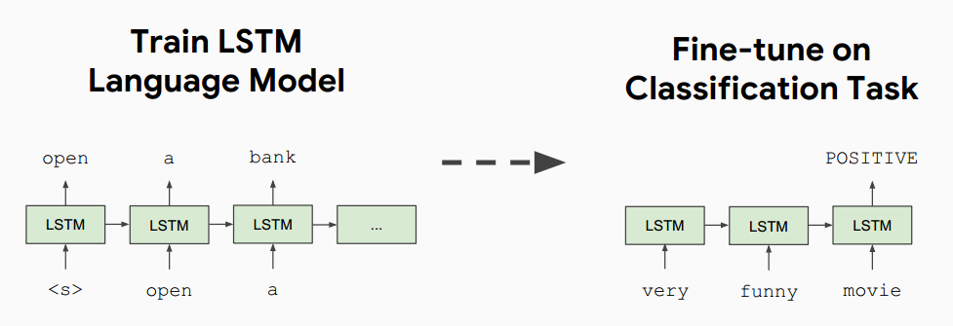
Contextual Representations
Semi-Supervised Sequence Learning, Google, 2015 (https://arxiv.org/abs/1511.01432)

Slide 7
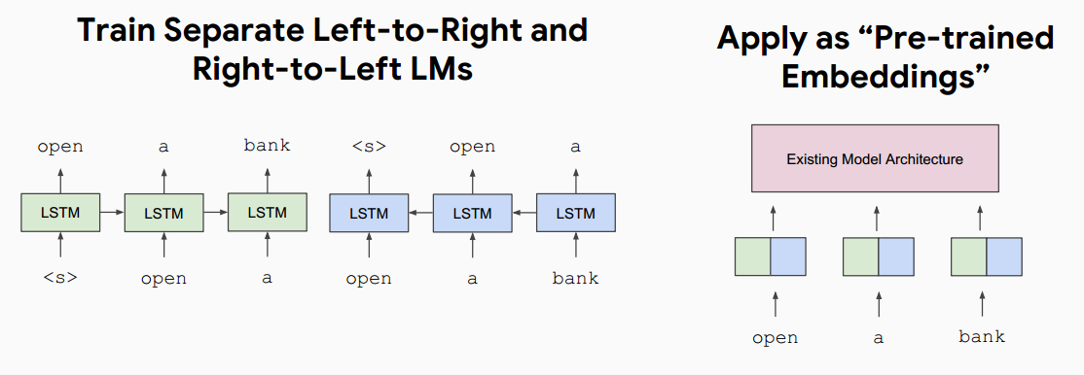
Contextual Representations
ELMo: Deep Contextual Word Embeddings, AI2 & University of Washington, 2017 (https://allennlp.org/elmo)

Slide 8
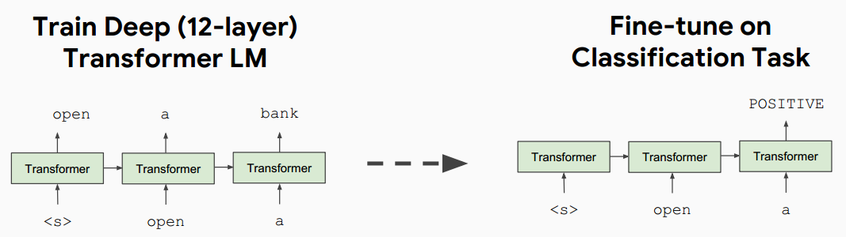
Contextual Representations
Improving Language Understanding by Generative Pre-Training, OpenAI, 2018 (https://openai.com/blog/language-unsupervised/)
8 P600 GPU's * 30 days * 12 TFLOPS/GPU * 0.33 utilization = = .96 pfs-days

Slide 9
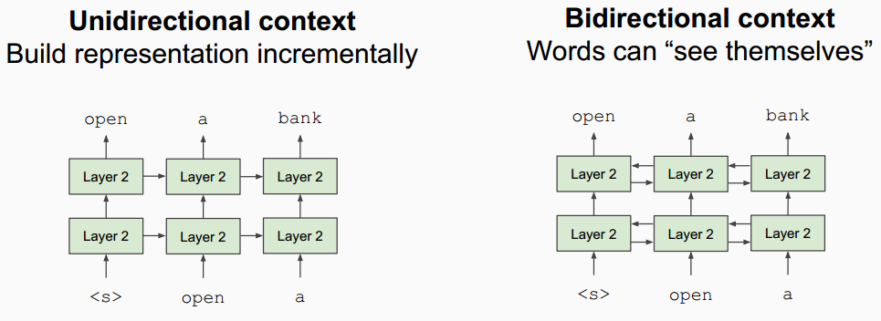
Problem with previous architectures
Words can “see themselves” in a bidirectional encoder.
Notes:
Language models only use left context or right context, but language understanding is bidirectional.

Slide 10
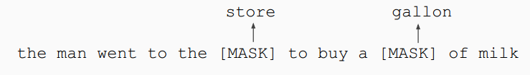
Bidirectional Approach - MLM
Mask out k% of the input words, and then predict the masked words
We always use k = 15%
Too little masking: Too expensive to train
Too much masking: Not enough context
MLM – Masked Language Model

Slide 11
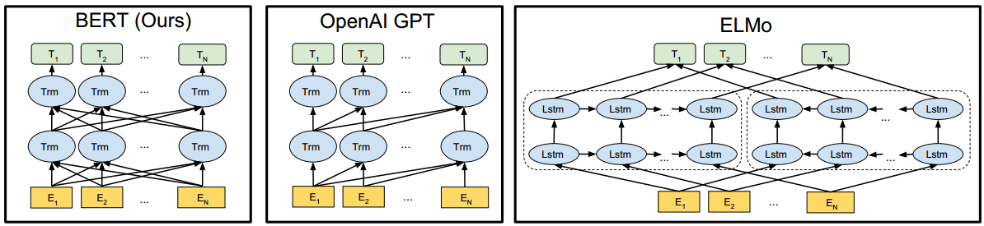
Architecture Difference in Bert, GPT, ELMo

Slide 12
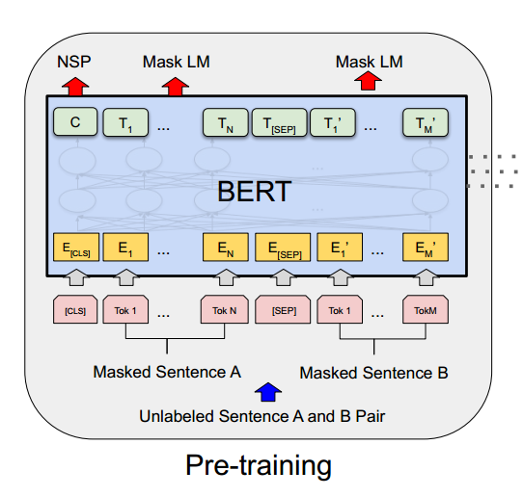
BERT Model
Pre-training: Semi-supervised training on large amounts of text (books, Wikipedia etc)
Fine-tuning: Supervised training on a specific task with a labeled datset
 | Bert (Base) | Bert (Large)
Layers | 12 | 24
Hidden Size | 768 | 1024
Self-Attention head | 12 | 16
Total Parameters | 110M | 340M

Slide 13
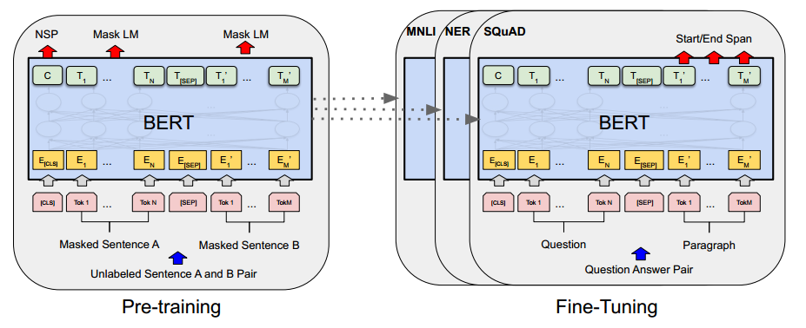
Fine-Tuning Procedure

Slide 14
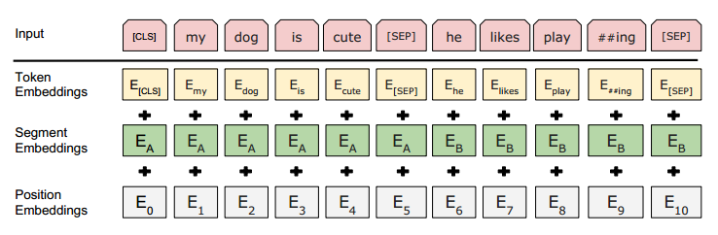
Input Representation
Use 30,000 WordPiece vocabulary on input.
Each token is sum of three embeddings
Single sequence is much more efficient.

Slide 15
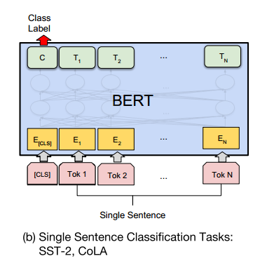
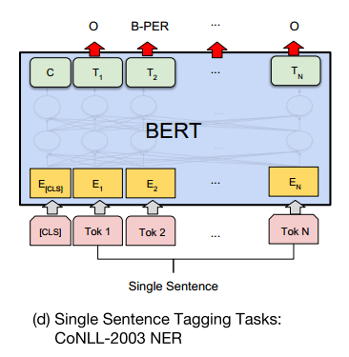
Fine-Tuning Procedure

Slide 16
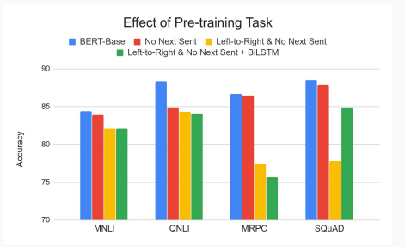
Effect of Pre-training Task
Masked LM (compared to left-to-right LM) is very important on some tasks, Next Sentence Prediction is important on other tasks.
Left-to-right model does very poorly on word-level task (SQuAD), although this is mitigated by BiLSTM

Slide 17
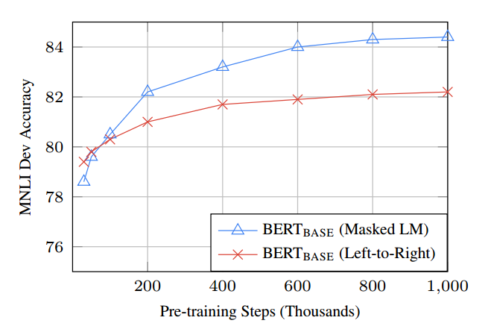
Effect of Directionality and Training Time
Masked LM takes slightly longer to converge because we only predict 15% instead of 100%
Absolute results are much better almost immediately

Slide 18
Summary
Bidirectional encodings
Easy Fine-tuning (Common Architecture)
Utilizes strong transformer network as backend

