Slide 1
Kubernetes
As I Know It
Ankit Bansal

Slide 2
Docker
Docker Glossary | Meaning | Equivalent
Images | Source code for our application with pre-installed software(s). | Any .exe file or installed software in a system
Container | A running image | A running software which executes a process
Dockerfile | A text document which contains commands to assemble an image | A shell script with build (make) commands
Host | The machine where you run your containers | Your physical machine with an OS
Registry | A place to store your images | Local disk/ Cloud Buckets
Volumes | Storage space within/outside the container | A local temp directory used by any software
Build | Process to build an image | Packing source code in a single executable file
https://www.tutorialspoint.com/docker/index.htm

Slide 3
Kubernetes Architecture
Container
Container
Container
Container
Container
Container
Container
Container
Pod
Pod
Pod
Pod
Physical Nodes or
Virtual Cluster (Namespace)
Physical Nodes or
Virtual Cluster (Namespace)
Cluster
https://kubernetes.io/docs/reference/glossary/?all=true#term-cluster

Slide 4
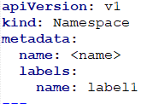
Namespace
Kubernetes namespaces help different projects, teams, or customers to share a Kubernetes cluster.
Namespace divides a physical cluster into virtual clusters
It does this by providing the following:
A scope for object Names.
A mechanism to attach authorization and policy to a subsection of the cluster.
Basically,
Namespace divides the cluster into different sub-sections.
Objects in different sections (or namespace) can have same name
Any Kubernetes cluster has 3 namespaces by default: Default, Kube-system, Kube-public
https://kubernetes.io/docs/tasks/administer-cluster/namespaces-walkthrough/
https://kubernetes.io/docs/concepts/overview/working-with-objects/namespaces/

Slide 5
Namespace
Cluster
Namespace A (Virtual Cluster A)
Namespace B (Virtual Cluster B)
Team A
Project A
Service A
Developer A – Access 1
Team B
Project B
Service B
Developer A – Access 2
https://kubernetes.io/docs/tasks/administer-cluster/namespaces-walkthrough/
https://kubernetes.io/docs/concepts/overview/working-with-objects/namespaces/

Slide 6
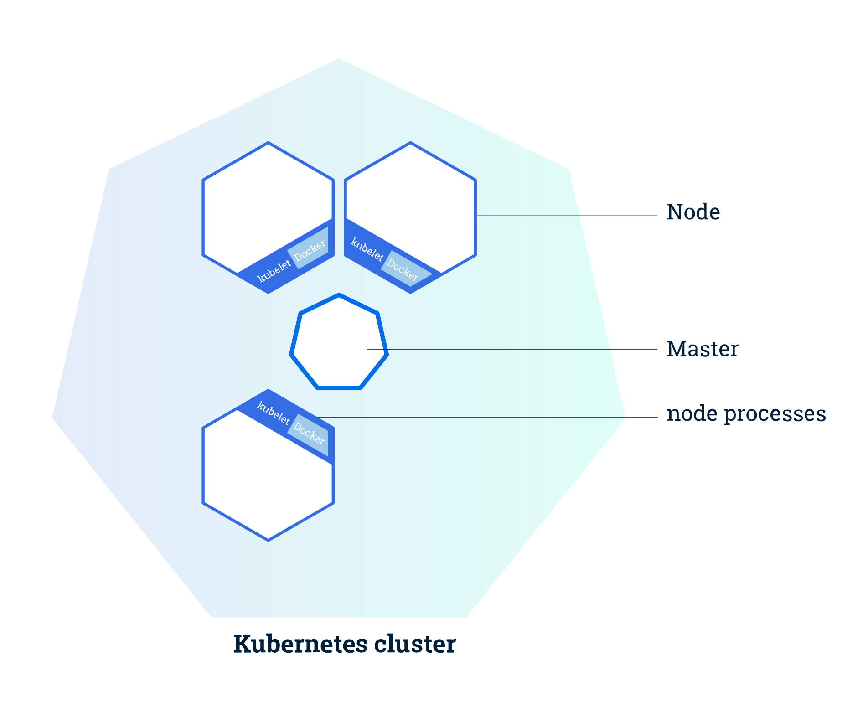
Cluster
https://kubernetes.io/docs/tutorials/kubernetes-basics/create-cluster/cluster-intro/
Notes:
Kubernetes coordinates a highly available cluster of computers that are connected to work as a single unit.
The abstractions in Kubernetes allow you to deploy containerized applications to a cluster without tying them specifically to individual machines.
Kubernetes automates the distribution and scheduling of application containers across a cluster in a more efficient way

Slide 7
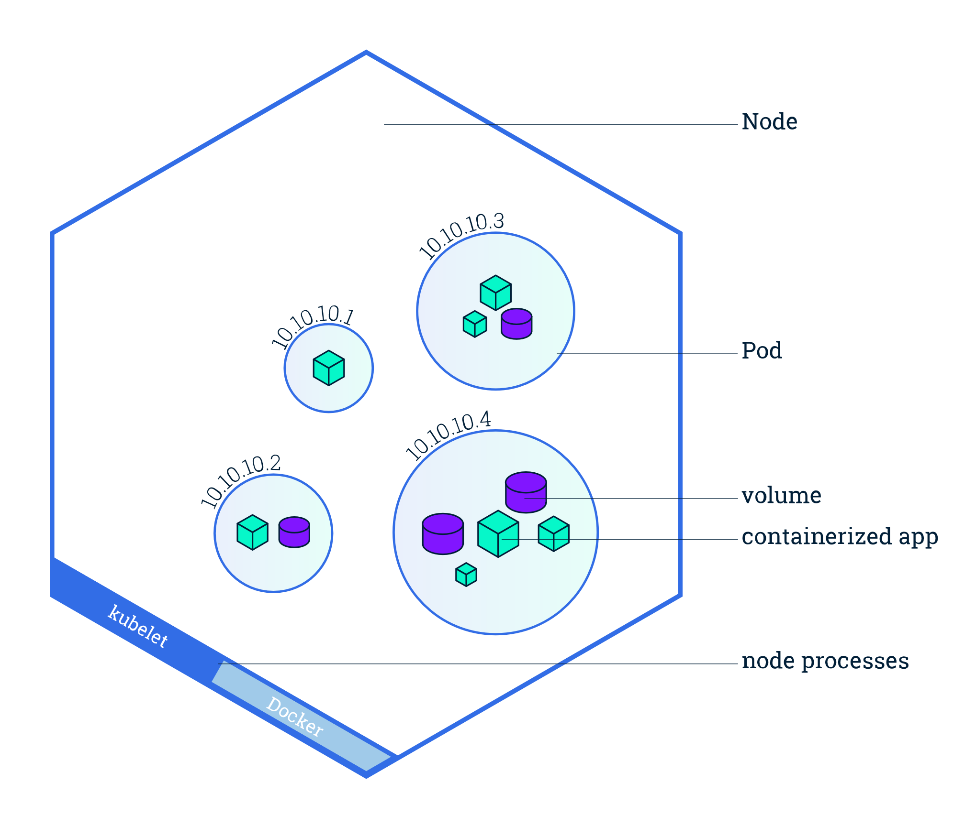
Nodes
Node := Docker Host
Managed by Master
https://kubernetes.io/docs/tutorials/kubernetes-basics/explore/explore-intro/
Notes:
Kubelet, a process responsible for communication between the Kubernetes Master and the Node; it manages the Pods and the containers running on a machine.
A container runtime (like Docker, rkt) responsible for pulling the container image from a registry, unpacking the container, and running the application.

Slide 8
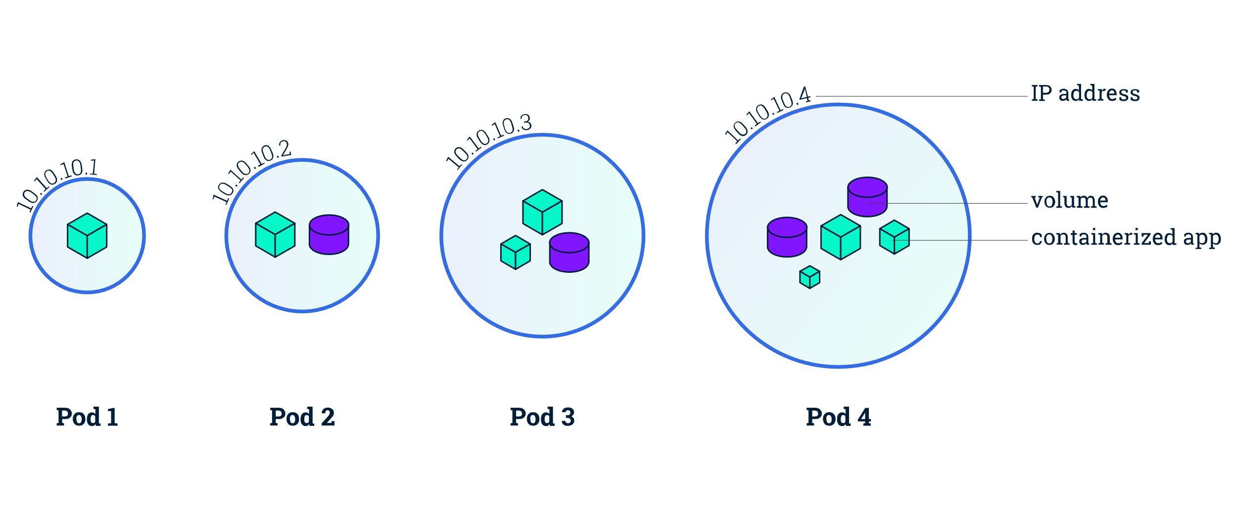
PODs
Smallest and simplest unit in the Kubernetes
A Pod represents processes running on your Cluster.
https://kubernetes.io/docs/concepts/workloads/controllers/deployment/
https://kubernetes.io/docs/concepts/workloads/pods/pod-overview/
Notes:
Most basic execution unit of a Kubernetes application–the smallest and simplest unit in the Kubernetes object model that you create or deploy.
A Pod represents processes running on your Cluster.
A Pod encapsulates an application’s container(s), storage resources, a unique network IP.
Containers within a Pod share an IP address, port space and shared volumes, and can find each other via localhost.
Containers within a Pod also have access to shared volumes, which are defined as part of a Pod and are made available to be mounted into each container’s filesystem.
Containers should only be scheduled together in a single Pod if they are tightly coupled and need to share resources such as disk.
Multi-container app: https://www.mirantis.com/blog/multi-container-pods-and-container-communication-in-kubernetes/

Slide 9
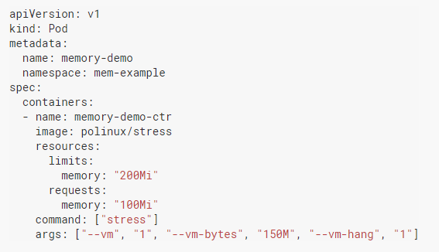
Pod Definition (Yaml)
Name of the pod
List of container(s)
Docker image
Physical Resources
Initialization Command

Slide 10
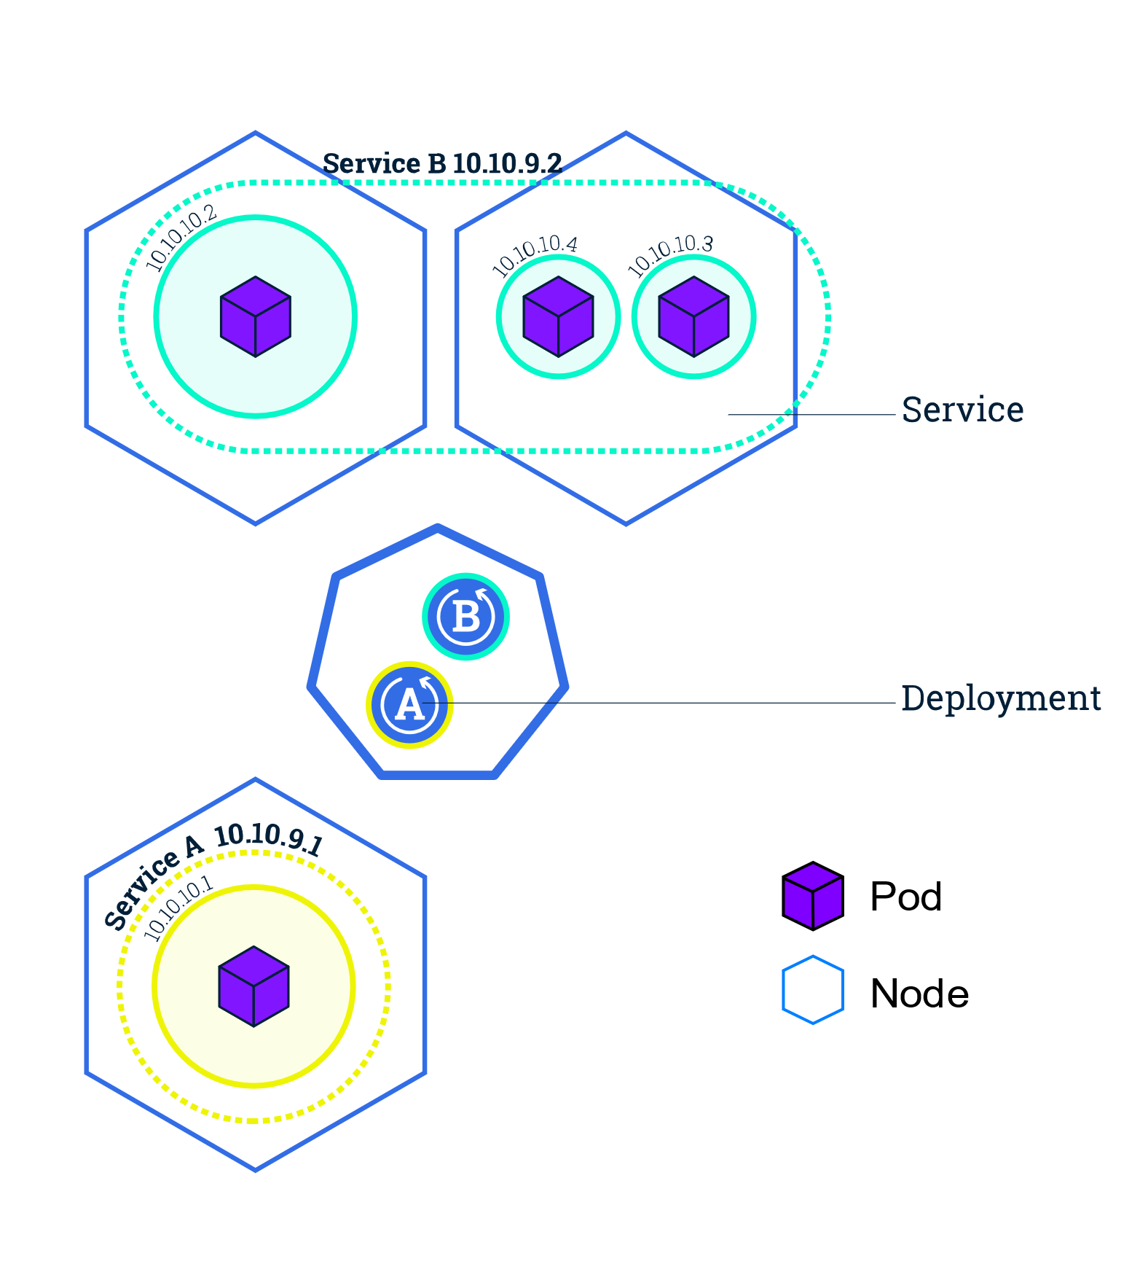
Services
https://kubernetes.io/docs/tutorials/kubernetes-basics/expose/expose-intro/
Notes:
Services are used to expose application to the Internet
A logical grouping of pods that perform the same function, grouped by label selector
Kubernetes provides the Deployment object for deploying stateless applications like web servers. Service objects define rules and load balancing for accessing your application from the internet.

Slide 11
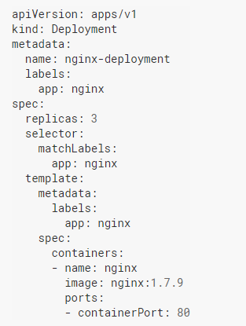
Controllers
Pod – Lowest unit of worker, ideal for single time uses
DaemonSets – one pod per physical node
Deployments – Most often used, stateless applications
Job – Run to completion
CronJob – Time triggered pods
https://kubernetes.io/docs/concepts/workloads/controllers/replicaset/

Slide 12
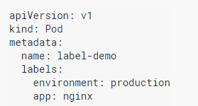
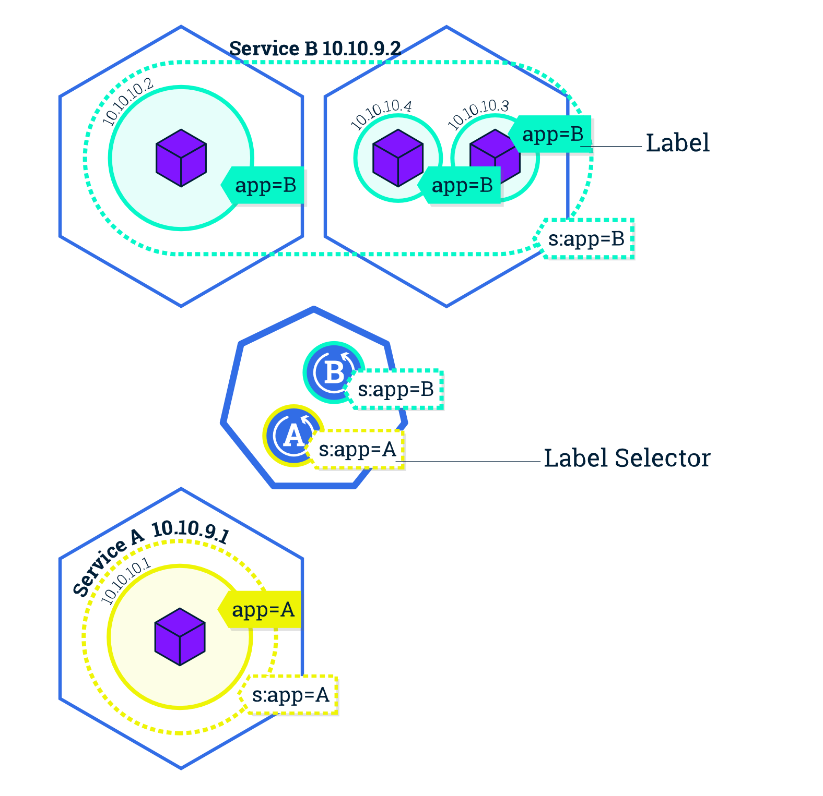
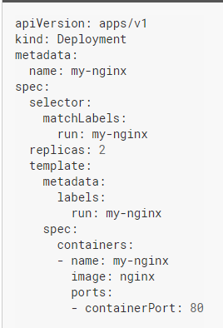
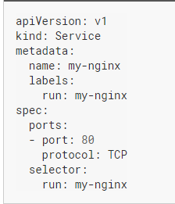
Labels and Selectors
https://kubernetes.io/docs/concepts/overview/working-with-objects/labels/#label-selectors
https://kubernetes.io/docs/tutorials/kubernetes-basics/expose/expose-intro/
Notes:
https://kubernetes.io/docs/concepts/overview/working-with-objects/names/
Unlike names and UIDs, labels do not provide uniqueness. In general, we expect many objects to carry the same label(s)
Label are a way to create subsets of any Kubernetes object ie POD A with label “app=A” can be distinguished from other POD B with label “app=B”
LabelSelectors use the above method to divide objects into groups

Slide 13
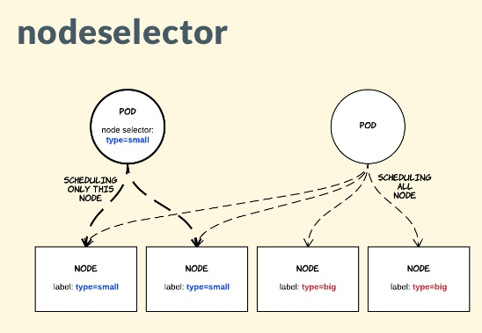
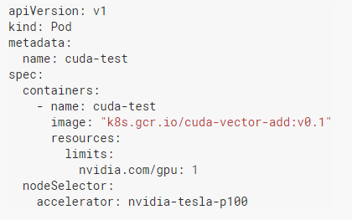
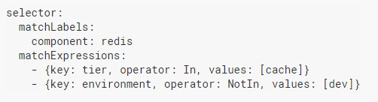
nodeSelector
Which node to select for a POD?
Think of SQL “select … where …”
Notes:
Controller uses nodeselector condition to schedule a pod on any specific node

Slide 14
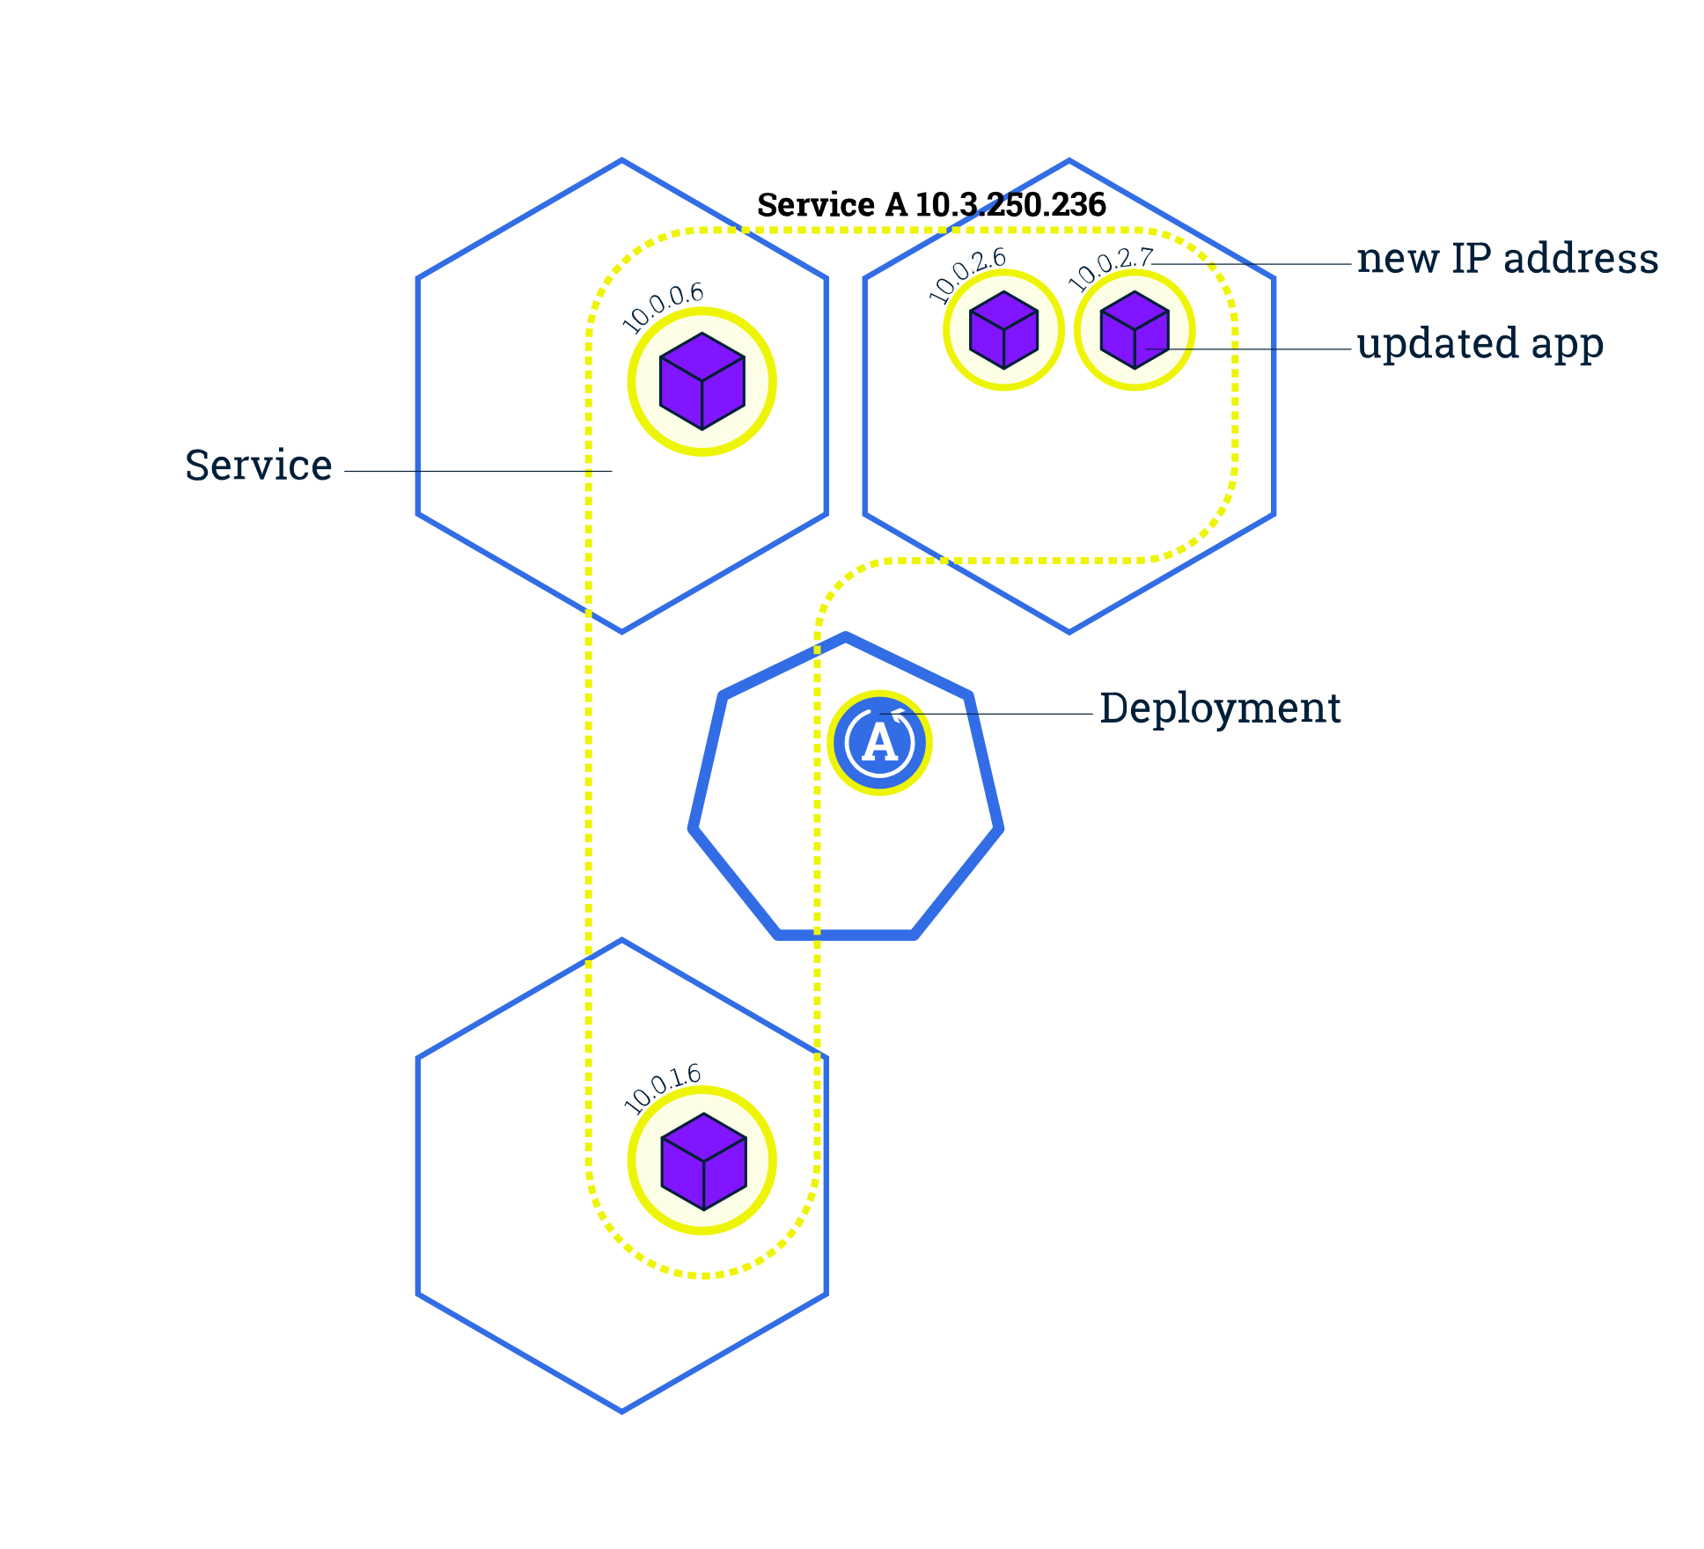
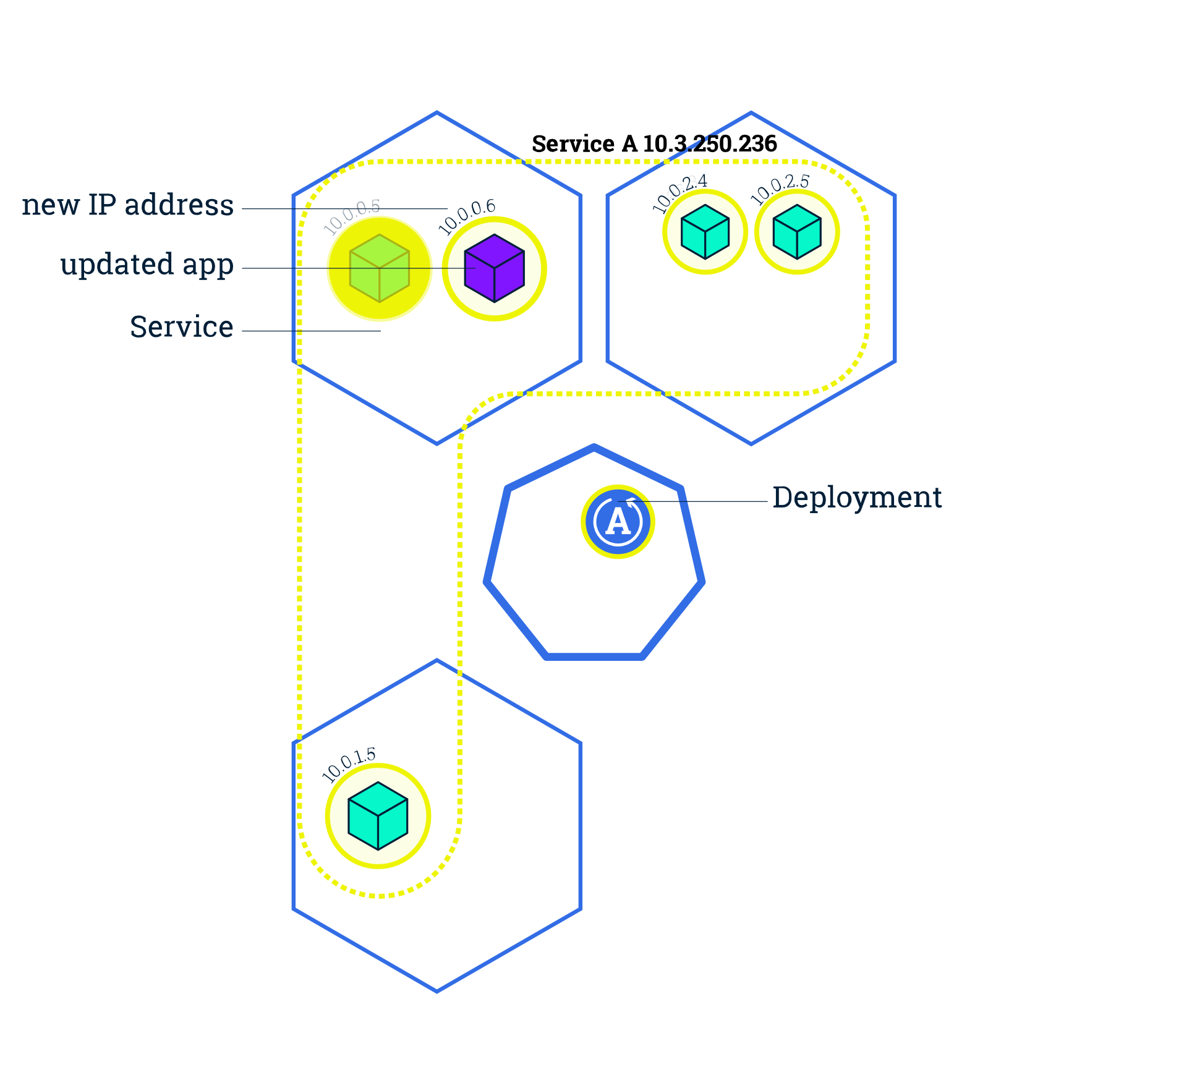
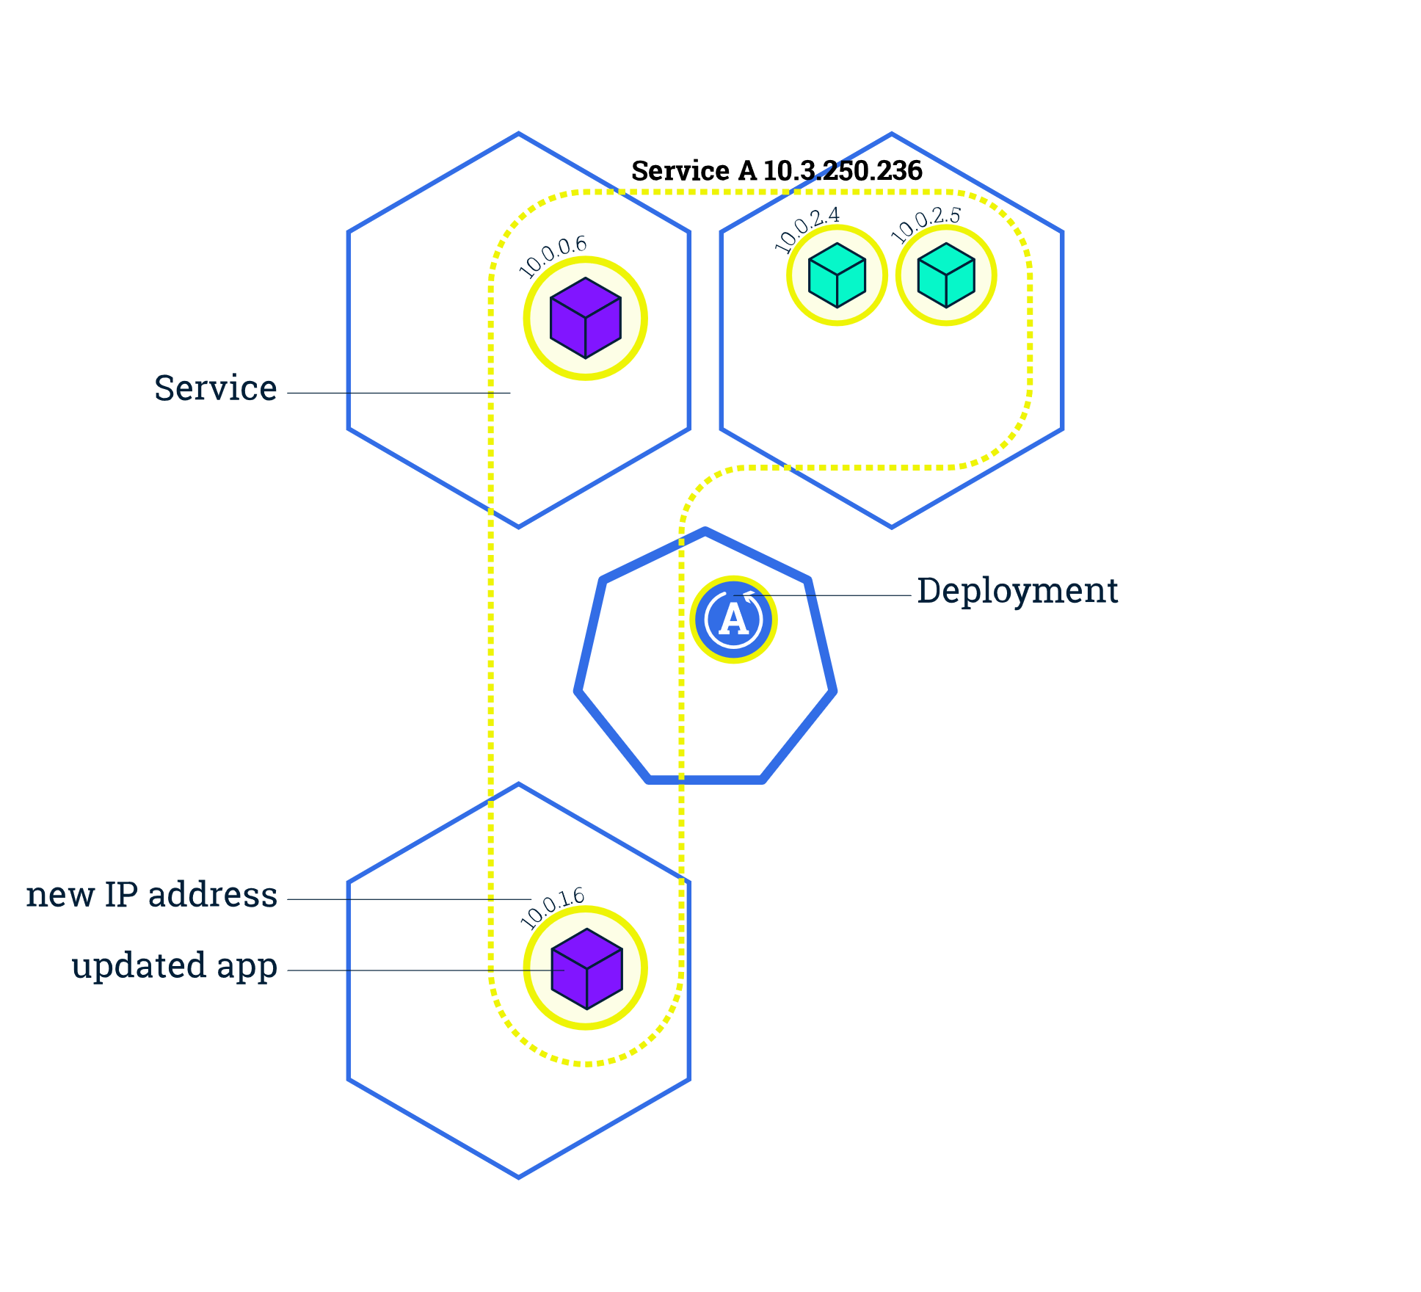
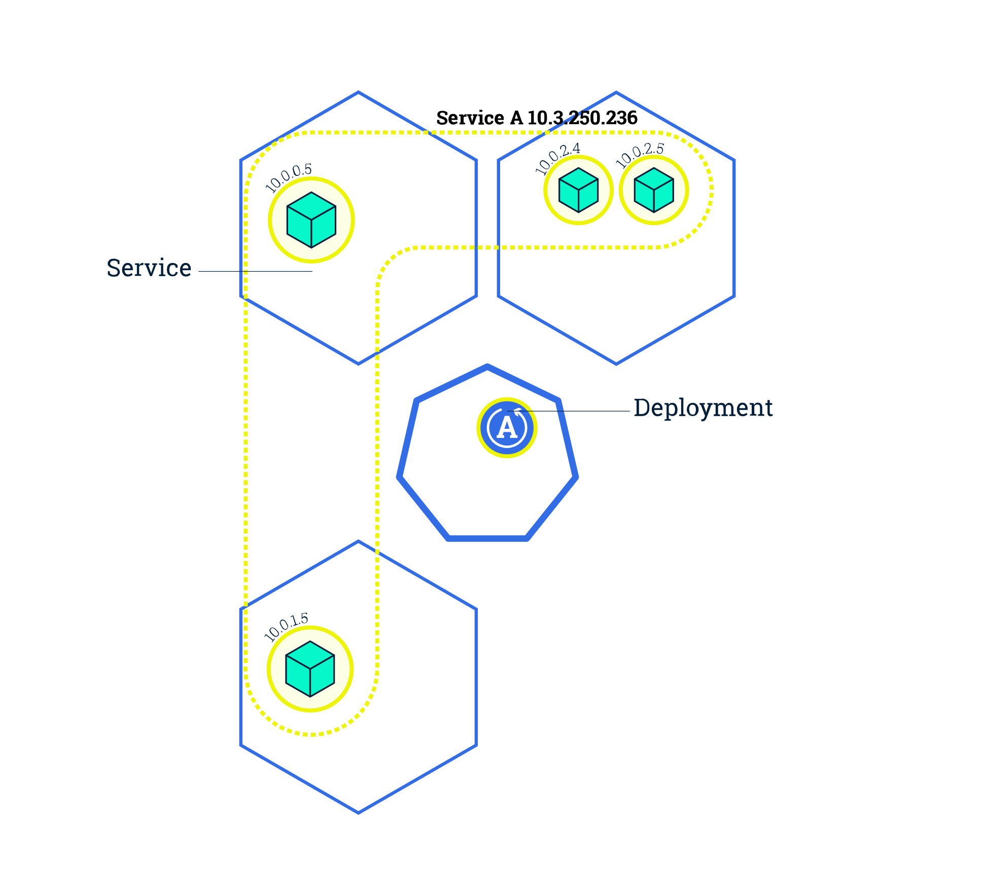
Rolling Update
kubectl rolling-update name new_name --image=image:TAG
kubectl rolling-update NAME -f FILE
# read the configuration from a file
https://kubernetes.io/docs/tutorials/kubernetes-basics/update/update-intro/
https://kubernetes.io/docs/reference/generated/kubectl/kubectl-commands#rolling-update
Notes:
Rolling updates allow Deployments' update to take place with zero downtime by incrementally updating Pods instances with new ones.
By default, the maximum number of Pods that can be unavailable during the update and the maximum number of new Pods that can be created, is one.

Slide 15
Rolling Update
kubectl rolling-update name new_name --image=image:TAG
kubectl rolling-update NAME -f FILE
# read the configuration from a file
https://kubernetes.io/docs/tutorials/kubernetes-basics/update/update-intro/
https://kubernetes.io/docs/reference/generated/kubectl/kubectl-commands#rolling-update
Notes:
Rolling updates allow Deployments' update to take place with zero downtime by incrementally updating Pods instances with new ones.
By default, the maximum number of Pods that can be unavailable during the update and the maximum number of new Pods that can be created, is one.

Slide 16
Rolling Update and Rollback
To update a service without an outage, kubectl supports what is called rolling update, which updates one pod at a time, rather than taking down the entire service at the same time.
A rolling update works by:
Creating a new replication controller with the updated configuration.
Increasing/decreasing the replica count on the new and old controllers until the correct number of replicas is reached.
Deleting the original replication controller.
kubectl rolling-update NAME NEW_NAME --image=IMAGE:TAG
kubectl rolling-update NAME -f FILE # read the configuration from a file
kubectl rolling-update NAME --rollback
https://kubernetes.io/docs/tutorials/kubernetes-basics/update/update-intro/

Slide 17
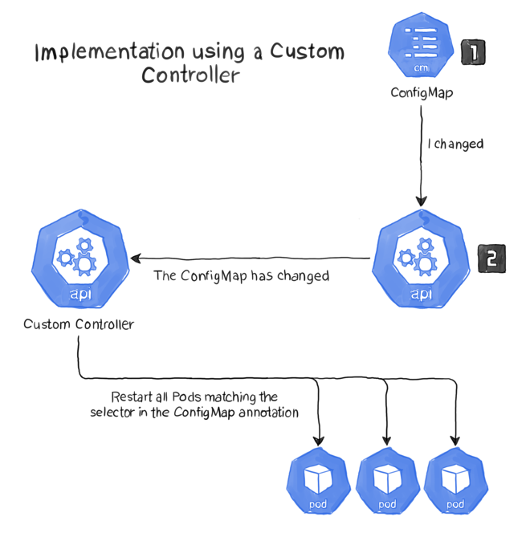
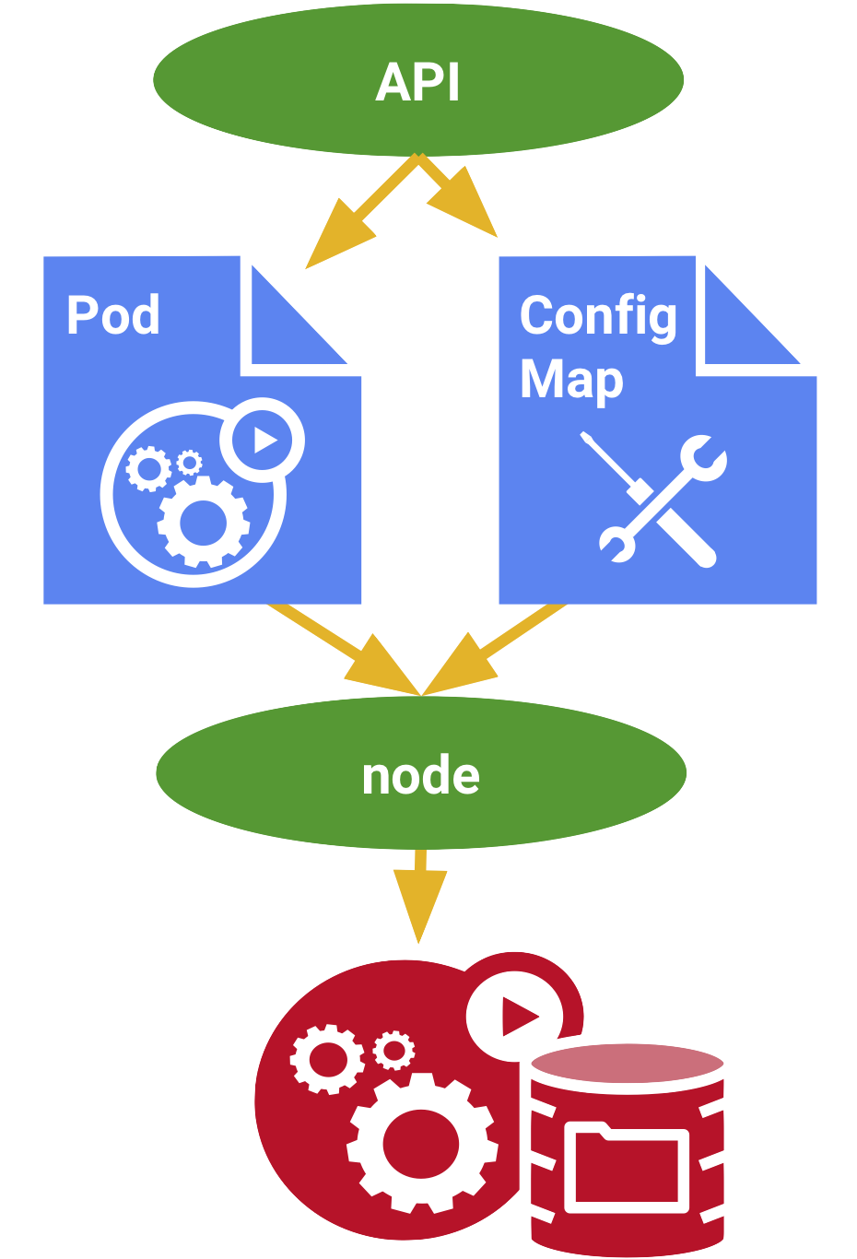
Configmap
Rolling update for small changes?
What about config like user changes?
https://www.magalix.com/blog/creating-custom-kubernetes-operators
Notes:
Used to
Populate the value of environment variable
Command line arguments
Config files

Slide 18
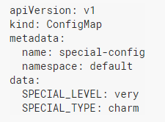
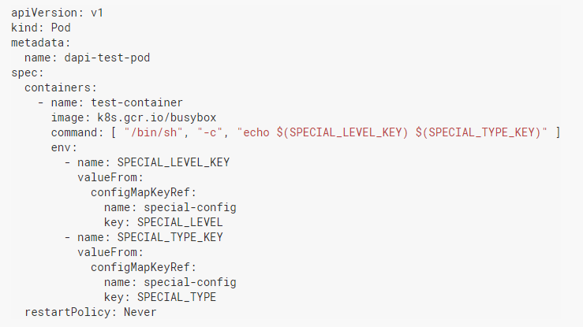
Configmap
Kubernetes object for injecting containers with configuration data
Can be : Individual key-value pair, JSON files, Config files
Same as Secrets, but used for non-confidential data
Mounted ConfigMaps are updated automatically
https://kubernetes.io/docs/tasks/configure-pod-container/configure-pod-configmap/

Slide 19
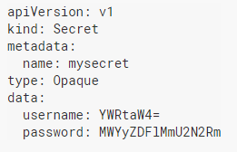
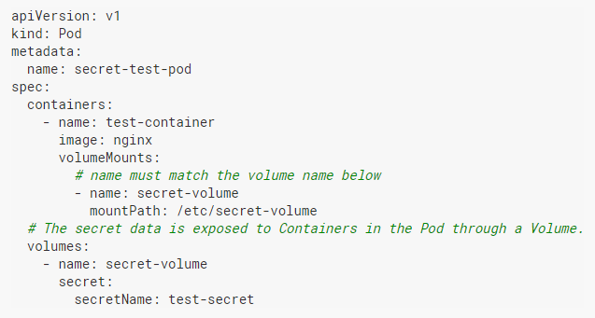
Secrets
Used to store the confidential information within the cluster
Pass confidential information to the containers
Scope: within the namespace
Creating Secret from File
kubectl create secret generic credentials --from-file=key.json=<path/to/file> --namespace=<namespace>
Creating secrete from literal values
kubectl create secret generic test-secret --from-literal=username='my-app' --from-literal=password='39528$vdg7Jb’ --namespace=<namespace>
https://kubernetes.io/docs/tasks/inject-data-application/distribute-credentials-secure/

Slide 20
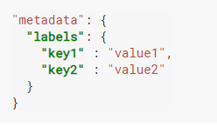
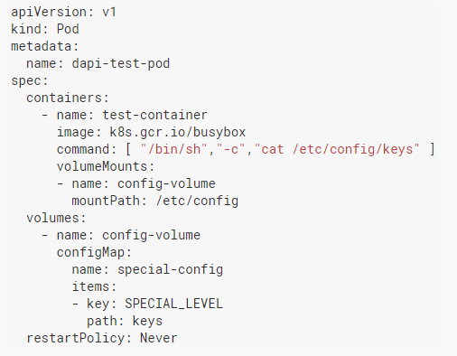
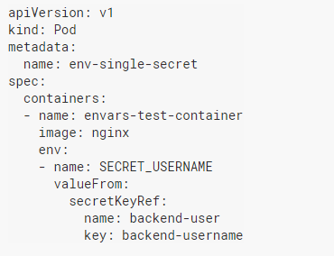
Configmap

Slide 21
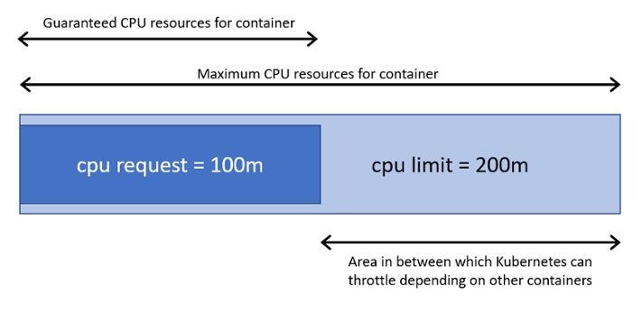
Resource Management
How many pods to schedule on a Node?
Resource Requirements of a pod (or containers)
What if resource requirements are flexible?
Specify Min and Max limits
https://kubernetes.io/docs/concepts/configuration/manage-compute-resources-container/

Slide 22
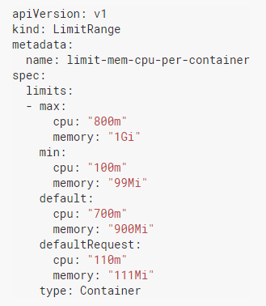
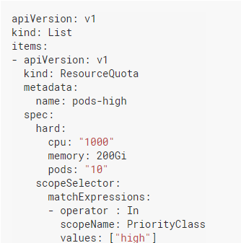
Resource Management (…contd)
Specify same thing n times?
Define defaults at pod/container level - LimitRange
How to limit resources for different namespaces?
Define ResourceQuotas
What type of resources can I control?
CPU, Memory, # PODs, Jobs, Deployments, Volumes
https://kubernetes.io/docs/concepts/policy/limit-range/
https://kubernetes.io/docs/concepts/policy/resource-quotas/
https://kubernetes.io/docs/tasks/administer-cluster/manage-resources/memory-default-namespace/

Slide 23
Resource Management in Kubernetes
If memory requests are higher than what is available on Node, the pod is terminated
Compute Resources:
CPU – Specified in mili cores. E.g. “200m” means 0.2 core
Memory – Specified in Mebibites (Mib) or Gibibites (Gib)
Object Resource Count:
Jobs, Deployments, secrets etc
Measures:
Limits – Maximum permissible resources available to a container
Requests – Min amount of resources allocated to the container
Can be managed at namespace or POD level
Mebibites = 2^20; Megabyte = 10^6
https://kubernetes.io/docs/concepts/configuration/manage-compute-resources-container/

Slide 24
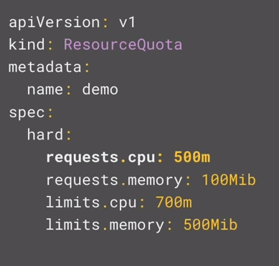
ResourceQuotas
ResourceQuotas manages total resources used by a particular namespace.
Quotas for specific priority can also be specified.
E.g. Production namespace can have higher resource than development namespace
Objects like secrets, deployments, services etc can also be limited using resource quota
https://kubernetes.io/docs/concepts/policy/resource-quotas/

Slide 25
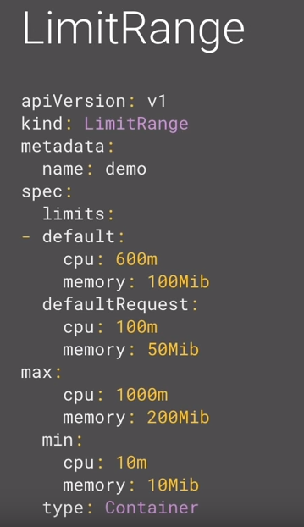
LimitRange
Multiple containers with the same resource requirements can be easily configured using default limits
Max-Min limits stop users from creating very small or very big containers
Max limits cannot be overwritten by container spec
If default not set, max is default
If max and default are not set min is default
Doesn’t apply to existing pods
Default resources for any container
Limits Max and Min resources
Min< Default < Max
https://kubernetes.io/docs/concepts/policy/limit-range/
https://kubernetes.io/docs/tasks/administer-cluster/manage-resources/memory-default-namespace/
Notes:
The maximum and minimum memory constraints imposed on a namespace by a LimitRange are enforced only when a Pod is created or updated. If you change the LimitRange, it does not affect Pods that were created previously.

Slide 26
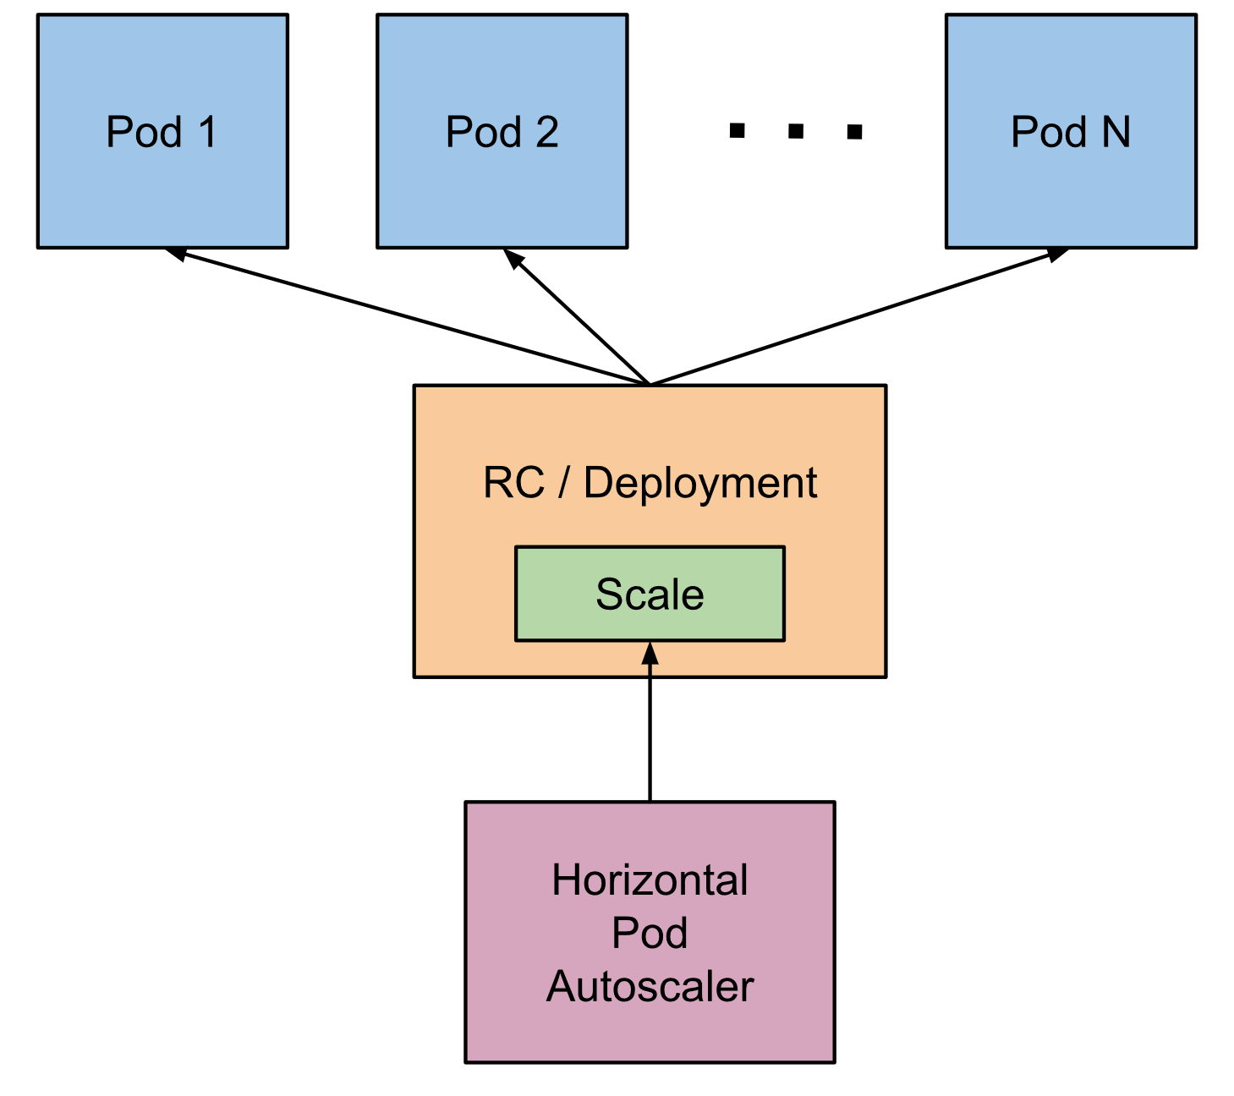
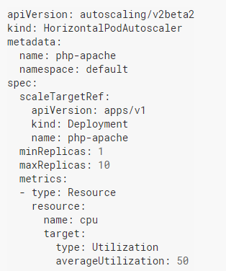
Horizontal Pod Autoscalar
Target Resource
# of Pods
Metrics
https://kubernetes.io/docs/tasks/run-application/horizontal-pod-autoscale/
https://kubernetes.io/docs/tasks/run-application/horizontal-pod-autoscale-walkthrough/
Notes:
Note that Horizontal Pod Autoscaling does not apply to objects that can’t be scaled, for example, DaemonSets.
Automatically scales the number of pods in a replication controller based on observed CPU utilization (or, with custom metrics support, on some other application-provided metrics).

Slide 27
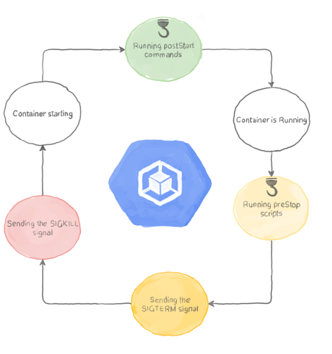
Container LifeCycle
https://kubernetes.io/docs/concepts/containers/container-lifecycle-hooks/
https://www.magalix.com/blog/kubernetes-patterns-application-process-management-1
Notes:
PostStart hook can be used to any script to setup the environment e.g. instead of saving your ML model in the image, you download it from the bucket.
Run EntryPoint Commands one container is in Running State
TerminationGracePeriod is the time difference between a SIGTERM and SIGKILL signal
preStop is used to run any script for cleaning purpose eg you have some output or failed process which you want to push to the queue
If any of the step fails, SIGKILL and container restart are followed

Slide 28
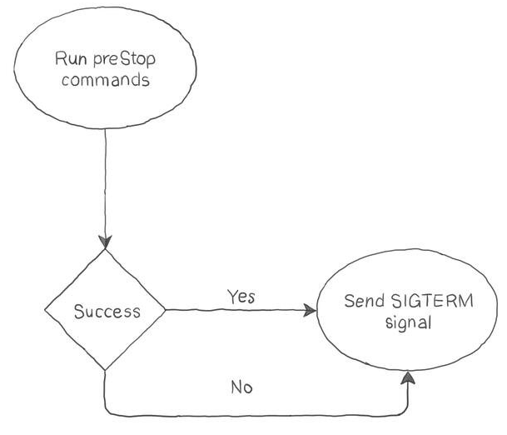
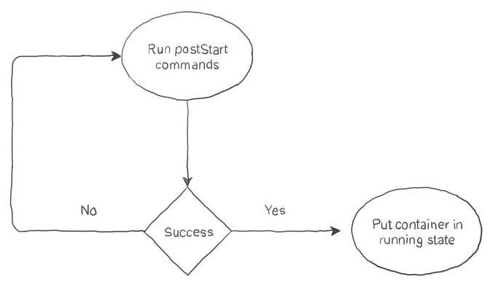
preStop & postStart

Slide 29
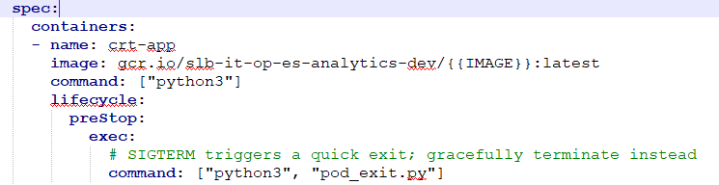
Container LifeCycle
PostStart – Any setup script, to be executed immediately after the container creation, is mentioned here
PreStop – Before the termination of any container (or Pod) controller sends ‘SIGTERM’ signal which is captured as PreStop hook. A script can be executed at this event.
terminationGracePeriodSeconds – time difference (in seconds) between SIGTERM signal and actual termination of the pod
https://kubernetes.io/docs/concepts/containers/container-lifecycle-hooks/
https://www.magalix.com/blog/kubernetes-patterns-application-process-management-1

Slide 30
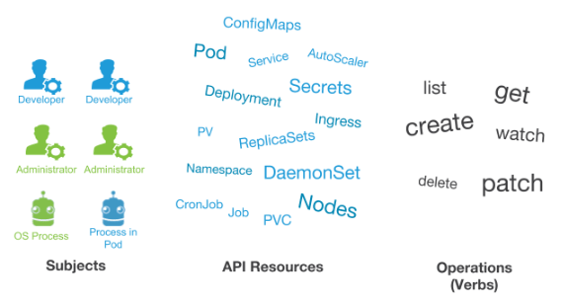
Access Control
Who should have what level of access?
Define Roles
Attach roles to users
https://kubernetes.io/docs/reference/access-authn-authz/rbac/
https://kubernetes.io/docs/reference/access-authn-authz/rbac/#privilege-escalation-prevention-and-bootstrapping
Notes:
Role and RoleBindings are defind for specific namespaces
ClusterRole and ClusterRoleBinding apply across the namespace
(C) – (Cluster)
(C)Role are the means to define access level to different k8s resources and represent set of permissions. These are additive in nature ie no deny rules.
(C)RoleBinding are used to assign different roles (ie access) to users/Service Accounts/ Groups

Slide 31
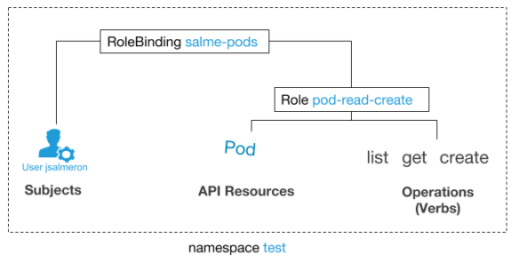
Role & RoleBinding
What about admin of the cluster?
Cluster Role
Cluster RoleBinding
Notes:
Subjects can be individual users, group of users and service accounts

Slide 32
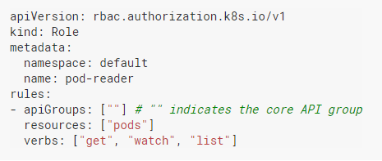
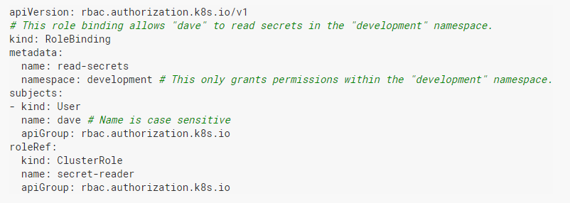
Creating Role and RoleBinding
RoleBinding can refer to the ClusterRole.
This can be used to provide the same access to different user in different namespaces without duplicating the ClusterRole to all the namespaces

Slide 33
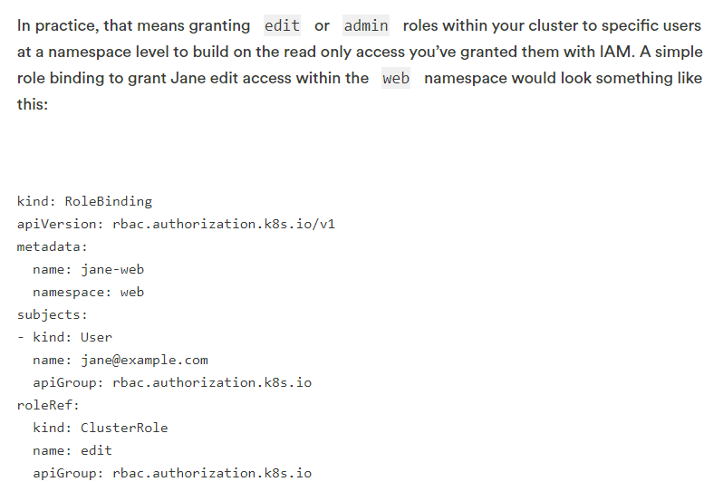
roleBinding

Slide 34
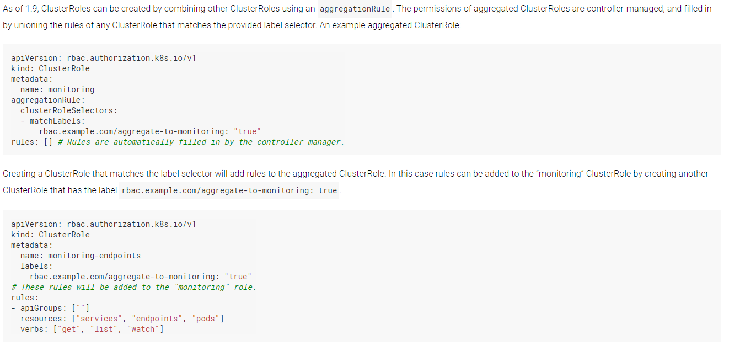
Aggregated ClusterRoles

Slide 35
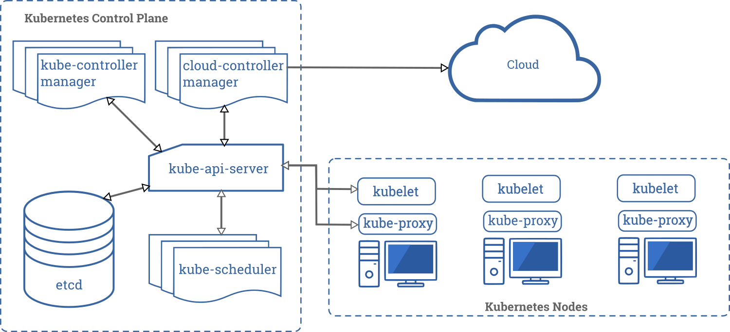
Kubernetes Components
Kube-apiserver: Exposes Kubernetes API to the user, same as front end of any application
Etcd: Key value store used as Kubernetes’ backing store for all cluster data
Kube-scheduler: Assigns new pods to the available nodes. Takes care of resource requirements, policy constraints etc
Kube-controller-manager: Runs controller processes; Node, Replication, Endpoints, Service Accounts & Token Controllers
Cloud-controller-manager: Interacts with underlying cloud service provider
Kubelet: Maintains pods on node as described in PodSpec
Kube-proxy: It is a network proxy and handles services running in each node.
https://kubernetes.io/docs/concepts/overview/components/
Notes:
Kube-apiserver: Exposes Kubernetes API to the user, same as front end of any application
Etcd: Key value store used as Kubernetes’ backing store for all cluster data
Kube-scheduler: Assigns new pods to the available pods. Takes care of resource requirements, policy constraints etc
Kube-controller-manager: Runs controller processes; Node, Replication, Endpoints, Service Accounts & Token Controllers
Cloud-controller-manager: Interacts with underlying cloud service provider
Kubelet: Maintains pods on node as described in PodSpec
Kube-proxy: It is a network proxy and handles services running in each node.

Slide 36
Kubernetes Components
https://kubernetes.io/docs/concepts/overview/components/
Notes:
Kube-apiserver: Exposes Kubernetes API to the user, same as front end of any application
Etcd: Key value store used as Kubernetes’ backing store for all cluster data
Kube-scheduler: Assigns new pods to the available pods. Takes care of resource requirements, policy constraints etc
Kube-controller-manager: Runs controller processes; Node, Replication, Endpoints, Service Accounts & Token Controllers
Cloud-controller-manager: Interacts with underlying cloud service provider
Kubelet: Maintains pods on node as described in PodSpec
Kube-proxy: It is a network proxy and handles services running in each node.

Slide 37


Thank You

