Slide 1
Intro to OpenVINO

Slide 2
What is OpenVINO?
OpenVINO stands for Open Visual Inference and Neural Network Optimization.
The OpenVINO™ toolkit quickly deploys applications and solutions that emulate human vision.
Enables CNN-based deep learning inference on the edge, maximizing performance
Speeds time-to-market via an easy-to-use library of computer vision functions and pre-optimized kernels
Includes optimized calls for computer vision standards, including OpenCV, OpenCL, and OpenVX

Slide 3
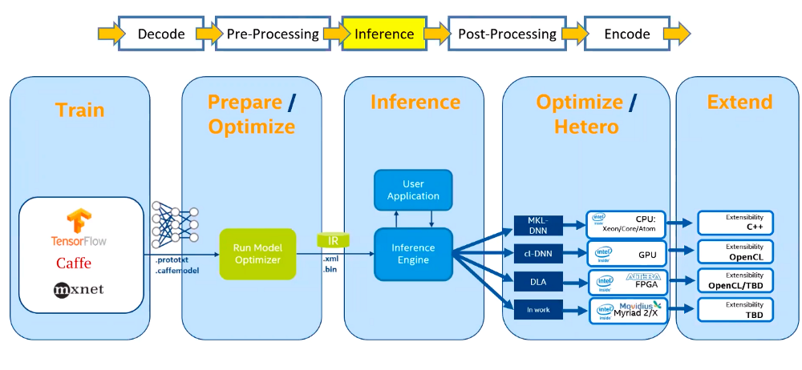
DL pipeline with OpenVINO

Slide 4
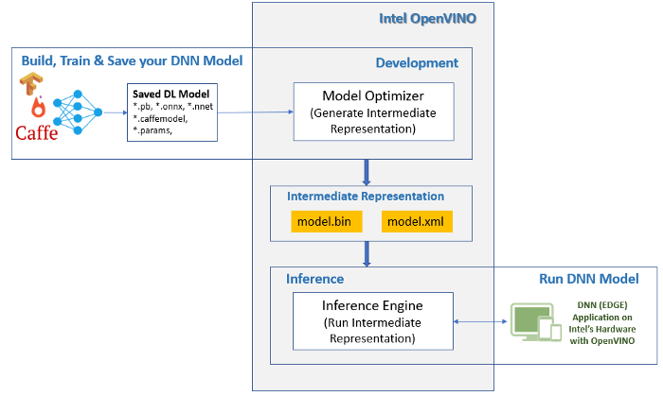
Notes:
MO produces an IR of the network, which can be read, loaded, and inferred with Inference Engine.
The Inference Engine API offers a unified API across a number of supported Intel platforms.
The Intermediate Representation is a pair of files describing the model:

Slide 5
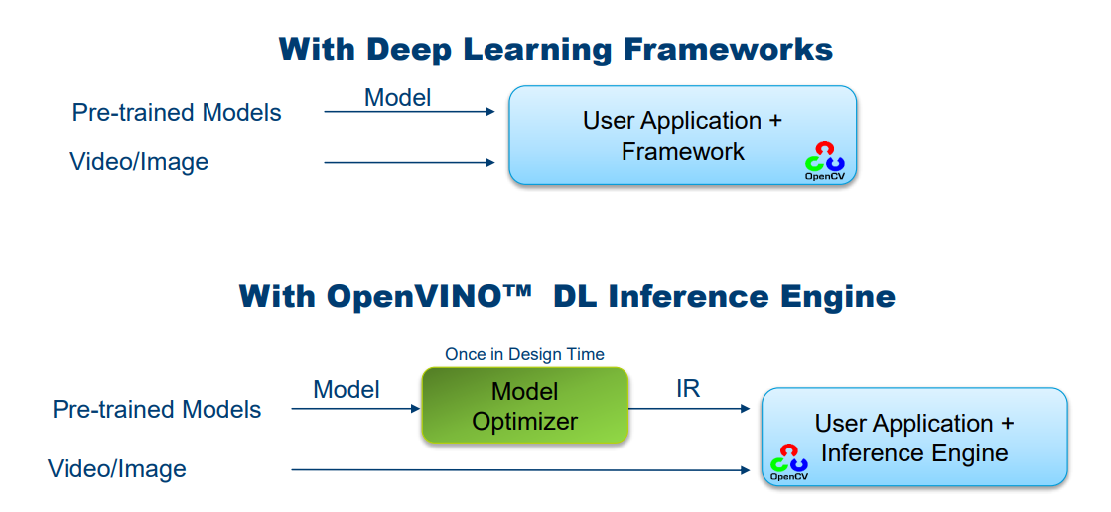

Slide 6
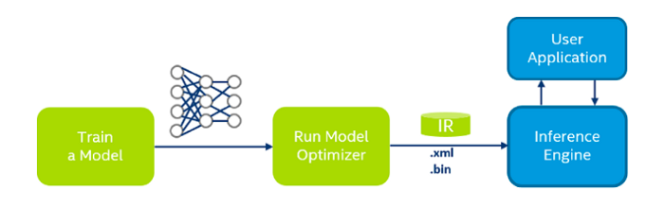
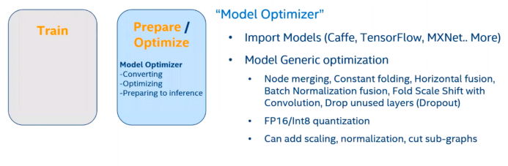
Model Optimizer
Reshaping
Batching
Quantization
Standardizing and Scaling
Modifying the Network Structure
*.xml - Describes the network topology
*.bin - Contains the weights (& biases) binary data

Slide 7
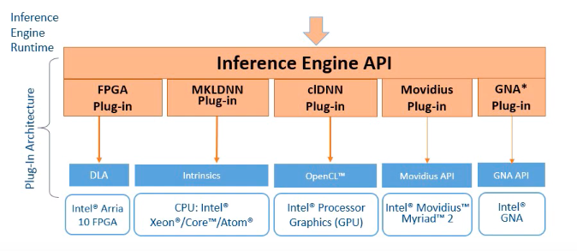
Deep Learning Inference Engine
Pure inference oriented solution (no training included)
Superior performance on Intel platform, highly optimized
Support for CPU, GPU, FPGA, Movidius
Heterogeneous execution support
Minimal memory use
No framework required in runtime
Cross-platform portability

Slide 8
Inference Engine
Heterogeneous Plug-in
Network Level Optimizations
Memory level optimizations
Kernel level optimizations

Slide 9
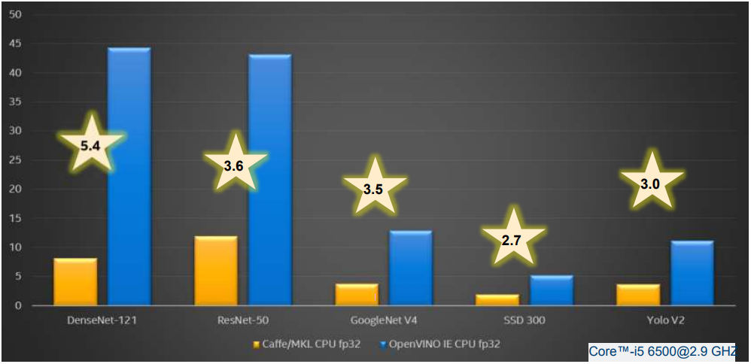
DL Model Performance using OpenVINO
Source: https://www.slideshare.net/YuryGorbachev1/openvino-introduction

Slide 10
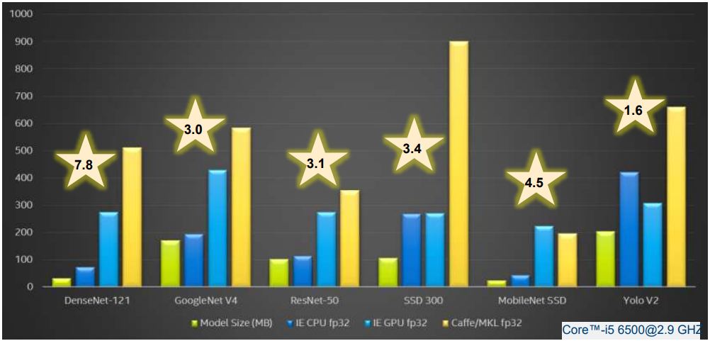
Inference Memory Footprint on CPU
Source: https://www.slideshare.net/YuryGorbachev1/openvino-introduction

Slide 11
Easier Deployment
Accurate against original framework
Direct replacement of original framework calls
No retraining/fine-tuning required
Unified support for multiple OSes
Linux and Windows are equally supported and performant
Encapsulates basic preprocessing
Mean subtraction / normalization integrated into model

Slide 12
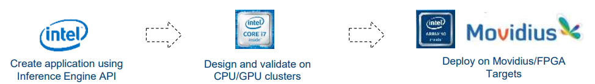
Portability across platforms
Single API across platforms
No need to change SDKs and application codes depending on targets
Consistent set of layers and accurate results across targets
Verified against reference model/framework
Heterogeneous execution for missing pieces
CPU fallback whenever needed
Intel has rapidly developing hardware set
Design app for existing targets first and move to new ones easy

Slide 13
Customization possibilities
OpenVINO™ is partially binary product right now
Possible to implement and add own layers
New topologies are easy to support
Most of the layers are delivered as a source
Check how it is done for known topologies
Base your implementation on those for faster TTM
Notes:
TTM – time to market

Slide 14
Open Model Zoo
Free reference models for Deep Learning Inference Engine
Object Detection (Face, People, Vehicles, etc.)
Object Analysis (Facial analysis, Head Pose, Vehicle attributes)
Text Detection (Text spotting, recognition, etc)
Text processing (QnA, Sentiment, etc)
Superior performance on Intel
Core™ i5 CPU: SSD 300 (6 fps) vs. People Detection Model (68 fps)
Significant reduction in development efforts, no dataset & training needed

Slide 15


Thank You - Ankit Bansal

