Slide 1
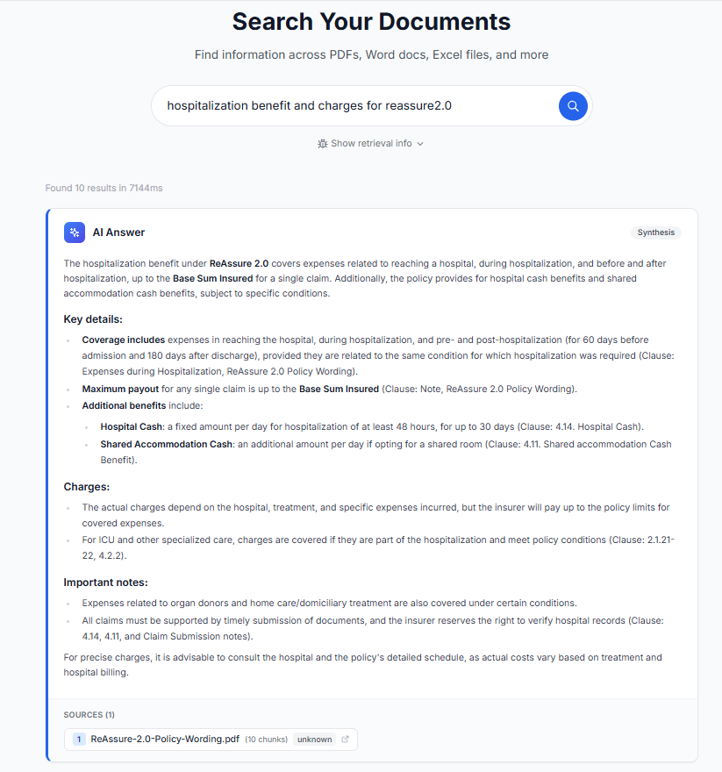
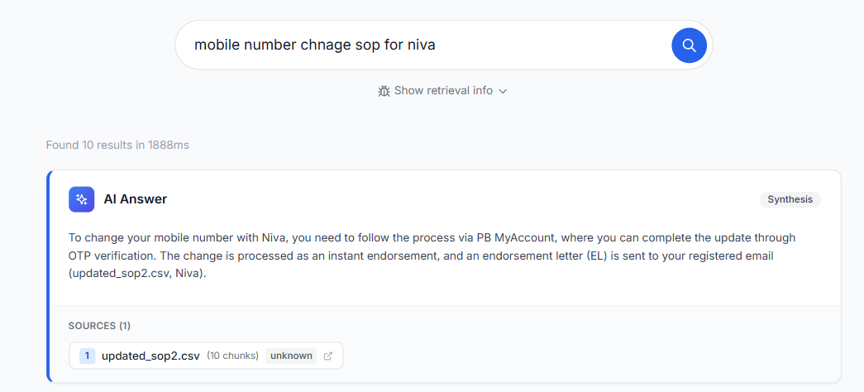
LAN FILE SEARCH SYSTEM
AI-Powered Enterprise Document Search | Runs Entirely on LAN
WHAT IT DOES
SEARCH RESULTS DEMO
• Natural language search across PDFs, Word docs, Excel, CSV files on your local network
• AI-synthesized answers with precise source attribution and confidence scoring
• Multi-vector semantic search combined with keyword matching (RRF fusion)
• Runs entirely on-premise — no data leaves your LAN
ARCHITECTURE FLOW
Documents (PDF, DOCX, XLSX, CSV)
↓ VLM-Powered Extraction (layout-aware parsing)
↓ LLM Enrichment (contextual metadata)
↓ Semantic Chunking (overlap + enriched chunks)
↓ Multi-Vector Indexing (FAISS dense + BM25 sparse)
↓ Hybrid Search (RRF rank fusion + HyDE)
↓ AI Synthesis + Response (attributed answers)
Policy search query with AI-synthesized answer
KEY TECHNOLOGIES
FastAPI · React + TailwindCSS · FAISS · Sentence Transformers · OpenAI / Gemini · HyDE · SQLite · BM25
SOP document search with source attribution
Built with FastAPI + React | FAISS + BM25 Hybrid Search | OpenAI / Gemini LLM Integration

