Slide 1
CLASSIFYING OUTCOMES BASED ON DRUG-REACTION COMBINATION
-By Team 5
-Ankit Bhayani, Rajat Agrawal, Vishakha Sawant

Slide 2
Introduction
"The FDA Adverse Event Reporting System (FAERS) is a database that contains information on adverse event and medication error reports submitted to FDA."
The FDA produces FDA Adverse Event Reporting System (FAERS) quarterly data. The FAERS include the following:
demographic and administrative information and the initial report image ID number (if available);
Drug information from the case reports;
Reaction information from the reports;
Patient outcome information from the reports;
Information on the source of the reports;
A "README" file containing a description of the files.

Slide 3
Problem statement
The problem addressed by this project is to classify the outcome of the drug reaction combination supplied to a patient based on the reported event. Since, we have different reported event by various organization we need to check whether the drug and reaction combination falls under following categories:
Death
Life-Threatening
Hospitalization
Initial or Prolonged
Disability
Congenital Anomaly
Required Intervention
Prevent Permanent Impairment/Damage
Other Serious (Important Medical Event)

Slide 4
Part 1: Parse files & Handling Missing data values
Link to Download data files:
http://www.nber.org/data/fda-adverse-event-reporting-system-faers-data.html
The goal of this exercise is to extract “all” csv files present on the faers website save them without any manual intervention.
Next step :
• Handle missing data
• Compute summary metrics
• Check for any observable anomalies and outliers.

Slide 5
Part 2: Machine Learning: Multi-class Classification
A Classification script in a Jupiter notebook in R/Python that builds a classification model for drug information from the case report / reaction information & patient outcome from the reports using downloaded dataset. Following steps would be covered:
Variable selection
Application of various ML Classification model
Deploy the best algorithm/algorithms on Azure ML studio
Create API(s)
Deploy the model using web based front end
Design of a pipeline and system to implement this approach and discussion on the system’s capabilities

Slide 6
Part 3: Summarization
Summarize the key insights related to different variables
Present the results using python notebook and Tableau/Power BI
Tools:
Python scikit-learn library for applying various classification model
Jupyter Notebook
Azure ML
Tableau for Data Visualization
Matplotlib library

Slide 7
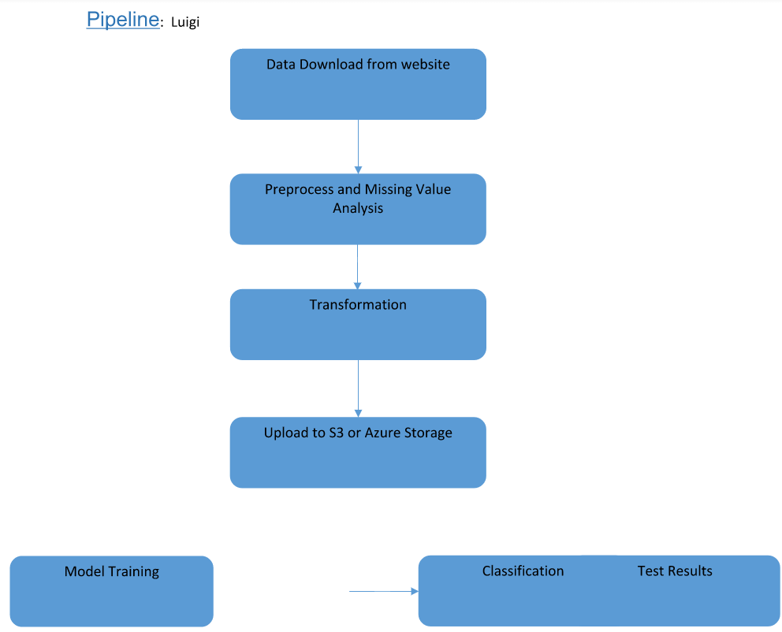

Slide 8
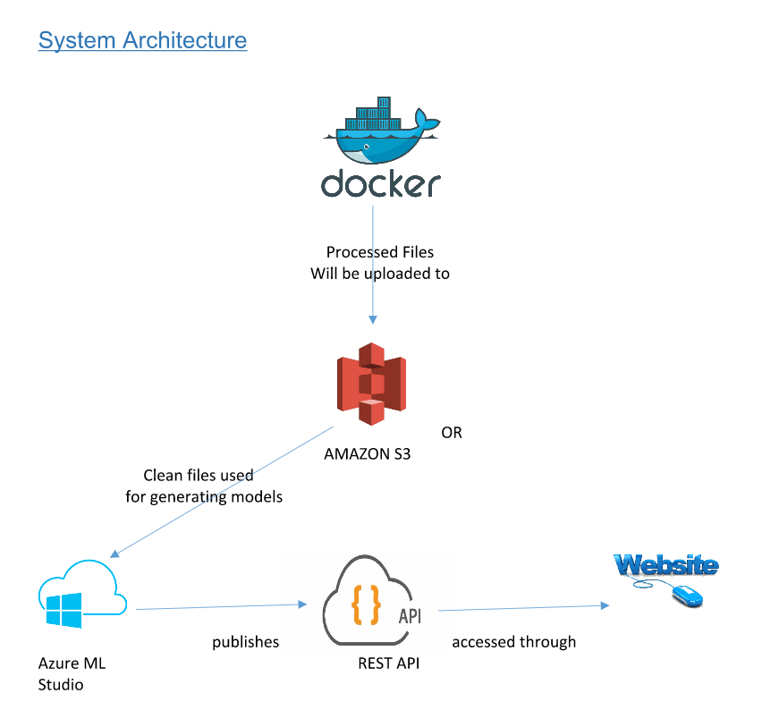

Slide 9
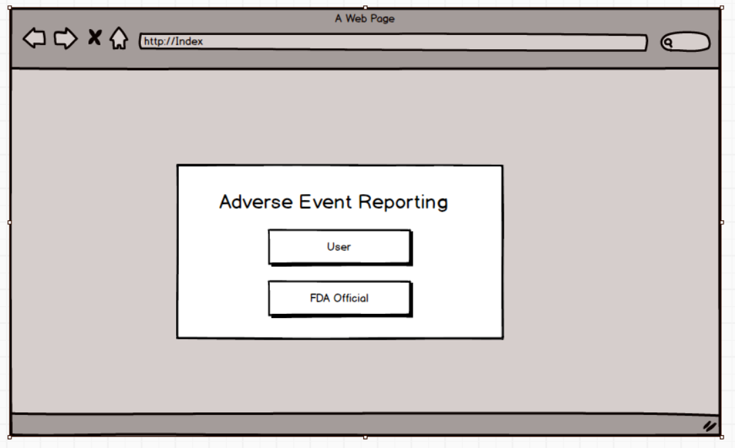

Slide 10
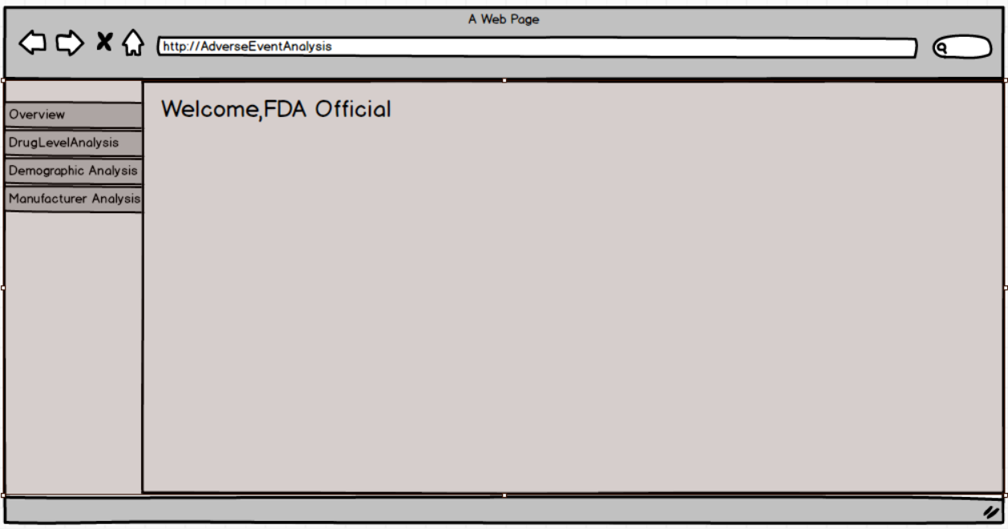

Slide 11
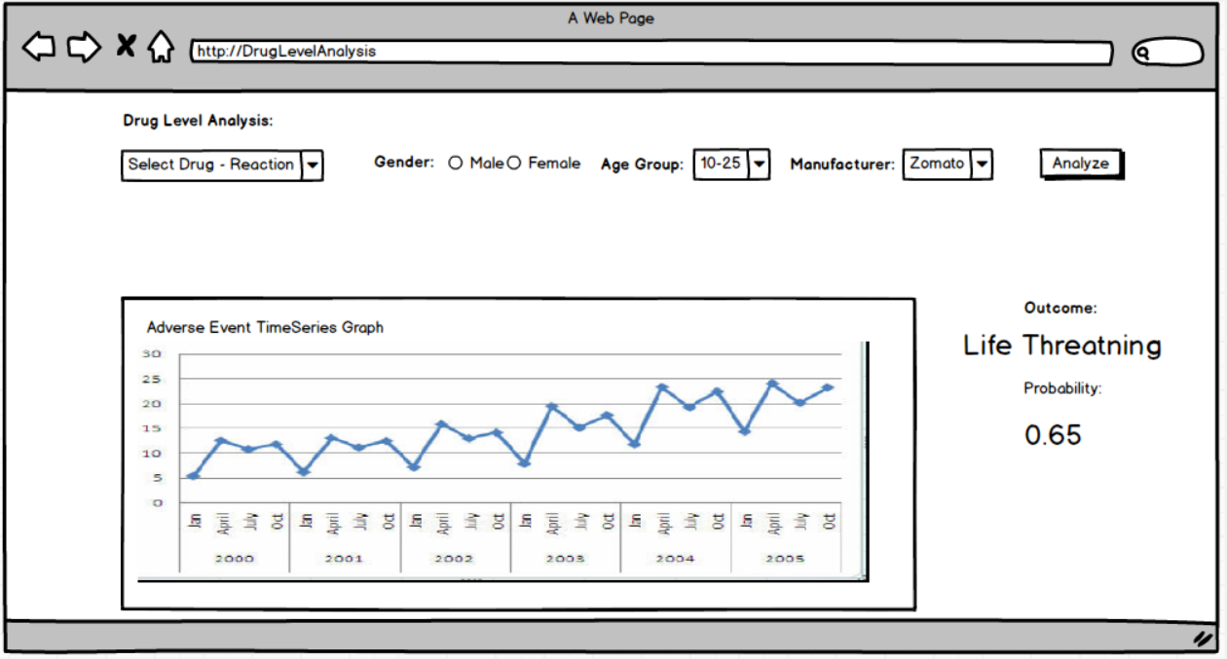

Slide 12
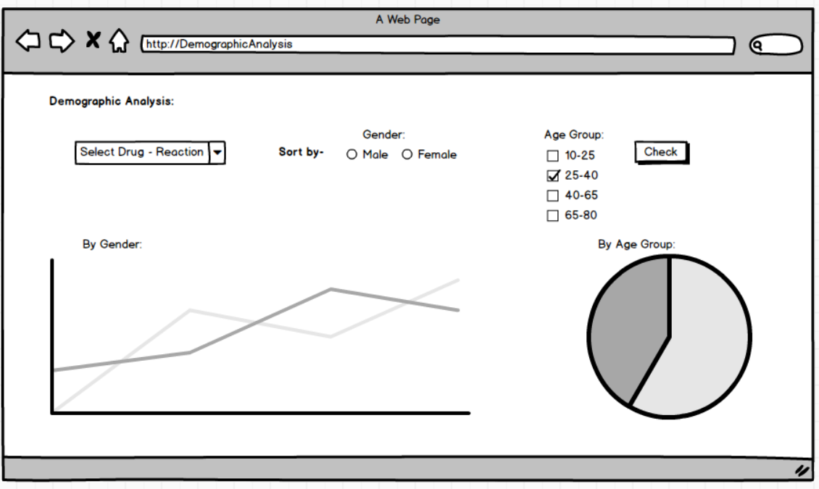

Slide 13
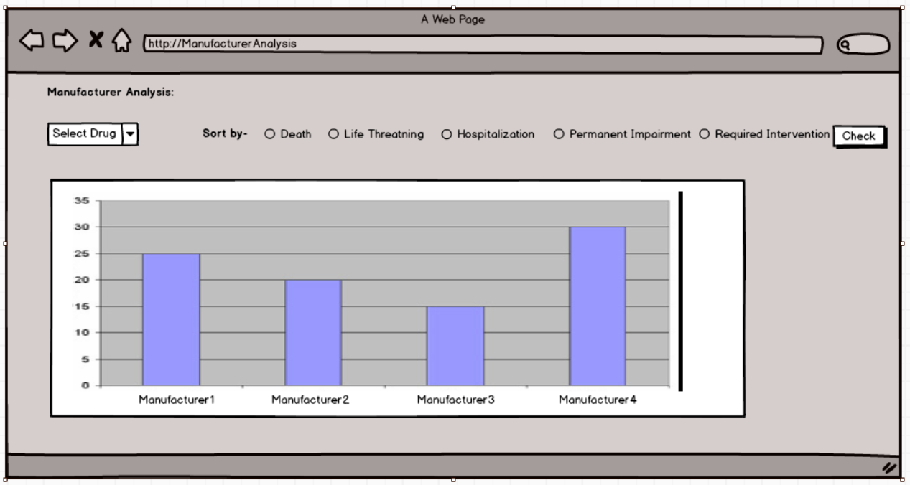

Slide 14
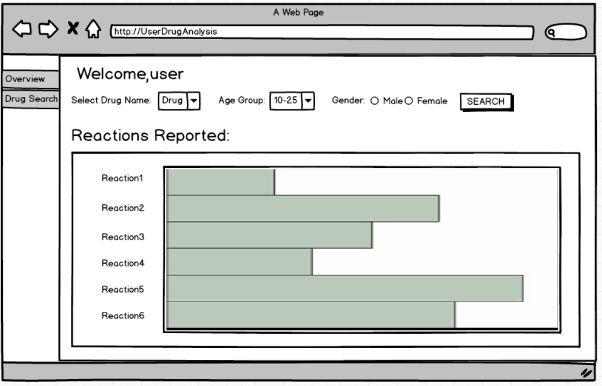

Slide 15
Thank you

