Slide 1
Amazon Machine Learning Google Machine Learning Domino Data Lab
Under the guidance of professor Srikanth Krishnamurthy
Team 5: Ankit Bhayani (https://www.linkedin.com/in/bhayaniankit/)
Rajat Agrawal (https://www.linkedin.com/in/ragraw26/)
Vishakha Sawant (https://www.linkedin.com/in/vishakhasawant/)

Slide 2
Agenda
Introduction
Demo – Amazon ML
Demo – Google ML
Demo – Domino Data Lab
Questions

Slide 3
Amazon Machine Learning
Amazon Machine Learning (Amazon ML) is a robust, cloud-based service that makes it easy for developers of all skill levels to use machine learning technology. Amazon ML provides visualization tools and wizards that guide you through the process of creating machine learning (ML) models without having to learn complex ML algorithms and technology. Once your models are ready, Amazon ML makes it easy to obtain predictions for your application using simple APIs, without having to implement custom prediction generation code, or manage any infrastructure.
Amazon Machine Learning Key Concepts
Data sources contain metadata associated with data inputs to Amazon ML..
ML models generate predictions using the patterns extracted from the input data.
Evaluations measure the quality of ML models.
Batch predictions asynchronously generate predictions for multiple input data observations.
Real-time predictions synchronously generate predictions for individual data observations.

Slide 4
Supported Approaches And Region
We can use supervised ML approaches for these specific machine learning tasks:
Binary classification (predicting one of two possible outcomes),
Multiclass classification (predicting one of more than two outcomes) and
Regression (predicting a numeric value).
Regions and Endpoints Amazon Machine Learning (Amazon ML) has two endpoints that support HTTPS requests. You can use these endpoints for the full range of Amazon ML functionality.
US East (N. Virginia) us-east-1
EU (Ireland) eu-west-1

Slide 5
Performance, Price And Practical Comparison
Performance wise:
Amazon’s Machine Learning (AML) clearly produced a better result than my best model created from Scikit-Learn’s.
AML is also extremely easy to use - It takes more days to implement of my Scikit-Learn’s models, yet with AML, total time taken was less than 30 minutes.
Price wise:
Creating a model cost almost nothing with AML (except for the time taken, which is quite long ~ 5 min, almost 5x comparing to Scikit-Learn’s model!).
However, keep in mind that it’s quite expensive to run your prediction, according to Amazon Machine Learning’s Pricing it cost $0.10 per 1000 batch predictions and $0.0001 per real-time prediction.
Practical wise:
AML gives us a production-ready service, scalability and deployment should be easily done. This is, in my opinion, the best-selling point of AML.
In some cases, AML is not very flexibly configurable to your special or domain oriented business needs, but most of the case, I strongly think that it should give a very good baseline approach to solve business’s data science problem effectively.

Slide 6
Google Machine Learning
Google Cloud Machine Learning Engine is a managed service that enables you to easily build machine learning models, that work on any type of data, of any size. The service is integrated with Google Cloud Dataflow for pre-processing, allowing you to access data from Google Cloud Storage, Google Big Query, and others.
Google Cloud Machine Learning Engine brings the power and flexibility of Tensor Flow to the cloud. You can use its components to select and extract features from your data, train your machine learning models, and get predictions using the managed resources of Google Cloud Platform.
Prerequisite:
Select or create a Cloud Platform project.
Enable billing for your project.
Enable the Cloud Machine Learning Engine and Compute Engine APIs.

Slide 7
The sample builds a wide and deep model for predicting income category based on United States Census Income Dataset.
Wide and deep models use deep neural nets (DNNs) to learn high level abstractions about complex features or interactions between such features. These models then combine the outputs from the DNN with a linear regression performed on simpler features. This provides a balance between power and speed that is effective on many structured data problems.
The sample defines the model using TensorFlow's prebuilt DNNCombinedLinearClassifier class, and need only define the data transformations particular to our dataset before assigning these (potentially) transformed features to either the DNN or the linear portion of the model.

Slide 8
DEMO : Google Machine Learning
Walk through a sample that uses a census dataset to:
Create a TensorFlow trainer and validate it locally.
Run your trainer on a single worker instance in the cloud.
Run your trainer as a distributed training job in the cloud.
Deploy a model to support prediction.
Request an online prediction and see the response.
Request a batch prediction.

Slide 9
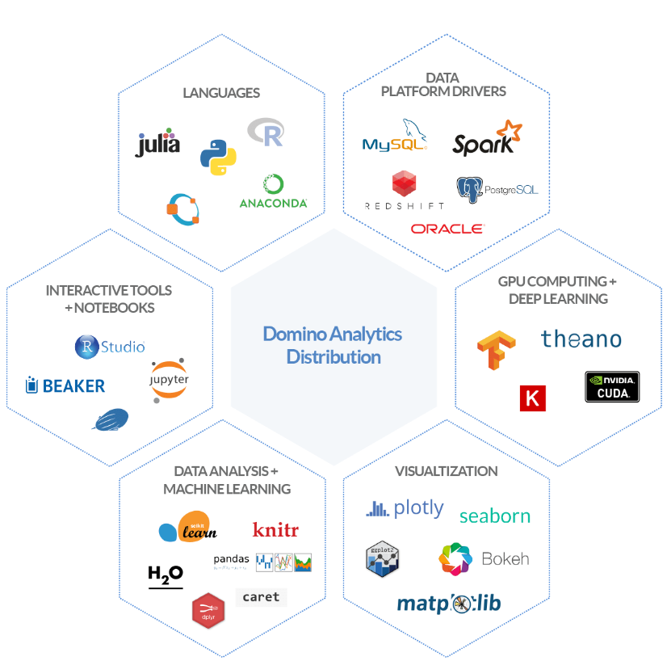
What is Domino?
Domino, a Platform-as-a-Service for data analysis, to equip a larger group of users with functionality that has typically been inaccessible to people without engineering abilities and/or a massive amount of time to set up infrastructure and plumbing.
Domino lets you run code, collaborate with your colleagues, and deploy models — all in a central place. It makes data scientists much more productive, and it enables best practices for teams, like reproducibility and collaboration.

Slide 10
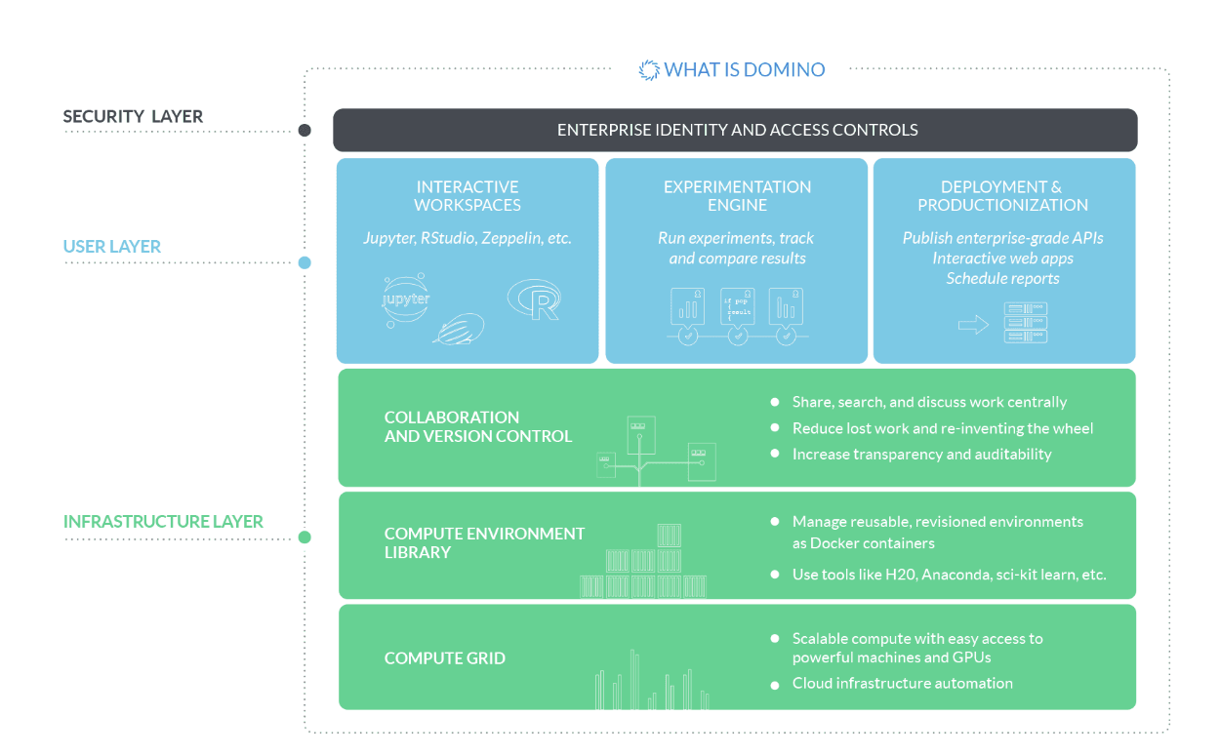

Slide 11
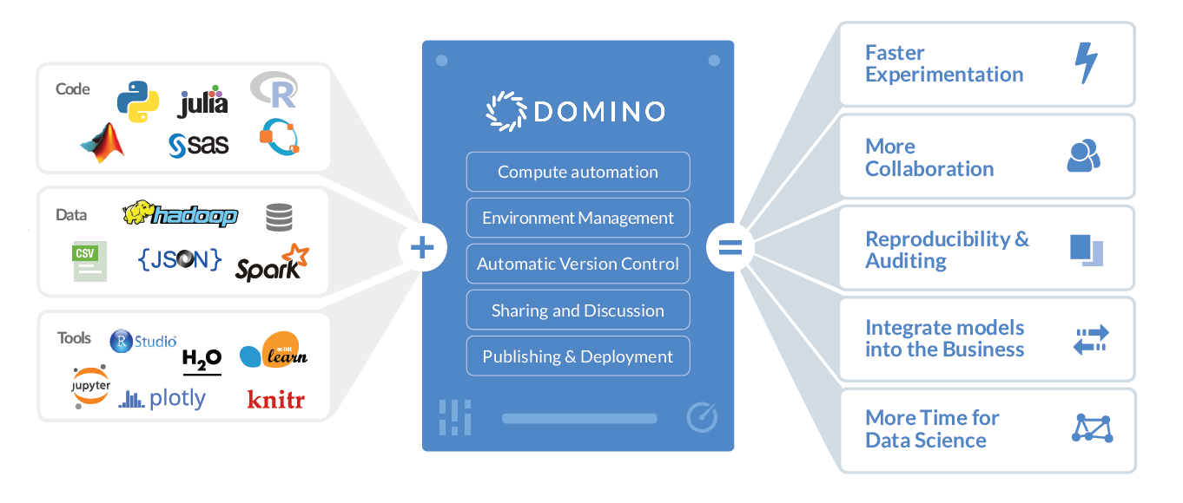
Domino Features

Slide 12
One click, unlimited computing power
Easily run your code on machines with up to 2TB of RAM and 100 cores, or specialized GPUs for deep learning. Run multiple experiments in parallel to iterate faster. Or run workloads over a Spark cluster with our first-class Spark support.
Self-service deployment and productionization
Building models is tough enough — deploying them shouldn’t be. Domino supports one-click publishing of your models as REST APIs or hosted interactive Shiny apps. You can also schedule recurring jobs for model retraining, report generation, or ETL tasks.
Version control designed for data science
Domino automatically tracks all your experiments, so you never lose work and can always reproduce
your results. Unlike source control systems, Domino keeps code, data, parameters, results and environments all linked together, creating a central place for finding, sharing, reviewing, and discussing your most important work.

Slide 13
Domino and Docker
While Docker focus on how engineers use Docker to ship their software, Domino use Docker in their product itself, to allow data scientists to easily control what sort of environment (packages, libraries, etc.) to use when they work. In other words, Domino expose Docker as a user-facing feature (in addition to using it internally as a DevOps tool).

Slide 14

Thank you…

Slide 15
References
https://cloud.google.com/ml-engine/docs/
http://docs.aws.amazon.com/machine-learning/latest/dg/tutorial.html?icmpid=docs_machinelearning_console
https://www.dominodatalab.com/resources/

