Slide 1


Sahayatri
Civic issue reporting and safer community services for Nepal
Team Name: RAS
Hackathon project presentation
INTRODUCTION
Notes:
Sources: README.md, docs/Sahayatri-research-paper.docx, and the official Sahayatri logo assets in frontend/assets. Team name supplied by the user: RAS.

Slide 2
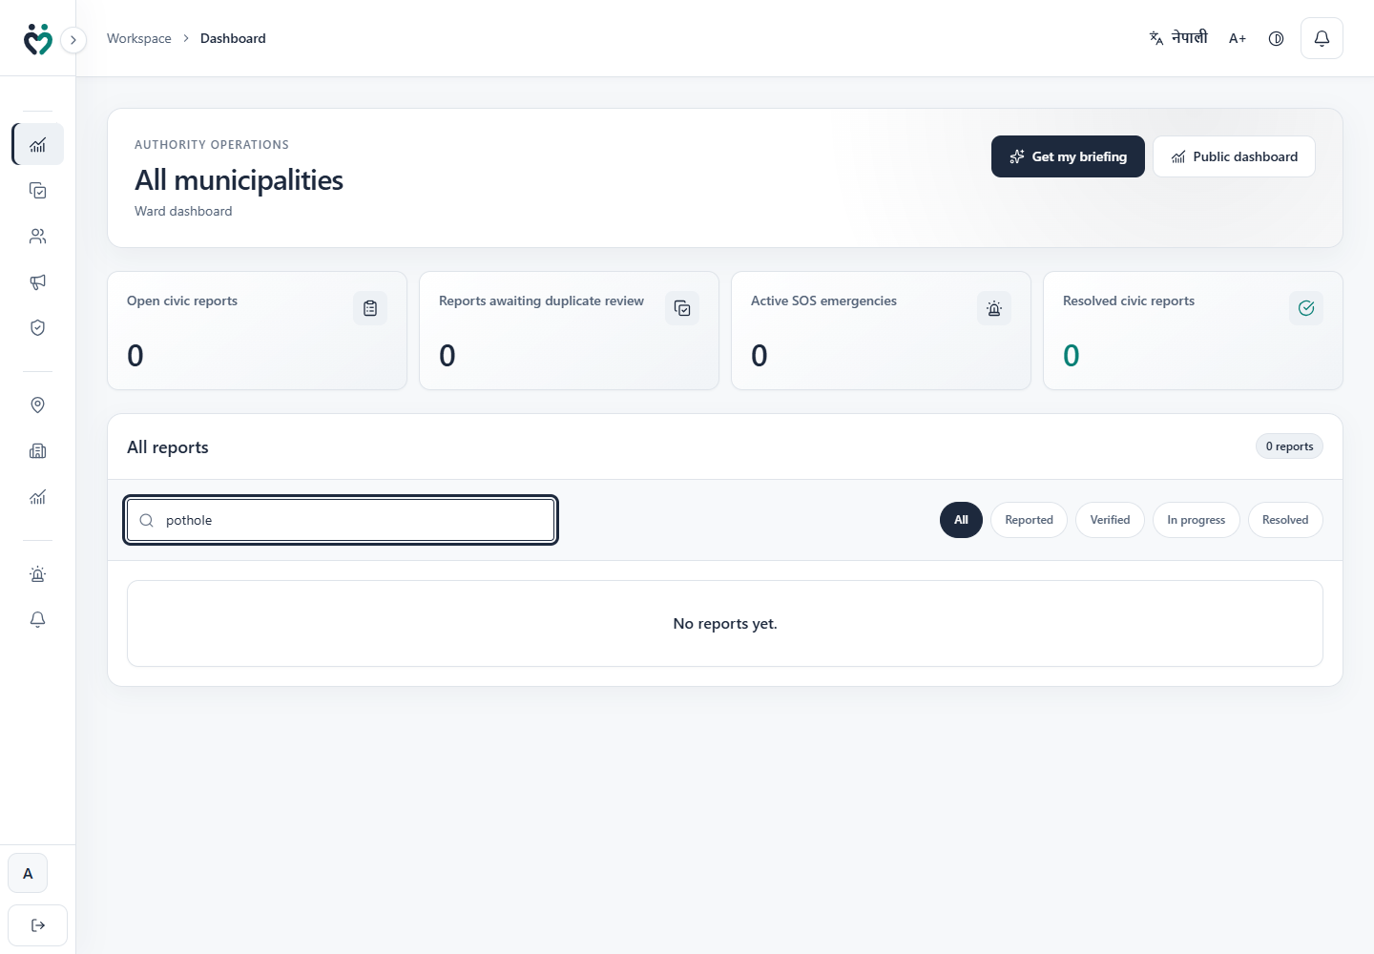
Project overview
A single workflow connects citizens, ward teams, and public accountability
WHAT SAHAYATRI IS
Sahayatri is a bilingual civic platform for Nepal. Citizens submit a local issue with GPS, a description, and an optional photo. The system routes it to the responsible ward, detects repeat reports, and keeps the ticket visible until resolution.
Core idea
One incident becomes one accountable parent ticket, while every reporter still receives status updates.
Authority workspace
1
Report
2
Consolidate
3
Resolve
Photo, location, category, and description
Likely repeats fold under one ticket
Ward action, timeline, and citizen updates
Notes:
Sources: README.md; docs/GUIDE.md sections 1 and 2; docs/Sahayatri-research-paper.docx section 3. Screenshot: frontend/test-results authority workspace.

Slide 3
The municipal reporting problem
More submissions do not automatically create a clearer queue
DUPLICATE FLOOD
01
Queue overload
12 reports
Officers may review several rows for the same physical problem and miss the real scale of the incident.
can describe
one pothole
02
Priority distortion
1
If reporters choose urgency, routine complaints compete with hazards that are genuinely dangerous.
incident
03
Loss of trust
When citizens cannot see progress or receive updates, reporting begins to feel pointless.
Unlinked volume becomes queue noise instead of evidence.
Notes:
Source: docs/Sahayatri-research-paper.docx, Introduction. The 12 report example is the project paper's motivating scenario, not a production statistic.

Slide 4
How Sahayatri solves it
Duplicate consolidation and evidence based priority work as two linked systems
1 DUPLICATE CONSOLIDATION
Four matching signals
Confidence decides the path
New report
High confidence: merge automatically
Lower confidence: officer review
Every merge can be reversed
35%
30%
20%
15%
GPS + text + optional photo
Category
Text
Photo
Location
A hard distance gate removes far away lookalikes. Missing photo data does not reduce the score because weights are recalculated over the signals present.
2 EVIDENCE BASED PRIORITY
Category severity
Repeat reports
Nearby confirmation
Disputes
Time unresolved
Priority queue
+
+
+
+
A human override locks the selected priority until the officer returns the ticket to automatic scoring.
Notes:
Sources: docs/Sahayatri-research-paper.docx sections 4 and 5; backend/app/services/ticket_service.py; backend/app/core/config.py. Current code includes auto merge at a confidence score of 0.80 with safeguards and reversible split behavior.

Slide 5
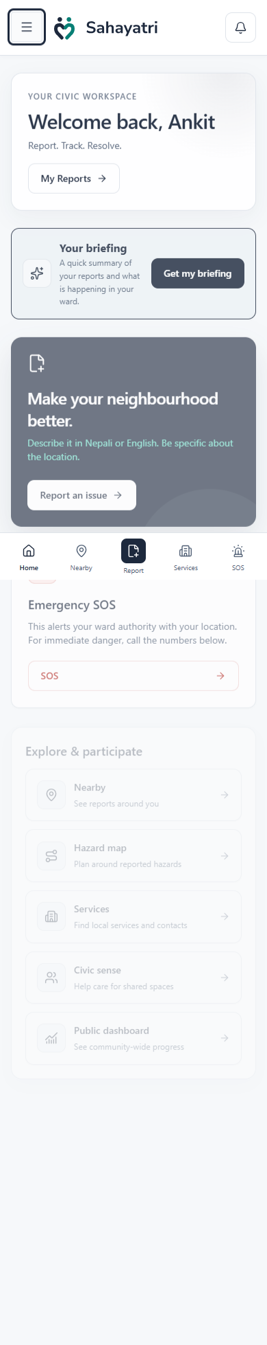
Key features
The product combines reporting, community evidence, emergency support, and public visibility
Issue reporting
Photo and GPS submission, ward routing, public ticket code, and status tracking
Community evidence
Nearby corroboration, dispute handling, and duplicate reports joined under one parent
Emergency support
One tap SOS, targeted public alerts, and an offline civic service directory
Hazard aware travel
Map of active hazards with route options for walking, wheelchair use, and driving
Inclusive access
Nepali and English, high contrast, large text, and text to speech before sign in
Public accountability
Aggregate dashboard, notifications, ticket timelines, and shared discussion threads
Citizen mobile workspace
Notes:
Sources: README.md feature map; frontend/UI.md; frontend/src/routes.ts; frontend/src/pages/citizen; docs/GUIDE.md sections 7, 10, and 11. Screenshot: frontend/test-results citizen mobile workspace.

Slide 6
Technology stack
A web and data architecture designed for modest infrastructure and clear security boundaries
User experience
React 19 • TypeScript • Vite • Tailwind CSS • PWA • Leaflet • Recharts
✓
Responsive citizen and authority workspaces
Application API
FastAPI • Pydantic • REST endpoints • Role and ward authorization
✓
Business rules and access checks in one service layer
Data and identity
PostgreSQL • pgvector • SQLAlchemy • Alembic • Supabase Auth and Storage
✓
Private photos and locked direct browser access
Matching and ML
scikit-learn • TF-IDF • SVD 256 • Logistic Regression • Pillow and ImageHash
✓
Laptop friendly models with no GPU dependency
Security boundary
The browser never receives the Supabase service role key. Every application table uses row level security with no browser policies.
Notes:
Sources: README.md architecture notes; frontend/package.json; backend/requirements.txt; docs/Sahayatri-research-paper.docx section 6.

Slide 7
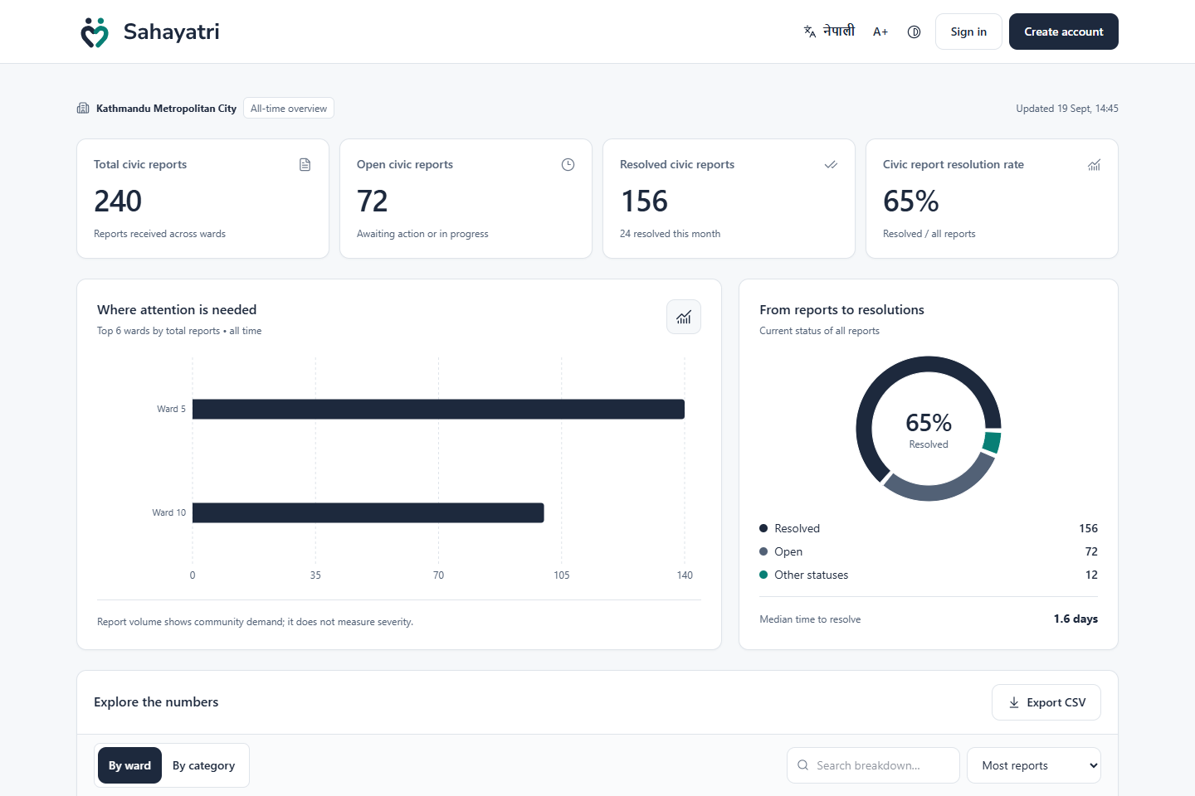
Measured behavior and transparency
The project reports pipeline results honestly and exposes aggregate service progress
HELD OUT GENERATED DATA
100%
duplicate recall
148 of 148 repeat reports matched to the correct parent
2.8%
false suggestion rate
5 of 179 unrelated reports raised a suggestion
Caveat: these results measure generated reports, not real Kathmandu performance.
Public transparency dashboard shown with test fixture data
Notes:
Sources: docs/Sahayatri-research-paper.docx sections 7.1 through 7.5. Metrics are from held out generated data. Screenshot: frontend/test-results public dashboard using Playwright fixture data, which is illustrative rather than production data.

Slide 8
Conclusion
Q&A
Repeat reports become one accountable ticket instead of separate queue noise.
Evidence and time determine priority, while officers keep final control.
Questions and discussion
Citizens see progress through updates, public aggregates, and shared ticket history.
The next step is a single ward pilot using real reports and officer decisions.
TEAM RAS
Notes:
Source: docs/Sahayatri-research-paper.docx conclusion and future work. The single ward pilot is identified in the paper as the immediate next step.

