Slide 1

MINOR PROJECT - I ON DevConnect (MCA – I SEMESTER; BATCH 2022-24)
Internal Guide
Name of the Mentor Ritika Wason
Presentation by
Name of the Student Ankit Budhori , Apoorv Chaturvedi
00811604422 , 02011604422
17-02-2023
Notes:
1

Slide 2
Contents
Problem Description
Aim and Objectives
Methodology and Technology Used for Project Development
Project Modules and My Role
Design Documents (Use Case, Data Flow Diagram, Entity-Relation Diagram, etc.)
Screenshots
Testing of Project
Conclusion
Future Scope
Bibliography

Slide 3
Problem Description
Implementing a secure and reliable authentication system.
Profile Management
Random Invitations
Technological Complexity:-Social media platforms typically involve a complex technology stack with multiple components and dependencies

Slide 4
Aim and Objectives
Aim:
A Social Media for Developers who want to connect and collaborate on projects.
Objectives:
To provide a social networking platform for developers.
To showcase their skills and experience.
To connect with colleagues and employees in your specialized field.
To solve user’s professional queries and suggest better options.

Slide 5
Methodology and Technology Used
Methodology used for Project Development:
Waterfall Model of SDLC
Technology used for Project Development:
Front-End: React
Back-End: Node JS 4.0, NPM, Express JS
Integrated Development Environment (IDE): VS Code, Visual Studio 2019
Database: MongoDB
Web Server: Express Web Server

Slide 6
System Design

Slide 7
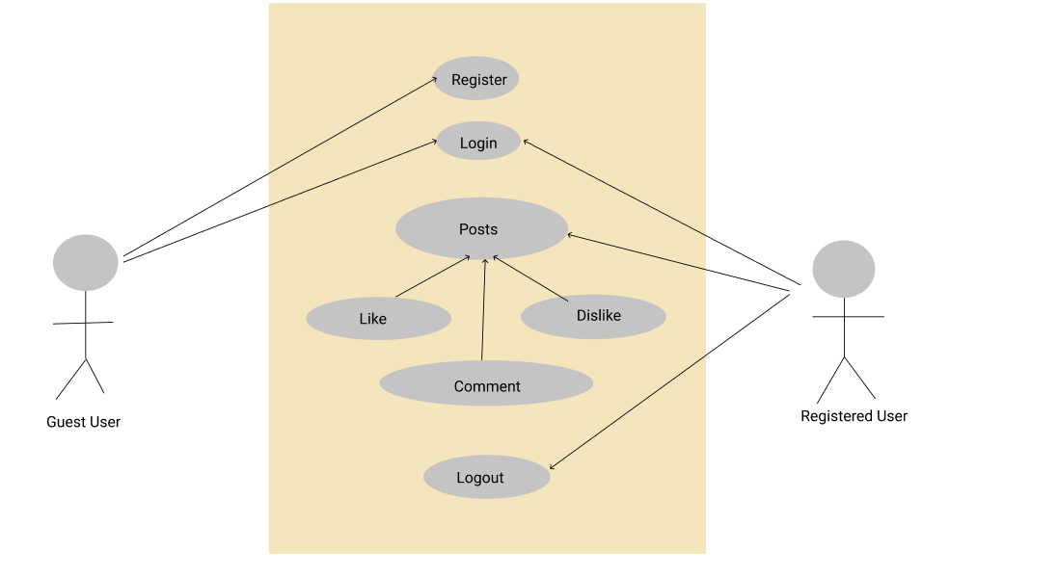
Use Case Diagram

Slide 8
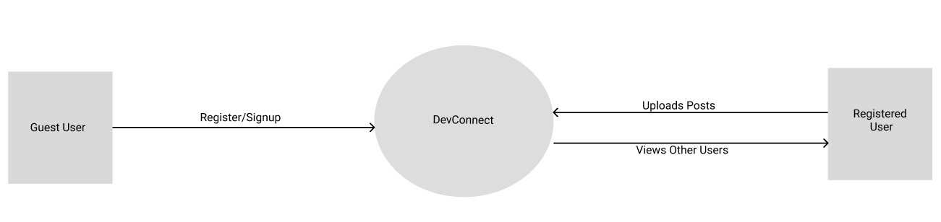
Data Flow Diagram (Level - 0)

Slide 9
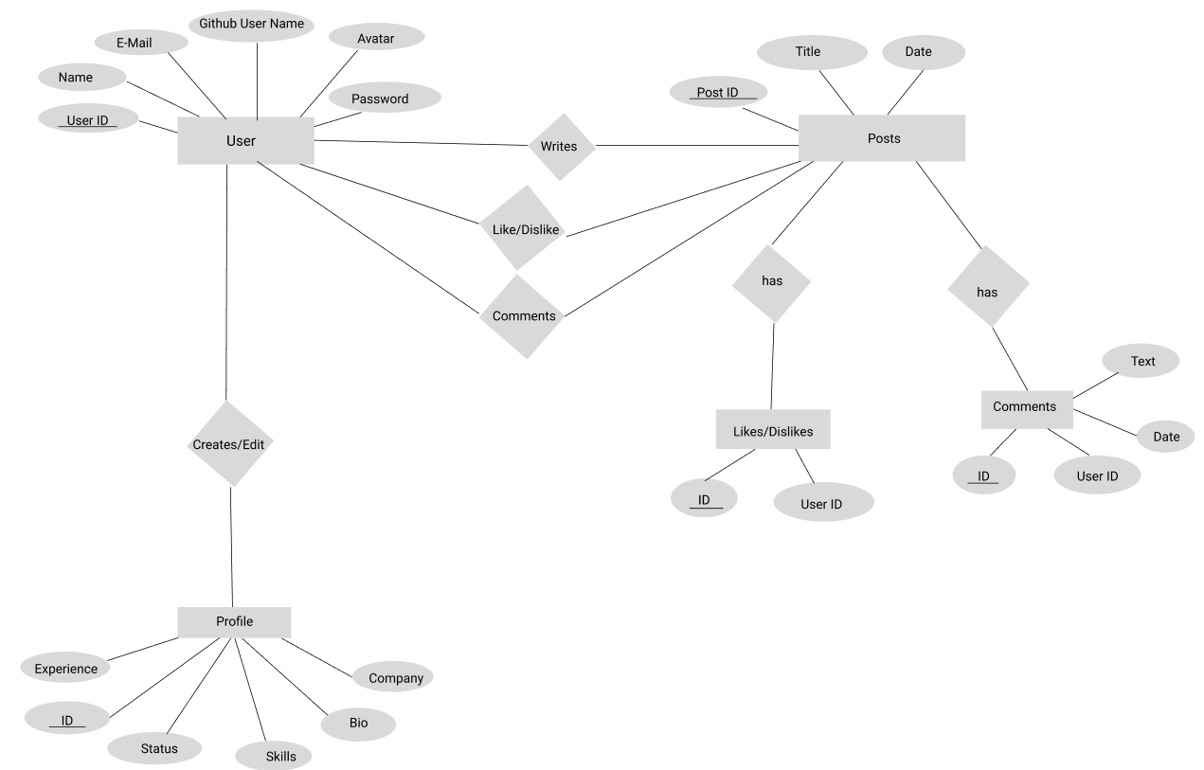
Entity-Relationship (E-R) Diagram

Slide 10
Screenshots

Slide 11
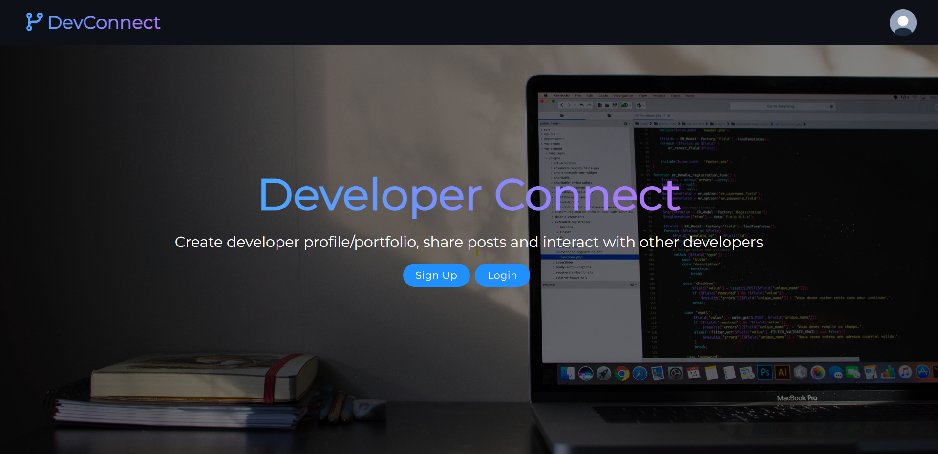
Home Page

Slide 12
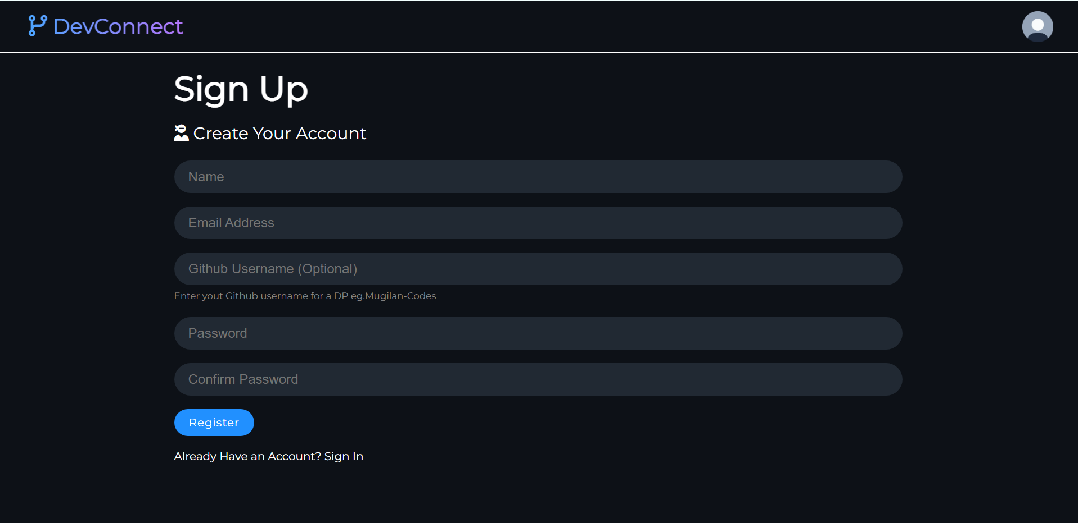
Sign Up

Slide 13
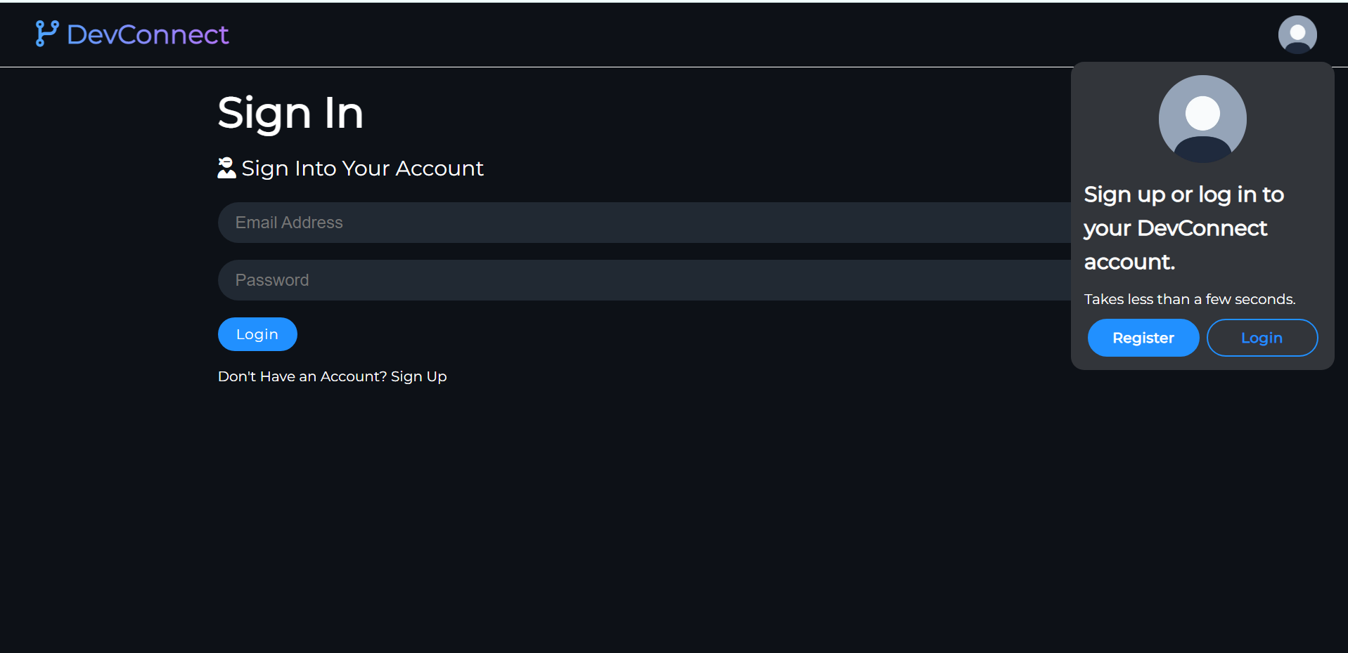
Sign In

Slide 14
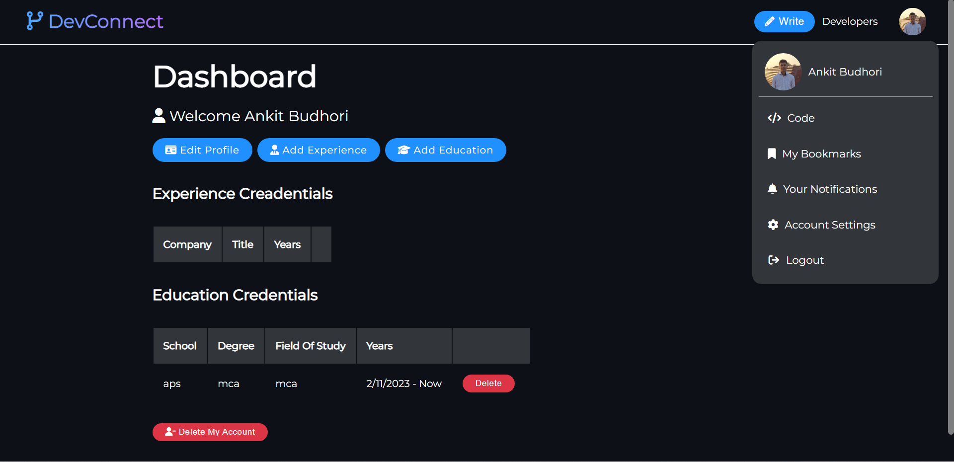
Dashboard

Slide 15
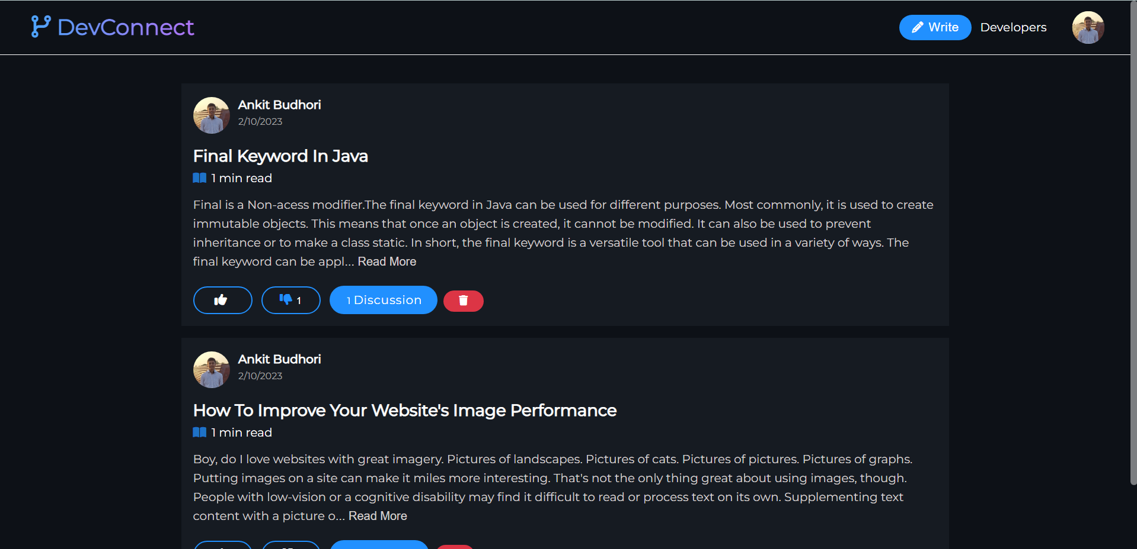
Feed

Slide 16
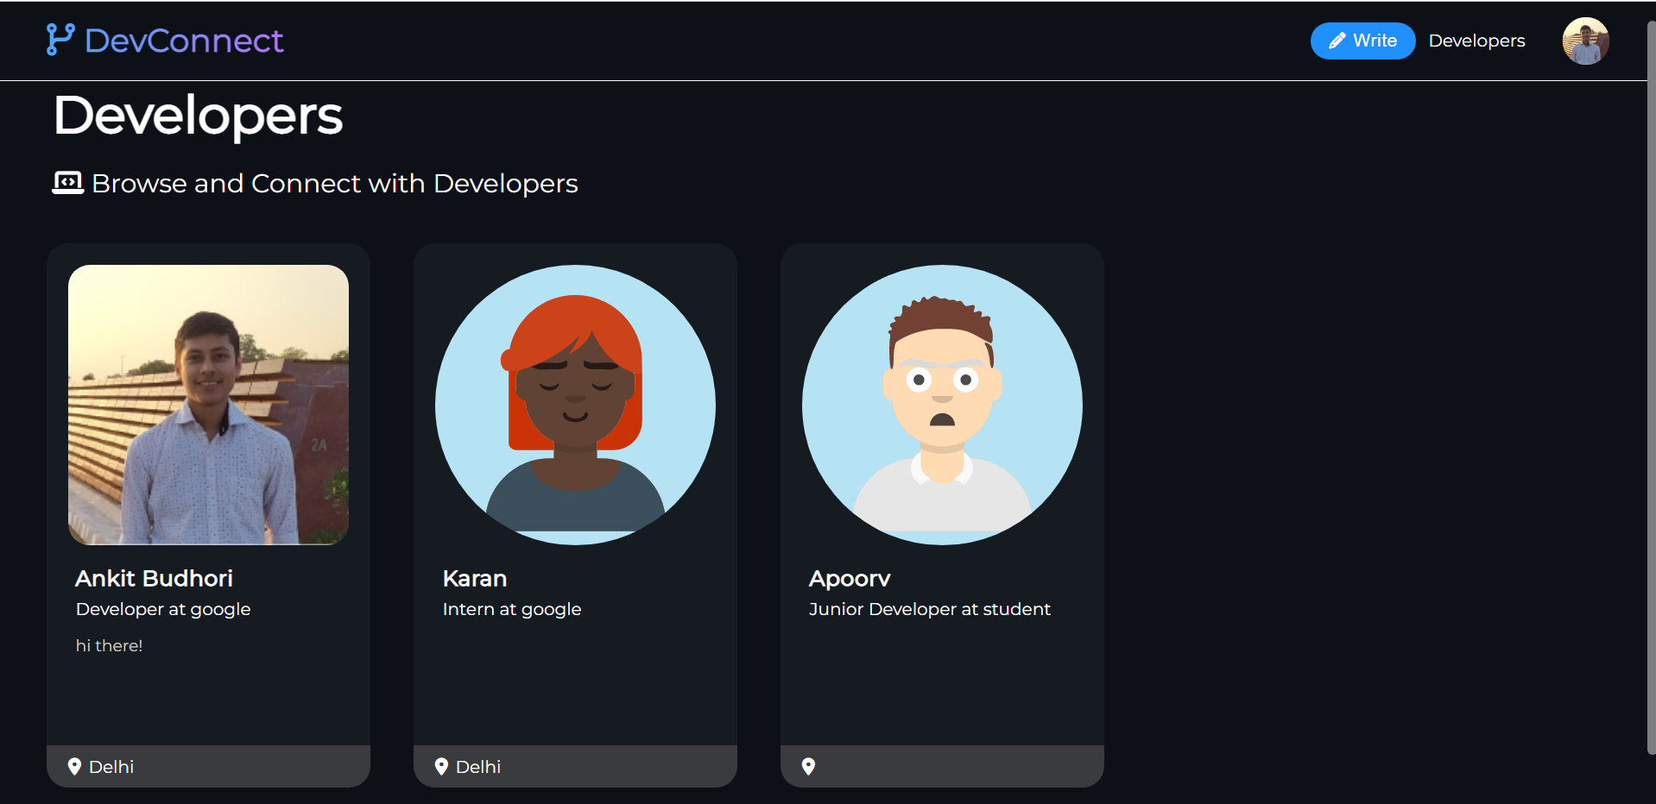
Users

Slide 17
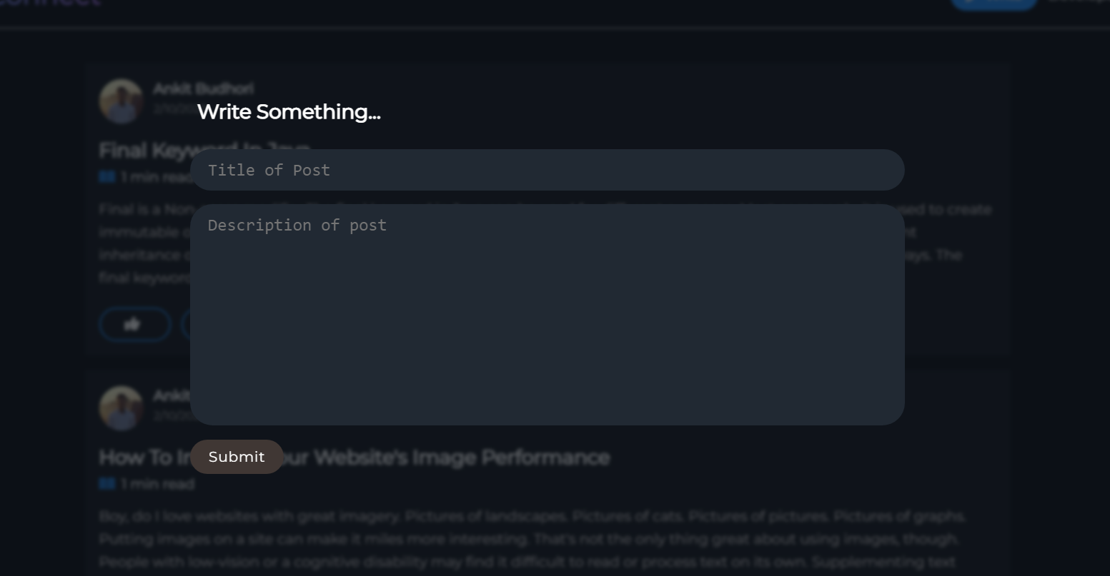
Create Post

Slide 18
Conclusion
A Social Media for Developers who want to connect and collaborate on projects.
React Js, Node Js Programming is used for System Development.
Waterfall model of SDLC has been followed for development of the project.
The developed application has following features:
Online accessibility.
Responsive user-friendly interfaces to interact with the system.
Three-tier architecture.

Slide 19
Bibliography
Websites:
W3school
React js

