Slide 1

CORONARY HEART DISEASE PREDICTION USING LOGISTIC REGRESSION
- Using CRISP-DM FRAMEWORK
Submitted by:-
Muktesh Sahu (10594774)
Maya Kumbhar (10594952)
Ankit Butola (10590492)
Notes:
Be specific and direct in the title. Use the subtitle to give the specific context of the speech.
-The goal should be to capture the audience’s attention which can be done with a quote, a startling statistic, or fact. It is not necessary to include this attention getter on the slide.

Slide 2

INDEX
Data Set Selection - Heart Disease
CRISP DM methodology
Business Understanding
Data Understanding
Data Preparation
Modeling
Evaluation
Optimization
Deployment
Notes:
Use the background points to post details that are not common knowledge, or that the audience will need to understand the context of the speech.
-Do not read these main points from the PowerPoint, instead elaborate on these points during the speech.

Slide 3
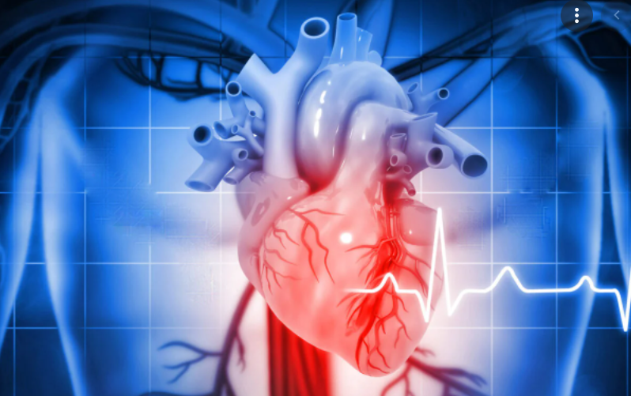
Some Facts about Heart Disease
As per WHO,
https://www.who.int/en/news-room/fact-sheets/detail/cardiovascular-diseases-(cvds)
Cardiovascular diseases (CVDs) are the leading cause of death globally.
An estimated 17.9 million people died from CVDs in 2019, Of these deaths, 85% were due to heart attack and stroke.
Most cardiovascular diseases can be prevented by addressing behavioural risk factors such as tobacco use, unhealthy diet, etc.
It is important to detect CVDs as early as possible.
Notes:
The title of main point #1 should be clear and concise. Each piece of evidence should be summarized for clarity and cited correctly. Do not simply read the pieces of evidence, but elaborate where needed.
[type notes for elaboration here]
Be sure to transition to main point #2 and the next slide.

Slide 4
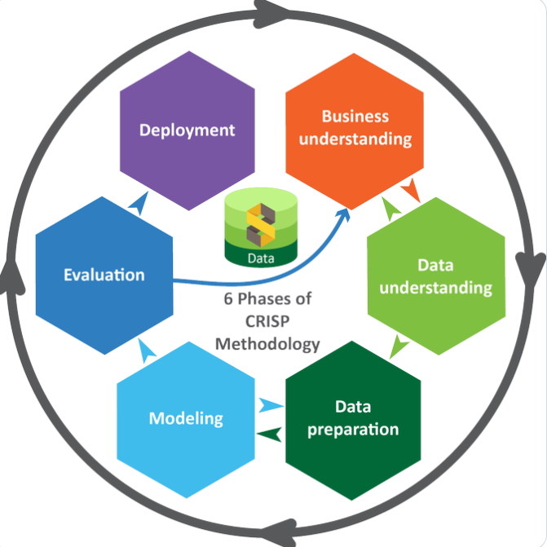
CRISP-DM Methodology
Notes:
Use the background points to post details that are not common knowledge, or that the audience will need to understand the context of the speech.
-Do not read these main points from the PowerPoint, instead elaborate on these points during the speech.

Slide 5
Business Understanding
Generate TenYearCHD for the patients based on the following requirement:
Individual Patient chances of Coronary heart disease based on Education.
Individual Patient chances of Coronary heart disease based on prevalent hyper tension.
Individual Patient chances of Coronary heart disease based on prevalent Blood pressure.
Individual Patient chances of Coronary heart disease based on prevalent Gender.
Individual Patient chances of Coronary heart disease based on prevalent Diabetes.
Individual Patient chances of Coronary heart disease based on prevalent Smoking habits.
Individual Patient chances of Coronary heart disease based on prevalent Stroke.
Notes:
Use the background points to post details that are not common knowledge, or that the audience will need to understand the context of the speech.
-Do not read these main points from the PowerPoint, instead elaborate on these points during the speech.

Slide 6
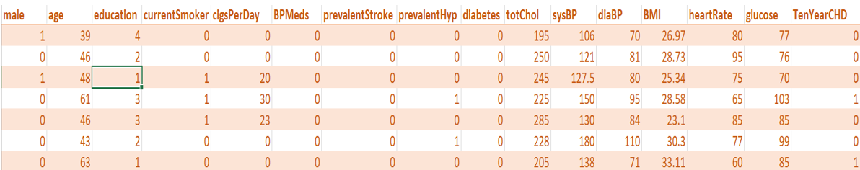
Data Understanding
This is an ongoing cardiovascular study on residents of the town of Farmingham, Massachusetts(U.S.A.).
Total records of around 4000, with 16 attributes including one label to predict.
Notes:
Use the background points to post details that are not common knowledge, or that the audience will need to understand the context of the speech.
-Do not read these main points from the PowerPoint, instead elaborate on these points during the speech.

Slide 7
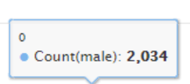
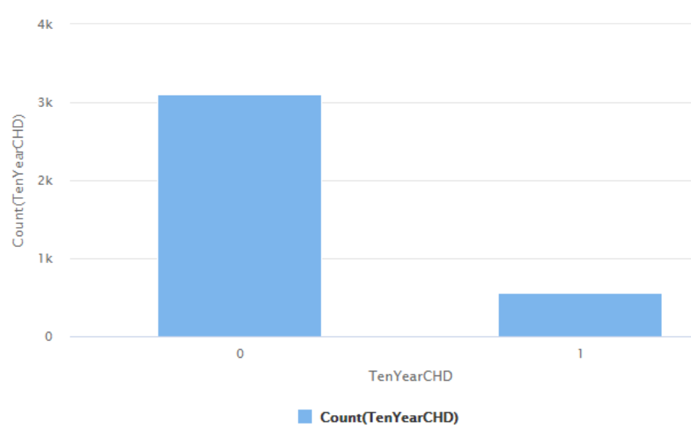
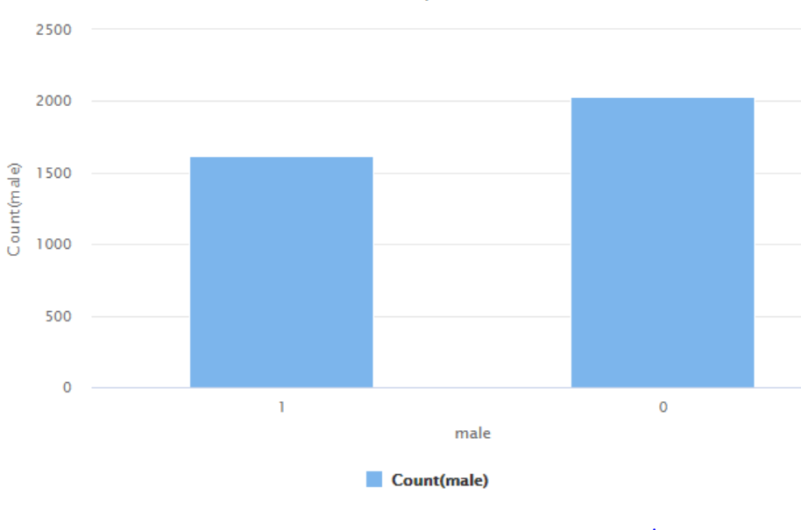



Data Understanding
Gender
0 is female
1 is male.
Prevalence/Non-Prevalence in 10yr
Gender
Notes:
Use the background points to post details that are not common knowledge, or that the audience will need to understand the context of the speech.
-Do not read these main points from the PowerPoint, instead elaborate on these points during the speech.

Slide 8
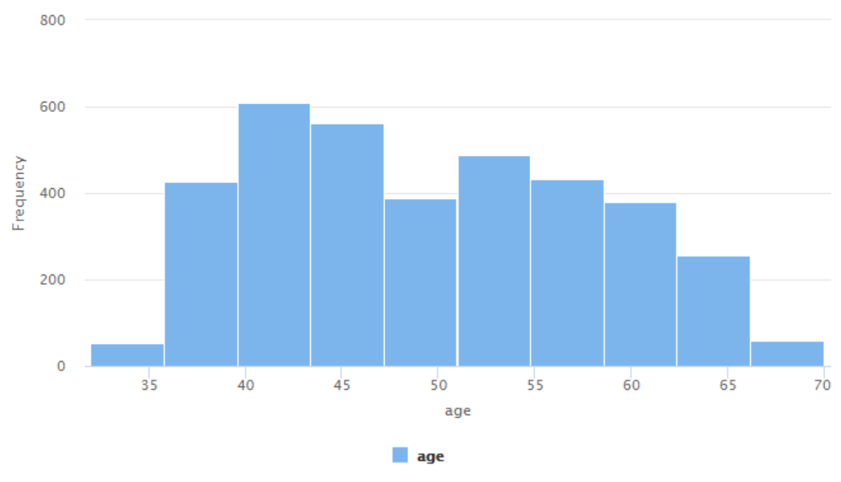
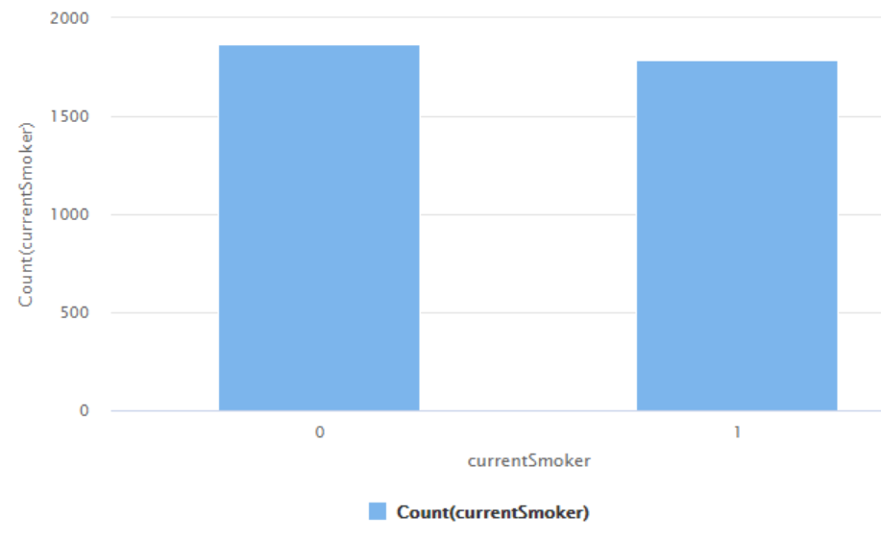
Data Understanding
Notes:
Use the background points to post details that are not common knowledge, or that the audience will need to understand the context of the speech.
-Do not read these main points from the PowerPoint, instead elaborate on these points during the speech.

Slide 9
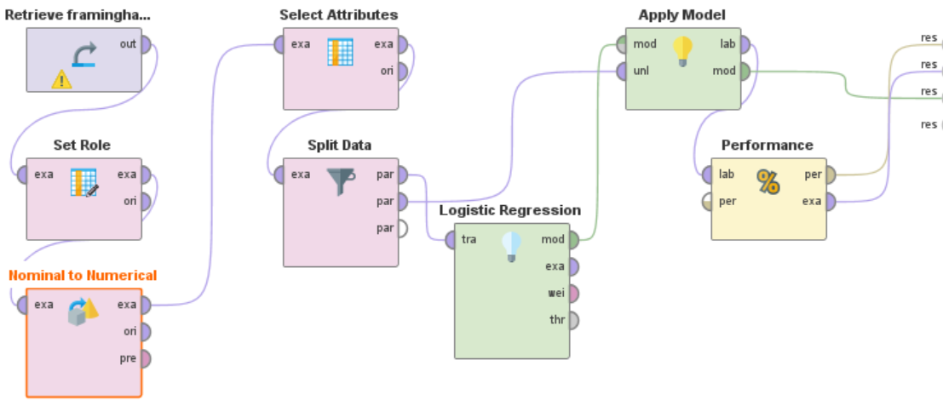
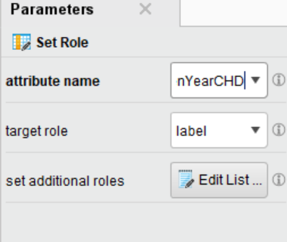
Data Preparation: Removing missing values and set labelled attribute
Removing missing values.
Setting role for the labelled attribute.
Notes:
Use the background points to post details that are not common knowledge, or that the audience will need to understand the context of the speech.
-Do not read these main points from the PowerPoint, instead elaborate on these points during the speech.

Slide 10
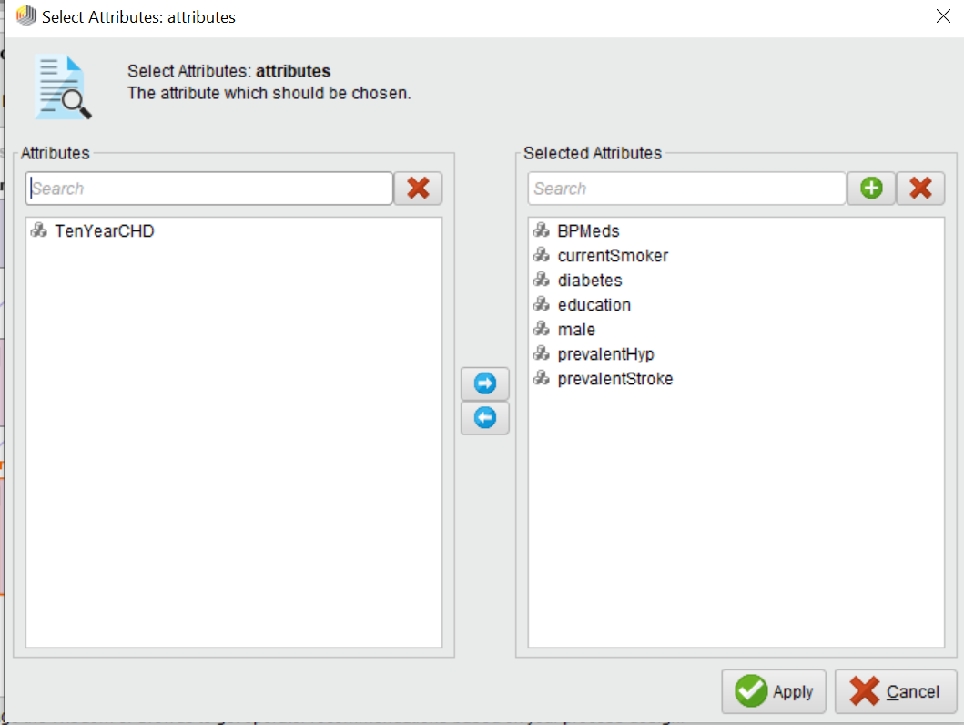
Data Preparation: Nominal to Numerical Attribute conversion
Data type conversion of the attributes.
Creating dummy variables
Notes:
Use the background points to post details that are not common knowledge, or that the audience will need to understand the context of the speech.
-Do not read these main points from the PowerPoint, instead elaborate on these points during the speech.

Slide 11

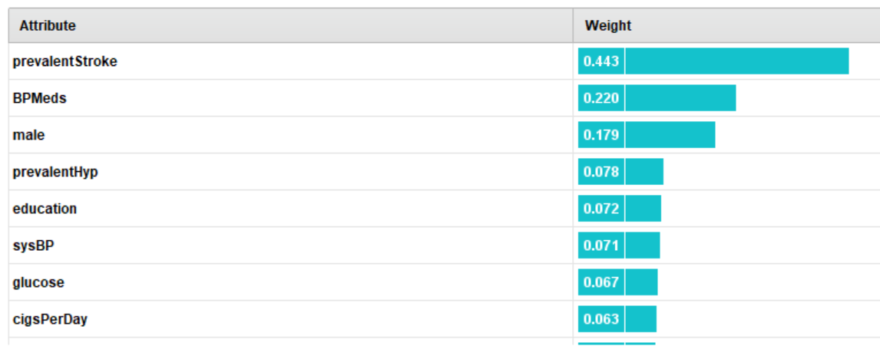

Modeling: Exploring Models

Slide 12
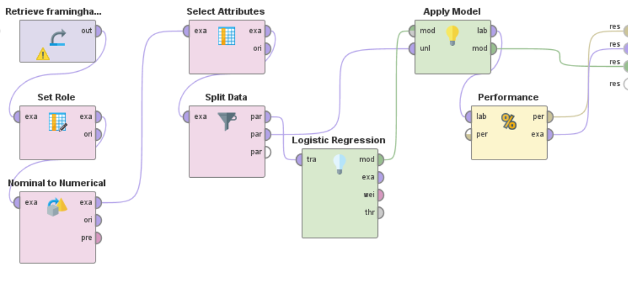
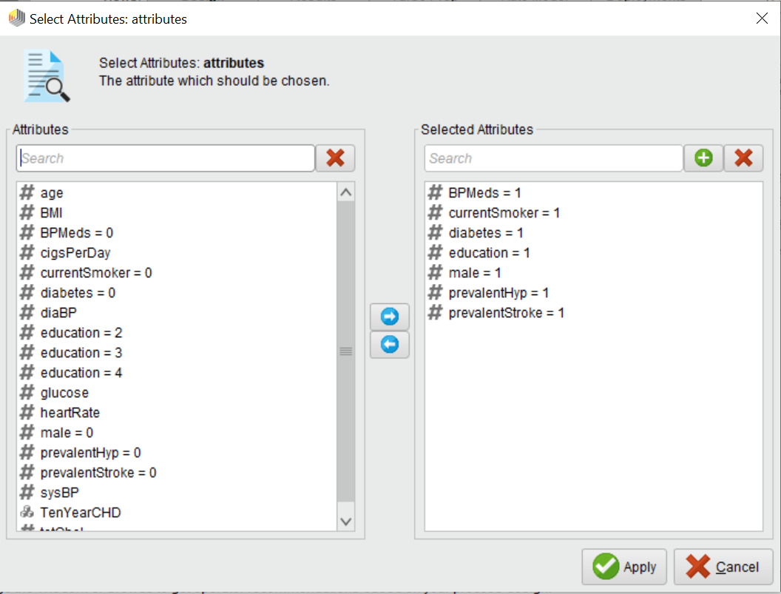
Modeling: Selecting Predictor Attributes(Independent Variables)
Selecting categorical attributes to feed into logistic regression model for predicting the result.
Notes:
Use the background points to post details that are not common knowledge, or that the audience will need to understand the context of the speech.
-Do not read these main points from the PowerPoint, instead elaborate on these points during the speech.

Slide 13
Modeling: Splitting data
Splitting data into 70:30.
And applying logistic regression model for predicting the values
Notes:
Use the background points to post details that are not common knowledge, or that the audience will need to understand the context of the speech.
-Do not read these main points from the PowerPoint, instead elaborate on these points during the speech.

Slide 14
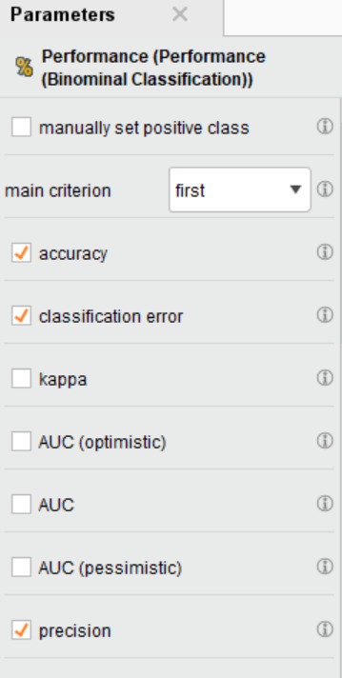
Evaluation: Selecting criteria
Choosing criteria to evaluate the performance of the model
Notes:
Use the background points to post details that are not common knowledge, or that the audience will need to understand the context of the speech.
-Do not read these main points from the PowerPoint, instead elaborate on these points during the speech.

Slide 15
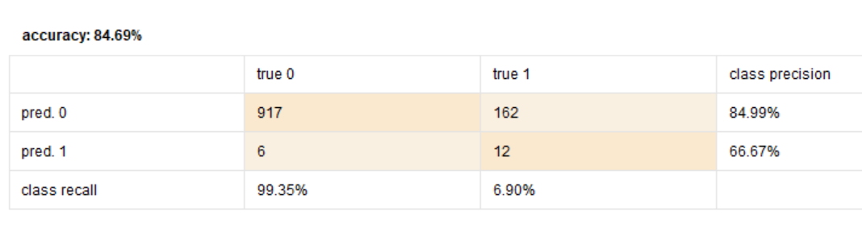
Evaluation: Result
Notes:
Use the background points to post details that are not common knowledge, or that the audience will need to understand the context of the speech.
-Do not read these main points from the PowerPoint, instead elaborate on these points during the speech.

Slide 16
Optimization: Optimization Techniques
By implementing threshold
By including SMOTE Upsampling
Notes:
Use the background points to post details that are not common knowledge, or that the audience will need to understand the context of the speech.
-Do not read these main points from the PowerPoint, instead elaborate on these points during the speech.

Slide 17
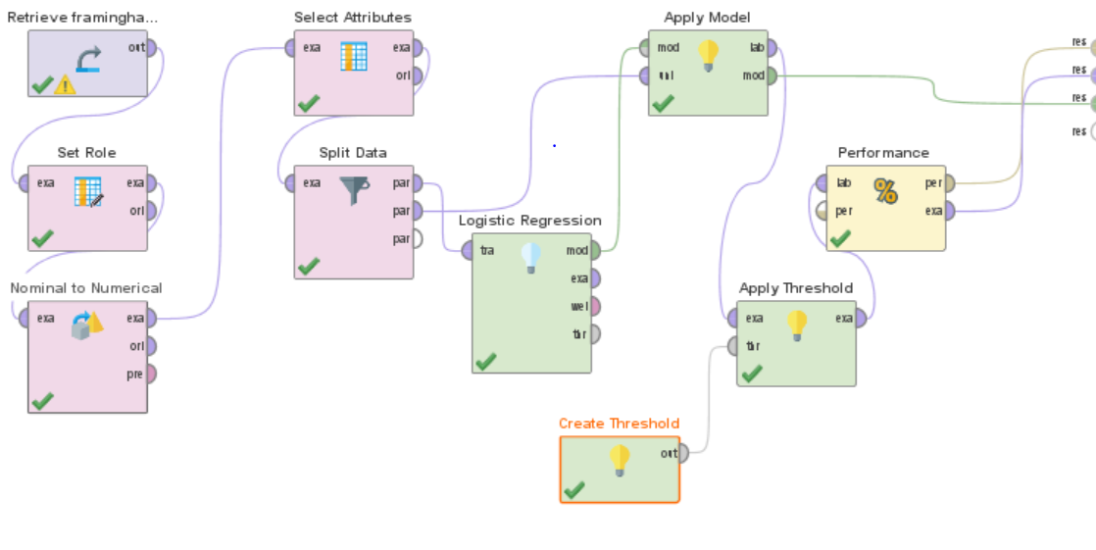
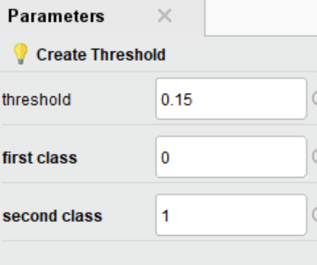
Optimization 1: Adjusting Threshold
Introducing Create threshold and Apply threshold functionality for Threshold adjustment
Notes:
Use the background points to post details that are not common knowledge, or that the audience will need to understand the context of the speech.
-Do not read these main points from the PowerPoint, instead elaborate on these points during the speech.

Slide 18
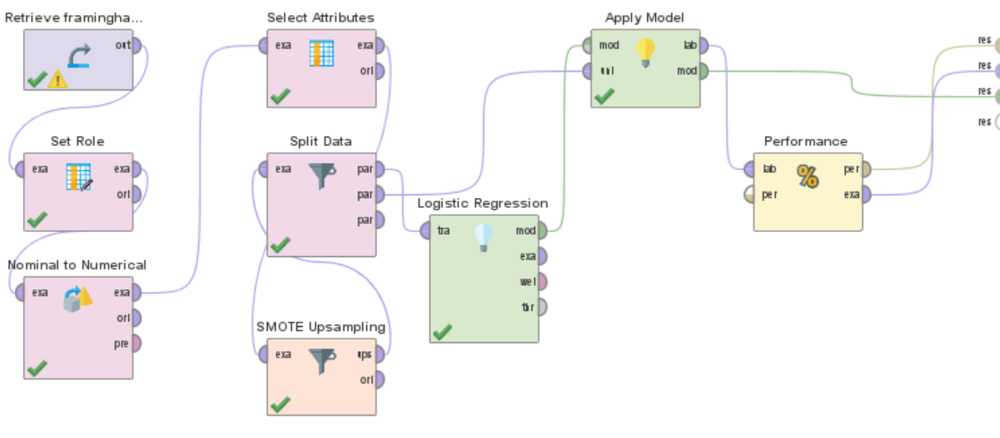
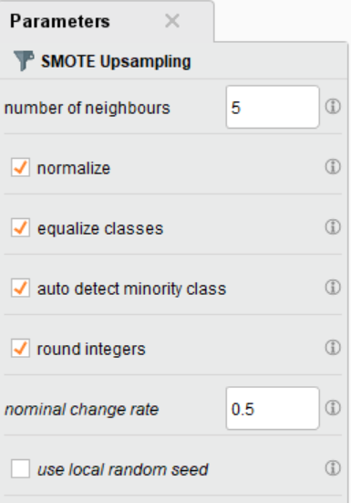
Optimization 2: Including SMOTE Upsampling
Introducing SMOTE technique to up sample the minority class
Notes:
Use the background points to post details that are not common knowledge, or that the audience will need to understand the context of the speech.
-Do not read these main points from the PowerPoint, instead elaborate on these points during the speech.

Slide 19
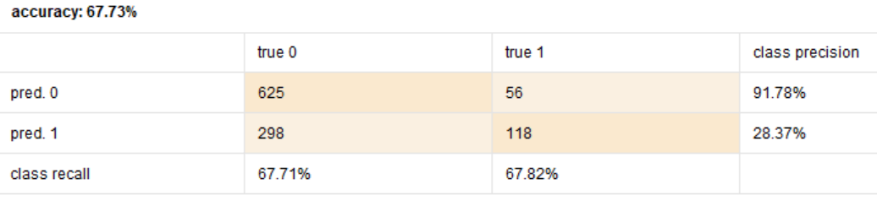
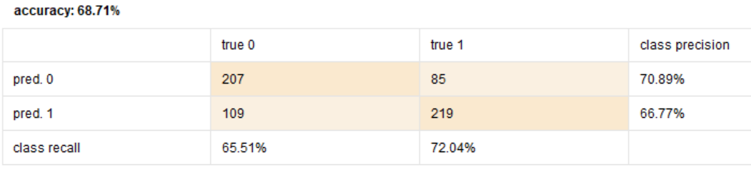
Optimization: Result Comparison
For Threshold = 0.15
With SMOTE:
For Threshold Value = 0.5
Notes:
Use the background points to post details that are not common knowledge, or that the audience will need to understand the context of the speech.
-Do not read these main points from the PowerPoint, instead elaborate on these points during the speech.

Slide 20
Optimization: Problem Definition and Technique Selection
Performance of SMOTE UP SAMPLING is better than THRESHOLD APPLICATION.
SMOTE UP SAMPLING is not preferred.
It involves creating artificial values.
Selecting THRESHOLD Technique for our model.
Notes:
Use the background points to post details that are not common knowledge, or that the audience will need to understand the context of the speech.
-Do not read these main points from the PowerPoint, instead elaborate on these points during the speech.

Slide 21
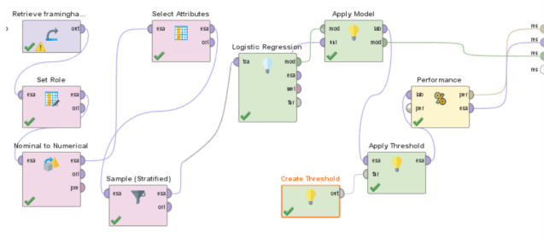
Business Validation: Stratified sampling
It captures key population characteristics from the dataset
Provides estimate result for subgroups
Ensures representation of all the groups of interest
Efficient in conducting the survey
Notes:
Use the background points to post details that are not common knowledge, or that the audience will need to understand the context of the speech.
-Do not read these main points from the PowerPoint, instead elaborate on these points during the speech.

Slide 22
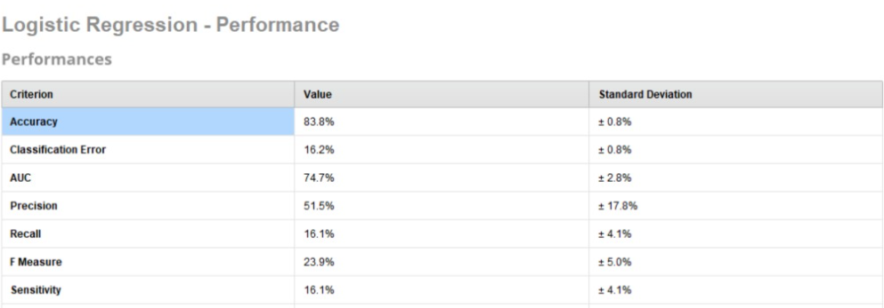
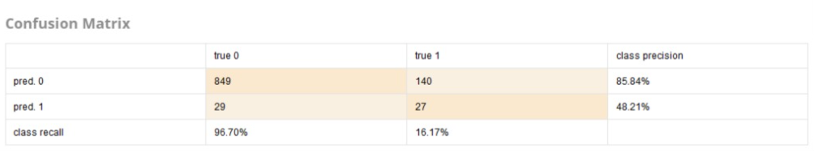
Business Validation: Output
Notes:
Use the background points to post details that are not common knowledge, or that the audience will need to understand the context of the speech.
-Do not read these main points from the PowerPoint, instead elaborate on these points during the speech.

Slide 23
Deployment:
Model can be deployed with a continuous maintenance and enhancement activities.
Can be deployed on a cloud or on premise Applications for usage.
Notes:
Use the background points to post details that are not common knowledge, or that the audience will need to understand the context of the speech.
-Do not read these main points from the PowerPoint, instead elaborate on these points during the speech.

Slide 24
Thank You! ☺
Notes:
The action step is what the audience is supposed to do or think about the topic. It should be one sentence that is written clearly and with much thought. It may also be the thesis statement restated as an action. The goal of this slide is to leave the audience with a clear message as to what they are to do or think at the end of the speech. It may be a good idea to end with a powerful quote or image.

