Slide 1

Object Oriented Programming with Java
Sandeep Kulange

Slide 2
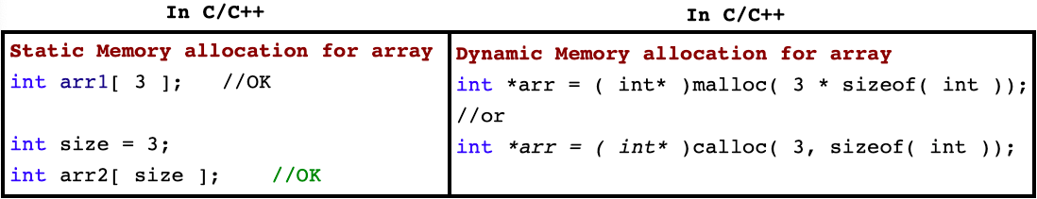
Introduction
Array, stack, queue, LinkedList are data structures.
In Java, data structure is called collection and value stored inside collection is called element.
Array is a sequential/linear container/collection which is used to store elements of same type in continuous memory location.

Slide 3
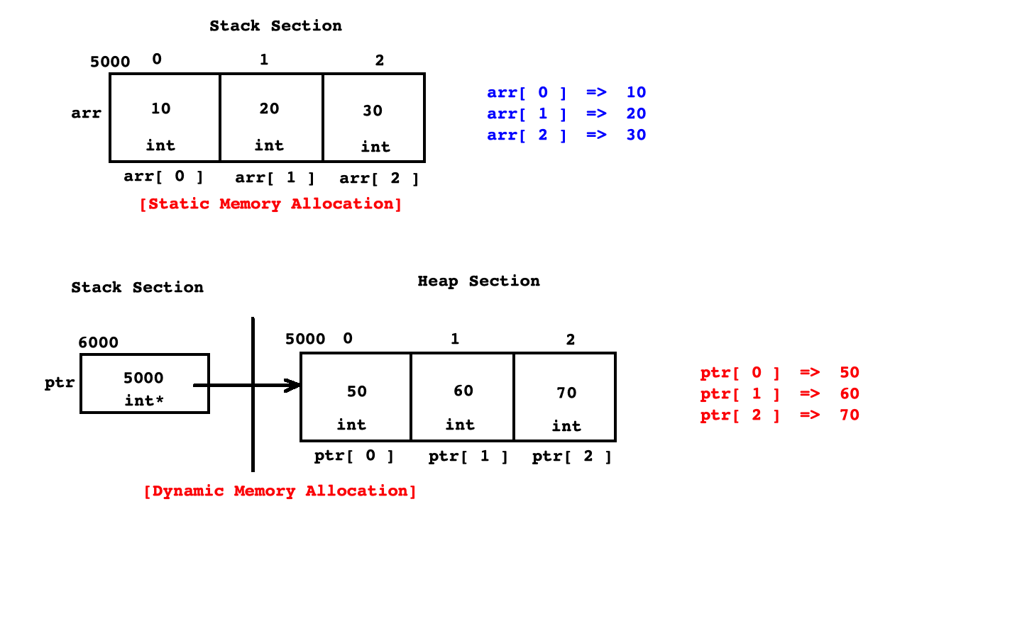
Static v/s Dynamic Memory Allocation In C/C++

Slide 4
Array Declaration and Initialization In C
int arr[ 3 ]; //OK : Declaration
int arr[ 3 ] = { 10, 20, 30 }; //OK : Initialization
int arr[ ] = { 10, 20, 30 }; //OK
int arr[ 3 ] = { 10, 20 }; //OK : Partial Initialization
int arr[ 3 ] = { }; //OK : Partial Initialization
int arr[ 3 ] = { 10, 20, 30, 40, 50 }; //Not recommended

Slide 5
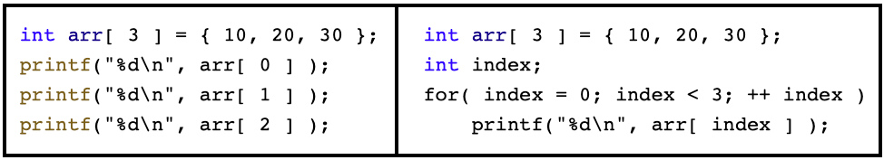
Accessing Elements Of Array
If we want to access elements of array then we should use integer index.
Array index always begins with 0.

Slide 6
Advantage and Disadvantages Of Array
Advantage Of Array
We can access elements of array randomly.
Disadvantage Of Array
We can not resize array at runtime.
It requires continuous memory.
Insertion and removal of element from array is a time consuming job.
Using assignment operator, we can not copy array into another array.
Compiler do not check array bounds( min and max index ).

Slide 7
Array In Java
Array is a reference type in Java. In other words, to create instance of array, new operator is required. It means that array instance get space on heap.
There are 3 types of array in Java:
Single dimensional array
Multi dimensional array
Ragged array
Types of loop in Java:
do-while loop
while loop
for loop
for-each loop
To perform operations on array we can use following classes:
java.util.Arrays
org.apache.commons.lang3.ArrayUtils( download .jar file )

Slide 8
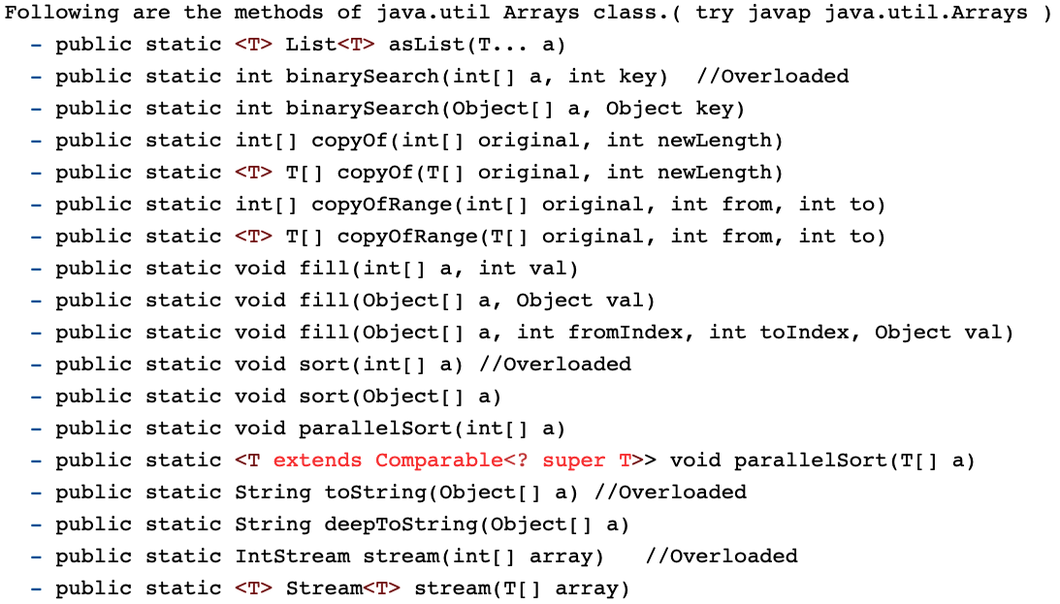
Methods Of java.util.Arrays Class

Slide 9
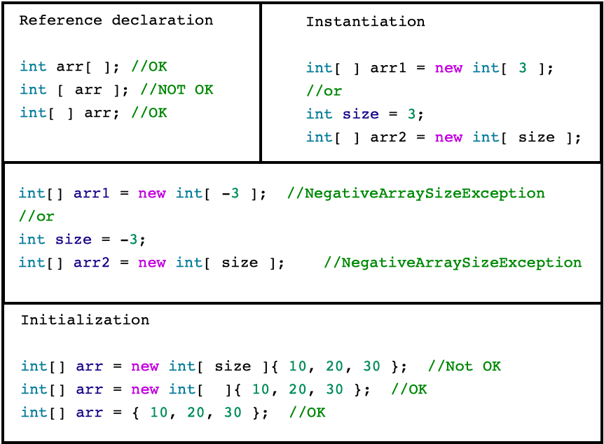
Single Dimensional Array

Slide 10
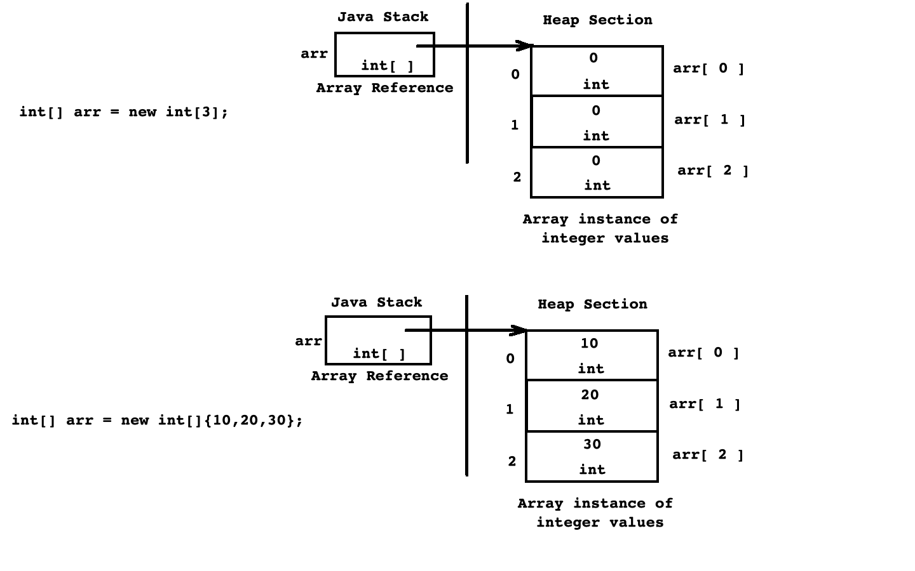
Single Dimensional Array

Slide 11
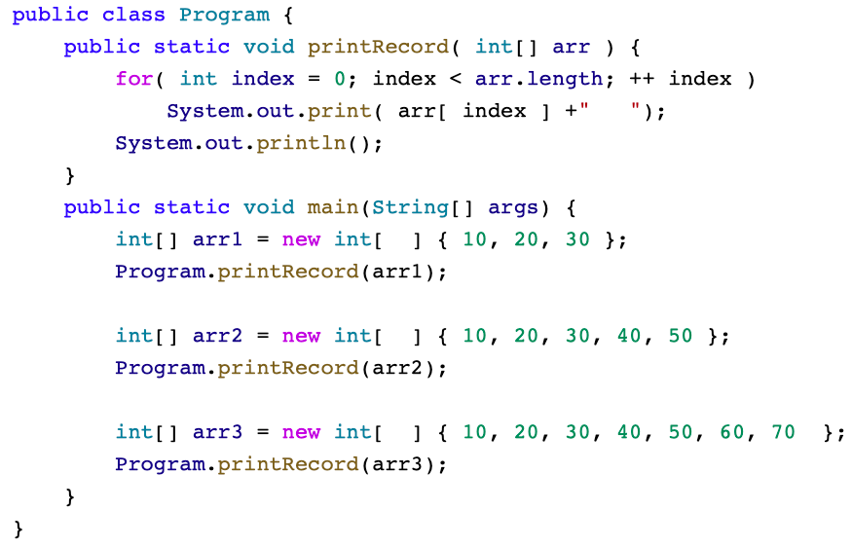
Using length Field

Slide 12
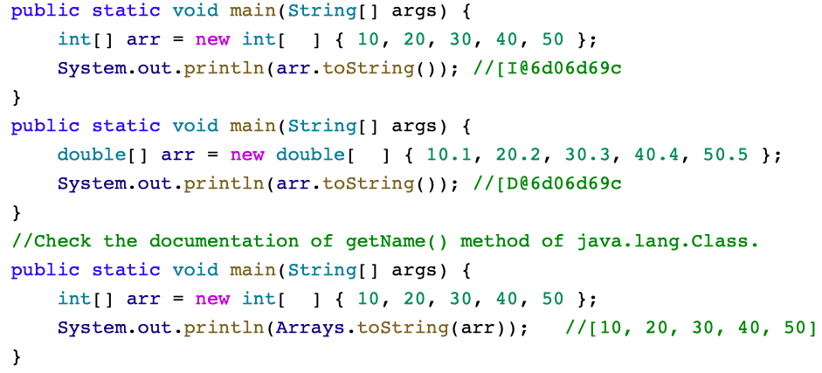
Using toString( ) Method

Slide 13
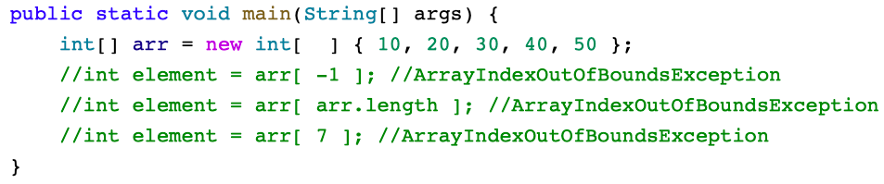
ArrayIndexOutOfBoundsException
Using illegal index, if we try to access elements of array then JVM throws ArrayIndexOutOfBoundsException. Consider following code:

Slide 14
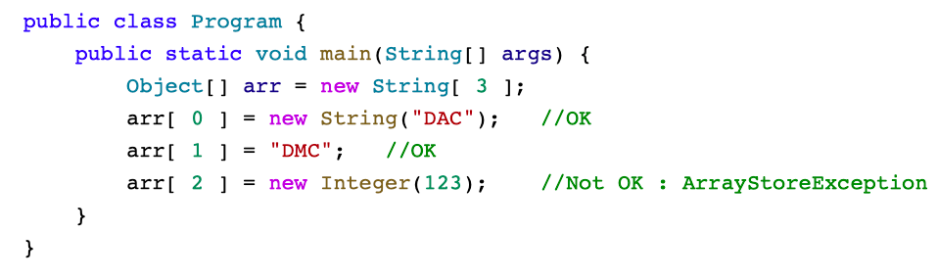
ArrayStoreException
If we try to store incorrect type of object into array then JVM throws ArrayStoreException.
Consider the following code:

Slide 15
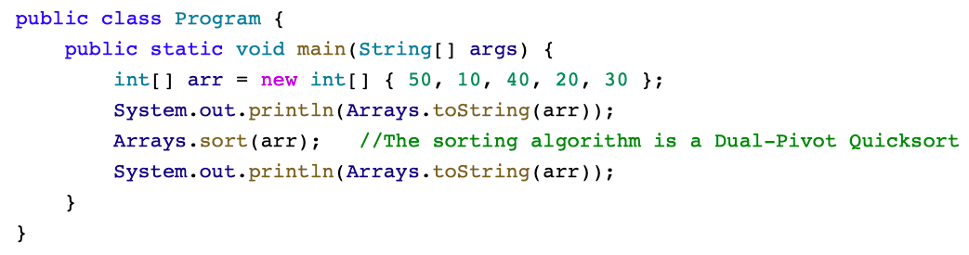
Sorting Array Elements

Slide 16
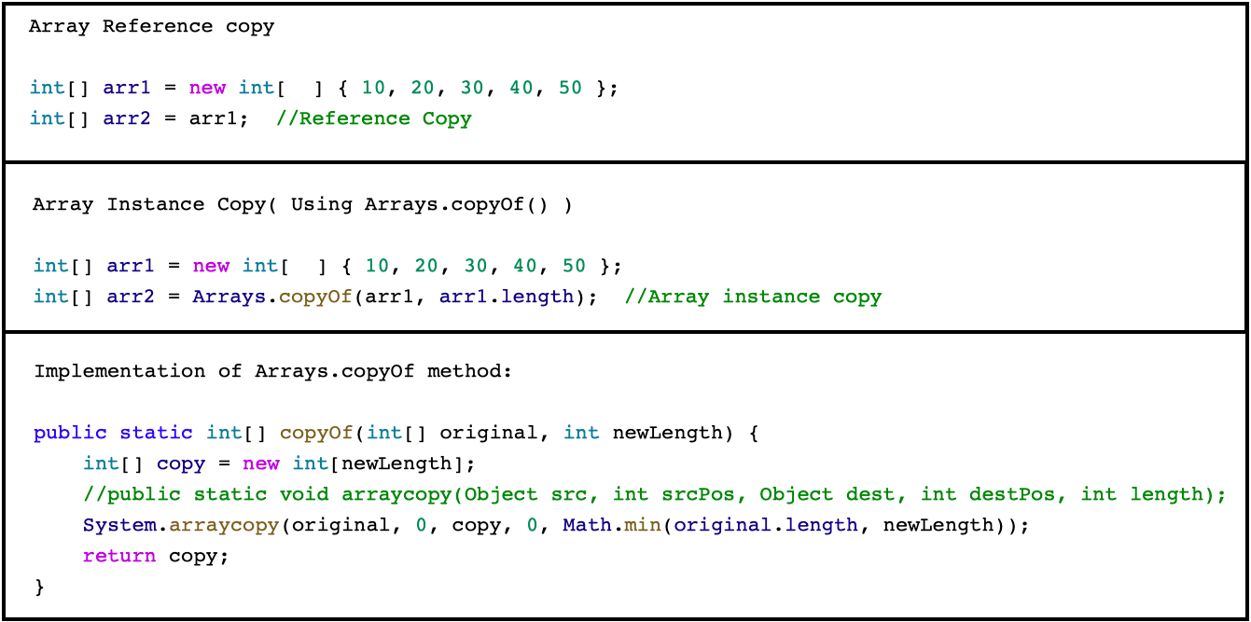
Reference Copy and Instance Copy

Slide 17
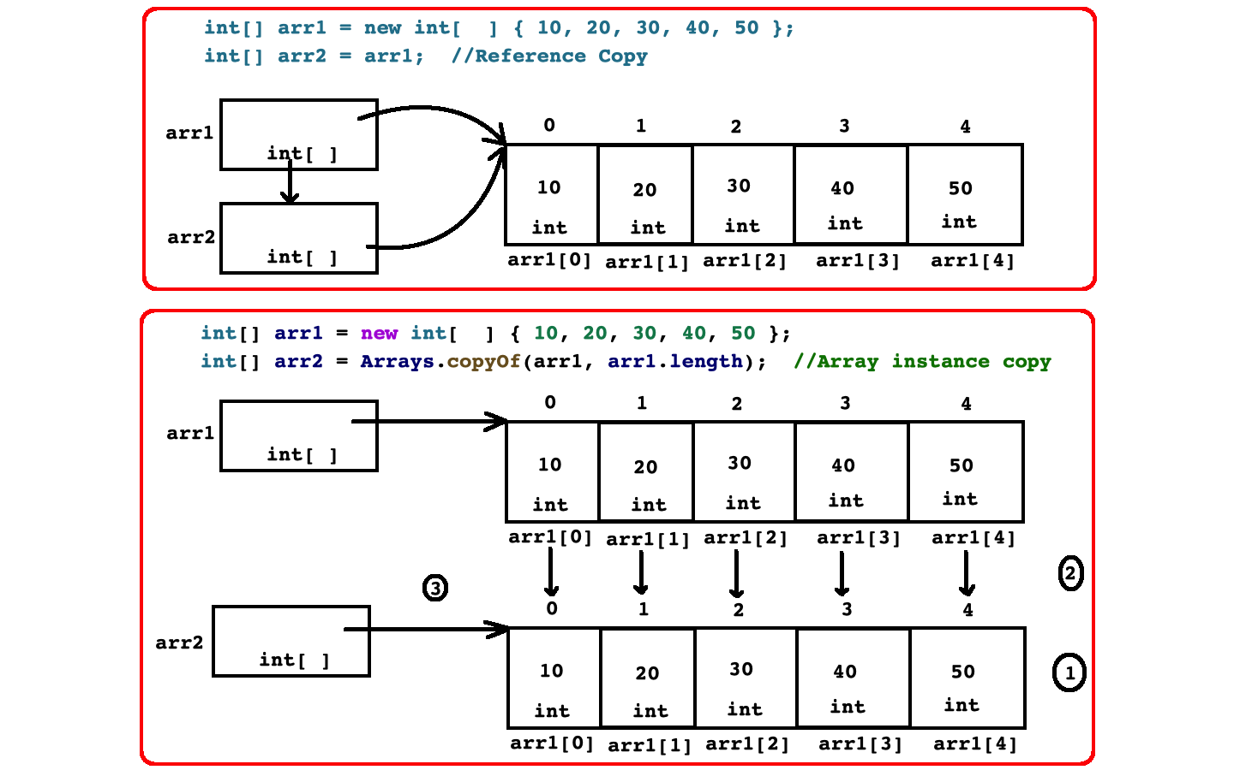
Reference Copy and Instance Copy

Slide 18
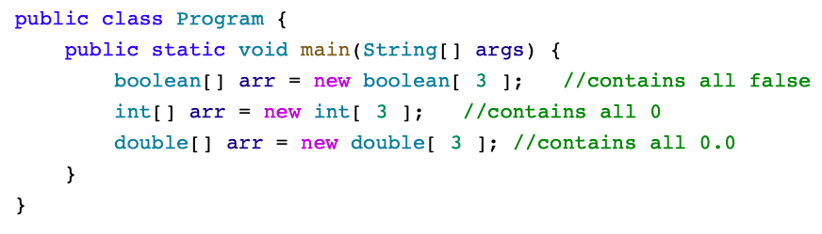
Array Of Primitive Values

Slide 19
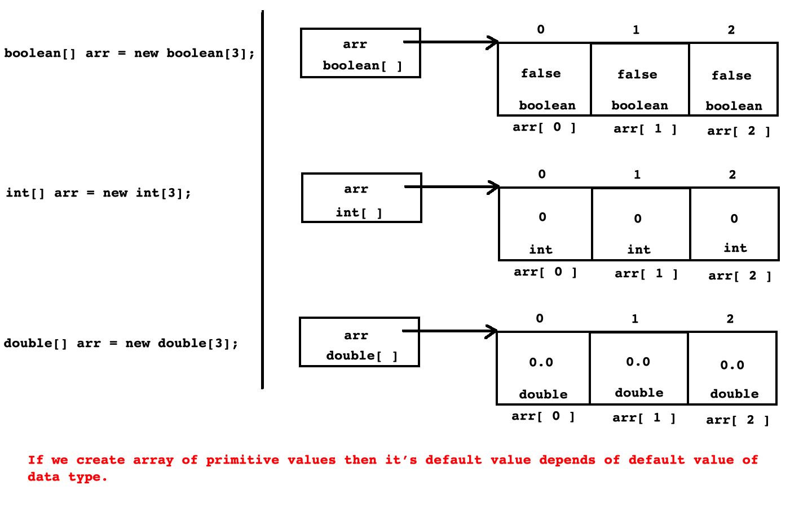
Array Of Primitive Values

Slide 20
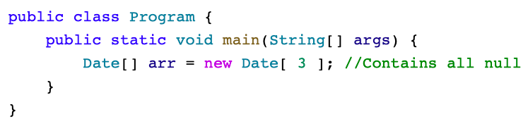
Array Of References

Slide 21
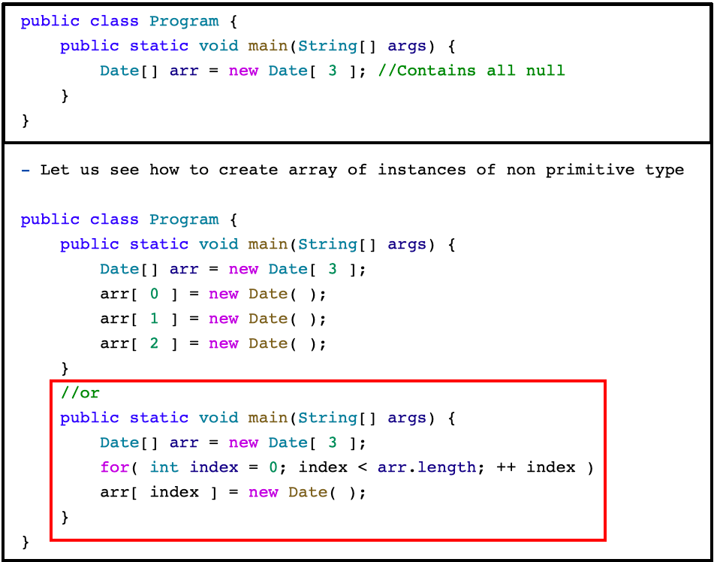
Array Of References and Instances

Slide 22
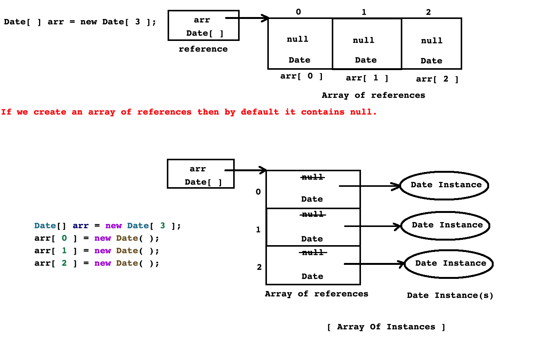
Array Of References and Instances

Slide 23
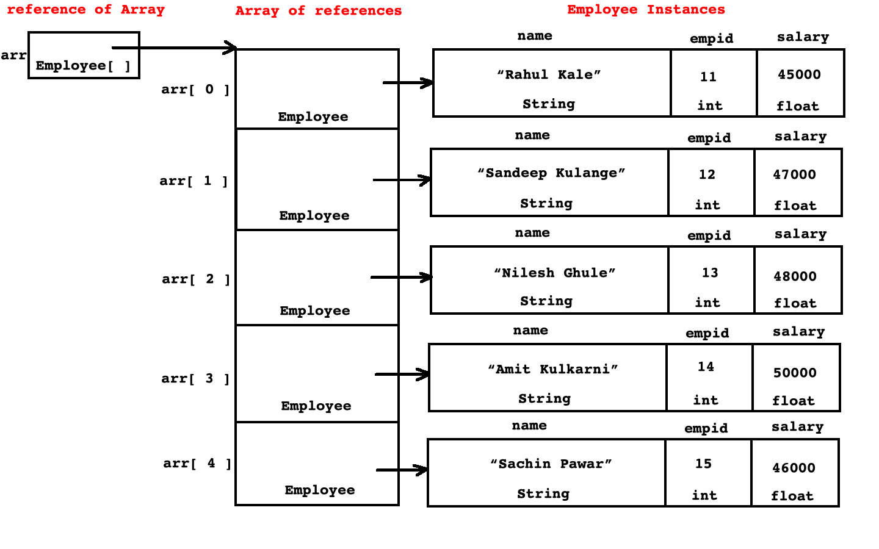
Array Of Instances

Slide 24
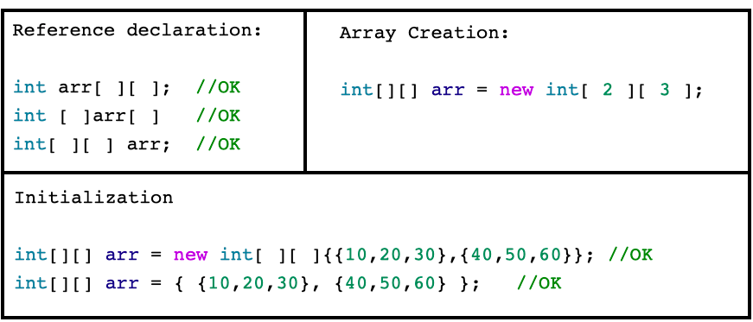
Multi Dimensional Array
Array of elements where each element is array of same column size is called as multi dimensional array.

Slide 25
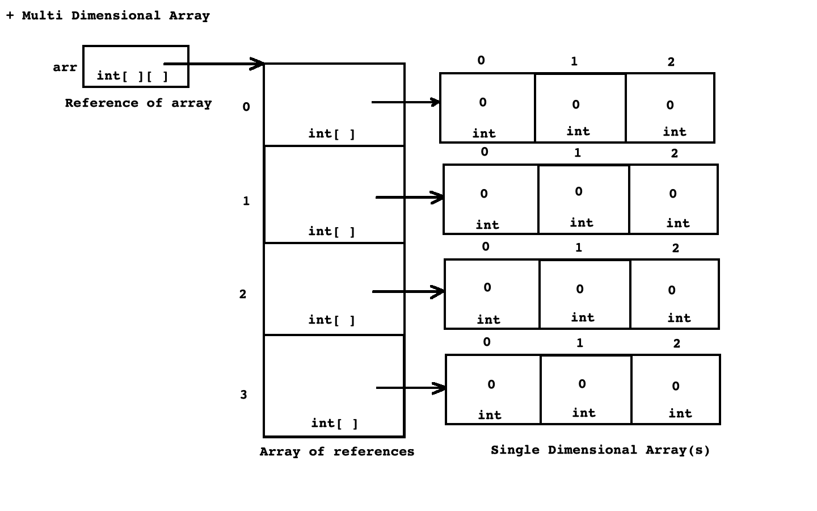
Multi Dimensional Array

Slide 26
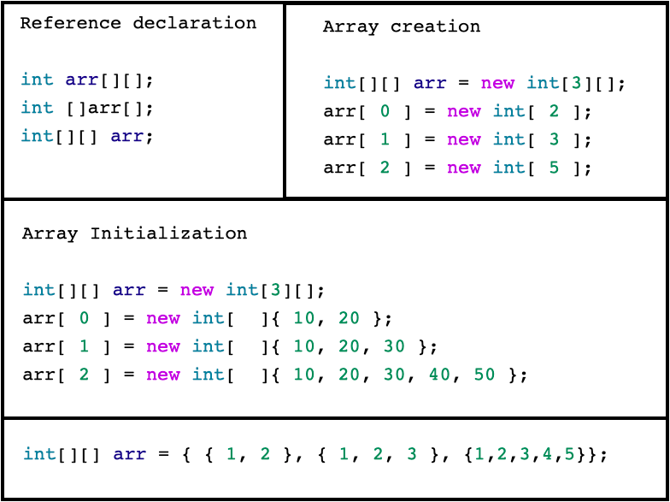
Ragged Array
A multidimensional array where column size of every array is different.

Slide 27
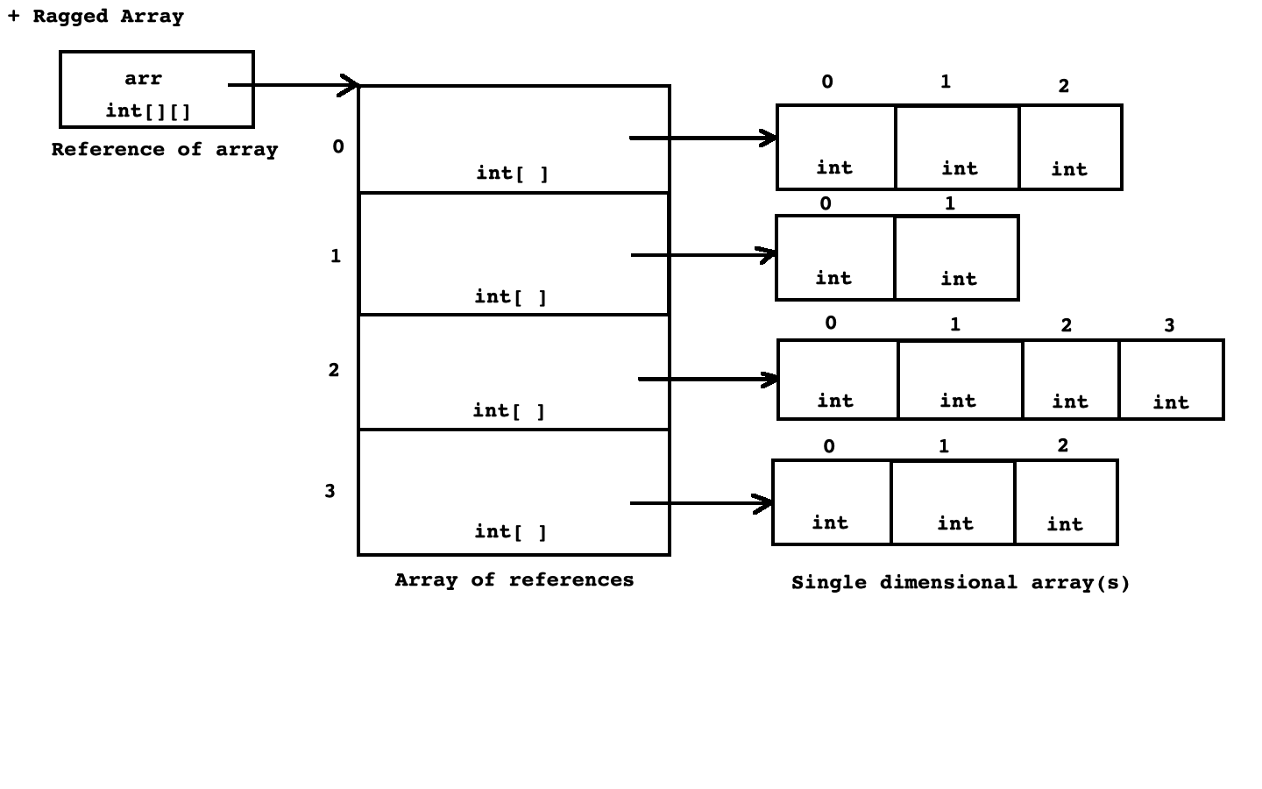
Ragged Array

Slide 28
Argument Passing Methods
In C programming language, we can pass argument to the function using 2 ways:
By value.
By address
In C++ programming language, we can pass argument to the function using 3 ways:
By value.
By address
By reference
In Java programming language, we can pass argument to the method using a way:
By value.
In other word, every variable of primitive type/non primitive type is pass to the method by value only.

Slide 29
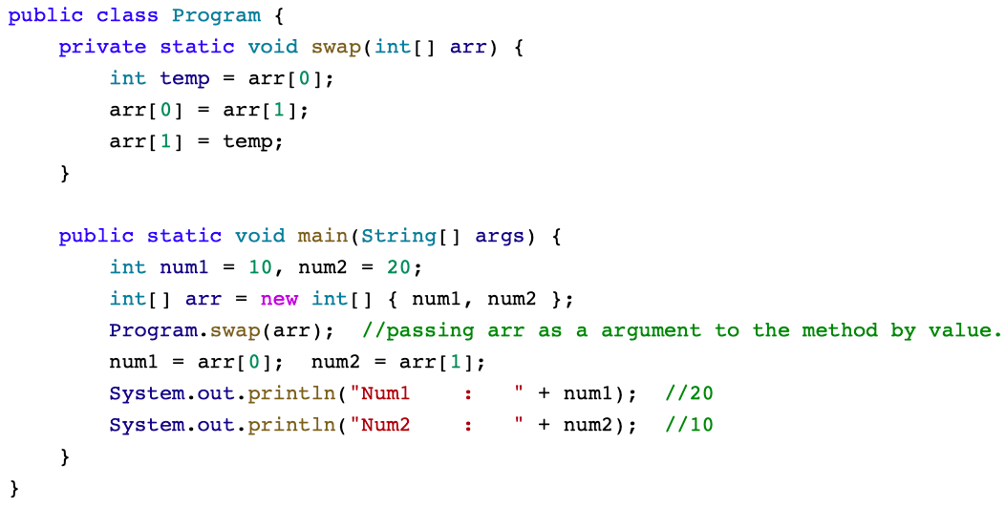
Simulation Of Pass By Reference in Java

Slide 30
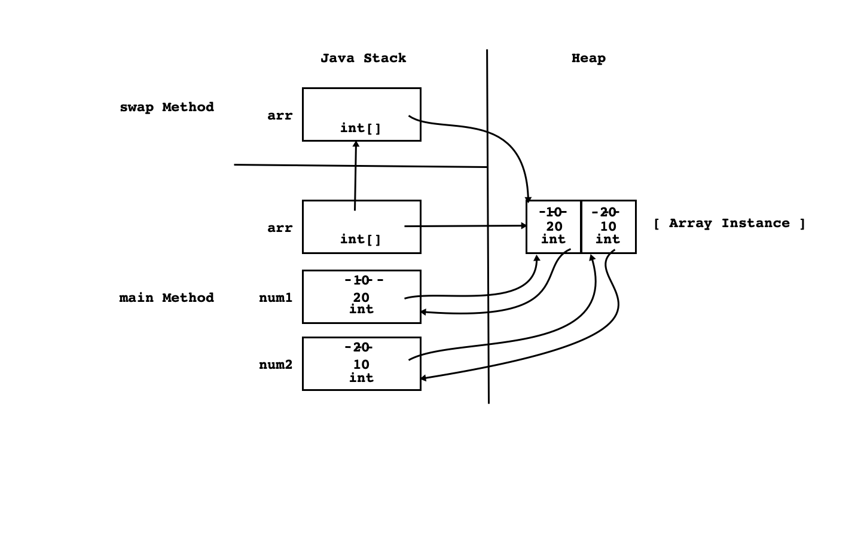
Simulation Of Pass By Reference in Java

Slide 31
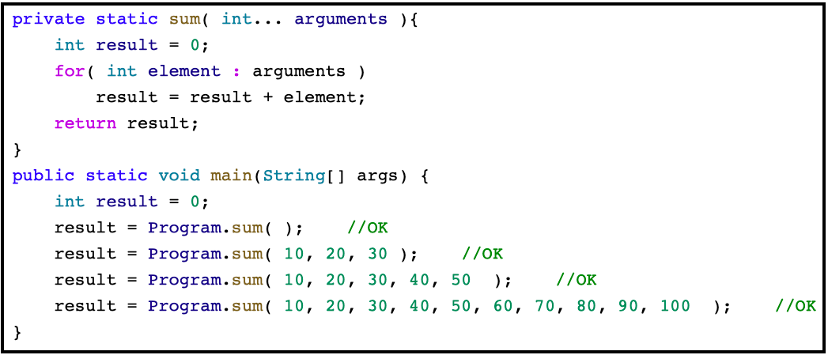
Variable Arity/Argument Method
Consider Examples from Java API:
public PrintStream printf(String format, Object... args);
public static String format(String format, Object... args);
public Object invoke(Object obj, Object... args);

Slide 32

Thank You.
[sandeepkulange@sunbeaminfo.com]

