Slide 1
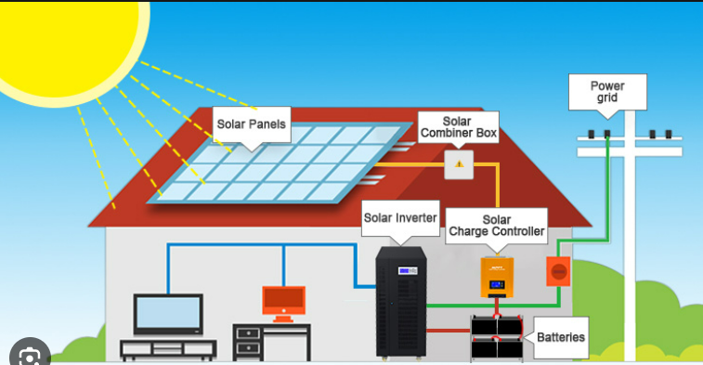
A three-phase inverter connected to a grid fed by PV operating at MPP

Slide 2
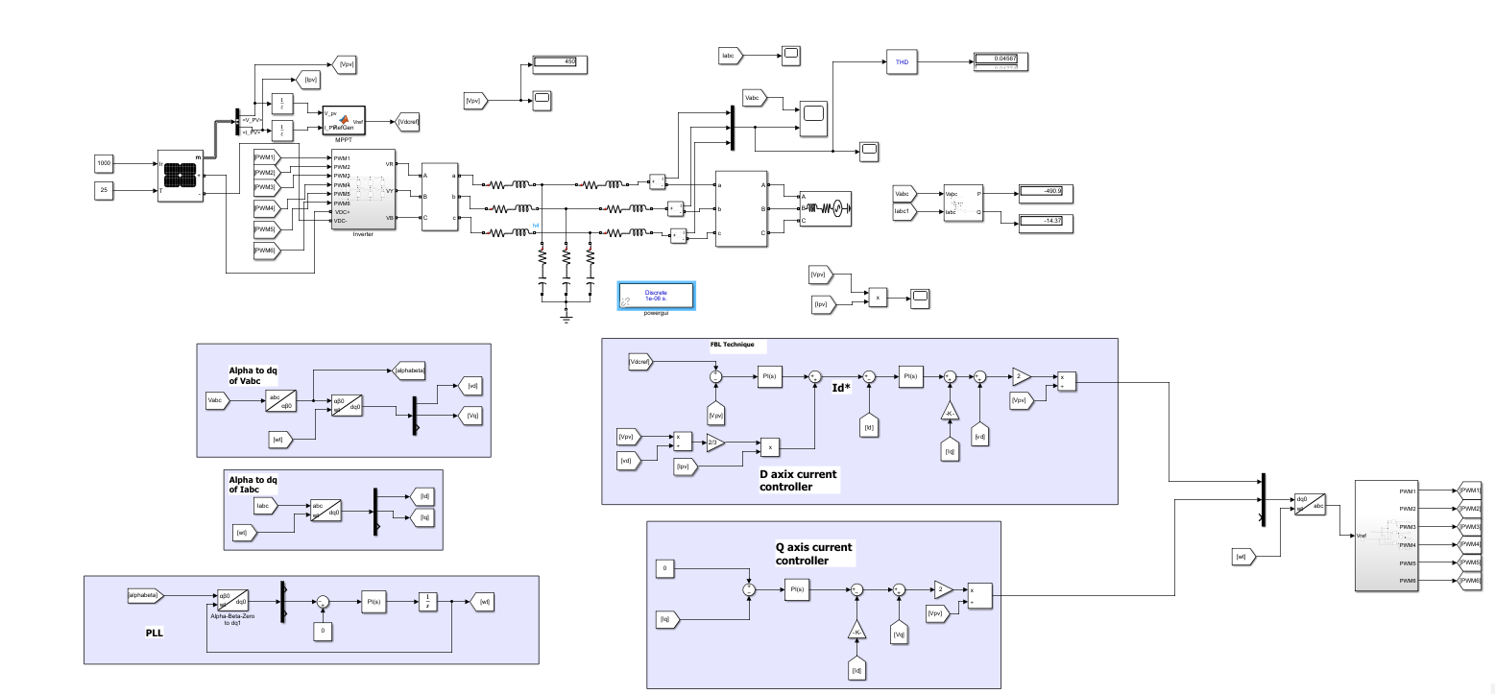

Slide 3
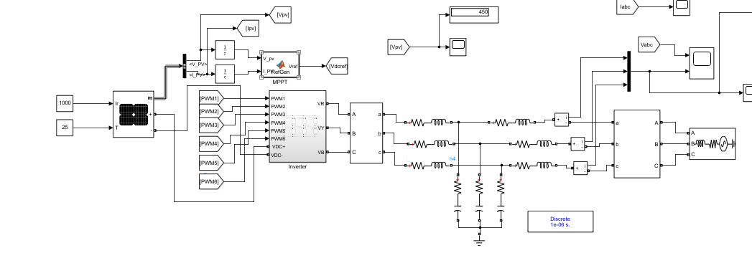
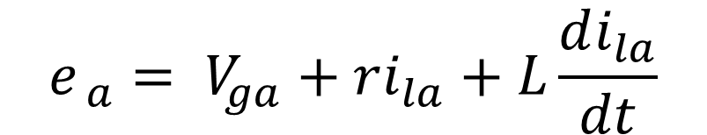
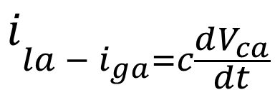

$$e_{ a}= V_{ga}+ri_{la}+L\frac{di_{la}}{dt}$$
From KVL equation
$$V_{ga}= V_{ca }$$
From KVL equation
$$i_{la − i_{ga}=c\frac{dV_{ca}}{dt}}$$
From KCL equation

Slide 4
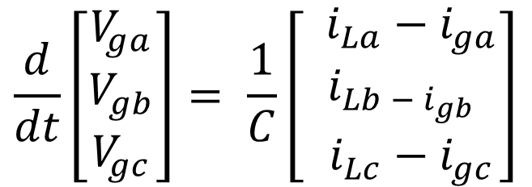
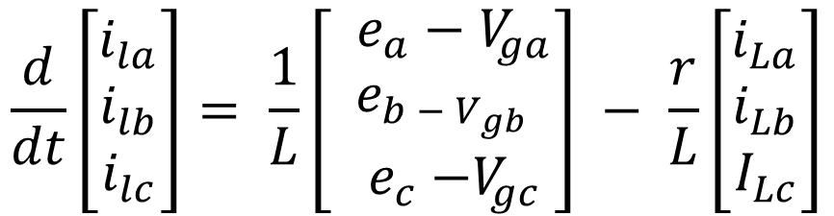
abc Matrix
$$\frac{d}{dt}\left[\begin{matrix}i_{la} \\ i_{lb} \\ i_{lc}\end{matrix}\right]= \frac{1}{L}\left[\begin{matrix} e_{a}−V_{ga} \\ e_{b − V_{gb}} \\ { e}_{c} −V_{gc}\end{matrix}\right] − \frac{r}{L}\left[\begin{matrix}i_{La} \\ i_{Lb} \\ I_{Lc}\end{matrix}\right]$$
$$\frac{d}{dt}\left[\begin{matrix}V_{ga} \\ V_{gb} \\ V_{gc}\end{matrix}\right]= \frac{1}{C}\left[\begin{matrix} i_{La}−i_{ga} \\ i_{Lb − i_{gb}} \\ { i}_{Lc} −{ i}_{gc}\end{matrix}\right]$$

Slide 5

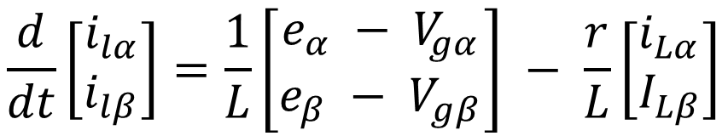
abc to αβ transformation
$$\frac{d}{dt}\left[\begin{matrix}i_{lα} \\ i_{lβ}\end{matrix}\right]=\frac{1}{L}\left[\begin{matrix}e_{α} − V_{gα} \\ e_{β} − V_{gβ}\end{matrix}\right] − \frac{r}{L}\left[\begin{matrix}i_{Lα} \\ I_{Lβ}\end{matrix}\right]$$
$$\frac{d}{dt}\left[\begin{matrix}V_{gα} \\ V_{gβ}\end{matrix}\right]=\frac{1}{C}\left[\begin{matrix}i_{Lα} − i_{gα} \\ i_{Lβ} − i_{gβ}\end{matrix}\right]$$

Slide 6

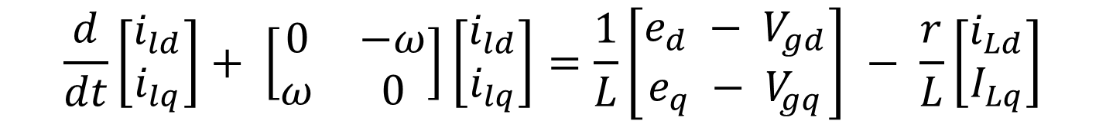
αβ to dq transformation
$$\frac{d}{dt}\left[\begin{matrix}i_{ld} \\ i_{lq}\end{matrix}\right]+ \left[\begin{matrix}0 & −ω \\ ω & 0\end{matrix}\right]\left[\begin{matrix}i_{ld} \\ i_{lq}\end{matrix}\right]=\frac{1}{L}\left[\begin{matrix}e_{d} − V_{gd} \\ e_{q} − V_{gq}\end{matrix}\right] − \frac{r}{L}\left[\begin{matrix}i_{Ld} \\ I_{Lq}\end{matrix}\right]$$
$$\frac{d}{dt}\left[\begin{matrix}V_{gd} \\ V_{gq}\end{matrix}\right]+ \left[\begin{matrix}0 & −ω \\ ω & 0\end{matrix}\right]\left[\begin{matrix}V_{gd} \\ V_{gq}\end{matrix}\right]=\frac{1}{C}\left[\begin{matrix}i_{Ld} − i_{gd} \\ i_{Lq} − i_{gq}\end{matrix}\right]$$

Slide 7
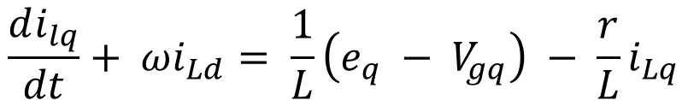
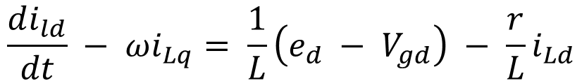


$$\frac{di_{ld}}{dt} − ωi_{Lq}= \frac{1}{L}\left(e_{d} − V_{gd}\right) − \frac{r}{L}i_{Ld}$$
equation 1
$$\frac{di_{lq}}{dt}+ ωi_{Ld}= \frac{1}{L}\left(e_{q} − V_{gq}\right) − \frac{r}{L}i_{Lq}$$
equation 2
$\frac{dV_{gd}}{dt}−{ωV}_{gq}= \frac{1}{C}\left(i_{Ld}−i_{gd}\right)$
equation 3
$\frac{dV_{gq}}{dt}−{ωV}_{gd}= \frac{1}{C}\left(i_{Lq}−i_{gq}\right)$
equation 4

Slide 8

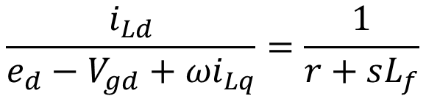
from equation 1 and 2
$$\frac{i_{Ld}}{e_{d}−V_{gd}+{ωi}_{Lq}}=\frac{1}{r+sL_{f}}$$
d axis transfer function
$$\frac{i_{Lq}}{e_{q}−V_{gq}−{ωi}_{Ld}}=\frac{1}{r+sL_{f}}$$
q axis transfer function

Slide 9



LC Filter design
Capacitance Calculation (from reactive power)
reactive power = 5% of rated power(from observation)
where
S = Total power of the system
Vg = Grid voltage
Ig = Grid current
F = frequency of ac
$$C=\frac{0.05∗s}{3∗2πf∗V_{g}^{2}}$$
Inductance Calculation
calculating from transfer function (Ig/Vinv) at s = jWsw (fsw = 10khz)
$$L=\frac{0.1∗V_{g}}{2πf∗i_{g}}$$
where
$$i_{g}=\frac{s}{3V_{g}}$$

Slide 10
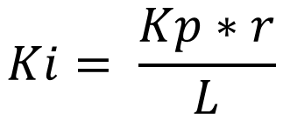
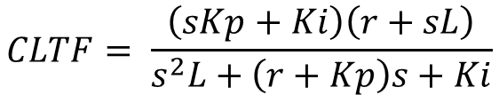

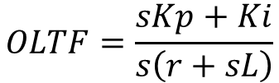
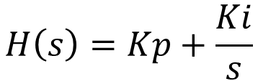
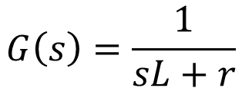
DQ - Current controller design
((calculated by using pole zero cancellation method))
We have -
$$G\left(s\right)=\frac{1}{sL+r}$$
$$H\left(s\right)=Kp+\frac{Ki}{s}$$
Calculating OLTF AND CLTF FROM G and H transfer function
$$OLTF=\frac{sKp+Ki}{s\left(r+sL\right)}$$
$$CLTF= \frac{\left(sKp+Ki\right)\left(r+sL\right)}{s^{2}L+\left(r+Kp\right)s+Ki}$$
((calculated by using pole zero cancellation method))
where fc is the cutoff frequency which is 1/10 times of Switching frequency
$$Ki= \frac{Kp∗r}{L}$$
$$Kp=2πf_{c}L$$

Slide 11
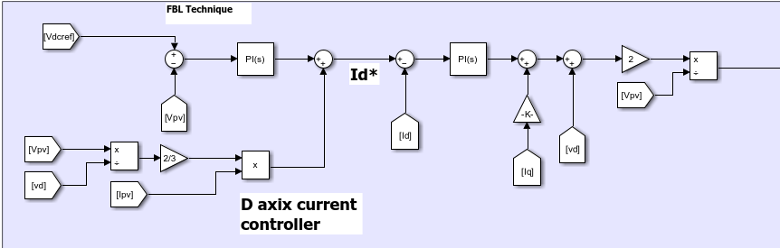
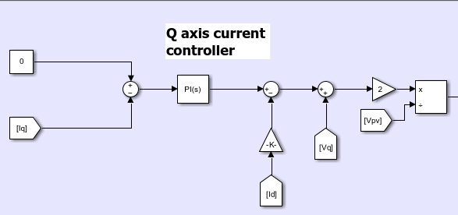

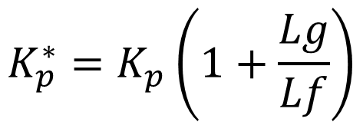
Considering grid inductance in the calculation
$$K_{p}^{∗}=K_{p}\left(1+\frac{Lg}{Lf}\right)$$
$$K_{i}^{∗}=K_{i}\left(1+\frac{Lg}{Lf}\right)$$

Slide 12
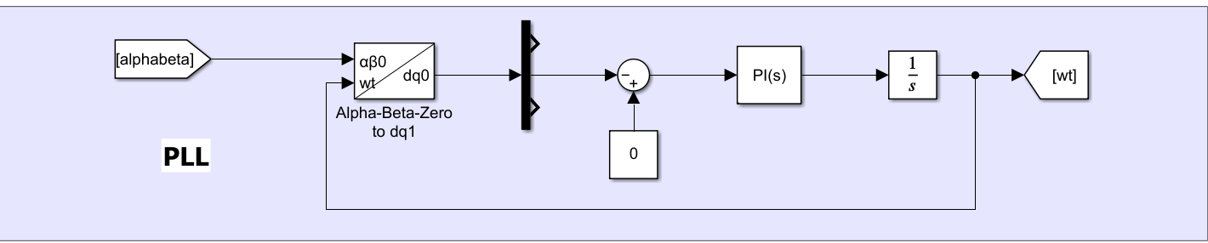
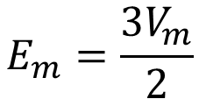
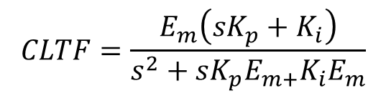

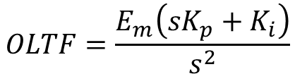
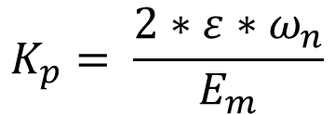
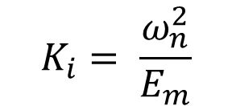
Designing PLL controller
Calculating OLTF AND CLTF FROM G and H transfer function
$$CLTF=\frac{E_{m}\left(sK_{p}+K_{i}\right)}{s^{2}+sK_{p}E_{m+}K_{i}E_{m}}$$
$$OLTF=\frac{E_{m}\left(sK_{p}+K_{i}\right)}{s^{2}}$$
((calculated by using pole Placing method))
$$K_{p}= \frac{2∗ε∗ω_{n}}{E_{m}}$$
$$K_{i}= \frac{ω_{n}^{2}}{E_{m}}$$
where
$$E_{m}=\frac{3V_{m}}{2}$$
$$ω_{n}=2πf$$

Slide 13
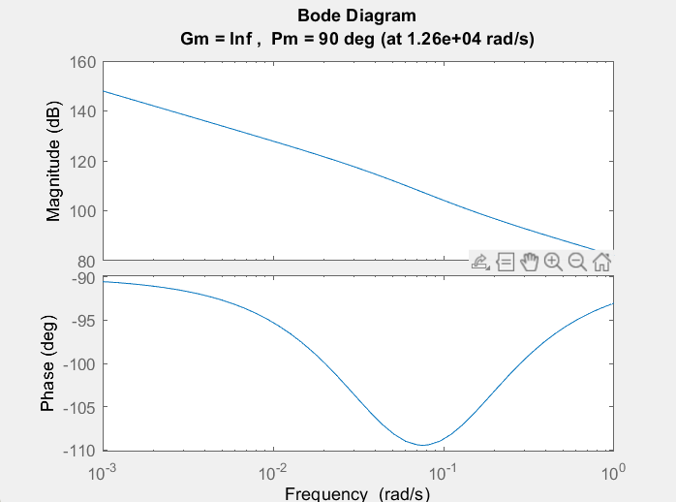
Bode plot of OLTF

Slide 14
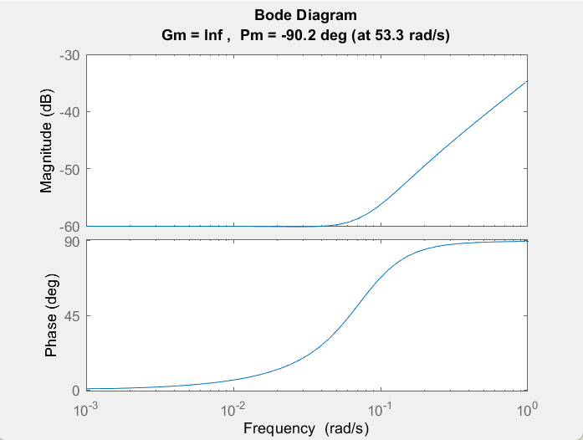
Bode plot of CLTF

Slide 15
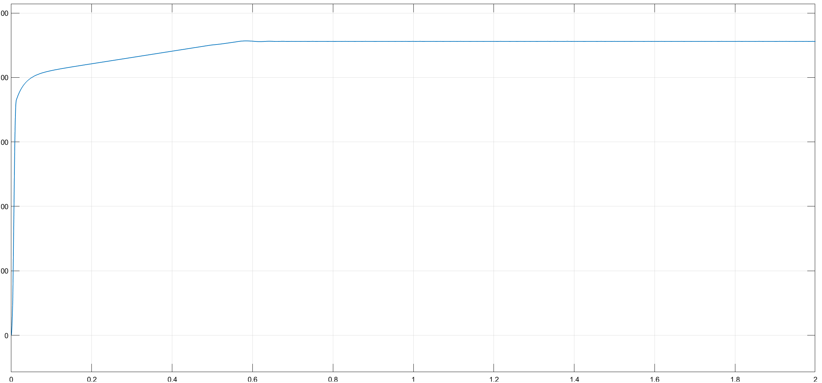
MPPT Tracking
VMPP Tracking graph

Slide 16
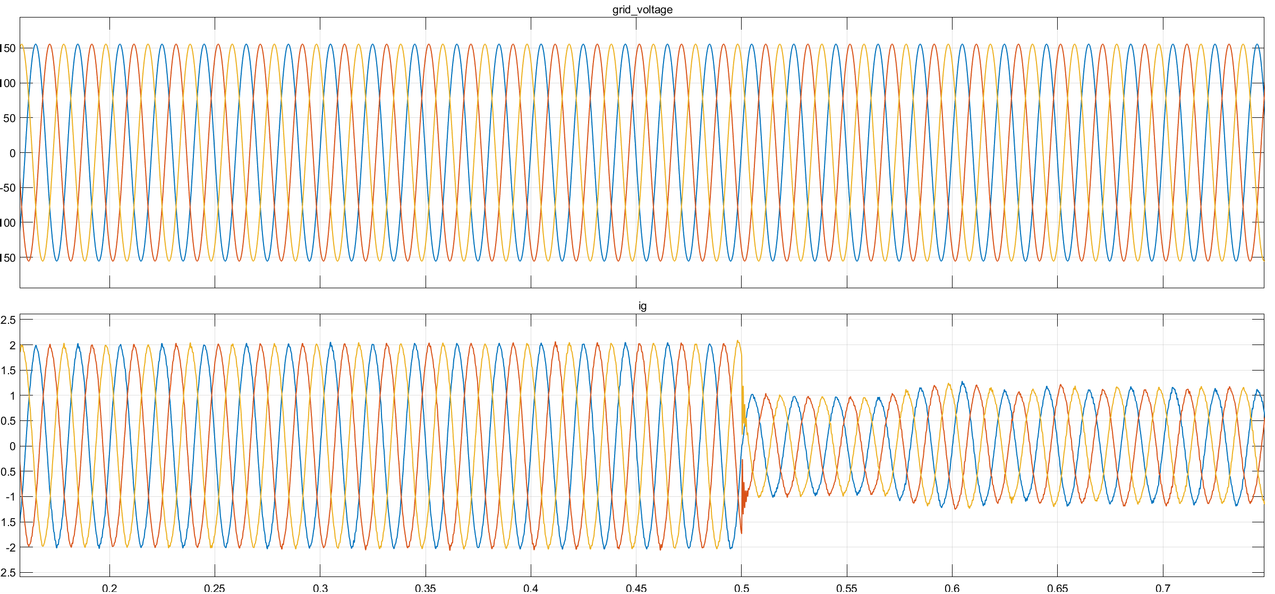
Graph of current feeding into grid

Slide 17
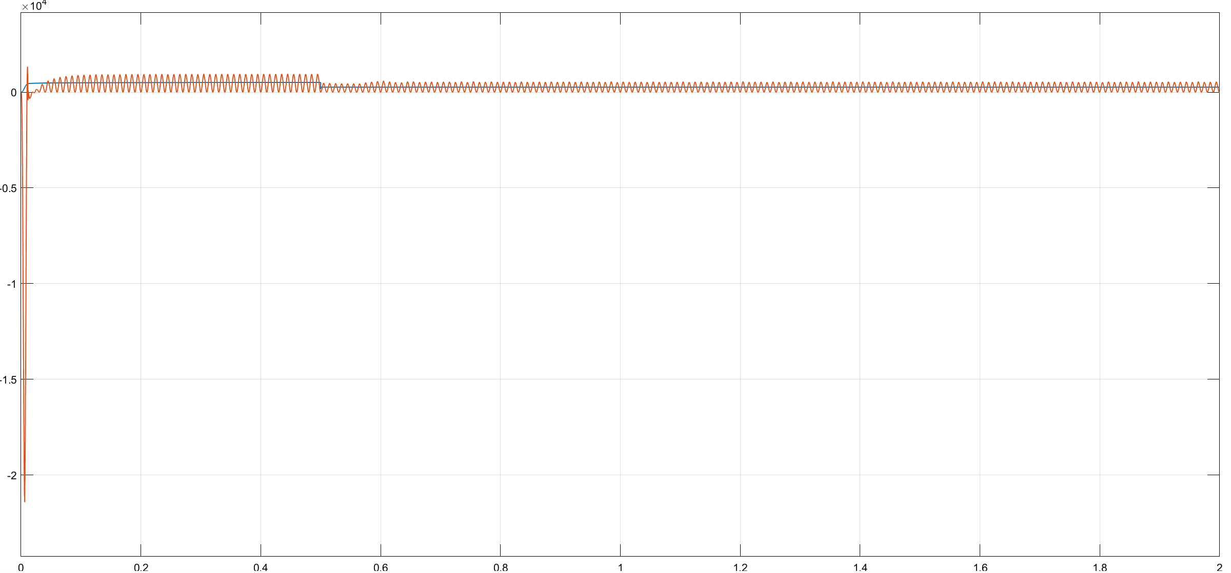
Comparing Power generated by panels vs Power that are fed into the Grid
Panel power = 513 W
Power transferred to the grid is = 500 W

Slide 18
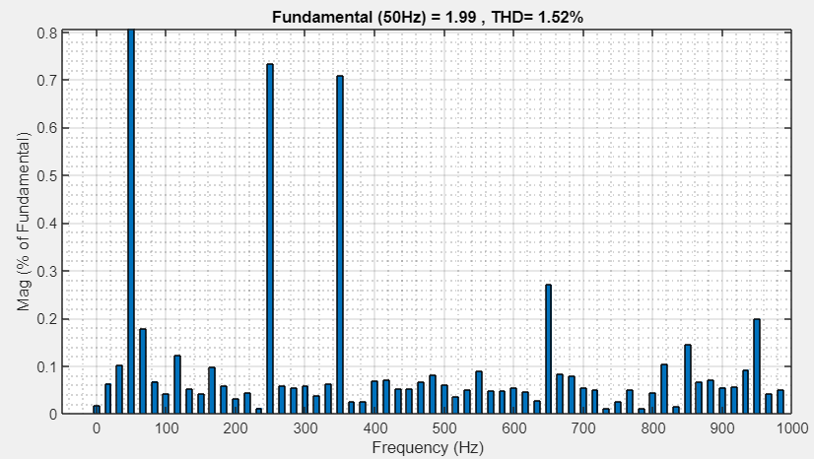
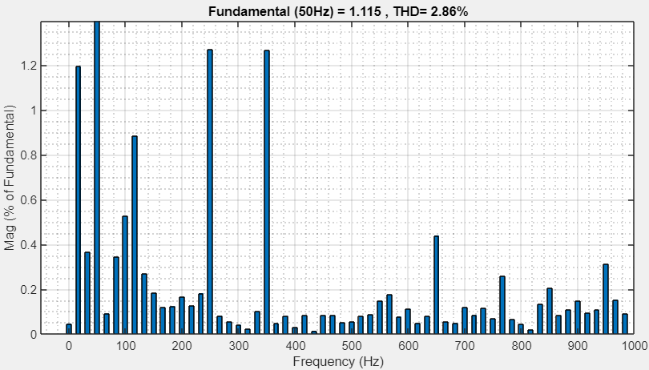
THD calculation
THD calculation in Dynamic state

