Slide 1
Clustering Analysis
Zhi Wei

Slide 2
Outline
Clustering Analysis
  Introduction, Distance
  K-Means Clustering
  Hierarchical Clustering

Slide 3
Typical Data Analysis
Three main types of statistical problems associated with most data analysis:
Identification of important features that characterize the data (sample classes) (feature or variable selection).
Identification of new/unknown sample classes using data (unsupervised learning – clustering)
Classification of sample into known classes (supervised learning – classification)

Slide 4
What is Cluster Analysis?
Finding groups of objects such that the objects in a group will be similar (or related) to one another and different from (or unrelated to) the objects in other groups
Inter-cluster distances are maximized
Intra-cluster distances are minimized

Slide 5
Clustering
Clustering is an exploratory tool to see who's running with who: Features and Samples.
“Unsupervised”
NOT for classification of samples.
NOT for identification of important features.

Slide 6
Applications of Clustering
Viewing and analyzing vast amounts of data as a whole set can be perplexing
It is easier to interpret the data if they are partitioned into clusters by combining similar data points.
Identification of outliers

Slide 7
Clustering algorithms
We can divide clustering methods into roughly three types:
hierarchical agglomerative clustering
  For example, hierarchical clustering
Model based
  For example, k-means, Gaussian mixtures
Iterative partitioning (top down)
  For example, graph based algorithms

Slide 8
Distance
We need a mathematical definition of distance between two points
What are points?
If each feature is a point, what is the mathematical definition of a point?

Slide 9
Points
1 2 . . . . . . . P
1
2
.
.
.
.
.
.
.
.
N
feature1= (E₁₁, E₂₁, …, E_{N1})’
feature2= (E₁₂, E₂₂, …, E_{N2})’
Sample1= (E₁₁, E₁₂, …, E_{1P})’
Sample2= (E₂₁, E₂₂, …, E_{2P})’
E_{ij}=data point of sample i
feature j,
DATA MATRIX
Notes:
Genes are in rows, samples in columns

Slide 10
Most Famous Distance
Euclidean distance
  Example distance between sample 1 and 2:
  Sqrt of Sum of (E_{1i} -E_{2i})², i=1,…,P
When N is 2, this is distance as we know it:
Baltimore
Distance
DC
When P is 20,000 you have to think abstractly

Slide 11
Correlation can also be used to compute distance
Pearson Correlation
Spearman Correlation
Uncentered Correlation
Absolute Value of Correlation
See http://gedas.bizhat.com/dist.htm for details for your interest.

Slide 12
The similarity/distance matrices
1 2 ……….P
1 2 ………………………………...N
1
2
.
.
.
.
.
.
.
.
N
1
2
.
.
.
.
.
.
.
.
N
DATA MATRIX
SAMPLE SIMILARITY MATRIX

Slide 13
The similarity/distance matrices
1 2 ……….P
1 2 …………..P
1
2
.
.
.
.
.
.
.
.
N
1
2
.
.
.
P
FEATURE SIMILARITY MATRIX
DATA MATRIX

Slide 14
Feature/Sample Selection
Do you want all features included?
Irrelevant features will affect your results.
Including all features: dendrogram can’t all be seen at the same time.
Perhaps screen the features?

Slide 15
Two commonly seen clustering approaches
K-means/K-medoids
  Partitioning method
  Requires user to define K = # of clusters a priori
  No picture to (over) interpret
Hierarchical clustering
  Dendrogram (red-green picture)
  Allows us to cluster both features and samples in one picture and see whole dataset “organized”

Slide 16

K-means Clustering
Partitional clustering approach
Each cluster is associated with a centroid (center point)
Each point is assigned to the cluster with the closest centroid
Number of clusters, K, must be specified
The basic algorithm is very simple

Slide 17
K-means Clustering – Details
Initial centroids are often chosen randomly.
  Clusters produced vary from one run to another.
The centroid is (typically) the mean of the points in the cluster.
‘Closeness’ is measured by “distance”, e.g. Euclidean distance, correlation, etc.
K-means will converge for common similarity measures mentioned above.
Most of the convergence happens in the first few iterations.
  Often the stopping condition is changed to ‘Until relatively few points change clusters’

Slide 18



Two different K-means Clustering
Original Points
Optimal Clustering
Sub-optimal Clustering

Slide 19






Importance of Choosing Initial Centroids

Slide 20
Importance of Choosing Initial Centroids

Slide 21
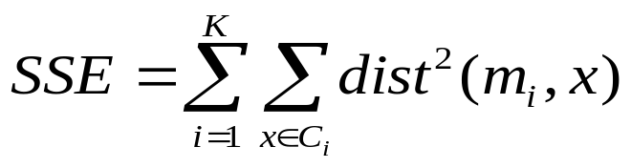
Evaluating K-means Clusters
Most common measure is Sum of Squared Error (SSE)
  For each point, the error is the distance to the nearest cluster
  To get SSE, we square these errors and sum them.
  x is a data point in cluster C_{i} and m_{i} is the representative point for cluster C_{i}
    can show that m_{i} corresponds to the center (mean) of the cluster
  Given two clusters, we can choose the one with the smallest error
  One easy way to reduce SSE is to increase K, the number of clusters
    A good clustering with smaller K can have a lower SSE than a poor clustering with higher K

Slide 22
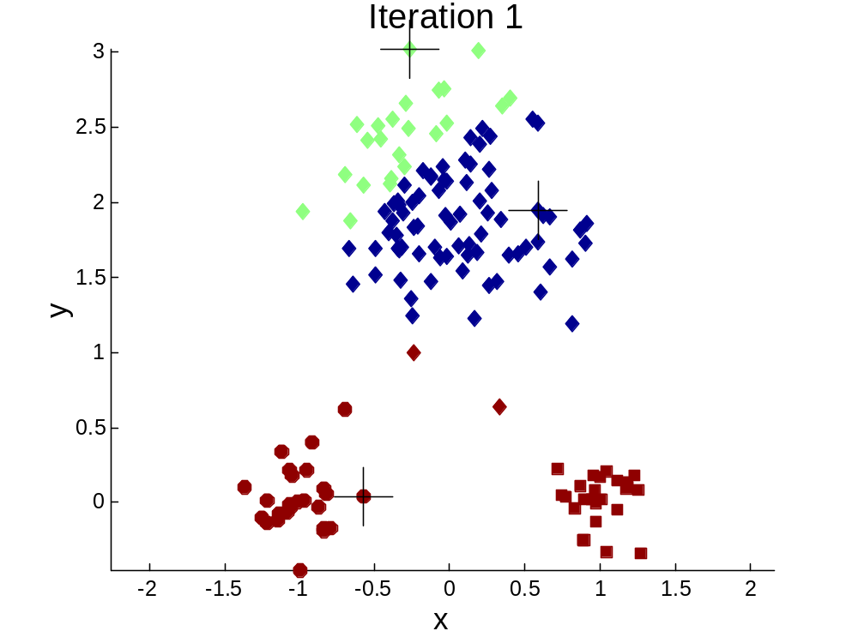


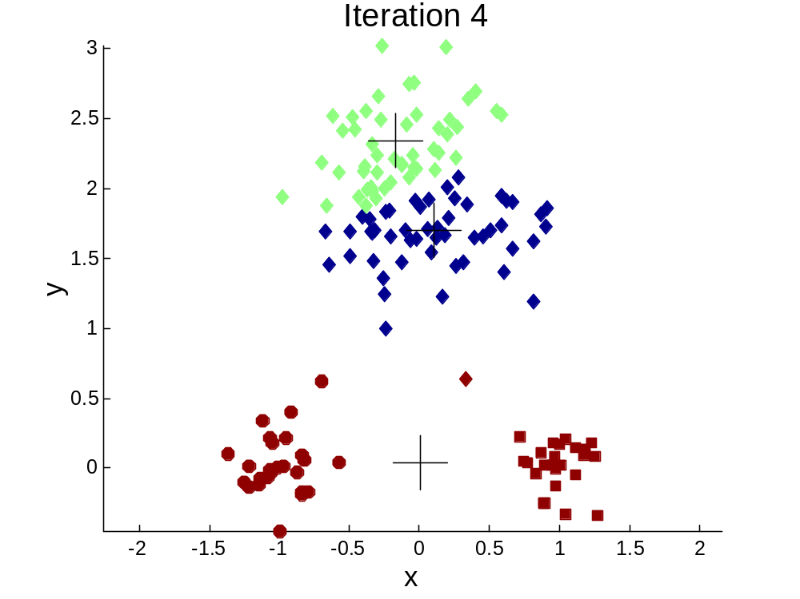
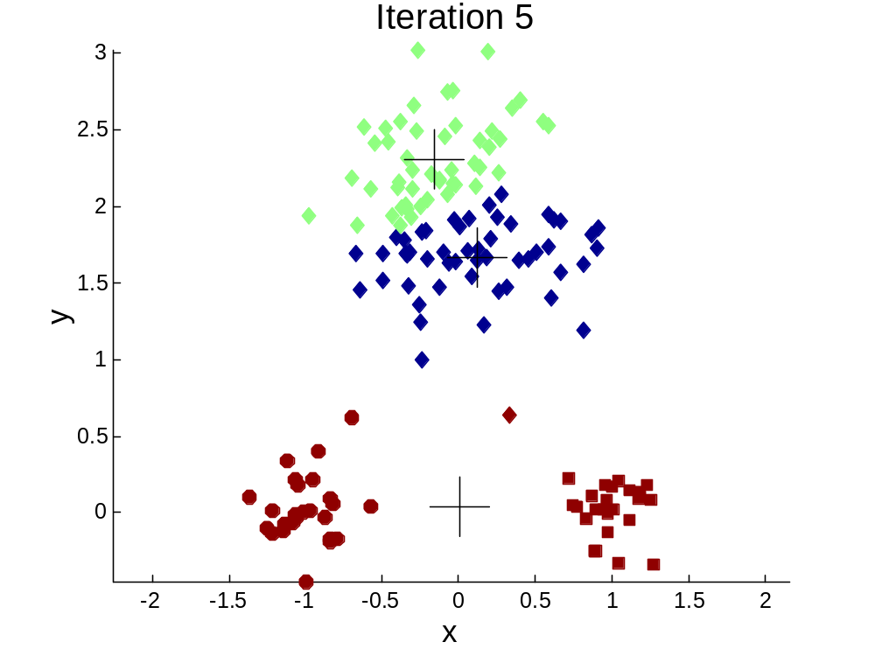
Importance of Choosing Initial Centroids …

Slide 23
Importance of Choosing Initial Centroids …

Slide 24
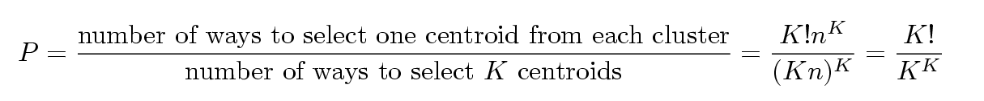
Problems with Selecting Initial Points
If there are K ‘real’ clusters then the chance of selecting one centroid from each cluster is small.
  Chance is relatively small when K is large
  If clusters are the same size, n, then
  For example, if K = 10, then probability = 10!/10¹⁰ = 0.00036
  Sometimes the initial centroids will readjust themselves in ‘right’ way, and sometimes they don’t
  Consider an example of five pairs of clusters

Slide 25
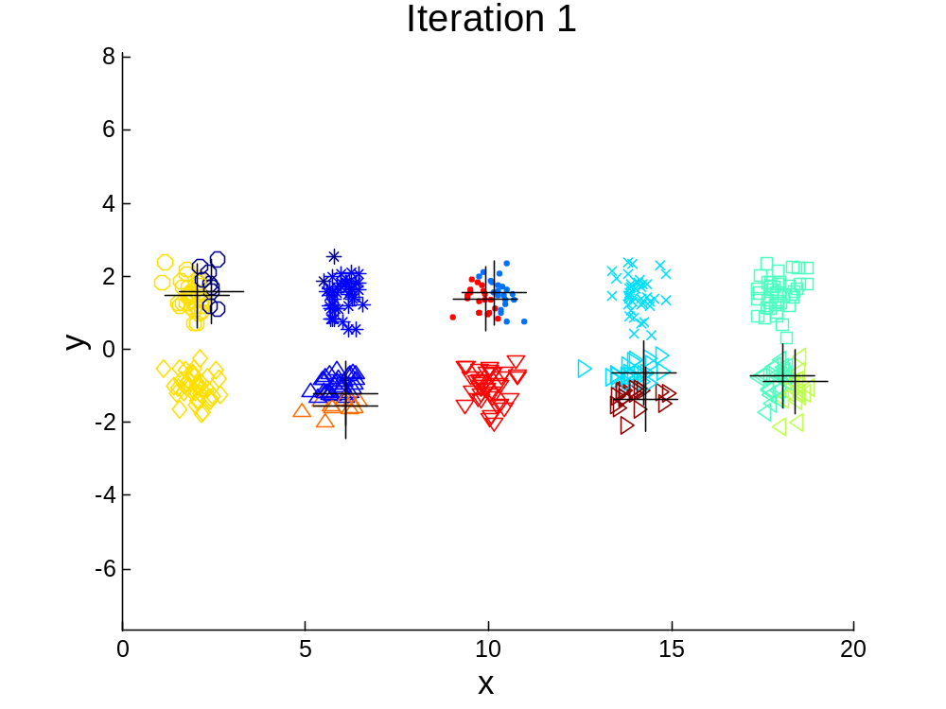
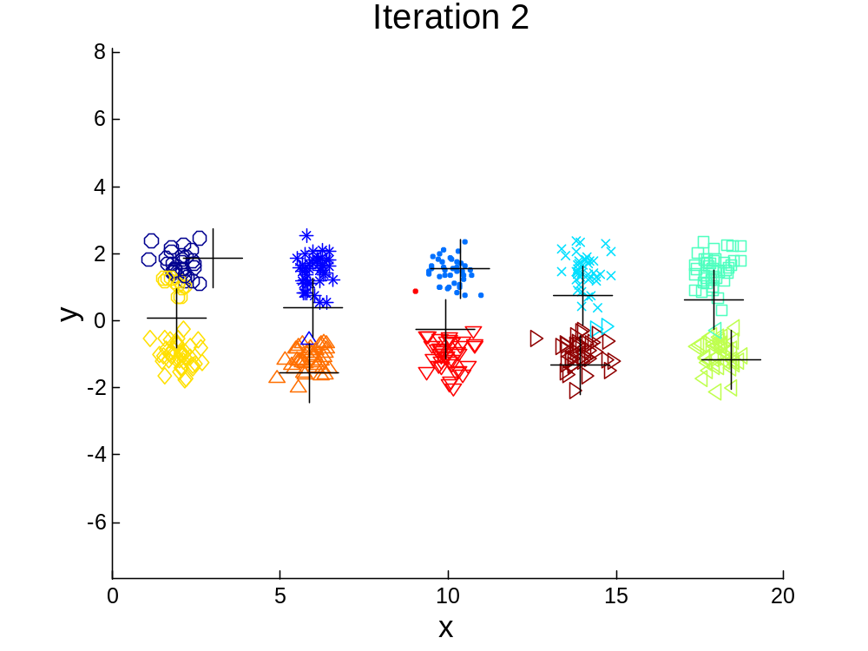
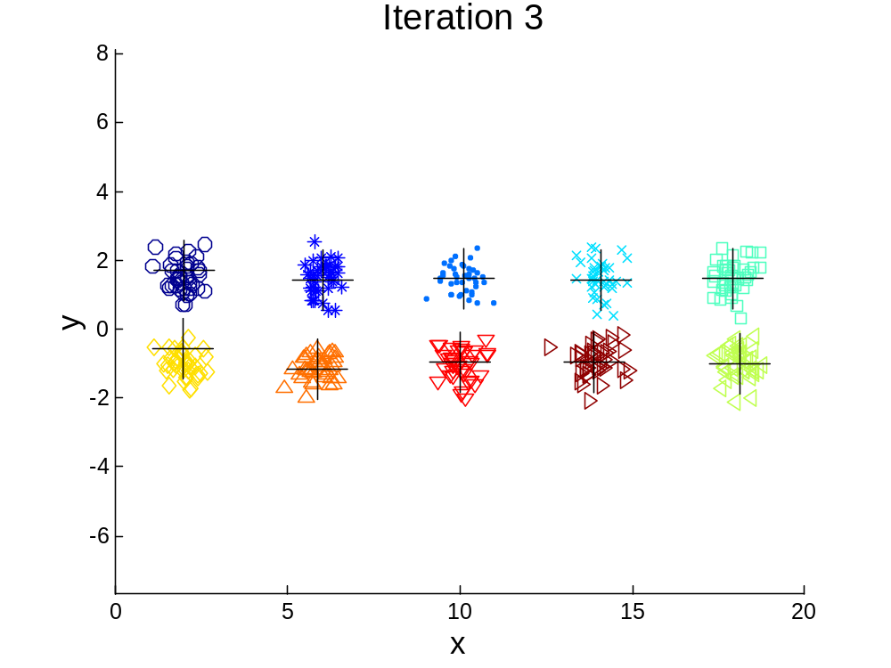

10 Clusters Example
Starting with two initial centroids in one cluster of each pair of clusters

Slide 26
10 Clusters Example
Starting with two initial centroids in one cluster of each pair of clusters

Slide 27
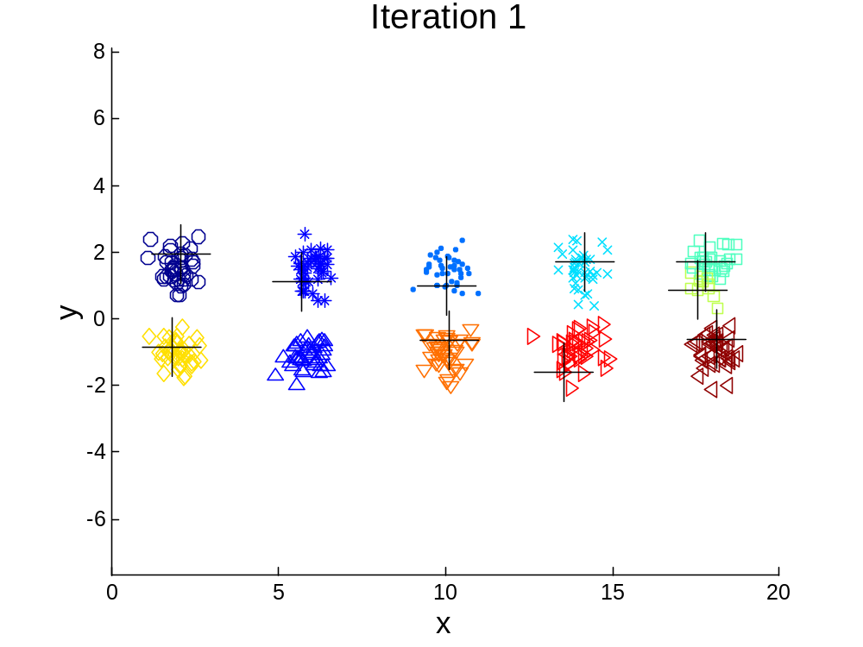



10 Clusters Example
Starting with some pairs of clusters having three initial centroids, while other have only one.

Slide 28
10 Clusters Example
Starting with some pairs of clusters having three initial centroids, while other have only one.

Slide 29
Solutions to Initial Centroids Problem
Multiple runs
  Helps, but probability is not on your side
Sample and use hierarchical clustering to determine initial centroids
Select more than k initial centroids and then select among these initial centroids
  Select most widely separated
Bisecting K-means
  Not as susceptible to initialization issues

Slide 30

Bisecting K-means
Bisecting K-means algorithm
  Variant of K-means that can produce a partitional or a hierarchical clustering

Slide 31
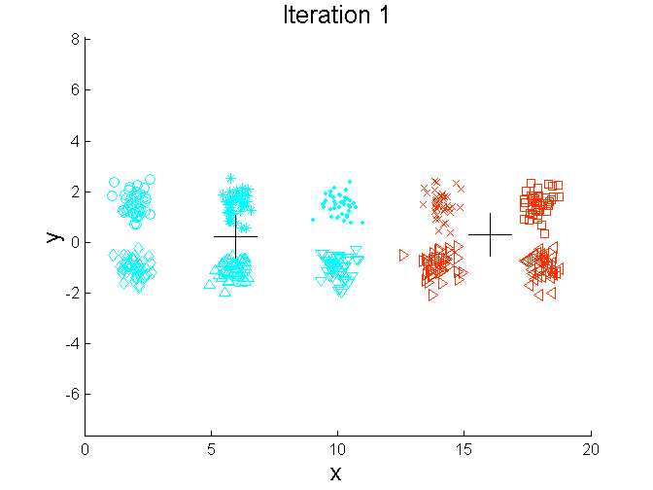
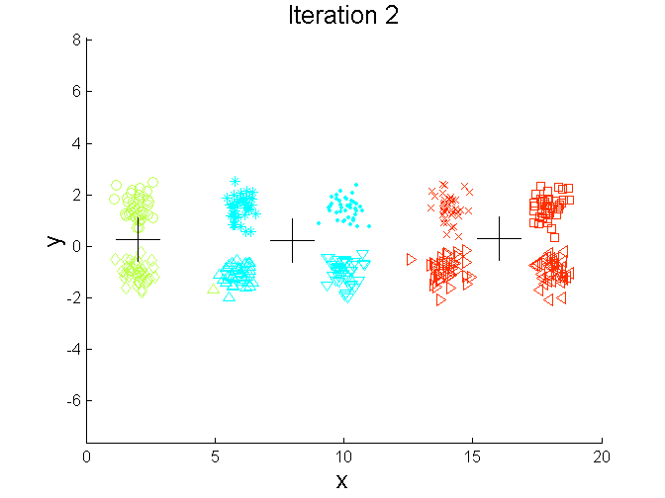
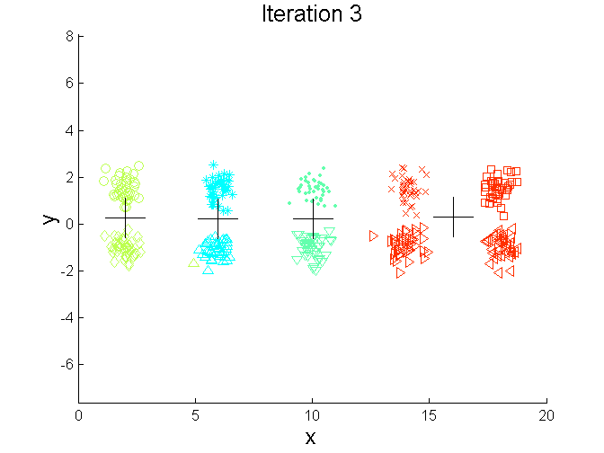
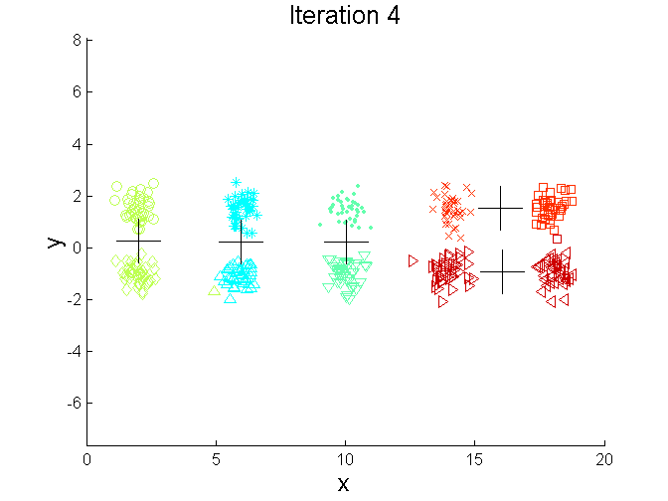
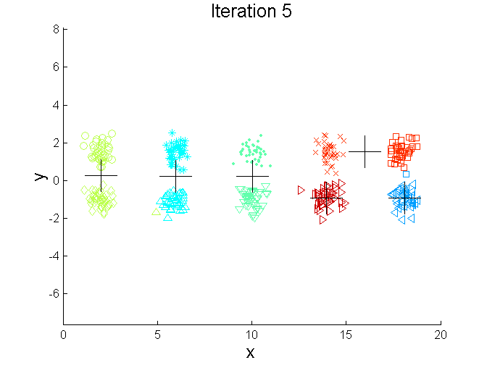
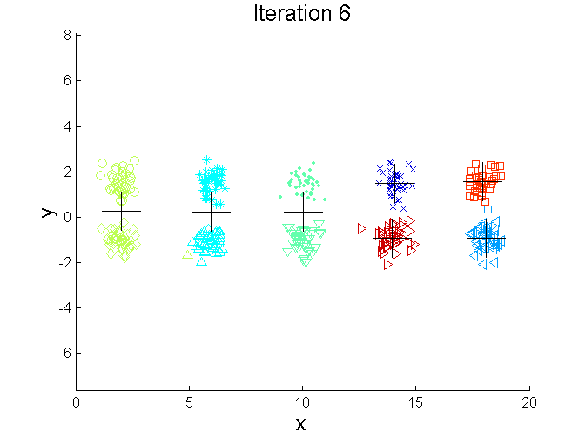
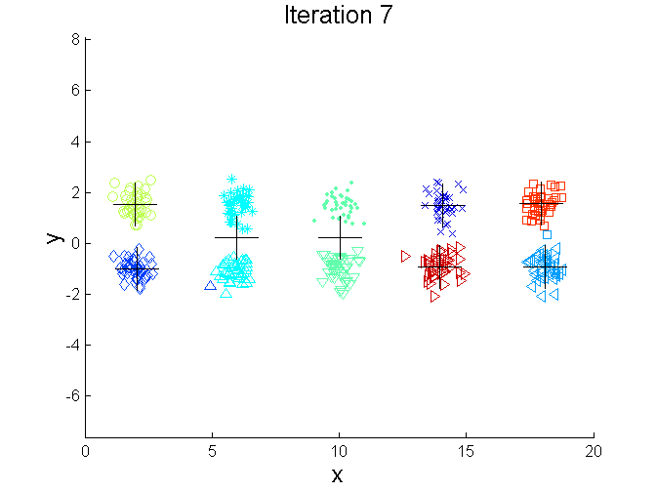
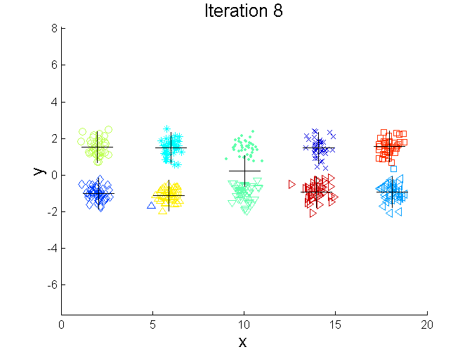
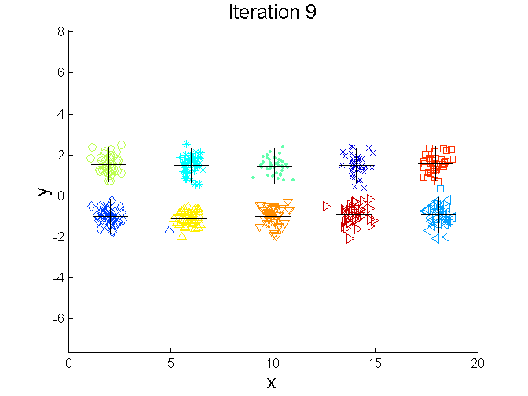
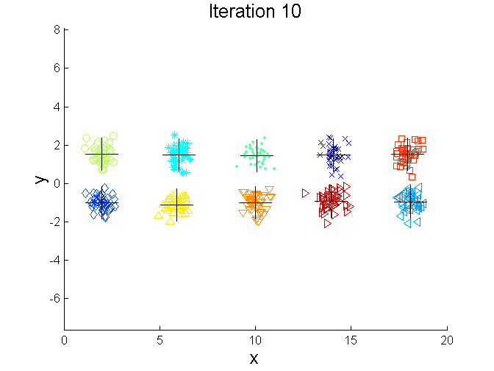
Bisecting K-means Example

Slide 32
Limitations of K-means
K-means has problems when clusters are of differing
  Sizes
  Densities
  Non-globular shapes
K-means has problems when the data contains outliers.

Slide 33


Limitations of K-means: Differing Sizes
Original Points
K-means (3 Clusters)

Slide 34


Limitations of K-means: Differing Density
Original Points
K-means (3 Clusters)

Slide 35


Limitations of K-means: Non-globular Shapes
Original Points
K-means (2 Clusters)

Slide 36

Overcoming K-means Limitations
Original Points K-means Clusters
One solution is to use many clusters.
  Find parts of clusters, but need to put together.

Slide 37
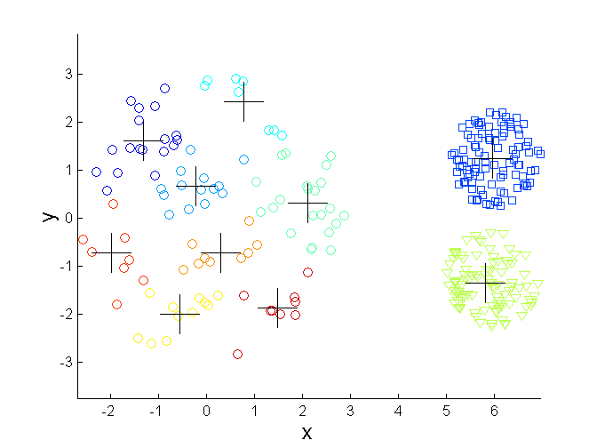
Overcoming K-means Limitations
Original Points K-means Clusters

Slide 38
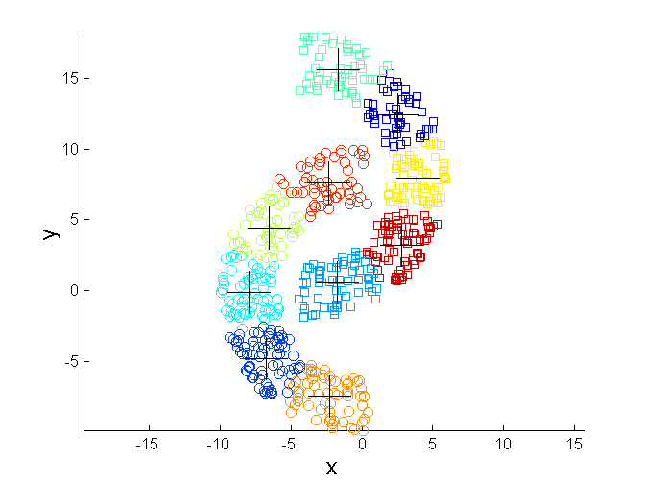
Overcoming K-means Limitations
Original Points K-means Clusters

Slide 39
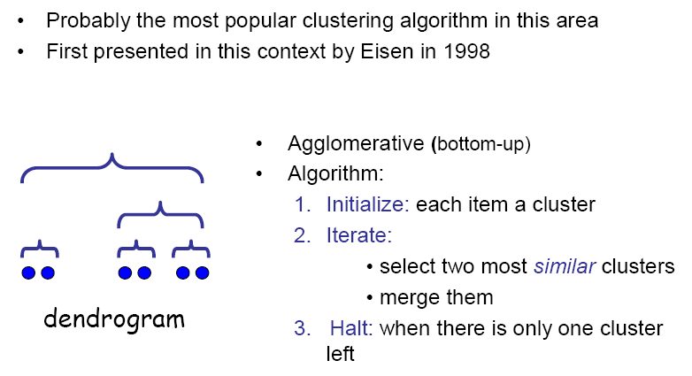
Hierarchical clustering

Slide 40
Strengths of Hierarchical Clustering
Do not have to assume any particular number of clusters
  Any desired number of clusters can be obtained by ‘cutting’ the dendogram at the proper level
They may correspond to meaningful taxonomies
  Example in biological sciences (e.g., animal kingdom, phylogeny reconstruction, …)

Slide 41
How to Define Inter-Cluster Similarity
p1
p2
p3
p4
p5
. . .
p1
Similarity?
p2
p3
p4
p5
MIN
MAX
Group Average
Distance Between Centroids
Other methods driven by an objective function
  Ward’s Method uses squared error
.
.
.
Distance Matrix

Slide 42
How to Define Inter-Cluster Similarity
p1
p2
p3
p4
p5
. . .
p1
p2
p3
p4
p5
MIN
MAX
Group Average
Distance Between Centroids
Other methods driven by an objective function
  Ward’s Method uses squared error
.
.
.
Distance Matrix

Slide 43
How to Define Inter-Cluster Similarity
p1
p2
p3
p4
p5
. . .
p1
p2
p3
p4
p5
MIN
MAX
Group Average
Distance Between Centroids
Other methods driven by an objective function
  Ward’s Method uses squared error
.
.
.
Distance Matrix

Slide 44
How to Define Inter-Cluster Similarity
p1
p2
p3
p4
p5
. . .
p1
p2
p3
p4
p5
MIN
MAX
Group Average
Distance Between Centroids
Other methods driven by an objective function
  Ward’s Method uses squared error
.
.
.
Distance Matrix

Slide 45
How to Define Inter-Cluster Similarity
p1
p2
p3
p4
p5
. . .
p1
×
×
p2
p3
p4
p5
MIN
MAX
Group Average
Distance Between Centroids
Other methods driven by an objective function
  Ward’s Method uses squared error
.
.
.
Distance Matrix

Slide 46
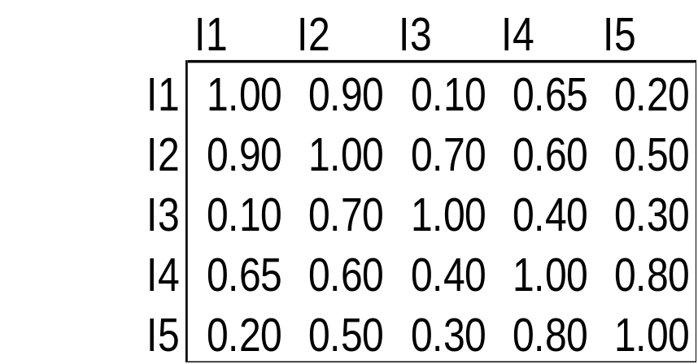
Cluster Similarity: MIN or Single Link
Similarity of two clusters is based on the two most similar (closest) points in the different clusters
  Determined by one pair of points, i.e., by one link in the proximity graph.
1
2
3
4
5

Slide 47
Hierarchical Clustering: MIN
5
1
3
5
0.2
2
1
2
0.15
3
6
0.1
4
0.05
4
0
3
6
2
5
4
1
Nested Clusters
Dendrogram

Slide 48
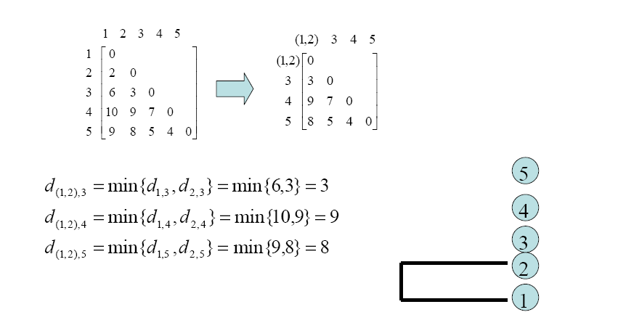
Example: MIN

Slide 49
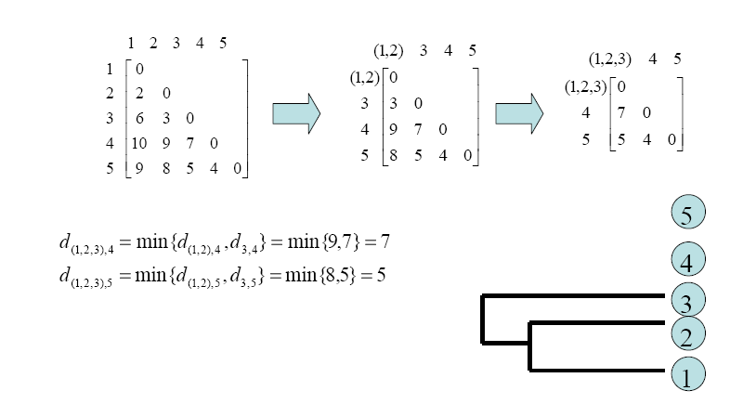
Example: MIN

Slide 50
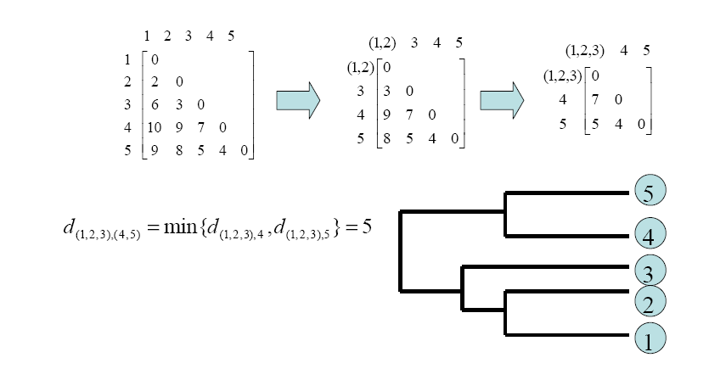
Example: MIN

Slide 51
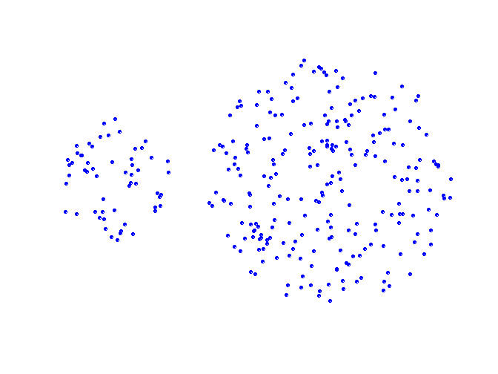
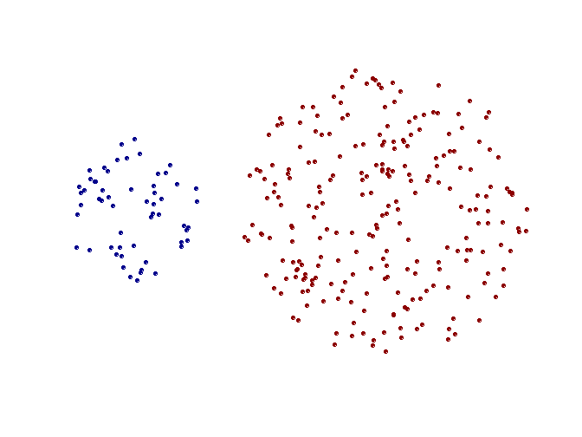
Strength of MIN
Original Points
Two Clusters
Can handle non-elliptical shapes

Slide 52
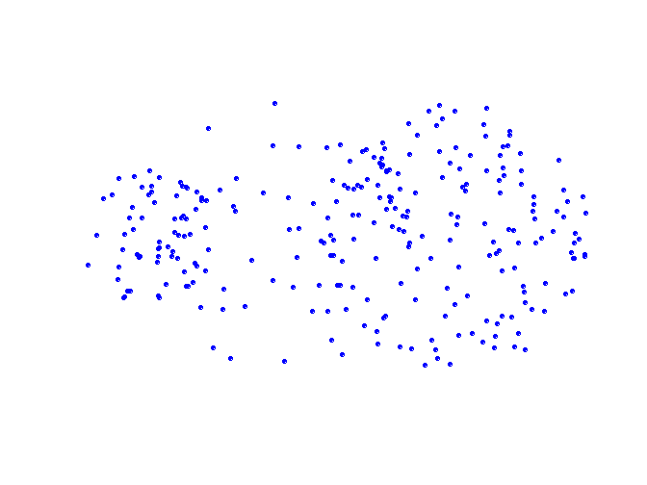
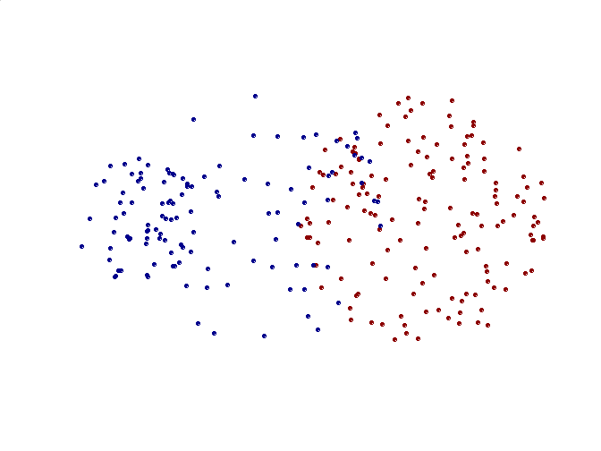
Limitations of MIN
Original Points
Two Clusters
Sensitive to noise and outliers

Slide 53

Cluster Similarity: MAX or Complete Linkage
Similarity of two clusters is based on the two least similar (most distant) points in the different clusters
  Determined by all pairs of points in the two clusters
1
2
3
4
5

Slide 54
Hierarchical Clustering: MAX
4
1
2
5
0.4
5
0.35
2
0.3
0.25
3
6
0.2
3
0.15
1
0.1
4
0.05
0
3
6
4
1
2
5
Nested Clusters
Dendrogram

Slide 55
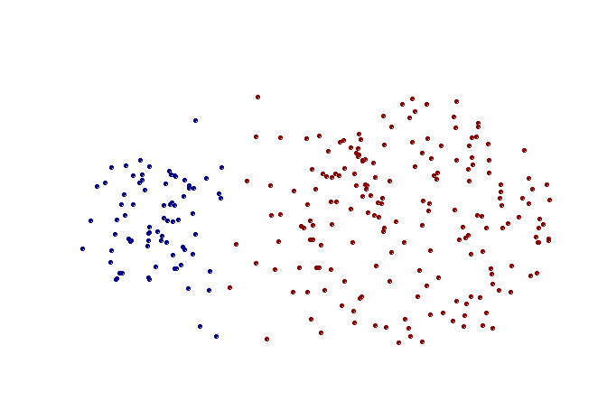
Strength of MAX
Original Points
Two Clusters
Less susceptible to noise and outliers

Slide 56
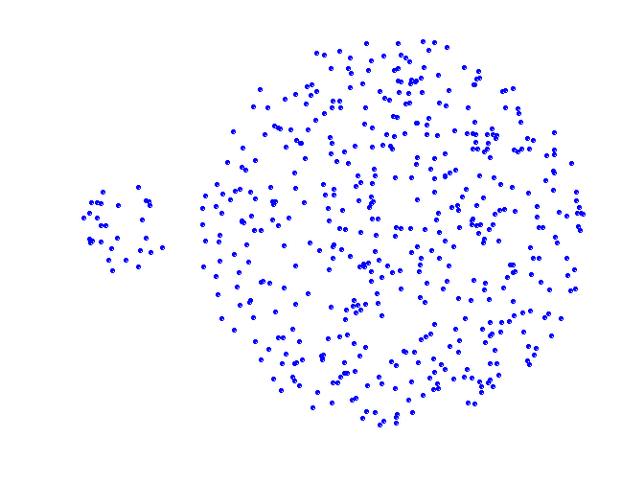
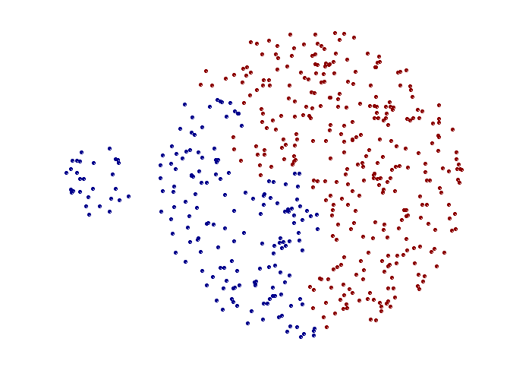
Limitations of MAX
Original Points
Two Clusters
Tends to break large clusters
Biased towards globular clusters

Slide 57
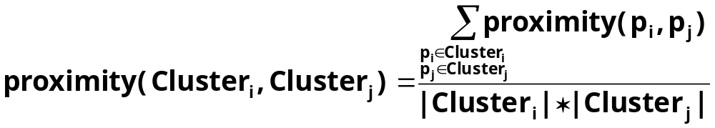

Cluster Similarity: Group Average
Proximity of two clusters is the average of pairwise proximity between points in the two clusters.
Need to use average connectivity for scalability since total proximity favors large clusters
1
2
3
4
5

Slide 58
Hierarchical Clustering: Group Average
5
4
1
2
0.25
5
0.2
2
0.15
3
6
0.1
1
0.05
4
3
0
3
6
4
1
2
5
Nested Clusters
Dendrogram

Slide 59
Hierarchical Clustering: Group Average
Compromise between Single and Complete Link
Strengths
  Less susceptible to noise and outliers
Limitations
  Biased towards globular clusters

Slide 60
Hierarchical Clustering: Comparison
5
1
4
1
3
2
5
5
5
2
1
MIN
2
MAX
2
3
6
3
3
6
1
4
4
4
5
1
2
5
2
3
6
Group Average
3
1
4
4

Slide 61
Hierarchical Clustering: Problems and Limitations
Once a decision is made to combine two clusters, it cannot be undone
No objective function is directly minimized
Different schemes have problems with one or more of the following:
  Sensitivity to noise and outliers
  Difficulty handling different sized clusters and convex shapes
  Breaking large clusters

Slide 62
R packages/functions
Hierarchical clustering
  hclust
Kmeans
  Kmeans
PCA (Dimension Reduction)
  prcomp

Slide 63
Acknowledgments
Tan, Steinbach, Kumar: for some of the slides adapted or modified from their book Introduction to Data Mining slides
Carlo Colantuoni: for some of the slides adapted or modified from his lecture slides at JHU
Ziv Bar-Joseph: for some of the slides adapted or modified from his lecture slides at CMU

