Slide 1
Debugging
Zhi Wei

Slide 2
Debugging
A grammatically correct program may give you incorrect results due to logic errors. In case such errors (i.e. bugs) occur, you need to find out why and where they occur so that you can fix them. The procedure to identify and fix bugs is called “debugging”.
R provides a number of tools for debugging:
  traceback()
  debug()
  browser()
  trace()
  recover()

Slide 3
traceback()
When an R function fails, an error is printed to the screen.
Immediately after the error, you can call traceback() to see in which function the error occurred.
The traceback() function prints the list of functions that were called before the error occurred.
The functions are printed in reverse order.

Slide 4
traceback()
Example:
  f<-function(x) {
  r<-x-g(x)
  r
  }
  g<-function(y) {
  r<-y*h(y)
  r
  }
  h<-function(z) {
  r<-log(z)
  if(r<10)
  r^2
  else
  r^3
  }

Slide 5
traceback()
> f(-1)
Error in if (r < 10) r^2 else r^3 : missing value where TRUE/FALSE needed
In addition: Warning message:
In log(z) : NaNs produced
> traceback()
3: h(y)
2: g(x)
1: f(-1)

Slide 6
debug()
traceback() does not tell you where in the function the error occurred. In order to know which line causes the error, you may want to step through the function using debug().
debug(foo) flags the function foo() for debugging.
undebug(foo) unflags the function.
When a function is flagged for debugging, each statement in the function is executed one at a time. After a statement is executed, the function suspends and you can interact with the environment.
After you obtained necessary information from the environment, you can let the function to execute the next statement. In this way, you can check the function line-by-line

Slide 7
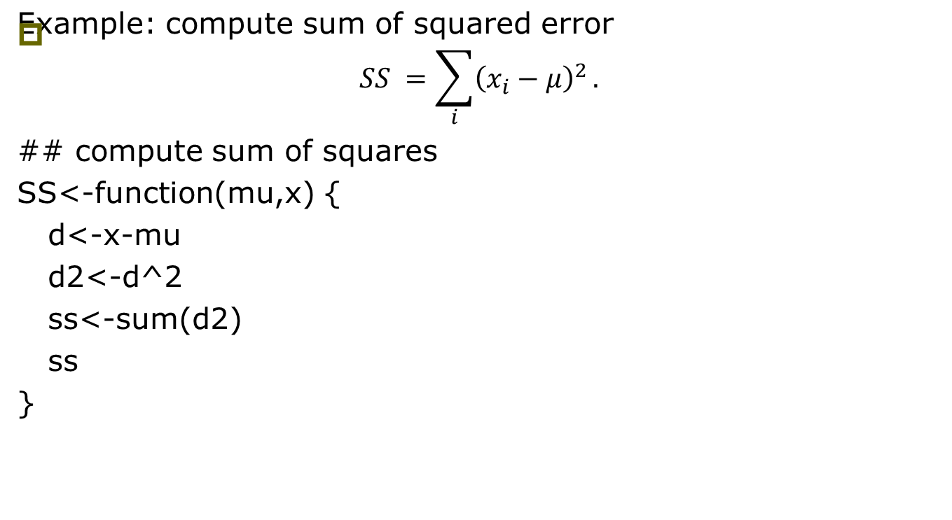
debug()
SS<- function(mu, x) {
d<- x – mu
d2 <- d^2
ss<- sum(d2)
ss
}

Slide 8
debug()
## set seed to get reproducible results
> set.seed(100)
> x<-rnorm(100)
> SS(1,x)
[2] 202.5615
## now start debugging
> debug(SS)
> SS(1,x)
debugging in: SS(1, x)
debug: {
d <- x - mu
d2 <- d^2
ss <- sum(d2)
ss
}
Browse[2]>

Slide 9
debug()
After you see the “Browse>” prompt, you can do different things:
  Typing n executes the current line and prints the next one;
  Typing c executes the rest of the function without stopping;
  Typing Q quits the debugging;
  Typing where tells where you are in the function call stack;
  Typing ls() list all objects in the local environment;
  Typing an object name or print(<object name>) tells you current value of the object. If your object has name n, c or Q, you have to use print() to see their values.

Slide 10
debug(): typing n
Browse[2]> n
debug at #2: d <- x - mu
Browse[2]> n
debug at #3: d2 <- d^2
Browse[2]> n
debug at #4: ss <- sum(d2)
Browse[2]> n
debug at #5: ss
Browse[2]> n
exiting from: SS(1, x)
[1] 202.5615

Slide 11
debug(): typing c
> SS(1,x)
debugging in: SS(1, x)
debug at #1: {
d <- x - mu
d2 <- d^2
ss <- sum(d2)
ss
}
Browse[2]> n
debug at #2: d <- x - mu
Browse[2]> c
exiting from: SS(1, x)
[1] 202.5615

Slide 12
debug(): ls, print, where, Q
> SS(1,x)
debugging in: SS(1, x)
debug: {
d <- x - mu
d2 <- d^2
...
Browse[1]> n
debug: d <- x - mu ## the next command
Browse[1]> ls() ## current environment
[1] "mu" "x" ## there is no d
Browse[1]> n ## go one step
debug: d2 <- d^2 ## the next command
Browse[1]> ls() ## current environment
[1] "d" "mu" "x" ## d has been created
Browse[1]> d[1:3] ## first three elements of d
[1] -1.5021924 -0.8684688 -1.0789171
Browse[1]> hist(d) ## histogram of d
Browse[1]> where ## current position in call stack
where 1: SS(1, x)
Browse[1]> n
debug: ss <- sum(d2)
Browse[1]> Q ## quit
>

Slide 13
undebug()
> undebug(SS) ## remove debug label
> SS(1,x) ## now call SS again will
[1] 202.5615 ## not start the debugger

Slide 14
debug()
You can label a function for debugging while debugging another function
  f<-function(x) {
  r<-x-g(x)
  r
  }
  g<-function(y) {
  r<-y*h(y)
  r
  }
  h<-function(z) {
  r<-log(z)
  if(r<10)
  r^2
  else
  r^3
  }

Slide 15
debug()
You can label a function for debugging while debugging another function
## If you only debug f, you will not go into g
> debug(f)
> f(-1)
debugging in: f(-1)
debug at #1: {
r <- x - g(x)
r
}
Browse[2]> n
debug at #2: r <- x - g(x)
Browse[2]> n
Error in if (r < 10) r^2 else r^3 : missing value where TRUE/FALSE needed
In addition: Warning message:
In log(z) : NaNs produced

Slide 16
debug()
## You can label g and h for debugging when you debug f
> f(-1)
debugging in: f(-1)
debug at #1: {
r <- x - g(x)
r
}
Browse[2]> n
debug at #2: r <- x - g(x)
Browse[2]> debug(g)
Browse[2]> n
debugging in: g(x)
debug at #1: {
r <- y * h(y)
r
}
Browse[3]> n
debug at #2: r <- y * h(y)
Browse[3]> debug(h)
Browse[3]> n
debugging in: h(y)
debug at #1: {
r <- log(z)
if (r < 10)
r^2
else r^3
}
Browse[4]> n
debug at #2: r <- log(z)
Browse[4]> n
debug at #3: if (r < 10) r^2 else r^3
Browse[4]> n
Error in if (r < 10) r^2 else r^3 : missing value where TRUE/FALSE needed
In addition: Warning message:
In log(z) : NaNs produced
>

Slide 17
browser()
Inserting a call to browser() in a function will pause the execution of a function at the point where browser() is called.
Similar to using debug() except you can control where execution gets paused.
h<-function(z) {
browser() ## a break point inserted here
r<-log(z)
if(r<10)
r^2
else
r^3
}

Slide 18
browser()
> f(-1)
debugging in: g(x)
debug at #1: {
r <- y * h(y)
r
}
Browse[2]>
debug at #2: r <- y * h(y)
Browse[2]>
Called from: h(y)
Browse[2]>
debug at #3: r <- log(z)
Browse[3]>
debug at #4: if (r < 10) r^2 else r^3
Browse[3]>
Error in if (r < 10) r^2 else r^3 : missing value where TRUE/FALSE needed
In addition: Warning message:
In log(z) : NaNs produced

Slide 19
trace()
Calling trace() on a function allows the user to insert bits of code into a function.
The syntax for trace() is a bit strange for first time users.
You might be better off using debug()

Slide 20
trace()
> trace("h",quote(if(is.nan(r)) {browser()}), at=3, print=FALSE)
[1] "h"
> f(1)
[1] 1
> f(-1)
Called from: eval(expr, envir, enclos)
Browse[1]> ls()
[1] "r" "z"
Warning message:
In log(z) : NaNs produced
Browse[1]> r
[1] NaN
Browse[1]> z
[1] -1
Browse[1]> c
Error in if (r < 10) r^2 else r^3 : missing value where TRUE/FALSE needed
> as.list(body(h))
[[1]]
`{`
[[2]]
r <- log(z)
[[3]]
if (r < 10) r^2 else r^3

Slide 21
trace()
> trace("h",quote(if(z<0) {z<-1}), at=2, print=FALSE)
[1] "h"
> f(-1)
[1] -1

Slide 22

untrace()
> trace("h",quote(if(is.nan(r)) {browser()}), at=3, print=FALSE)
[1] "h"
> f(-1)
Called from: eval(expr, envir, enclos)
Browse[1]> c
Error in if (r < 10) r^2 else r^3 : missing value where TRUE/FALSE needed
In addition: Warning message:
In log(z) : NaNs produced
> untrace(h)
> f(-1)
Error in if (r < 10) r^2 else r^3 : missing value where TRUE/FALSE needed
In addition: Warning message:
In log(z) : NaNs produced

Slide 23
recover()
When you are debugging a function, recover() allows you to check variables in upper level functions.

Slide 24
recover()
> trace("h",quote(if(is.nan(r)) {recover()}), at=3, print=FALSE)
[1] "h"
> f(-1)
Enter a frame number, or 0 to exit
1: f(-1)
2: #2: g(x)
3: #2: h(y)
Selection: 1
Called from: eval(expr, envir, enclos)
Browse[1]> ls()
[1] "x"
Warning message:
In log(z) : NaNs produced
Browse[1]> x
[1] -1
Browse[1]> c

Slide 25
recover()
Enter a frame number, or 0 to exit
1: f(-1)
2: #2: g(x)
3: #2: h(y)
Selection: 2
Called from: eval.parent(exprObj)
Browse[2]> ls()
[1] "y"
Browse[2]> y
[1] -1
Browse[2]> c

Slide 26
recover()
Enter a frame number, or 0 to exit
1: f(-1)
2: #2: g(x)
3: #2: h(y)
Selection: 3
Called from: eval(expr, p)
Browse[3]> ls()
[1] "r" "z"
Browse[3]> r
[1] NaN
Browse[3]> z
[1] -1
Browse[3]> c

Slide 27
recover()
Enter a frame number, or 0 to exit
1: f(-1)
2: #2: g(x)
3: #2: h(y)
Selection: 0
Error in if (r < 10) r^2 else r^3 : missing value where TRUE/FALSE needed

Slide 28
recover()
recover() can be used as an error handler, set using options() (e.g. options(error=recover), options(error=NULL) to remove it).
When a function throws an error, execution is halted at the point of failure. You can browse the function calls and examine the environment to find the source of the problem.

