Slide 1
Final Review
Zhi Wei

Slide 2
Final Exam
When: Dec 15, 2018
Where: CKB 204
Time: 2:30 am – 5:00 am
What: cumulative
Format: in-class, closed-book, (1) A4-sized cheat-sheets are allowed.

Slide 3
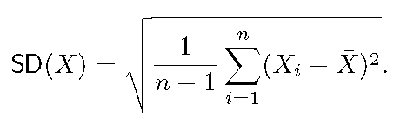
What have been covered
https://web.njit.edu/~zhiwei/CS636/
R basics
  Data structures: vector, matrix, list, data frame, factor
  Basic and common operations/concepts: indexing, vectorization, split, subset
  Data input/output: read.table(), write.table()
  Control Structures: if/else, for, while, repeat, break, next
  Functions: definition, arguments

Slide 4
R advanced
dplyr verbs | Description
select() | select columns
filter() | filter rows
arrange() | re-order or arrange rows
mutate() | create new columns
summarise() | summarise values
group_by() | allows for group operations in the “split-apply-combine” concept
String operations
  Regular expression
  grep(), stringr packages
Data Manipulation
  dplyr
  reshape2: melt (wide -> long format), cast ( long -> wide format)

Slide 5
R Misc
R graphics: plot(), par(), points(), lines(), text(), abline(), legend(), title(), math notations, axes, multiple figures, margin
Debugging: traceback(), debug(), browers(), trace(), recover()
Packaging: package.skeleton()
Profiling: system.time(), Rprof(), summaryRprof()

Slide 6
Data Analytics
Probability Basics & Data Exploration
  Mean, variance, median
  Common distributions
  d, p, q, and r functions in R
  table, barplot, boxplot, IQR, outlier, histogram
Clustering
  Kmeans
  Hierarchical clustering: single-linkage, complete-linkage, group-average
Regression and Classification

Slide 7
Data Analytics – Supervised learning
Regression and Classification
  Supervised learning
  Linear models
  Training, Testing, Cross Validation
  ROC, AUC
Model Selection: filter method, wrapper method, embedded method
Representative Classifiers
  SVM: basic idea, support vectors
  Tree-based classifiers: Decision Trees, Random Forest, Boosting
  KNN (K-nearest neighbors)
  Neural Network

Slide 8
Practice Problems
Quizzes
Labs, homework
Midterm

Slide 9
Thank you!
Good luck!!!

