Slide 1
Looking at Data - Distributions
Displaying Distributions with Graphs
© 2009 W.H. Freeman and Company

Slide 2
Outline
Displaying distributions with graphs
Variables
Types of variables
Graphs for categorical variables
  Tables
  Bar graphs
  Pie charts
Graphs for quantitative variables
  Histograms
Interpreting histograms

Slide 3
Variables
In a study, we collect information—data—from individuals. Individuals can be people, animals, plants, or any object of interest.
A variable is any characteristic of an individual. A variable varies among individuals.
  Example: age, height, blood pressure, ethnicity, leaf length, first language
The distribution of a variable tells us what values the variable takes and how often it takes these values.

Slide 4
Two types of variables
Variables can be either numerical…
  Something that takes numerical values for which arithmetic operations, such as adding and averaging, make sense.
  Example: How tall you are, your age, your blood cholesterol level, the number of credit cards you own.
… or categorical.
  Something that falls into one of several categories. What can be counted is the count or proportion of individuals in each category.
  Example: Your blood type (A, B, AB, O), your hair color, your ethnicity, whether you paid income tax last tax year or not.

Slide 5
How do you know if a variable is categorical or numerical?
Ask:
What is the average value?
  If it doesn’t make sense → categorical
  Make sense but might not be an answer (e. g. age) → discrete
  Otherwise → numerical (quantitative)
Categorical
Each individual is assigned to one of several categories.
Numerical
Each individual is attributed a numerical value.
Individuals in sample | DIAGNOSIS | AGE AT DEATH
Patient A | Heart disease | 56
Patient B | Stroke | 70
Patient C | Stroke | 75
Patient D | Lung cancer | 60
Patient E | Heart disease | 80
Patient F | Accident | 73
Patient G | Diabetes | 69

Slide 6
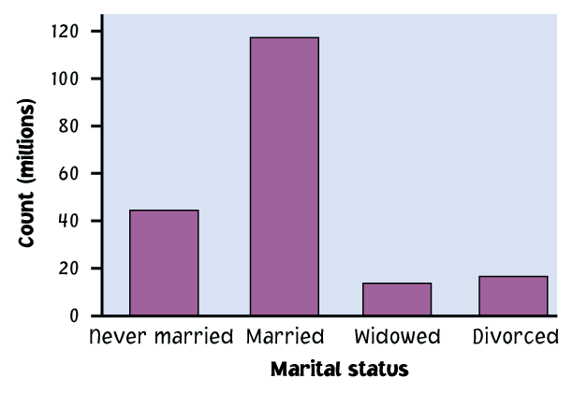
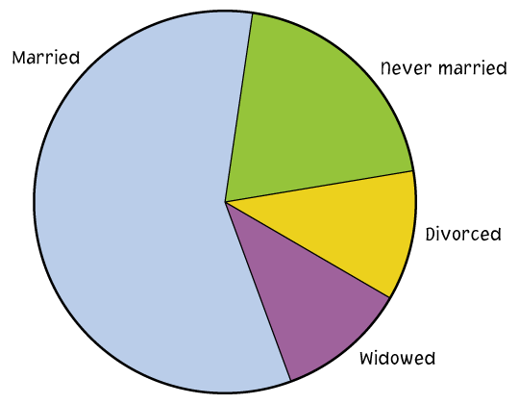
Ways to chart categorical data
Because the variable is categorical, the data in the graph can be ordered any way we want (alphabetical, by increasing value, by year, by personal preference, etc.)
  Bar graphs
  Each category is
  represented by
  a bar.
  Pie charts
  The slices must
  represent the parts of one whole.
  Tables
    Never married Married Widowed Divorced
    42 118 16 18

Slide 7
Tables
Widely used to summarize data
table()
> res=c("Y", "Y", "N", "Y", "N")
> table(res)
res
N Y
2 3
Another example
>library(UsingR)
>central.park.cloud
>table(central.park.cloud)

Slide 8
Example: Top 10 causes of death in the United States 2001
Rank | Causes of death | Counts | % of top 10s | % of total deaths
1 | Heart disease | 700,142 | 37% | 29%
2 | Cancer | 553,768 | 29% | 23%
3 | Cerebrovascular | 163,538 | 9% | 7%
4 | Chronic respiratory | 123,013 | 6% | 5%
5 | Accidents | 101,537 | 5% | 4%
6 | Diabetes mellitus | 71,372 | 4% | 3%
7 | Flu and pneumonia | 62,034 | 3% | 3%
8 | Alzheimer’s disease | 53,852 | 3% | 2%
9 | Kidney disorders | 39,480 | 2% | 2%
10 | Septicemia | 32,238 | 2% | 1%
 | All other causes | 629,967 |  | 26%
For each individual who died in the United States in 2001, we record what was the cause of death. The table above is a summary of that information.

Slide 9
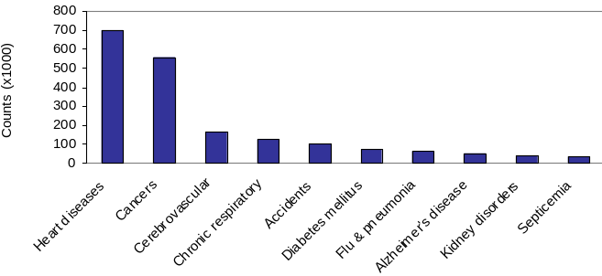
Bar graphs
Each category is represented by one bar. The bar’s height shows the count (or sometimes the percentage) for that particular category.
Top 10 causes of deaths in the United States 2001
The number of individuals who died of an accident in 2001 is approximately 100,000.

Slide 10
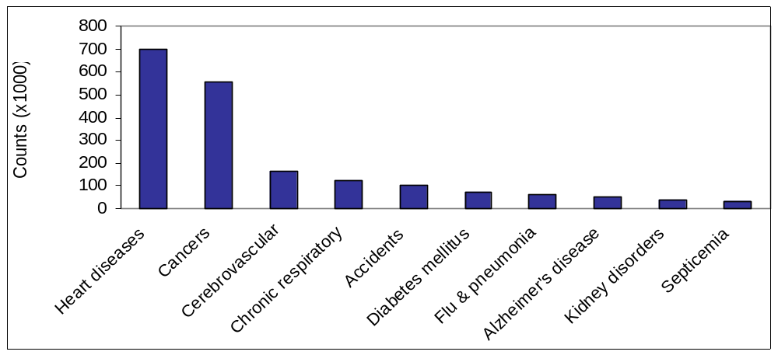
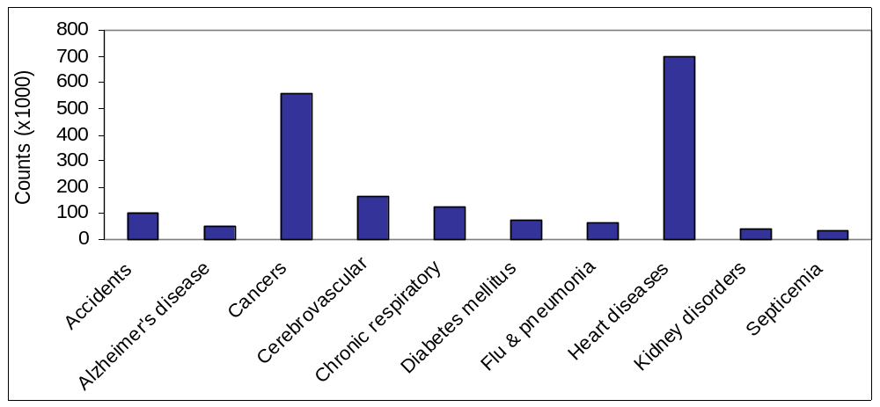
Top 10 causes of deaths in the United States 2001
Bar graph sorted by rank
→ Easy to analyze
Sorted alphabetically
→ Much less useful

Slide 11
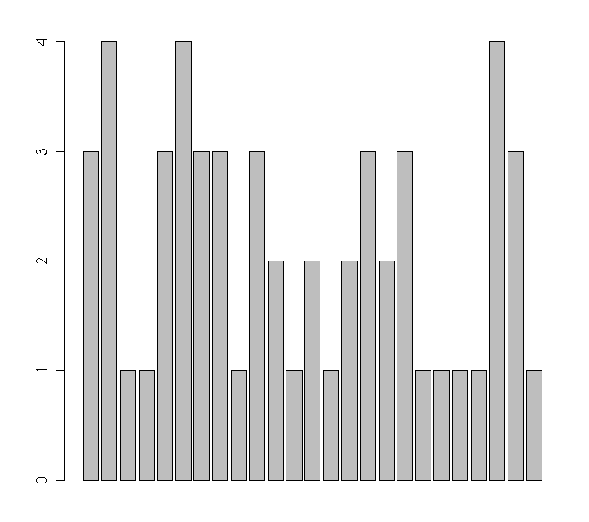
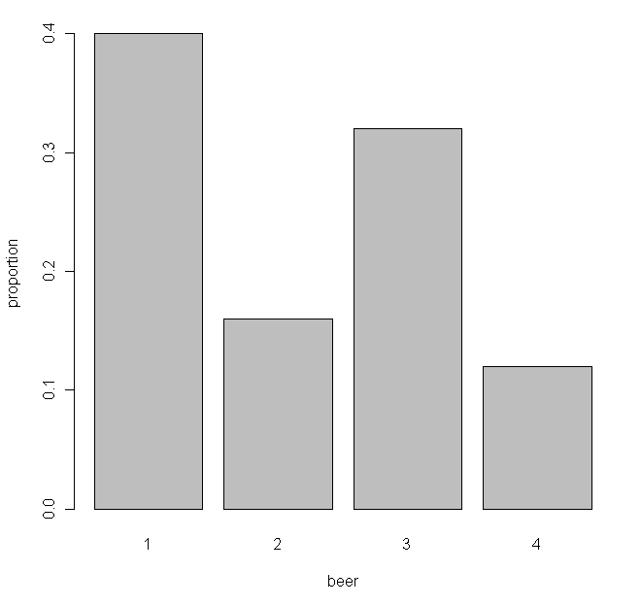
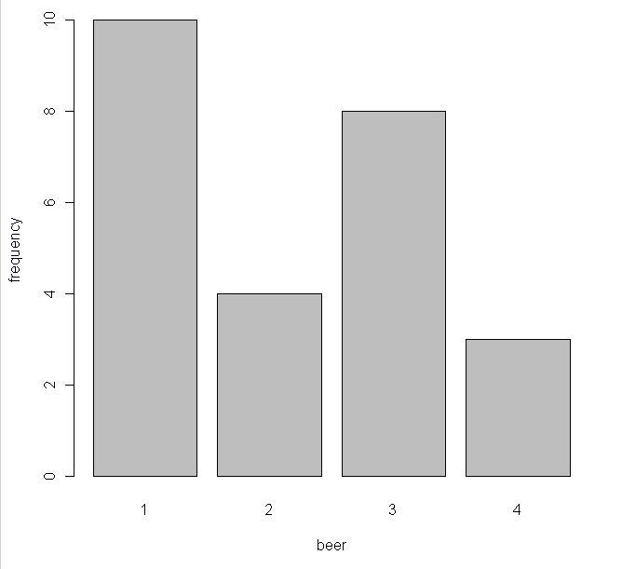
Barplots in R
>beer=scan()
1: 3 4 1 1 3 4 3 3 1 3 2 1 2 1 2 3 2 3 1 1 1 1 4 3 1
26:
>barplot(beer) # this isn’t correct
>barplot(table(beer),xlab=“beer”,ylab=“frequency”)
>barplot(table(beer)/length(beer),xlab=“beer”,ylab=“proportion”)

Slide 12
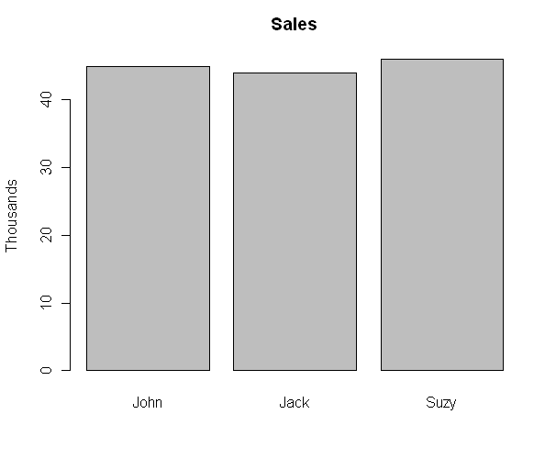
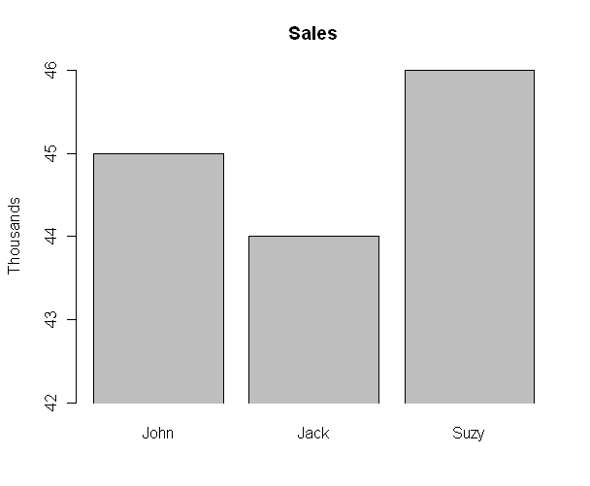
Misleading barplots
>sales=c(45,44,46)
> names(sales)=c("John", "Jack", "Suzy")
> barplot(sales, main="Sales", ylab="Thousands")
> barplot(sales, main="Sales", ylab="Thousands",ylim=c(42,46),xpd=FALSE)

Slide 13
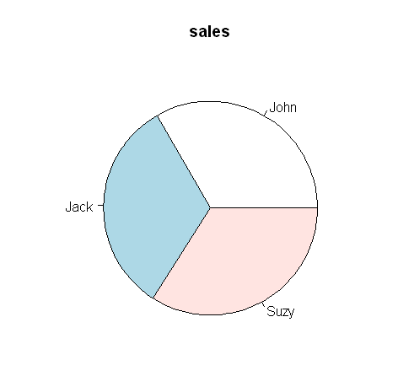
Pie charts
Each slice represents a piece of one whole. The size of a slice depends on what
percent of the whole this category represents.
> sales
John Jack Suzy
45 44 46
>pie(sales)
Why are pie charts a poor choice?
The help page for pie(), (?pie)
Pie charts are a very bad way of displaying information. The eye is good at judging linear measures and bad at judging relative areas. A bar chart or dot chart is a preferable way of displaying this type of data.
Notes:
Another way to graphically illustrate the same categorical data is using a Pie Chart.
Here is listed in order, and can see relative proportions as pieces of pie.
Notice here that we have changed from the numbers of people dying to the percent of people dying
To make a pie chart, typically use percentages, and they have to add up to one, or you won’t have the whole pie.
?

Slide 14
Ways to chart quantitative data
Histograms
  These are summary graphs for a single variable. They are very useful to understand the pattern of variability in the data.

Slide 15
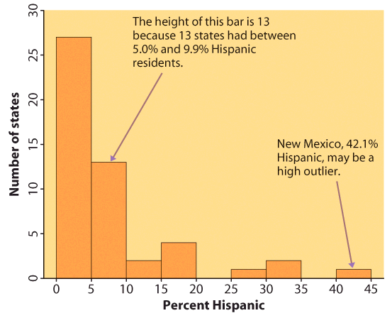
Histograms
The range of values that a variable can take is divided into equal size intervals.
The histogram shows the number of individual data points that fall in each interval.
The first column represents all states with a Hispanic percent in their population between 0% and 4.99%. The height of the column shows how many states (27) have a percent in this range.
The last column represents all states with a Hispanic percent in their population between 40% and 44.99%. There is only one such state: New Mexico, at 42.1% Hispanics.

Slide 16
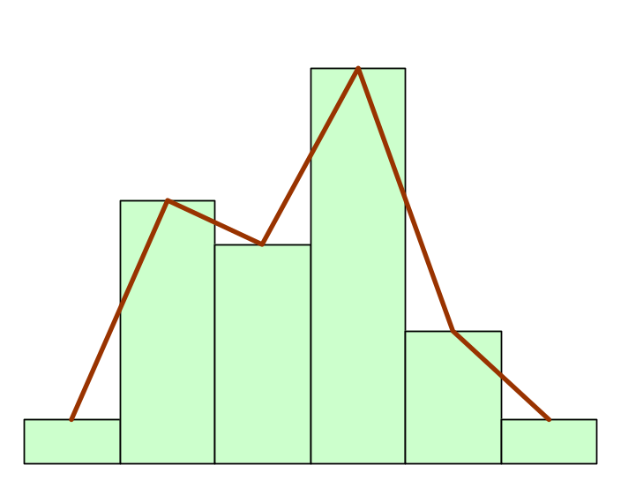
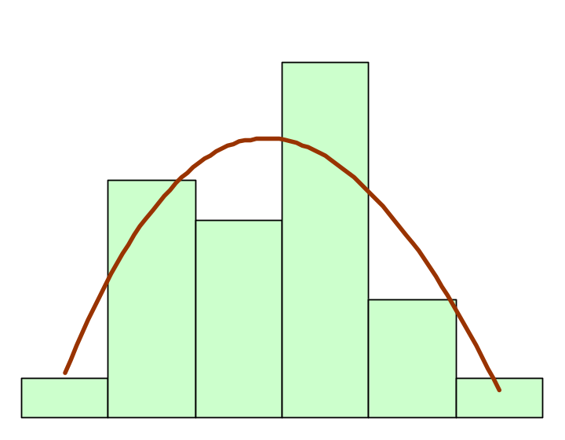
Interpreting histograms
When describing the distribution of a quantitative variable, we look for the overall pattern and for striking deviations from that pattern. We can describe the overall pattern of a histogram by its shape, center, and spread.
Histogram with a line connecting each column → too detailed
Histogram with a smoothed curve highlighting the overall pattern of the distribution

Slide 17
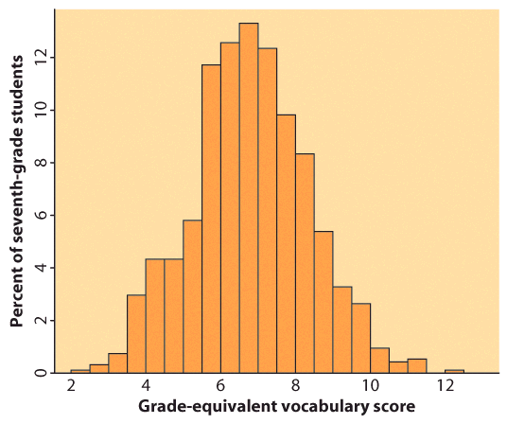
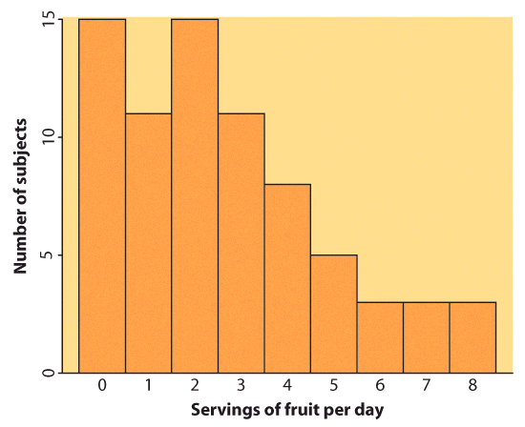
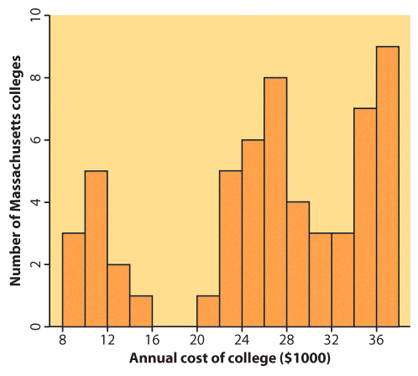
Most common distribution shapes
Symmetric distribution
A distribution is symmetric if the right and left sides of the histogram are approximately mirror images of each other.
A distribution is skewed to the right if the right side of the histogram (side with larger values) extends much farther out than the left side. It is skewed to the left if the left side of the histogram extends much farther out than the right side.
Skewed distribution
Complex, multimodal distribution
Not all distributions have a simple overall shape, especially when there are few observations.

Slide 18
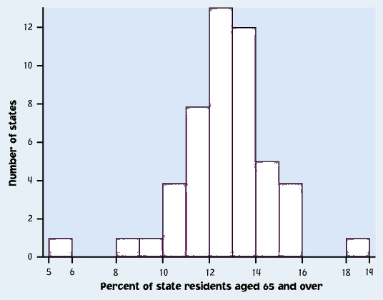
Outliers
An important kind of deviation is an outlier. Outliers are observations that lie outside the overall pattern of a distribution. Always look for outliers and try to explain them.
The overall pattern is fairly symmetrical except for 2 states that clearly do not belong to the main trend. Alaska and Florida have unusual representation of the elderly in their population.
A large gap in the distribution is typically a sign of an outlier.
Alaska
Florida
Notes:
This is from the book. Imagine you are doing a study of health care in the 50 US states, and need to know how they differ in terms of their elderly population.
This is a histogram of the number of states grouped by the percentage of their residents that are 65 or over.
You can see there is one very small number and one very large number, with a gap between them and the rest of the distribution.
Values that fall outside of the overall pattern are called outliers. They might be interesting, they might be mistakes - I get those in my data from typos in entering RNA sequence data into the computer.
They might only indicate that you need more samples. Will be paying a lot of attention to them throughout class both for what we can learn about biology and also because they can cause trouble with your statistics.
Guess which states they are (florida and alaska).

Slide 19
How to create a histogram
It is an iterative process – try and try again.
What bin size should you use?
Not too many bins with either 0 or 1 counts
Not overly summarized that you loose all the information
Not so detailed that it is no longer summary
➔ rule of thumb: start with 5 to 10 bins
Look at the distribution and refine your bins
(There isn’t a unique or “perfect” solution)

Slide 20
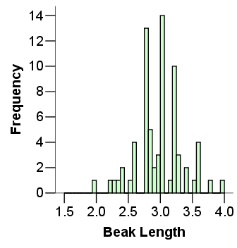
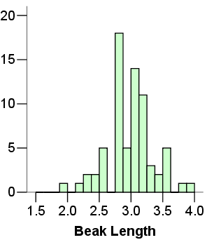

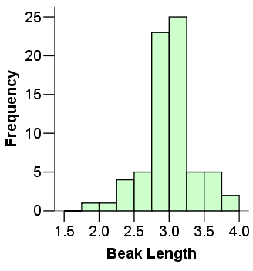
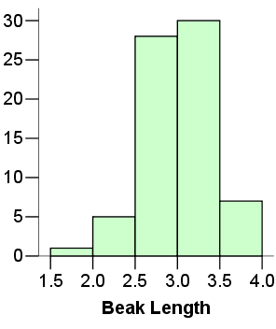
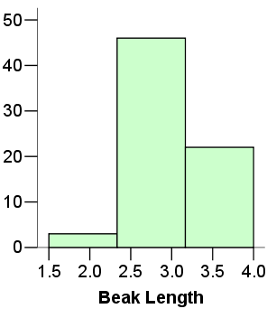
Same data set
Not summarized enough
Too summarized

Slide 21
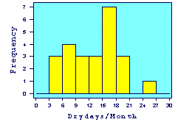
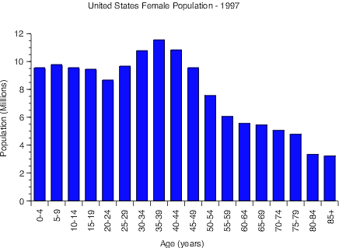
IMPORTANT NOTE:
Your data are the way they are. Do not try to force them into a particular shape.
Histogram of Drydays in 1995
It is a common misconception that if you have a large enough data set, the data will eventually turn out nice and symmetrical.

Slide 22
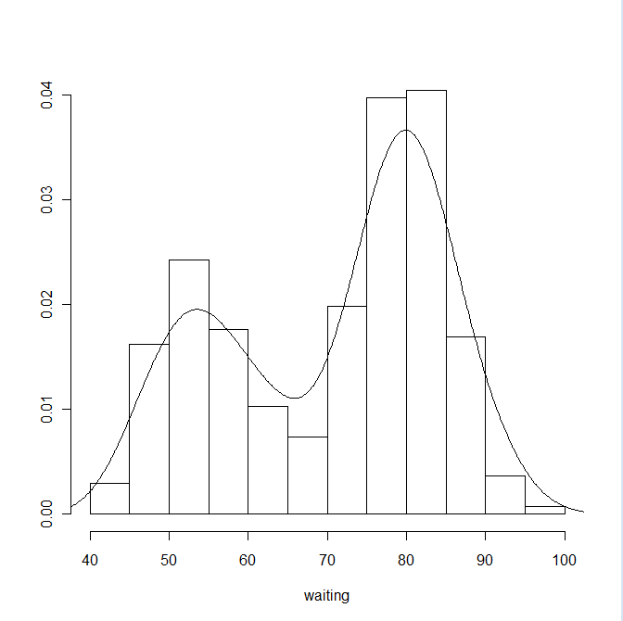
Histogram in R
With hist() function
> attach(faithful)
> hist(waiting) # use defaults
> hist(waiting, breaks=10) # suggest 10 breaks, not necessarily 10
> hist(waiting, breaks=seq(43,108,length=10)) # use these breaks
> hist(waiting, breaks ="scott” ) #Use “Scott” algorithm
>hist(waiting, prob=T) # Use proportions
Estimating the density
> hist(waiting, breaks="scott", prob=T, main="", ylab="")
> lines(density(waiting))

Slide 23
Looking at Data - Distributions
Describing distributions with numbers
© 2009 W.H. Freeman and Company

Slide 24
Outline
Describing distributions with numbers
Measures of center: mean, median
Mean versus median
Measures of spread: quartiles, standard deviation
Five-number summary and boxplot
Choosing among summary statistics

Slide 25
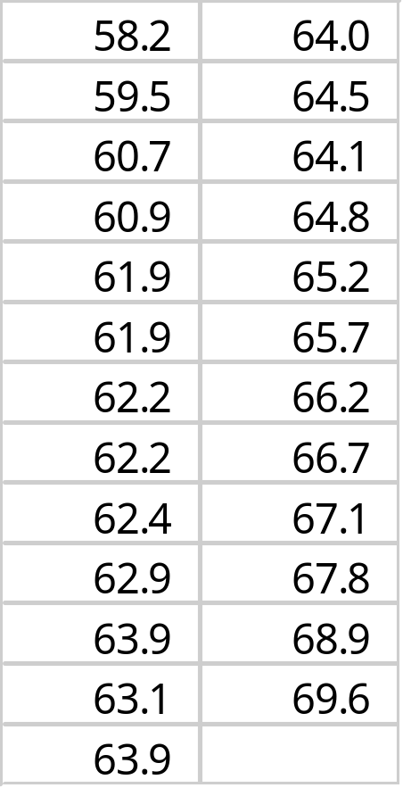
Measure of center: the mean
The mean or arithmetic average
To calculate the average, or mean, add all values, then divide by the number of individuals. It is the “center of mass.”
Sum of heights is 1598.3
divided by 25 women = 63.9 inches
Notes:
Most of you know what a mean, or common arithmetic average is.
You should know how to calculate the mean both by hand and using your calculator. See Dr. Baldi.

Slide 26
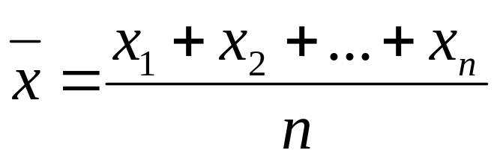
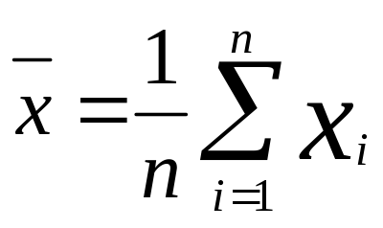
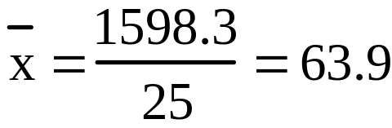
Mathematical notation:
w
o
ma
n
h
ei
gh
t
w
o
ma
n
h
ei
gh
t
(
i
)
(
x
)
(
i
)
(
x
)
i
=
1
x
1
=
5
8
.
2
i
=
14
x
14
=
6
4
.
0
i
=
2
x
2
=
5
9
.
5
i
=
15
x
15
=
6
4
.
5
i
=
3
x
3
=
6
0
.
7
i
=
16
x
16
=
6
4
.
1
i
=
4
x
4
=
6
0
.
9
i
=
17
x
17
=
6
4
.
8
i
=
5
x
5
=
6
1
.
9
i
=
18
x
18
=
6
5
.
2
i
=
6
x
6
=
6
1
.
9
i
=
19
x
19
=
6
5
.
7
i
=
7
x
7
=
6
2
.
2
i
=
20
x
20
=
6
6
.
2
i
=
8
x
8
=
6
2
.
2
i
=
21
x
21
=
6
6
.
7
i
=
9
x
9
=
6
2
.
4
i
=
22
x
22
=
6
7
.
1
i
=
10
x
10
=
6
2
.
9
i
=
23
x
23
=
6
7
.
8
i
=
11
x
11
=
6
3
.
9
i
=
24
x
24
=
6
8
.
9
i
=
12
x
12
=
6
3
.
1
i
=
25
x
25
=
6
9
.
6
n
=
Σ
=
1
5
9
8
.
3
i
=
13
x
13
=
6
3
.
9
2
5
Learn right away how to get the mean using your calculators.
Notes:
There is some standard math notation for referring to the mean and the numbers used to calculate it.
We number the individuals using the letter I, here I goes from 1 to 25.
The total number is n, or 25
We refer to the variable height, associated with each individual, using x. Doesn’t have to be I or x, but usually is. I will always make it clear to you what is what, as in column headings here.
The x’s get numbered to match the individual.
The mean, x BAR, is the sum of the individual heights, or the x sub I’s, divided by the total
Number of individuals n.
A shorthand way to write the same equation is below, where the summation symbol means to sum the x values, or heights, as I goes from 1 to n.
Mean height is about 5’4”

Slide 27
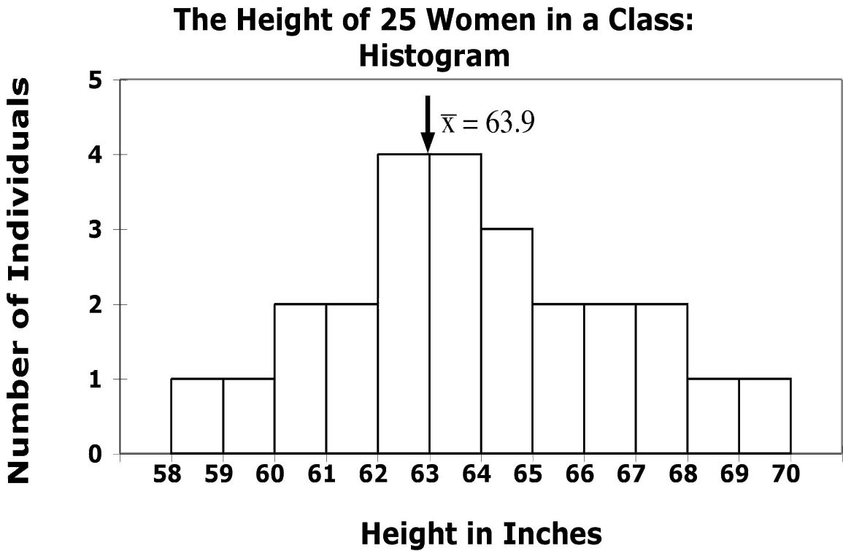

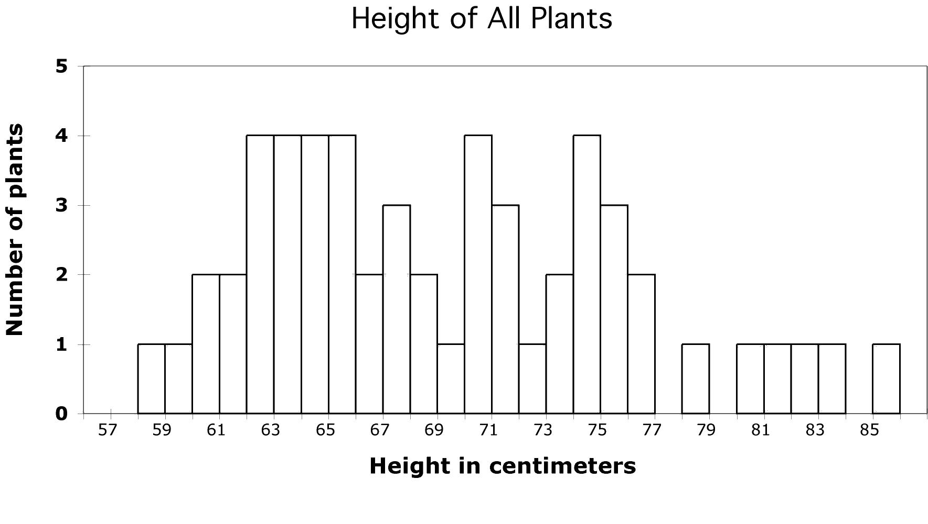

Your numerical summary must be meaningful.
Height of 25 women in a class
  The distribution of women’s heights appears coherent and symmetrical. The mean is a good numerical summary.
  Here the shape of the distribution is wildly irregular. Why?
  Could we have more than one plant species or phenotype?
Notes:
While we are looking at a number of histograms at once, and talking about means, here is another example of how you might use histograms and descriptive statistics like means to find out something of biological interest.
You are interested in studying what pollinators visit a particular species of plant. Let’s say that there has been an increase in agriculture in the area with all the pesticide spraying that comes along with that. If insects are needed to pollinate the plant, and the pesticides kill the insects, the plant species may go extinct.
Here is the mean of this distribution., but is it a good description of th center? Why would we care? Maybe plant height is a measure of plant age, and we wonder how well the population is holding up. - here you see there are not very many little plants, which might make you worry that there has been insufficient pollination.
One of the things you have noticed about the plants is that the flower color varies. Pollinators are attracted to flower color, so you happen to have the plants divided up into three groups - red pink and white flowers. Typically hummingbirds pollinate red flowers and moths pollinate white flowers. Which makes you start to wonder about your sample. So group them by flower color and get means for each group.

Slide 28

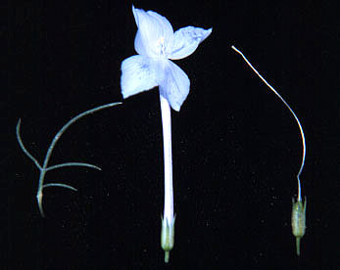

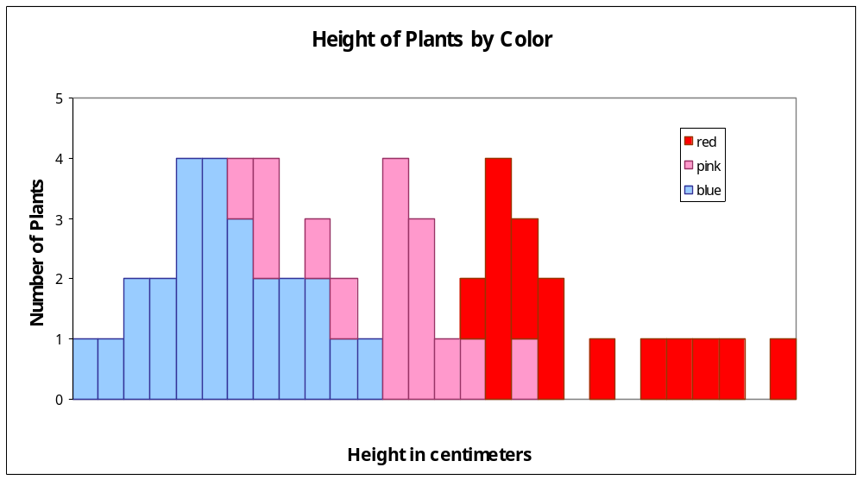



58 60 62 64 66 68 70 72 74 76 78 80 82 84
A single numerical summary here would not make sense.
Notes:
Here you see part of the reason for that broad lumpy distribution. The plants with different flower colors also have different
Size distributions. What you may be looking at here are two species - big ones with red and little one with white flowers, and their hybrids, which are
Intermediate in both size and color.
By adding extra information, here, grouping based on another categorical variable, histograms you might get insights you would never have gotten otherwise.
So that is the mean - a simple statistic used to describe the center of a distribution. Didn’t look like we had a center before, once we realize we have separate samples here they do in fact appear more as centers.

Slide 29
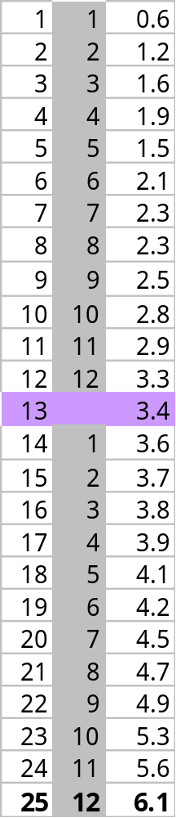
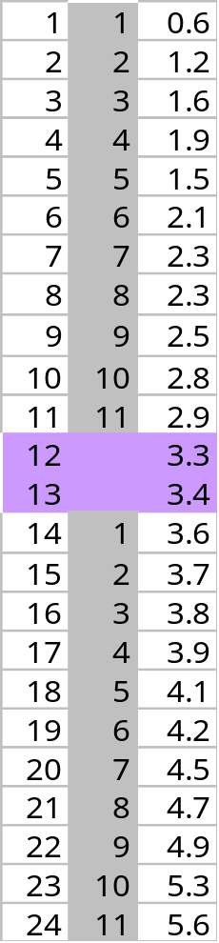
Measure of center: the median
The median is the midpoint of a distribution—the number such that half of the observations are smaller and half are larger.
1. Sort observations by size.
n = number of observations
______________________________
2.a. If n is odd, the median is observation (n+1)/2 down the list
⬅ n = 25
(n+1)/2 = 26/2 = 13
Median = 3.4
2.b. If n is even, the median is the
mean of the two middle observations.
n = 24 ➔
n/2 = 12
Median = (3.3+3.4) /2 = 3.35

Slide 30
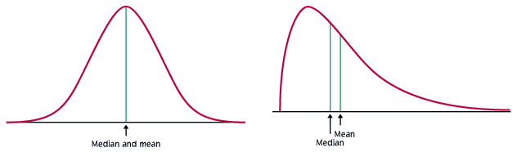
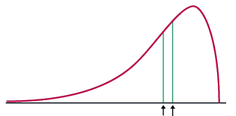
Comparing the mean and the median
The mean and the median are the same only if the distribution is symmetrical. The median is a measure of center that is resistant to skew and outliers. The mean is not.
Mean and median for a symmetric distribution
Mean
Median
Mean and median for skewed distributions
Left skew
Mean
Median
Right skew
Mean
Median

Slide 31
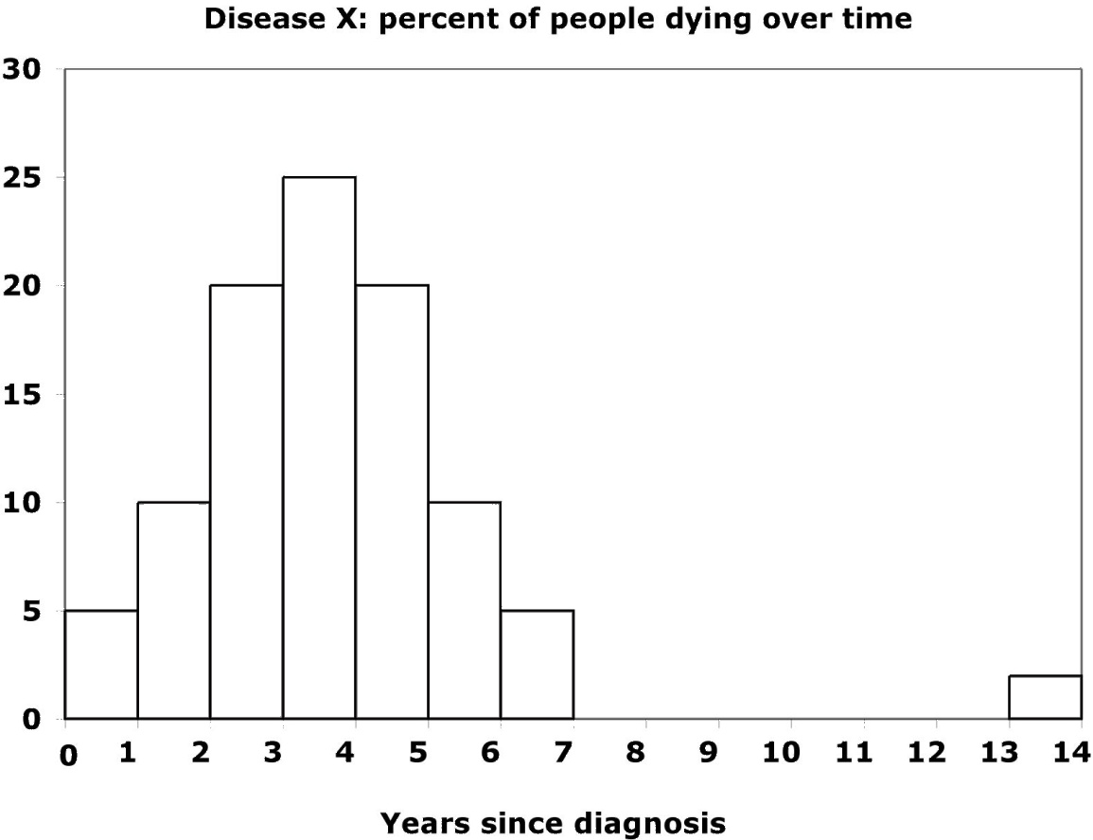


Mean and median of a distribution with outliers
Without the outliers
Percent of people dying
With the outliers
The mean is pulled to the right a lot by the outliers
(from 3.4 to 4.2).
The median, on the other hand, is only slightly pulled to the right by the outliers (from 3.4 to 3.6).
Notes:
Here is the same data set with some outliers - some lucky people who managed to live longer than the others.
The few large values moved the mean up from 3.5 to 4.0
However, the median , the number of years it takes for half the people to die only went from 3.4 to 3.6
This is typical behavior for the mean and median. The mean is sensitive to outliers, because when you add all the values up to get the mean the outliers are weighted disproportionately by their large size.
However, when you get the median, they are just another two points to count - the fact that their size is so large does not matter much.

Slide 32
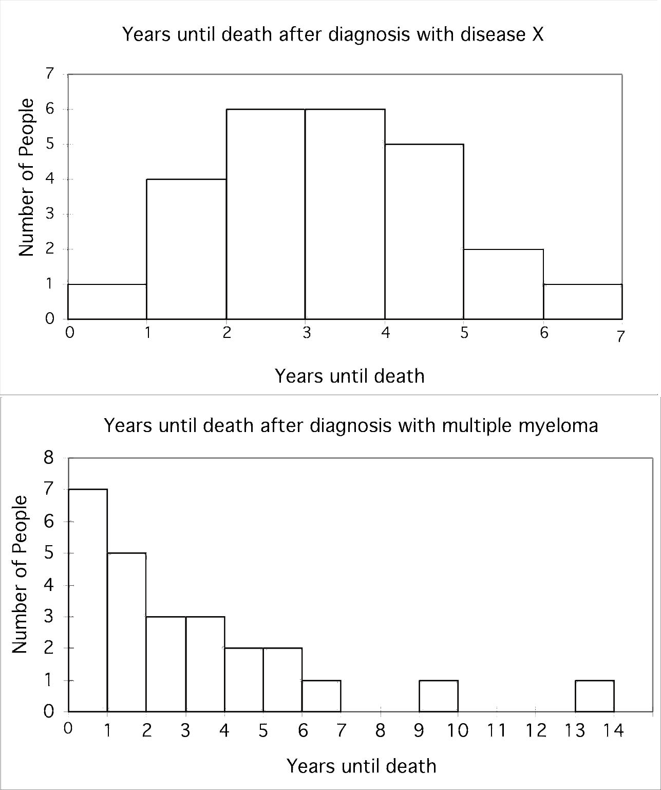
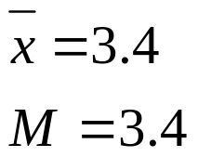
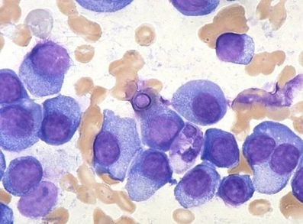
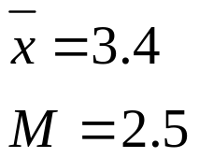
Impact of skewed data
Symmetric distribution…
Disease X:
Mean and median are the same.
… and a right-skewed distribution
Multiple myeloma:
The mean is pulled toward the skew.
Notes:
It is maybe easier to see that by comparing the two distributions we just looked at that show time to death after diagnosis.
For both disease X and MM you have on average 3 years to live. Does that mean you don’t care which one you get?
Well, of the 25 people getting disease X, only 1 died in the first year after diagnosis. Of the ones getting MM, 7 did.
So if you get X, according to what we see here only 1/25 or about 4 percent of people don’t make it through year one.
But if you get MM, well, if 1 in 7 die in year one, it means you have an almost 30% chance of not making it even a year.
Now, you might be one of these very few who live a long time, but it is much more likely that it is time to get your will together
and hurry around to say goodbye to your loved ones.
Means are the same, medians are different, because of the shape of the distribution.
This is one of the major take-home messages from this class - you all thought you knew what an average meant, and you did,
But you should also realized that what the average is telling you is different depending on the distribution.
When the doctor diagnoses you with some disease, and people with that disease live on average for 3 years,
You say Doctor! Show me the distribution!
And as you go on in biology and you see charts like this in journal articles or even in the paper, you now know why they are showing them to you.
Statistical descriptors, like using the mean to describe the center, are only telling you so much.
To really understand what is going on you have to plot the data and look at the distribution for things like overall shape, symmetry, and the presence of outliers, and you have to understand the effect they have on things like the mean.
Now, the next obvious question for a biologist of course is why you see these different types of patterns.
The top is a normal distribution, represents lots of things in the natural world as we have seen in our women’s height and toucan bill examples.
The distribution on the bottom is very different, and when you see something like this it challenges researchers to understand it - why do such a large percentage of people die so quickly - is there one single thing that if we could figure it out would save a huge chunk of the people dying down here? Could they figure out what it is about either these people or their treatment that allowed them to live so long? Lots still not known but a big part of it is that this diagnosis, MM, does not have the word multiple in its name for no reason. When you get down to the level of the cells involved, lots of different ones - so is really a suite of diseases. So this diagnosis is like “cancer” in general - a term that covers a broad range of biological phenomena that you can study and pick apart and understand on the cell biology to epidemiological level using not your intuition, but statistics.
Now let’s move on from describing the center to describing the spread and symmetry, which are, again, really different for these two distributions.

Slide 33
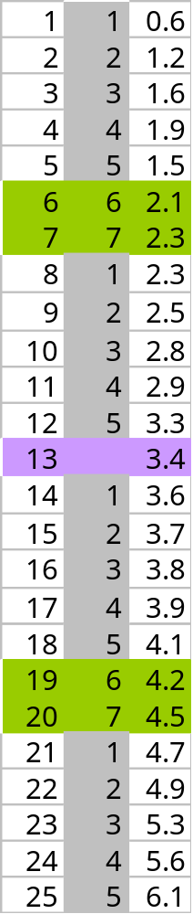
Measure of spread: the quartiles
The first quartile, Q₁, is the value in the sample that has 25% of the data at or below it (⬄ it is the median of the lower half of the sorted data, excluding M).
The third quartile, Q₃, is the value in the sample that has 75% of the data at or below it (⬄ it is the median of the upper half of the sorted data, excluding M).
Q₁= first quartile = 2.2
M = median = 3.4
Q₃= third quartile = 4.35
Notes:
We are going to start out with a very general way to describe the spread that doesn’t matter whether it is symmetric or not - quartiles.
Just as the word suggests - quartiles is like quarters or quartets, it involves dividing up the distribution into 4 parts.
Now, to get the median, we divided it up into two parts. To get the quartiles we do the exact same thing to the two halves.
Use same rules as for median if you have even or odd number of observations.
Now, what an we do with these that helps us understand the biology of these diseases?

Slide 34
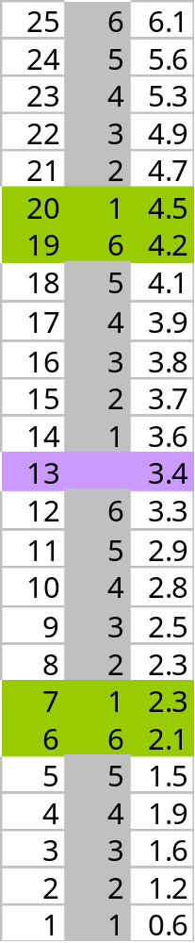
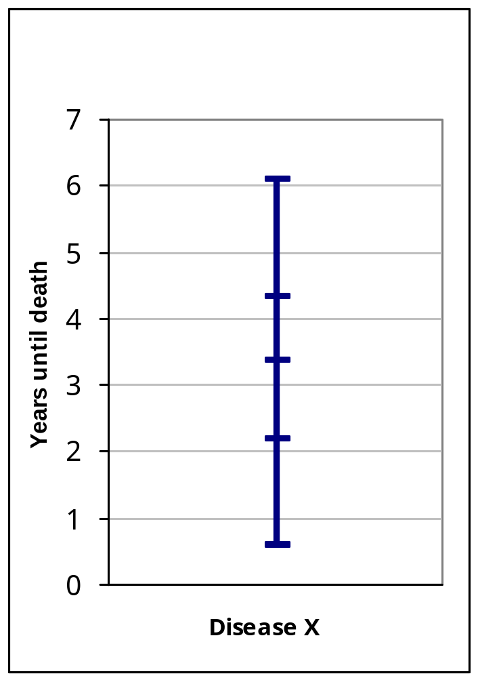
Five-number summary and boxplot
Largest = max = 6.1
BOXPLOT
Q₃= third quartile
= 4.35
M = median = 3.4
Q₁= first quartile
= 2.2
Five-number summary:
min Q₁ M Q₃ max
Smallest = min = 0.6
Notes:
Add in a one other thing we know - the spread - the largest and smallest values, and make a box plot.
Now, why would you want to make one of these?

Slide 35
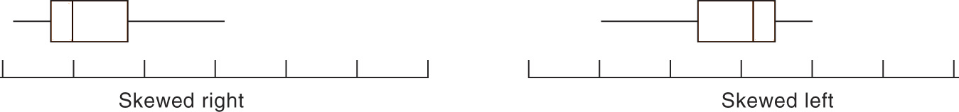
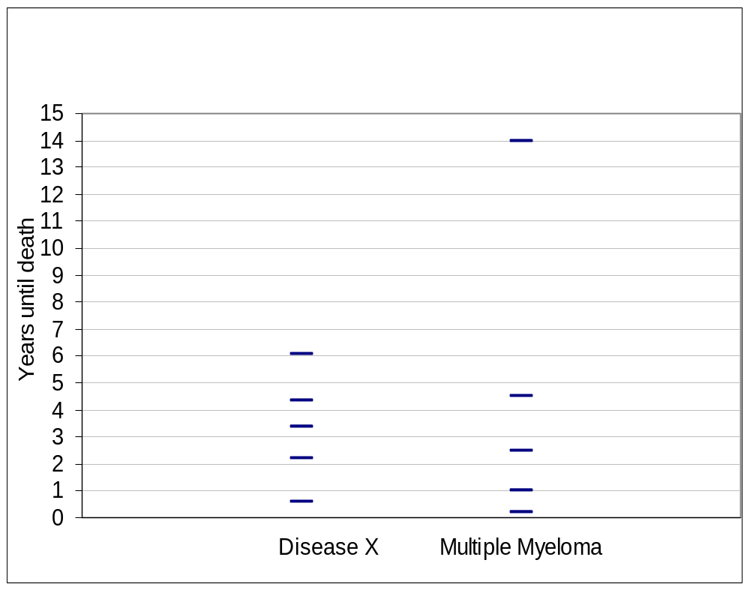
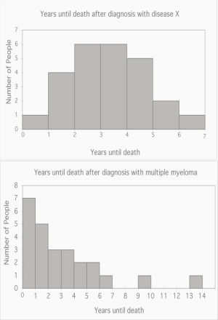
Boxplots for skewed data
Comparing box plots for a normal
and a right-skewed distribution
Boxplots remain true to the data and depict clearly symmetry or skew.
Notes:
They are most useful for comparing two things.
Here we see immediately that they are different beasts.
Start at the bottom - you can die of either in the first year,
The first quarter of individuals die of disease X in 2 years, only takes 1 for MM
Medians, or point at which half are dead, are not too different - 3 1/2 vs 2 1/2
For both diseases 3/4 of people are dead by about 4.5 years.
Disease X kills everyone by year 6 while some people with MM hang on a long time.
Quite obvious that the distribution of variation around midpoint is symmetric for X and highly skewed towards larger values for MM.
That is actually quite a bit of information -

Slide 36
Suspected outliers
Outliers are troublesome data points, and it is important to be able to identify them.
One way to raise the flag for a suspected outlier is to compare the distance from the suspicious data point to the nearest quartile (Q₁ or Q₃). We then compare this distance to the interquartile range (distance between Q₁ and Q₃).
We call an observation a suspected outlier if it falls more than 1.5 times the size of the interquartile range (IQR) below the first quartile or above the third quartile. This is called the “1.5 * IQR rule for outliers.”
Notes:
Add in a one other thing we know - the spread - the largest and smallest values, and make a box plot.
Now, why would you want to make one of these?

Slide 37
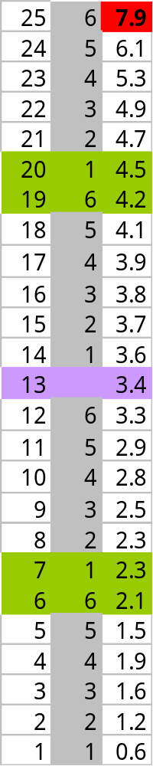
8
Distance to Q₃
7.9 − 4.35 = 3.55
Q₃ = 4.35
Interquartile range
Q₃ – Q₁
4.35 − 2.2 = 2.15
Q₁ = 2.2
Individual #25 has a value of 7.9 years, which is 3.55 years above the third quartile. This is more than 3.225 years, 1.5 * IQR. Thus, individual #25 is a suspected outlier.
Notes:
Add in a one other thing we know - the spread - the largest and smallest values, and make a box plot.
Now, why would you want to make one of these?

Slide 38




Measure of spread: the standard deviation
The standard deviation “s” is used to describe the variation around the mean. Like the mean, it is not resistant to skew or outliers.
1. First calculate the variance s².
2. Then take the square root to get the standard deviation s.
Mean
± 1 s.d.
Notes:
Boxplots are used to show the spread around a median - can use no matter what the distribution, and is a good way to contrast variables having different distributions.
But if your distribution is symmetrical, you can use the mean as the center of your distribution, you can use a different (and more common) measure of spread around the mean - standard deviation.
The Standard Deviation measures spread by looking at how far the observations are from their mean.
Go through calc. This is women’s height data again, First, N is again the number of observations. From this we calculate the degrees of freedom, which is just n-1.
Come back to this in a second.
Take difference from mean, square it so all are positive, add them up. Then divide not by number of observations by by n-1 = df
Although variance is a useful measure of spread, it’s units are units squared.
So we like to take the square root and use that number, the SD, which has the same units as the mean.
Height squared is not intuitive.
Now, as to why dividing by n-1 instead of n. When we got the mean it was easy to imagine why we divided by N intuitively.
But actually, what we are doing even there is dividing by the number of independent pieces of information that go into the estimate of a parameter.
This number is called the degrees of freedom (df, and it is equal to the number of independent scores that go into the estimate minus the number of parameters estimated as intermediate steps in the estimation of the parameter itself. For example, if the variance, s2 , is to be estimated from a random sample of N independent scores, then the degrees of freedom is equal to the number of independent scores (N) minus the number of parameters estimated as intermediate steps (here, we have estimated the mean) and is therefore equal to N-1.
But why the term “degrees of freedom”?
When we calculate the s-square of a random sample, we must first calculate the mean of that sample and then compute the sum of the several squared deviations from that mean. While there will be n such squared deviations only (n - 1) of them are, in fact, free to assume any value whatsoever. This is because the final squared deviation from the mean must include the one value of X such that the sum of all the Xs divided by n will equal the obtained mean of the sample. All of the other (n - 1) squared deviations from the mean can, theoretically, have any values whatsoever. For these reasons, the statistic s-square is said to have only (n - 1) degrees of freedom.
I know this is hard to understand. I don’t expect you to understand it completely. But in a second I will come back to it to show you the effect of dividing by n-1 rather than n, and perhaps that will make is easier to accept.

Slide 39
Properties of Standard Deviation
s measures spread about the mean and should be used only when the mean is the measure of center.
s = 0 only when all observations have the same value and there is no spread. Otherwise, s > 0.
s is not resistant to outliers.
s has the same units of measurement as the original observations.

Slide 40

Choosing among summary statistics
Because the mean is not resistant to outliers or skew, use it to describe distributions that are fairly symmetrical and don’t have outliers.
→ Plot the mean and use the standard deviation for error bars.
Otherwise use the median in the five number summary which can be plotted as a boxplot.
Boxplot Mean ± SD

Slide 41
What should you use, when, and why?
$$$
Arithmetic mean or median?
Middletown is considering imposing an income tax on citizens. City hall wants a numerical summary of its citizens’ income to estimate the total tax base.
In a study of standard of living of typical families in Middletown, a sociologist makes a numerical summary of family income in that city.
  Mean: Although income is likely to be right-skewed, the city government wants to know about the total tax base.
  Median: The sociologist is interested in a “typical” family and wants to lessen the impact of extreme incomes.

Slide 42


Boxplot in R
summary() function
> attach(cfb) # it is a data frame
> summary(VEHIC)
Min. 1st Qu. Median Mean 3rd Qu. Max.
0 3875 11000 15400 21300 188000
> hist(VEHIC, br="Scott", prob=T)
> lines(density(VEHIC))
Making boxplots in R
> attach(alltime.movies)
> boxplot(Gross, ylab="All-time gross sales")
> f=fivenum(Gross)
> text(rep(1.3,5), f, labels=c("min","Q1",
"median","Q3","max"))

Slide 43
Getting the outliers
> the.names=rownames(alltime.movies)
> the.names[Gross > f[4] + 1.5*(f[4]-f[2])]
[1] "Titanic "
[2] "Star Wars "
[3] "E.T. "
[4] "Star Wars: The Phantom Menace"
[5] "Spider-Man "
> detach(alltime.movies) #tidy up

