Slide 1
Random variable and probability distribution
Zhi Wei

Slide 2

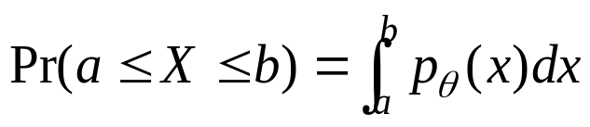
Random Variable and Distribution
A random variable X is a numerical outcome of a random experiment
The distribution of a random variable is the collection of possible outcomes along with their probabilities:
  Categorical case:
  Numerical case:

Slide 3

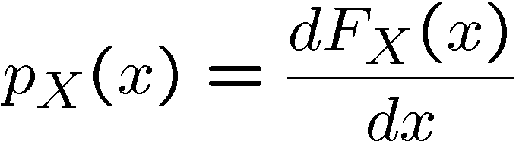
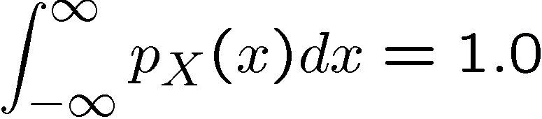
Random Variables Distributions
Cumulative Probability Distribution (CDF):
Probability Density Function (PDF):

Slide 4
Random Variable: Example
Let S be the set of all sequences of three rolls of a die. Let X be the sum of the number of dots on the three rolls.
What are the possible values for X?
Pr(X = 5) = ?, Pr(X = 10) = ?
Notes:
10=1+3+6=2+2+6=2+3+5=2+4+4
5=1+1+3=1+2+2

Slide 5
Expectation value
Division of the stakes problem
Henry and Tony play a game. They toss a fair coin, if get a Head, Henry wins; Tail, Tony wins. They contribute equally to a prize pot of $100, and agree in advance that the first player who has won 3 rounds will collect the entire prize. However, the game is interrupted for some reason after 3 rounds. They got 2 H and 1 T. How should they divide the pot fairly?
It seems unfair to divide the pot equally Since Henry has won 2 out of 3 rounds. Then, how about Henry gets 2/3 of $100?
Other thoughts?
X | 0 | 100
P | 0.25 | 0.75
X is what Henry will win if the game not interrupted
Notes:
Suppose they continue to play, at most two rounds, the game will end, the possible outcomes
H, TH, TT
Expectation value, proposed firstly by a French mathematician Pascal in 1600s.

Slide 6
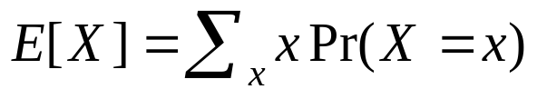
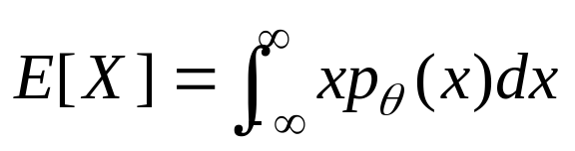
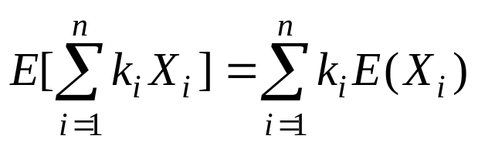
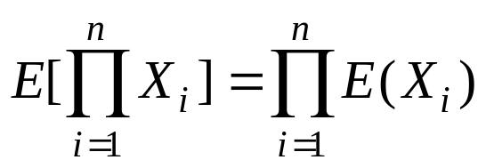
Expectation
Definition: the expectation of a random variable is
  , discrete case
  , continuous case
Properties
  Summation: For any n≥1, and any constants k₁,…,k_{n}
  Product: If X₁, X₂, …, X_{n} are independent

Slide 7
Expectation: Example
Let S be the set of all sequence of three rolls of a die. Let X be the sum of the number of dots on the three rolls.
What is E(X)?
Let S be the set of all sequence of three rolls of a die. Let X be the product of the number of dots on the three rolls.
What is E(X)?

Slide 8
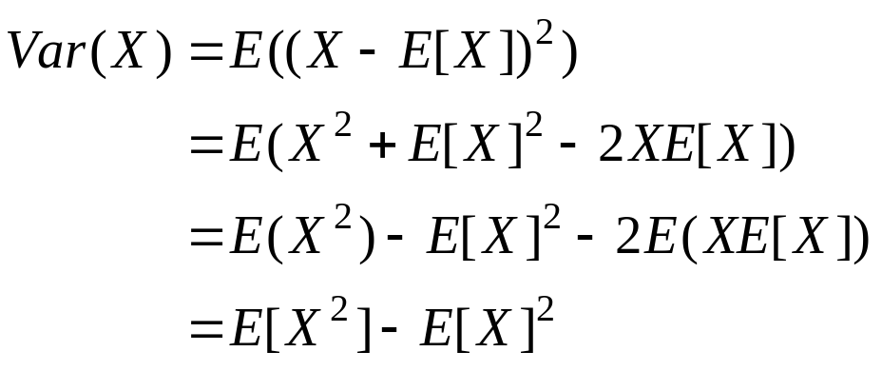
Variance
Definition: the variance of a random variable X is the expectation of (X-E[x])² :
Properties
  For any constant C, Var(CX)=C²Var(X)
  If X₁, X₂, …, X_{n} are independent

Slide 9
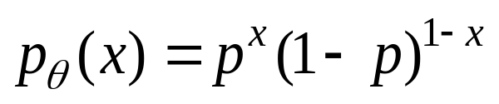
Bernoulli Distribution
The outcome of an experiment can either be success (i.e., 1) and failure (i.e., 0).
Pr(X=1) = p, Pr(X=0) = 1-p, or
E[X] = p, Var(X) = p(1-p)
Using sample() to generate Bernoulli samples
> n = 10; p = 1/4;
> sample(0:1, size=n, replace=TRUE, prob=c(1-p, p))
[1] 0 1 0 0 0 1 0 0 0 1

Slide 10
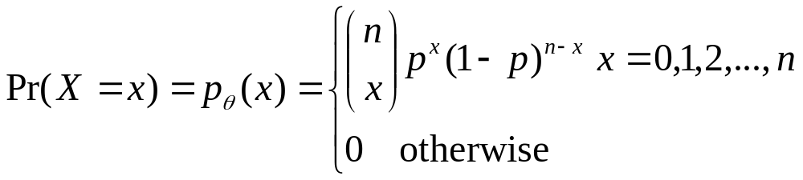
Binomial Distribution
n draws of a Bernoulli distribution
  X_{i}~Bernoulli(p), X=∑_{i=1}^{n} X_{i}, X~Bin(p, n)
Random variable X stands for the number of times that experiments are successful.
  n = the number of trials
  x = the number of successes
  p = the probability of success
E[X] = np, Var(X) = np(1-p)

Slide 11
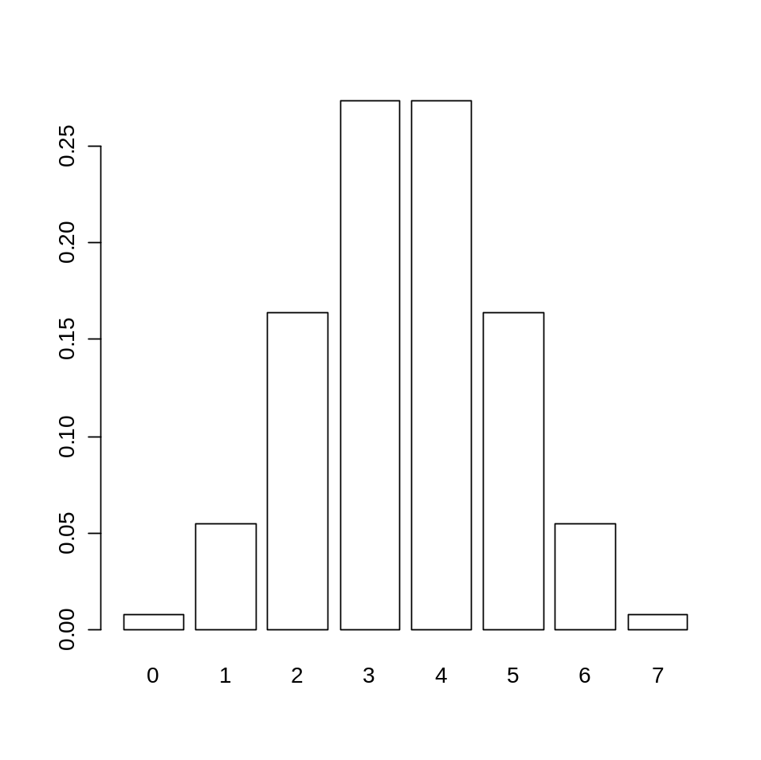
the binomial distribution in R
dbinom(x, size, prob)
Try 7 times, equally likely succeed or fail
  > dbinom(3,7,0.5)
  [1] 0.2734375
  >barplot(dbinom(0:7,7,0.5),names.arg=0:7)

Slide 12
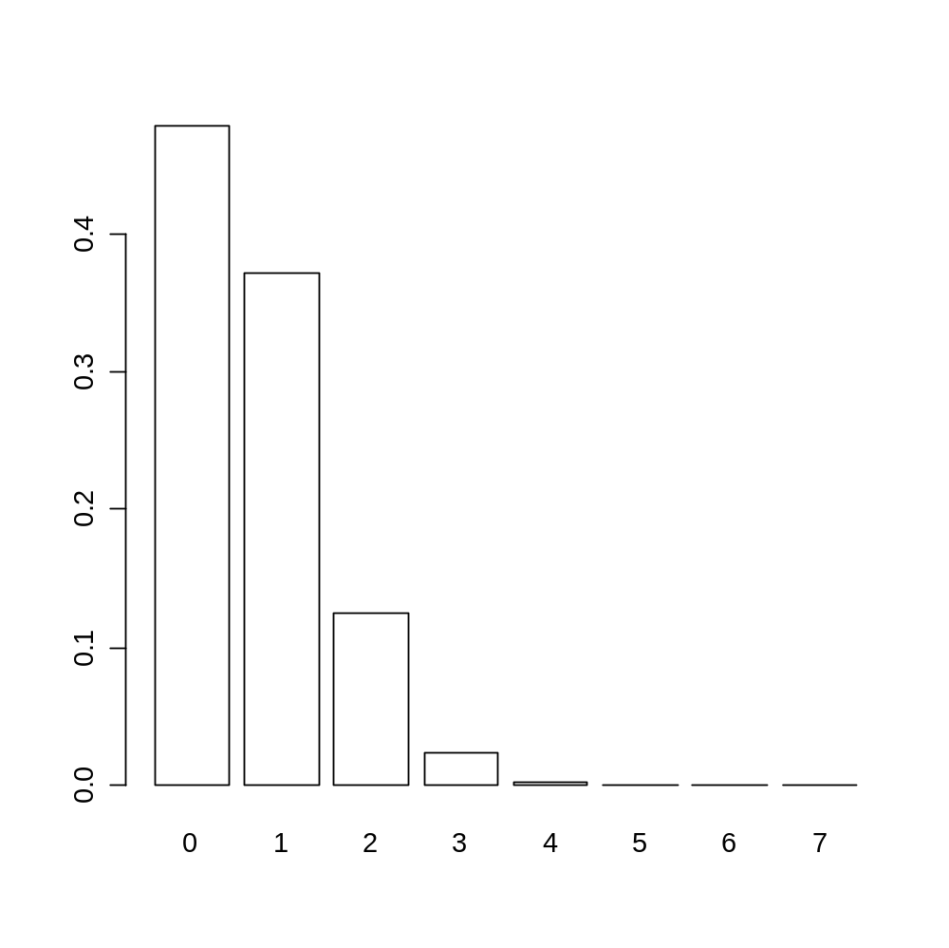
what if p ≠ 0.5?
> barplot(dbinom(0:7,7,0.1),names.arg=0:7)

Slide 13
Which distribution has greater variance?
p = 0.5
p = 0.1
var = n*p*(1-p) = 7*0.5*0.5 = 7*0.25
var = n*p*(1-p) = 7*0.1*0.9=7*0.09

Slide 14
briefly comparing an experiment to a distribution
nExpr = 1000
tosses = 7; y=rep(0,nExpr);
for (i in 1:nExpr) {
x = sample(c("H","T"), tosses, replace = T)
y[i] = sum(x=="H")
}
hist(y,breaks=-0.5:7.5)
lines(0:7,dbinom(0:7,7,0.5)*nExpr)
points(0:7,dbinom(0:7,7,0.5)*nExpr)
theoretical
distribution
result of 1000 trials
Histogram of y
300
250
200
150
Frequency
100
50
0
0
2
4
6
y

Slide 15
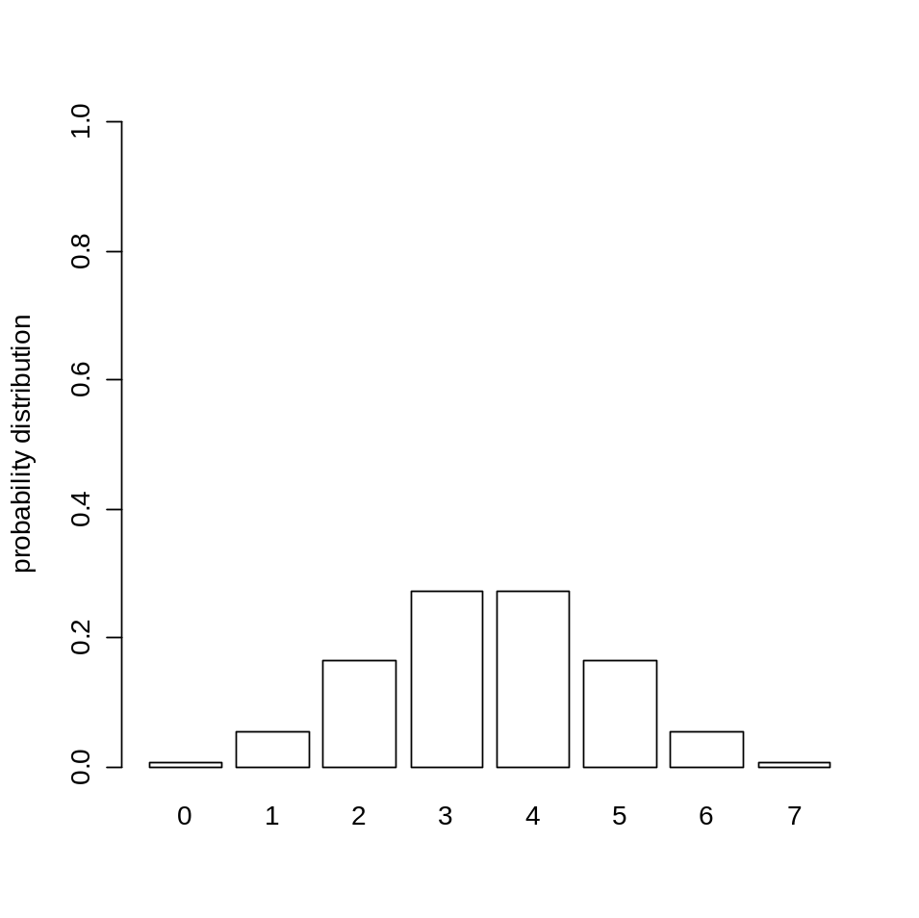
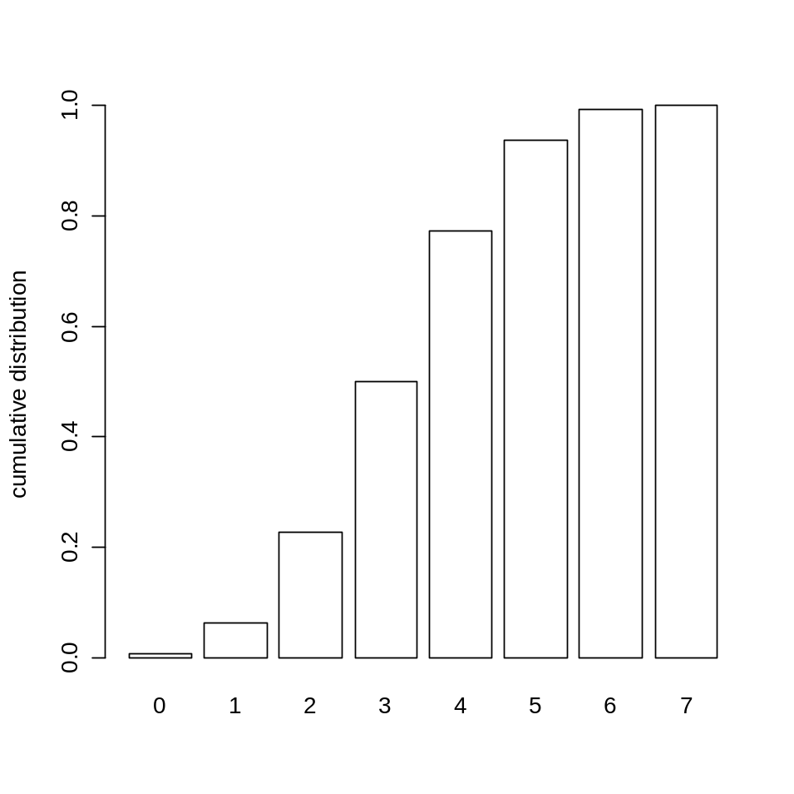
Cumulative distribution
P(X=x)
P(X≤x)
> barplot(dbinom(0:7,7,0.5),names.arg=0:7)
> barplot(pbinom(0:7,7,0.5),names.arg=0:7)

Slide 16
cumulative distribution
1.0
1.0
0.8
0.8
0.6
0.6
probability distribution
cumulative distribution
0.4
0.4
0.2
0.2
0.0
0.0
0
1
2
3
4
5
6
7
0
1
2
3
4
5
6
7
P(X=x)
P(X≤x)

Slide 17
example: surfers on a website
Your site has a lot of visitors 45% of whom are female
You’ve created a new section on gardening
Out of the first 100 visitors, 55 are female.
What is the probability that this many or more of the visitors are female?
P(X≥55) = 1 – P(X≤54) = 1-pbinom(54,100,0.45)

Slide 18
Another way to calculate cumulative probabilities
?pbinom
P(X≤x) = pbinom(x, size, prob, lower.tail = T)
P(X>x) = pbinom(x, size, prob, lower.tail = F)
> 1-pbinom(54,100,0.45)
[1] 0.02839342
> pbinom(54,100,0.45,lower.tail=F)
[1] 0.02839342

Slide 19
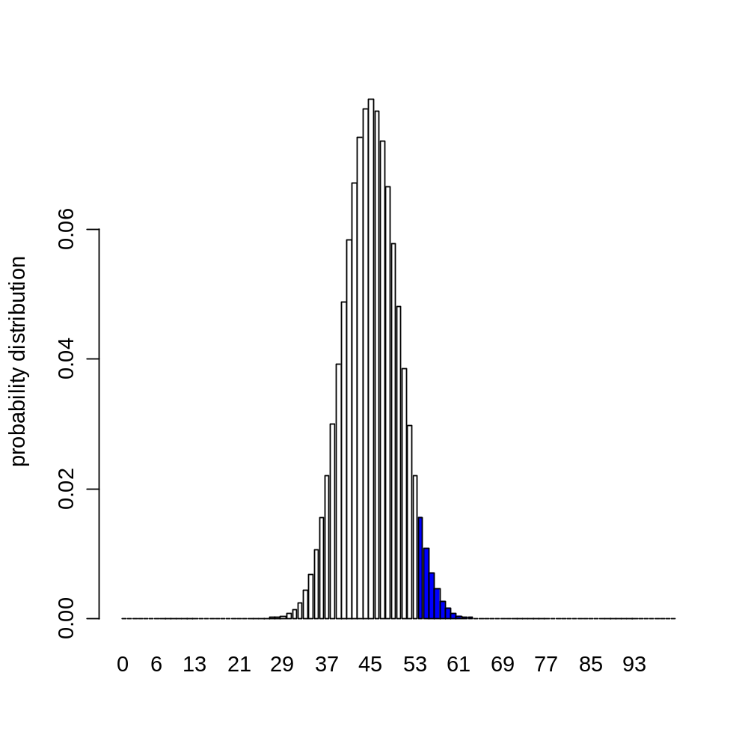
Female surfers visiting a section of a website
what is the area under the curve?

Slide 20
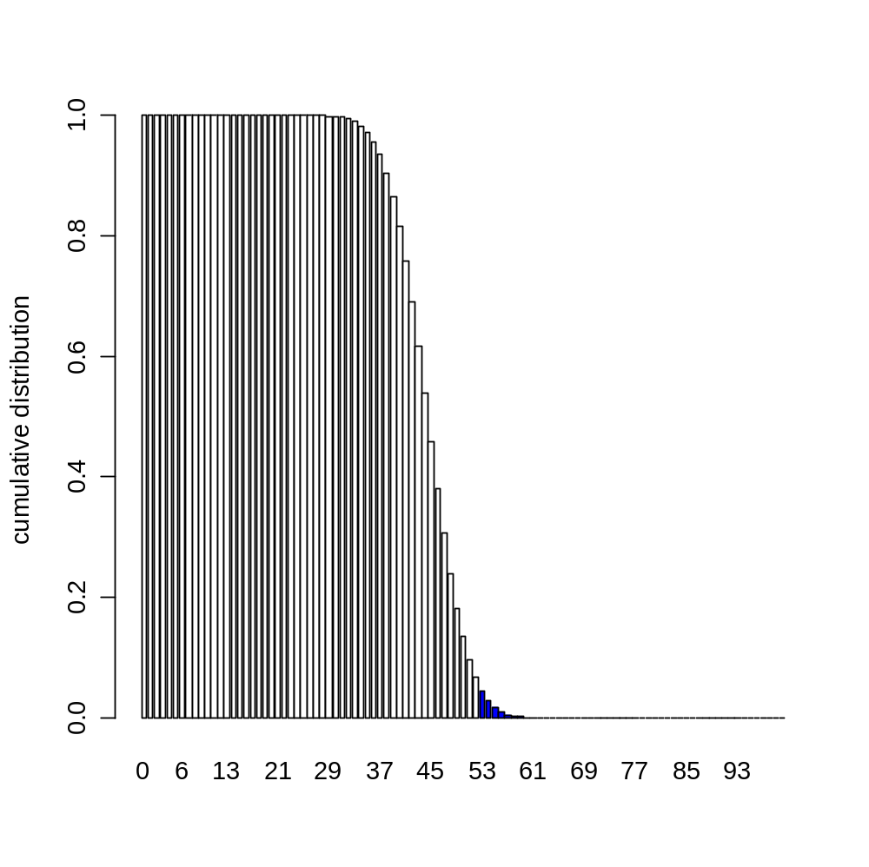
Cumulative distribution
> 1-pbinom(54,100,0.45)
[1] 0.02839342
<3 %

Slide 21
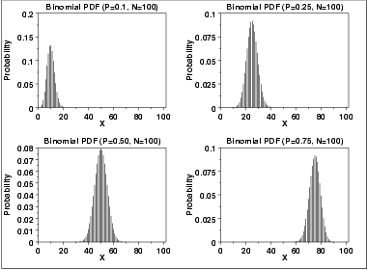
Plots of Binomial Distribution

Slide 22
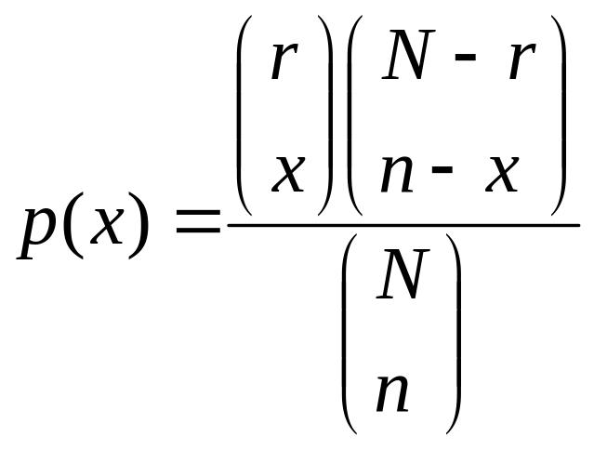
Another discrete distribution: hypergeometric
Randomly draw n elements without replacement from a set of N elements, r of which are S’s (successes) and (N-r) of which are F’s (failures)
hypergeometric random variable x is the number of S’s in the draw of n elements

Slide 23
hypergeometric example
fortune cookies
there are N = 20 fortune cookies
r = 18 have a fortune, N-r = 2 are empty
What is the probability that out of n = 5 cookies, s=5 have a fortune (that is we don’t notice that some cookies are empty)
> dhyper(5, 18, 2, 5)
[1] 0.5526316
So there is a greater than 50% chance that we won’t notice.

Slide 24
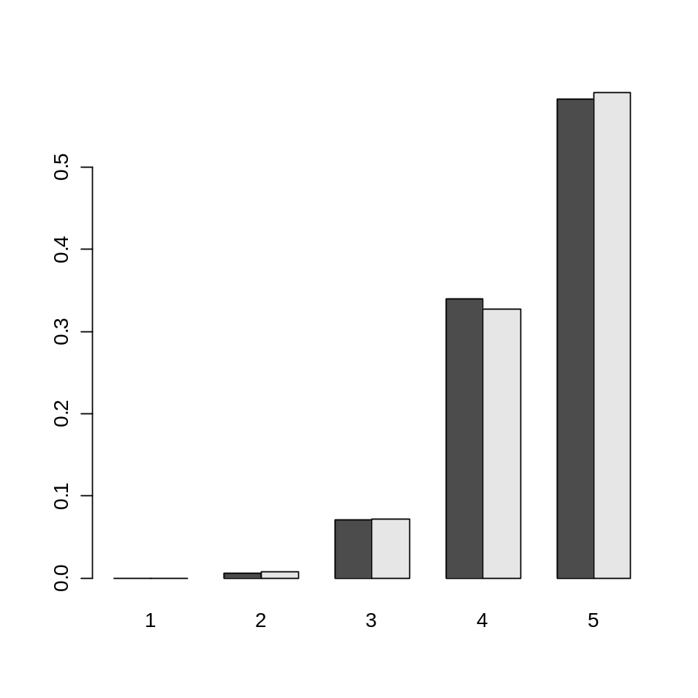
hypergeometric and binomial
When the population N is (very) big, whether one samples with or without replacement is pretty much the same
100 cookies, 10 of which are empty
binomial
hypergeometric
number of full cookies out of 5

Slide 25
code aside
> x = 1:5
> y1 = dhyper(1:5,90,10,5)
> y2 = dbinom(1:5,5,0.9)
> tmp = as.matrix(t(cbind(y1,y2)))
> barplot(tmp,beside=T,names.arg=x)
hypergeometric probability
binomial probability

Slide 26
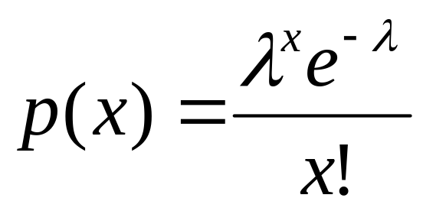
Poisson distribution
# of events in a given interval
  e.g. number of light bulbs burning out in a building in a year
  # of people arriving in a queue per minute
  λ = mean # of events in a given interval
E[X] = λ, Var(X) = λ

Slide 27
Example: Poisson distribution
You got a box of 1,000 widgets.
The manufacturer says that the failure rate is 5 per box on average.
Your box contains 10 defective widgets. What are the odds?
> ppois(9,5,lower.tail=F)
[1] 0.03182806
Less than 3%, maybe the manufacturer is not quite honest.
Or the distribution is not Poisson?

Slide 28
Poisson approximation to binomial
If n is large (e.g. > 100) and n*p is moderate (p should be small) (e.g. < 10), the Poisson is a good approximation to the binomial with λ = n*p
binomial
Poisson
0.15
0.10
0.05
0.00
0
1
2
3
4
5
6
7
8
9
11
13
15

Slide 29
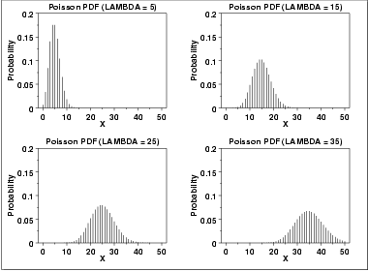
Plots of Poisson Distribution

Slide 30
Normal (Gaussian) Distribution
Normal distribution (aka “bell curve”)
fits many biological data well
  e.g. height, weight
serves as an approximation to binomial, hypergeometric, Poisson because of the Central Limit Theorem
Well studied

Slide 31
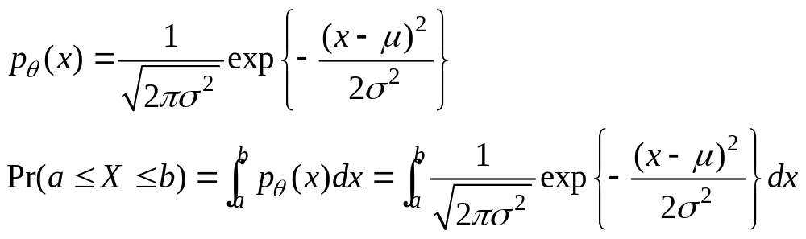
Normal (Gaussian) Distribution
X~N(μ,σ)
E[X]= μ, Var(X)= σ²
If X₁~N(μ₁,σ₁), X₂~N(μ₂,σ₂), and X₁, X₂ are independent
  X= X₁+ X₂ ?
  X= X₁- X₂ ?

Slide 32
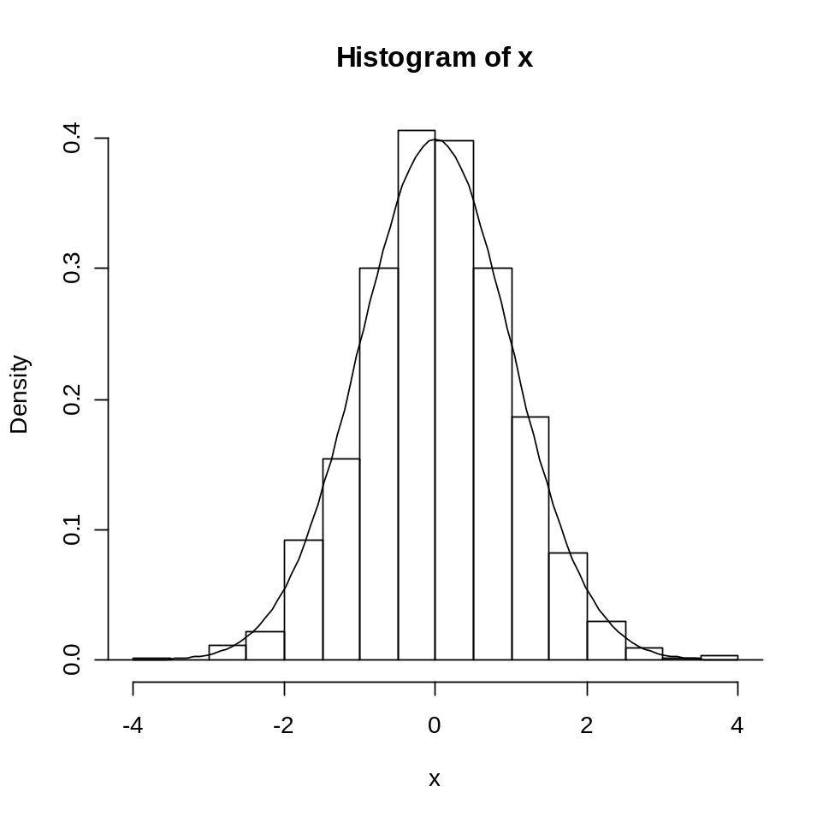
sampling from a normal distribution
x <- rnorm(1000)
h <- hist(x, plot=F)
ylim <- range(0,h$density,dnorm(0))
hist(x,freq=F,ylim=ylim)
curve(dnorm(x),add=T)

Slide 33
Normal Approximation based on Central Limit Theorem
Central Limit Theorem
  If x_{i} ~i.i.d with (μ, σ²) and when n is large, then
  (x₁+…+x_{n})/n ~ N(μ, σ²/n)
  Or (x₁+…+x_{n}) ~ N(nμ, nσ²)
Example
  A population is evenly divided on an issue (p=0.5). For a random sample of size 1000, what is the probability of having ≥550 in favor of it?
  n=1000, x_{i}~Bernoulli (p=0.5), i.e. E(x_{i})=p; V(x_{i})=p(1-p)
  (x₁+…+x_{n}) ~ Binomial(n=1000, p=0.5)
  Pr((x₁+…+x_{n})>=550) =1-pbinom(550,1000,0.5)
  Normal Approximation:
  (x₁+…+x_{n}) ~ N(np, np(1-p))=N(500, 250)
  Pr((x₁+…+x_{n})>=550) =1-pnorm(550, mean=500, sd=sqrt(250))

Slide 34
d, p, q, and r functions in R
In R, a set of functions have been implemented for each of almost all known distributions.
r<distname>(n,<parameters>)
  Possible distributions: binom, pois, hyper, norm, beta, chisq, f, gamma, t, unif, etc
You find other characteristics of distributions as well
  d<dist>(x,<parameters>): density at x
  p<dist>(x,<parameters>): cumulative distribution function to x
  q<dist>(p,<parameters>): inverse cdf

Slide 35
Example: Uniform Distribution
The uniform distr. On [a,b] has two parameter. The family name is unif. In R, the parameters are named min and max
> dunif(x=1, min=0, max=3)
[1] 0.3333333
> punif(q=2, min=0, max=3)
[1] 0.6666667
> qunif(p=0.5, min=0, max=3)
[1] 1.5
> runif(n=5, min=0, max=3)
[1] 2.7866852 1.9627136 0.9594195 2.6293273 1.6277597

Slide 36
Bayes’ rule

Slide 37
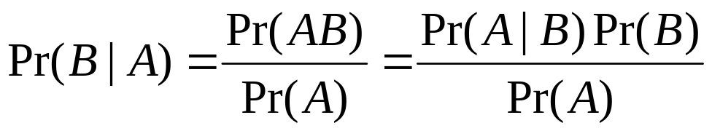
Bayes’ Rule
Given two events A and B and suppose that Pr(A) > 0. Then
Example:
Pr(R) = 0.8
R: It is a rainy day
W: The grass is wet
Pr(R|W) = ?
Pr(W|R) | R | ¬R
W | 0.7 | 0.4
¬W | 0.3 | 0.6

Slide 38
Bayes’ Rule
 | R | ¬R
W | 0.7 | 0.4
¬W | 0.3 | 0.6
R: It rains
W: The grass is wet
Information
Pr(W|R)
R
W
Inference
Pr(R|W)

Slide 39
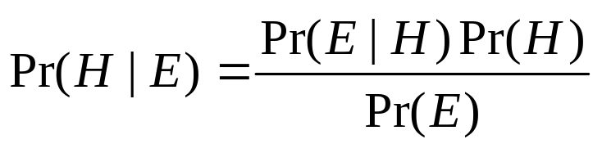
Bayes’ Rule
 | R | ¬R
W | 0.7 | 0.4
¬W | 0.3 | 0.6
R: The weather rains
W: The grass is wet
Information: Pr(E|H)
Hypothesis H
Evidence E
Posterior
Likelihood
Prior
Inference: Pr(H|E)

Slide 40
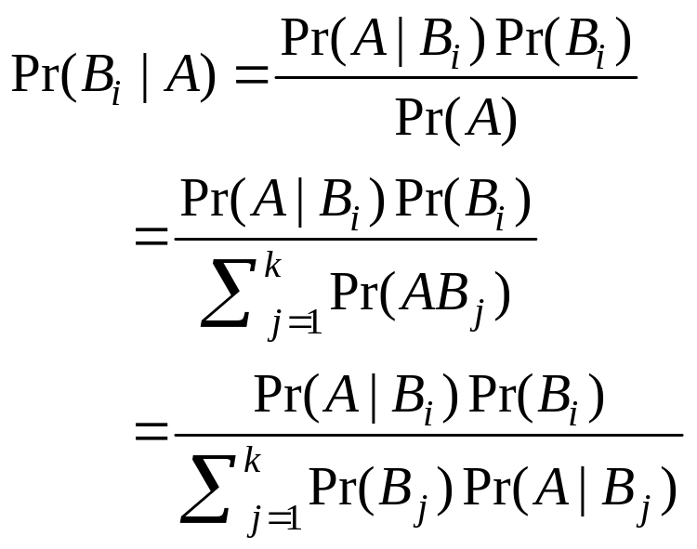
Summation (Integration) out tip
Suppose that B₁, B₂, … B_{k} form a partition of Ω:
B₁ ∪ B₂ ∪ …∪ B_{k} = Ω and B₁, B₂, … B_{k} are mutually exclusive
Suppose that Pr(B_{i}) > 0 and Pr(A) > 0. Then

Slide 41

Summation (Integration) out tip
Suppose that B₁, B₂, … B_{k} form a partition of Ω:
B₁ ∪ B₂ ∪ …∪ B_{k} = Ω and B₁, B₂, … B_{k} are mutually exclusive
Suppose that Pr(B_{i}) > 0 and Pr(A) > 0. Then

Slide 42
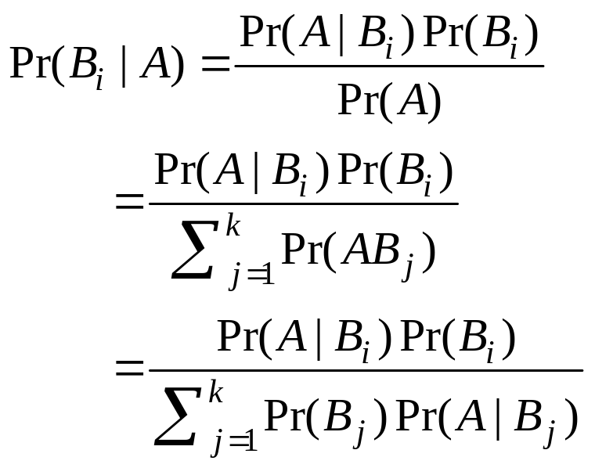
Summation (Integration) out tip
Suppose that B₁, B₂, … B_{k} form a partition of Ω:
B₁ ∪ B₂ ∪ …∪ B_{k} = Ω and B₁, B₂, … B_{k} are mutually exclusive
Suppose that Pr(B_{i}) > 0 and Pr(A) > 0. Then
Key: Joint distribution!

Slide 43
Application of Bayes’ Rule
R | It rains
W | The grass is wet
U | People bring umbrella
Pr(UW|R)=Pr(U|R)Pr(W|R) Pr(UW| ¬R)=Pr(U| ¬R)Pr(W| ¬R)
R
W
U
Pr(R) = 0.8
Pr(W|R) | R | ¬R
W | 0.7 | 0.4
¬W | 0.3 | 0.6
Pr(U|R) | R | ¬R
U | 0.9 | 0.2
¬U | 0.1 | 0.8
Pr(U|W) = ?

Slide 44
A More Complicated Example
R | It rains
W | The grass is wet
U | People bring umbrella
Pr(UW|R)=Pr(U|R)Pr(W|R) Pr(UW| ¬R)=Pr(U| ¬R)Pr(W| ¬R)
R
W
U
Pr(R) = 0.8
Pr(W|R) | R | ¬R
W | 0.7 | 0.4
¬W | 0.3 | 0.6
Pr(U|R) | R | ¬R
U | 0.9 | 0.2
¬U | 0.1 | 0.8
Pr(U|W) = ?

Slide 45
A More Complicated Example
R | It rains
W | The grass is wet
U | People bring umbrella
Pr(UW|R)=Pr(U|R)Pr(W|R) Pr(UW| ¬R)=Pr(U| ¬R)Pr(W| ¬R)
R
W
U
Pr(R) = 0.8
Pr(W|R) | R | ¬R
W | 0.7 | 0.4
¬W | 0.3 | 0.6
Pr(U|R) | R | ¬R
U | 0.9 | 0.2
¬U | 0.1 | 0.8
Pr(U|W) = ?

Slide 46
Acknowledgments
Peter N. Belhumeur: for some of the slides adapted or modified from his lecture slides at Columbia University
Rong Jin: for some of the slides adapted or modified from his lecture slides at Michigan State University
Jeff Solka: for some of the slides adapted or modified from his lecture slides at George Mason University
Brian Healy: for some of the slides adapted or modified from his lecture slides at Harvard University

