Slide 1
Feature and Model selection

Slide 2
Feature Selection
  Thousands to millions of low level features: select the most relevant one to build better, faster, and easier to understand learning machines.
n
n’
X
m

Slide 3
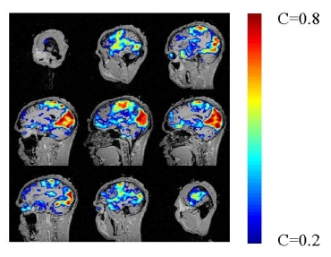
Applications
examples
Customer knowledge
Quality control
10⁶
Market
Analysis
OCR
HWR
10⁵
Machine vision
Text
Categorization
10⁴
10³
System diagnosis
Bioinformatics
10²
10
10
10²
10³
10⁴
10⁵
variables/features

Slide 4
A taxonomy of feature selection techniques
Filter method: ranks features or feature subsets independently of the predictor (classifier).
  Univariate method: considers one variable (feature) at a time.
  Multivariate method: considers subsets of variables (features) together.
Wrapper method: uses a classifier to assess features or feature subsets.
Embedded method: the search for an optimal subset of features is built into the classifier construction, and can be seen as a search in the combined space of feature subsets and hypotheses
Notes:
Linear/non linear.

Slide 5
Filters,Wrappers, and Embedded methods
Feature subset
All features
Filter
Predictor
Multiple Feature subsets
All features
Predictor
Wrapper
Feature subset
Embedded method
All features
Predictor
Notes:
Wrappers are

Slide 6
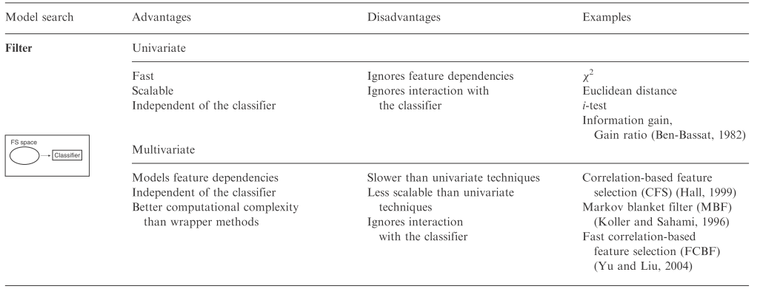
Filter
Filter method: ranks features or feature subsets independently of the predictor (classifier).
  Univariate method: considers one variable (feature) at a time.
  Multivariate method: considers subsets of variables (features) together.

Slide 7
Univariate feature ranking: two sample t-test
μ-
μ+
P(X_{i}|Y=1)
P(X_{i}|Y=-1)
-1
x_{i}
σ-
σ+
Normally distributed classes, equal variance σ² unknown; estimated from data as σ²_{within}.
Null hypothesis H₀: μ+ = μ-
T statistic: If H₀ is true,
t= (μ+ - μ-)/(σ_{within}√1/m⁺+1/m⁻) Student(m⁺+m⁻-2 d.f.)

Slide 8
Statistical tests
Null distribution
H₀: X and Y are independent.
Relevance index ⬄ test statistic.
P Value ⬄ Independence evidence
Multiple testing problem
  Family-wise error rate: use Bonferroni correction pval ⬅ n pval
  False discovery rate: FDR = n_{fp} / n_{selected}
pval
r₀
r

Slide 9
Information Theory: Univariate Dependence
Independence:
P(X, Y) = P(X) P(Y)
Measure of dependence: Mutual Information
MI(X, Y) = ∫ ∫ P(X,Y) log dX dY
= KL( P(X,Y) || P(X)P(Y) ) (Kullback-Leibler Distance)
= H(X,Y) – H(X|Y) – H(Y|X) (H, entropy fun)
P(X,Y)
P(X)P(Y)

Slide 10
Other criteria
The choice of feature selection ranking methods depends on the nature of:
the variables and the target (binary, categorical, continuous)
the problem (dependencies between variables, linear/non-linear relationships between variables and target)
the available data (number of examples and number of variables, noise in data)

Slide 11
Typical cases/methods for testing association of X ~ Y
(1) X continuous, Y continuous
  Regression Y ~ b*X+b0
  Log Likelihood ratio test H0: b==0
(2) X categorical, Y continuous
  Method 1
    Divide Y into K groups based on the K categories that X has
    K=2, two-sample t-test; K>2, ANNOVA test
  Method 2: regression Y ~ b*X+ b0 as above
(3) X continuous, Y categorical
  Similar as (2) but switch X with Y
(4) X categorical, Y categorical
  Fisher test, or chi square test.

Slide 12
Multivariate selection
Univariate selection may fail
Guyon-Elisseeff, JMLR 2004; Springer 2006
Multivariate: Models feature dependencies
  Correlation-based feature selection (CFS) (Hall, 1999)
  Markov blanket filter (MBF) (Koller and Sahami, 1996)
Notes:
Example of NL classifier: SVM

Slide 13
Filters,Wrappers, and Embedded methods
Feature subset
All features
Filter
Predictor
Multiple Feature subsets
All features
Predictor
Wrapper
Feature subset
Embedded method
All features
Predictor
Notes:
Wrappers are

Slide 14
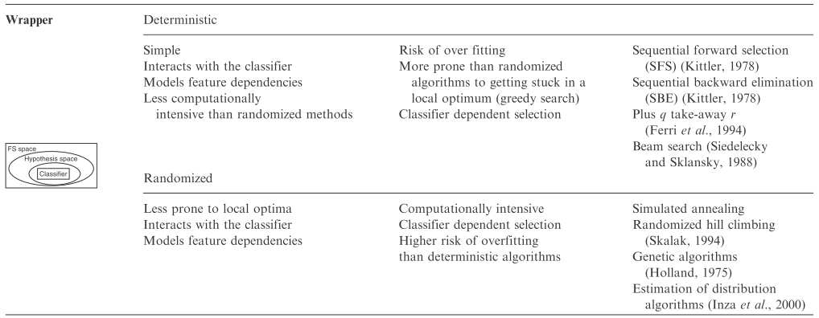
Wrapper
Wrapper method: uses a classifier to assess features or feature subsets.

Slide 15
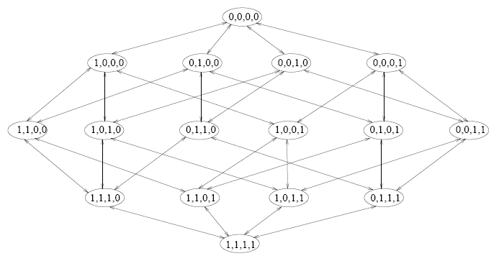
Wrappers for feature selection
Kohavi-John, 1997
N features, 2^{N} possible feature subsets!
Notes:
Multivariate FS implies a search in the space of all possible combinations of features.
For n features, there are 2^n possible subsets of features.
This yields both to a high computational and statistical complexity. Wrappers use
the performance of a learning machine to evaluate each subset. Training 2^n learning machines
is infeasible for large n, so most wrapper algorithms resort to greedy or heuristic search.
The statistical complexity of the learning problem is governed by the ratio n/m where m is the number of examples, but can be reduced to log n/m for regularized algorithms and forward or backward selection procedures.
Filters function analogously to wrappers, but they use in the evaluation function something cheaper to compute than the performance of the target learning machine (e.g. a correlation coefficient or the performance of a simpler learning machine).
Embedded methods

Slide 16
Search Strategies
Exhaustive search.
Simulated annealing, genetic algorithms.
Beam search: keep k best path at each step.
Greedy search: forward selection or backward elimination.
PTA(l,r): plus l , take away r – at each step, run SFS l times then SBS r times.
Floating search (SFFS and SBFS): One step of SFS (resp. SBS), then SBS (resp. SFS) as long as we find better subsets than those of the same size obtained so far. Any time, if a better subset of the same size was already found, switch abruptly.
n-k
g

Slide 17

Forward Selection (wrapper)
Start
n
n-1
n-2
1
…
Also referred to as SFS: Sequential Forward Selection

Slide 18
Backward Elimination (wrapper)
Also referred to as SBS: Sequential Backward Selection
1
n-2
n-1
n
…
Start

Slide 19

Support Vector Machine Recursive Feature Elimination (SVM-RFE)
Train a linear SVM based on feature set
Compute the weight vector
Compute the ranking coefficient w_{i}² for the ith feature
Remove the feature with smallest ranking coefficient
N
Is feature
set empty?
Y
Notes:
Wrapper method utilize the classifier as a black box to score the feature set. The rationale here is the higher accuracy the classifier works with the selected features, the better the quality of the feature set. Of course, the it is costly to evaluate the accuracy of classifier directly. So usually, we use some objective function or coefficient.
The defect of SVM-RFE is that it has some difficulty in selecting a set of highly discriminative features when the number of features is small. This is because it greedily remove unimportant features. However the features it removes at early stage may work well for the set of features chosen at final stage. Also, the linear kernel does not work well for some data.

Slide 20
Embedded method
Embedded method: the search for an optimal subset of features is built into the classifier construction, and can be seen as a search in the combined space of feature subsets and hypotheses
  Features are selected while the classifier is built.
Embedded methods are therefore not too far from wrapper techniques and can be extended to multiclass, regression, etc…
Feature selection by regularization (penalization)

Slide 21
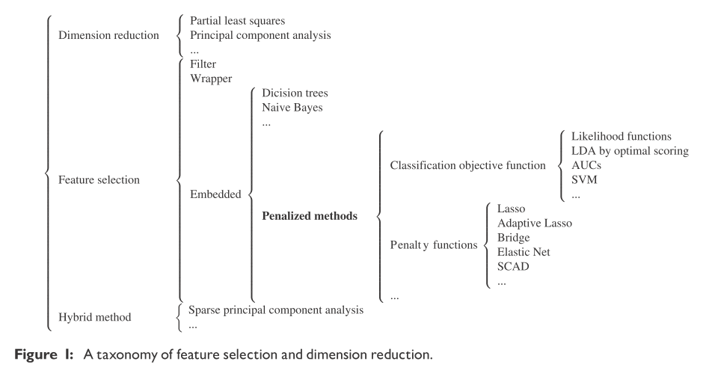

Feature selection by penalization

Slide 22
Linear Separators revisited
Binary classification can be viewed as the task of separating classes in feature space:
w^{T}x + b = 0
w^{T}x + b > 0
w^{T}x + b < 0
f(x) = sign(w^{T}x + b)

Slide 23
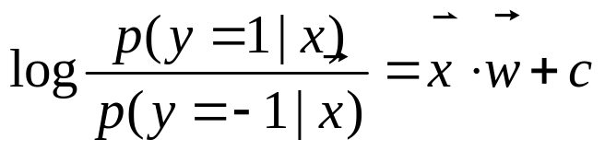
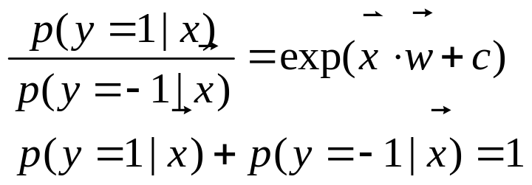
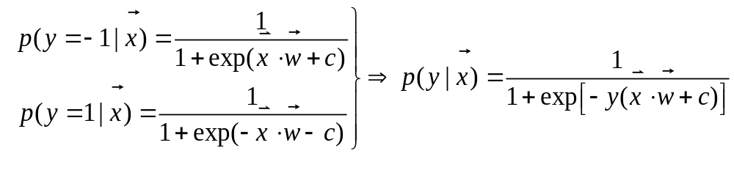
Logistic Regression Model
The log-ratio of positive class to negative class
Results

Slide 24
Logistic Regression Model
The log-ratio of positive class to negative class
Results

Slide 25
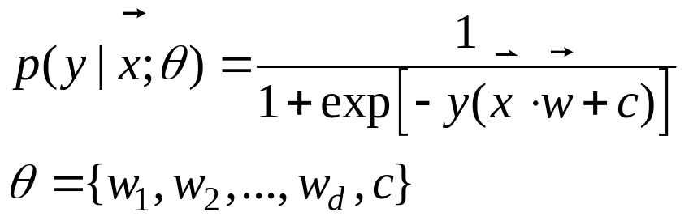

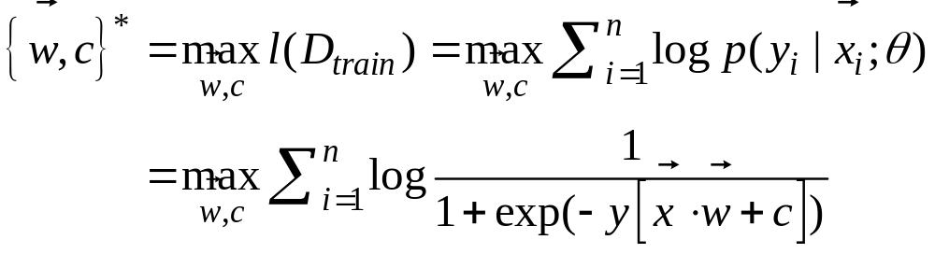
Logistic Regression Model
Assume the inputs and outputs are related in the log linear function
Estimate weights: MLE approach

Slide 26
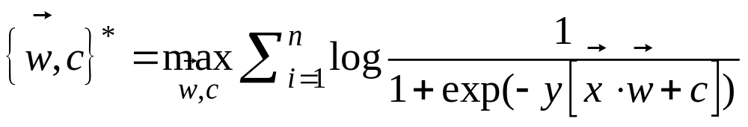
Problems with Logistic Regression
Convex objective function
Existence of Maximum Likelihood Estimates
  perfect separation
  All samples from one class

Slide 27
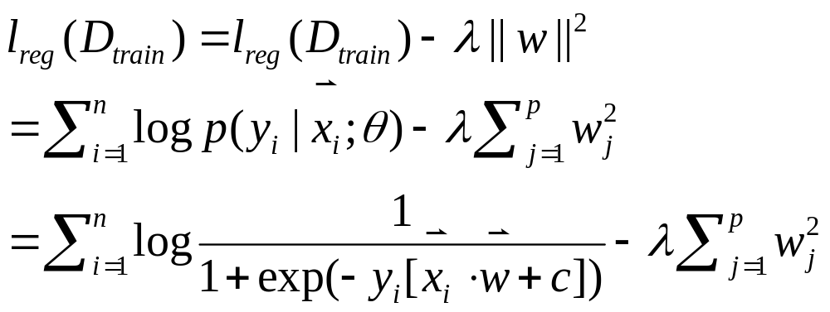
Solution: L2 Regularization
L2 Regularized log-likelihood
λ||w||² is called the L2 regularizer
  Favors small weights
  Prevents weights from becoming too large

Slide 28
Sparse Solution
What does the solution of regularized logistic regression look like ?
A sparse solution
  Most weights are small and close to zero

Slide 29
Why do We Need Sparse Solution?
Two types of solutions
  Many non-zero weights but many of them are small
  Only a small number of non-zero weights, and many of them are large
Occam’s Razor: the simpler the better
  A simpler model that fits data unlikely to be coincidence
  A complicated model that fit data might be coincidence
  Smaller number of non-zero weights
  → less amount of evidence to consider
  → simpler model
  → case 2 is preferred

Slide 30
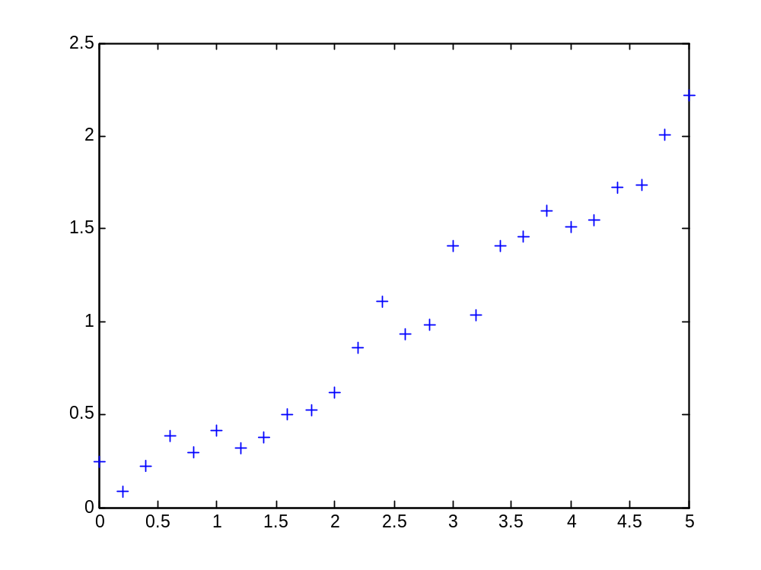
Occam’s Razer

Slide 31
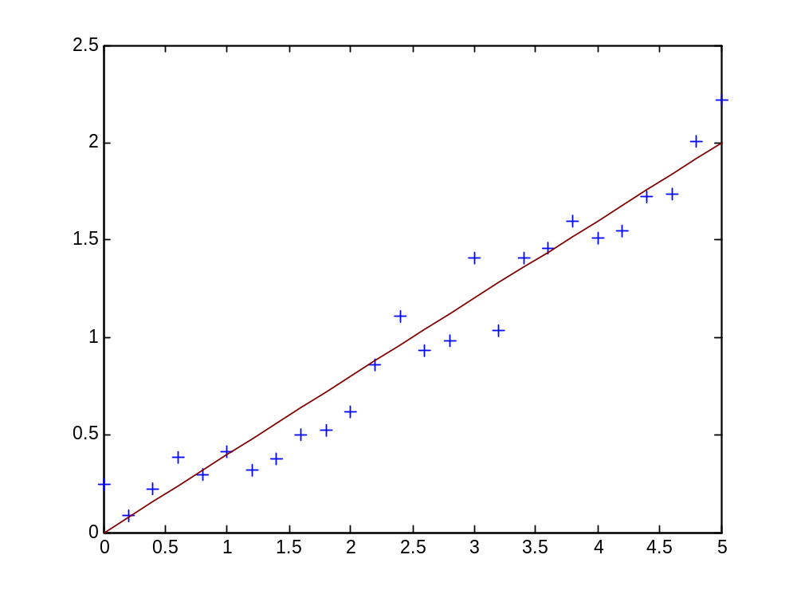
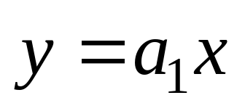
Occam’s Razer: Dimensionality = 1

Slide 32
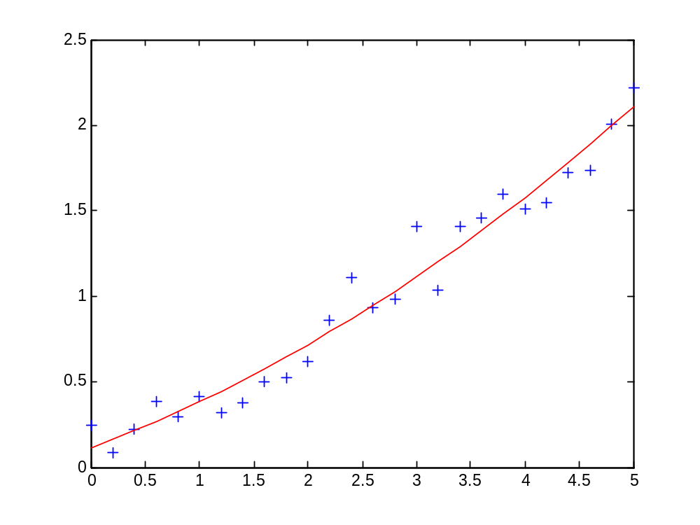
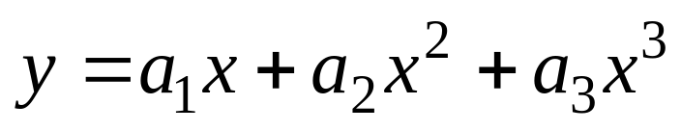
Occam’s Razer: Dimensionality = 3

Slide 33
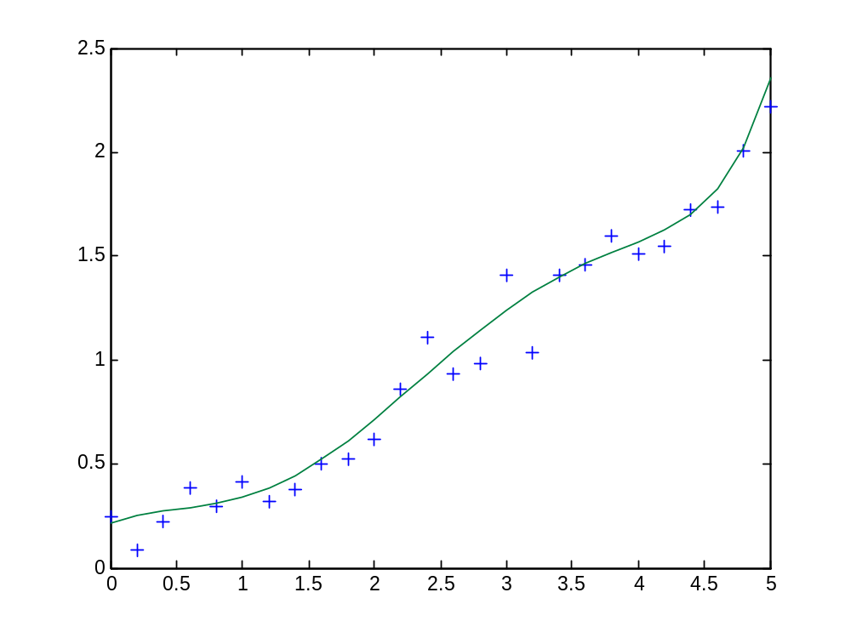
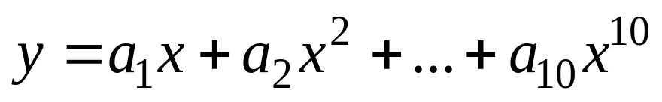
Occam’s Razor: Dimensionality = 10

Slide 34
Complexity versus Goodness of Fit
Training data
Too simple?
y
y
x
x
Too complex ?
About right ?
y
y
x
x

Slide 35
Complexity and Generalization
Score Function
e.g., classification
error
S_{test}(θ)
S_{train}(θ)
Complexity = degrees
of freedom in the model
(e.g., number of variables)
Optimal model
complexity

Slide 36
Complexity and Generalization
Score Function
e.g., classification
error
S_{test}(θ)
S_{train}(θ)
High bias
Low variance
Low bias
High variance

Slide 37
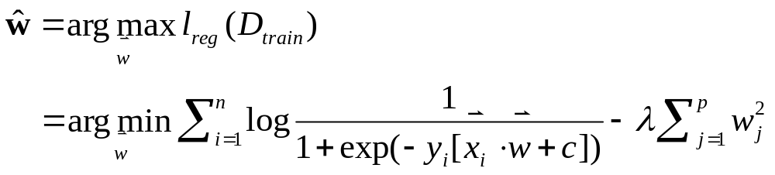
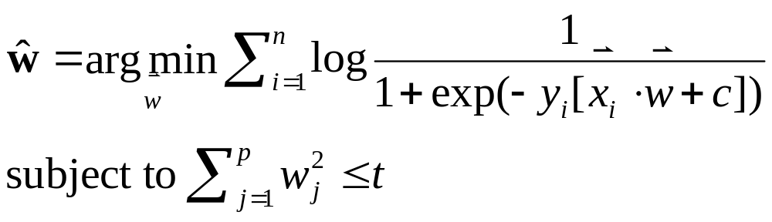
Revisited: L2 Logistic Regression
Penalize by sum-of-squares of parameters
Or

Slide 38
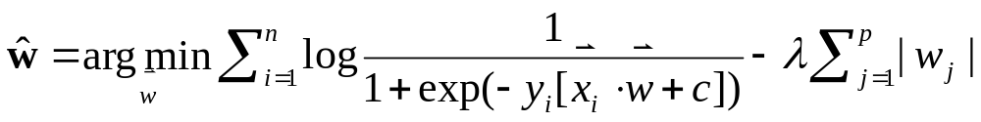
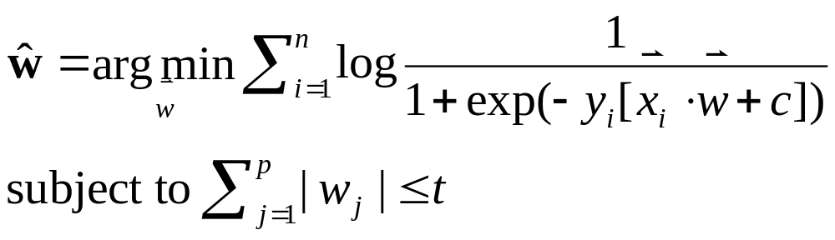
Sparse Solution: L1 (Lasso) Logistic Regression
Penalize by absolute value of parameter
or
λ|w| is called the L1 regularizer (Lasso for L1 linear regression)
  Shrinks tiny weights to zero!

Slide 39
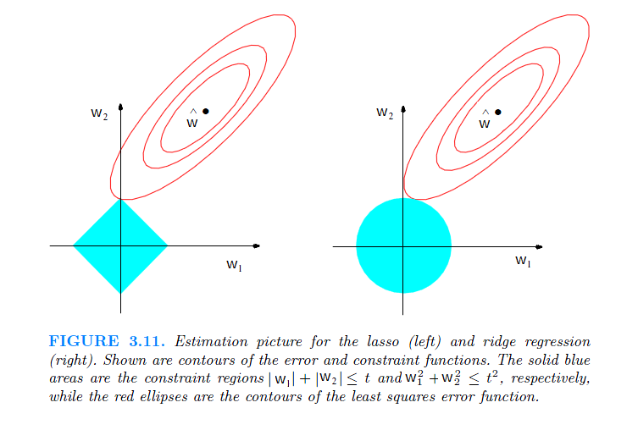
Why L1 is sparse?

Slide 40
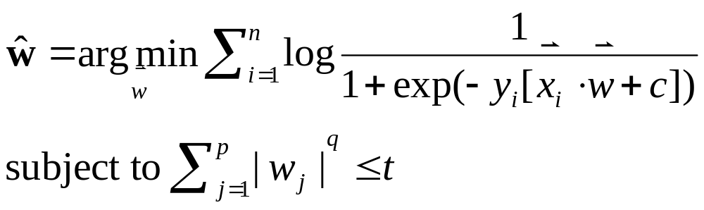
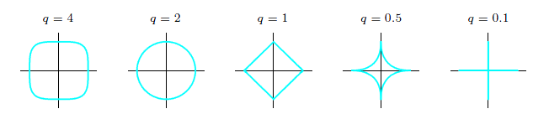
Lq regularization
Regularized by λ|w_{j}|^{q}

Slide 41
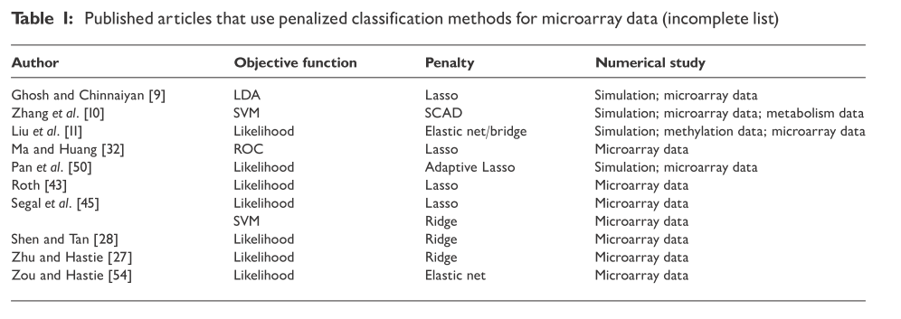
Applications of Penalization
Ridge: L2; Lasso: L1; Bridge: Lq, 0<q≤1; Adaptive Lasso: weighted L1
Elastic Net: Bridge + Ridge ; SCAD: piecewise L1+L2

Slide 42
L1 and Bridge penalty
For feature selection purpose q≤1
Bridge: Lq, 0<q≤1;
L1 is the only q being convex optimization problem → computationally feasible
In general, L1 is not variable selection consistent in the sense that the whole Lasso path may not contain the true model when sample size → ∞
For linear models with n>>p the bridge penalty with q<1 is feature selection consistent; when n<<p , under certain conditions, consistency holds too

Slide 43
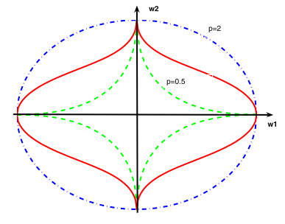
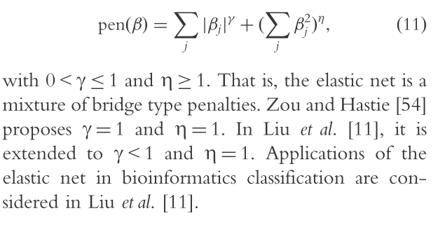
Elastic Net Penalty
For linear models, when there exist highly correlated input variables, the Lasso (L1) tends to select only one of the correlated variables (Zou and Hastie, JRSSB, 2005)
One penalty that can effectively deal with high correlations is the elastic net penalty:

Slide 44
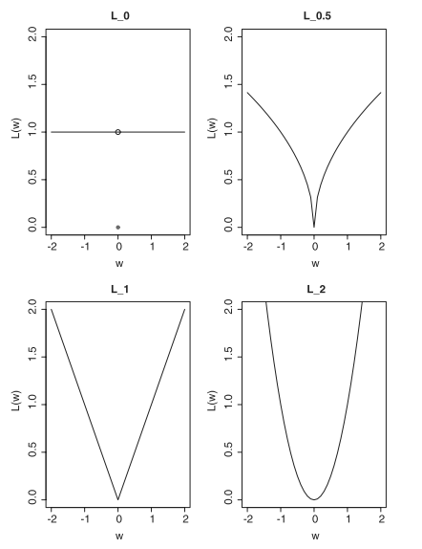
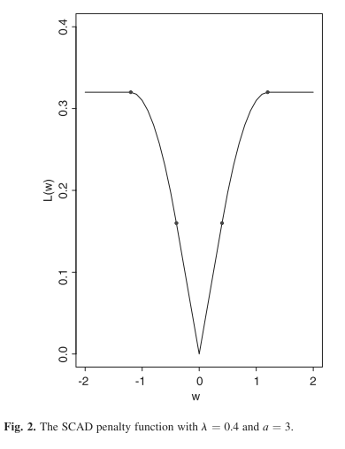
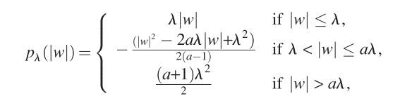
SCAD Penalty
For L1 and Elastic net, the penalty increases with |β| → biased estimates of large coefficients

Slide 45
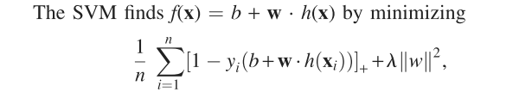
The L₁ & SCAD SVM
The objection function of SVM can be written as
A version of SVM where Ω(w)=||w||² is replaced by the L₁ norm Ω(w)=∑_{i} |w_{i}|
Also can be replaced by SCAD penalty , (Zhang 2006).
Can be considered an embedded feature selection method:
  Some weights will be drawn to zero (tend to remove redundant features)
  Difference from the regular SVM where redundant features are included
(Bi et al 2003, Zhu et al, 2003)

Slide 46
Bilevel optimization (including tuning penalty parameter)
N variables/features
Split data into 3 sets:
training, validation, and test set.
m₁
1) For each feature subset, train predictor on training data.
2) Select the feature subset, which performs best on validation data.
  Repeat and average if you want to reduce variance (cross-validation).
3) Test on test data.
M samples
m₂
m₃
Notes:
How do we determine whether or not there is performance degradation?
This is what is called a two-level of inference process. Finding the parameters of the classifier based on training data is the first level of inference. Selecting features with validation data is the second level of inference.
In practice we usually have only little or no test data, but let us conceptually imagine that we have a lot such that what we call performance on the test set is close to the true generalization error or the expected value of the test error.

Slide 47
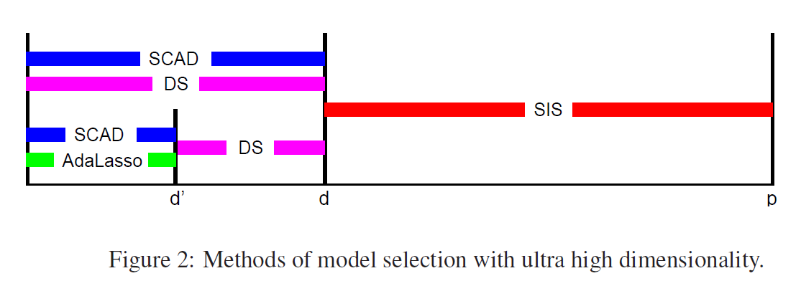
A two–step strategy for ultrahigh dimensionality
Fan, J. and Lv, J. (2008). Sure independence screening for ultrahigh dimensional feature space (with discussion). Journal of the Royal Statistical Society Series B 70, 849–911.
  Step 1: Simple univariate method to reduce p to d (d<n)
  Step 2: embedded method (regularization) to reduce d to d’

