Slide 1
Support Vector Machines

Slide 2
Linear Separators
Binary classification can be viewed as the task of separating classes in feature space:
w^{T}x + b = 0
w^{T}x + b > 0
w^{T}x + b < 0
f(x) = sign(w^{T}x + b)

Slide 3
Linear Separators
The problem in perceptron: which of the linear separators is optimal?

Slide 4
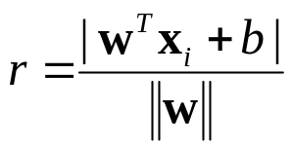
Classification Margin
Distance from example x_{i} to the separator is
Examples closest to the hyperplane are support vectors.
Margin ρ of the separator is 2* the distance between the separator and the support vector(s) from either class.
ρ
r

Slide 5
Maximum Margin Classification
Maximizing the margin is good according to intuition.
Implies that only support vectors matter; other training examples are ignorable.

Slide 6
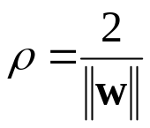
Linear SVM Mathematically
Let training set {(x_{i}, y_{i})}_{i=1..n}, x_{i}∈R^{d}, y_{i} ∈ {-1, 1} be separated by a hyperplane with margin ρ. Then for each training example (x_{i}, y_{i}):
For every support vector x_{s} the above inequality is an equality. Scale w in the equality so that ||w||* ρ/2=1
Then the margin can be expressed through (rescaled) w and b as:
And the constraints change to y_{i}(w^{T}x_{i} + b) ≥ 1
(w^{T}x_{i} + b)/||w|| ≤ - ρ/2 if y_{i} = -1
(w^{T}x_{i} + b) /||w|| ≥ ρ/2 if y_{i} = 1
⇔
y_{i}(w^{T}x_{i} + b)/||w|| ≥ ρ/2

Slide 7
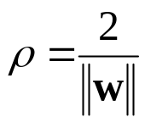
Linear SVMs Mathematically (cont.)
Then we can formulate the quadratic optimization problem:
Which can be reformulated as:
Find w and b such that
is maximized
and for all (x_{i}, y_{i}), i=1..n : y_{i}(w^{T}x_{i} + b) ≥ 1
Find w and b such that
Φ(w) = ½*||w||²=½*w^{T}w is minimized
and for all (x_{i}, y_{i}), i=1..n : y_{i} (w^{T}x_{i} + b) ≥ 1

Slide 8
Solving the Optimization Problem
Need to optimize a quadratic function subject to linear constraints.
Quadratic optimization problems are a well-known class of mathematical programming problems for which several (non-trivial) algorithms exist.
The solution involves constructing a dual problem where a Lagrange multiplier α_{i} is associated with every inequality constraint in the primal (original) problem:
Find w and b such that
Φ(w) =½*w^{T}w is minimized
and for all (x_{i}, y_{i}), i=1..n : y_{i} (w^{T}x_{i} + b) ≥ 1
Find α₁…α_{n} such that
Q(α) =Σα_{i} - ½ΣΣα_{i}α_{j}y_{i}y_{j}x_{i}^{T}x_{j} is maximized and
(1) Σα_{i}y_{i} = 0
(2) α_{i} ≥ 0 for all α_{i}

Slide 9
The Optimization Problem Solution
Given a solution α₁…α_{n} to the dual problem, solution to the primal is:
Each non-zero α_{i} indicates that corresponding x_{i} is a support vector.
Then the classifying function is (note that we don’t need w explicitly):
Notice that it relies on an inner product between the test point x and the support vectors x_{i} – we will return to this later.
Also keep in mind that solving the optimization problem involved computing the inner products x_{i}^{T}x_{j} between all training points.
w =Σα_{i}y_{i}x_{i} b = y_{k} - Σα_{i}y_{i}x_{i} ^{T}x_{k} for any α_{k} > 0
f(x) = Σα_{i}y_{i}x_{i}^{T}x + b

Slide 10
Soft Margin Classification
What if the training set is not linearly separable?
Slack variables ξ_{i} can be added to allow misclassification of difficult or noisy examples, resulting margin called soft.
ξ_{i}
ξ_{i}

Slide 11
Soft Margin Classification Mathematically
The old formulation:
Modified formulation incorporates slack variables:
Parameter C can be viewed as a way to control overfitting: it “trades off” the relative importance of maximizing the margin and fitting the training data.
Find w and b such that
Φ(w) =w^{T}w is minimized
and for all (x_{i} ,y_{i}), i=1..n : y_{i} (w^{T}x_{i} + b) ≥ 1
Find w and b such that
Φ(w) =w^{T}w + CΣξ_{i} is minimized
and for all (x_{i} ,y_{i}), i=1..n : y_{i} (w^{T}x_{i} + b) ≥ 1 – ξ_{i,} , ξ_{i} ≥ 0

Slide 12
Soft Margin Classification – Solution
Dual problem is identical to separable case (would not be identical if the 2-norm penalty for slack variables CΣξ_{i}² was used in primal objective, we would need additional Lagrange multipliers for slack variables):
Again, x_{i} with non-zero α_{i} will be support vectors.
Solution to the dual problem is:
Find α₁…α_{N} such that
Q(α) =Σα_{i} - ½ΣΣα_{i}α_{j}y_{i}y_{j}x_{i}^{T}x_{j} is maximized and
(1) Σα_{i}y_{i} = 0
(2) 0 ≤ α_{i} ≤ C for all α_{i}
Again, we don’t need to compute w explicitly for classification:
w =Σα_{i}y_{i}x_{i}
b= y_{k}(1- ξ_{k}) - Σα_{i}y_{i}x_{i}^{T}x_{k} for any k s.t. α_{k}>0
f(x) = Σα_{i}y_{i}x_{i}^{T}x + b

Slide 13
Linear SVMs: Overview
The classifier is a separating hyperplane.
Most “important” training points are support vectors; they define the hyperplane.
Quadratic optimization algorithms can identify which training points x_{i} are support vectors with non-zero Lagrangian multipliers α_{i}.
Both in the dual formulation of the problem and in the solution training points appear only inside inner products:
Find α₁…α_{N} such that
Q(α) =Σα_{i} - ½ΣΣα_{i}α_{j}y_{i}y_{j}x_{i}^{T}x_{j} is maximized and
(1) Σα_{i}y_{i} = 0
(2) 0 ≤ α_{i} ≤ C for all α_{i}
f(x) = Σα_{i}y_{i}x_{i}^{T}x + b

Slide 14
Non-linear SVMs
Datasets that are linearly separable with some noise work out great:
But what are we going to do if the dataset is just too hard?
How about… mapping data to a higher-dimensional space:
0
x
0
x
x²
0
x

Slide 15
Non-linear SVMs: Feature spaces
General idea: the original feature space can always be mapped to some higher-dimensional feature space where the training set is separable:
Φ: x → φ(x)

Slide 16
The “Kernel Trick”
The linear classifier relies on inner product between vectors K(x_{i},x_{j})=x_{i}^{T}x_{j}
If every datapoint is mapped into high-dimensional space via some transformation Φ: x → φ(x), the inner product becomes:
K(x_{i},x_{j})= φ(x_{i}) ^{T}φ(x_{j})
A kernel function is a function that is eqiuvalent to an inner product in some feature space.
Example:
2-dimensional vectors x=[x₁ x₂]; let K(x_{i},x_{j})=(1 + x_{i}^{T}x_{j})²,
Need to show that K(x_{i},x_{j})= φ(x_{i}) ^{T}φ(x_{j}):
K(x_{i},x_{j})=(1 + x_{i}^{T}x_{j})²,= 1+ x_{i1}²x_{j1}² + 2 x_{i1}x_{j1} x_{i2}x_{j2}+ x_{i2}²x_{j2}² + 2x_{i1}x_{j1} + 2x_{i2}x_{j2}=
= [1 x_{i1}² √2 x_{i1}x_{i2} x_{i2}² √2x_{i1} √2x_{i2}]^{T} [1 x_{j1}² √2 x_{j1}x_{j2} x_{j2}² √2x_{j1} √2x_{j2}] =
= φ(x_{i}) ^{T}φ(x_{j}), where φ(x) = [1 x₁² √2 x₁x₂ x₂² √2x₁ √2x₂]
Thus, a kernel function implicitly maps data to a high-dimensional space (without the need to compute each φ(x) explicitly).

Slide 17
What Functions are Kernels?
For some functions K(x_{i},x_{j}) checking that K(x_{i},x_{j})= φ(x_{i}) ^{T}φ(x_{j}) can be cumbersome.
Mercer’s theorem:
Every semi-positive definite symmetric function is a kernel
Semi-positive definite symmetric functions correspond to a semi-positive definite symmetric Gram matrix:
K(x₁,x₁) | K(x₁,x₂) | K(x₁,x₃) | … | K(x₁,x_{n})
K(x₂,x₁) | K(x₂,x₂) | K(x₂,x₃) |  | K(x₂,x_{n})
… | … | … | … | …
K(x_{n},x₁) | K(x_{n},x₂) | K(x_{n},x₃) | … | K(x_{n},x_{n})
K=

Slide 18
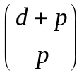
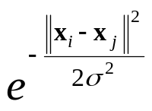
Examples of Kernel Functions
Linear: K(x_{i},x_{j})= x_{i}^{T}x_{j}
  Mapping Φ: x → φ(x), where φ(x) is x itself
Polynomial of power p: K(x_{i},x_{j})= (1+ x_{i}^{T}x_{j})^{p}
  Mapping Φ: x → φ(x), where φ(x) has dimensions
Gaussian (radial-basis function): K(x_{i},x_{j}) =
  Mapping Φ: x → φ(x), where φ(x) is infinite-dimensional: every point is mapped to a function (a Gaussian); combination of functions for support vectors is the separator.
Higher-dimensional space still has intrinsic dimensionality d, but linear separators in it correspond to non-linear separators in original space.

Slide 19
Non-linear SVMs Mathematically
Dual problem formulation:
The solution is:
Optimization techniques for finding α_{i}’s remain the same!
Find α₁…α_{n} such that
Q(α) =Σα_{i} - ½ΣΣα_{i}α_{j}y_{i}y_{j}K(x_{i}, x_{j}) is maximized and
(1) Σα_{i}y_{i} = 0
(2) α_{i} ≥ 0 for all α_{i}
f(x) = Σα_{i}y_{i}K(x_{i}, x)+ b

Slide 20
SVM applications
SVMs were originally proposed by Boser, Guyon and Vapnik in 1992 and gained increasing popularity in late 1990s.
SVMs are currently among the best performers for a number of classification tasks ranging from text to genomic data.
SVMs can be applied to complex data types beyond feature vectors (e.g. graphs, sequences, relational data) by designing kernel functions for such data.
SVM techniques have been extended to a number of tasks such as regression [Vapnik et al. ’97], principal component analysis [Schölkopf et al. ’99], etc.
Most popular optimization algorithms for SVMs use decomposition to hill-climb over a subset of α_{i}’s at a time, e.g. SMO [Platt ’99] and [Joachims ’99]
Tuning SVMs remains a black art: selecting a specific kernel and parameters is usually done in a try-and-see manner.

Slide 21
SVM vs LR vs LDA
Which data points matter?
  SVM: only support vectors matter
  LDA: All points matter
  LR: All points matter with (limited) weight
SVM vs LR
  SVM: features expanded implicitly, save computational cost
  LR: predict +1, -1 with probability, better interpretability

Slide 22
Other Representative Classifiers
Tree-based classifiers
  Decision Trees
  Random Forest, Boosting
KNN (K-nearest neighbors)
Neural Network

Slide 23
Other Representative Classifiers
Tree-based classifiers
  Decision Trees
  Random Forest, Boosting
KNN (K-nearest neighbors)
Neural Network

Slide 24
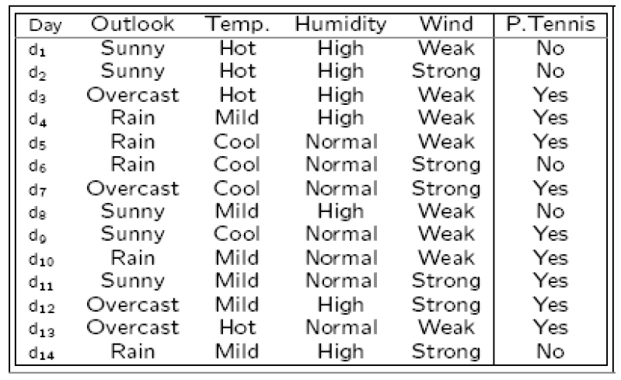
When to play tennis?
4 discrete-valued attributes
“Yes/No” classification

Slide 25

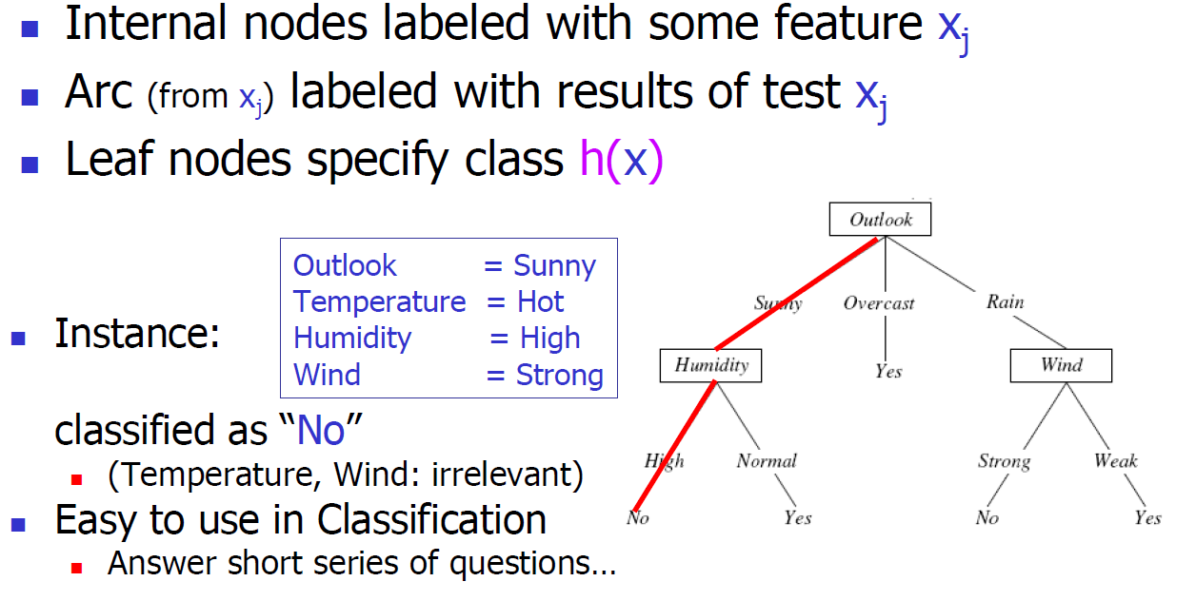
Decision Tree

Slide 26
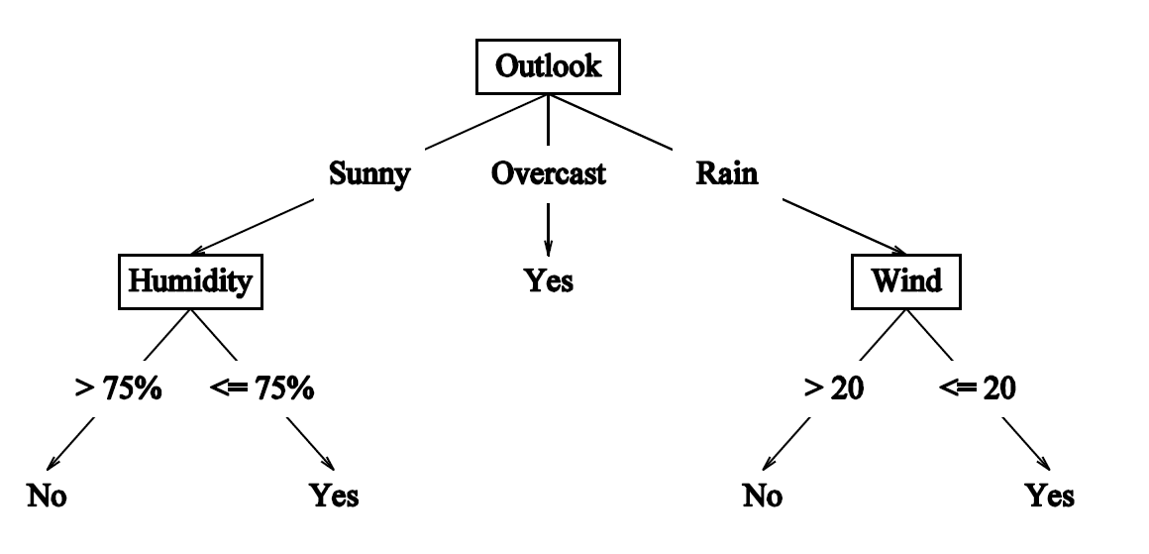
Continuous Features
If feature is continuous, internal nodes may test value against threshold

Slide 27
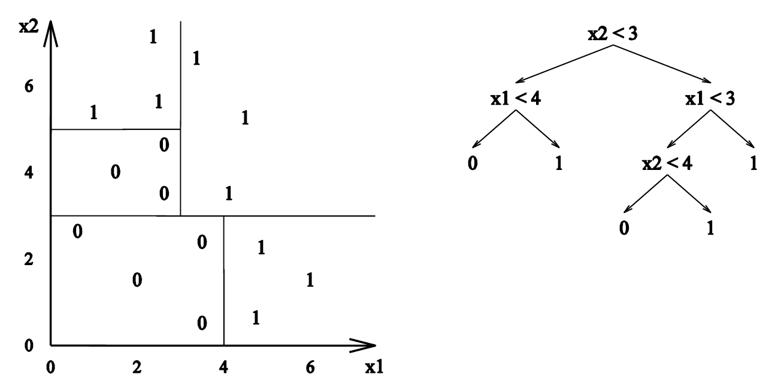
Decision Tree Decision Boundaries
Decision Trees divide the feature space into axis-parallel rectangles and label each rectangle with one of the K classes

Slide 28
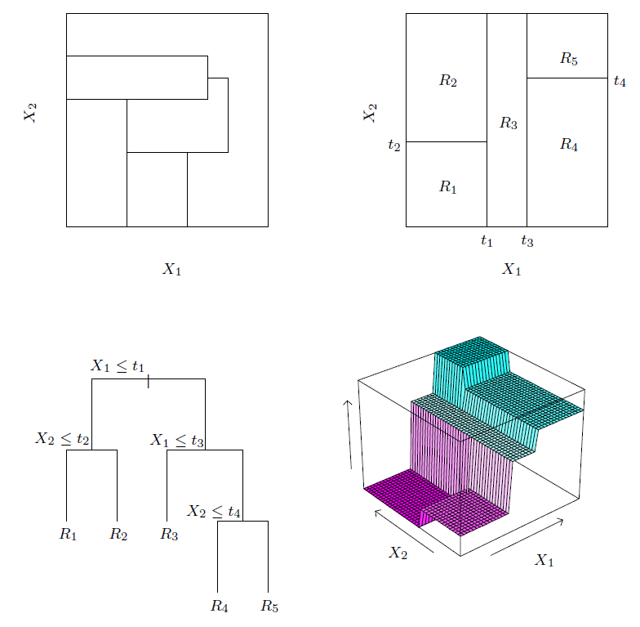
Space Partition
Top right: a partition of a two-dimensional feature space by recursive binary splitting applied to some fake data.
Top left: a general partition that cannot be obtained from recursive binary splitting.
Bottom left: the tree corresponding to the partition in the top right panel
Bottom right: a perspective plot of the prediction surface.

Slide 29
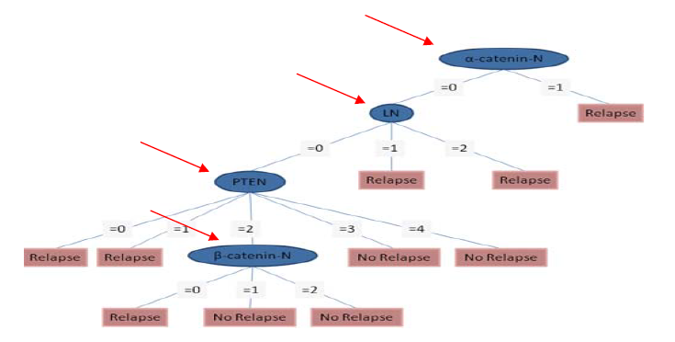
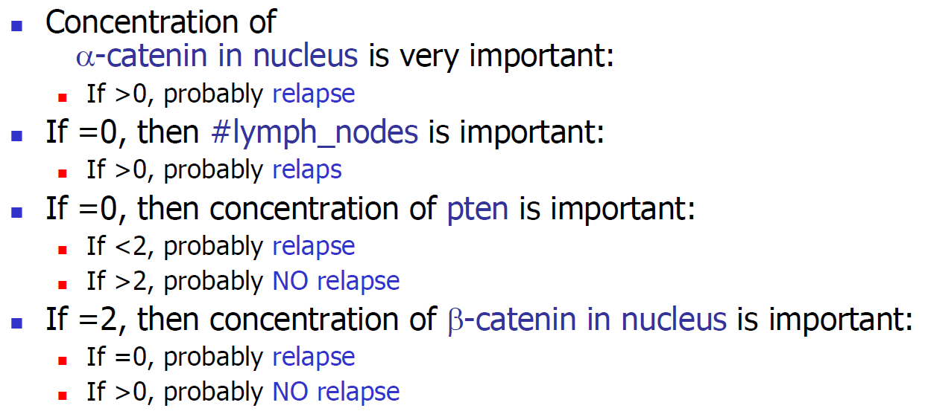
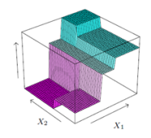


Remarks of Trees
Well known Tree implementations: CART (Classification And Regression Tree), ID3 → C4.5 → C5.0
Good interpretability
Instability
  A small change in the data can result a very different tree, due to the hierarchical nature of the tree building procedure.
Lack of smoothness
Difficulty in capturing additive structure: X1 + X2 vs X1*X2

Slide 30
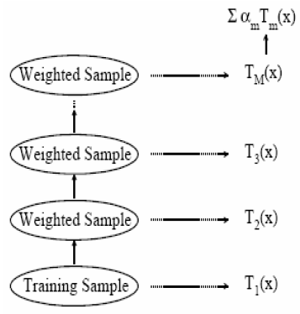
Boosting the Decision Tree
Decision trees have been known for some time, but often are unstable; a small change in the training sample can produce a large difference
Boosting the decision tree
  Give the training events misclassified under this procedure a higher weight.
  Continuing build perhaps 1000 trees and average the results.

Slide 31
Radom Forest
Random forests (Breiman, 2001) is a substantial modification of bagging that builds a large collection of de-correlated trees, and then averages them.
The authors make grand claims about the success of random forests: “most accurate”,“ most interpretable” and the like.
On many problems the performance of random forests is very similar to boosting, and they are simpler to train and tune. As a consequence, random forests are popular, and are implemented in a variety of packages
  R package: randomForest
  http://www.math.usu.edu/~adele/forests/

Slide 32
Other Representative Classifiers
Tree-based classifiers
  Decision Trees
  Random Forest, Boosting
KNN (K-nearest neighbors)
Neural Network

Slide 33
Basic k-nearest neighbor (KNN) classification
Training method:
  Save the training examples
At prediction time:
  Determine parameter k
  Find the k training examples (x₁,y₁),…(x_{k},y_{k}) that are closest to the test example x
  Predict the most frequent class among those y_{i}’s.
Example: http://cgm.cs.mcgill.ca/~soss/cs644/projects/simard/
Properties:
  A “lazy” classifier. No training.
  Feature selection and distance measure are crucial.

Slide 34
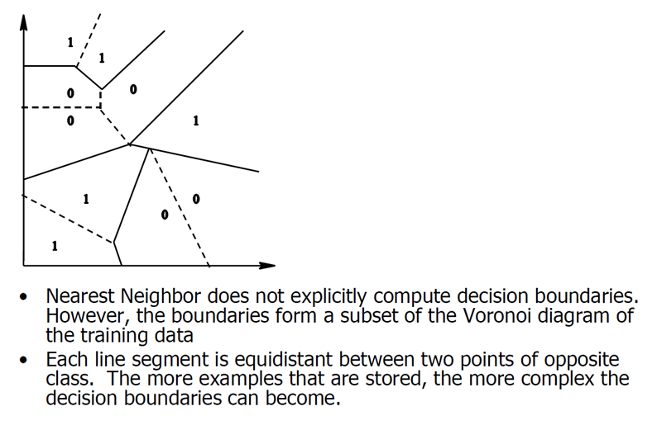
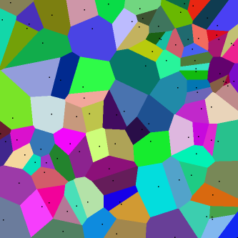
Decision Boundaries of 1-NN: the Voronoi Diagram

Slide 35
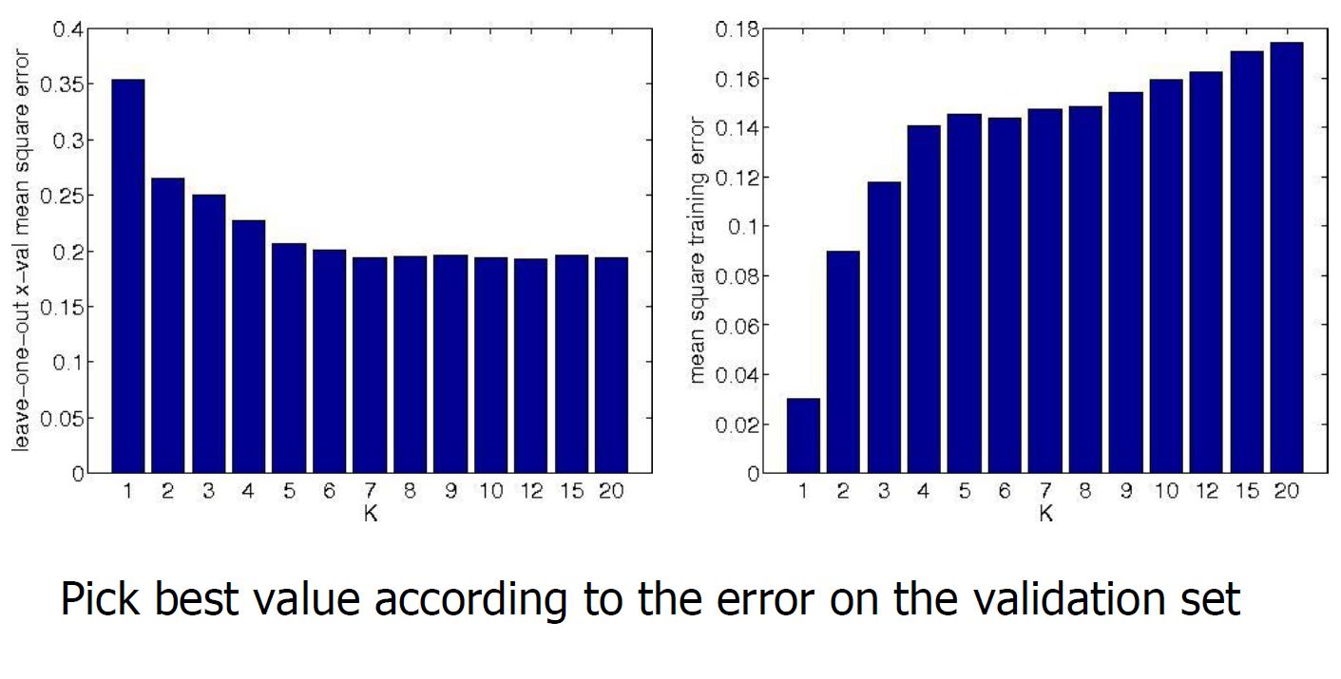
Picking K
Value of k is typically odd to avoid ties
Use V-fold cross validation: pick the one that minimizes cross validation error.

Slide 36
Normalizing attribute values
Distance could be dominated by some attributes with large numbers:
  Ex: features: age, income
  Original data: x₁=(35, 76K), x₂=(36, 80K), x₃=(70, 79K)
  Assume: age in [0,100], income in [0, 200K]
  After normalization:
  x₁=(0.35, 0.38), x₂=(0.36, 0.40), x₃ = (0.70, 0.395).

Slide 37
K-NN and irrelevant features
+
+
+
o
?
o
o
o
o
o
+
+
o
+
o
o
o
o
o
+
o
o
o
o
o
o
+

Slide 38
K-NN and irrelevant features
+
o
+
?
o
o
o
+
o
o
o
o
o
o
+
o
+
+
+
o
o
+
o
o
o
o
o

Slide 39
The Choice of Features
Imagine there are 100 features, and only 2 of them are relevant to the target label.
kNN is easily misled in high-dimensional space.
➔ Feature weighting or feature selection

Slide 40
Feature weighting
Stretch j-th axis by weight w_{j},
Use cross-validation to automatically choose weights w₁, …, w_{n}
Setting w_{j} to zero eliminates this dimension altogether.
+
o
+
?
o
o
o
+
o
o
o
o
+
o
o
o
+
o
+
o
+
o
+
o
o
o
o

Slide 41
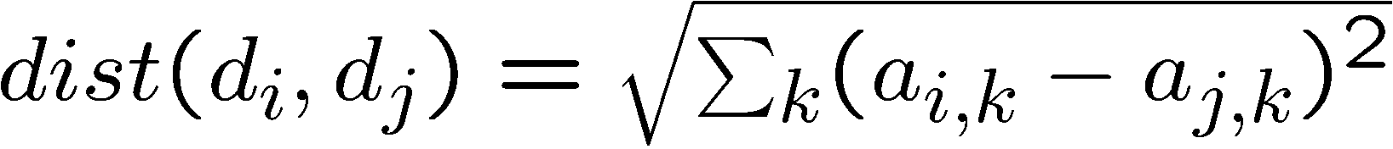
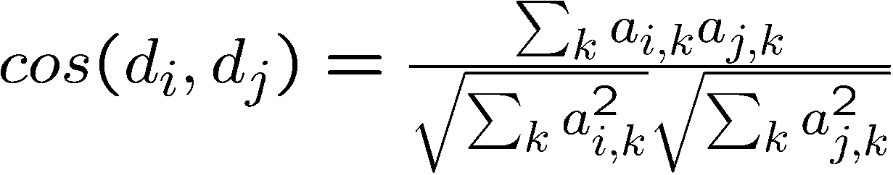
Similarity measure
Euclidean distance:
Weighted Euclidean distance:
Similarity measure: cosine

Slide 42
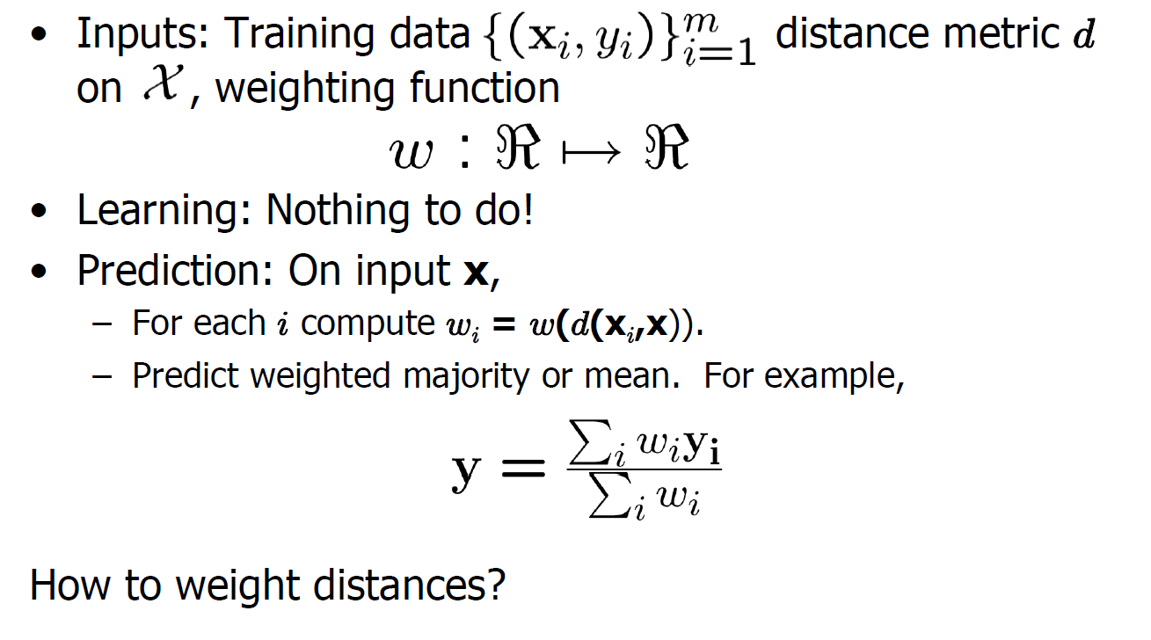
Weighted kNN

Slide 43
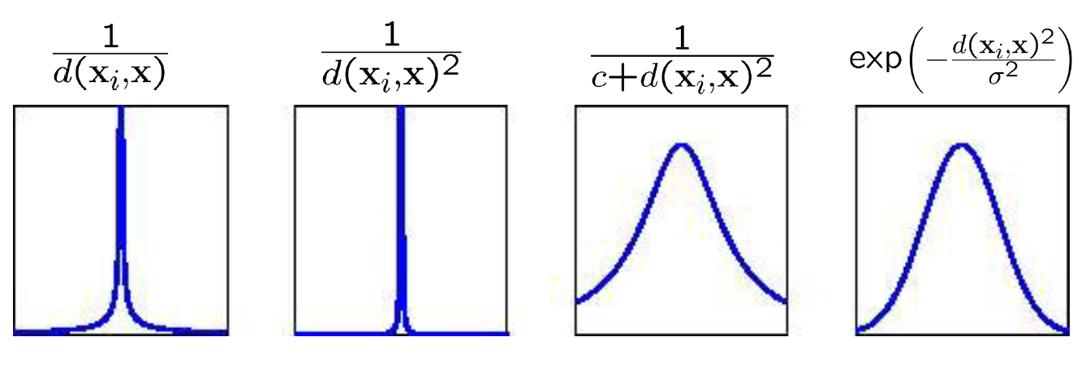
Some weighting functions

Slide 44
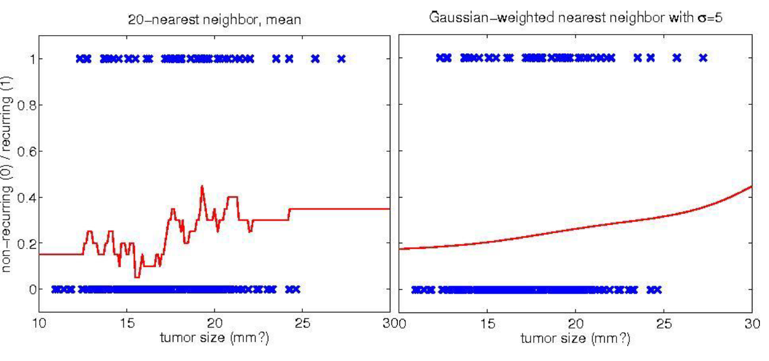
Example: Gaussian weighting

Slide 45
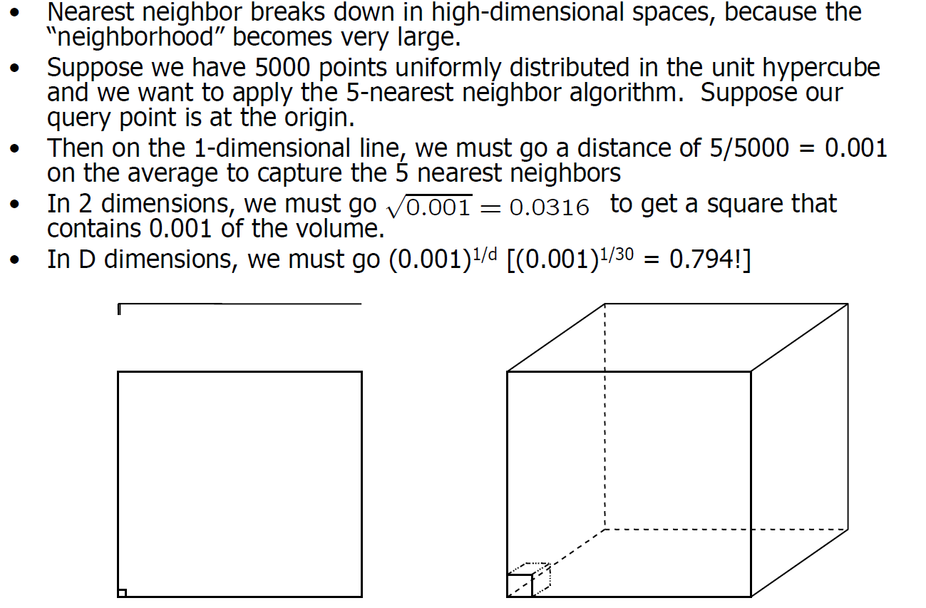
The Curse of Dimensionality

Slide 46
Summary of kNN
Strengths:
  Simplicity (conceptual)
  Efficiency at training: no training
  Handling multi-class
  Very flexible decision boundaries
Weakness:
  Theoretical validity
  It is not clear which types of distance measure
  Irrelevant features must be eliminated
  typically cannot handle more than 30 features
  computational costs: memory to store all training samples; and testing-time: need to calculate all distances

Slide 47
Other Representative Classifiers
Tree-based classifiers
  Decision Trees
  Random Forest, Boosting
KNN (K-nearest neighbors)
Neural Network

Slide 48
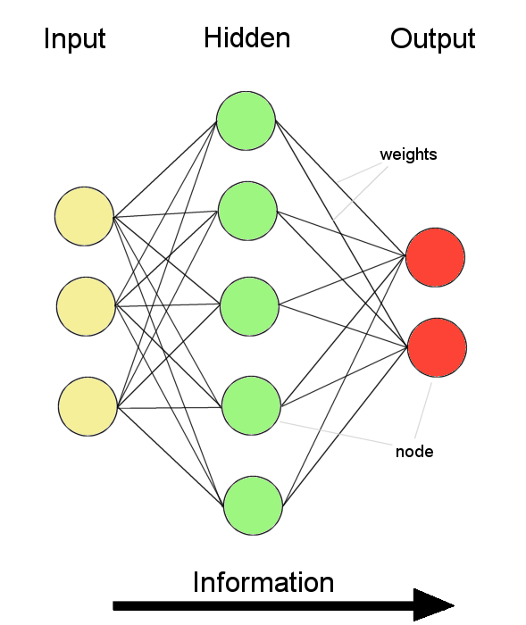
Artificial Neural Network
Information flow is unidirectional
  Data is presented to Input layer
  Passed on to Hidden Layer
  Passed on to Output layer
Information is distributed
Information processing is parallel
Internal representation (interpretation) of data

Slide 49
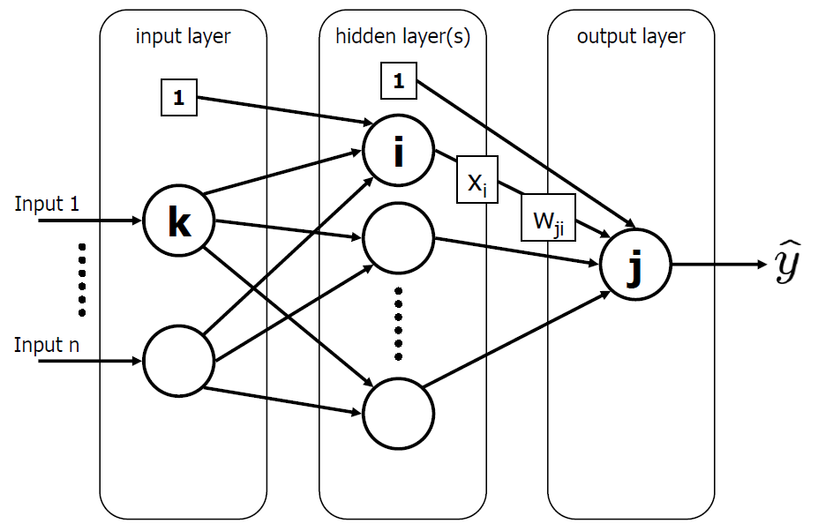
Feed-forward (neural) network

Slide 50
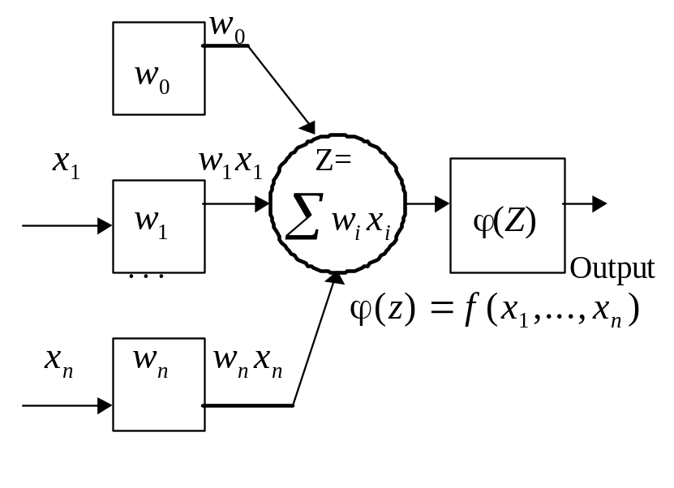








Artificial Neuron
A neuron has a set of n synapses associated to the inputs. Each of them is characterized by a weight .
A signal at the i^{th} input is multiplied (weighted) by the weight
The weighted input signals are summed. Thus, a linear combination of the input signals is obtained. A "free weight" (or bias) , which does not correspond to any input, is added to this linear combination and this forms a weighted sum .
A (nonlinear) activation function φ is applied to the weighted sum. A value of the activation function is the neuron's output.
x₁
w₁
x₂
y
w₂
x_{n}
w_{n}

Slide 51
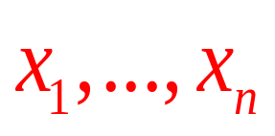
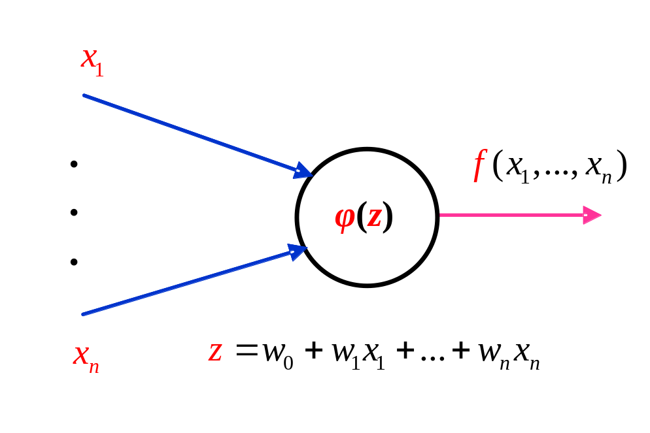
A Neuron
Neurons’ functionality is determined by the nature of its activation function, that will specify its main properties, its plasticity and flexibility, its ability to approximate a function to be learned
are the inputs, f is a function to be learned
φ is the activation function
Z is the weighted sum

Slide 52



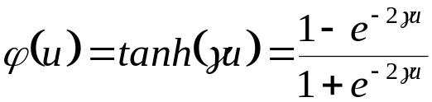
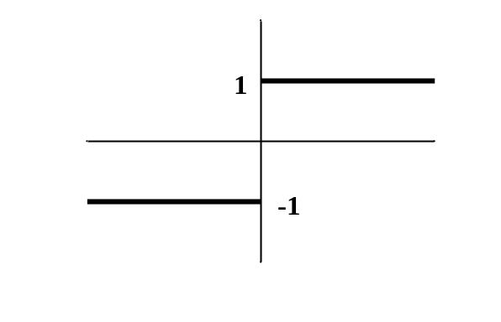
Artificial Neuron: Classical Activation Functions
Linear activation
Logistic activation
1
z
0
z
Threshold activation
Hyperbolic tangent activation
One simple perctron
1
z
0
z
-1

Slide 53
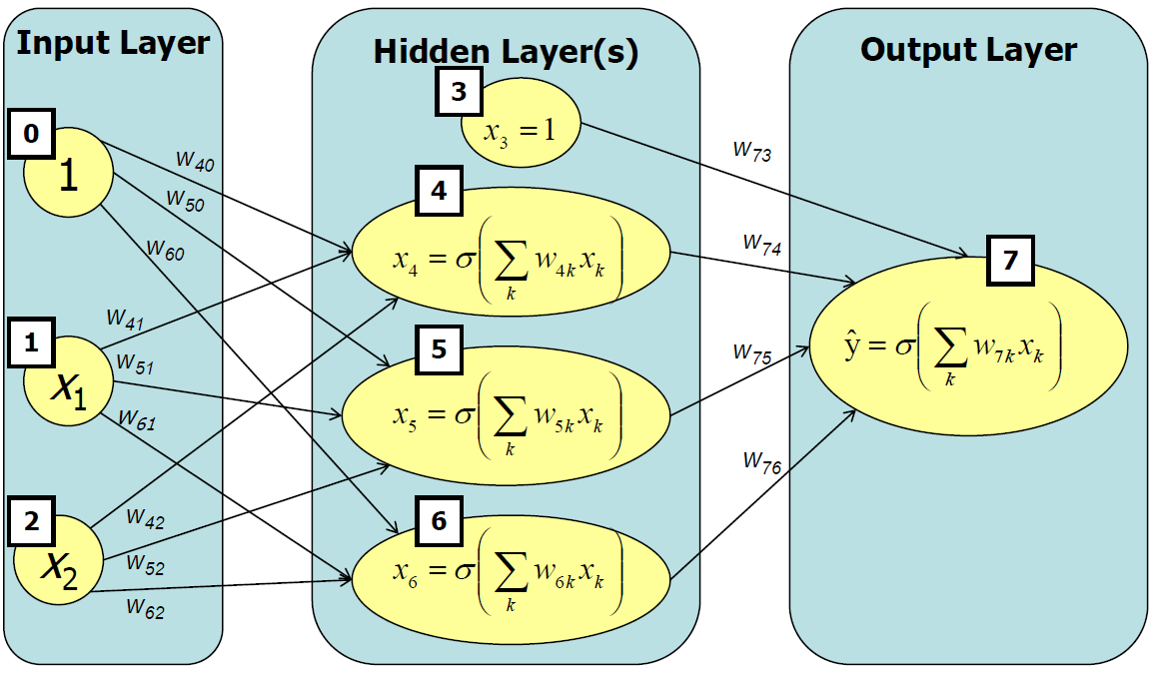
A 1-HIDDEN LAYER NET

Slide 54
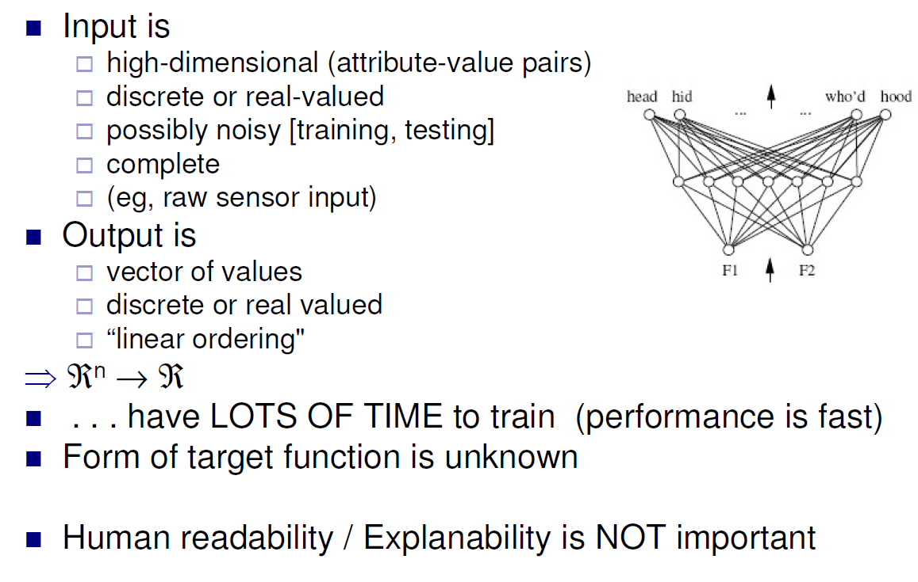
When to Consider Neural Networks

Slide 55
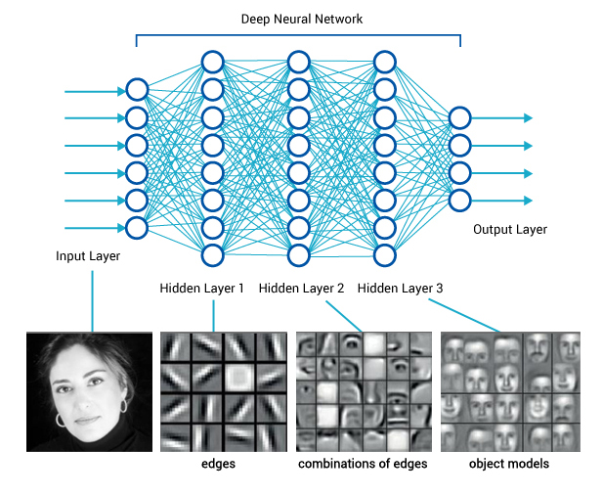
Deep Neural Network (Deep Learning)

Slide 56
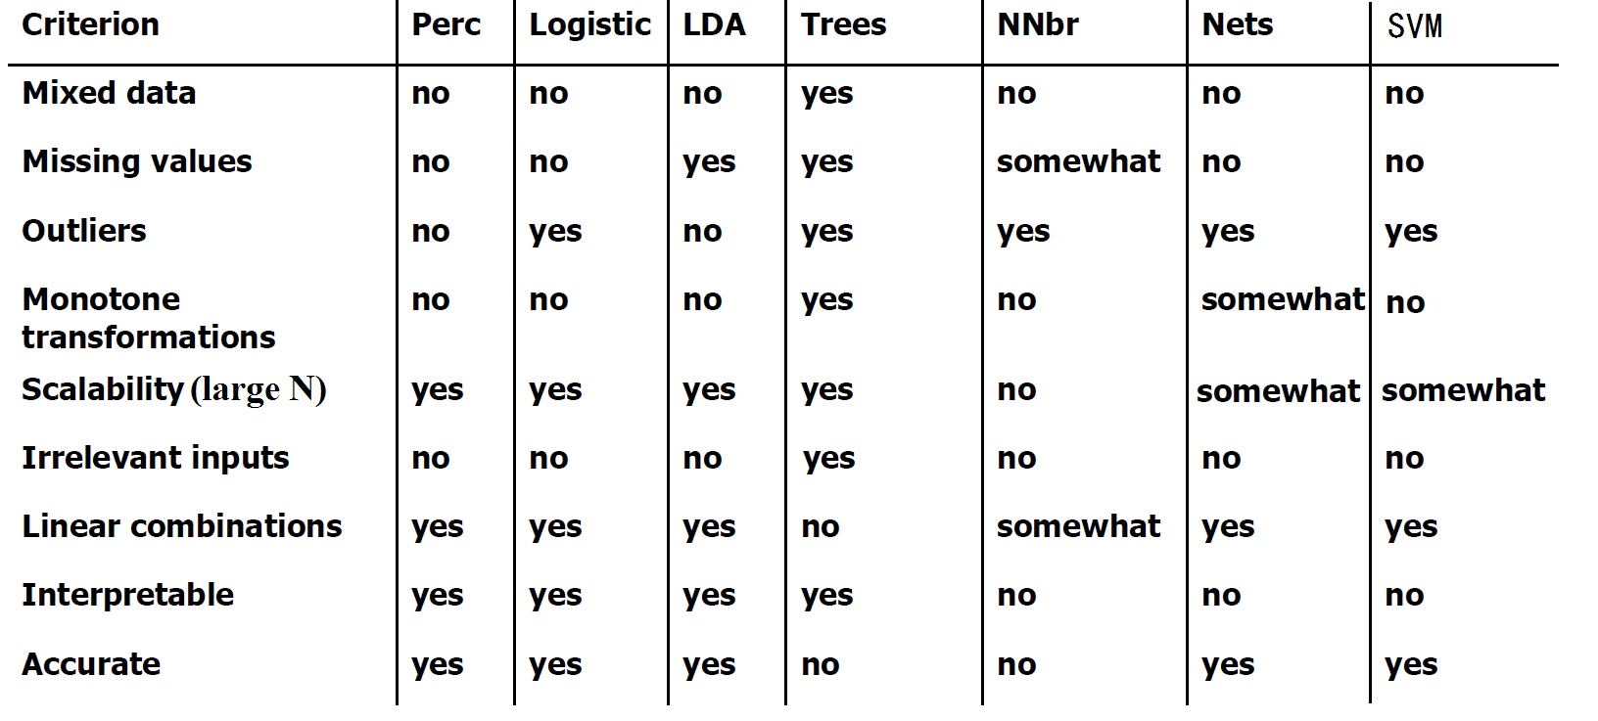
Summary of Representative Classifiers

Slide 57
R Packages
Linear models with regularization (feature selection): glmnet
  https://cran.r-project.org/web/packages/glmnet/index.html
SVM: e1071
  https://cran.r-project.org/web/packages/e1071/index.html
Trees: rpart
  https://cran.r-project.org/web/packages/rpart/index.html
Random Forest: randomForest
  https://cran.r-project.org/web/packages/randomForest/index.html
Boosting: gbm
  https://cran.r-project.org/web/packages/gbm/
K-Nearest Neighbor: knn
  https://cran.r-project.org/web/packages/kknn
Neural Network: nnet
  https://cran.r-project.org/web/packages/nnet/index.html
Deep learning: http://deeplearning.net/software_links/

