Slide 1

Final Project –[Naïve Bayes Classifier]
[Harshvardhan Sawal – hc655]
[Ankit Chaudhary – ac957]

Slide 2
Project Topic
Naïve Bayes Classifier

Slide 3


Solution Highlights
Describe how you implemented it
What APIs you have you used and what functions you have written
Any data structure that you have used for efficiency

Slide 4
Dataset Description
Adult
https://archive.ics.uci.edu/ml/datasets/adult
3.8 MB
Characteristics
How you used it for this problem

Slide 5
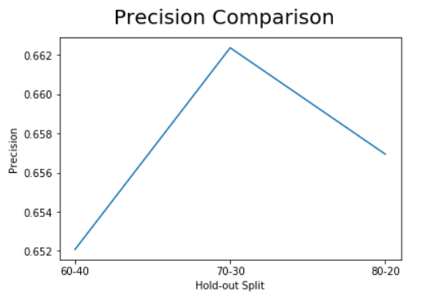
Results
Y- axis: precision, x axis: hold out split

Slide 6
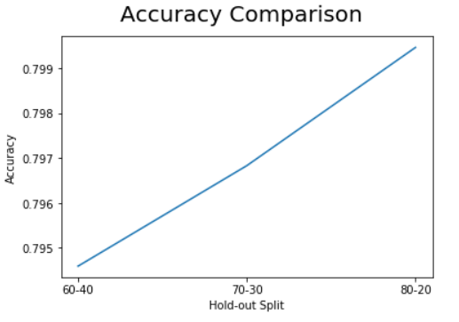
Y- axis: accuracy, x axis: hold out split

Slide 7
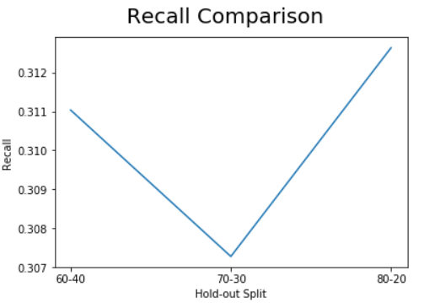
Y- axis: recall, x axis: hold out split

Slide 8

Conclusion
If the group has multiple students, describe who did what
What have you learnt
What were some of the pain points.

