Slide 1
linear regression

Slide 2
Linear regression
In correlation, the two variables are treated as equals. In regression, one variable is considered independent (=predictor) variable (X) and the other the dependent (=outcome) variable Y.

Slide 3
What is “Linear”?
Remember this:
Y=mX+B?
m
B

Slide 4
What’s Slope?
A slope of 2 means that every 1-unit change in X yields a 2-unit change in Y.

Slide 5
Prediction
If you know something about X, this knowledge helps you predict something about Y. (Sound familiar?…sound like conditional probabilities?)

Slide 6
Predicted value for an individual…
y_{i}= α + β*x_{i} + random error_{i}
Fixed – exactly on the line
Follows a normal distribution

Slide 7
Assumptions (or the fine print)
Linear regression assumes that…
  1. The relationship between X and Y is linear
  2. Y is distributed normally at each value of X
  3. The variance of Y at every value of X is the same (homogeneity of variances)
  4. The observations are independent

Slide 8
The standard error of Y given X is the average variability around the regression line at any given value of X. It is assumed to be equal at all values of X.
Sy/x
Sy/x
Sy/x
Sy/x
Sy/x
Sy/x

Slide 9


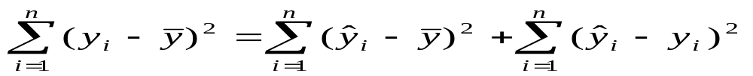
Regression Picture
y_{i}
C
A
B
y
B
A
C
y_{i}
*Least squares estimation gave us the line (β) that minimized C²
x
R²=SSreg/SStotal
A² B² C²
SS_{total}
Total squared distance of observations from naïve mean of y
Total variation
SS_{reg}
Distance from regression line to naïve mean of y
Variability due to x (regression)
SS_{residual}
Variance around the regression line
Additional variability not explained by x—what least squares method aims to minimize

Slide 10
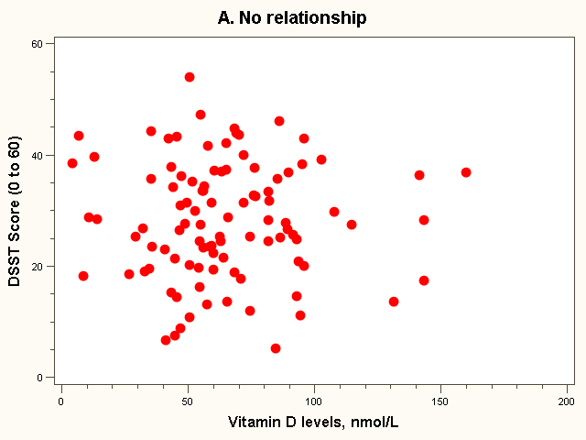
Dataset 1: no relationship

Slide 11
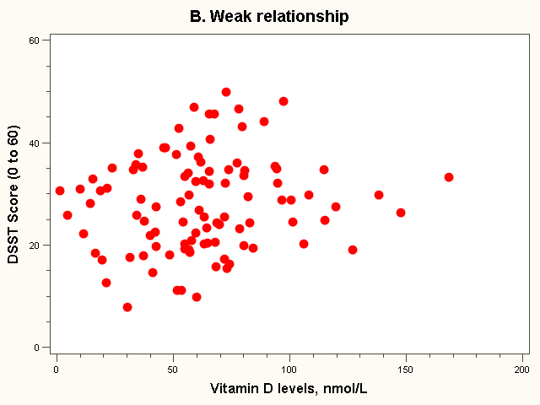
Dataset 2: weak relationship

Slide 12
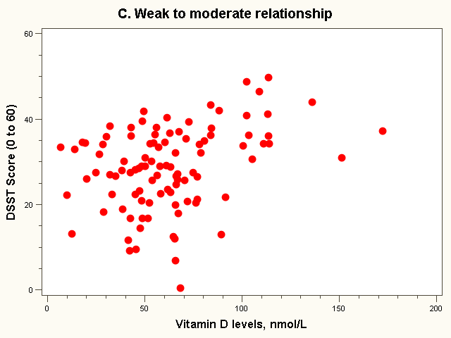
Dataset 3: weak to moderate relationship

Slide 13
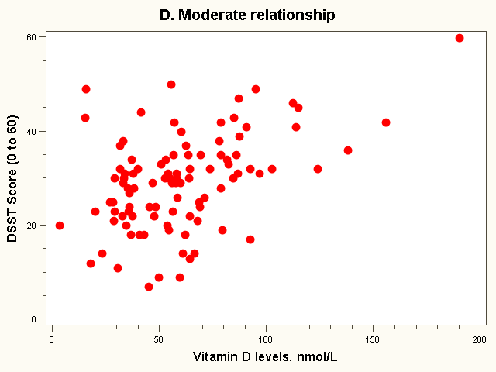
Dataset 4: moderate relationship

Slide 14
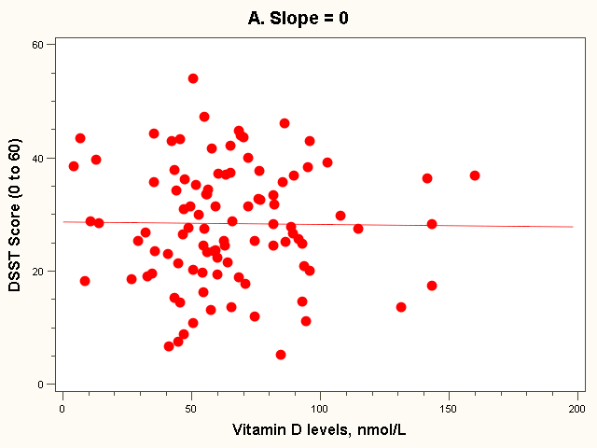
The “Best fit” line
Regression equation:
E(Yi) = 28 + 0*vit Di (in 10 nmol/L)

Slide 15
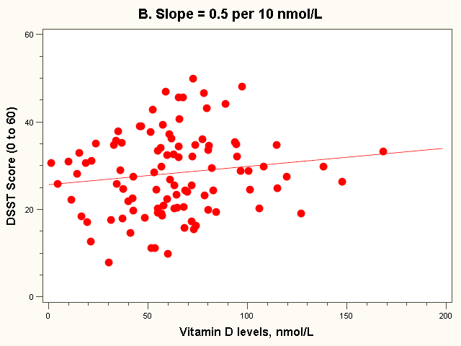
The “Best fit” line
Note how the line is a little deceptive; it draws your eye, making the relationship appear stronger than it really is!
Regression equation:
E(Yi) = 26 + 0.5*vit Di (in 10 nmol/L)

Slide 16
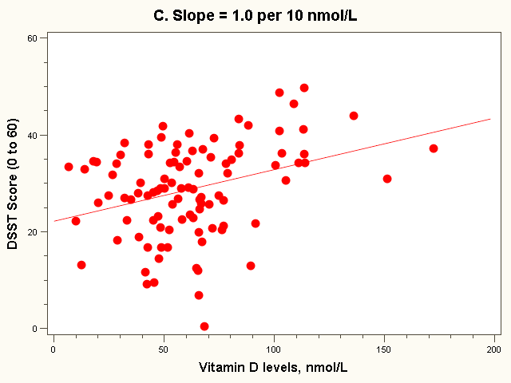
The “Best fit” line
Regression equation:
E(Yi) = 22 + 1.0*vit Di (in 10 nmol/L)

Slide 17
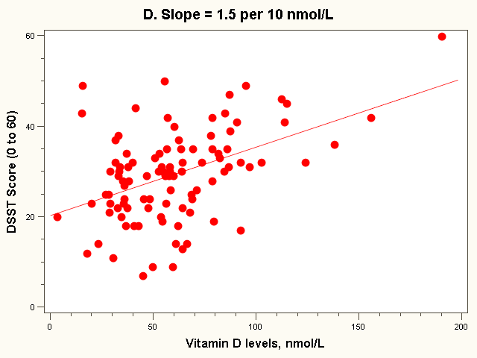
The “Best fit” line
Regression equation:
E(Yi) = 20 + 1.5*vit Di (in 10 nmol/L)
Note: all the lines go through the point (63, 28)!

Slide 18
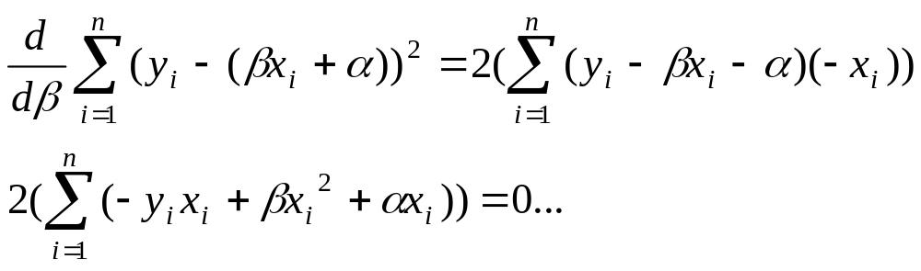
Estimating the intercept and slope: least squares estimation
** Least Squares Estimation
A little calculus….
What are we trying to estimate? β, the slope, from
What’s the constraint? We are trying to minimize the squared distance (hence the “least squares”) between the observations themselves and the predicted values , or (also called the “residuals”, or left-over unexplained variability)
Differencei = yi – (βx + α) Differencei² = (yi – (βx + α)) ²
Find the β that gives the minimum sum of the squared differences. How do you maximize a function? Take the derivative; set it equal to zero; and solve. Typical max/min problem from calculus….
From here takes a little math trickery to solve for β…

Slide 19
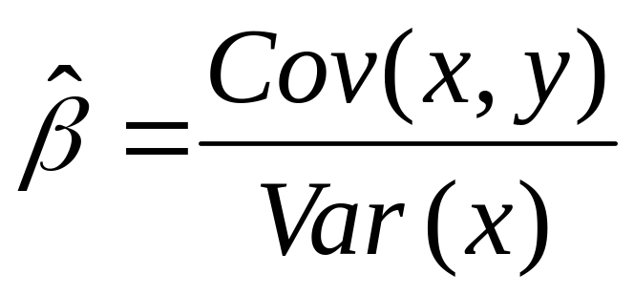
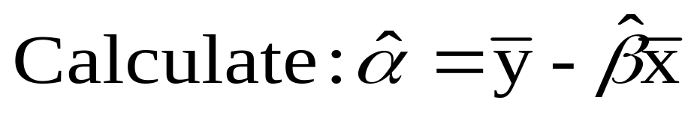
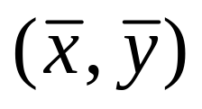
Resulting formulas…
Slope (beta coefficient) =
Intercept=
Regression line always goes through the point:

Slide 20
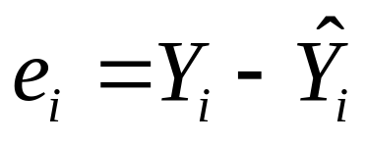
Residual Analysis: check assumptions
The residual for observation i, e_{i}, is the difference between its observed and predicted value
Check the assumptions of regression by examining the residuals
  Examine for linearity assumption
  Examine for constant variance for all levels of X (homoscedasticity)
  Evaluate normal distribution assumption
  Evaluate independence assumption
Graphical Analysis of Residuals
  Can plot residuals vs. X

Slide 21
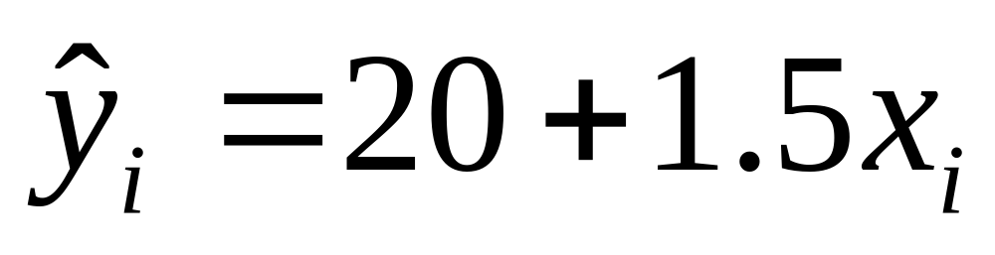
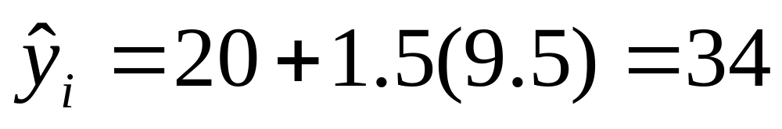
Predicted values…
For Vitamin D = 95 nmol/L (or 9.5 in 10 nmol/L):

Slide 22
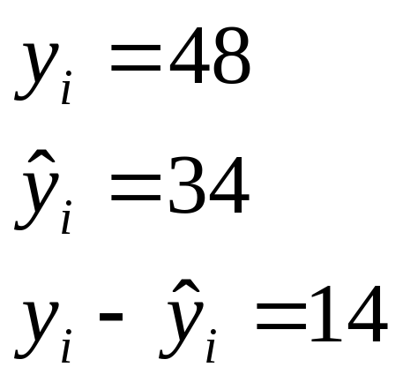
Residual = observed - predicted
X=95 nmol/L
34

Slide 23

Residual Analysis for Linearity
Y
Y
x
x
residuals
x
x
residuals
Not Linear
✓
Linear
Slide from: Statistics for Managers Using Microsoft® Excel 4th Edition, 2004 Prentice-Hall

Slide 24

Residual Analysis for Independence
Not Independent
✓
Independent
residuals
X
residuals
X
residuals
X
Slide from: Statistics for Managers Using Microsoft® Excel 4th Edition, 2004 Prentice-Hall

Slide 25
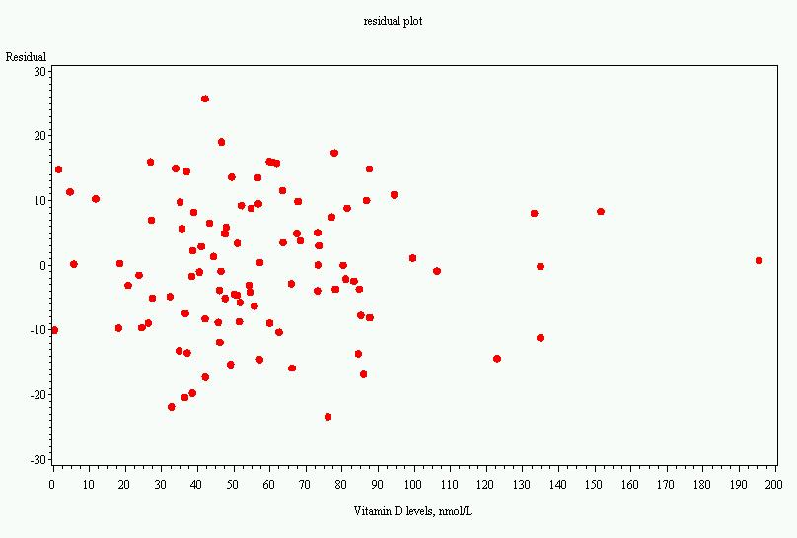
Residual plot, dataset 4

Slide 26
Multiple linear regression…
What if age is a confounder here?
  Older men have lower vitamin D
  Older men have poorer cognition
“Adjust” for age by putting age in the model:
  DSST score = intercept + slope₁xvitamin D + slope₂ xage

Slide 27
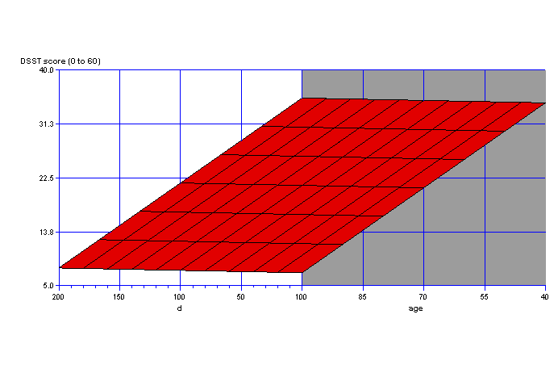
Fit a plane rather than a line…
On the plane, the slope for vitamin D is the same at every age; thus, the slope for vitamin D represents the effect of vitamin D when age is held constant.

Slide 28
Multiple Linear Regression
More than one predictor…
E(y)= α + β₁*X + β₂ *W + β₃ *Z…
Each regression coefficient is the amount of change in the outcome variable that would be expected per one-unit change of the predictor, if all other variables in the model were held constant.

Slide 29
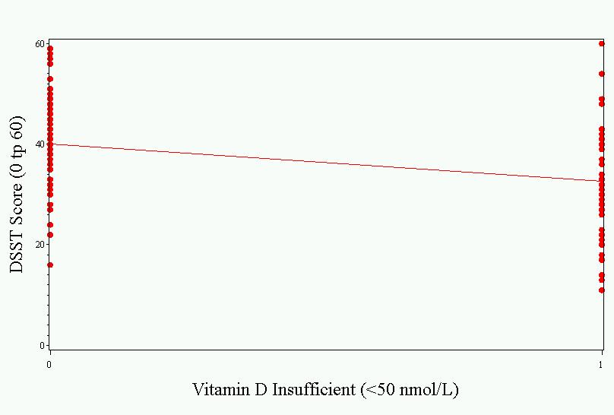
As a linear regression…
Intercept represents the mean value in the sufficient group.
Slope represents the difference in means between the groups. Difference is significant.
Parameter ````````````````Standard
Variable Estimate Error t Value Pr > |t|
Intercept 40.07407 1.47511 27.17 <.0001
insuff -7.53060 2.17493 -3.46 0.0008

Slide 30
Other types of multivariate regression
Multiple linear regression is for normally distributed outcomes
Logistic regression is for binary outcomes

Slide 31
Common multivariate regression models.
Outcome (dependent variable) | Example outcome variable | Appropriate multivariate regression model | Example equation | What do the coefficients give you?
Continuous | Blood pressure | Linear regression | blood pressure (mmHg) = α + βsalt*salt consumption (tsp/day) + βage*age (years) + βsmoker*ever smoker (yes=1/no=0) | slopes—tells you how much the outcome variable increases for every 1-unit increase in each predictor.
Binary | High blood pressure (yes/no) | Logistic regression | ln (odds of high blood pressure) = α + βsalt*salt consumption (tsp/day) + βage*age (years) + βsmoker*ever smoker (yes=1/no=0) | odds ratios—tells you how much the odds of the outcome increase for every 1-unit increase in each predictor.

Slide 32
Overfitting
In multivariate modeling, you can get highly significant but meaningless results if you put too many predictors in the model.
The model is fit perfectly to the quirks of your particular sample, but has no predictive ability in a new sample.

Slide 33
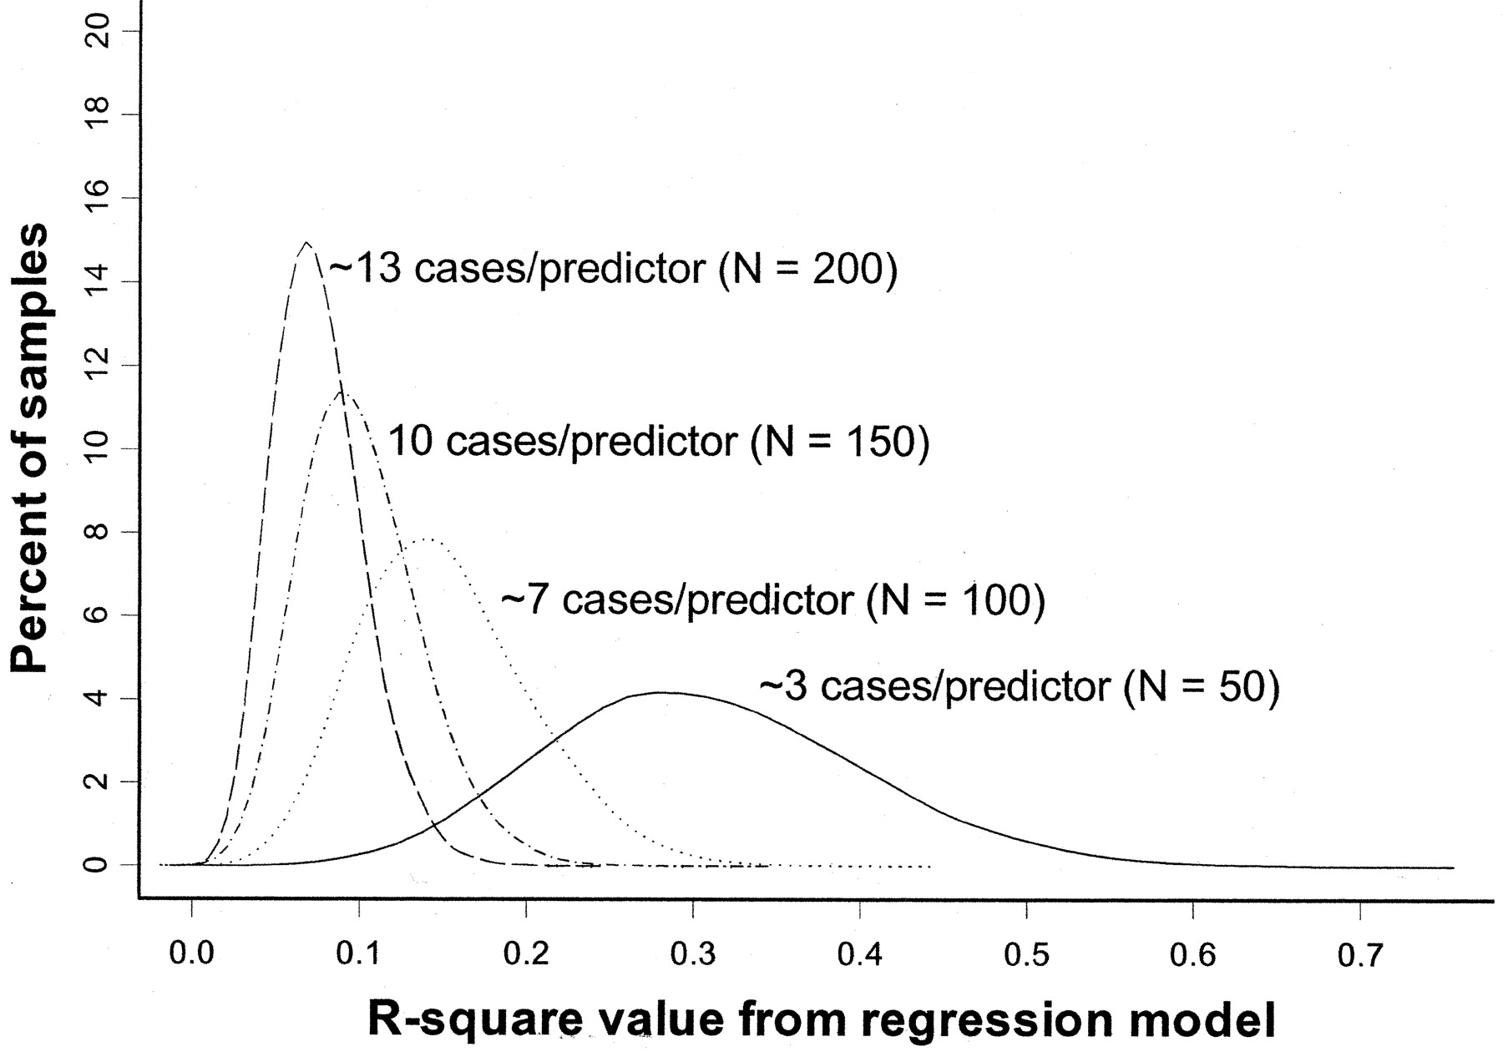
Overfitting
Rule of thumb: You need at least 10 subjects for each additional predictor variable in the multivariate regression model.
Pure noise variables still produce good R² values if the model is overfitted. The distribution of R² values from a series of simulated regression models containing only noise variables.
(Figure 1 from: Babyak, MA. What You See May Not Be What You Get: A Brief, Nontechnical Introduction to Overfitting in Regression-Type Models. Psychosomatic Medicine 66:411-421 (2004).)

