Slide 1
E-retail factors for customer activation and retention
A case study from Indian e-commerce customers

Slide 2
Problem statement and understanding
Import Libraries and dataset
Table of Contents
EDA and visualizations
Steps and assumptions
Conclusion

Slide 3
Problem statement and understanding
Customer satisfaction has emerged as one of the most important factors that guarantee the success of online store; it has been posited as a key stimulant of purchase, repurchase intentions and customer loyalty. A comprehensive review of the literature, theories and models have been carried out to propose the models for customer activation and customer retention. Five major factors that contributed to the success of an e-commerce store have been identified as: service quality, system quality, information quality, trust and net benefit. The research furthermore investigated the factors that influence the online customers repeat purchase intention. The combination of both utilitarian value and hedonistic values are needed to affect the repeat purchase intention (loyalty) positively. The data is collected from the Indian online shoppers. Results indicate the e-retail success factors, which are very much critical for customer satisfaction.

Slide 4
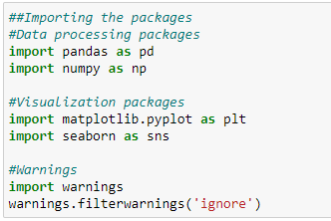
Import Libraries

Slide 5
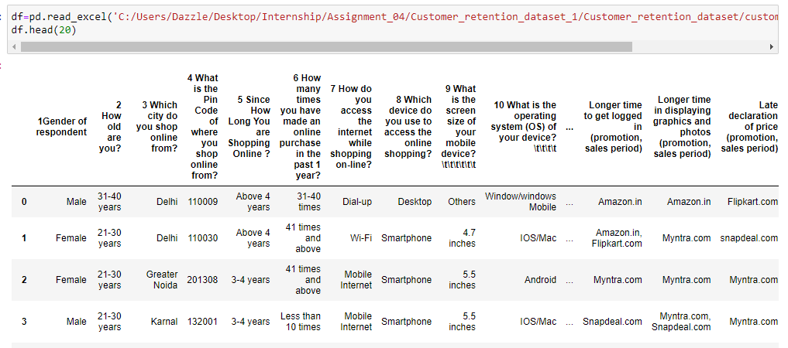
Import dataset

Slide 6
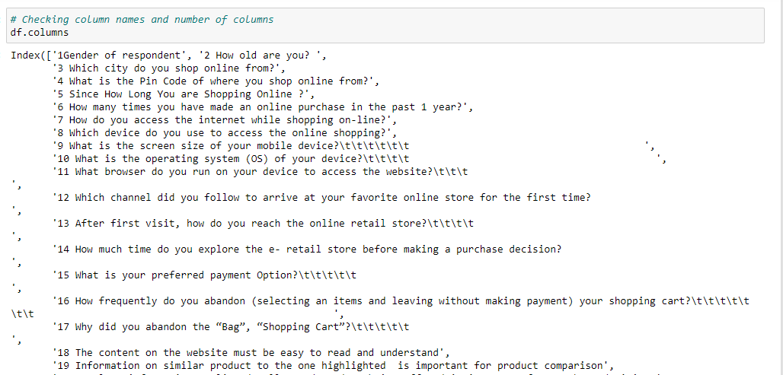
Checking column details

Slide 7
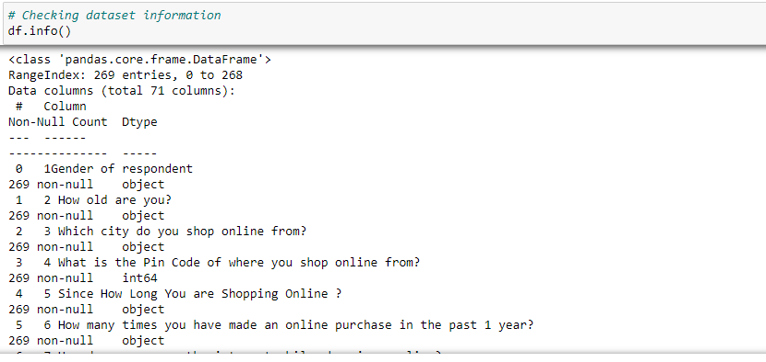
Checking for dataset information
Here, we get the consolidated details regarding data columns, data types, non-null values, range index, etc.

Slide 8
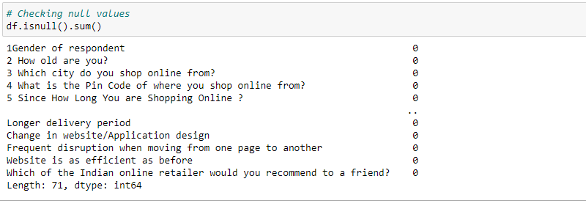
Exploratory Data Analysis
No null values are present in the dataset.

Slide 9
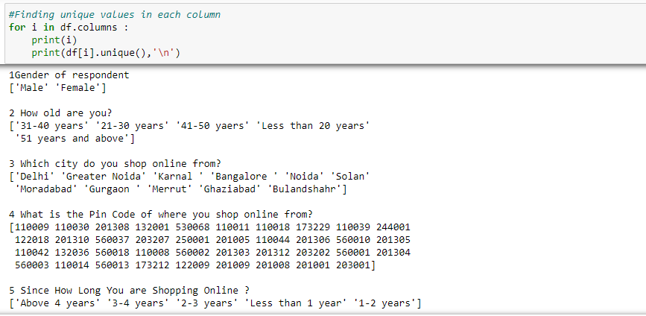
Checking for the unique values present in each column

Slide 10
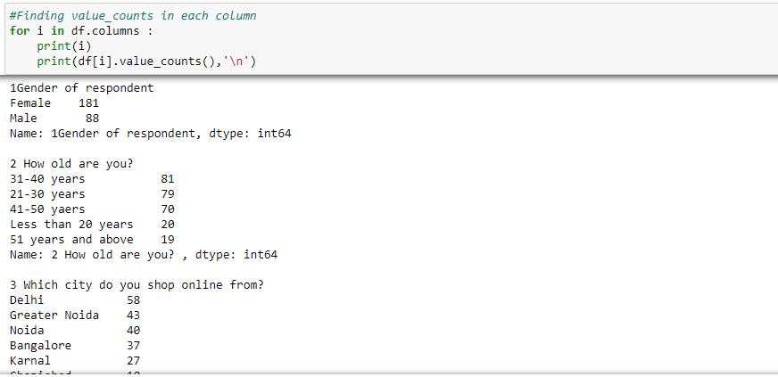
Finding the value counts in each column

Slide 11
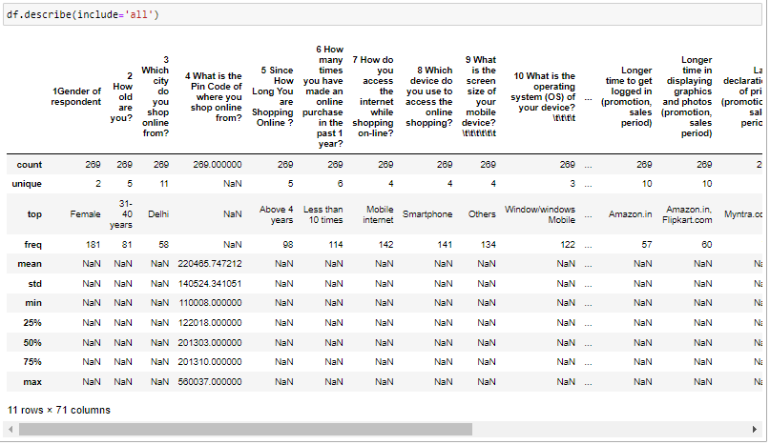
Dataset description

Slide 12
Inference
Female online buyers are more as compare to male buyers.
Out of 5 age groups 31-40 years of age group have high number of buyers. Delhi have highest number of online shop customers.
A good number of people use mobile internet and smart phones having windows for online shopping. Amazon.in takes longer time to get logged in.
Changed in website/Application design, shows frequent disruption when moving from one page to another but still highly voted for as efficient as before and online retailer that would be highly recommended.PAytm.com has Longest delivery period.
Myntra.com is on first for Late declaration of price (promotion, sales period) and Longer page loading time (promotion, sales period).
Snapdeal.com is opted out the most for Limited mode of payment on most products (promotion, sales period).

Slide 13
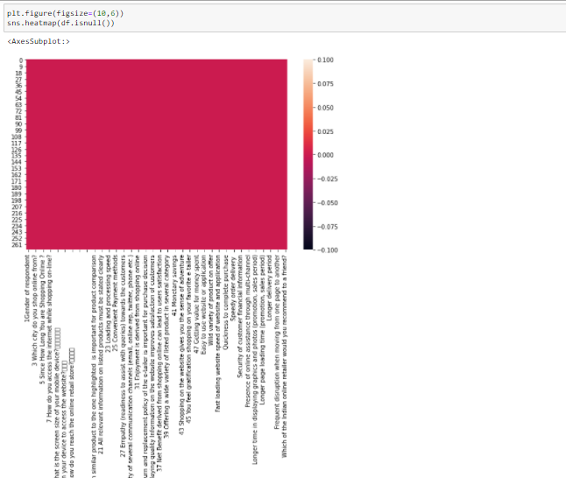
Heatmap showing no null values in the dataset.

Slide 14
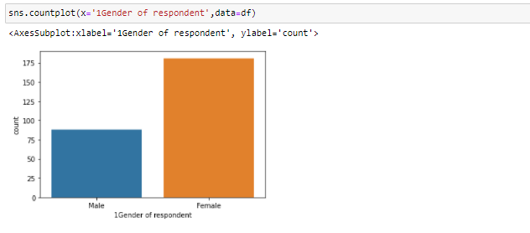
Countplot showing gender of respondents
There are high number of female buyers. So females can be targeted more for
offer, style, trends recommendations.

Slide 15
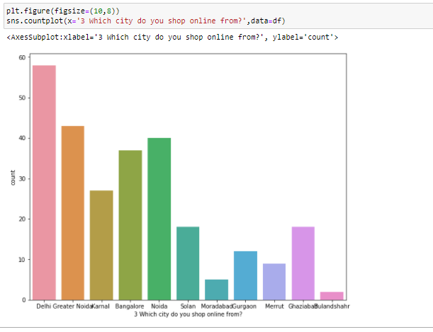
Countplot showing cities of buyers
Delhi is at the top for having highest numbers of online buyers, then Greater Noida, Noida, Bangalore.

Slide 16
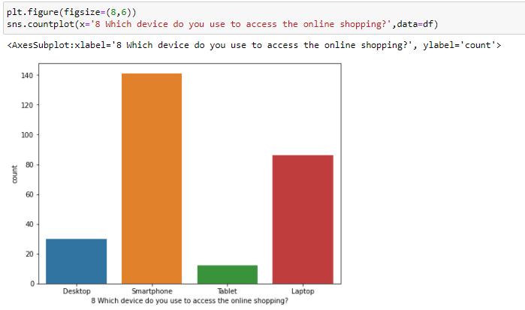
Countplot showing devices used for online shopping
Smartphone are mostly used for online purchase.

Slide 17
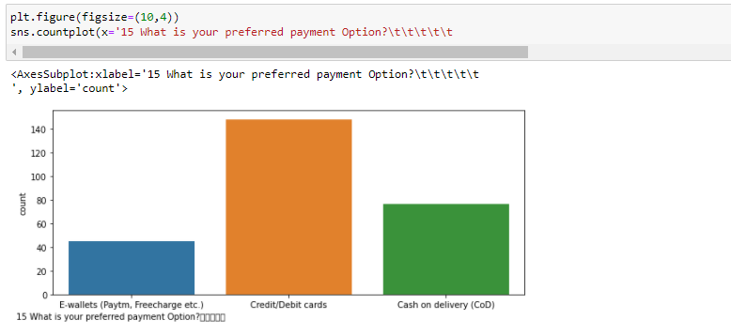
Countplot showing payment options available and used
Credit/Debit cards are widely used as online payment methods.

Slide 18
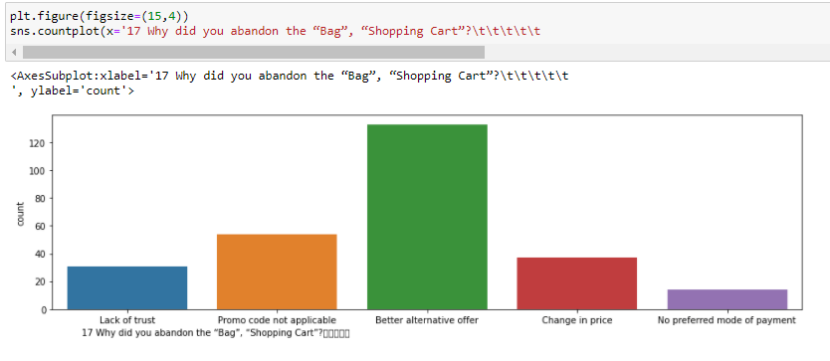
Countplot showing why bags, carts are abandoned
Bags, shopping carts are mostly abandoned due to better alternative offer available.

Slide 19
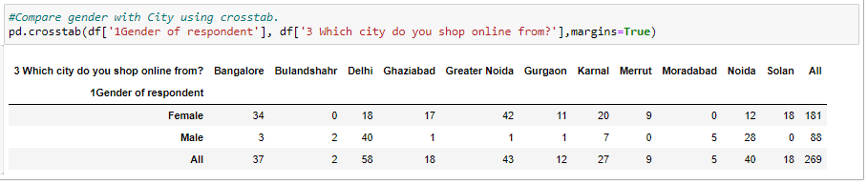
Crosstab showing gender and cities for online shopping comparison
Showing gender wise division of buyers in different cities. Male buyers are more in numbers in Delhi and Noida and there are no male buyers in Merrut and Solan. High number of female buyers are in Bangalore, Greater noida, Karnal.

Slide 20
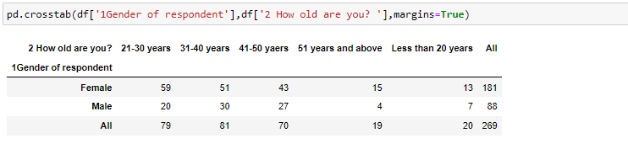
Crosstab showing pivot table of gender and age groups
In all the age groups, female buyers are high in number than male buyers.

Slide 21
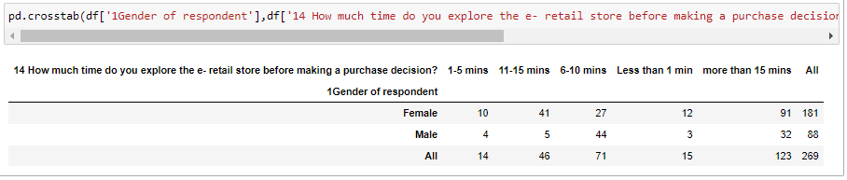
Pivot table showing time spent on exploring the website before making a purchase
Mostly men explore the e-retail store for about 6-10 minutes but mostly women explore the e-retail stores for more than 15 minutes.

Slide 22
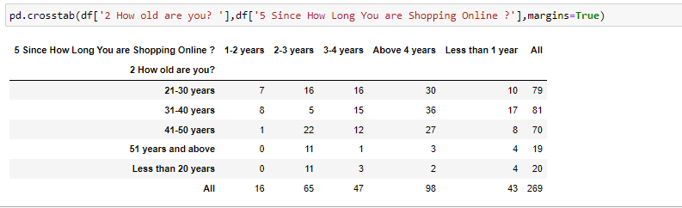
Plot showing since how long people are shopping online
Most buyers are from age group 21-50 years who are shopping online Above 4 years.

Slide 23
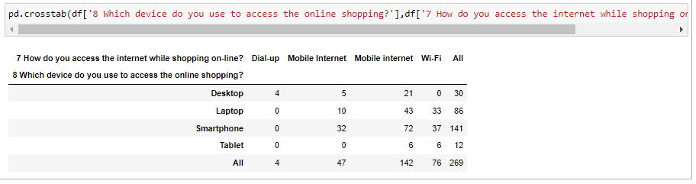
Plot showing device and internet access medium for online shopping
Mobile internet is mostly used to access online sites with Smartphone at the top then Laptop and then Desktop. After mobile internet, Wi-Fi is used through Smartphones and then Laptops. Tablets are rarely used for online shopping that is also through Mobile internet or Wi-Fi.

Slide 24
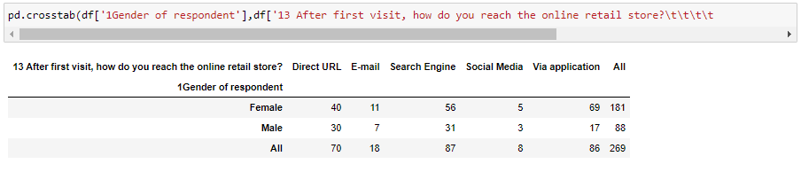
Plot showing how customers reach to online retail store
Highly used interface to reach the online retail store is Search Engine, then Via application, and then Direct URL. All these are used in high number by female customers.

Slide 25
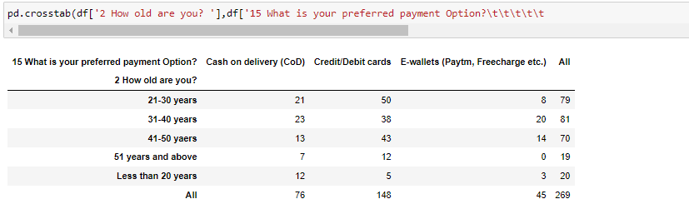
Plot showing preferred payment options by different age groups
Most preferred payment option is Credit/Debit cards by the age group of 21-51 years and above. The next preferred option is Cash on delivery (CoD) by less than 20 years to 40 years.

Slide 26
Votings of customers for different features and processes considered for rating from 1(Strongly Disagree) to 5(Strongly Agree) will be presented by pie charts from next slides

Slide 27
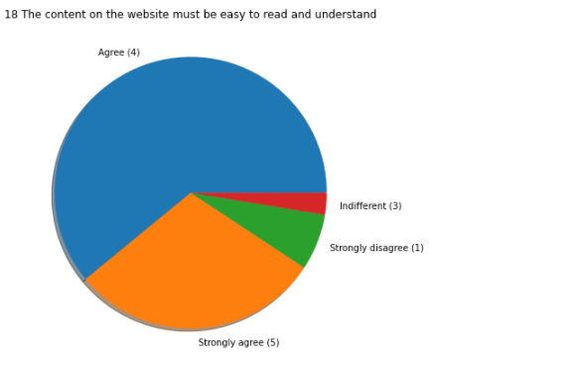
The content on the website must be easy to read and understand
A high number of customers agreed on the content on the website must be easy to read and understand. So website contents should be made as per customers convenience.

Slide 28
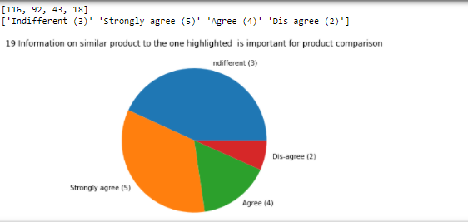
Information on similar product to the one highlighted is important for product comparison
Most people gave neutral opinion for Information on similar product to the one highlighted is important for product comparison

Slide 29
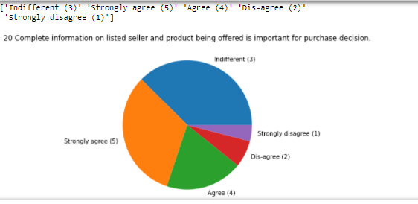
Complete information on listed seller and product being offered is important for purchase decision
Most people gave neutral opinion for Complete information on listed seller and product being offered is important for purchase decision.

Slide 30
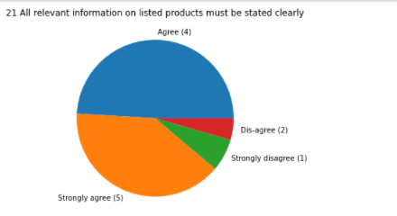
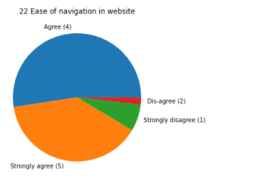
All relevant information on listed products must be stated clearly and Ease of navigation in website
Customers are highly satisfied with listed relevant information and ease of navigation.

Slide 31
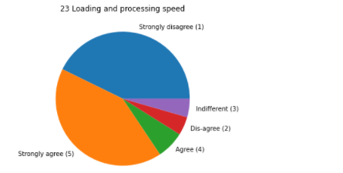
Loading and processing speed
Approx equal number of people agree and disagree on loading and processing speed of the websites so here we consider it under area of improvement.

Slide 32
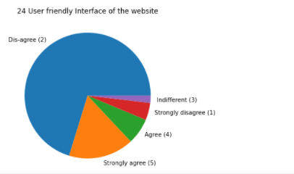
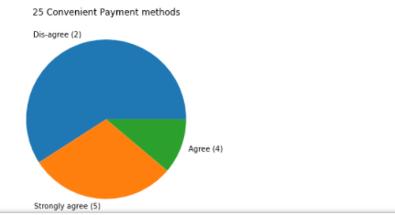
User friendly Interface of the website and Convenient Payment methods
High number of customers disagree with user friendly interface of the website and convenient payment methods, hence online websites need to work on this area.

Slide 33
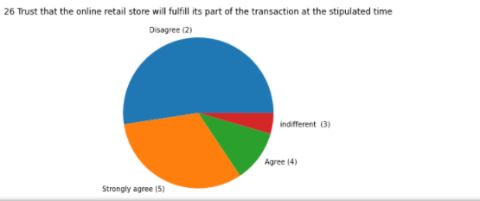
Trust that the online retail store will fulfill its part of the transaction at the stipulated time
Trust is the most important factor on which a high number of customers have disagreed and this should be the first and foremost step to be taken under consideration.

Slide 34
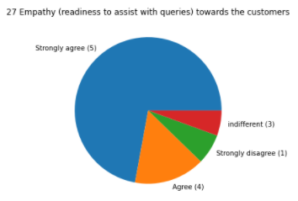
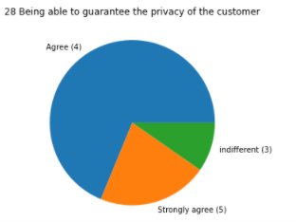
Empathy (readiness to assist with queries) towards the customers and Being able to guarantee the privacy of the customer
Customers are happy with empathy and guaranteed privacy of the customer.

Slide 35
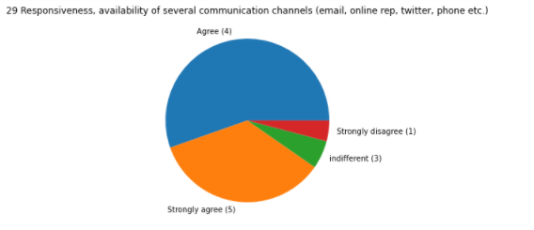
Responsiveness, availability of several communication channels (email, online rep, twitter, phone etc.)
Buyers are highly satisfied with Responsiveness, availability of several communication channels (email, online rep, twitter, phone etc.)

Slide 36
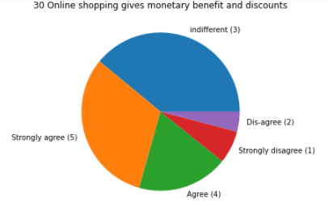
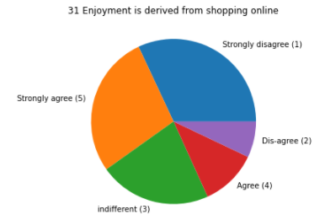
Online shopping gives monetary benefit and discounts and Enjoyment is derived from shopping online
Customers are not much satisfied with above points and hence e-retailer needs to improve in these fields.

Slide 37
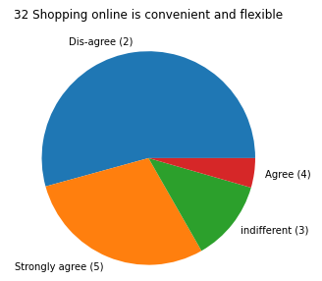
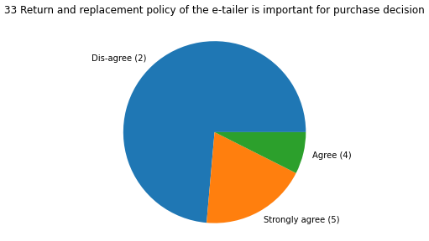
Shopping online is convenient and flexible and Return and replacement policy of the e-retailer is important for purchase decision
High number of customers disagree with convenience and return and replacement policies.

Slide 38
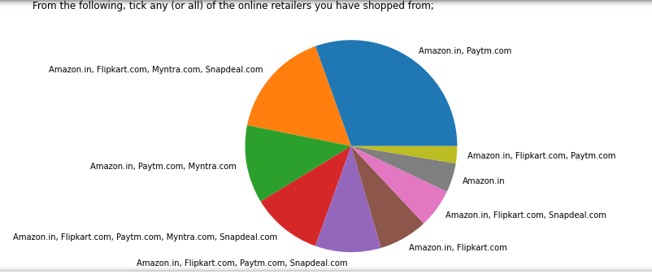
Tick any (or all) of the online retailers you have shopped from
Amazon.in, Paytm.com together have the highest number of customers.

Slide 39
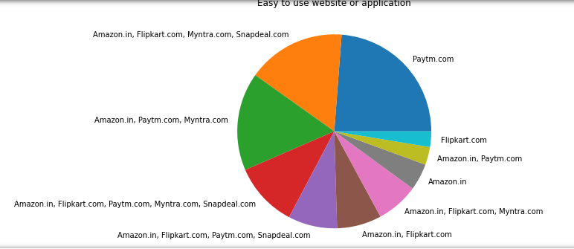
Easy to use website or application
Paytm.com is highly voted for easy to use website/application and some people have also
voted for other applications.

Slide 40
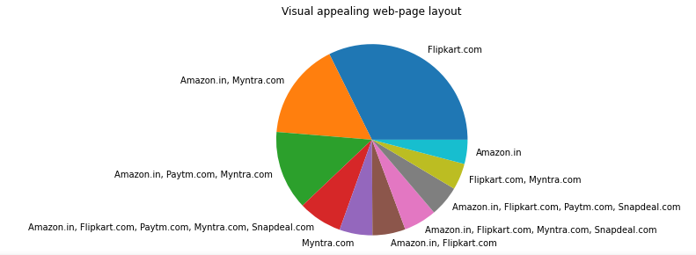
Visual appealing web-page layout
Visuals are best for Flipkart.com and then Amazon.in, Myntra.com

Slide 41
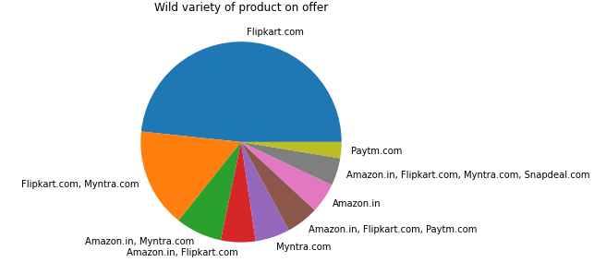
Wide variety of product on offer
Flipkart offers a wide variety of products on offer s.

Slide 42
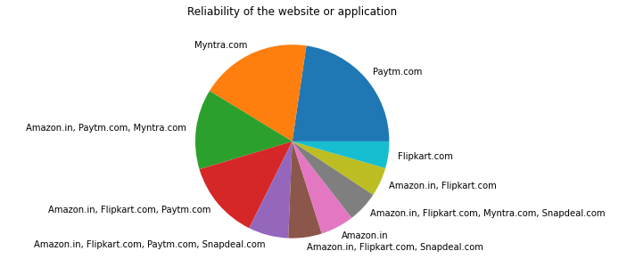
Reliability of the website or application
Customers are happy with reliability of website/application of Paytm.com and Myntra.com and also Amazon.in

Slide 43
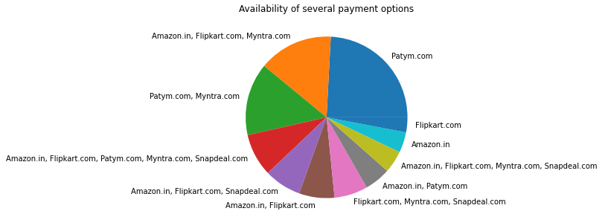
Availability of several payment options
Paytm.com has several payment options available and highly voted by customers.

Slide 44
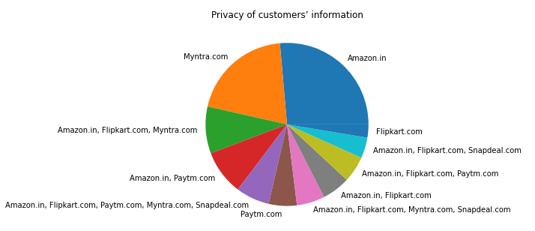
Privacy of customers’ information
Privacy of the customers is highly taken care by Amazon.in and then Myntra.com as per buyers.

Slide 45
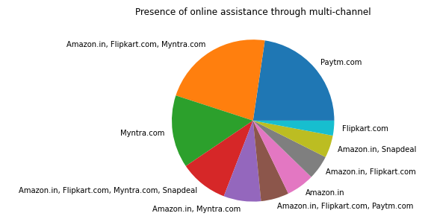
Presence of online assistance through multi-channel
Customers are good with online assistance provided through multi-channel by Paytm.com, Amazon.in, Flipkart.com, Myntra.com

Slide 46
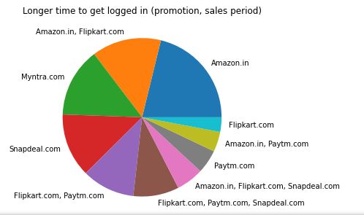
Longer page loading time (promotion, sales period)
Amazon.in takes longer page loading time, hence it needs to improve this service.

Slide 47
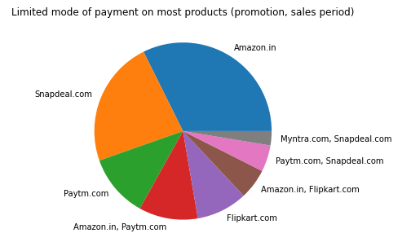
Limited mode of payment on most products (promotion, sales period)
Amazon.in and then Snapdeal.com have limited mode of payment on most of the products.

Slide 48
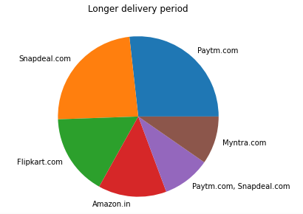
Longer delivery period
Paytm.com, Snapdeal.com and then Flipkart.com have longer delivery period.

Slide 49
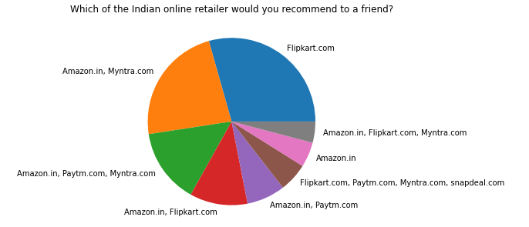
Which of the Indian online retailer would you recommend to a friend?
Flipkart.com is highly recommended website/application for online shopping after that Amazon.in and Myntra.com comes for recommendation.

Slide 50
Steps and assumptions with Chi-square test
Here the assumption is :-
Ho → Two variables taken in pd.crosstab in observed variable to calculated chi2, p-value, Degree of freedom and expected values, are independent of each other.
Ha → Two variables are dependent of each other.
(If p-value > 0.05, Ho is accepted otherwise Ho is rejected and Ha is accepted.)

Slide 51
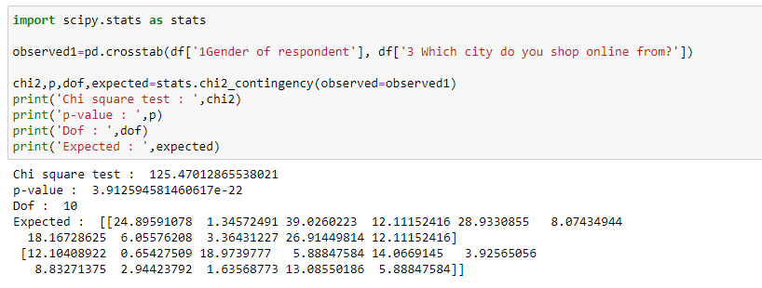
p-value=3.9 is greater than 0.05(Significant value). Therefore, Ho is accepted and shows two variables are independent of each other.

Slide 52

p-value=0.29 is greater than 0.05(Significant value). Therefore, Ho is accepted and shows two variables are independent of each other.

Slide 53

p-value=9.9 is greater than 0.05(Significant value). Therefore, Ho is accepted and shows two variables are independent of each other.

Slide 54

p-value=1.8 is greater than 0.05(Significant value). Therefore, Ho is accepted and shows two variables are independent of each other.

Slide 55

p-value=2.2 is greater than 0.05(Significant value). Therefore, Ho is accepted and shows two variables are independent of each other.

Slide 56

p-value=0.03 is less than 0.05(Significant value). Therefore, Ho is rejected and shows two variables are dependent on each other.

Slide 57

p-value=0.001 is less than 0.05(Significant value). Therefore, Ho is rejected and shows two variables are dependent on each other.

Slide 58
Conclusion
Most respondents are Female so females should be targeted more.
Age group from 21 to 50 are in large numbers who are buying products online.
A good number of buyers are from Delhi, Greater Noida, Noida, Bangalore.
Pincode 201308 has most number of customers. So need to work on connecting customers from other regions too.
Most of the responses were for Less than 10 times online purchase in the past 1 year.
Mostly customers access the internet with Mobile Internet and Smartphone device while shopping on-line.
Google chrome is widely used to access websites.
Most preferred payment option is Credit/Debit cards.
Bags, shopping carts are mostly abandoned due to Better alternative offer available.
Customers strongly agree on Ease of navigation in website, trust that the online retail store will fulfil its part of the transaction at the stipulated time.
Responsiveness, availability of several communication channels (email, online rep, twitter, phone etc.)
Buyers strongly agree that Online shopping gives monetary benefit and discounts.
Enjoyment is derived from shopping online.

Slide 59
Continue…
Return and replacement policy of the e-retailer is important for purchase decision.
Gaining access to loyalty programs is a benefit of shopping online.
Displaying quality Information on the website improves satisfaction of customers, User derive satisfaction while shopping on a good quality website or application.
Net Benefit derived from shopping online can lead to users satisfaction.
User satisfaction cannot exist without trust, Offering a wide variety of listed product in several category, Provision of complete and relevant product information.
Monetary savings. Most of the customers shop from Amazon.in, Flipkart.com, Paytm.com, Myntra.com, Snapdeal.com with Easy to use website or application interface. Amazon.in, Flipkart.com are most voted Visual appealing web-page layout, Wild variety of product on offer and Complete, relevant description information of products. Amazon.in is mostly voted for Fast loading website speed of website and application.
Reliability of the website or application and Quickness to complete purchase, Speedy order delivery, Privacy of customers’ information.
Perceived Trustworthiness. Paytm.com has the Longer delivery period so it should work more for customer satisfaction.
Amazon.in takes longer page loading time, hence it needs to improve this service.

