Slide 1

Major Project-1 Presentation-II
B.E. (Computer) Sem - VII
Lokmanya Tilak College of Engineering, Navi Mumbai
Computer Engineering
2023-24

Slide 2

COUNTERFEIT PRODUCT IDENTIFICATION USING BLOCKCHAIN
Group members:
Aayushi Saraswat BEB201
Sakshi Naik BEB212
Sayali Virkar BEB216
Ankit Dubey BEB227
Name of Project Guide:
Prof. Kahkashan Siddavatam

Slide 3
Presentation Outline
Abstract
Introduction
Literature Survey
Limitations of Existing system
Scope
Proposed System
Analysis/Framework/ Algorithm
Details of Hardware & Software
Design details
Methodology
Implementation Plan for next semester
Conclusion
References

Slide 4
ABSTRACT
The use of blockchain for fake product detection will help the consumer determine if the goods are real or not and will assist the merchant win over the customer's trust. The production of fake goods has increased dramatically over the past several years, which has led to a loss of income and profit and damaged the reputation of the firm. The purchaser of a copycat or replicated goods will also be dissatisfied and runs the danger of having his or her safety. Blockchain technology is a decentralized, distributed ledger that keeps all transactional data in the form of immutable, highly secure blocks that are linked by chains. With this technology, a consumer may verify a product's authenticity without depending on a third party, which is advantageous to both them and the product's owner.

Slide 5
INTRODUCTION
Blockchain is a decentralized system in which records may only be added and are hence unchangeable. Blockchain technology aids in addressing the issue of counterfeit product.
The technique of storing the product's details is called fake product detection via blockchain. It is feasible to keep all of the product's transaction records after the product is placed on the network and given a hash number.
There won't be a third party involved, making it impossible for anybody to hack the systems stored data. For such product transactions, a chain with the manufacturer’s information will be formed.
In the blockchain, all transaction histories will be kept as blocks. In the suggested system, each product is given a generated QR code, which the client may scan to learn all there is to know about that product. We can tell whether a product is genuine or not by scanning the QR code.

Slide 6
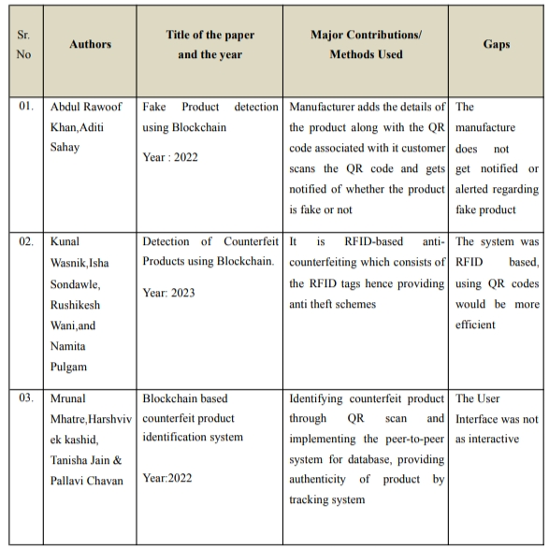
LITERATURE SURVEY

Slide 7
LIMITATIONS OF EXISTING SYTEM
Many existing blockchain-based counterfeit detection systems face scalability issues, especially on public blockchains. As the number of products and transactions grows, the network may become congested, leading to slower transaction processing times and higher fees.
Existing projects often struggle with maintaining data privacy between the manufacturer and customers.
The existing system does not alert or notify the manufacturer that the product is fake. It only tells the customer this detail. And the customer has to update the manufacturer about this information.

Slide 8
PROBLEM STATEMENT & OBJECTIVES
Counterfeit products jeopardize consumer safety and brand integrity. To address this issue, there is a need for a blockchain-based solution that ensures efficient and secure product authenticity verification in the supply chain, ultimately safeguarding consumers and maintaining trust in the marketplace.
1. Develop a Blockchain-Based Platform: Design and develop a blockchain-based platform for registering and verifying product authenticity in the supply chain.
2. QR Code Generation and Registration: Create a system for generating and associating unique QR codes with each genuine product during manufacturing or at an appropriate stage in the supply chain.
3. Efficient Product Registration: Establish a user-friendly mechanism for manufacturers and authorized entities to register products on the blockchain, including product details and QR code association.
4. Ensure Customer’s Trust: The project is made to ensure that customer’s feel secure about the products they buy, and not fall into traps.

Slide 9
SCOPE
It can be difficult on the manufacturer side to add all the details of the products manufactured so instead of manually adding the products details, data can be extracted using company’s API which can increase efficiency and manufacturer friendly.
QR code is not hackable but information in it can be copied or known to generate similar QR code, as well as print out of QR code works well to scan and retrieve information. So in order to overcome this secure graphic QR code can be used that when QR code is photocopied then it will lose information due to the ink smearing.
The future work of the system can be proof of code simplicity which can indirectly increase consumer’s trust because of distributed applications.

Slide 10
PROPOSED SYSTEM
Nowadays, with the rise of technology and markets the problem to differentiate with original and duplicate has incurred a lot of damage to consumers, distributors, retailers and also manufacturers. Therefore, in order to combat this a blockchain based application fake product detector is proposed. The system will detect counterfeit products using QR (Quick response) code, where QR code is chained to a specific product and linked to smart contracts to scan the code using smart phones or any device that scan. The system consists of:
MANUFACTURE END: The company after verification of mail ID for registration and authentication purpose. They can login to the system and add new product/item, upload the product details with system generated QR code which stores all the details of the products.
CUSTOMER END: Customer has to register/login with email ID and password. After the completion of user authentication, the product initiates with scan button to scan QR code of the product.

Slide 11
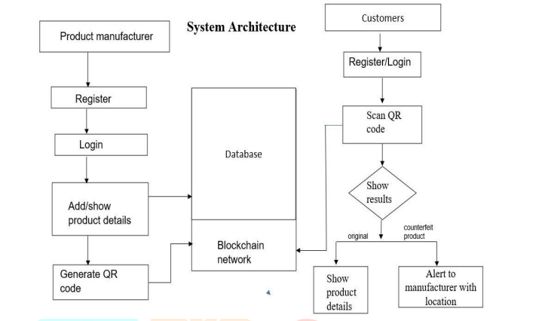
Analysis/Framework/ Algorithm

Slide 12
Details of Hardware & Software
HARDWARE:
Servers: 4 to 6 high-performance servers
Processor: Intel Xeon or AMD EPYC processors
RAM: 64GB to 128GB per server
SOFTWARE:
Blockchain Platform: Ethereum
Operating System: Windows 10
Smart Contracts: Solidity
Tools: Ganache and MetaMask

Slide 13
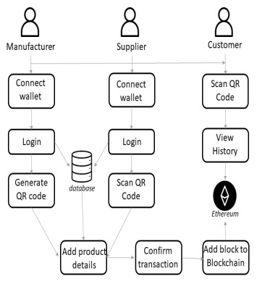
Design Details

Slide 14
Methodology
In this project, Quick Response (QR) codes provide a robust technique to fight the practice of counterfeiting the products. Counterfeit products are detected using a QR code scanner.
This system will require the manufacturer to store product details and generate unique code of that product as blocks in the database.
The website will contain the details of the product and manufacturer detail.
Now, the customer can register, order and receive the product and login to the site. Customers scan the QR code on the product or package using the smartphone’s QR code reader application or customer application have the option of QR code scanner.
After scanning, the customer gets the result if the product is real or fake.
In the end, the Blockchain system holds these product details along with a history of transactions to enable the tracking of the product along the distribution chain. All the product details, block name, a hash value is stored in the database.

Slide 15
Implementation Plan for next semester
Implementation for Term 1 included Research Papers, Requirement Analysis, and Structure of the Project.
Plan for Term 2:
Defining the Structure of the UI as well as the System
Model Development
Integration with Ethereum
Performance Evaluation
Model Testing
Deployment
Documentation and Report
Final Submission

Slide 16
Conclusion
The fully functional website can effectively reduce the threshold of the anti-counterfeiting of branded goods and provide the industries with limited financial resources and also easier approach to provide consumers with the trust and surety that they will not be purchasing unsusceptible counterfeited goods. Overall, this blockchain technology-based application can emerge as a life saver for the companies and provide a new system for trading, marking and purchasing which is more secure and user friendly.

Slide 17
REFERENCES
M. C. Jayaprasanna, V. A. Soundharya, M. Suhana and S. Sujatha, "A Block Chain based Management System for Detecting Counterfeit Product in Supply Chain," 2021 Third International Conference on Intelligent Communication Technologies and Virtual Mobile Networks (ICICV), 2021, pp. 253-257
Singh, Shivam & Choudhary, Gaurav & Kumar, Shishir & Sihag, Vikas & Choudhary, Arjun. (2021). Counterfeited Product Identification in a Supply Chain using Blockchain Technology. 10.22667/ReBiCTE.2021.07.15.003.
Umesh Bodkhe, Sudeep Tanwar, Karan Parekh, Pimal Khanpara, Sudhanshu Tyagi, Neeraj Kumar and Mamoun Alazab, “Blockchain for Industry 4.0: A Comprehensive Review” IEEE Access (Volume: 8) 17 April 2020.

Slide 18
Thank You!

