Slide 1
InteractiveResume.py

Slide 2
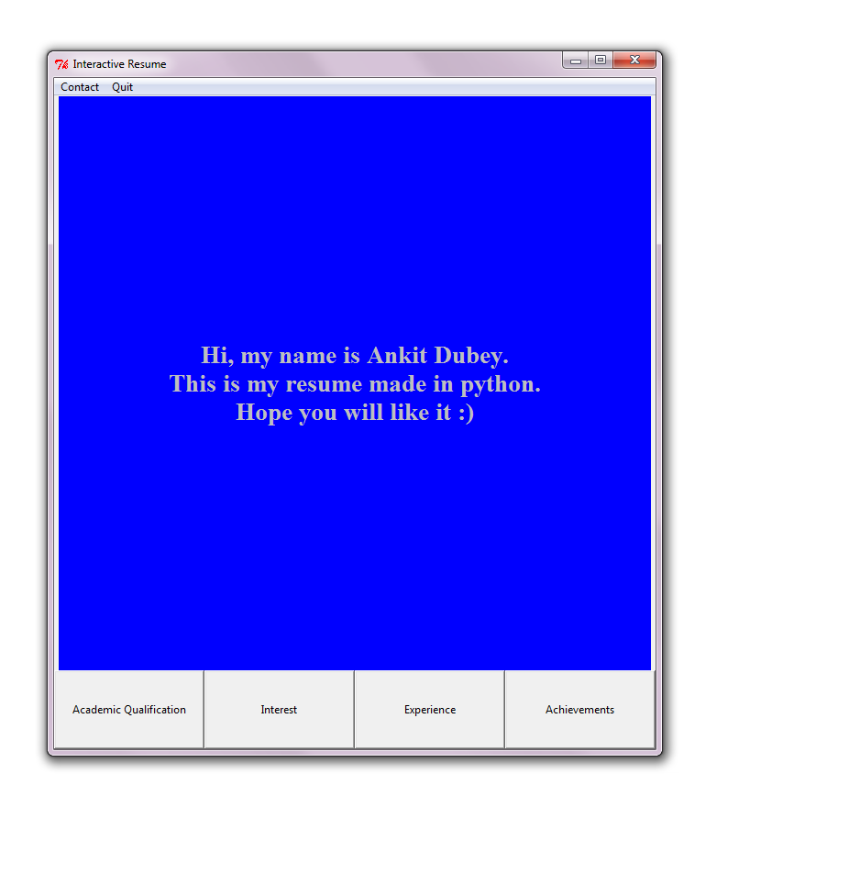
Home page of the program

Slide 3
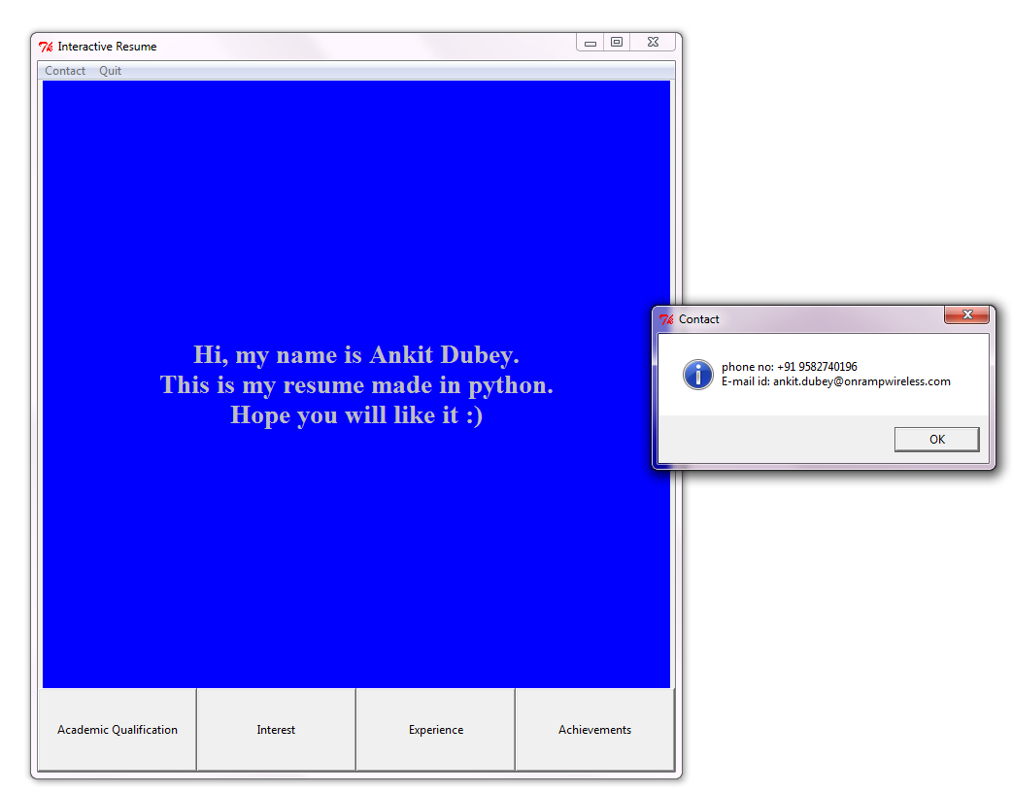
By clicking on the Contact button

Slide 4
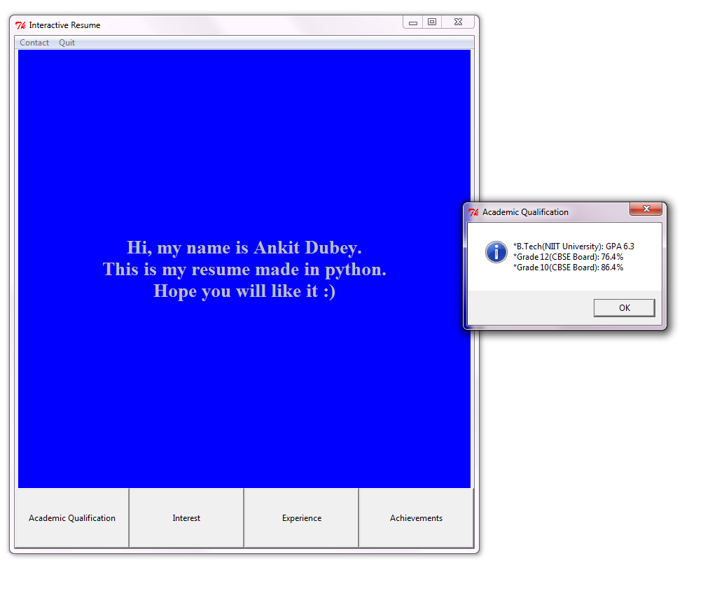
By clicking on the Academic button

Slide 5
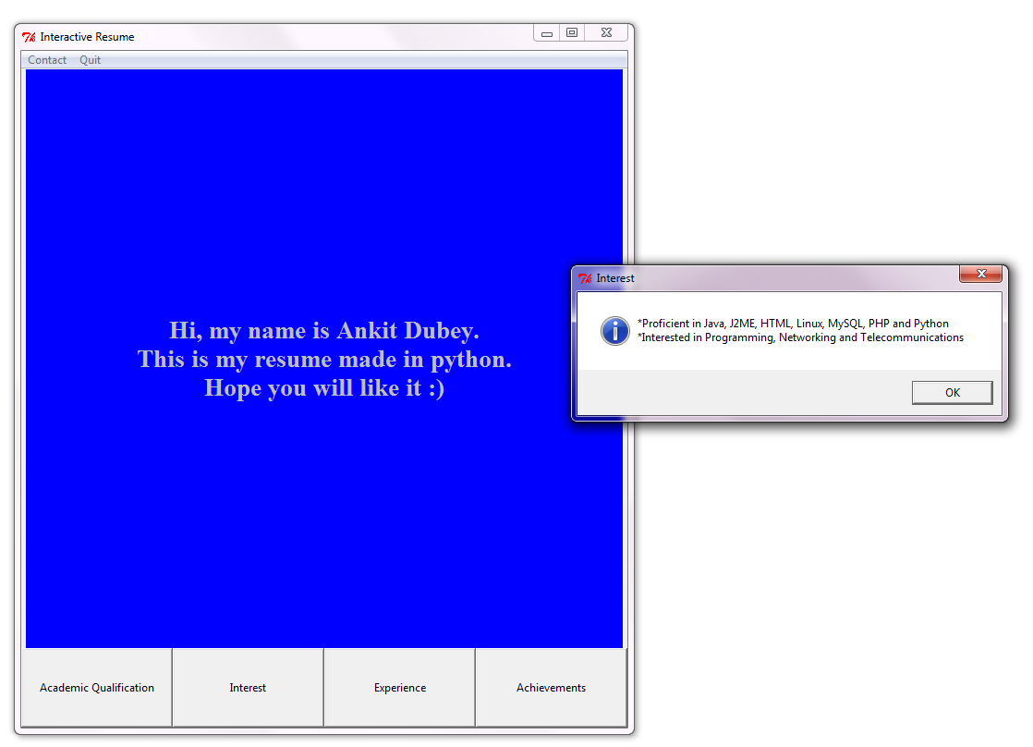
By clicking on the Interest button

Slide 6
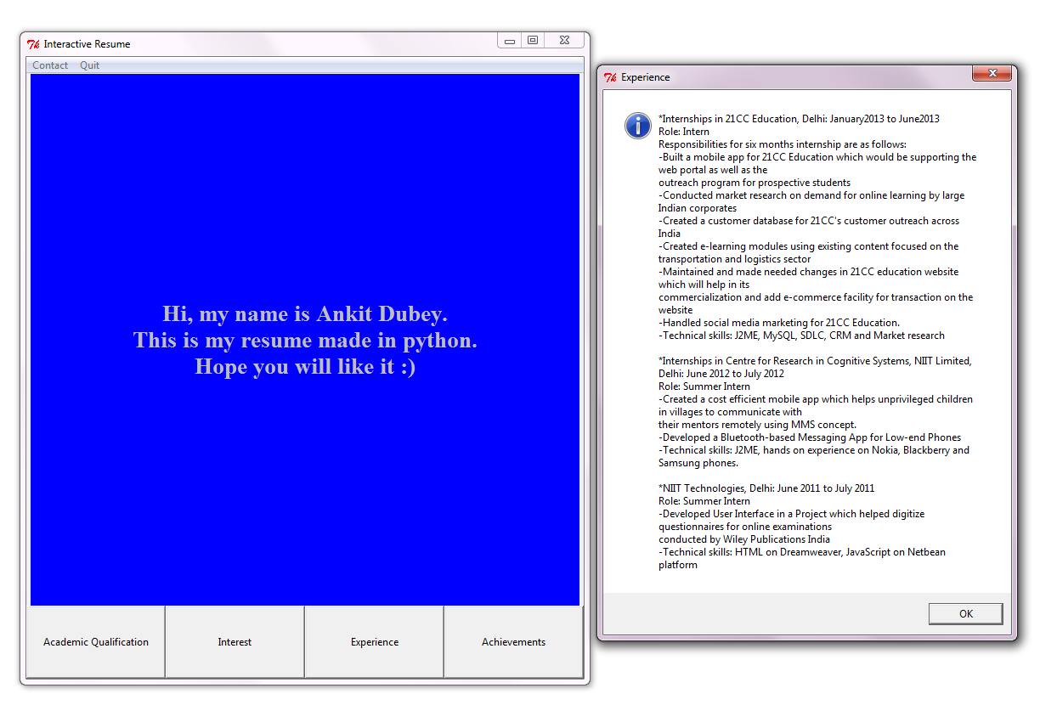
By clicking on the Experience button

Slide 7
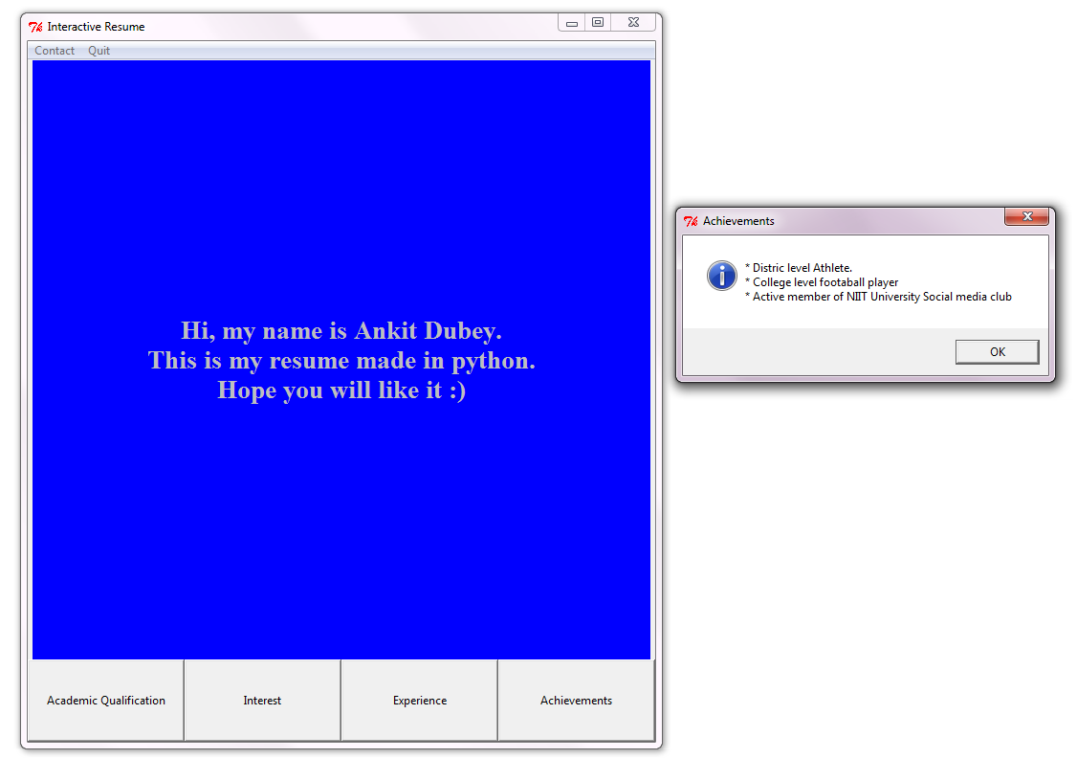
By clicking on the Achievements button

Slide 8
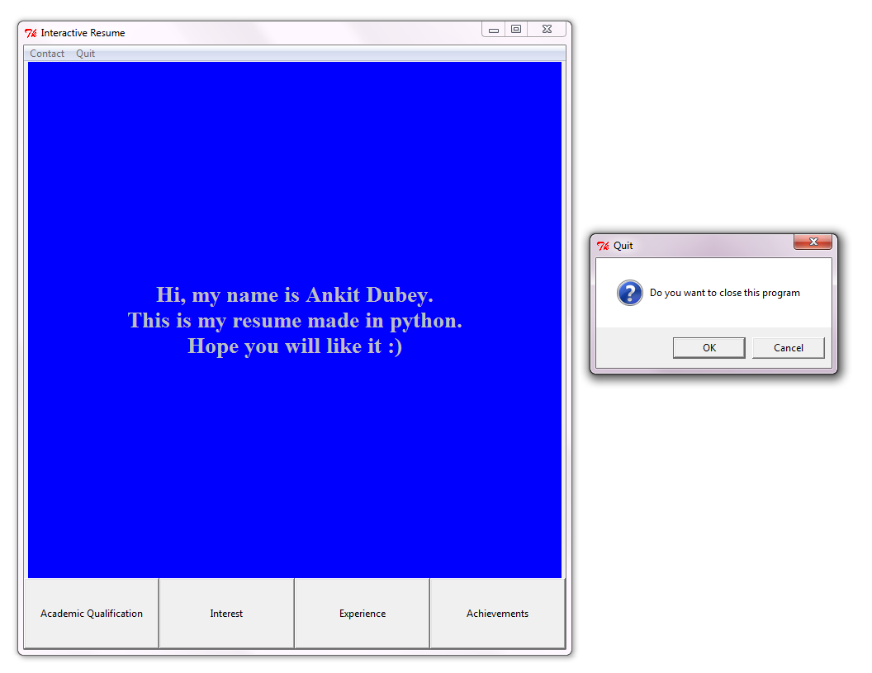
By clicking on the Quit button

