Slide 1
REPORT-5

Slide 2
CONTENT
Level 0 data flow diagram
Level 1 data flow diagram
Level 2 data flow diagram
Brief description about app
How to use app
Database operations
Software used

Slide 3
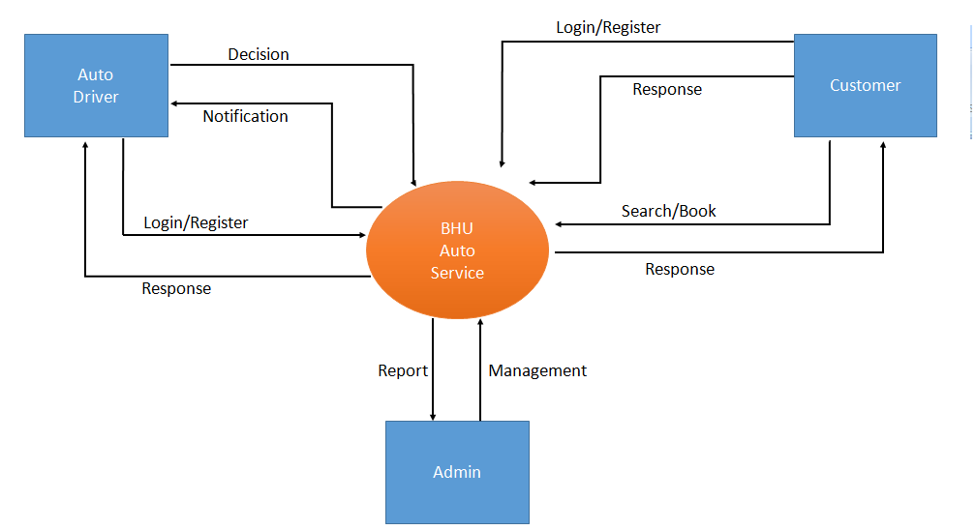
LEVEL 0 DATA FLOW DIAGRAM

Slide 4
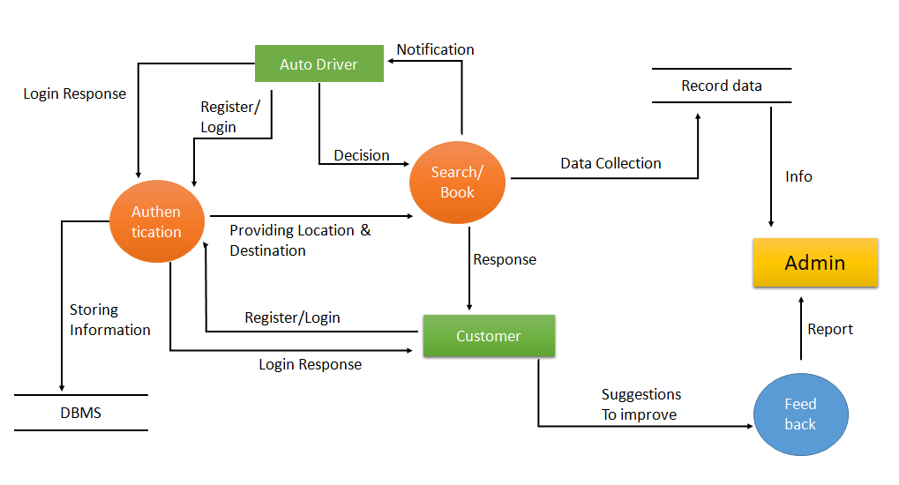
LEVEL 1 DATA FLOW DIAGRAM

Slide 5
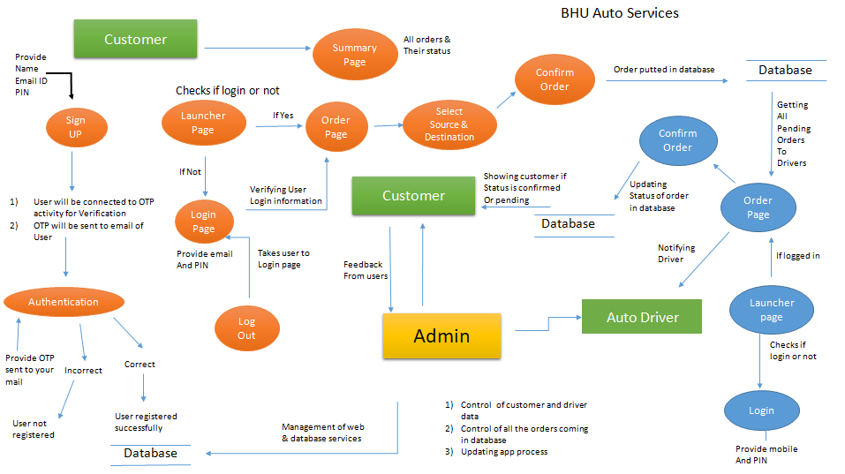
Level 2 data flow diagram

Slide 6
BRIEF DESCRIPTION ABOUT APP
There are tow main profile.
-Costumer profile -Auto driver profile
Only for inside BHU.
All data is recorded.
User friendly.

Slide 7
HOW TO USE APP
For Costumer
Sign up/ Login
Verify through OTP
Can go to order page or can see own old book history
Can book auto

Slide 8

This is Launcher activity
Here it checks if app is connected to network
If yes
It will check if user or driver is logged in
or not
If yes
It will take you to order activity
If no
It will take you to login activity

Slide 9
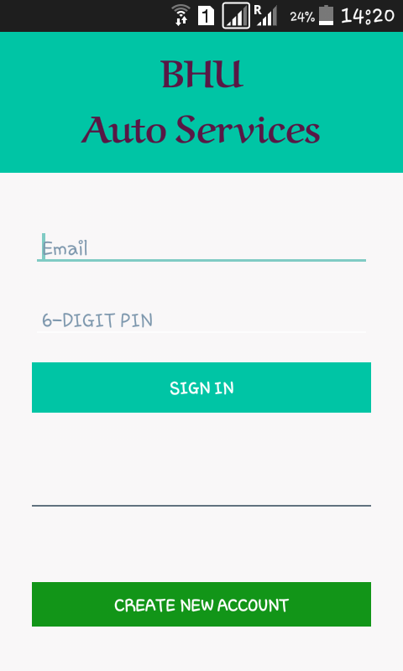
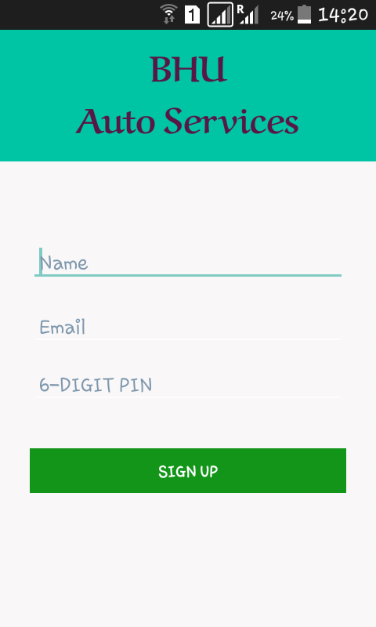
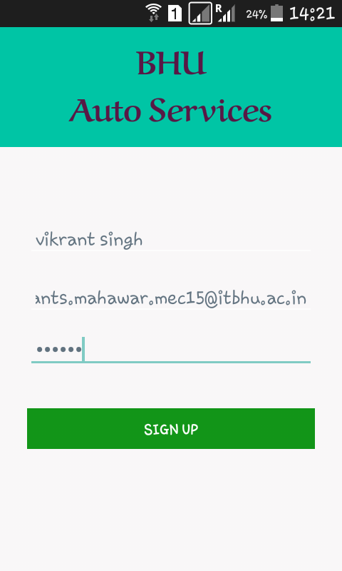
User login interface
Sign up interface

Slide 10
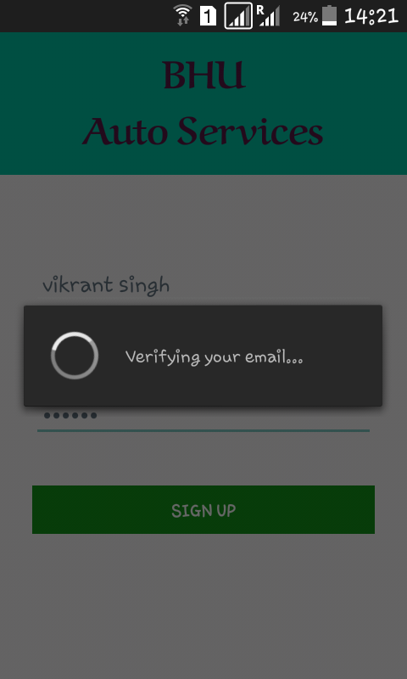
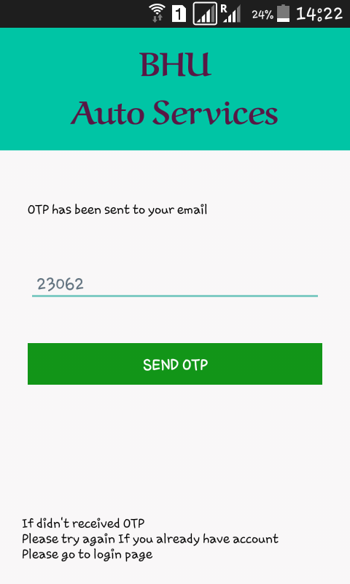
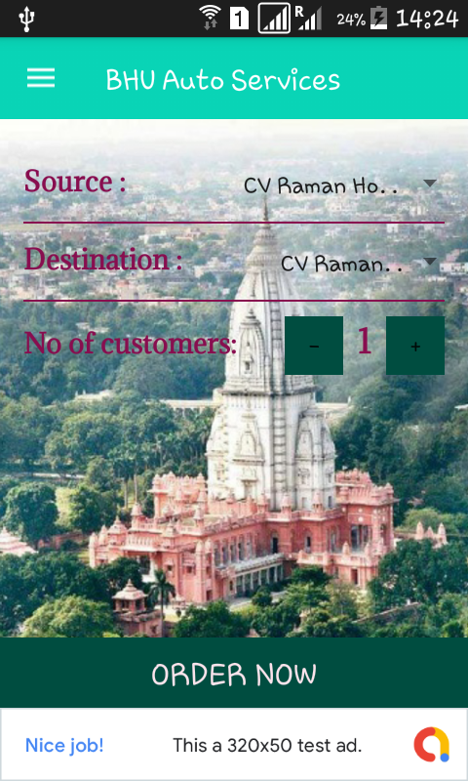
OTP interface
Order interface

Slide 11
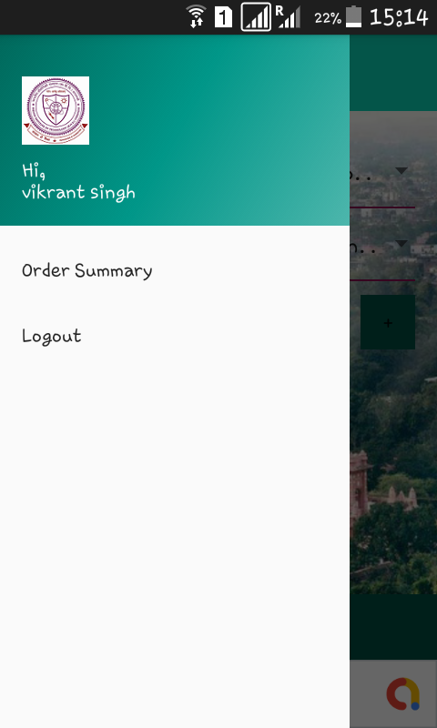
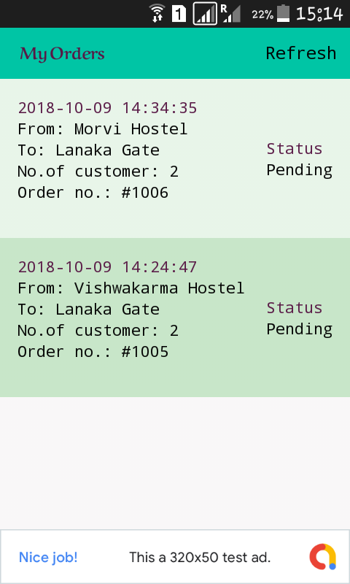
Click refresh
To see current
Status of your
order
Navigation bar
Order history

Slide 12
For Auto driver
Sign up through Admin
Can see notification of costumer booking
Can response

Slide 13
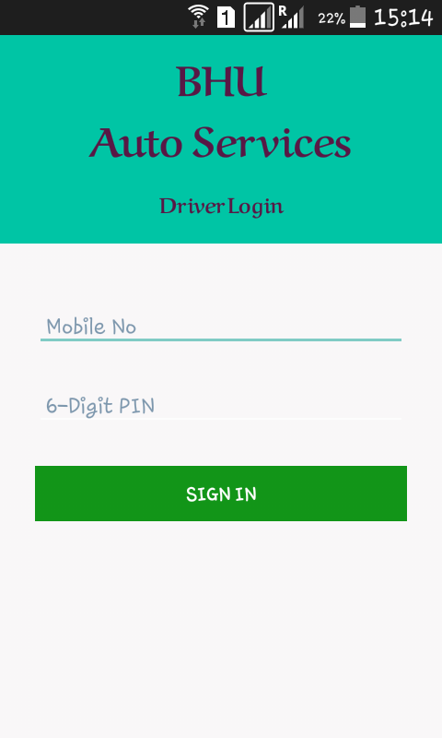
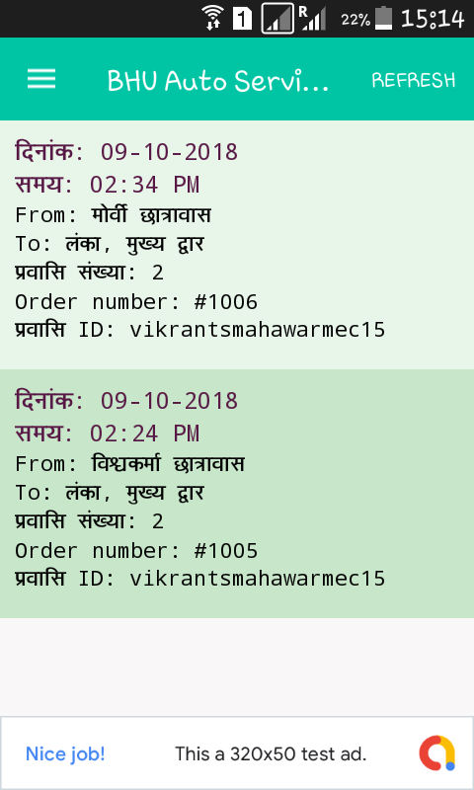
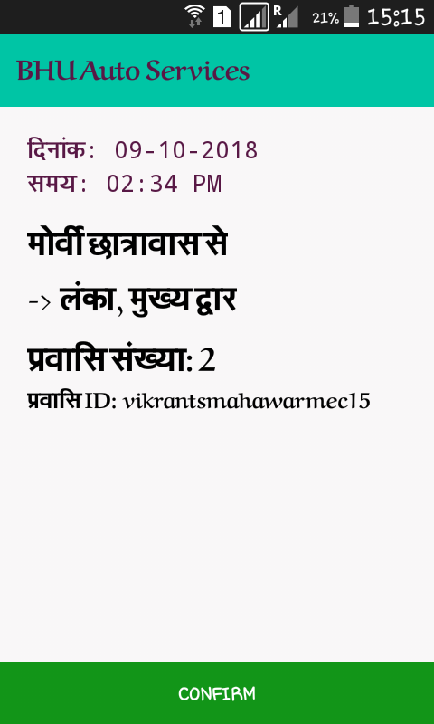

Slide 14
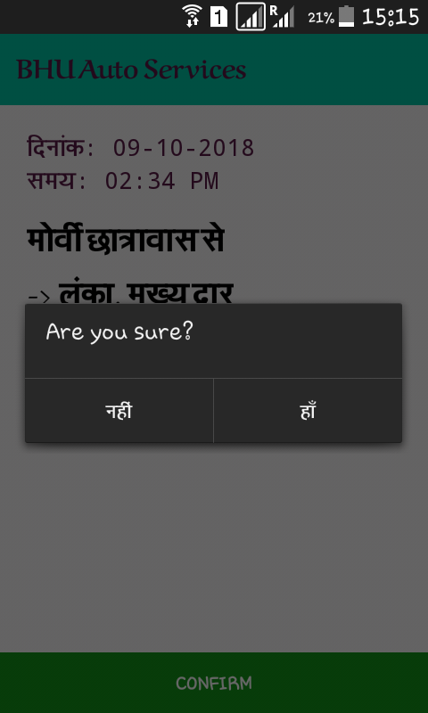
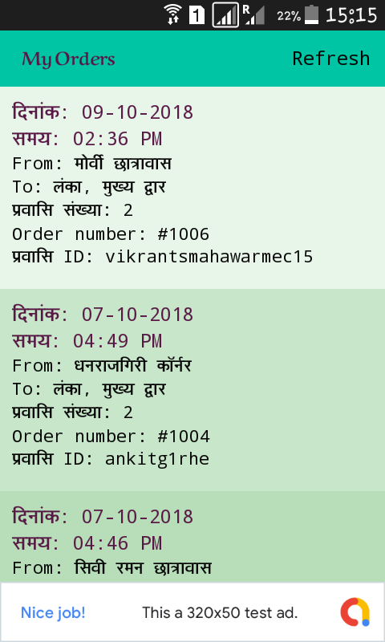

Slide 15
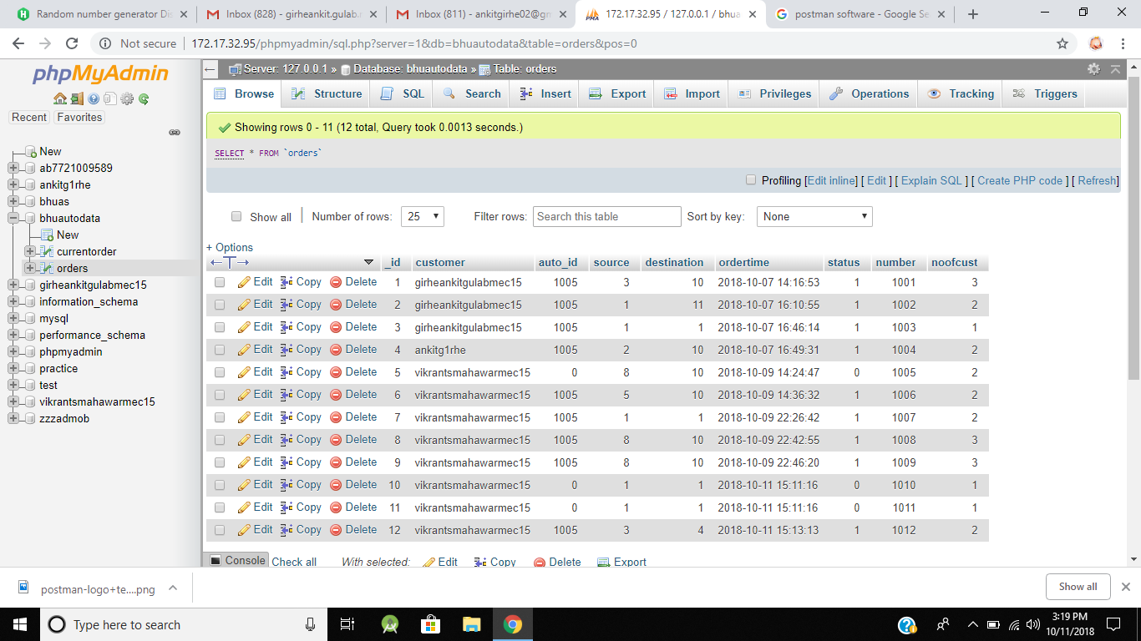
DATABASE OPERATIONS
All the orders from all customers will be saved here

Slide 16
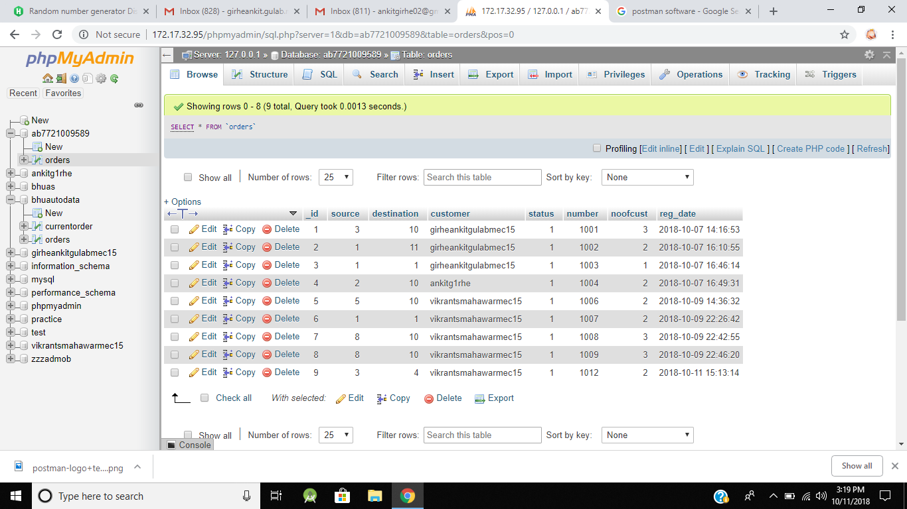
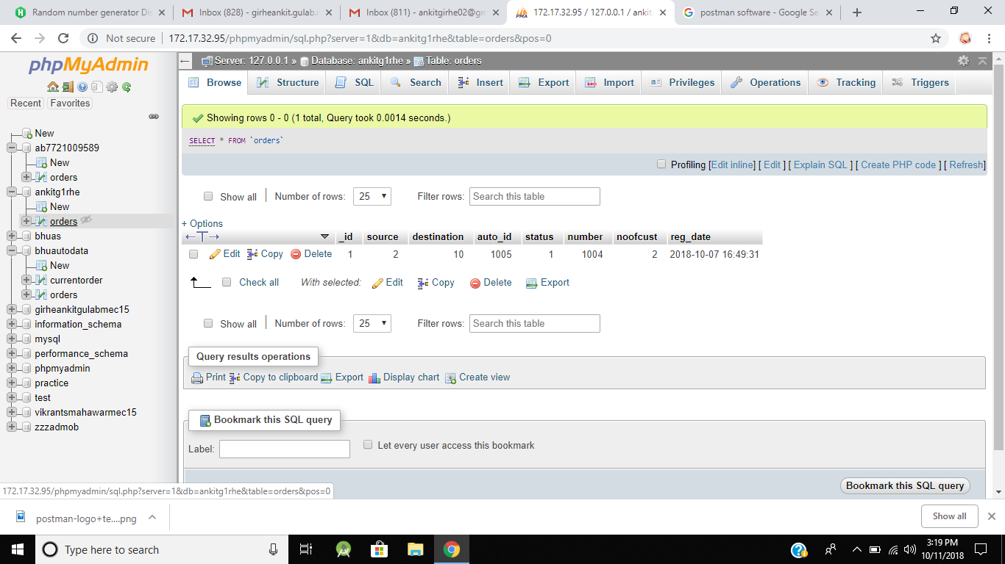
Order accepted by particular driver
will be saved in his database
Order sent by particular customer
will be saved in his database

Slide 17
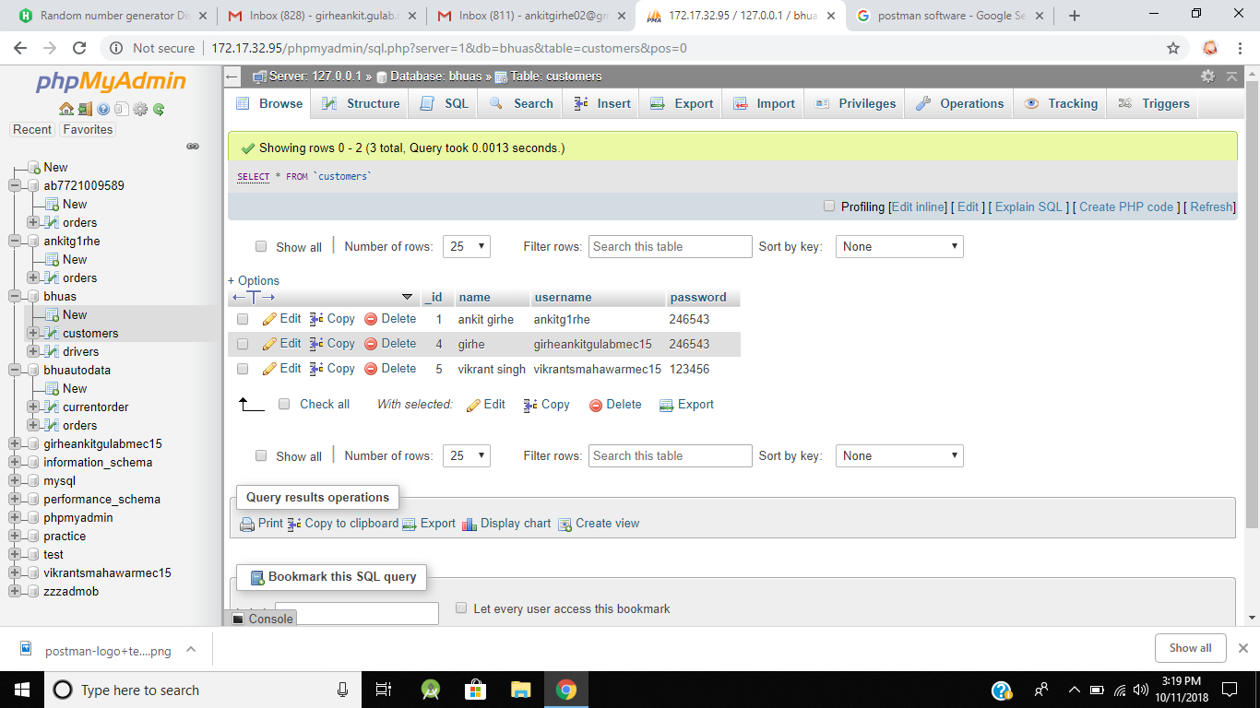
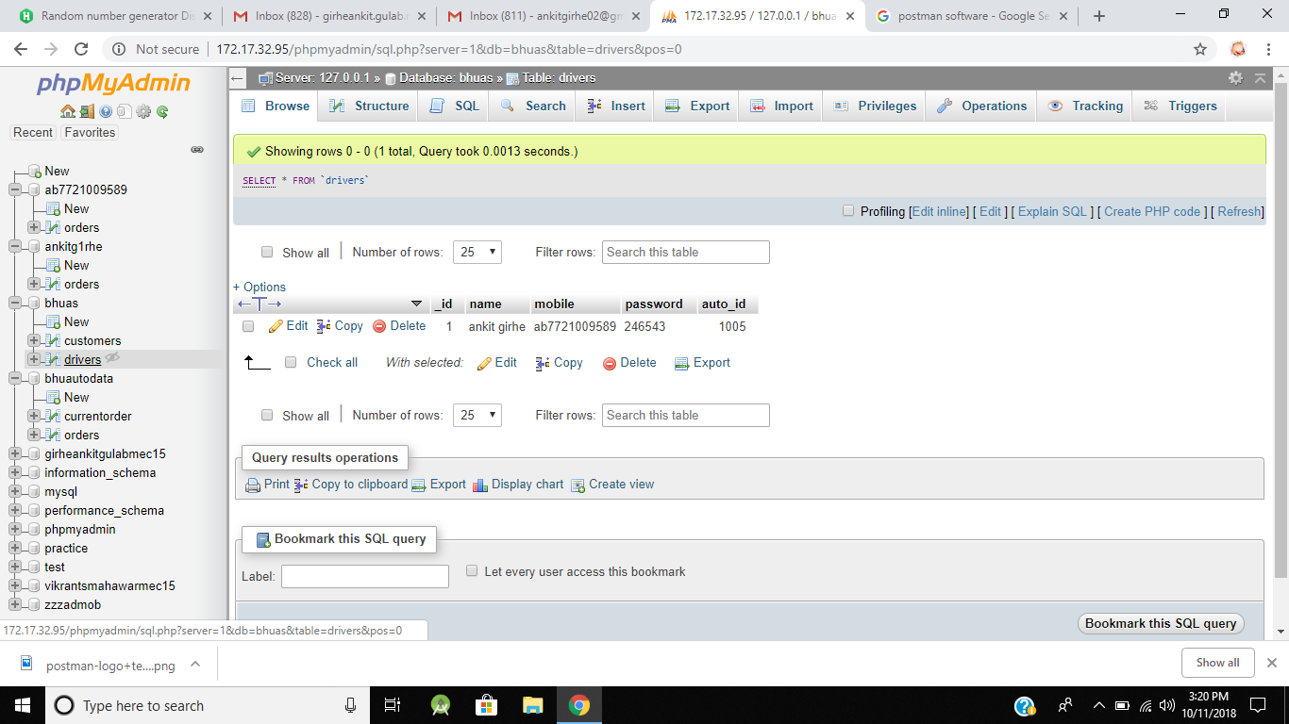
Data of customers
Username and passwords
Data of drivers
Username and passwords

Slide 18



SOFTWARE USED
Android Studio
Used for developing android application
XAMPP Operator
Provides APACHE server to create server on PC
phpMyAdmin
Provides database operation using
PHP and MySQL

Slide 19


SOFTWARE USED
PHPMailer
Used for elctronically genearating
sending mails automatically.
Postman
Web server application testing software

Slide 20
THANKYOU

