Slide 1
REPORT-5

Slide 2
CONTENT
Level 0 data flow diagram
Level 1 data flow diagram
Level 2 data flow diagram
Brief description about app
How to use app
Database operations
Software used
Limitation
Future updates

Slide 3
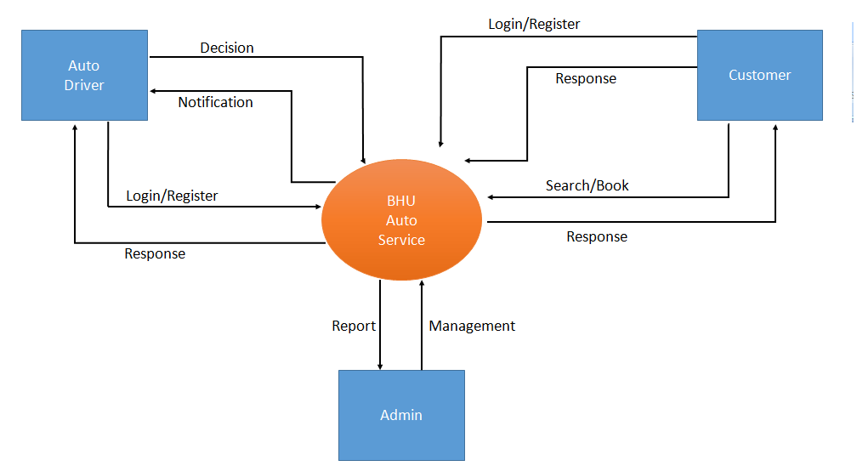
LEVEL 0 DATA FLOW DIAGRAM

Slide 4
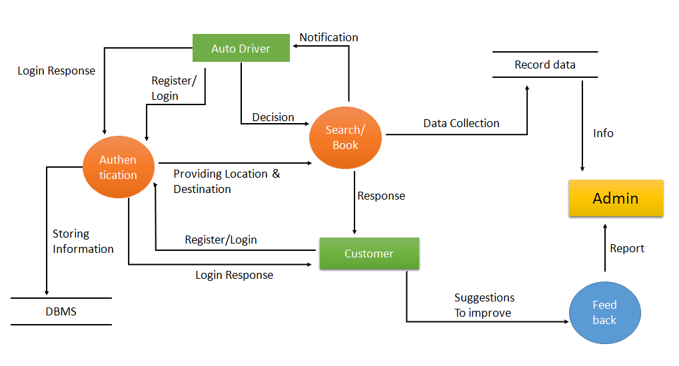
LEVEL 1 DATA FLOW DIAGRAM

Slide 5
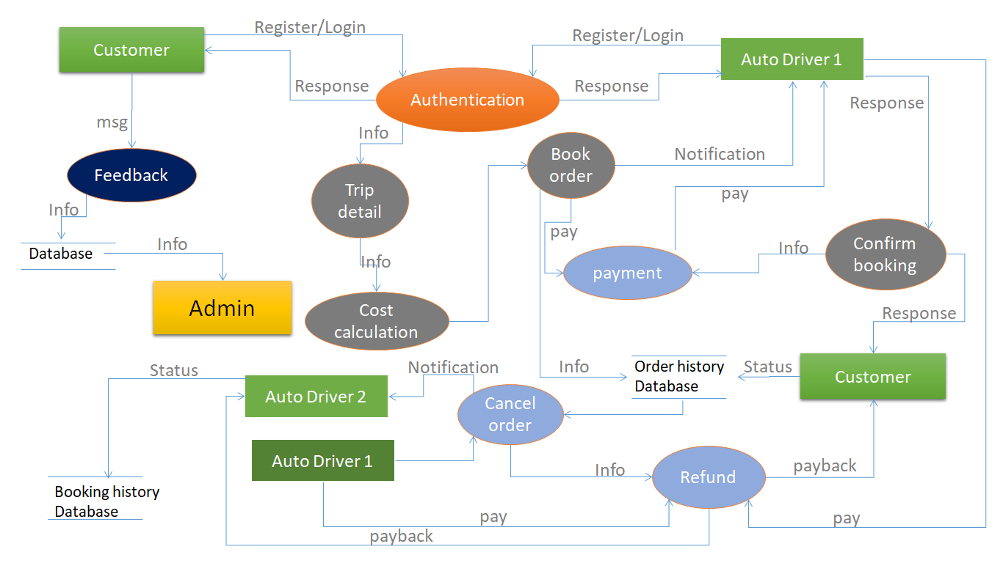
Level 2 data flow diagram

Slide 6
BRIEF DESCRIPTION ABOUT APP
There are tow main profile.
-Costumer profile -Auto driver profile
Only for inside BHU.
All data is recorded.
User friendly.

Slide 7
HOW TO USE APP
For Costumer
Sign up/ Login
Verify through OTP
Can go to order page
Can see own old book history
Can book auto

Slide 8
For Auto driver
Sign up through Admin
Can see notification of booking
Can response

Slide 9
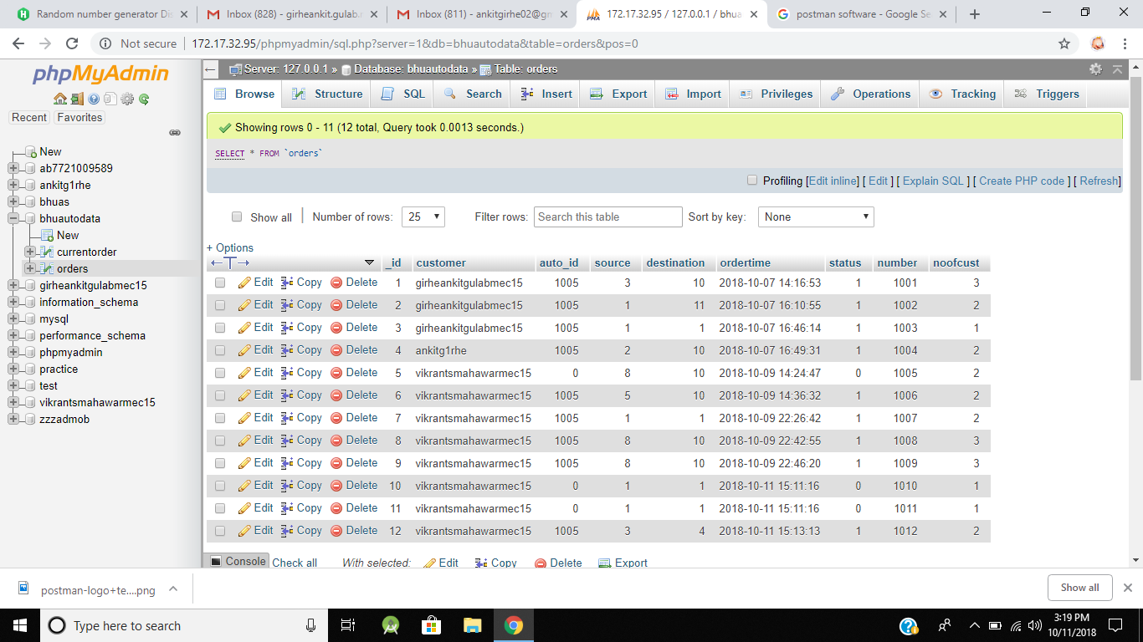
DATABASE OPERATIONS
All the orders from all customers will be saved here

Slide 10
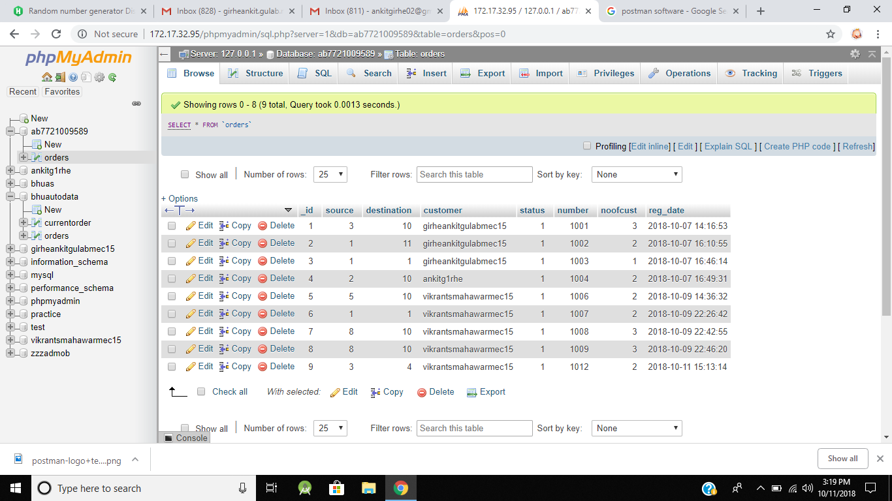
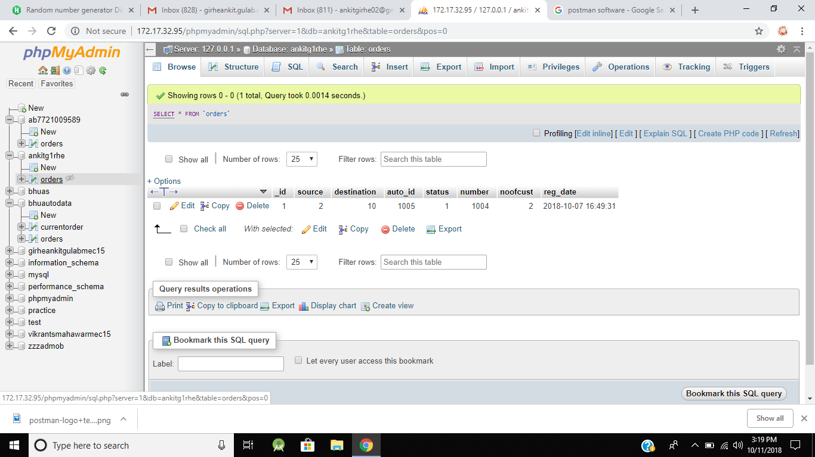
Order accepted by particular driver
will be saved in his database
Order sent by particular customer
will be saved in his database

Slide 11
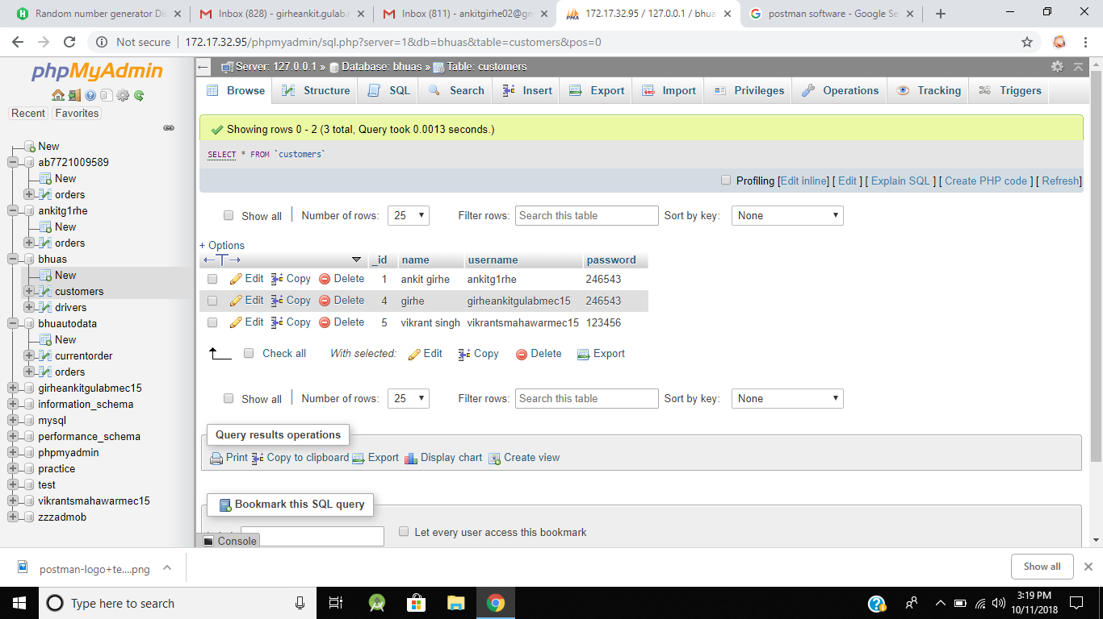
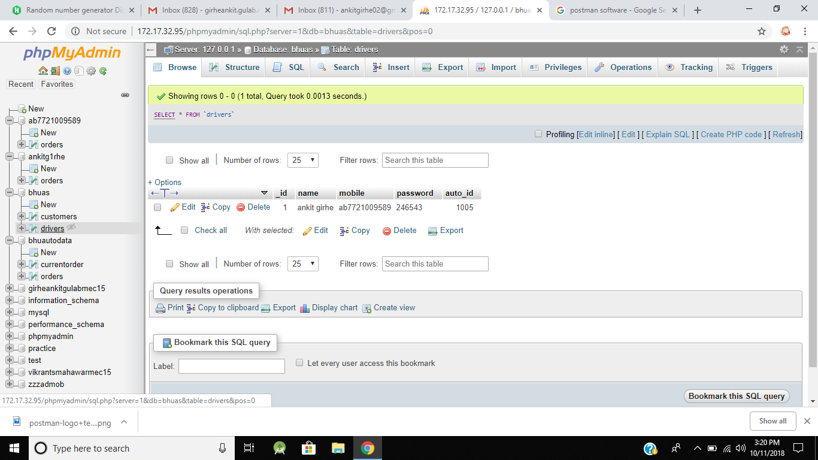
Data of customers
Username and passwords
Data of drivers
Username and passwords

Slide 12



SOFTWARE USED
Android Studio
Used for developing android application
XAMPP Operator
Provides APACHE server to create server on PC
phpMyAdmin
Provides database operation using
PHP and MySQL

Slide 13


SOFTWARE USED
PHPMailer
Used for electronically generating
sending mails automatically.
Postman
Web server application testing software

Slide 14
LIMITATION
Static app
Auto driver registration
This service only for HG to Lanka
Payment issue

Slide 15
FUTURE UPDATES
Dynamic app
E-wallet

Slide 16
THANKYOU

