Slide 1

DIH Summer Project -2017
Flywheel Based Battery Charger
Presented by:
Lokendra Rathore
Abhishek Singh
Girhe Ankit Gulab
Satish Kumar
Under Supervision of: Dr. Amit Tyagi Assistant Professor, Mechanical Engineering

Slide 2
Contents
Abstract
Introduction
Model
Project prototype
Different components
Mechanism
What We Did
Result
Scope of project

Slide 3
Abstract
As the name suggests, this project is about fabrication of flywheel based battery charger for purpose of producing electrical energy from mechanical energy which is going waste during any physical work by human being like in gym, riding bicycle, running on trade-mill or working on non-electrical juice grinder and sewing machine. This physical energy is converted to rotational energy of flywheel which is then transmitted to electricity generator using a transmission that multiplicities speed of the flywheel and transmit it to the generator unit. The mechanical power from the flywheel thus gets converted into electric power which is stored in a secondary battery using electric circuit that has various functionalities associated with it. The whole assembly is put together in frame space as far as possible to be made portable. Considering commercial point of view, this project has very potential as load shading is major issue in remote, rural as well as urban area. Thus the device can play multiple roles in everyday life.

Slide 4
Introduction
The objective of our project is to fabricate a flywheel based battery charger.
The flywheel is used in the project so that it keeps rotating even in the event of the driver slowing down or getting changed.
We have used a cast iron pulley as the flywheel for easy and efficient transfer of power from it to the DC motor which has another pulley attached to it to increase speed.
This flywheel is made to run by human power using a bicycle, which is transmitted through paddle, sprocket, chain and free wheel mechanism.
The mechanical energy is obtained in the form of rotational energy using a bicycle and this energy is then transferred to the DC motor via flywheel and a pulley (attached to DC motor). The DC motor converts this rotational energy to electrical energy.

Slide 5
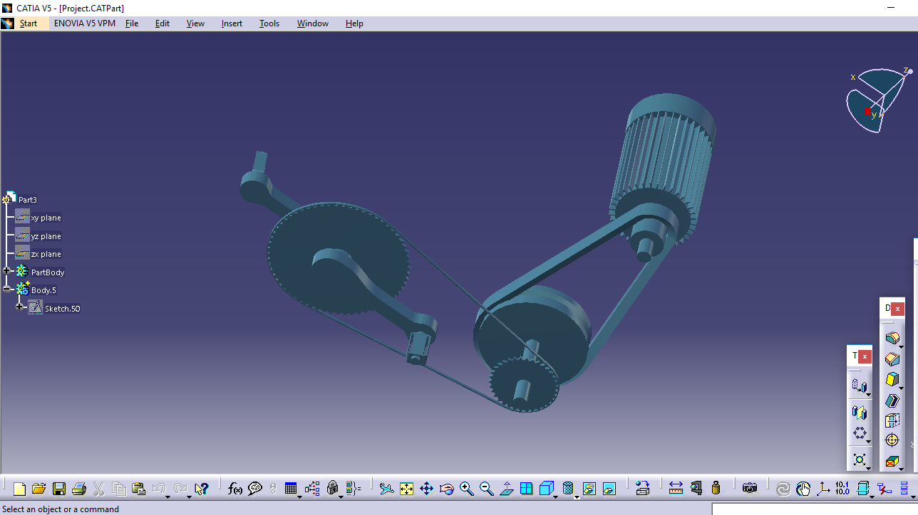
Model

Slide 6
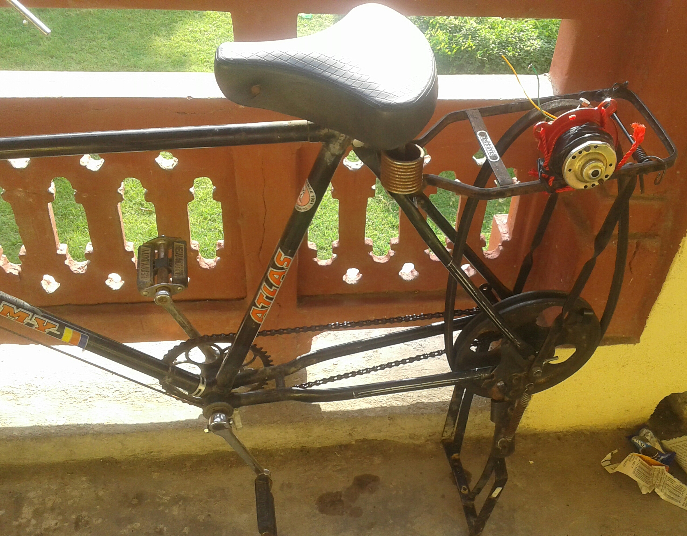
Project prototype

Slide 7
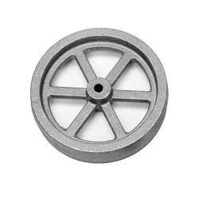
Different Components
Flywheel
A flywheel is a mechanical device specifically designed to efficiently store rotational energy. It resists change in rotational speed due to its large moment of inertia. The amount of energy stored in a flywheel is proportional to the square of its rotational speed , i.e.,
E_{k} = ½(Iw²)
Where E_{k} = Energy stored in the flywheel
I = moment of inertia of the flywheel
w = angular speed of the flywheel
Flywheel is used in our model so that it keeps rotating also in the event of someone slowing down or the driver being changed.
In our model, pulley is used as the flywheel so that rotational energy can be transmitted easily and the rpm of the generating machine can be increased.

Slide 8
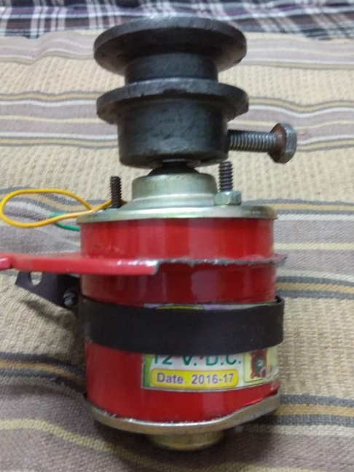

DC motor (as a generator)
A DC motor is a readymade generator that generates electricity. To generate electricity, we only have to rotate the axle of the motor using an outside mechanical source of energy. In this model, DC motor is used to convert rotational energy from pulley to electricity.
Avg. emf generated =
z – total number of armature conductors c – number of parallel paths through winding between positive and negative brushes Φ –useful flux per pole p – no. of pairs of pole N – speed of revolution(RPM)

Slide 9
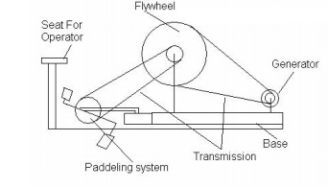
Mechanism
The mechanism uses mechanical (rotational) energy spent on paddling to create electrical energy.
The flywheel is connected to the shaft of the rear wheel of a bicycle, which in turn is connected to a smaller pulley using a belt.
The smaller pulley is used to rotate the axle of the DC motor in order to generate electrical energy.

Slide 10
What We Did
We acquired the required components for our model; including pulleys, belt, DC motor, etc.
We generated the working mechanism and produced the desired results (the conversion of mechanical energy into electrical energy and its usage).
We tested the mechanism and generated results.

Slide 11
Result
We were able to produce a voltage of ~3V with our model, using the energy used in paddling.
For paddling at 60 rpm, the rpm of motor was found to be ~600 rpm and the voltage gain was 0.9V.
For paddling at 120 rpm, the rpm of motor was found to be ~1200 rpm and the voltage gain was 1.7V.
This voltage can be used to charge a rechargeable battery.

Slide 12
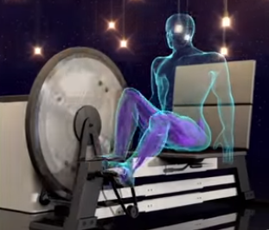
Scope of the project
We can use a gym cycle instead of a regular one so that the energy used during workout can be used.
If the model can be made mobile, energy can be produced while riding a bicycle.

Slide 13
Thank You!

