Slide 1
Comparative Analysis of Machine Learning Approaches for Classifying Erythemato-Squamous Skin Diseases

Slide 2
AUTHORS
Bhavana Kaushik | Ankur Vijayvargiya | Jayant Uppal | Ankit Gupta
School of Computer Science University of Petroleum and Energy Studies Dehradun, India | Samsung R&D Noida, India | PeopleStrong Gurugram, India | Accenture Bengaluru, India
bkaushik@ddn.upes.ac.in | ankurvijayvargiya10@gmail.com | jayantuppal1707@gmail.com | ankitg777jr@gmail.com

Slide 3
AGENDA
Introduction
Material
Methods
Discussion
Results
Future Scope
Conclusion
References

Slide 4
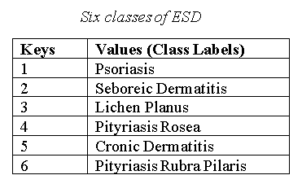
INTRODUCTION
In Dermatology, differential diagnosis of erythemato-squamous disorders (ESD) is quite challenging in real life because most skin diseases share many histopathological features.
Numerous machine learning algorithms that aid in the difficult segmentation and categorization of skin-related disorders in this work, that has been proven to be successful in preserving state information through exact segmentation/classification.
The figure shown aside lists the six classes of ESD that are among the skin illnesses for which eight alternative algorithms are tested, and discussed further.
Figure 1- Six classes of ESD

Slide 5
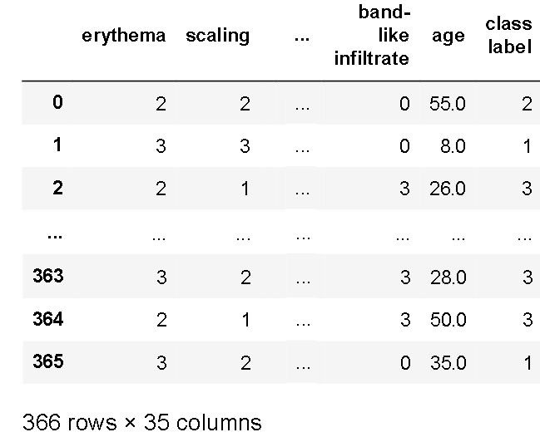
MATERIAL
The standardized dermatology data set from the University of California, School of Information and Computer Science's machine learning repository or UCI is taken for the experiment.
It has 34 properties, 12 of which are clinical and 22 of which are histopathological. Age and family history are continuous characteristics in the data set, with values ranging from 0-1.
Every additional clinical and histopathological feature was assigned a degree from 0 to 3, with 0 indicating that the feature was not present, 3 indicating the maximum amount possible, and 1, 2 indicating relative intermediate values.
Figure 2 - Visualization of the dataset

Slide 6

METHODS
The eight ML Classification Algorithms investigated in this research are listed below:
Naive Bayes
Random Forest
Support Vector Machines
XGBoost
Multi-layered perceptron
K-nearest neighbors
Decision tree
Gradient boosting DT

Slide 7
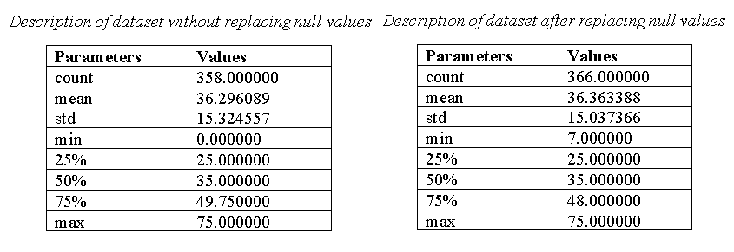
DISCUSSION
To do this analysis few pre-processing steps are to be applied to the used dataset. First, the count of null values of attributes will be checked.
Accordingly, there are 8 rows of the age attribute with null values.
From the description/composition of the dataset it can be seen that there is only a slight difference in the mean frequency of the dataset after replacing the null values.
Mean frequency difference percentage = 0.18%.
Figure 3 – Dataset composition comparative analysis

Slide 8
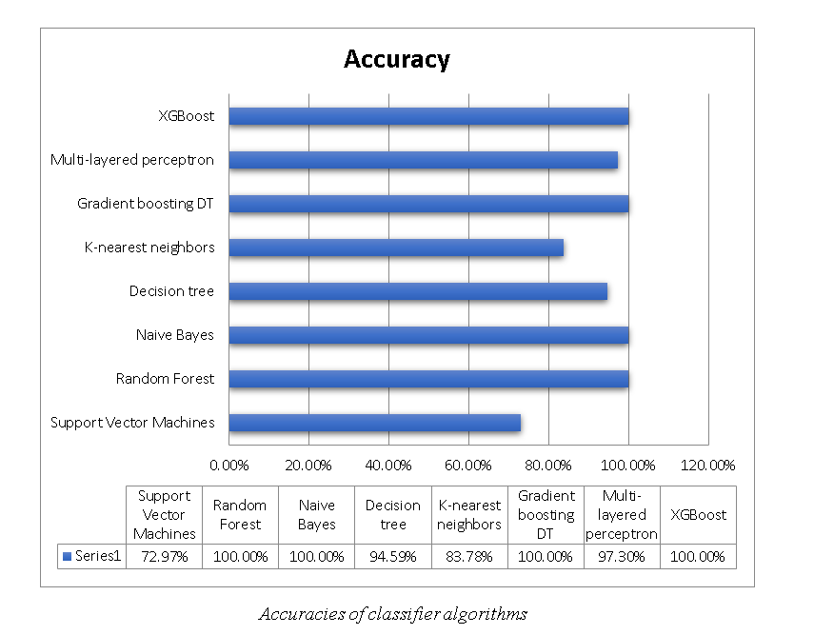
RESULTS
The machine learning models used in the research are trained using the various classifier techniques discussed above.
After the successful test of their accuracy the listed below methods emerged as the most popular with 100% accuracy, which can be inferred from the figure mentioned aside:
Random Forest
Naive Bayes
Gradient Boosting DT
XGBoost
Figure 4 - Accuracies of classifier algorithms

Slide 9

FUTURE SCOPE
The dataset is very limited and hence requires continuous integration of the new records to derive the prediction with more realistic values.
To introduce an auto-feedback mechanism to provide the required remediation to the predicted class of ESD.
Upgrading the dataset with visual images of the ESD-impacted skin area to correlate it with the predicted class of ESD for reducing parameter-based analysis to image visualization.

Slide 10

CONCLUSION
We can see from the preceding calculations that utilizing the attribute's median to replace missing values results in a very small percentage change in the dataset's mean frequency.
Furthermore, while comparing eight other classification methods, we can find that XGBoost fared exceptionally well with a 100% accuracy rate for three of them, namely Random Forest, Naive Bayes, and Gradient Boosting DT.
XGBoost could be useful since it uses a mixture of software and hardware enhancement methods to provide supercilious prediction results with minimal computer assets in a small quantity period.

Slide 11
REFERENCES
[1] Nilsel Ilter, H. Altay Guvenir, "Dermatology Data Set," 01 January 1998. [Online]. Available: https://archive.ics.uci.edu/ml/datasets/dermatology.
[2] R. Gandhi, "Support Vector Machine — Introduction to Machine Learning Algorithms," 7 June 2018. [Online]. Available: https://towardsdatascience.com/support-vector-machine-introduction-to-machine-learning-algorithms-934a444fca47.
[3] H. Wang, Y. Shao, S. Zhou, C. Zhang and N. Xiu, " Support Vector Machine Classifier via Soft-Margin Loss," IEEE Transactions on Pattern Analysis and Machine Intelligence, pp. 1-11, 2021.
[4] J. Brownlee, "Support Vector Machines for Machine Learning," 20 April 2016. [Online]. Available: https://machinelearningmastery.com/support-vector-machines-for-machine-learning/.
[5] C. GOYAL, "Top 15 Questions to Test your Data Science Skills on SVM," 20 May 2021. [Online]. Available: https://www.analyticsvidhya.com/blog/2021/05/top-15-questions-to-test-your-data-science-skills-on-svm/.
[6] T. Yiu, "Understanding Random Forest," 12 June 2019. [Online]. Available: https://towardsdatascience.com/understanding-random-forest-58381e0602d2.

Slide 12
THANK YOU

