Slide 1

IT Tickets Analysis &
Agent Performance Dashboard
An Excel-based data analytics deep-dive into ticket volume, resolution
efficiency, and agent performance (2016 – 2020)
PRESENTED BY
Ankit S. Gaikwad

Slide 2



Problem Statement
Identify Performers
The IT support ticket management system needs a full performance review. This analysis evaluates agent performance, resolution efficiency, and employee satisfaction to identify high and low performers, assess team effectiveness, and pinpoint where the resolution process breaks down.
The end goal: informed staffing decisions — hiring, training, and process change — that raise service quality and team performance.
Spot high and low performing agents
Assess Efficiency
Evaluate ticket resolution effectiveness
Improve Process
Pinpoint gaps in the resolution workflow
2016–2020
Analysis Time Span
2

Slide 3



Dataset Structure
97,498
50
5 Years
20
Tickets Analyzed
IT Agents
2016 – 2020
Quarters of Data
Datasets Used
Cleaning & Quality
Why This Data Matters
Tickets Sheet — 97,498 records: Ticket ID, Date, Employee ID, Agent ID, Category, Issue Type, Severity, Priority, Resolution Time, Satisfaction Rate.
IT Agents Sheet — 50 agents with demographic info (Agent ID, name, date of birth).
Fixed spelling inconsistencies (e.g. "Mayor" → "Major", duplicate "Unassigned/Unclassified" labels).
Confirmed zero missing values across every column.
Standardized category names and naming conventions.
Full visibility into the ticket lifecycle, from assignment through resolution.
Enables individual agent performance and productivity evaluation.
Supports KPIs for both day-to-day operations and long-term decisions.
3

Slide 4

Ticket Category Distribution
Key Insight
System tickets lead the volume: 39,002 tickets (40.0% of all tickets).
Login Access follows closely: 29,193 tickets (29.9%).
Together, System and Login Access account for 68,195 tickets (70.0%) — the largest workload concentration.
These two categories are the strongest candidates for automation and process redesign.
4

Slide 5
Average Resolution Time by Ticket Category
Key Insight
Hardware is consistently the slowest category, averaging 7.5–7.7 days per quarter with little variation.
System stays steady near 6.6 days (6.58–6.64) across all four quarters.
Software holds around 5.2–5.3 days, with its best quarter (5.16 days) in Qtr 3.
Login Access is resolved fastest by far — consistently close to 0.31 days.
5

Slide 6
Average Satisfaction Rate Over Time
Key Insight
Satisfaction improved steadily: from 3.95 in Q1 2016 to 4.13 in Q4 2020.
Highest satisfaction recorded: 4.19, in Q2 and Q3 2020.
Scores held stable between roughly 4.07 and 4.14 from 2017 onward, despite quarterly fluctuations.
6

Slide 7
Priority-wise Ticket Volume
Key Insight
High priority leads: 35,549 tickets (36.5%) are marked high priority.
Unassigned tickets remain significant: 29,410 tickets (30.2%) have no priority assigned.
High + Unassigned together account for 66.6% of all tickets — a strong concentration in these two groups.
7

Slide 8
Severity-wise Ticket Volume
Key Insight
Normal severity dominates: 88,656 tickets (90.9%).
Major + Urgent together account for 6,228 tickets (6.4%).
Urgent is only 1,392 tickets (1.4%).
356 tickets (0.4%) are Unclassified — a small triage-quality gap worth closing.
8

Slide 9
Ticket Volume Over Time
Ticket volume rose from 13,051 in 2016 to 29,088 in 2020 — a 122.9% increase over five years, with 2020 alone growing 35.36% year over year. The trend points to a need for scalable capacity and stronger ticket triage.
13,051
14,915
18,954
21,490
29,088
2016
2017
2018
2019
2020
+14.28% YoY
+27.08% YoY
+13.38% YoY
+35.36% YoY
9

Slide 10
Distribution of Tickets by Resolution Time
Key Insight
47,014 tickets (48.2%) were resolved within 0–3 days.
75,106 tickets (77.0%) were resolved within 0–7 days.
Only 1,979 tickets (2.0%) took more than 16 days.
The distribution is concentrated in shorter resolution windows, with a small long tail.
10

Slide 11
Distribution of Tickets by Satisfaction Rate
Key Insight
50,770 tickets (52.1%) received the top score of 5.
Scores of 4 or 5 total 78,332 tickets (80.3%).
A score of 1 appears about 5× as often as a score of 2.
Overall feedback is strongly concentrated toward high satisfaction.
11

Slide 12
Age Group vs. Average Satisfaction Rate
Key Insight
29–33 has the highest average satisfaction: 4.21.
34–38 has the lowest: 3.96 — highlighted above.
39–43 improves to 4.14; 49–54 reaches 4.20.
The 0.25-point gap between the highest and lowest groups identifies 34–38 as the clearest improvement area.
12

Slide 13


Recommendations
Prioritized actions with measurable targets and deadlines
1
2
3
Reduce Resolution Time
Automate High-Volume Work
Improve Ticket Triage
Hardware averages 7.63 days and System 6.62 days — both well above the 4.55-day overall average. Streamlining escalation and parts/access workflows should close most of this gap.
System and Login Access together drive 70% of all ticket volume. Self-service password resets and automated system-status alerts can deflect a meaningful share before they reach an agent.
356 tickets (0.37%) remain Unclassified, leaving them outside normal SLA tracking. Enforcing mandatory categorization at ticket creation removes this blind spot.
Target: within 3 months
Target: reduce volume by 20% in 6 months
Target: fewer than 200 within 3 months
4
5
6
Train Bottom Performers
Lift the Weakest Satisfaction Group
Plan Capacity for Growth
Agents 3, 6, 22 and 28 show the weakest combination of resolution time and satisfaction score. A 12-week coaching plan paired with shadowing top performers should close the gap.
Employees aged 34–38 report the lowest satisfaction at 3.96/5, a 0.25-point gap versus the top group. Targeted follow-up surveys can pinpoint the specific friction this group faces.
Ticket volume grew 122.9% between 2016 and 2020, with 2020 alone up 35.4% year over year. Staffing and infrastructure plans should scale ahead of demand, not react to it.
Target: 10% lower average resolution time
Target: reach at least 4.10 / 5 within 6 months
Review capacity & staffing quarterly against growth and SLA
13

Slide 14
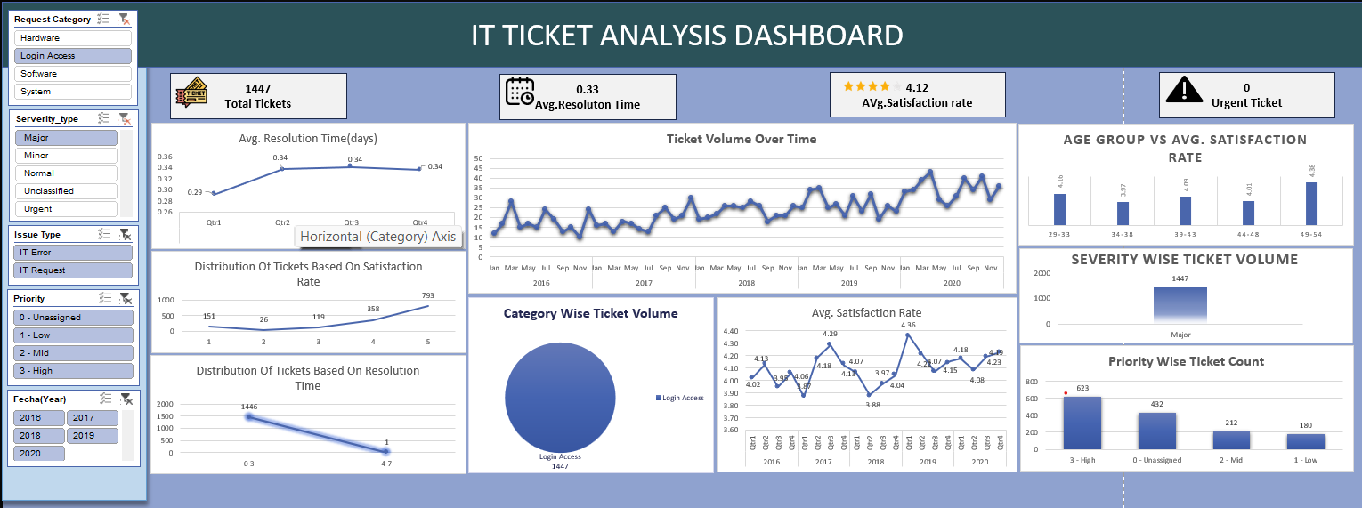
IT Ticket Analysis Dashboard
14

Slide 15
Conclusion
Key findings and performance highlights
1
High Ticket Volume — The support team handled 97,498 tickets, indicating a substantial and sustained service workload.
2
Significant Volume Growth — Ticket volume increased by 122.9% from 2016–2020, showing rising demand for IT support.
3
Resolution Time Needs Attention — The overall average resolution time is 4.55 days, with Hardware and System tickets taking longer to resolve.
4
High-Volume Workflows Drive Demand — Login Access and System workflows account for a major share of ticket volume, making them key workload drivers.
5
Triage & Classification Gap — There are 356 unclassified tickets (0.37%), indicating room for better ticket categorization and routing.
6
Satisfaction & Agent Performance Vary — Overall satisfaction is 4.1/5, with the 34–38 age group lowest at 3.96/5. Some agents also show weaker resolution performance.
15

Slide 16
Acknowledgements & References
DATA SOURCES
TOOLS USED
Tickets Dataset
Microsoft Excel
97,498 records with complete ticket metadata.
Source: Internal IT Management System
Primary platform for analysis & dashboard creation
PivotTables
IT Agents Dataset
Aggregation and cross-tabulation of ticket data
50 agents with demographic and performance data.
Charts & Graphs
Visualizing trends and performance metrics
Created By
Ankit S. Gaikwad
Formulas Used
AVERAGE, XLOOKUP, IF, TEXT, MID, ROUND
16

