Slide 1


Slide 2

By 2010, enterprises that lack ongoing KM infrastructure will lag KM-enabled competitors by 30-40% in speed of deployment for new competitive programs and products
(Gartner Group)
Notes:
The Conference Board conducted a survey this year of 200 executives at large organizations on their perspectives for knowledge management and organizational learning.
The organizations included IBM, Shell, British Petroleum, Deere, US Postal Service, US Army, and Price WaterhouseCoopers.
They found that interest in KM is still building, although 80% of the firms have it underway somewhere in their organization, 6% have it implemented enterprise-wide, 25% have a designated CKO. It is projected this will grow to 60% in the next 5 years, indicating most organizations are rapidly moving to make KM a strategic part of their business.

Slide 3
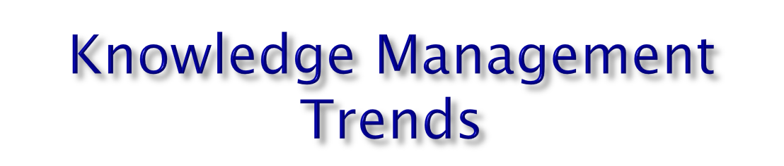
Survey of 200 Large Firms found:
  82% have KM underway in their organization
  50% have KM staff & budget
  27% have a Chief Knowledge Officer
  (Conference Board)
Survey of nations leading CEOs:
  Second top priority “Improving KM” (88%)
    (Foundation for Malcolm Baldridge Award)
Notes:
The Conference Board conducted a survey this year of 200 executives at large organizations on their perspectives for knowledge management and organizational learning.
The organizations included IBM, Shell, British Petroleum, Deere, US Postal Service, US Army, and Price WaterhouseCoopers.
They found that interest in KM is still building, although 80% of the firms have it underway somewhere in their organization, 6% have it implemented enterprise-wide, 25% have a designated CKO. It is projected this will grow to 60% in the next 5 years, indicating most organizations are rapidly moving to make KM a strategic part of their business.

Slide 4
Intel’s Invisible Balance Sheet
Assets
Finance
Cash
Debt
Current Assets
$29 Bn
Visible Equity $21 Bn
Equipment
Customer Capital
External Structure
Structural Capital
Goodwill
Invisible Equity
~$106 Bn
Internal Structure
Intangible Assets
Intellectual Capital
Human Capital
Market Value ~ $127 Bn
Indiv. Competence

Slide 5
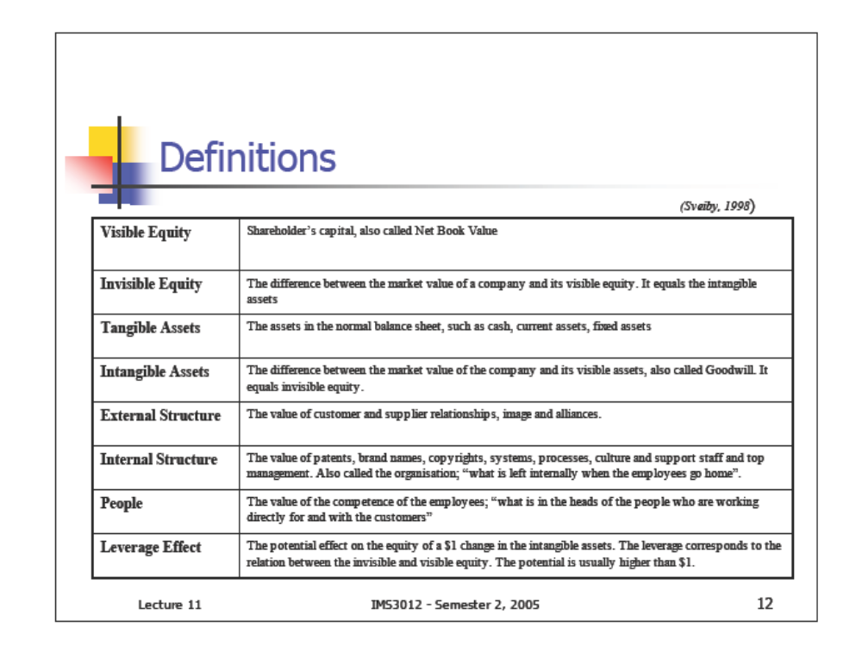

Slide 6

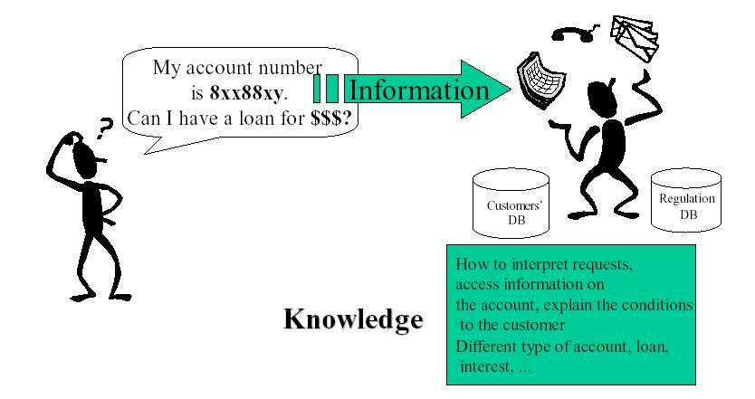

Slide 7

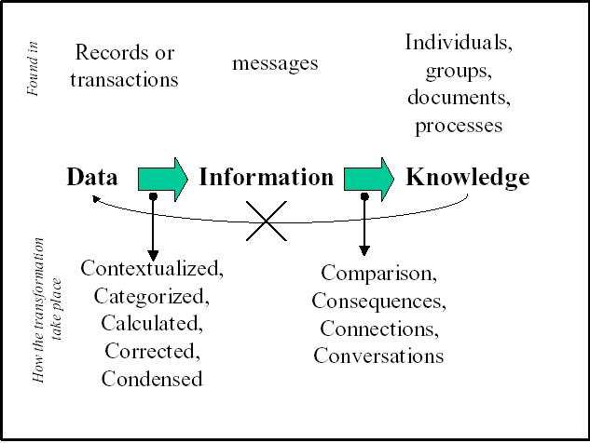

Slide 8

Dominant group of workers in the 21st century.
Specialists with job-specific skills.
Have significant formal education or formal training.
Are self-directed learners
Require multiple, continuous learning opportunities to maintain their specialized knowledge

Slide 9


Slide 10

  Concepts, methodologies
  Facts, beliefs, truths & laws
  Know what, Know how, Know why
  Judgments & expectations, insights
  Relationships, leverage points
  Intuition & feelings
  Meaning and sense making

Slide 11


Patents
Explicit
Knowledge
Policies
Plans
Specs
T
Financials
Copyrights
Org charts
Procedures
Imagination
Opinions
Religions
Beliefs
Confidence
Intuition
Tacit
Knowledge
Influences
Ethics
Curiosity
Experience
Relationships
Feelings
Judgment
Creativity
Taboos
Know-how

Slide 12
The notions of tacit and explicit knowledge introduced by Polanyi in the 1950s
  Tacit
  -Is personal, context-specific knowledge, difficult to formalize,record, or articulate, it is stored in the heads of people. Tacit knowledge mainly developed through a process of trial & error encountered in practiced
  Explicit
  - Can be codified and transmitted in a systematic and formal language: documents, databases,e-mail,etc

Slide 13

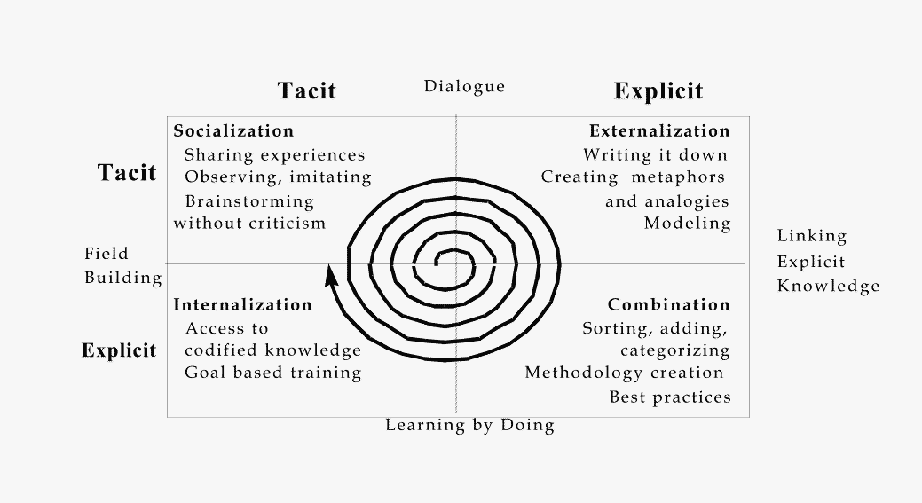

Slide 14

Socialization (tacit to tacit): Socialization includes the shared formation and communication of tacit knowledge between people, e.g., in meetings. Knowledge sharing is often done without ever producing explicit knowledge and, to be most effective, should take place between people who have a common culture and can work together effectively . Thus tacit knowledge sharing is connected to ideas of communities and collaboration. A typical activity in which tacit knowledge sharing can take place is a team meeting during which experiences are described and discussed
Externalization (tacit to explicit):
By its nature, tacit knowledge is difficult to convert into explicit knowledge. Through conceptualization, elicitation, and ultimately articulation, typically in collaboration with others, some proportion of a person's tacit knowledge may be captured in explicit form. Typical activities in which the conversion takes place are in dialog among team members, in responding to questions, or through the elicitation of stories.
Tacit
Explicit
Socialization
Externalization
(Capture)
Internalization (explicit to tacit):
In order to act on information, individuals have to understand and internalize it, which involves creating their own tacit knowledge. By reading documents, they can to some extent re-experience what others previously learned. By reading documents from many sources, they have the opportunity to create new knowledge by combining their existing tacit knowledge with the knowledge of others. However, this process is becoming more challenging because individuals have to deal with ever-larger amounts of information. A typical activity would be to read and study documents from a number of different databases.
Combination: (explicit to explicit):
Explicit knowledge can be shared in meetings, via documents, e-mails, etc., or through education and training. The use of technology to manage and search collections of explicit knowledge is well established. However, there is a further opportunity to foster knowledge creation, namely to enrich the collected information in some way, such as by reconfiguring it, so that it is more usable. An example is to use text classification to assign documents automatically to a subject schema. A typical activity here might be to put a document into a shared database.
Tacit
Internalization
Combination
(Dissemination)
Explicit

Slide 15
Knowledge Management Framework

Slide 16

Socio-cultural &
Organizational Components
Creation/
Acquisition
Knowledge
Organ-
ization/
Storage/
Retention
Application
/ Utilization
Distribution
/Transfer
Technology
Source: Arthur Andersen

Slide 17

20% Right Technology
80% Cultural change
  Behavior of the leaders
  What type of learning is valued
  Informal structure of the company
  How are mistakes handled
  What is rewarded and what is punished
  How is information shared

Slide 18

There are a number of technologies commonly thought of when the term "knowledge management" is intoned.
Intranets
Document Management Systems
Information Retrieval Engines
Relational and Object Databases
Electronic Publishing Systems
Groupware and Workflow Systems
Push Technologies and Agents
Help-Desk Applications
Brainstorming Applications
Data Warehousing and Data Mining Tools
Technologies that should be included knowledge management

Slide 19

Knowledge
Creation/
Acquisition
Knowledge
Organization/
Storage/Retention
Knowledge
Distribution/
Transfer
Knowledge
Application/
Utilization

Slide 20

Knowledge Creation
- This comprises of activities associated with entry of new knowledge into the system, and includes knowledge development, discovery and capture
Knowledge Retention/Storage
- This includes all activities that preserve knowledge and allow it to remain in the system once introduced. It also includes those activities that maintain the viability of knowledge within the system
Knowledge Transfer
- This refers to activities associated with the flow of knowledge from one party to another. This includes communication, translation, conversion, filtering and rendering
Knowledge Utilization
- This includes the activities and events connected with the application of knowledge to business processes

Slide 21

CREATION
UTILIZATION
TRANSFER
RETENTION

Slide 22

There are three types of repositories of knowledge.
They are Structured Repositories, Unstructured Repositories, and People and they form a continuum (range) in terms of search ability.
Structured Repositories - explicit
Structured repositories are databases, expert systems and the like. They are characterized by their ease of search ability because they have search aids like indexes, keywords, controlled vocabulary and so forth.
Unstructured Repositories - explicit
In most organizations these include project reports, sales-call notes and other sources. These are searchable by free text means.
The two repositories mentioned above are for explicit knowledge, the knowledge that is out there for all to find, see and use. There's also tacit knowledge.
People as Repositories of Knowledge- tacit
Tacit knowledge resides in the heads of people. The tools to get to this knowledge are phone directories, annotated company directories, company-knowledge yellow pages and other people listings.

Slide 23

The concept of Community of Practices (CoPs) first introduced by Lave and Wenger (1991)
They described a Community of Practice as “.. a set of relations among persons, activity and world, over time and in relation and other tangential and overlapping CoPs
In such a community, a newcomer learns from the old-timers by being allowed to participate in certain task that is related to the practice of the community
A Community of Practice is regarded as “ an intrinsic condition for the exisitence of knowledge”
A CoP does not imply co-presence, socially visible boundaries or well-defined or identifiable group. However, it does imply participation in an activity where participants have a common understanding of what is it and what is means for their lives and community. The community and the participation in it are inseparable from the practice.

Slide 24

Teams
  Common goals
  Formal
  Assigned roles
  More static
  Till job is done
  Hierarchical
  Goal oriented
  Cooperation
Comm. Of Practice
  Common interests
  Informal
  Voluntary
  Dynamic
  Long lasting
  Self-organizing
  Process oriented
  Knowledge sharing
Common
activities

