Slide 1

Prospection: Interpretable Plans From Language By Predicting the Future
Chris Paxton, Yontatan Bisk, Jesse Thomason, Arunkumar Byravan, Dieter Fox
Submitted By:
Karan Mittal(2017ME20671) Ankit Garg(2017EE10439)

Slide 2
Contents
Problem Statement
Baseline
Technical Approach
Results
Applications

Slide 3
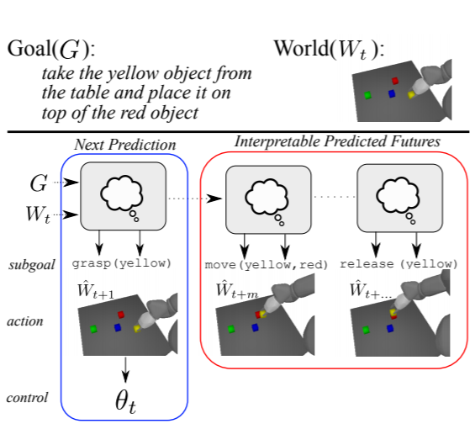
Problem Statement
Input :- High level language command, Raw sensor data
Output :- Sequence of low level actions for the robotic arm, that can achieve the intended task.
Rather than using standard templates, it should able to process real world language commands
Prospection :- The agent should be able to predict future actions and world states based on current world state

Slide 4
Contents
Problem Statement
Baseline
Technical Approach
Results
Applications

Slide 5
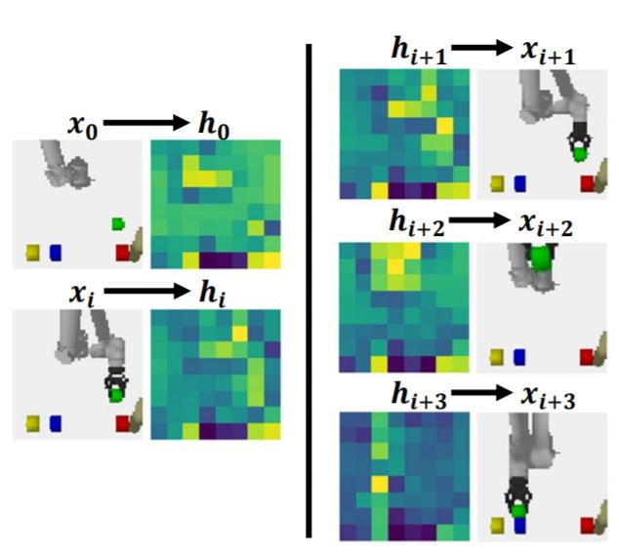
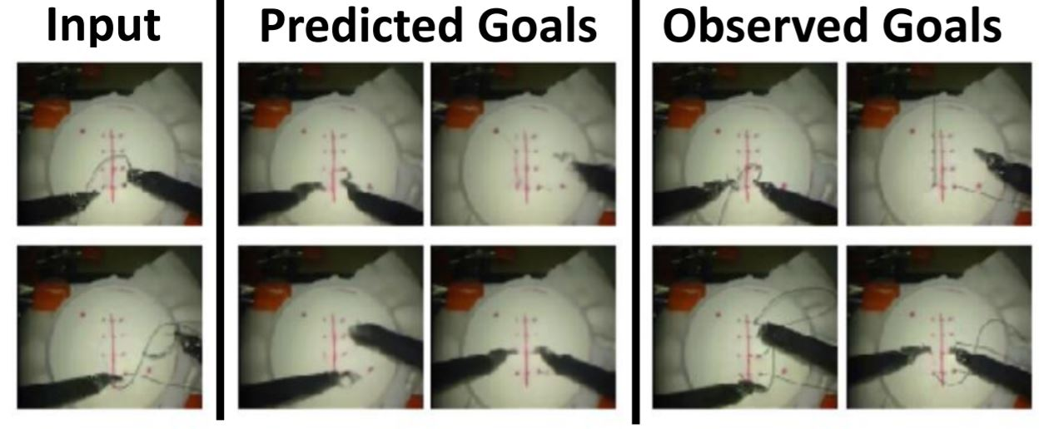
Visual Robot Task Planning
Discusses the idea of prospection for task planning
Outcomes of a chain of high level actions can be simulated
Intermediate motion goals can be visualised

Slide 6
Contents
Problem Statement
Baseline
Technical Approach
Results
Applications

Slide 7
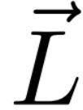


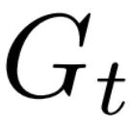
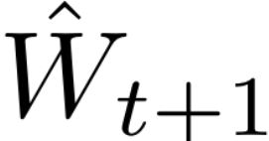
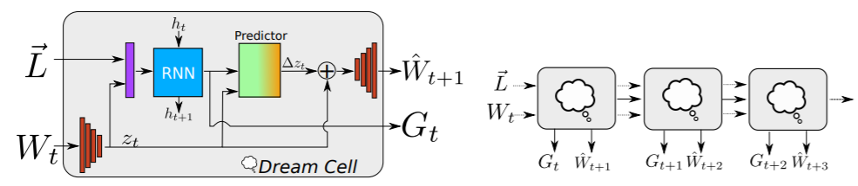
Dream Cell
The inputs to the cell at each time step are:
Encoded language vector
Current World State
Initial World State
The predictions made by the cell at each timestep are:
Sub-goal
Next World State

Slide 8
Sub-goal Module
Input :- The final hidden state generated by the LSTM is concatenated with the hidden representation of the world generated by the encoder
Output :- Subgoals of the form (action, main object, auxiliary object) are produced upto a horizon of length h

Slide 9

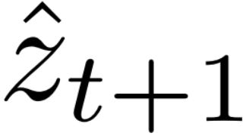
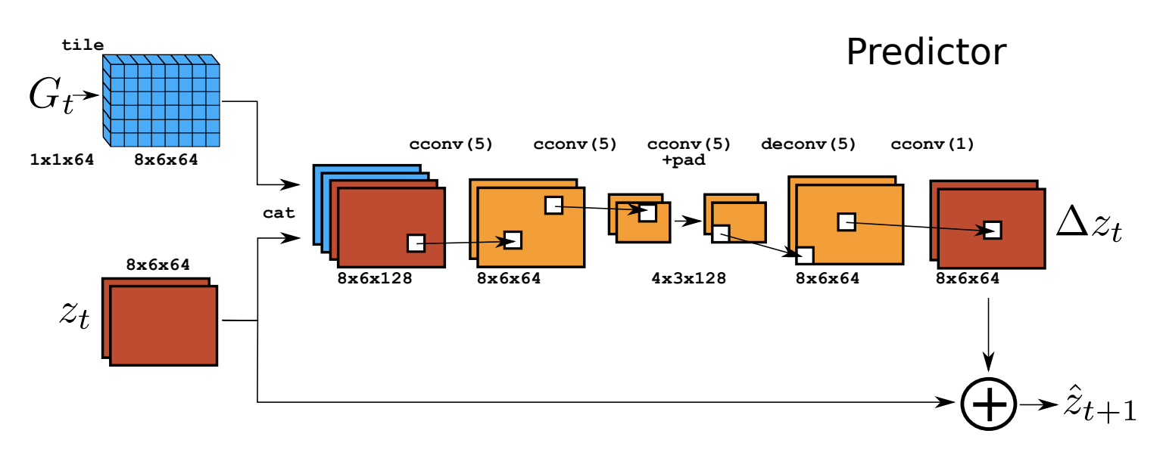
World-Predictor Module
Inputs of the prediction cell:
Current hidden state
Predicted Sub-goal
Output of the prediction cell:
Next hidden state
Notes:
The prediction cell, shown in Fig. 3, takes in the current hidden state zt and the predicted subgoal Gt. Each prediction model outputs a predicted latent-state subgoal zˆt+1, such that P(zt, Gt) = ˆzt+1. In effect, we learn a many-to-one mapping across multiple timesteps, all of which need to produce the same goal. We should also be able to roll this simulation forward in time in order to visualize future actions. Training this prediction space is a difficult problem and requires a complex loss function involving multiple components. The prediction cell is a simple autoencoder mapping inputs W to and from a learned latent space, as show in Fig. 2. World observations Wt and W0 are combined into a single estimated latent state zt. The vector containing the predicted subgoal Gt is tiled onto this state. We use a bottleneck within each prediction cell to force information to propagate across the entire predicted image, and then estimate a change in latent state ∆z such that zˆt+1 = zt + ∆z. When visualizing the predicted image Wˆ t+1, we use a decoder consisting of a series of 5x5 convolutions and bilinear interpolation for upsampling.

Slide 10
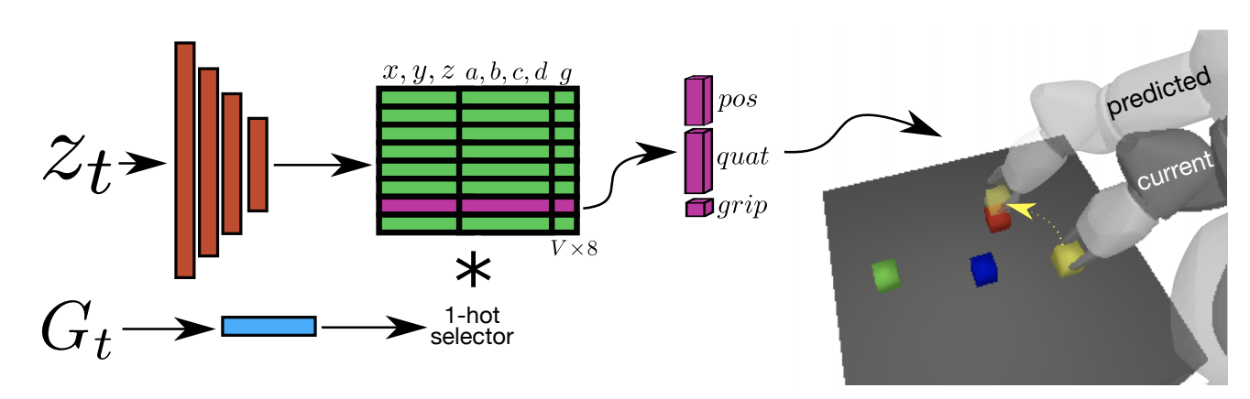
Actor Module
Inputs of the actor module:
Hidden State
Sub-goal
Outputs of the actor module:
Gripper instruction g
Cartesian position (x,y,z)
Unit Quaternion (a,b,c,d)
Notes:
The actor module, shown in Fig. 4, predicts the parameters of an action that can be executed on the robot. Specifically, it takes in zt and the current high-level action and predicts a destination end effector pose that corresponds to the robot’s position at zt. The architecture is a simple set of convolutions: the highlevel action is concatenated with the current zt as in the prediction module, then a set of three 3x3 convolutions with 64, 128, and 256 filters, each followed by a 2x2 max pool. This is followed by a dropout and a single 512 dimensional fully connected layer, and then to Nverbs × 8 outputs, predicting gripper command g ∈ (0, 1), Cartesian end effector position, and a unit quaternion for each highlevel action verb. The gripper command uses a sigmoid activation where 0 represents closed and 1 represents open, and Cartesian end effector position uses a tanh activation function. All pose values are normalized to be in (−1, 1). A one-hot attention over action verbs chooses which pose and gripper command should be executed. In effect, the actor learns to compute a set of pose features for predicting the next manipulation goal and learns a simple perceptron model for each action verb in order to choose where the arm should go and whether the gripper should be opened or closed after the motion is complete.

Slide 11
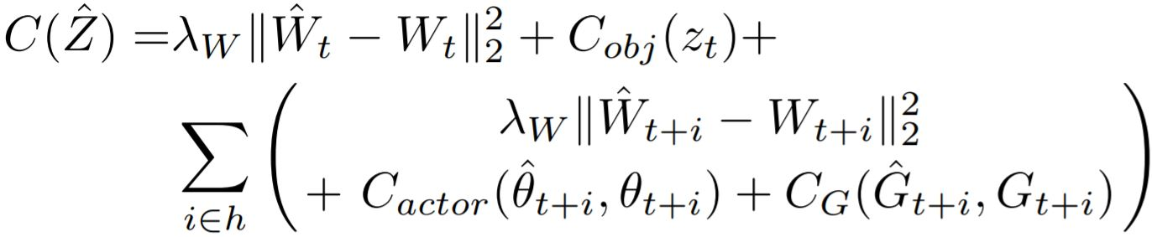
Training
Combined Prediction Loss includes:
Image Reconstruction Loss
Subgoal Recovery Loss
Actor Loss
Object Pose Estimation Loss

Slide 12
Contents
Problem Statement
Baseline
Technical Approach
Results
Applications

Slide 13
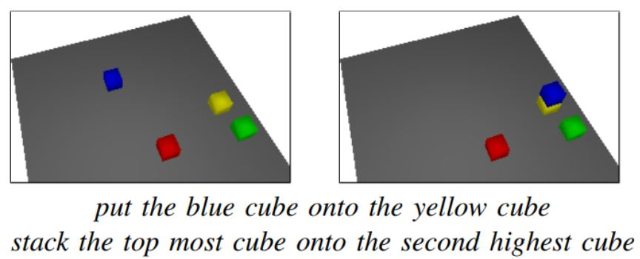
Experimental Setup
Blocks are randomly placed on a table
The initial location of the robot’s arm is also random
An experience is generated by :-
Align over a random block
Grasp that block
Lift it up
Move it over another random block
Release the block
Mechanical Turk was used to create high level language command for each experience

Slide 14
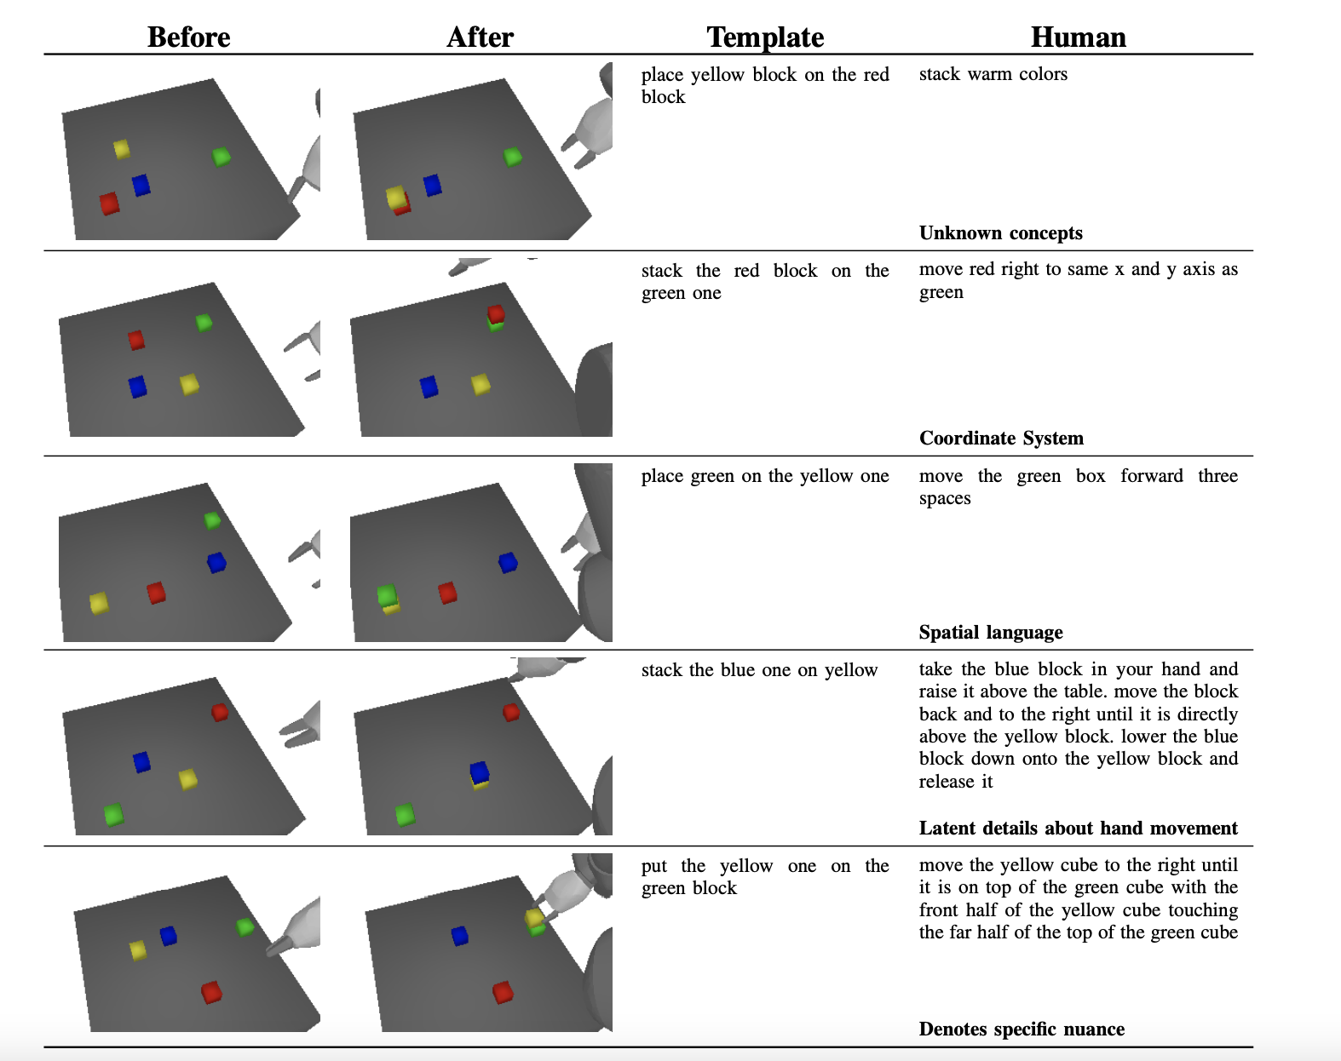
Real language vs Template

Slide 15
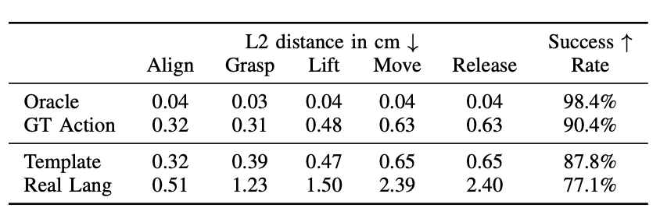
Execution Results
Performance is reported on a test set (held out scenarios)
Comparison with three different scenarios :-
Subgoals given
Unambiguous template language
Natural Language
Performance of GT action and template language are similar
Performance of real language is considerably low

Slide 16
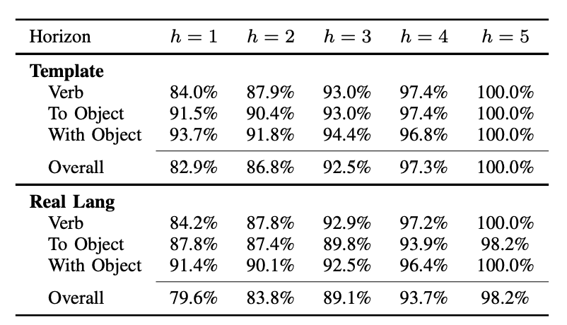
Sub goal Module Results
Sub goal prediction is difficult for the real language data.
Higher accuracy towards the end of the horizon.
Ambiguity in real language is one of the main reasons for underperformance in real language

Slide 17
Contents
Problem Statement
Baseline
Technical Approach
Results
Applications

Slide 18
Applications
Since this model, is trained on crowd sourced high level commands, this can be highly useful in household settings :-
Cooking
Cleaning
Folding Clothes
All the above tasks require a sequence of actions, that need to be interpreted from a high level language command.
Since these commands can vary from person to person, this model would be highly effective, since it is trained in crowd sourced language.

Slide 19
Conclusion
The central idea is to infer various sub goals from high level language command
The key thing to this is the idea of prospection, which justifies the actions taken by the agent
The prediction of future world states help the agent realize the consequences of its actions
Apart from template language, the agent can perform tasks for real language as well

Slide 20
References
[1] C. Paxton, Y. Bisk, J. Thomason, A. Byravan and D. Foxl, "Prospection: Interpretable plans from language by predicting the future," 2019 International Conference on Robotics and Automation (ICRA), 2019, pp. 6942-6948, doi: 10.1109/ICRA.2019.8794441.
[2] C. Paxton, Y. Barnoy, K. Katyal, R. Arora and G. D. Hager, "Visual Robot Task Planning," 2019 International Conference on Robotics and Automation (ICRA), 2019, pp. 8832-8838, doi: 10.1109/ICRA.2019.8793736.

